Slide 1
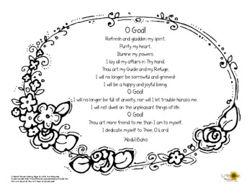
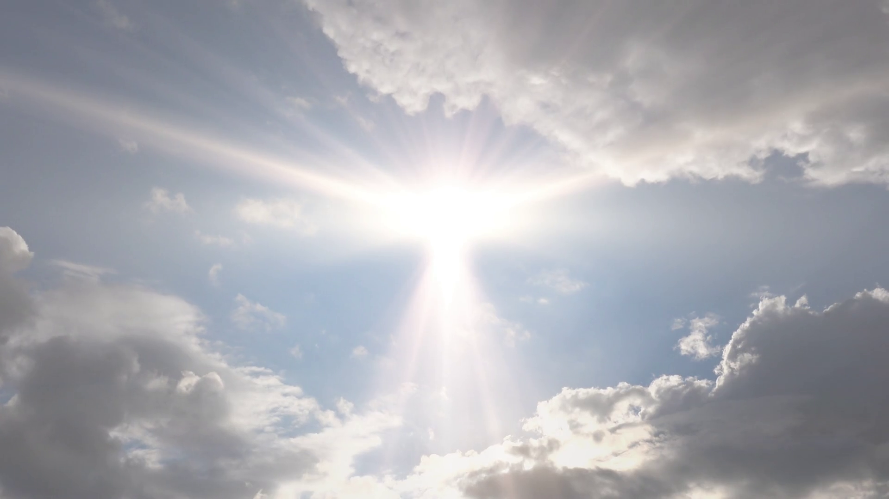
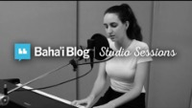
Prayers
Prayers

Slide 2
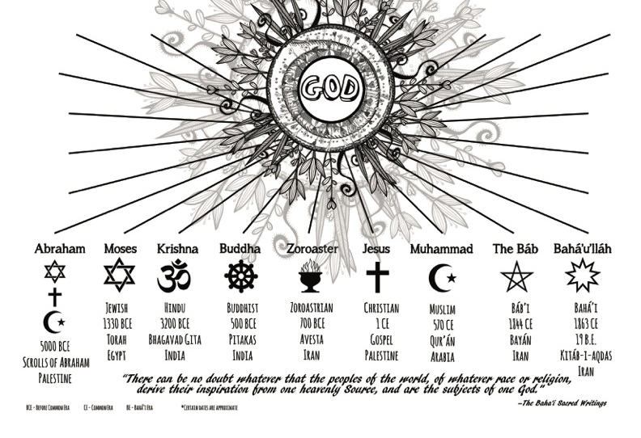

Slide 3
Discussion
In lesson 1 and 2, we learnt about the Manifestations of God. We now know that these Manifestations of God are very special Beings Who come from time to time to guide humanity.
To manifest something: is to show forth its qualities.
The Manifestations of God reflect the attributes and qualities of God as a mirror reflects the light of the sun. Through Them, we learn about God and His attributes.
What are some of the attributes of God ?

Slide 4
We also learnt that God is the unknowable Essence. It is through these Manifestations of God that we know of God and His attributes.
They shed the light of God upon humanity.
Let’s turn all our light switches off or pull the blind/curtain. Can we all see?

Slide 5
When there is light, we are able to see, are we not?
The light that the Manifestations bring is the light of the knowledge of God. It enables us to understand how He wants us to live and to behave towards one another.
We know that, when we follow their teachings, the capacities God has given us – like the capacity to love, to forgive, to be merciful- develop.
We grow spiritually and help the world become as He created it to be.
It is our love for the beauty of God that makes us want to follow His commandments (laws) as given to us through His Manifestations.

Slide 6
We could say that God’s Manifestations are like Divine Teachers, or Educators, Who have appeared all throughout history among diverse peoples.
Soon we will learn about the lives and teachings of some of these Manifestations and see how they have all come for the purpose of educating people and establishing bonds of unity and love among them.
But there is another important message they all brought.

Slide 7
Each One has given the promise that a time would eventually come when all humanity would learn how to live in peace and happiness.
Injustice, hatred and war would disappear, and the nations of the world would join in friendship.
For centuries, people everywhere have anxiously awaited this Promised Day of God.
We are Lucky, to know that this new Day has dawned and that the time to build a new world has come. So special is this Day that God sent not one but two Manifestations to guide humanity to His Kingdom:
  The Bab appeared first to prepare the way for the coming of the Promised One of All Ages, Baha’u’llah.

Slide 8
Baha’u’llah’s teachings will enable humanity to do away with war and establish lasting peace.
The Bab and Baha’u’llah are the Twin Manifestations of God for today

Slide 9
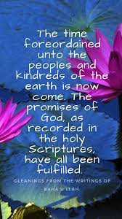
Quote
Foreordained:
appoint or decree something beforehand.
e.g. Amy studies hard to succeed. Success is not
foreordained.
Kindreds:
a person's relatives
e.g. He went out to sea, and never saw his kindred again.
Scriptures:
writings considered sacred
e.g.she found peace reading the holy scriptures

Slide 10
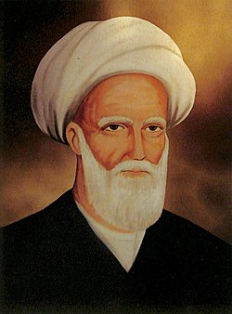
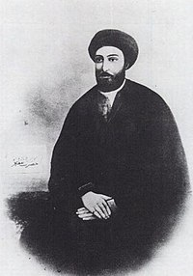
Story 1
Siyyid Kazim and the meeting with the Bab
Pure souls knowing that a new day is near
Siyyid Kazim was a great learned and teacher in Karbala.

Slide 11
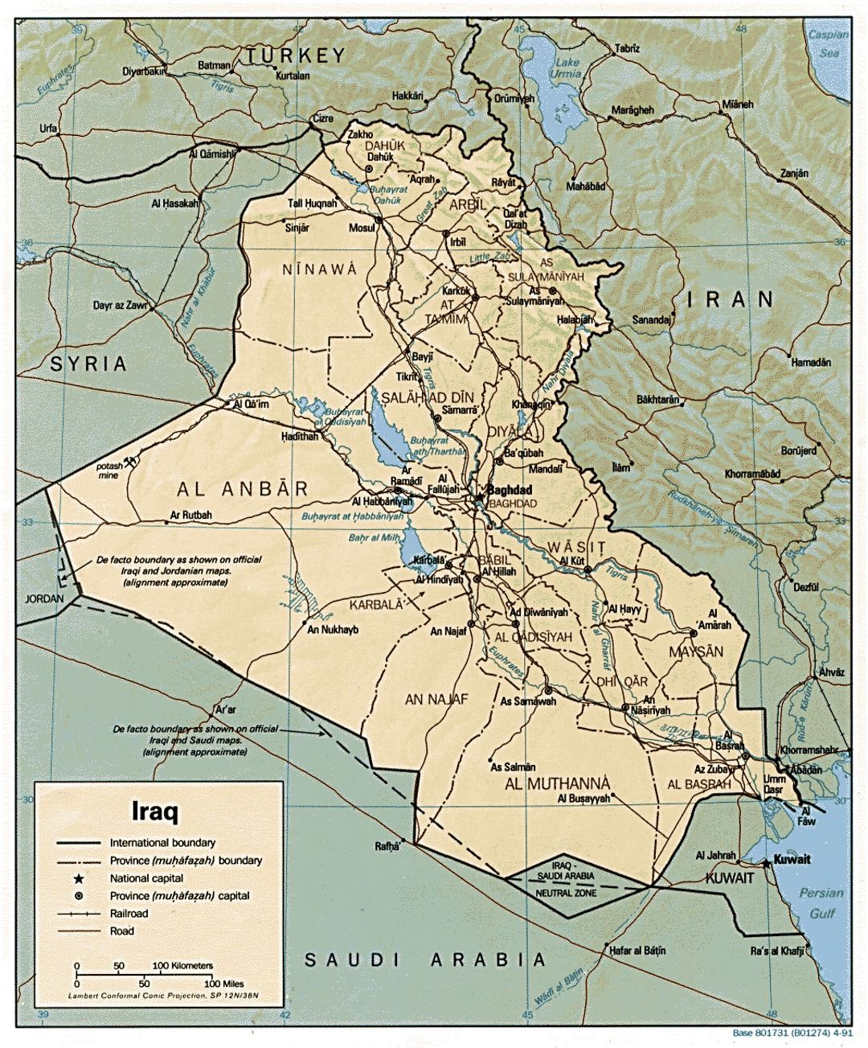
One morning he took one of his students to meet a Youth…

Slide 12
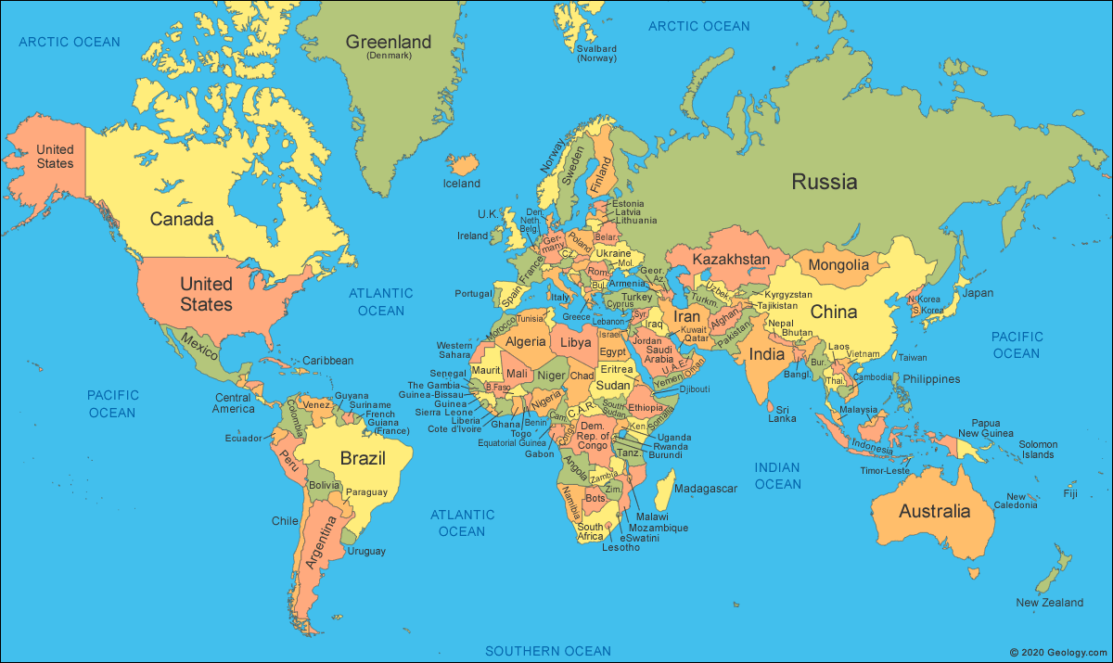

Slide 13
Story 2
The beaten Babi who dreams of Baha’u’llah

Slide 14

Song
This life’s too great to just resign
investigate soon
What are these truths that we all should seek
Well, how ‘bout a language that we all can speak
Male and female equality – all kinds of prejudice are wrong
Now religion and science both agree, about the Oneness of humanity God’s Faith should cause harmony just like this song
Chastity, integrity
Humanity and unity
Our actions should cause unity and shine like a star
All the people around can plainly see
We handle ourselves a little differently
They’ll know who we are.
Krishna, Buddha, Zoroaster Abraham, Moses, Christ Muhammad, The Báb, Bahá'u'lláh The Spirit’s the same
Bahá'u'lláh teaches for today
Tells us to look to the spirit
Not to worship the Name
Now we have automobiles, we have electric lights We can fly around, we can see a lot of sights World movements for human rights
We can even take a trip to the moon
Now some people say that these are terrible times But it’s a brand new day friends, these are the signs

Slide 15
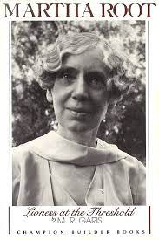
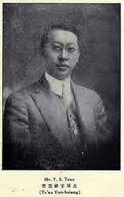
Story 3
Martha Root and the Chinese believer Cao Yunxiang

Slide 16
Drama
Act out the stories, remembering not to act out and present the Holy personage of the Bab.

Slide 17
Games
Remembering a story line…
One person starts with a sentence (story), the next person adds to the sentence and the story continues around until the turn reaches the first person who ends the story.

Slide 18
Review Quote from last year’s lesson:
So powerful is the light of unity that it can illuminate the whole earth

