Slide 1

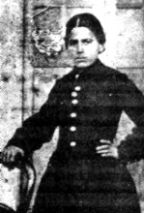
BADI
Pride of martyrs

Slide 2
Badí' was a rebellious youth
His father described him as "the despair of his family".
Nabil-A'zam met with Badí' and discussed the suffering and tribulations of Bahá'u'lláh, and read verses from the poem which Bahá'u'lláh composed while in Sulaymaniyyih.
Badí, after hearing them, begun to weep.

Slide 3
'Hearing these divine themes, the colour of the visage of that youth reddened. His eyes welled with tears, and the sound of his lamentation rose high.
I calmed his agitation, but throughout that night, his enamourment and attraction kept sleep away from the eyes of Shaykh Muhammad and myself.
Until the light broke we read and recited from the holy script.
In the morning, when he prepared the samovar for tea, and went out to fetch milk, his father came and said:
"I had never heard my son weep. I thought that nothing could move him. Now, what is the spell cast on him to make his tears flow and to cause him to cry out, to make him afire with the love of God?"

Slide 4
The next morning, Nabil-A'zam told Aba Badí' that the youth was no longer in command of himself and has given in to God.
Badí' insisted on accompanying Nabil-A'zam to Mashhad.
His father requested that he finish his education beforehand, offering to provide his travel expenses, including a steed, upon completing his study of the Kitab-i-Iqán.

Slide 5
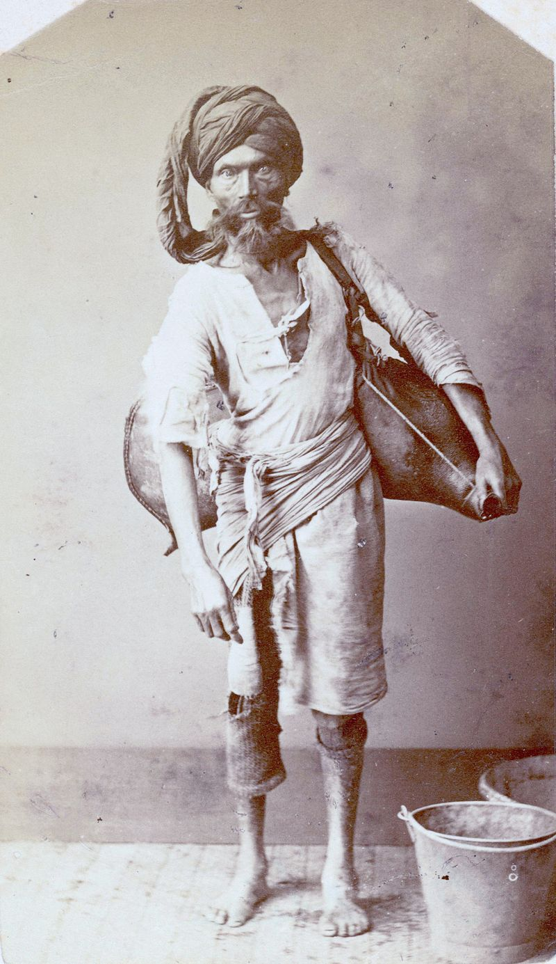
When he arrived to Baghdad, he served as the water-carrier of the companions.
News reached that Baha’u’llah was exiled to Akka. Badi could no longer wait.
Later, he set out for the presence of Baha’u’llah. He walked all the way from Mosul to the citadel of Akká, arriving in the spring of 1869.

Slide 6
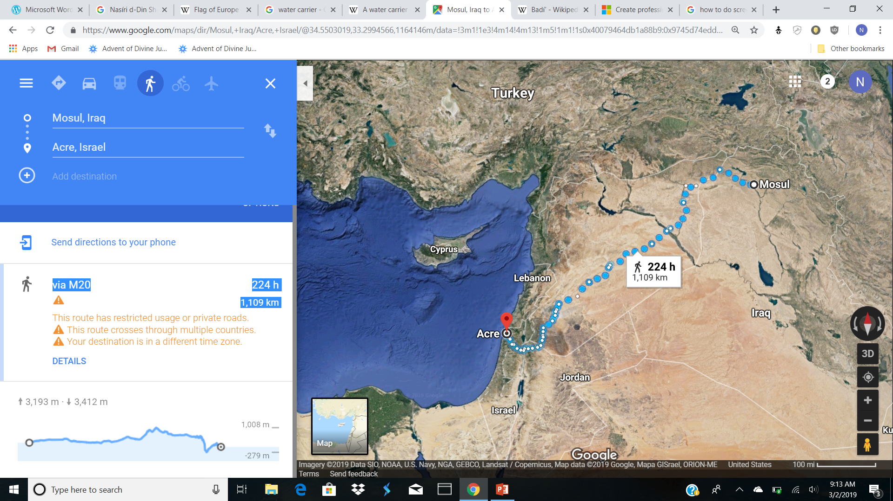
He arrived in 1869

Slide 7
Since he was still wearing the simple garb of a water-carrier, he passed through the city gate and the vigilant guards. Once inside the city, with the fear of being discovered and not knowing whom to contact, he quietly slipped into a mosque to pray.
This surprise, he recognized 'Abdu'l-Bahá among a group of Persians attending evening prayers.
Badí' wrote a note on a piece of paper and managed to slip it to him. Arrangements were made later that same night for Badí' to enter the citadel and be in the presence of Bahá'u'lláh.

Slide 8
Badi was
RECREATED
Badí' was given two interviews by Bahá'u'lláh;
He indicates that when He desired to create a new creation He summoned Badí' to come to His room and uttered 'one word' to him, a word which caused his whole being to tremble ‘…had it not been for the divine protection vouchsafed to him at that moment, Badí' would have swooned away. Then the Hand of Omnipotence, began to create him anew and breathed into him the spirit of might and power. So great was the infusion of this might, that single and alone he could have conquered the world through the power of God, had he been ordered to do so. ‘

Slide 9
Bahá'u'lláh states that when this new creation came into being he smiled in His presence and manifested such steadfastness that the Concourse on High were deeply moved and exhilarated and the voice of God was heard calling aloud:
'Hallowed and glorified be Baha for having fashioned a new and wonderful creation.’
Bahá'u'lláh disclosed to his eyes the 'Kingdom of Revelation', and as a result his whole being was filled with an ecstasy that rid him of all attachments to this world and made him arise to assist his Lord and bring victory to His Cause.

Slide 10
Badí' subsequently asked for the honor of delivering the Lawh-i-Sultán to the Shah and his request was granted.
Upon receiving the box he held it in both hands, kissed it, and then prostrated himself.

Slide 11
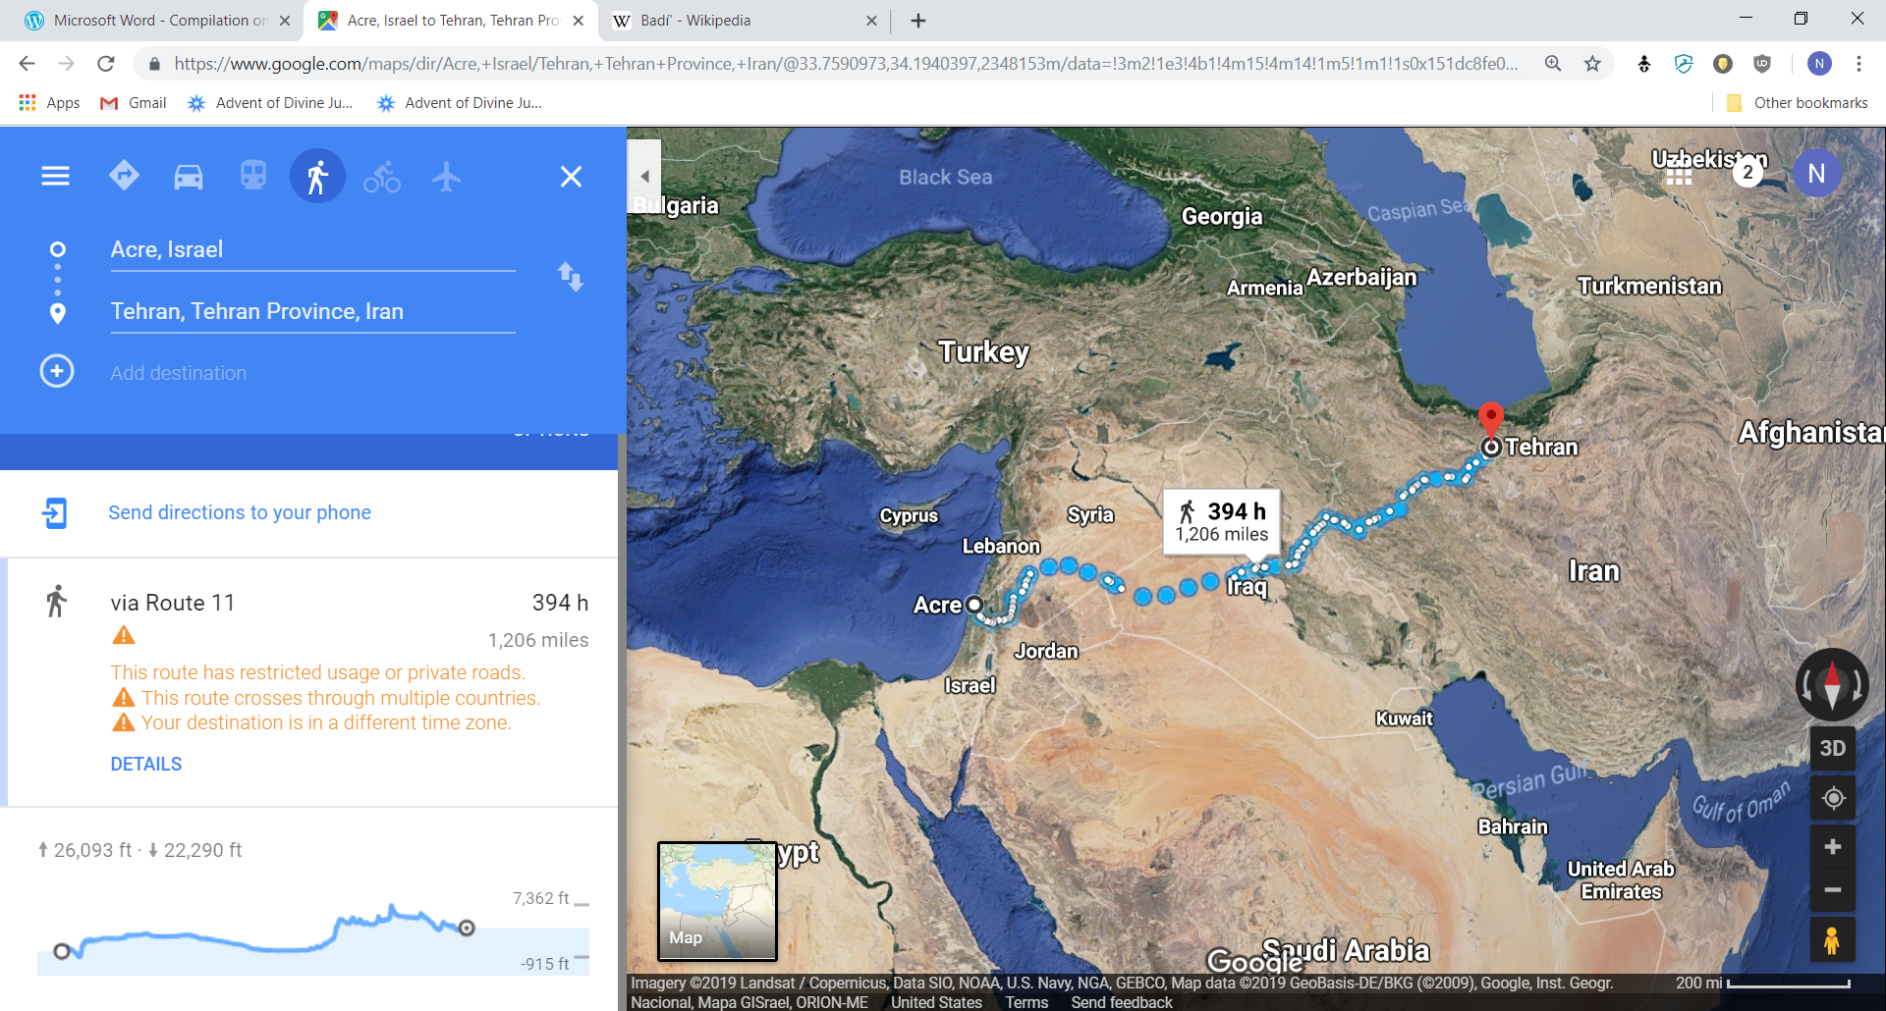
Badí' plodded on, a solitary figure, over deserts and mountain peaks, for four months, never seeking a companion, never choosing a friend with whom he could share his great secret. His father had no knowledge of his return. (KOG)

Slide 12
No one knew. Even his father didn't even know he was in Tehran
"From Trebizond to Tabriz I was in his [Badí's] company for some of the stages of the journey. He was full of joy, laughter, gratitude and forbearance. And I only knew that he had been in the presence of Bahá'u'lláh and was now returning to his home in Khurasan. Time and again I observed that, having walked a little more or less than one hundred paces, he would leave the road and, turning to face 'Akká, would prostrate himself and could be heard to say: 'O God, that which you have bestowed upon me through Your bounty, do not take back through Your justice; rather grant me strength to safeguard it.' (KOG)

Slide 13
Dangerous Mission
  Shah ruled his country with a rod of iron
  Showed his authority through tyranny – people were accustomed to deal ruthelesslyl with anyone who dared to say a word, or raise a finger against the regime/king.
  King was frightful! When the forward section of the royal escort arrived in the street, the herrold who announced his coming struck terror in the hearts of people: 'Everyone die', 'Everyone go blind.’
  The king can do what he pleased; his word was law that no one changed.; appointed and dismissed all ministers, officers, officials, and judges; had the power of life and death without reference to any tribunal. The property of any such individual, if disgraced or executed, goes to him. The right to take life in any case is vested in him alone( could be delegated to governors or deputies). The shah never attend at state dinner or eat with his subjects at table, with the exception of a single banquet to his principal male relatives at Naw-Ruz, ’May I be your sacrifice, Asylum of the Universe’ is the common mode of address adopted even by subjects of the highest rank.

Slide 14
After three days of fasting, Badi found out where Shah's summer camp was located
He sat on a rock for 4 days, waiting for the king to pass by , so that he might be seen and taken to the Shah.
Badi was instructed that once he reached Tehran, to put on a white robe and hold the Tablet over his head so they could all see he had no weapons on him.
The hour came when the Shah set out on a hunting expedition; Badí' approached him calmly, addressing….

Slide 15
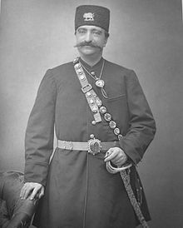
"O King! I have come to thee from Sheba with a weighty message”
Shah requested the letter to be brought to him since he believed it was a petition from someone. Badi told him it was not a petition but a command
Násiri'd-Dín Sháh may have been taken aback, but the confident tone of that youth had already convinced hime that this message had come to him from Bahá'u'lláh.
Badi bravely told the Shah that His Beloved told him the Shah was going to kill him to which the Shah angrily replied: I won’t kill you so we prove your Master wrong. Immediately Badi was seized by the guards.
The Shah ordered the Tablet to be sent to the clerics of Tehran for a reply to be prepared for Bahá’u’lláh.
The clerics, ignoring this command suggested Badi to be executed.

Slide 16
For three days, Badi’s body was tortured, branded with hot irons.
They wanted to get information on the Baha’is but the more they tortured Badi, the happier he looked! It was as if he knew that the time of his martyrdom was rapidly approaching..
“If you want Bahá'ís, they are numerous in Iran, and if you want my comrades, I was all alone and have none." I pressed him to tell me the names of his comrades and the names of the Bahá'ís of Iran, particularly those of Tihran. And he persisted with his denial: "I have no comrade and I do not know the Bahá'ís of Iran. I swore to him: "If you tell me these names I will obtain your release from the Shah and save you from death." His reply to me was: "I am longing to be put to death. Do you think that you frighten me?"

Slide 17
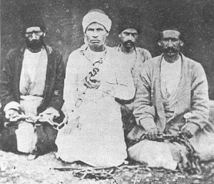
The Shah, who was usually eager to see the photographs of prisoners, ordered a photograph to be taken of Badi’, especially when he had heard the stories of his fortitude under torture. This photograph shows the brazier of fire containing the rods of iron in the foreground and is the best testimony to the spirit of steadfastness and resignation, of calm and assurance which Badi”s face portrays.
(Adib Taherzadeh, The Revelation of Baha’u’llah v 3, p. 186)

Slide 18
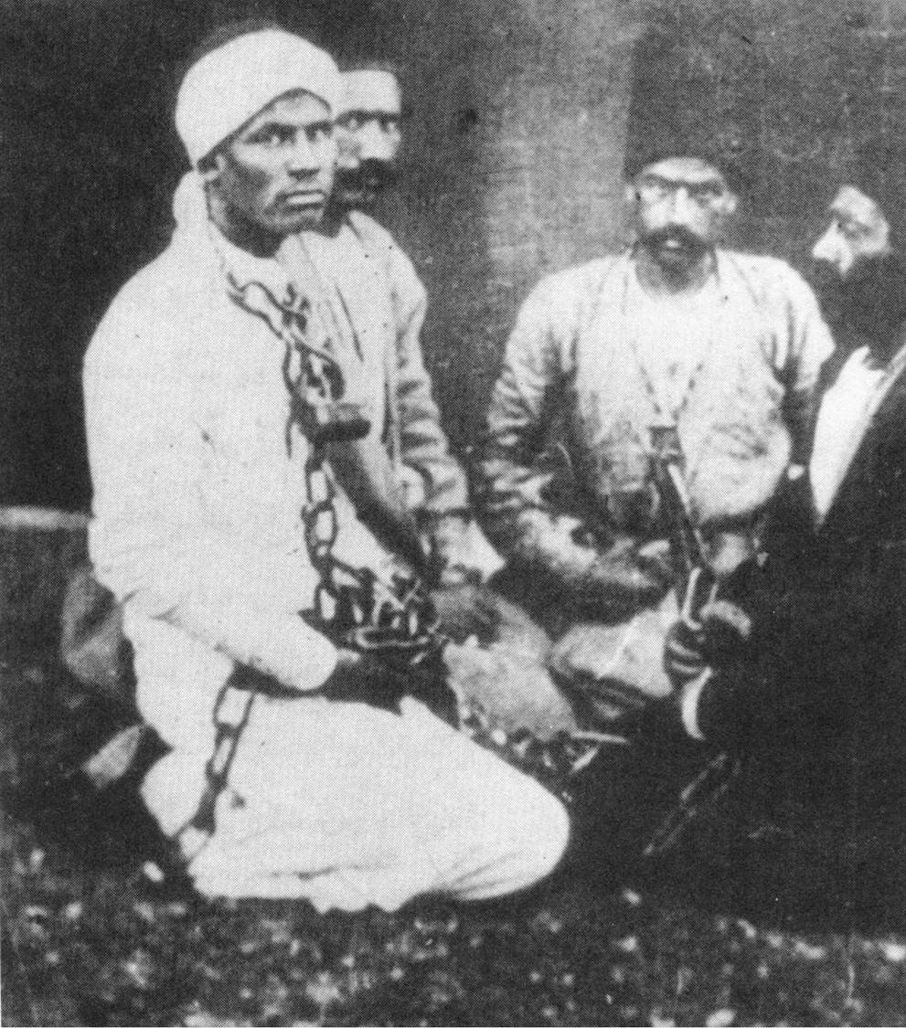
We have also sent unto thee a photograph of His Holiness the glorious Badí whom thy Lord did send to His Highness Nassir-ed’Din-Shah with a manifest epistle by which He perfected the proof and evidence to the people of Persia. … He was sitting between the executioners at the time of his death with all dignity, while turning unto God.
Abdu’l-Baha

Slide 19
After three months of this event, the Shah ordered for the Tablet to be taken to him. After reading some of it he shouted that the Tablet should be taken from him because if he read any more, himself would become a Baha’i.
Badi was a perfect example of courage, love, steadfastness and determination. His life and important mission will be remembered throughout history.
Bahá’u’lláh named Badi one of his nineteen apostles and wrote:

Slide 20
Everlasting honor
He sent Badí' with a Book in which He had proclaimed His Cause and declared conclusively; His proofs to all humanity: He had removed from the person of Badí' every trace of fear, adorned him with the ornament of faith and power, fired his soul with the utterance of a Word and sent him out as a ball of fire to proclaim His Cause...
"the Temple of the Cause of God was adorned by Badí'. The pillars of tyranny were shaken and the countenance of victory unveiled itself. Badí' had attained to such heights in the world above that no mention could be made of it.“
In these Tablets, Bahá'u'lláh not only glorifies the station of Badí', but also attaches great importance to the proclamation of His message to the Shah of Persia.
‘He had offered up the life of one of His servants after having created him anew with the hands of might and power, and sent him straight into the mouth of a serpent, so that the peoples of the world might become assured that the Almighty God stands transcendent and supreme over His creation.

Slide 21
