Slide 1

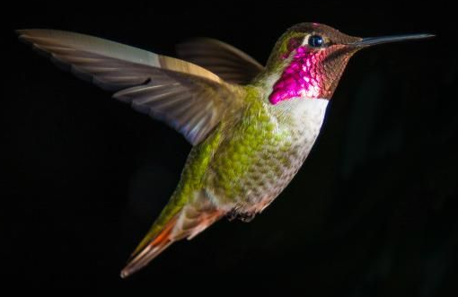
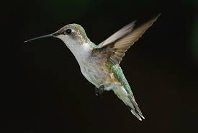

Slide 2
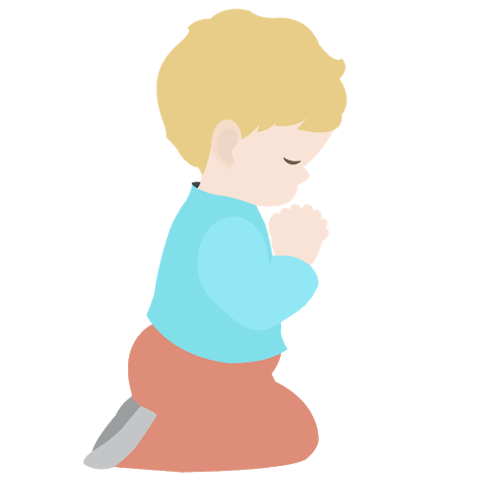
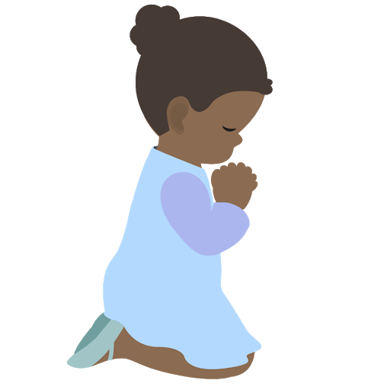
Prayer Stars⭐
⭐️
⭐️
Cassedy | ⭐️⭐️⭐️⭐️⭐️⭐️⭐️⭐️⭐️⭐️⭐️⭐️⭐️✅
Milan | ⭐️⭐️⭐️⭐️⭐️
Devin | ⭐️⭐️⭐️⭐️⭐️⭐️⭐️⭐️⭐️⭐️✅
Kim | ⭐️⭐️⭐️⭐️⭐️⭐️⭐️⭐️⭐️⭐️⭐️⭐️⭐️⭐️⭐️⭐️⭐️⭐️⭐️✅
Cora | ⭐️⭐️⭐️⭐️⭐️⭐️⭐️⭐️⭐️⭐️⭐️✅
Hudson | ⭐️⭐️⭐️⭐️⭐️⭐️⭐️⭐️⭐️
Dev | ⭐️⭐️⭐️⭐️⭐️⭐️⭐️
Manny | ⭐️⭐️⭐️⭐️⭐️⭐️⭐️⭐️⭐️⭐️⭐️⭐️✅
Camila | ⭐️⭐️⭐️⭐️⭐️⭐️⭐️⭐️⭐️⭐️⭐️⭐️✅
Phoenix | ⭐️⭐️⭐️⭐️⭐️⭐️⭐️⭐️⭐️⭐️⭐️
⭐️
⭐️

Slide 3
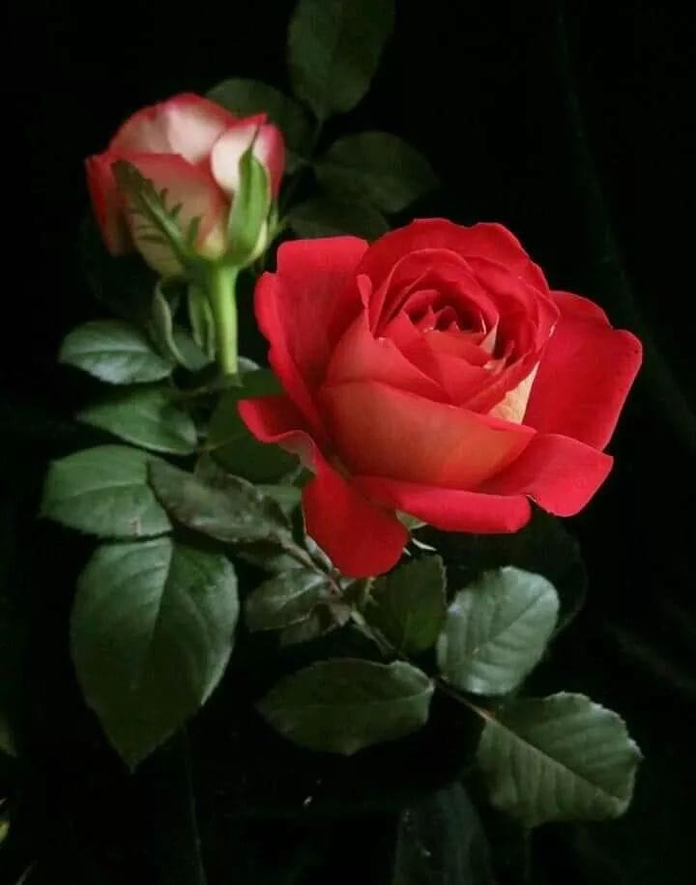
OPENING PRAYERS
Notes:
Prayer sharers from memory

Slide 4
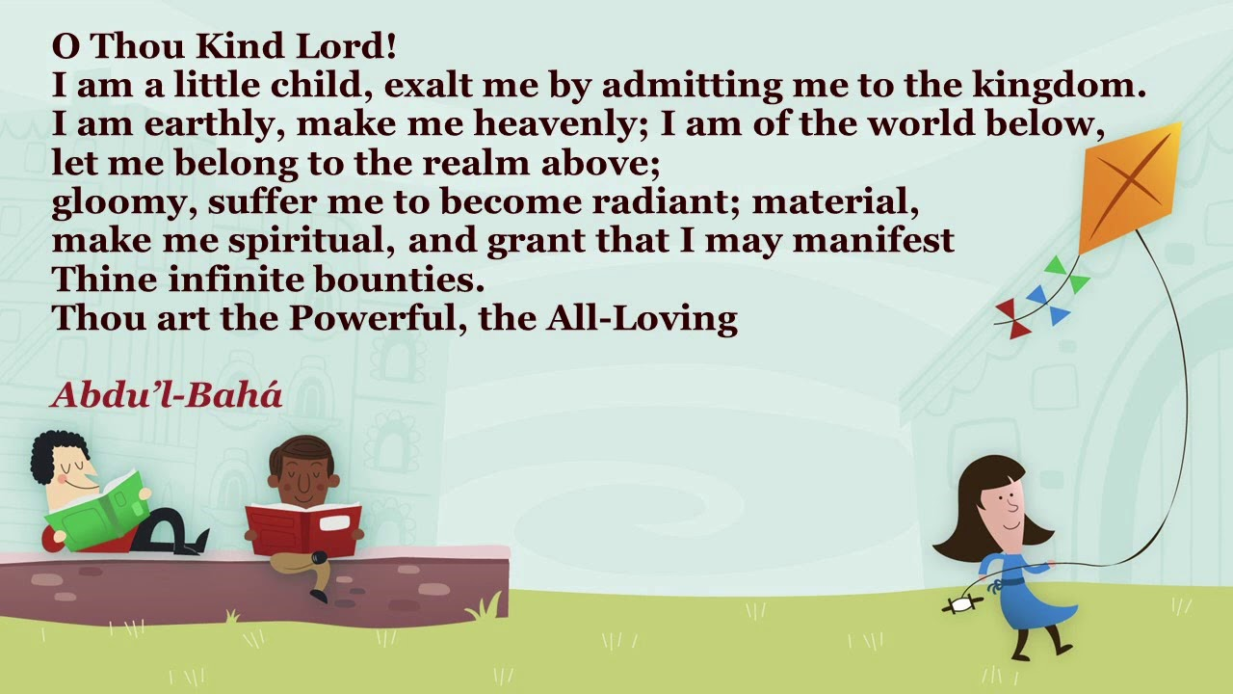
Notes:
Everyone and Diedre review with gestures

Slide 5
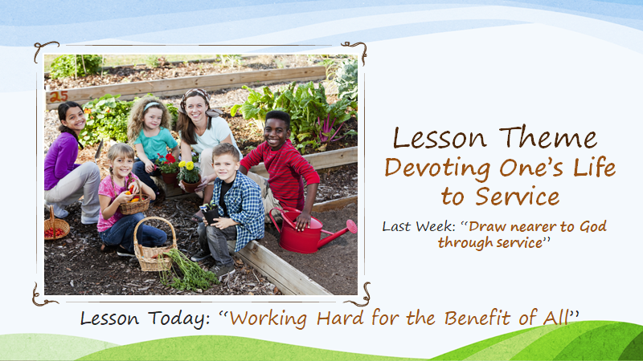

Slide 6
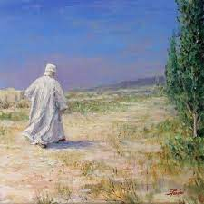
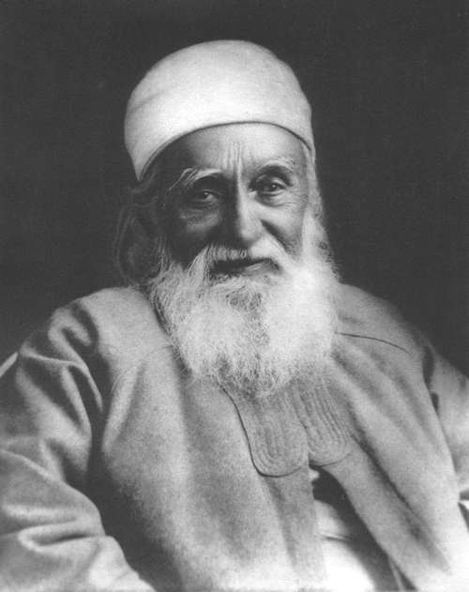
Notes:
With His heart filled with the love of God, 'Abdu'l-Baha spent every moment in service to humanity. He is the perfect Example of how we should serve. 'Abdu'l-Baha was constantly active, working for the good of all. Early each morning He would make His round of visits to the residents of 'Akka. He would visit the elderly, the sick, and the suffering, seeing to their needs and offering them comfort and assistance. People from all walks of life would bring their problems and concerns to Him, seeking His guidance and counsel. He would give them encouragement and advice and would help to ease their difficulties.

Slide 7
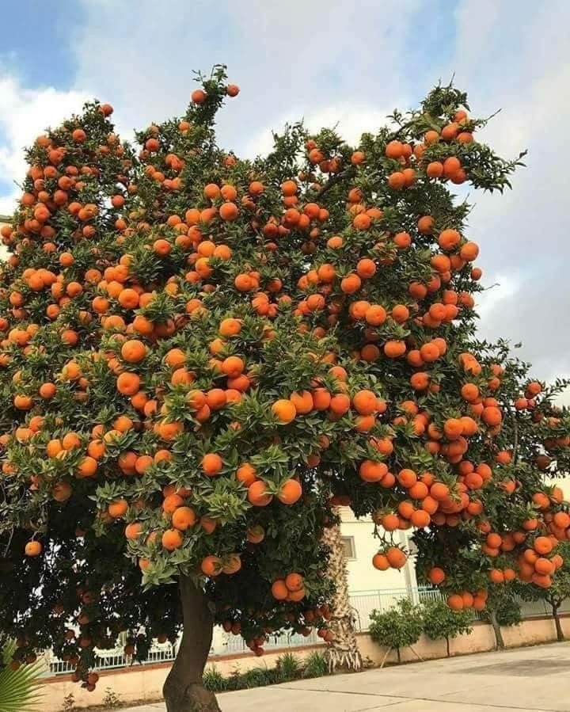
If we are to serve God and humanity, effort is required. We must be diligent and hard working. Like trees that give forth goodly and wondrous fruits for the benefit and enjoyment of all, we make effort and work for the good of those around us. And we know that God promises to assist our efforts. So we rise every day, turn our hearts to Him in prayer, and then set out, confident that His love surrounds us and eager to do what little we each can to make this world an earthly paradise. And at the end of each day, we think about what we have done and thank God for His aid and assistance, knowing that we will try even harder the next day.
Notes:
Intro by Noura

Slide 8
“...your hearts may leap for joy
in the breathings of servitude
which well out from the breast
of ‘Abdu’l-Baha…”
Notes:
“Abdu’l-Baha encourages us saying May your hearts leap for joy…
It’s interesting that ‘Abdu’l-Baha speaks of the similarity between breathing and serving others.
‘Abdu’l-Baha didn’t take a breath without thinking of how He could improve the lives of others.

Slide 9
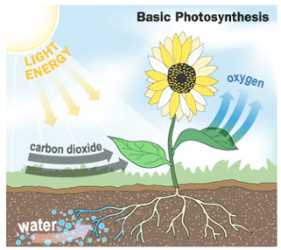
Notes:
Let’s look at trees. Through a process called photosynthesis, leaves pull in carbon dioxide and water and use the energy of the sun to convert this into chemical compounds that feed the tree. But as a by-product of that chemical reaction oxygen is produced and released by the tree. In one year a mature tree will absorb more than 48 pounds of carbon dioxide from the atmosphere and release oxygen in exchange. One large tree can provide a day’s supply of oxygen for up to four people. See how the trees serve all of us.

Slide 10
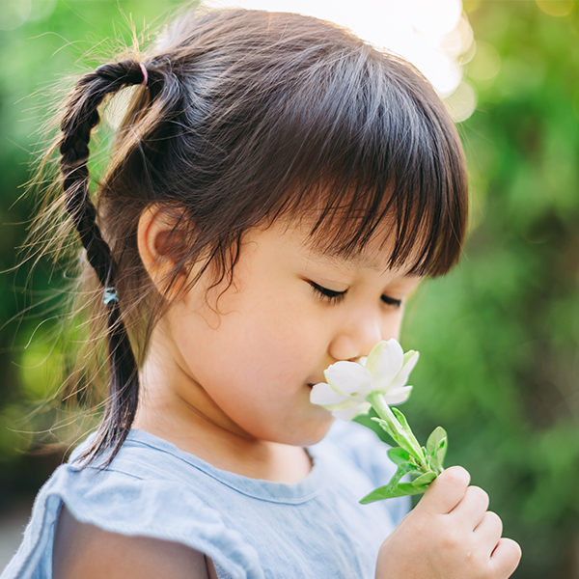
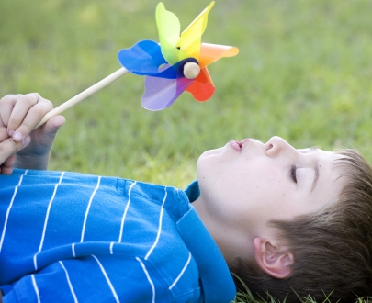
When we breathe in, it is like we are breathing
in God’s love, and when we breathe out we are
spreading God’s love.
.
Notes:
How many times would you guess you breath in and out each day? 22,000 times. It’s so automatic, we don’t even have to think about it.
When we breathe in, it is like we are breathing in God’s love (everyone inhale)
And with God’s love in our hearts we spread His love to everyone around us. One of the very best ways to share that love is through service.

Slide 11
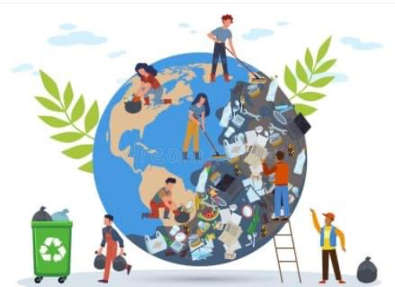
Notes:
Look at this picture and raise your hand if you can see one form of service and the effect it has in a community.

Slide 12
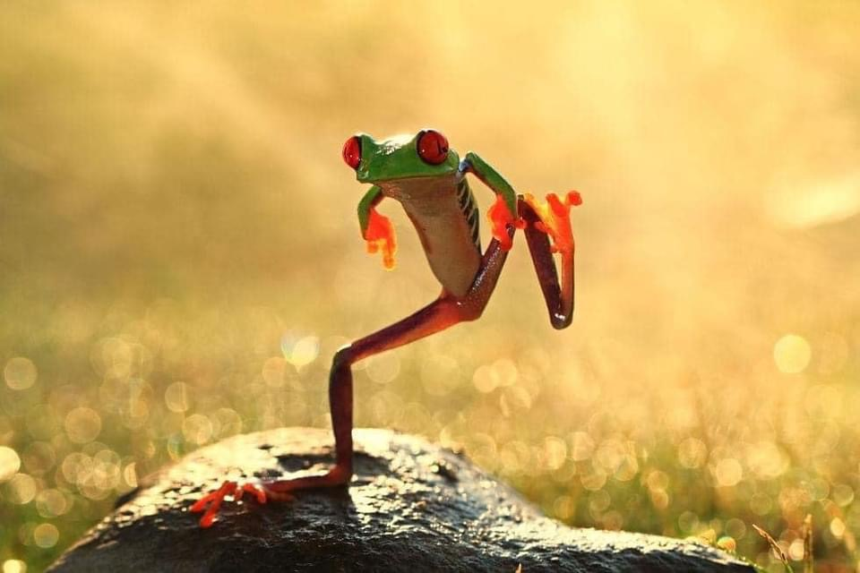
MOVEMENT ACTIVITY
Notes:
Everyone stand up behind your chair. Isn’t this a cute picture; the frog is exercising by making EXTRA large movements. Look how high he is stepping. One at a time, each student is going to be called upon to make a BIG movement, maybe jumping as high as you can. Let’s take an example: a student might say, “Kayla!” while dramatically dropping to one knee and doing Jazz Hands. After Kayla does her move, the rest of the class says Kayla’s name in unison and imitates her moves.

Slide 13
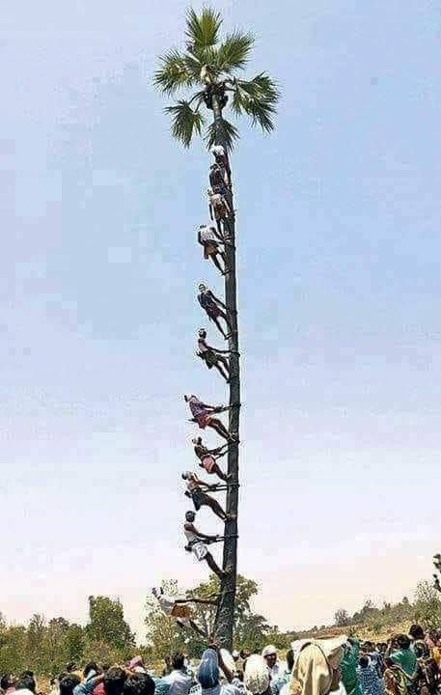
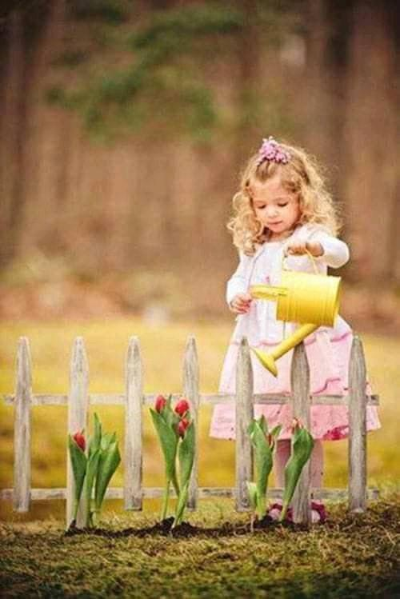
Notes:
Let’s look at the men climbing the tree. It really looks like very hard work. How do you think they are contributing to their community who are looking on with so much interest? (helping bring down the coconuts safely) How ‘bout the little girl. She can’t climb a huge palm tree. What is she doing that will benefit her community?

Slide 14
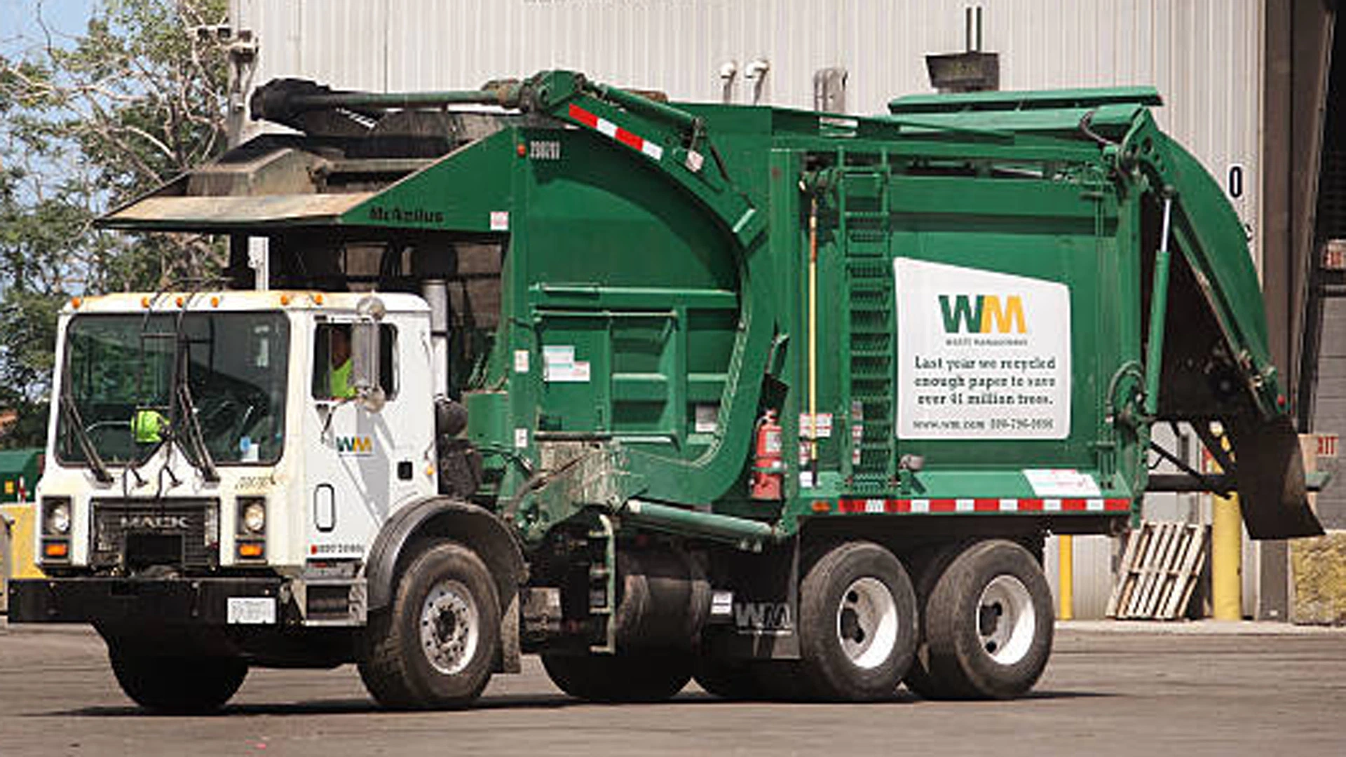
https://www.youtube.com/watch?v=gvdIaLHYUws&list=RDCMUCILamLkehRwaRRBjhNIw_1g
STORY TIME
Notes:
Read beginning story until audio starts.
Talk about the story--- have you ever thought of the garbage man as serving God as they go around your neighborhood?
Any work done in the spirit of service is worship, prayer.

Slide 15

Art
Activity
Notes:
Have you thought what you would like to do when you grow up? (Veterinarian, fireman, scientist…)
Draw picture of yourself in the future when you are a grown-up working in a service occupation.

Slide 16

https://www.youtube.com/watch?v=fbM1LbQELGE
Closing Prayers
Notes:
Play Blessed is the Spot URL audio only https://www.youtube.com/watch?v=fbM1LbQELGE
Children repeat gestures with Diedre and try to sing along.

Slide 17
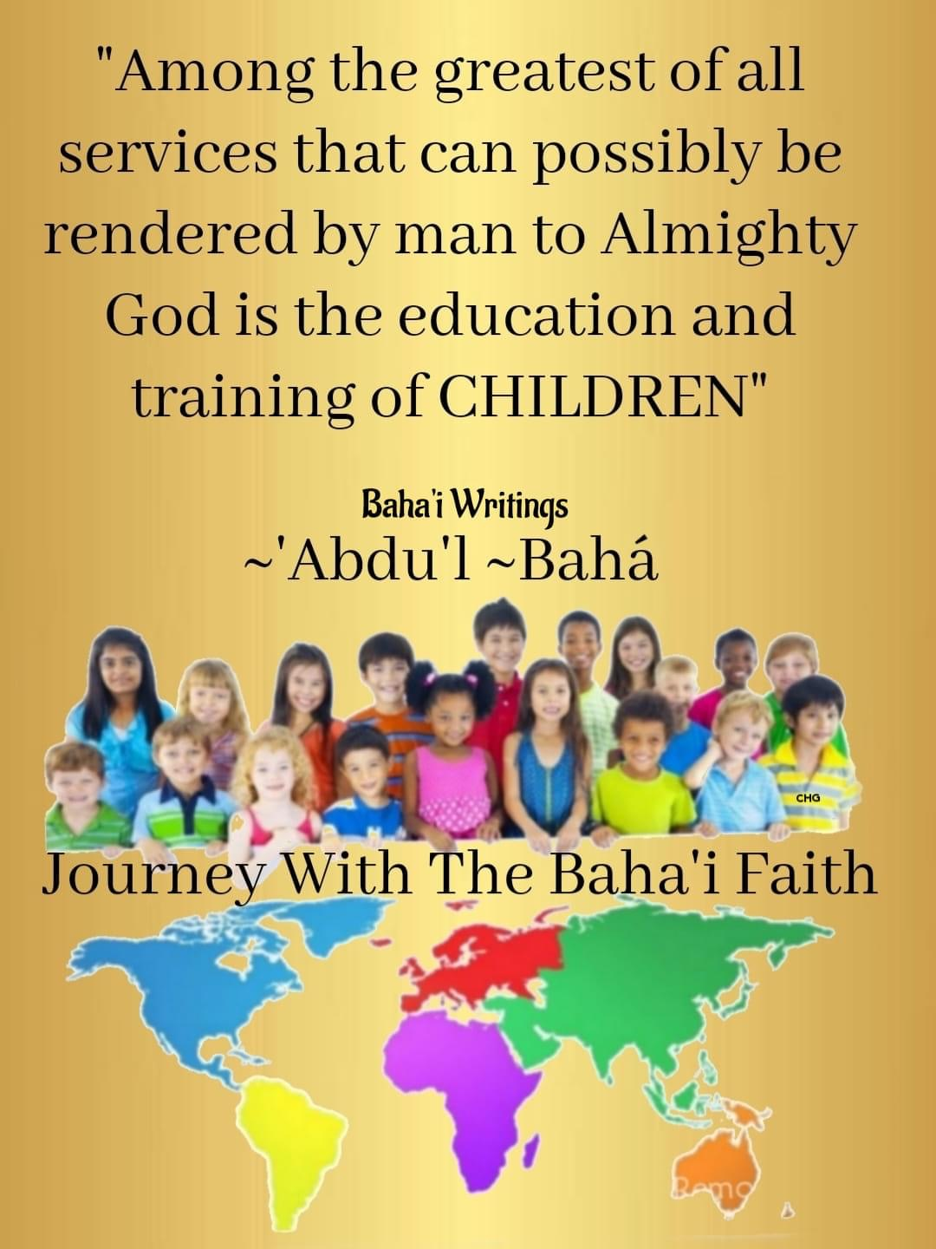
Thank You
Miss Noura

Slide 18
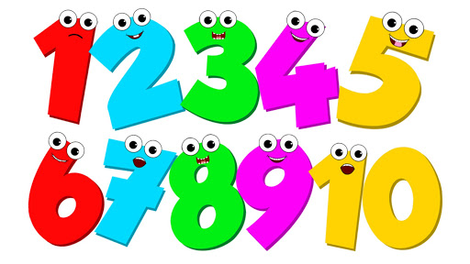
COUNTING GAME

