Slide 1

WELCOME BACK

Slide 2
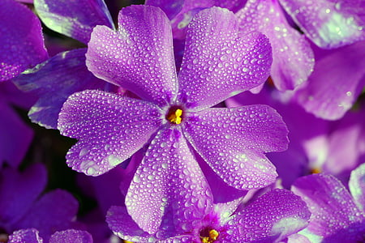
OPENING PRAYERS
https://www.youtube.com/watch?v=449ivdKkHwY
Notes:
Ask Cora and Kim to recite with gestures.
Blessed is Spot to music
Ask each child that can to say as prayer sharer today.
As many children as possible say Blessed is the Spot from memory

Slide 3
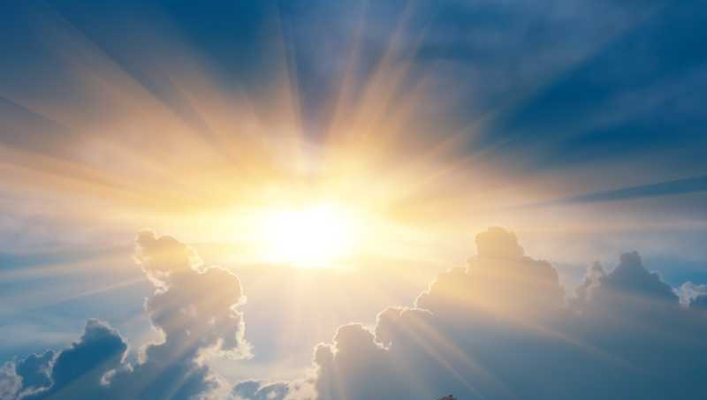
Why Do We Pray
Notes:
Noura-- When you were in Grade 1 you learned the different virtues. Now in Grade 2 you are learning how to put the virtues into action.
Ask children who can read this slide? Do you think if we know why we should pray, we will want to pray more often?
Intro To seek His bounty and blessings, to immerse ourselves in the ocean of communion, entreaty and supplication.”
We talked about the meaning of the words communion and supplication? Have children repeat new words a couple of times.
Define entreaty (pleading, begging)

Slide 4
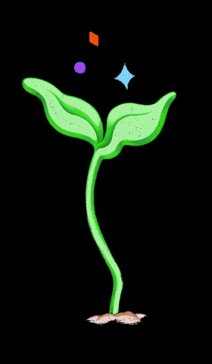
Prayer Brings Life to Our Soul
Notes:
Noura-- Who can read this slide? Let’s slowly all read it together.
Plants need water to grow, our souls need prayer to grow.

Slide 5
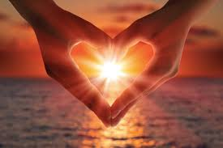
Prayer is the Greatest Longing of Every Soul
Notes:
Noura-- Read quote. Do you long for your birthday to get here sooner?....Do you long to have more time with your friends?
God is your most Great Friend and we long to turn our hearts to Him and tell Him how much we love Him.

Slide 6
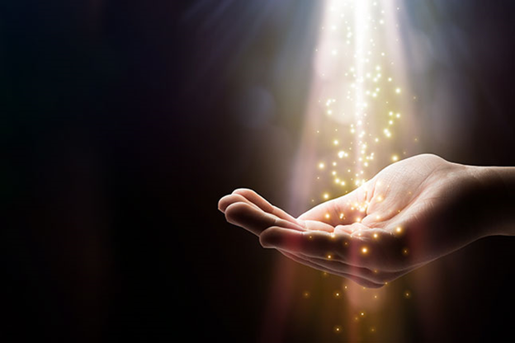
May Thy Will
Be Done
Notes:
Noura-- Occasionally we pray for something that is in agreement with Divine wisdom, then God will bestow it upon us. Like if we ask to become more generous, more loving...But occasionally we unknowingly ask for things that will harm us, (maybe like too much candy or screen time) and God, in His infinite wisdom, does not grant our wish. No matter how much we may desire somethings, we are confident that He will do what is best for us. Why do we pray “May God’s will be done”?

Slide 7
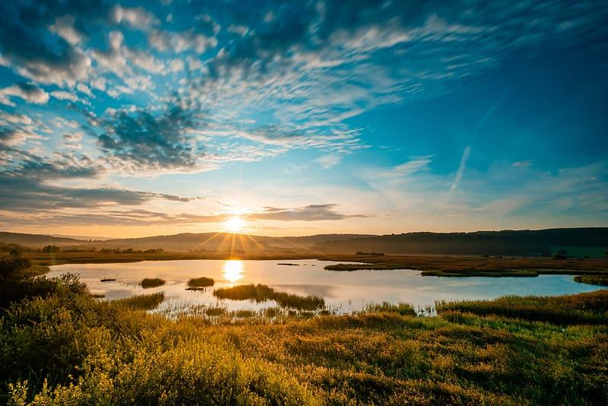
“Remembrance of Me is a healing medicine to the souls and a light to the hearts of men.”
-Baha’u’llah
Notes:
Noura--Read. We have the healing prayers but even just thinking of God is a healing medicine to our souls. “Remembrance of Thee is my remedy.”
What other benefits does prayer have according to this quote? The answer is in the second line. Can you find it? (It brings light to our hearts)

Slide 8
O thou who art turning thy face towards God!
Close thine eyes to all things else,
and open them to the realm of the All-Glorious.
Ask whatsoever thou wishest of Him alone;
seek whatsoever thou seekest from Him alone.
With a look He granteth a hundred thousand hopes,
with a glance He healeth a hundred thousand incurable ills,
with a nod He layeth balm on every wound,
with a glimpse He freeth the hearts from the shackles of grief.
He doeth as He doeth, and what recourse have we?
He carrieth out His Will, He ordaineth what He pleaseth.
Then better for thee to bow down thy head in submission,
and put thy trust in the All-Merciful Lord.”
-‘Abdu’l-Bahá,
With a look He granteth a hundred thousand hopes
Notes:
Noura--This is a quote from ‘Abdu’l-Baha and He says an incredible thing about the power of God! (Read only hi-light and ask How much is 100,000? )
Is there anything in the world more powerful than prayer?

Slide 9
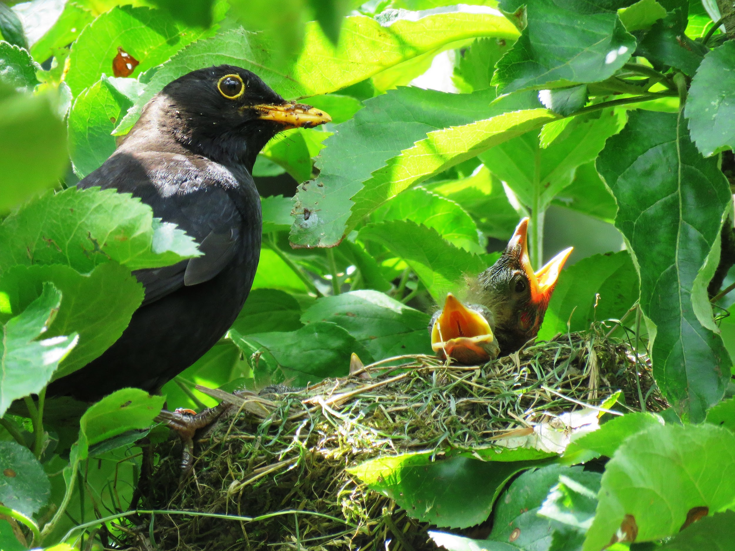
“Blessed is he who remembereth his parents when communing with God.”
-The Bab
Notes:
Noura-- Here is another reason we pray. Read slide. How many of you pray for your parents each day? The Bab tells us if we do, just the process of doing so, blesses us thousands of times more than it blesses our parents.

Slide 10
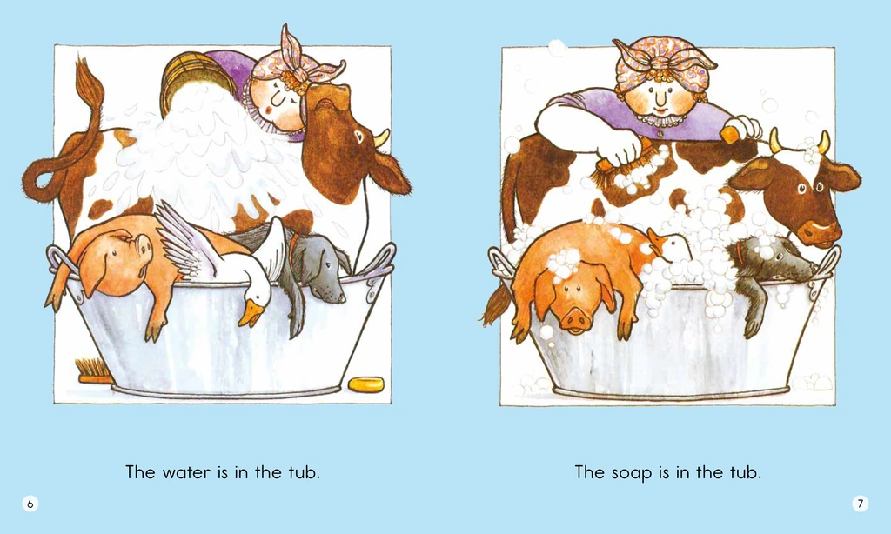
https://www.youtube.com/watch?v=OYL20BXslQc
https://www.youtube.com/watch?v=zWlTaSxOt0s
Moovement Activity
Notes:
Wishy Washy Washer Woman url top left
Alternate: Hopscotch Activity top right

Slide 11

STORY TIME

Slide 12
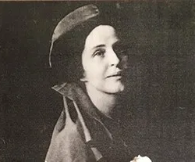
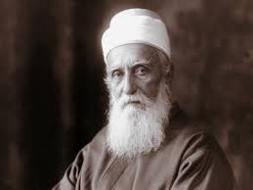
Lua Getsinger
‘Abdu’l-Baha
Notes:
Noura--”Abdu’l-Baha taught Lua Getsinger she should feed her soul first, before feeding her body. WHY? (If you don’t do it first, you might get busy and forget. Right? Then your soul would be hungry.) I’ll tell story first then call on someone to retell the story to the class.Tell story.
Loua was also impulsive and didn’t like to wait. She had to learn patience to do what ‘Abdu’l-Baha had asked of her.

Slide 13
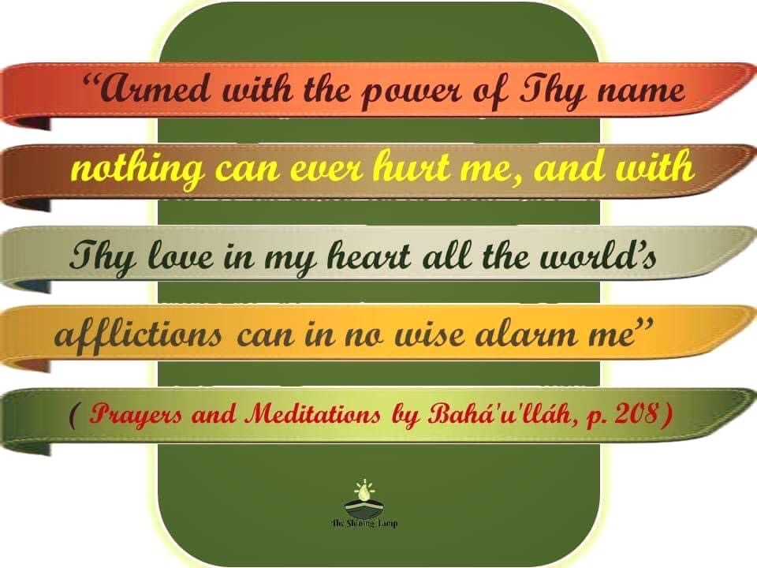
Notes:
Noura:. This is a prayer for protection. We are asking God to keep us safe. Read quote. Help children memorize -- Noura sing

Slide 14

Notes:
Diedre--Here’s another reason why we pray. To make ourselves joyful AND to bring happiness to others.

Slide 15

ART ACTIVITY
Notes:
Noura---- Alternate activity since repeating lesson. (Diedre--- Child Praying in Bed Tutorial. We can pray in many different ways…) Girls will want to change hair so looks like a girl.
Play Song by Elika Mahonny about the power of God With a look He granteth a hundred thousand hopes)

Slide 16

Art Show
Notes:
Ask children what they have each done to help them to remember to pray when they wake up and in the evening?

Slide 17

WHY WE PRAY
We long to tell God how much we love Him
Notes:
Noura-- When your parents ask you what you studied in class today, you can say we learned Why We Pray. Of course they will ask you ‘why DO we pray?’

Slide 18
Prayer Brings Life to Our Soul
Notes:
You can also tell them prayer feeds our soul and helps it grow

Slide 19
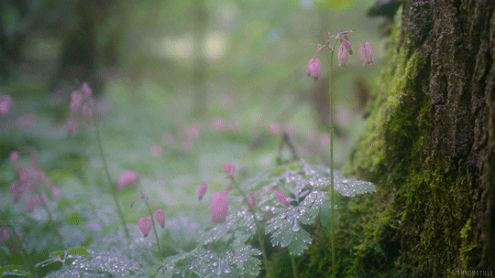
To seek God's bounties and blessings

Slide 20
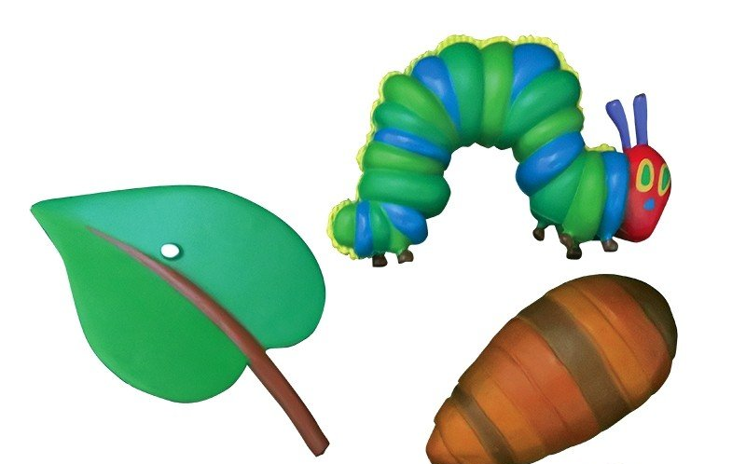
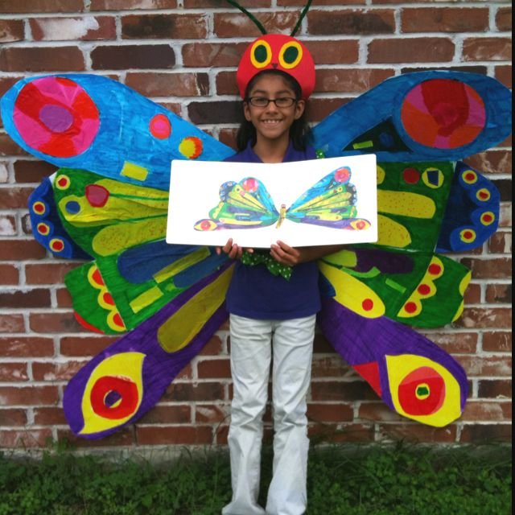
Turn Our Troubles
Into Ease
Notes:
We ask God to turn our troubles into ease

Slide 21
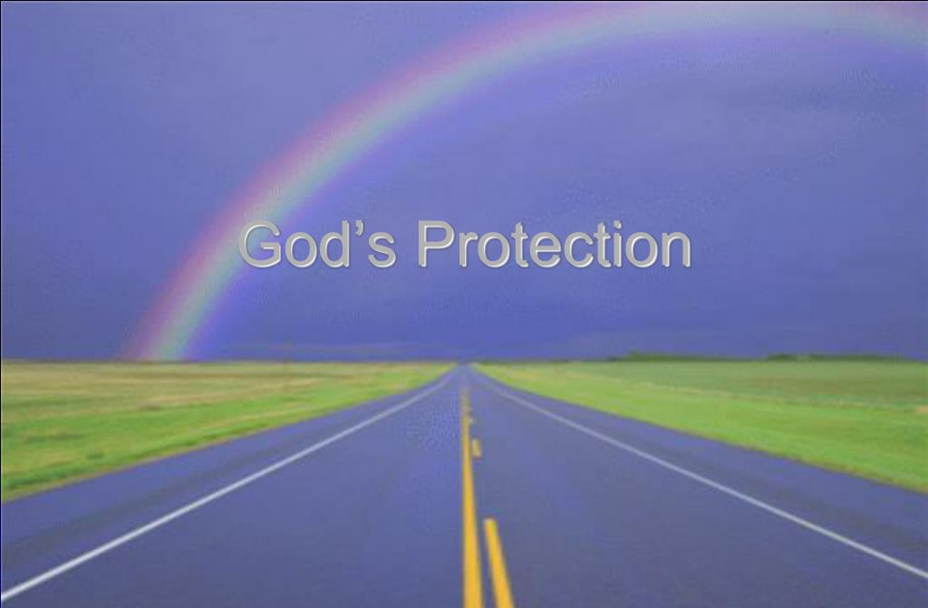
Notes:
Whether traveling or at home we ask God to protect us

Slide 22
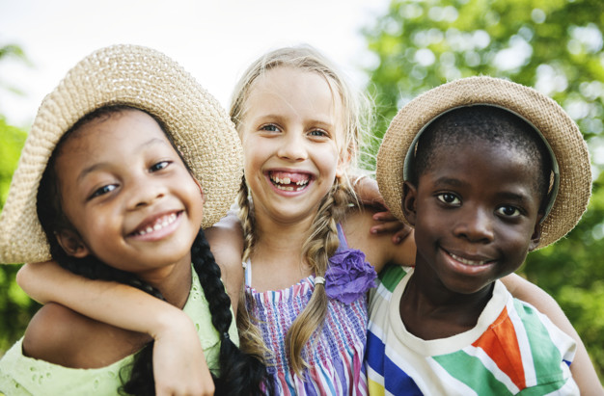
To bring us joy and to bring happiness to others

Slide 23
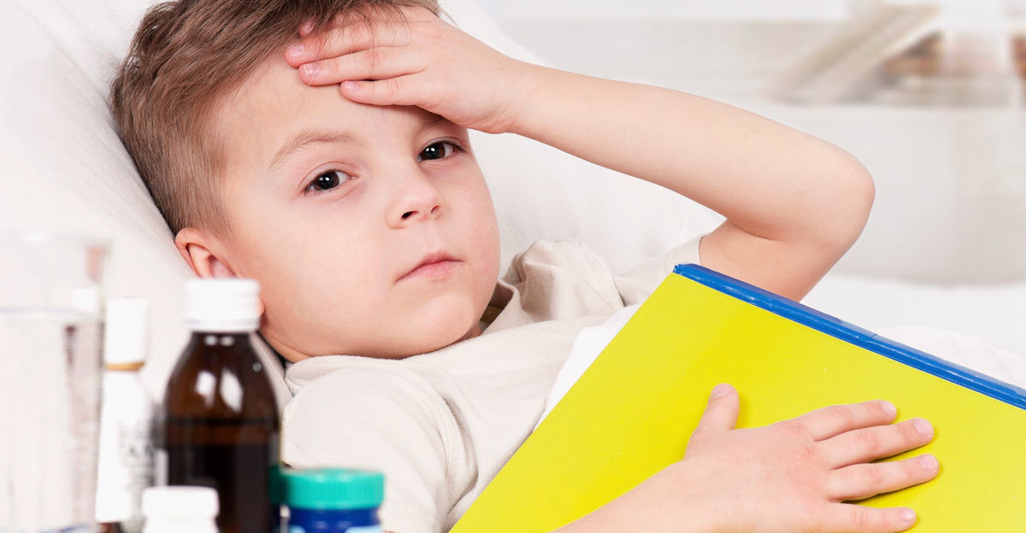
Prayer is a Healing Medicine to our Soul
Notes:
Prayer is a healing medicine to our soul. Why would souls need healing? Disease of racism, et Remember the prayer “Thy Name is my healing”? It is for both physical and spiritual healing.

Slide 24
May Thy Will
Be Done
Notes:
And most of all we pray to ask God’s will be done.

Slide 25
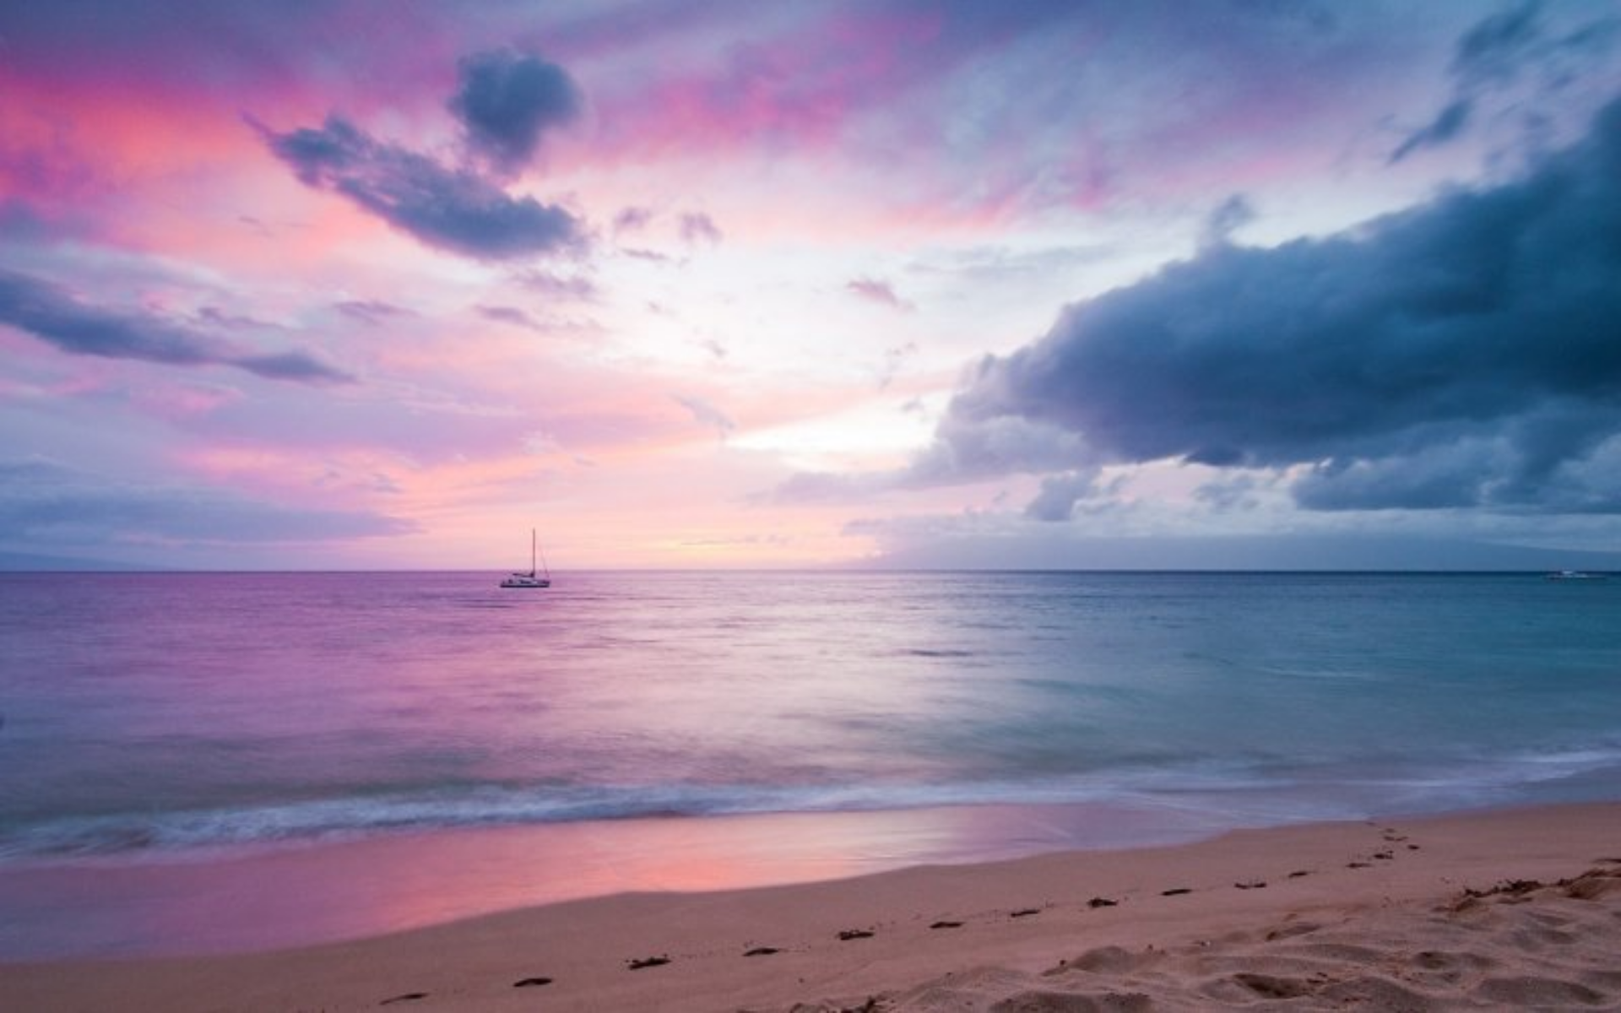
Closing Prayers
Notes:
Armed with the power of Thy name…Teacher sing
Prayer sharers
Diedre: “Reveal to us, O God, Thine exalted eternity -- that Thou hast ever been and will ever be, and that there is no God save Thee. Verily, in Thee will we find comfort and strength." -Baha’u’llah
(Song: May my life be sacrificed)

Slide 26
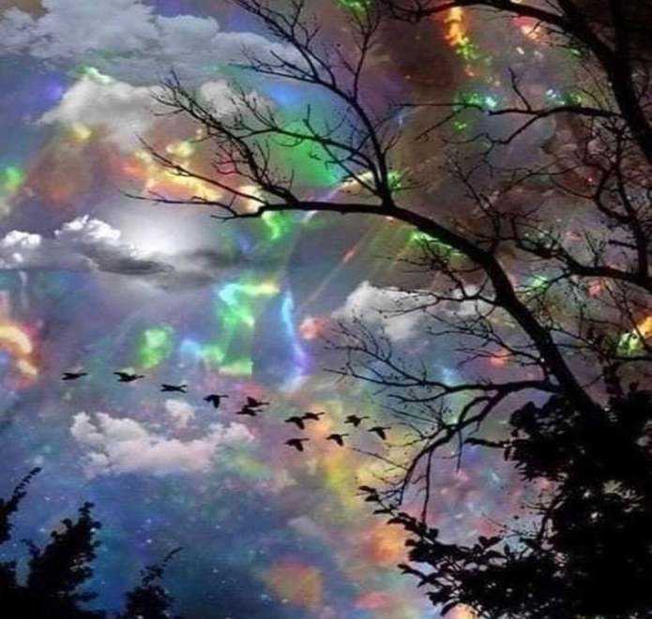
Notes:
Diedre: rainbow breaking up

Slide 27
EXTRA GAME TIME
A THIRD level challenge

Slide 28
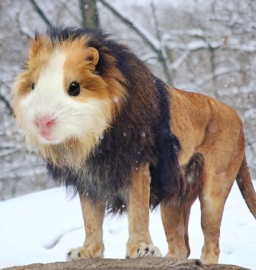
Notes:
Answer: Hamster or Guinea pig/Lion

Slide 29
Notes:
Answer: Penguin/Killer Whale (Orca)

Slide 30
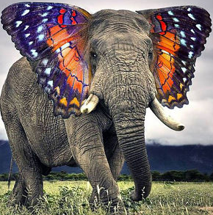
Notes:
Answer: Elephant/Butterfly

Slide 31
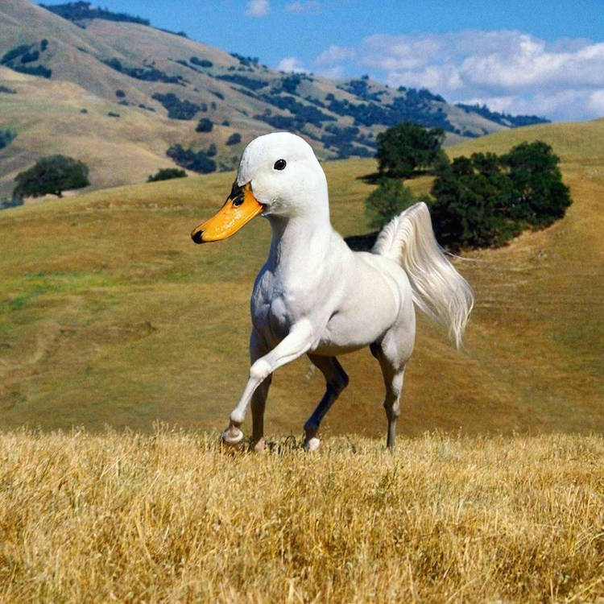
Notes:
Answer: Duck/Horse

Slide 32
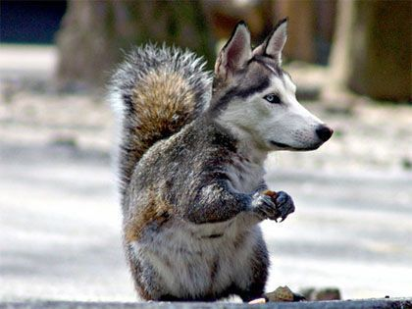
Notes:
Answer: Squirrel/Wolf

Slide 33
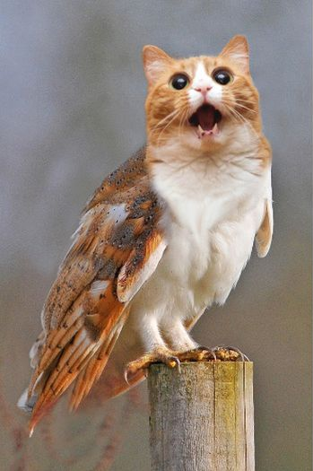
Notes:
Answer: Cat/Owl

Slide 34

THANK
YOU
Notes:
And Maia--- we are off for winter break and we will see you January 6th

Slide 35
If find need to redirect:
Remind children of God’s infinite love for them.
“We allow God’s love to reach us more easily when….”

Slide 36
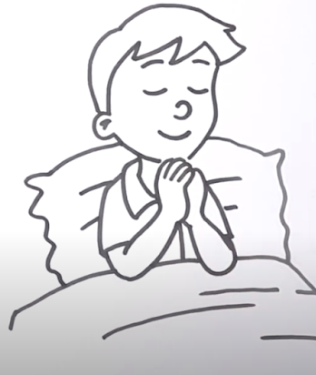
https://www.youtube.com/watch?v=4rH-s6-ZHIg
https://music.elikamahony.com/track/a-hundred-thousand-hopes-feat-fiona-doomun-rouhani
ART ACTIVITY
Notes:
Alternate activity since repeating lesson. (Diedre--- Child Praying in Bed Tutorial. We can pray in many different ways…) Girls will want to change hair so looks like a girl.
Play Song by Elika Mahonny about the power of God With a look He granteth a hundred thousand hopes)

Slide 37
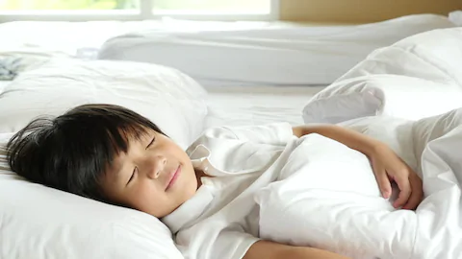
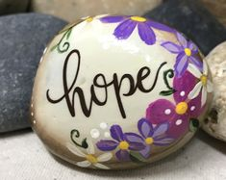
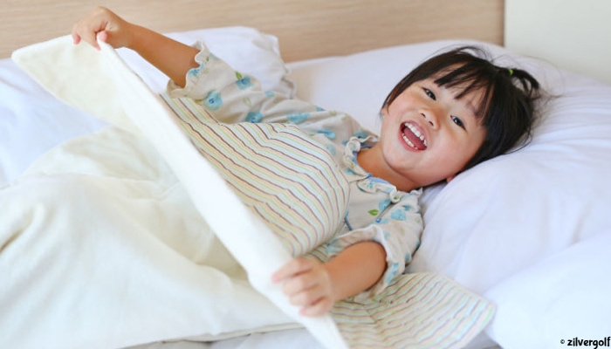
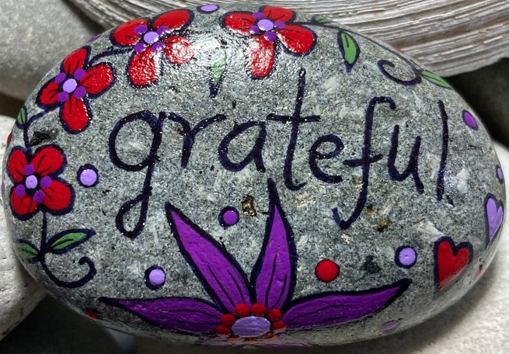
Notes:
Diedre-- Raise your hand if you remembered to say prayers last night. (Maybe you wanted to thank God for all His blessings that you received yesterday, maybe you wanted to pray for your parents, for all the people who are sick) Raise your hand if you remembered to say your prayers this morning when you woke up? If we were meeting in person we would paint rocks to help us remember to say prayers first thing when we wake up and when we go to bed. (Place rock under pillow, on floor next to bed) In the Muslim Faith, they stop and pray 5 times a day; everything comes to a stop when they hear the call to prayer broadcast from the loudspeakers. No one can forget when they hear the call.

