Slide 1
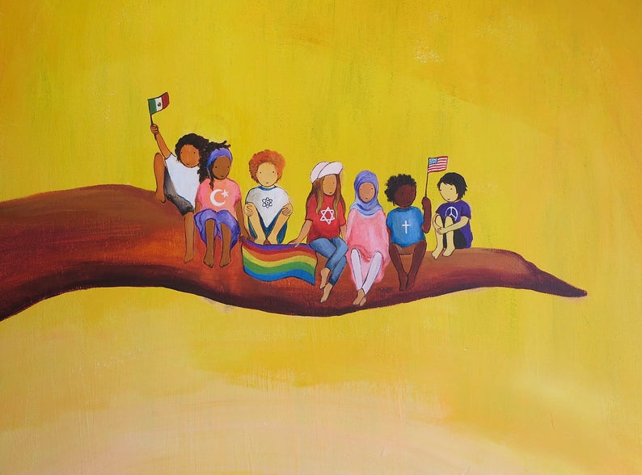
WELCOME ALL

Slide 2
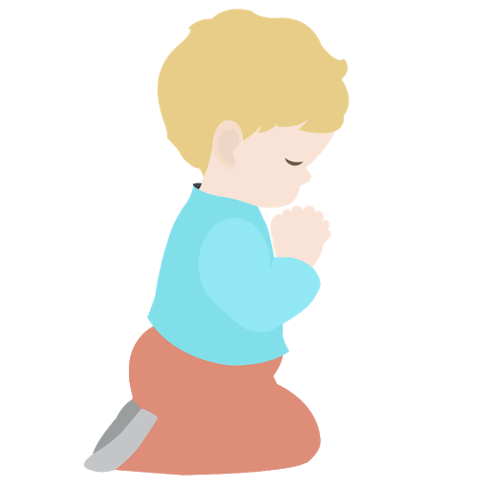
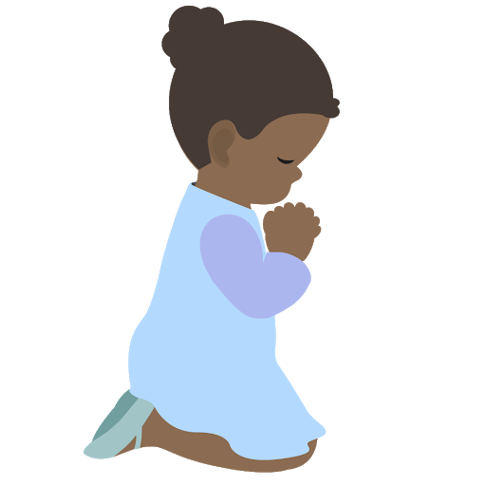
⭐️
⭐️
Prayer Stars⭐
Cassedy | ⭐️⭐️⭐️⭐️⭐️⭐️⭐️⭐️⭐️
Milan | ⭐️⭐️⭐️⭐️⭐️
Devin | ⭐️⭐️⭐️⭐️⭐️⭐️⭐️⭐️⭐️⭐️
Kim | ⭐️⭐️⭐️
Cora | ⭐️⭐️⭐️⭐️⭐️⭐️⭐️
Hudson | ⭐️⭐️⭐️⭐️⭐️⭐️⭐️
Dev | ⭐️
Manny | ⭐️⭐️⭐️⭐️⭐️⭐️
Camila | ⭐️⭐️⭐️⭐️⭐️
⭐️
⭐️
Notes:
Add Manny and Camila

Slide 3
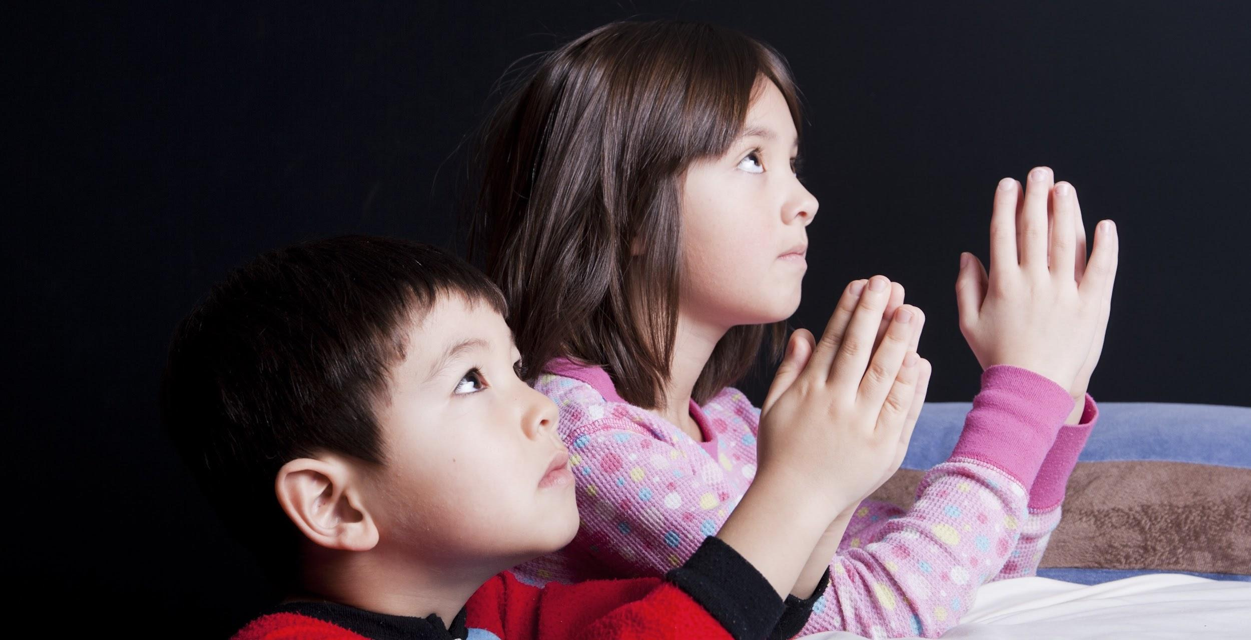
OPENING PRAYERS
Notes:
Diedre lead gestures with O God Educate These Children https://www.youtube.com/watch?v=FyFOoMMZp7Q
utube.com/watch?v=FyFOoMMZp7Q
https://www.youtube.com/watch?v=FyFOoMMZp7Q

Slide 4
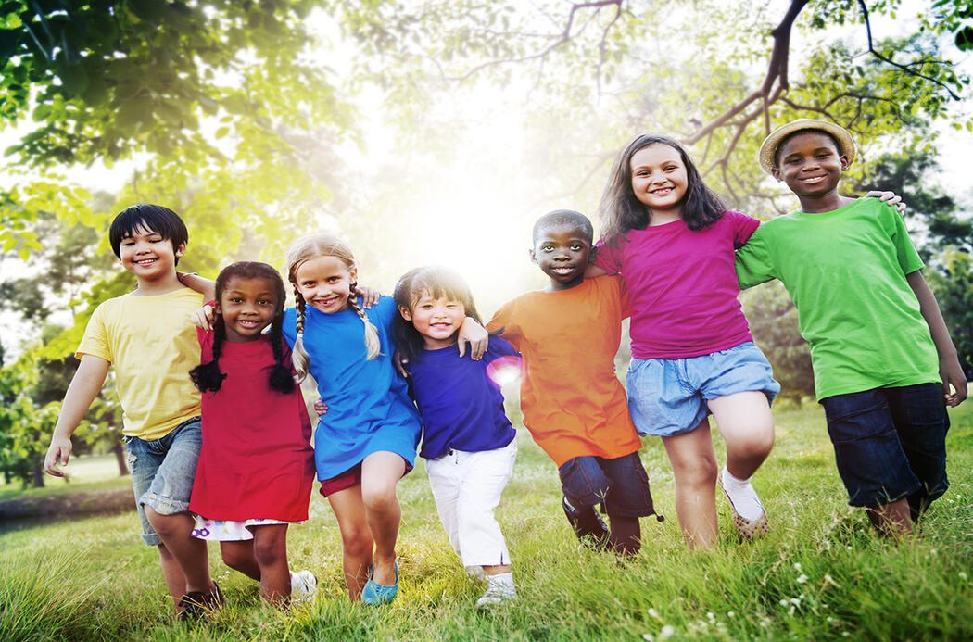
COOPERATING WITH OTHERS
Notes:
Cooperating with one another is part of living in harmony, the theme of our last two lessons.
Present 1st paragraph p. 95 Grade 2 Lesson 12 Knowing that we are members of one family...

Slide 5


CHORUS
You and me and our families are living side by side
Let’s see what we can do when we help each other
We can cross the seven sea, we can build communities
What joy we feel as we work together!
CHORUS
Let’s all help each other x 2!
There’s a dog and a blind man walking side by side
Let’s see what they can do when they help each other
They go all through the town, they go upstairs and down!
What a joy we feel as we work together!
CHORUS:
Side by side, working together
Side by side, let’s all help each other
Side by side, working together
Side by side, let’s all help each other
There’s a truck and an excavator working side by side
Let’s see what they can do when they help each other
They dig holes in the ground and they clear away the land
What a joy we feel as we work together!

Slide 6
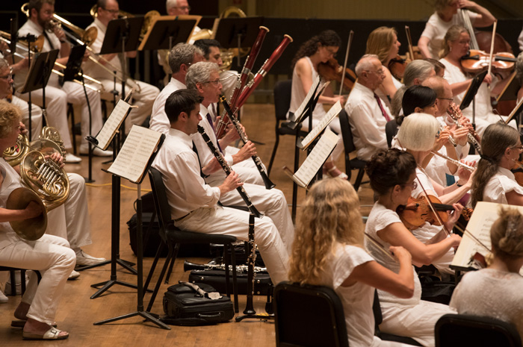
Notes:
How many of you have had the chance to listen to an orchestra? Look at all these different instruments, yet all the instruments blend together to make the most beautiful music.

Slide 7


“The diversity of the human family
should be the cause of abiding
love and harmony as it is in
music where many different
notes blend together in the
making of a perfect chord.”
‘Abdu’l-Baha
Notes:
Ask Dev to read and if not ask Cassedy

Slide 8
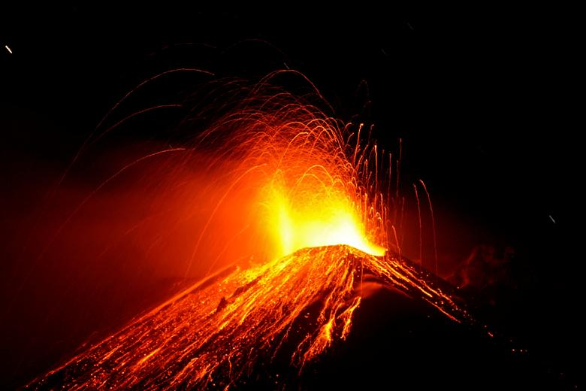
https://www.youtube.com/watch?v=wbNAiN8FTfc
Movement Activity
Notes:
https://www.youtube.com/watch?v=wbNAiN8FTfc
Red Hot Lava

Slide 9
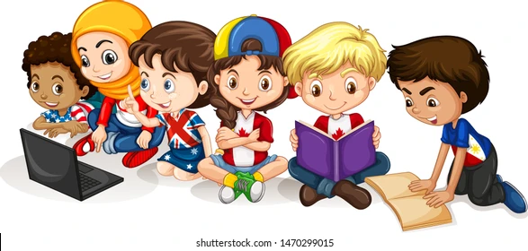
STORY TIME
Notes:
Story of Nettie Tobin

Slide 10
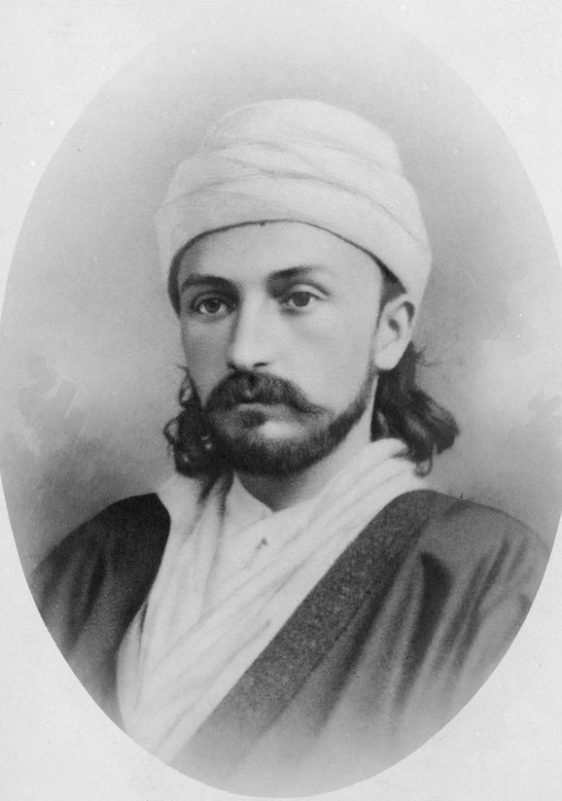
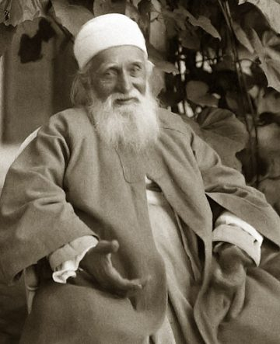
Notes:
Here is a photo of the son of Baha’u’llah. Do you remember His name? Was He a Manifestation? He insisted He was the servant of the Manifestation of God. This is a photo of Him when He was a young man and another photo at the age when He traveled to the United to share His Father’s message of the oneness of mankind.The true story that I am going to share with you will show us what can be accomplished through cooperation.
During Abdul-Baha’s travels in America, one of the places He visited was a special piece of land that had been purchased in order to build a Bahai House of Worship, a beautiful temple where all people could come and commune with God. Before construction on the House of Worship began, a gathering was held to say prayers on that spot, after which Abdu’l-Baha would lay with His own hands the first stone of the building- the cornerstone.

Slide 11
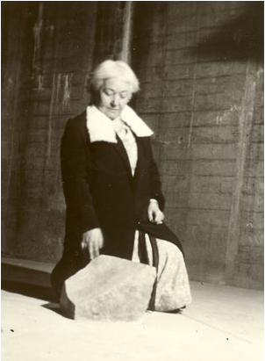
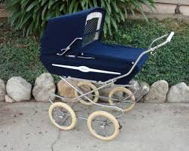
Notes:
One of the friends, a lady named Nettie Tobin, longed to give something to help build the House of Worship. She did not have any money to offer, but the day before the meeting, she had an idea. She went to a building under construction near her home. Cast off to the side was a pile of large stones, and she asked whether she might take one.
“Help yourself,” said the builder. “These are rejected.” You see, the builder needed a particular kind of stone, and the ones in the pile could not have been used. Nettie chose a stone but discovered it was too heavy for her to lift. So, she went home and got an old baby carriage, ask for help loading the stone into it, and wheeled it home. That was as far as she could manage on her own.

Slide 12
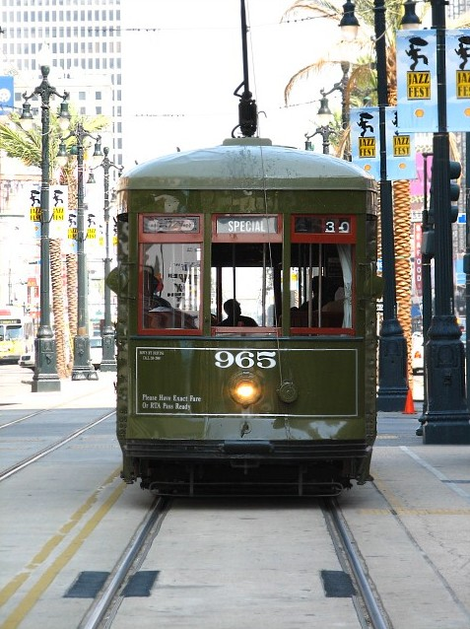
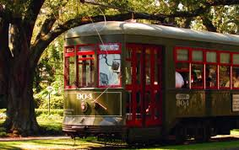
Notes:
Now, in those days, many cities had streetcars to take people from one place to another, much like we have buses today. And, with the help of a friend, Nettie took the stone on three streetcars the next morning. Together, they lifted the baby carriage onto the first streetcar, then off again. They waited for the second streetcar, loaded the carriage onto it and then off again, and finally heaved it onto the third streetcar, which took them close to the spot where the House of Worship was to be built. There was still some distance to walk, and the two friends started pushing the baby carriage over the broken pavement. But suddenly it collapsed. They were at a loss for what to do! Even together the two of them could not carry the heavy stone the remaining distance. It was late, and they feared the gathering had already started. After such a long journey, it seemed that Nettie and her friend would miss everything.

Slide 13
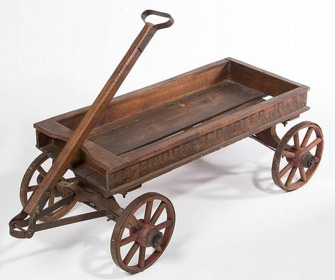
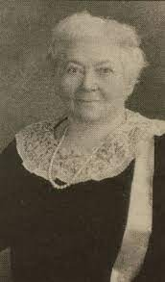
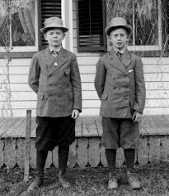
Notes:
Just then, two boys with an express wagon came along. With their help, the stone was loaded into the wagon, and off they all went to the gathering- Nettie, her friend, the two boys, and the stone. Somehow knowing they were coming, “Abdu’l-Baha had waited to start the ceremony until they arrived. Imagine Nettie’s joy when Abdu’l-Baha chose that very stone to mark the location where the Temple would be built.

Slide 14
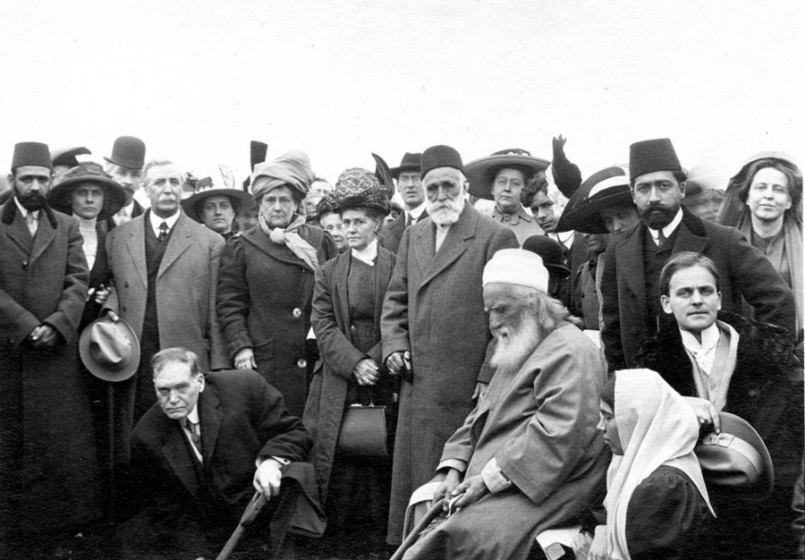
Notes:
A hole needed to be dug so the stone would stay in place. ‘Abdu’l-Baha was the first to dig, then representatives from the various American Baha’i Assemblies, followed by representatives from the orient. Among them were representatives from Persian and Arabian backgrounds, also Baha’is of Muslim background. In addition there was one Eastern woman as well. Remember how we learned that Baha’u’llah taught us about the equality of men and women? It was important then for ‘Abdu’l-Baha to include a woman in this special ceremony.

Slide 15
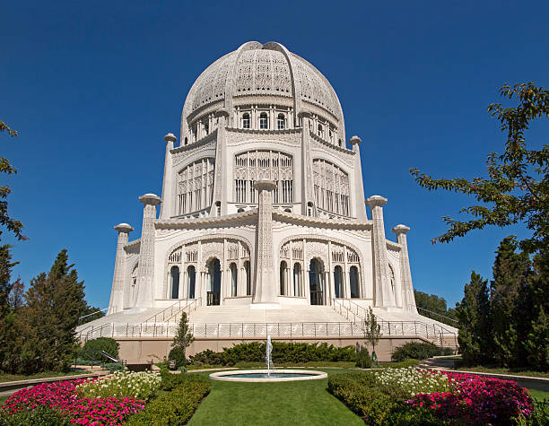
Notes:
In time, a beautiful House of Worship was built on that piece of land,

Slide 16
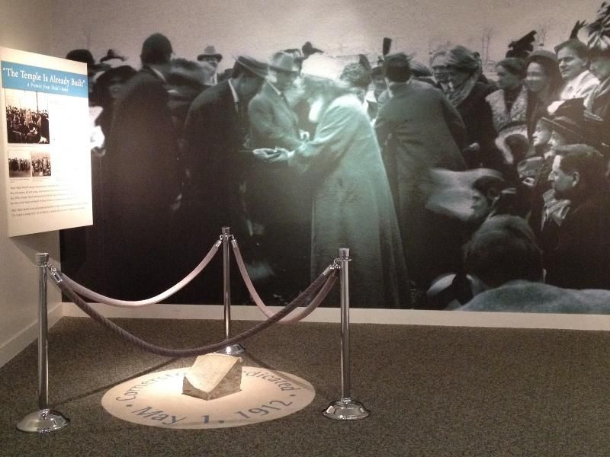
Notes:
Today you can visit the Baha’i temple in Chicago and see the stone which Nettie and her friend and the two boys worked together to bring to ‘Abdu’l-Baha to dedicate the Temple site. What does this story tell us about how cooperating together helps us achieve things we couldn’t do alone?

Slide 17

https://www.youtube.com/watch?v=TgaQUGo3AUM
ART ACTIVITY
Notes:
Part of cooperating with others during COVID is wearing our masks
Write virtues that describe them for the words
URL: shorten Mask self portrait--- start video at 1 min 40 seconds
Circle of Light while drawing
https://www.youtube.com/watch?v=xJWRKjAe3zQ

Slide 18
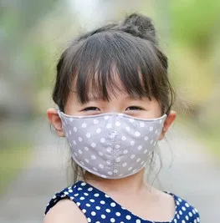
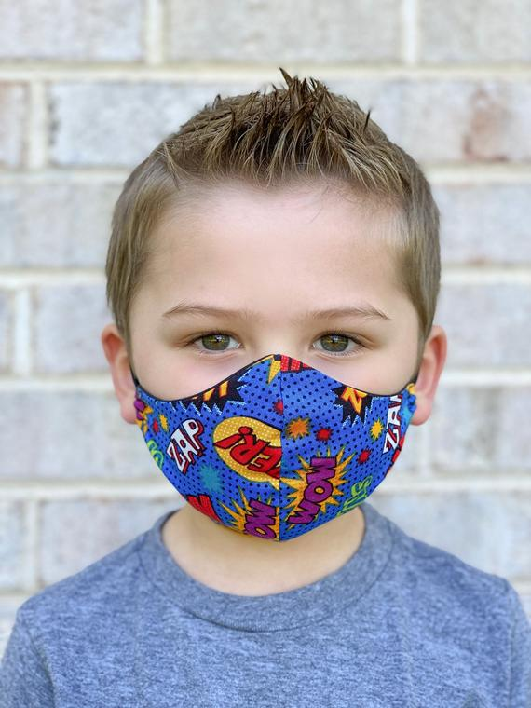
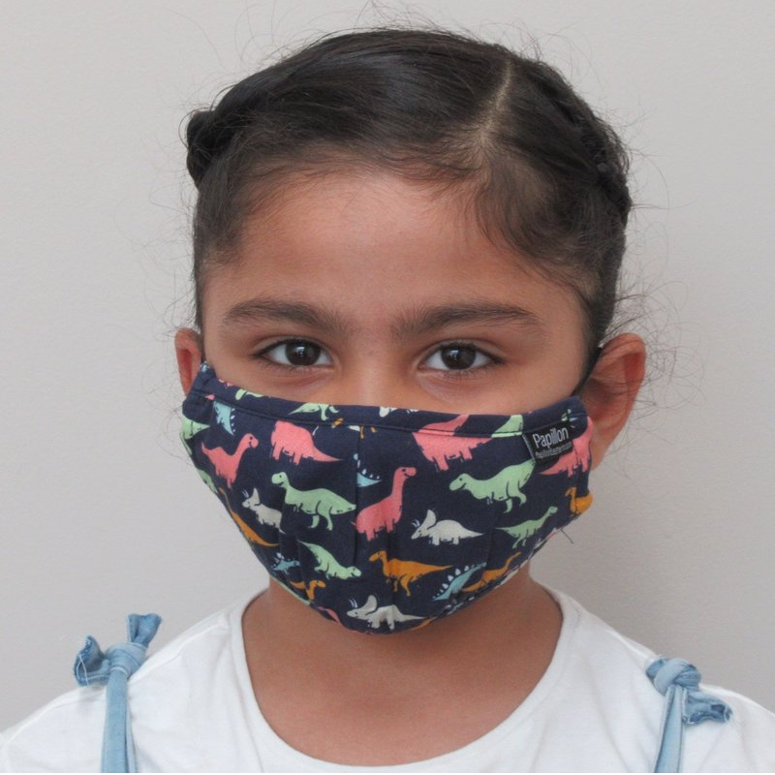
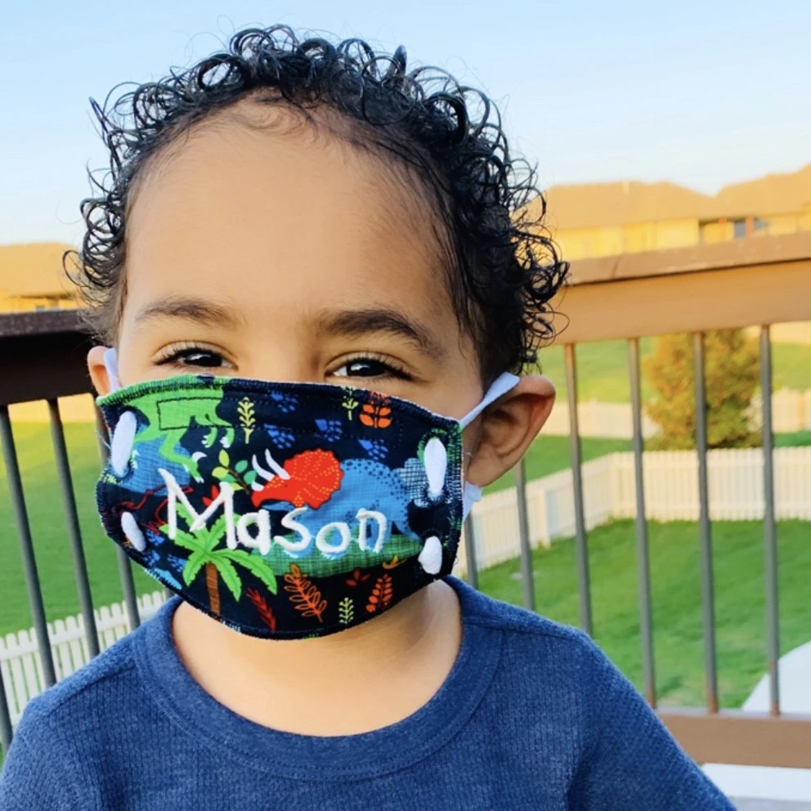
ART SHOW

Slide 19

CLOSING PRAYERS

Slide 20


