Slide 1

WELCOME

Slide 2
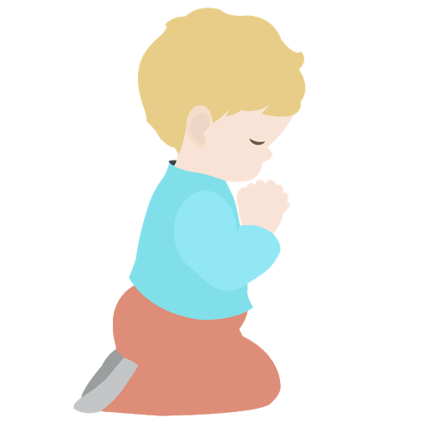
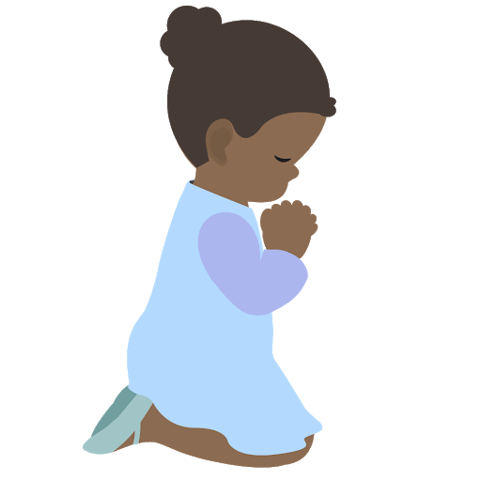
⭐️
⭐️
Prayer Stars⭐
Cassedy | ⭐️⭐️⭐️⭐️⭐️⭐️⭐️⭐️⭐️⭐️⭐️⭐️⭐️✅
Milan | ⭐️⭐️⭐️⭐️⭐️
Devin | ⭐️⭐️⭐️⭐️⭐️⭐️⭐️⭐️⭐️⭐️✅
Kim | ⭐️⭐️⭐️⭐️
Cora | ⭐️⭐️⭐️⭐️⭐️⭐️⭐️⭐️⭐️⭐️⭐️✅
Hudson | ⭐️⭐️⭐️⭐️⭐️⭐️⭐️
Dev | ⭐️⭐️⭐️
Manny | ⭐️⭐️⭐️⭐️⭐️⭐️⭐️⭐️⭐️⭐️⭐️⭐️✅
Camila | ⭐️⭐️⭐️⭐️⭐️⭐️⭐️⭐️⭐️⭐️⭐️⭐️✅
⭐️
⭐️
Notes:
Cora, Cassedy, and Devin did you receive your lego kits in the mail?

Slide 3
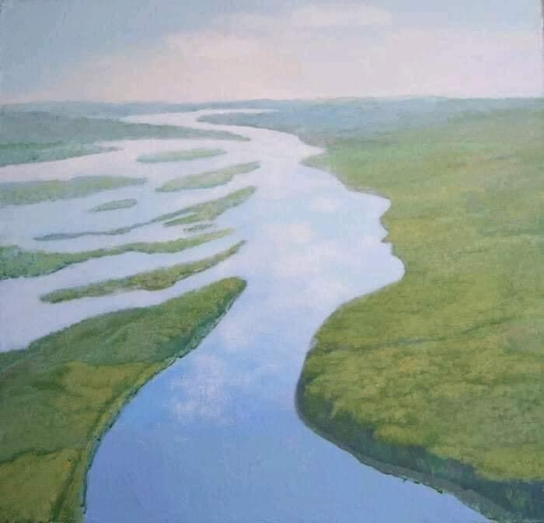
Opening
Prayers
https://www.youtube.com/watch?v=MM1XDNn6QFg
Notes:
URL: We Are Drops of One Ocean
What do you see in this photo--- does it remind you of the oneness of mankind? How we are all connected?

Slide 4
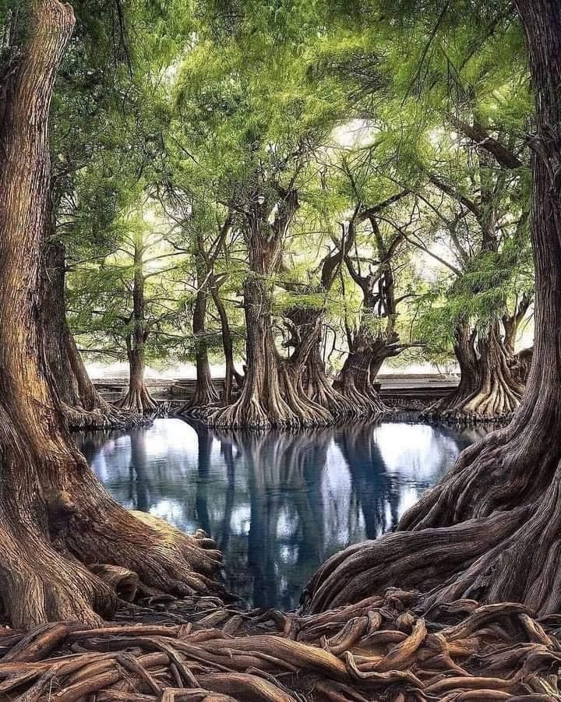
When we make a habit of saying prayers and reading the Divine Word, we gain in spiritual insight and see things more clearly.
Notes:
Read slide. What do you see in this photo? What spiritual significance does this have to you? (love) Let’s think about the trees as members of a family and how they have been created out of God’s love. How ‘bout if we looked at it as the trees of humanity?

Slide 5
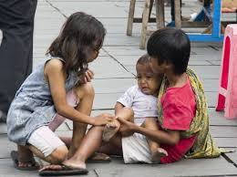
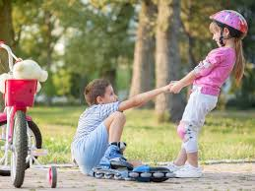
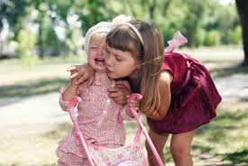
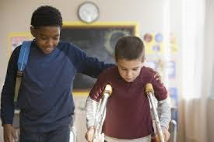
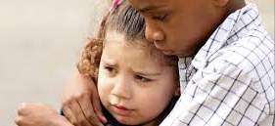
Taking Care of Friends
Notes:
Last class we learned that true friends are trustworthy. Today we are going to explore how friends can take care of one another.
Intro from Ruhi 3

Slide 6
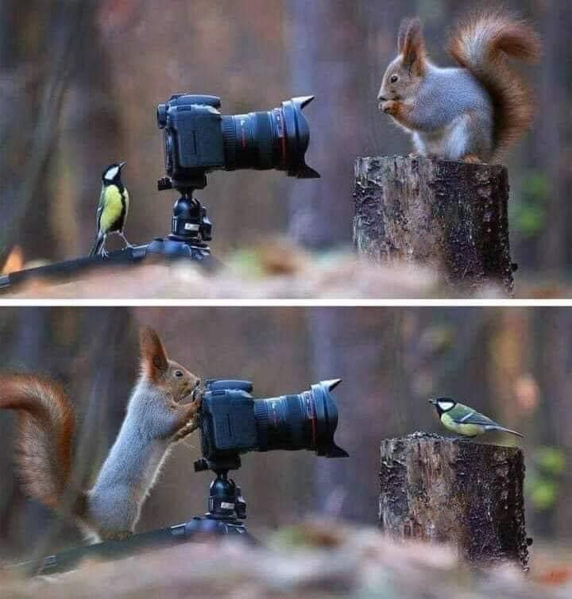
Notes:
The bird and squirrel are friends. They are keeping an eye on one another.
The more time they spend together the more they learn about each other. You can tell they are looking very carefully to see what more they can learn about each other. Let’s look at the friendship between people. What do you need to learn about someone so you can care for them? How do you and your friend take care of each other?

Slide 7
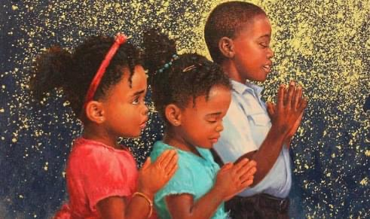
A friend is one who
Strengthens you
with prayers
Blesses you
with love
Encourages you
with hope
Proverbs 27:9
A sweet friendship refreshes the soul.
Notes:
This quote is from the Bible. Read quote. Stress #2 above (Strengthens you with prayer) Do you think you can strengthen a classmate’s soul by praying for him or her?
Tell the children that they will be praying for a classmate and will find out after class which classmate--- Contact parents after class telling them who their child will be praying for during the week. No one will know who their prayer partner is until next class..

Slide 8
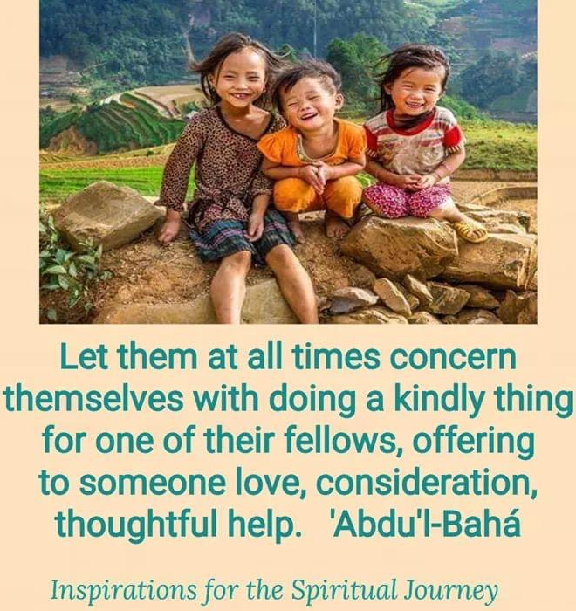
Notes:
Have dev or other child read the quote
We want to care for everyone who may cross our path.
“Thoughtful help” is like the squirrel and his friend-- being observant of the friend and what he needs at any particular time--- mindful of each other's needs

Slide 9
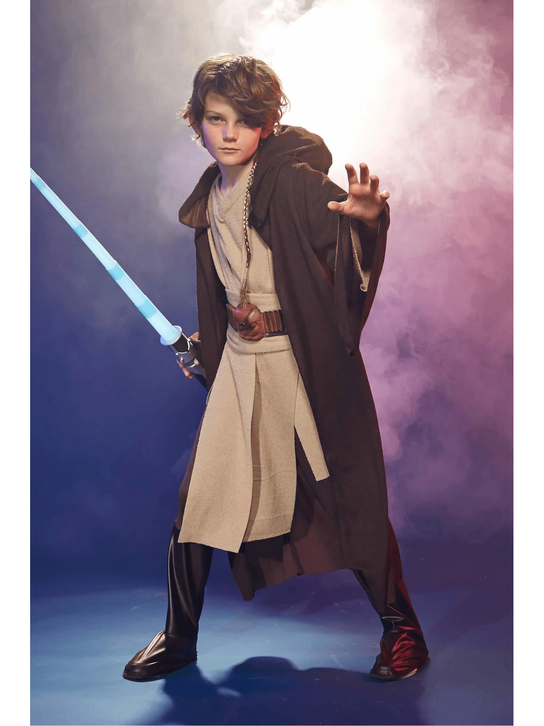
Movement
Activity
https://www.youtube.com/watch?v=aNTTMeduOw0
Notes:
Noura Start 1 minute 5 seconds

Slide 10
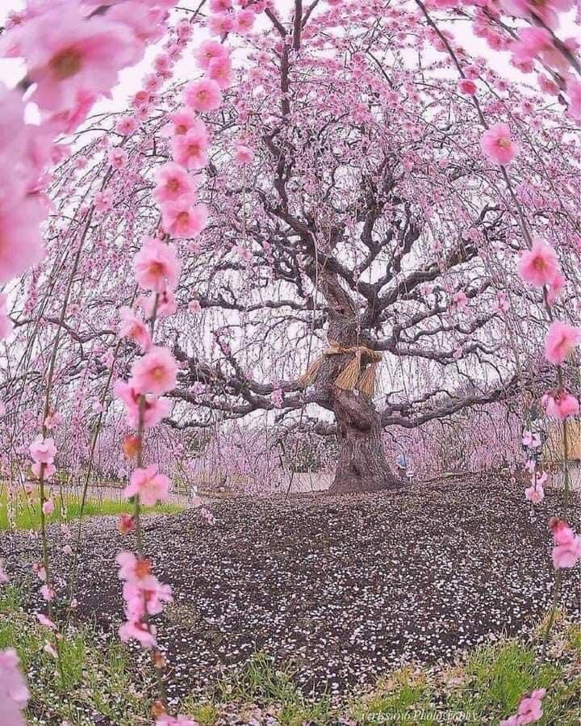
“...strive ye with all
your might to create,
through the power of
the Word of God, genuine love, spiritual communion and durable bonds among individuals.”
Notes:
Read quote. It is those spiritual bonds that last forever.

Slide 11
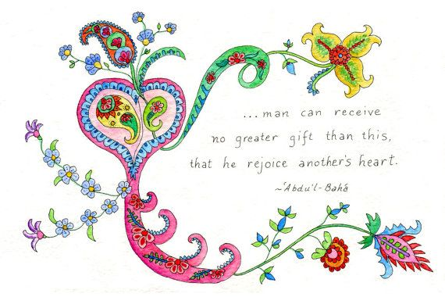
Notes:
Isn’t it fun to be able to make our friends laugh and be happy? Read quote.
This is why ‘Abdu’l-Baha was always happy bec He spent His entire life bringing joy to others.

Slide 12
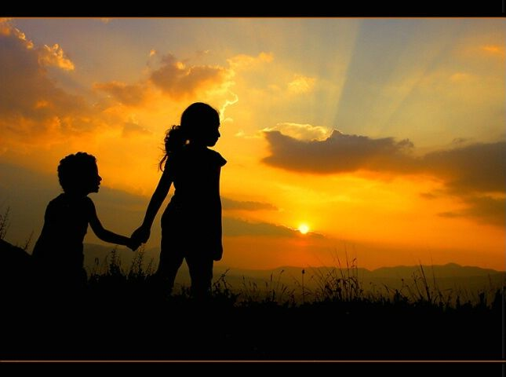
We are all accompanying each other on our journey back to God
Notes:
We all come from God and we will all return to Him. Right. So in a sense we are all accompanying each other on our journey back to God.

Slide 13
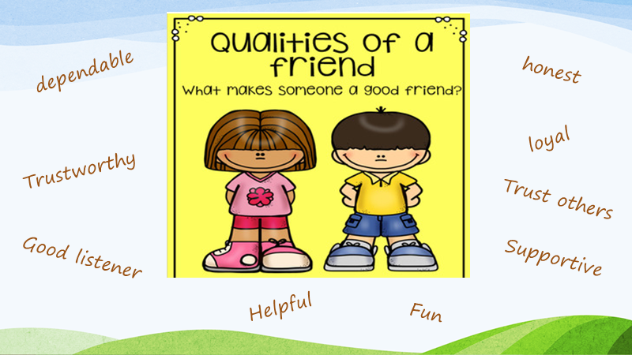
Notes:
After reading the different virtues (adding others) that characterize a good friend, ask each student to identify their favorite quality of a special friend.

Slide 14
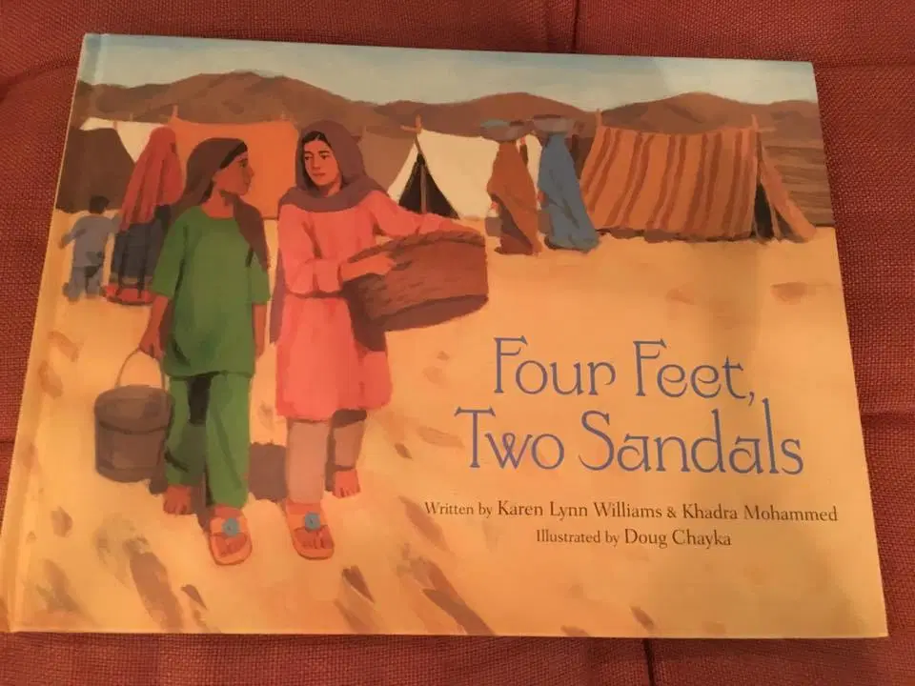
https://www.youtube.com/watch?v=o4NLYmiriME
Notes:
Story Time

Slide 15
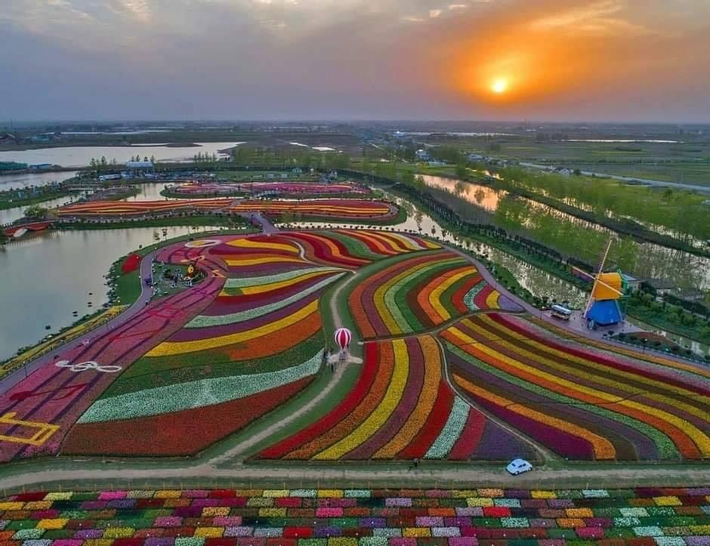
Art Activity
Notes:
Art activity-- making a card for best friend with virtues/qualities they have--- have kids draw on one side a picture of them together doing their favorite thing. Use crayons or colored pencils so doesn’t bleed through.

Slide 16

Hi (friend’s name),
You are a great friend because you are generous, (virtue),(virtue),
(virtue).
I appreciate you so much.
Your friend,
(Your name)

Slide 17
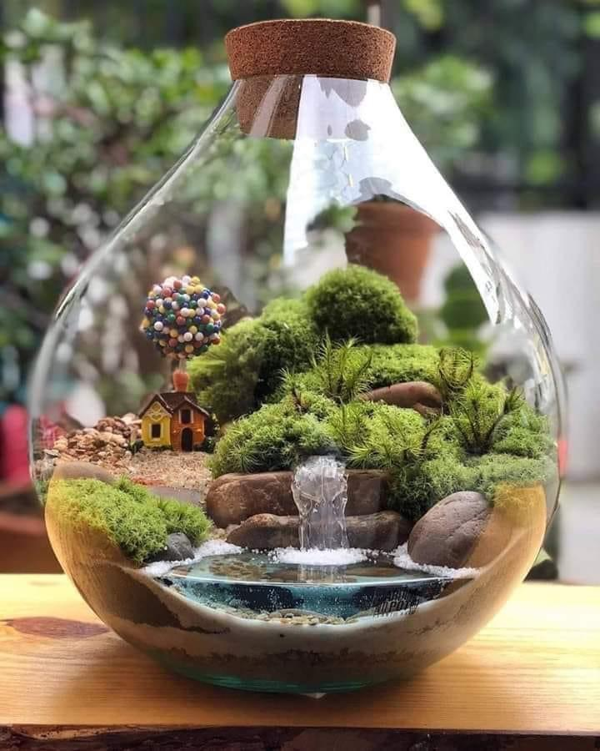
Closing
Prayer
https://www.youtube.com/watch?v=NJ-VfqK1fS4
Notes:
O God! Unite the hearts of Thy servants.

Slide 18


Slide 19
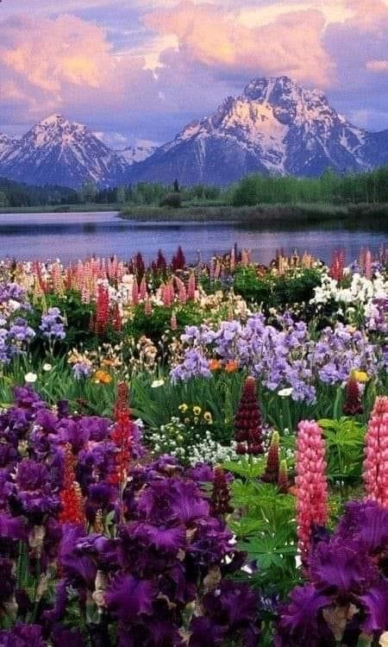
“I Spy”
with my
spiritual
eye
https://www.youtube.com/watch?v=MGzcRzNjVHU
Notes:
Explain modified “I Spy” game. Looking for spiritual meanings in photos. Baha’u’llah refers to us as “O Man of Two Visions”.
Let’s listen to this short quote put to music and you will understand better how to play this game.
Know that there are no wrong answers in this game. (Ye are the flowers of one garden)

Slide 20
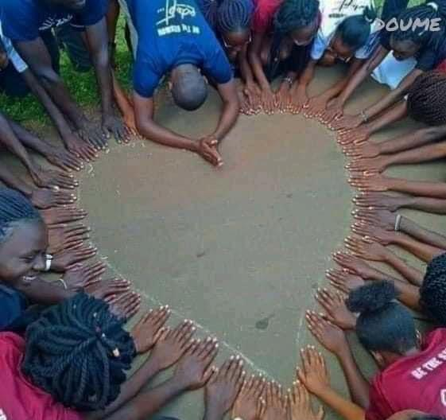
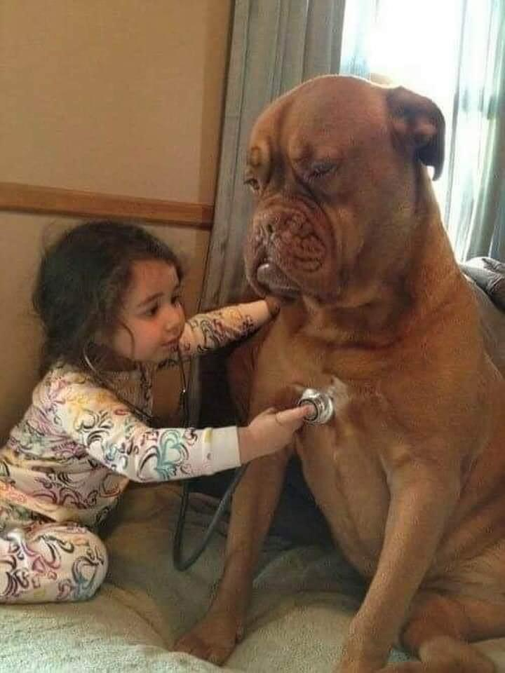
Notes:
Look at the photo on the left with your spiritual eye. What does it remind you of? The power of love/cooperation; caring for friends.

Slide 21
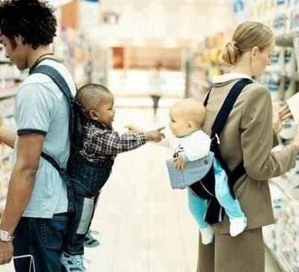
Notes:
What do you see in this picture? We are born without prejudice. Prejudice is learned

Slide 22
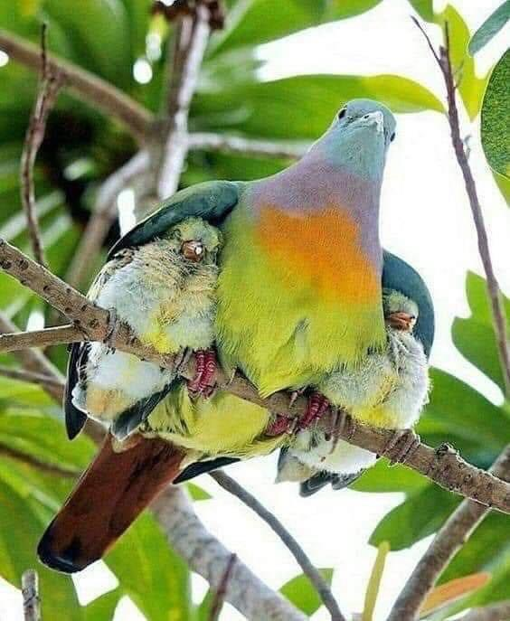
Notes:
?? (Shelter the destitute/under the wing of God’s protection)

Slide 23
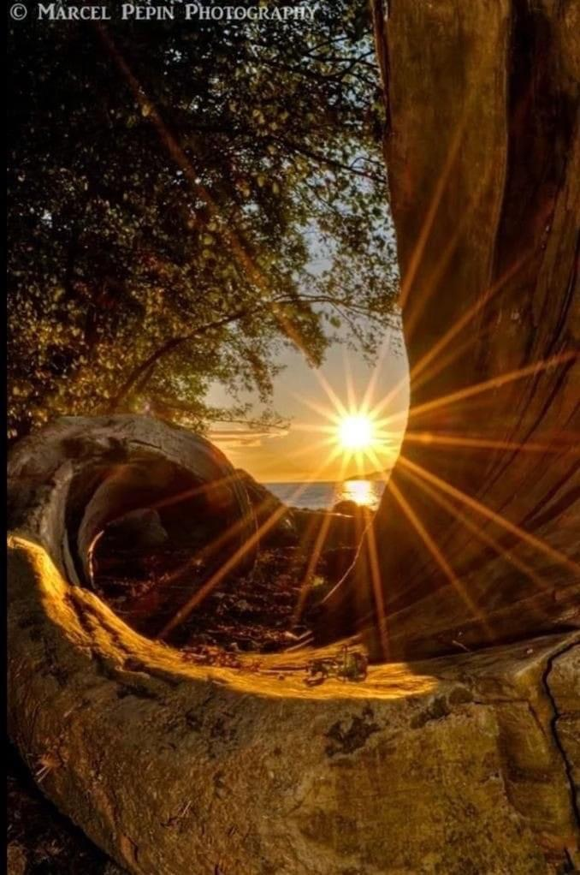
Notes:
?? (God always sends Messengers to guide us)

Slide 24
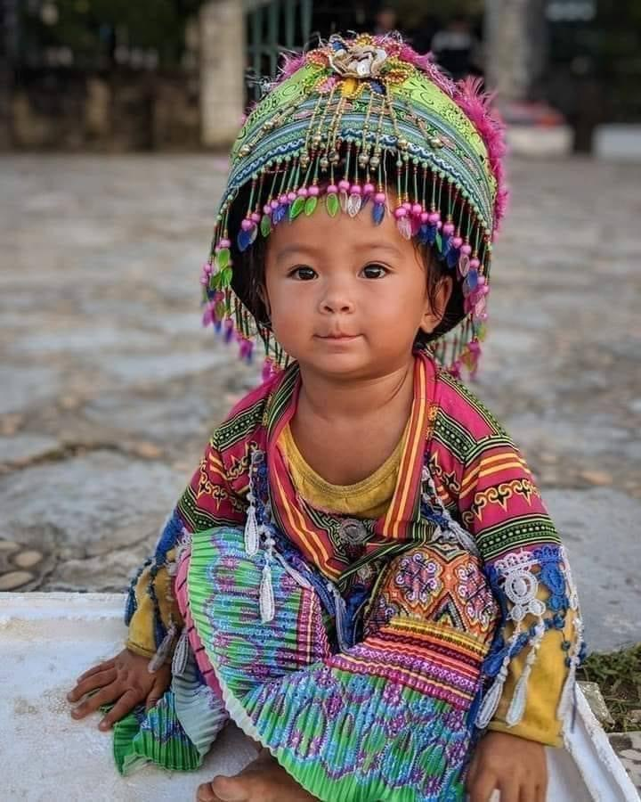
Notes:
What about this one? What do you see with your spiritual eye?

Slide 25
“...and adorn
your soul
with the
ornament
of honesty.”

