Slide 1
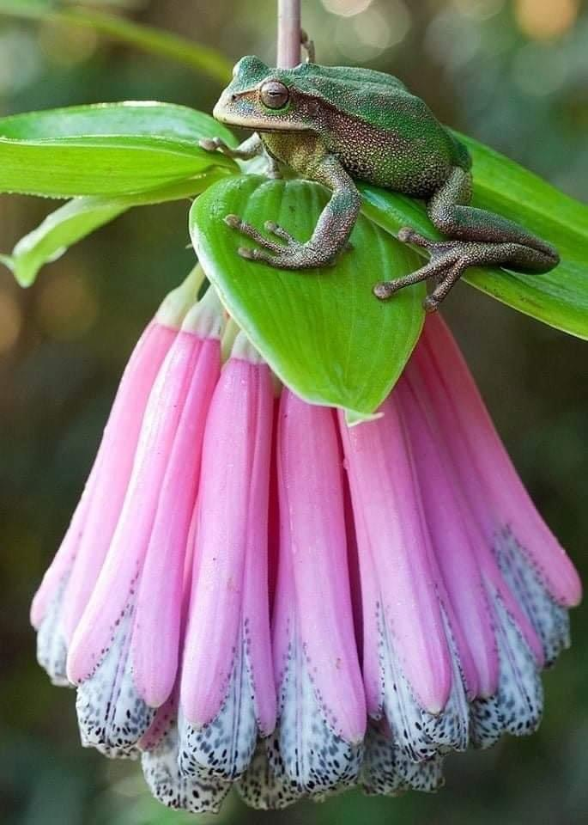
Welcome

Slide 2
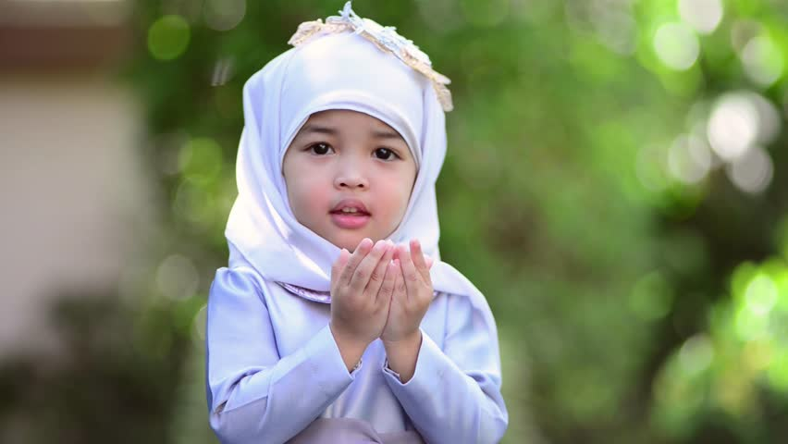
OPENING PRAYERS
Notes:
Diedre: Teach O Thou Kind Lord

Slide 3
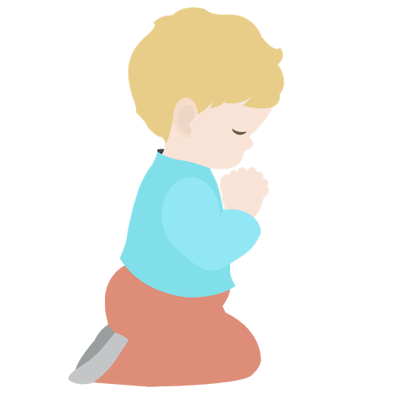
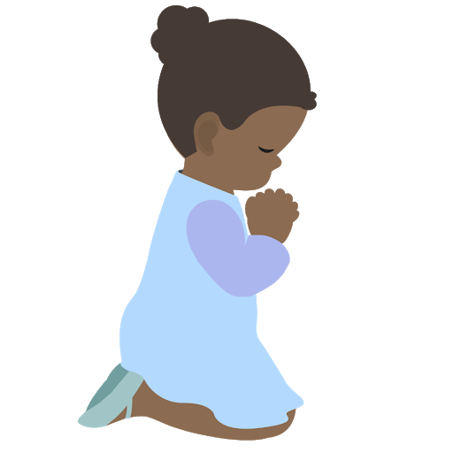
⭐️
⭐️
Prayer Stars⭐
Cassedy | ⭐️
Milan
Devin
Kim
Cora
Hudson
Dev
⭐️
⭐️
Notes:
Explain reward for saying prayers in the morning.

Slide 4
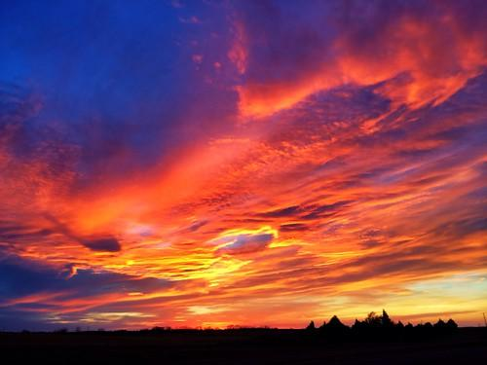
STRIVING DAILY
Grade 2 Lesson 6
Notes:
Noura intro

Slide 5
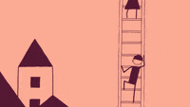
Notes:
Noura-- What are we striving to do? Striving to go step by step to ascend to the realm of God

Slide 6
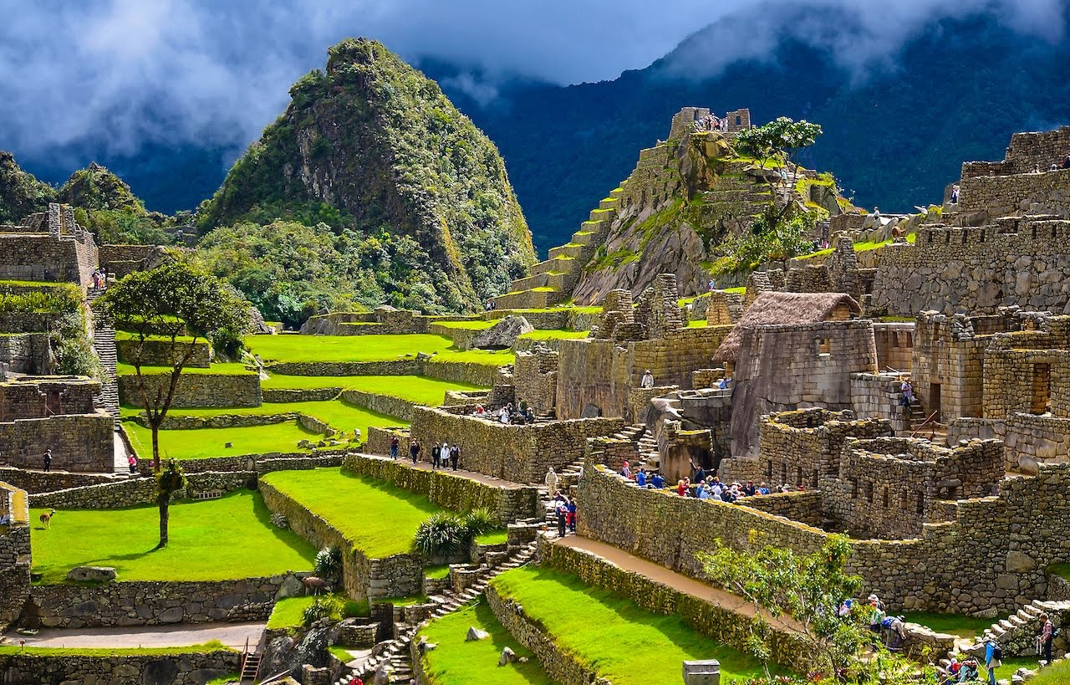
https://vimeo.com/15649720
Notes:
Noura-- Machu Picchu: One of seven wonders of the world. It is a treasure. People all over the world go to visit it. It was built in 1400s-- look at all the stones and detail, it must have taken so much work but they did it step by step URL: Little by little, day by day

Slide 7
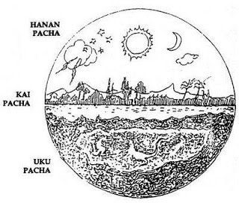
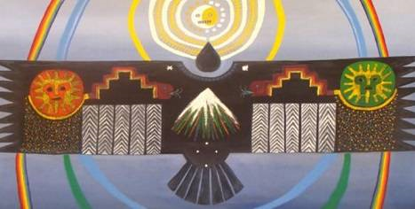
Notes:
Noura-- Spiritual significance of Inca buildings
Top photo= existence of god
Hanan Pacha. Three realms of existence God, earth, and hell.
Lightening, rainbows connect realm of God with realm of man (earth)

Slide 8
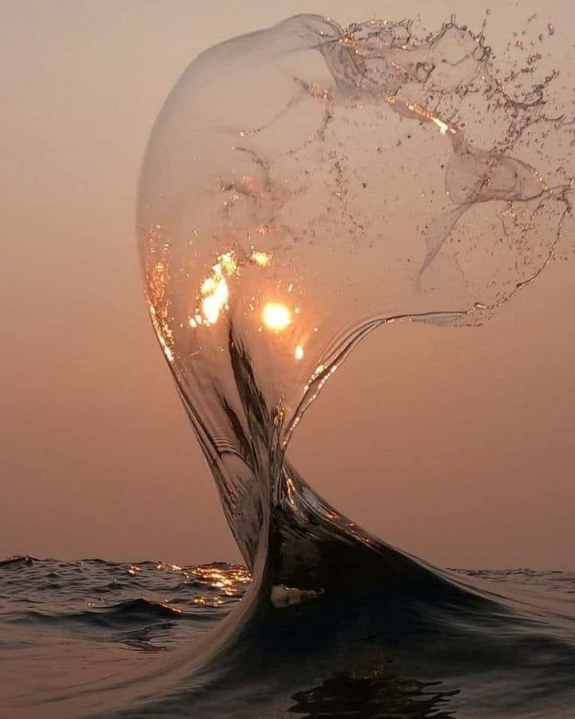
O SON OF MAN!
Neglect not My commandments
if thou lovest My beauty, and
forget not My counsels if thou
wouldst attain My good
pleasure.
Baha’u’llah
https://drive.google.com/file/d/1XPiQaF5lLIkiwGdUDgq2BQ6eB8i-VTOC/view?usp=sharing
Notes:
Noura Read quote then go to song URL Neglect not my commandments (English)

Slide 9

https://www.youtube.com/watch?v=DS8yeXFeEPA
Movement Activity

Slide 10
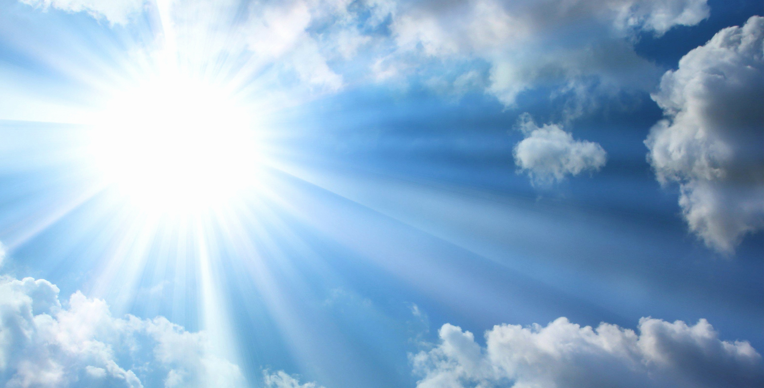
O Ye Sons of Spirit !
Notes:
Diedre- We are going to learn a song, first let’s go over the words!

Slide 11
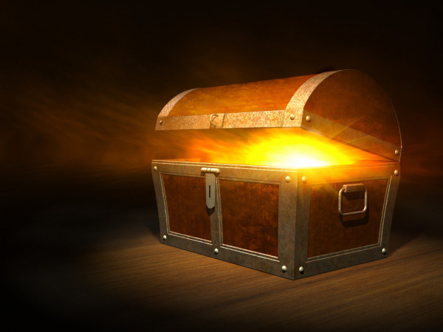
Ye are My treasury
Notes:
Ye are My treasury,

Slide 12
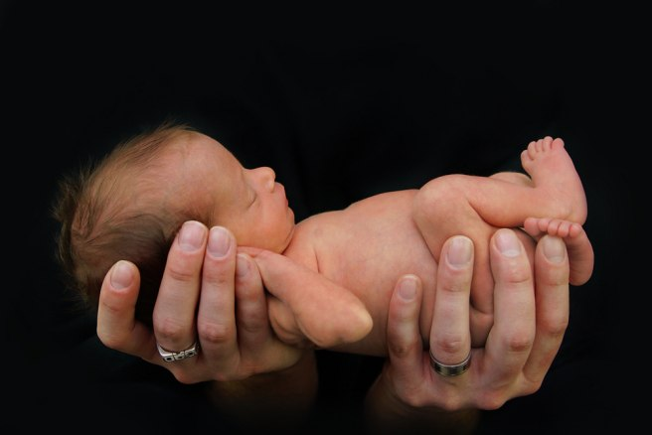
for in you I have treasured

Slide 13
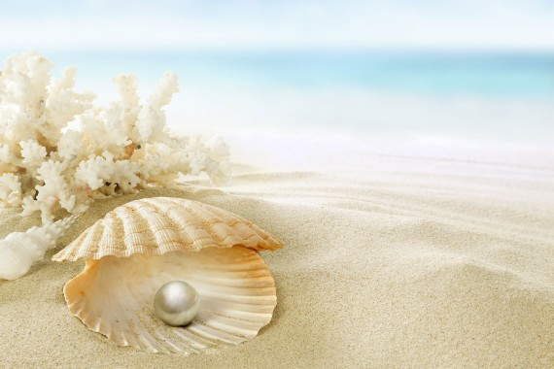
the pearls of My mysteries

Slide 14
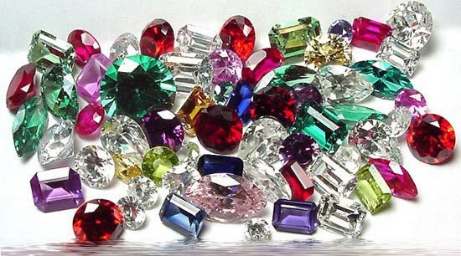
and the gems of My knowledge.
Notes:
Back to slide 9 for memorizing song

Slide 15
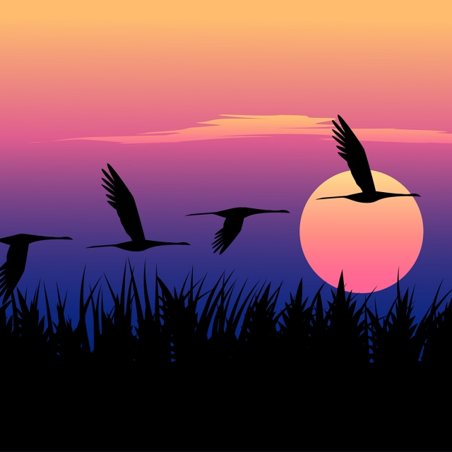
STORY TIME
Notes:
Noura: Slide 20

Slide 16
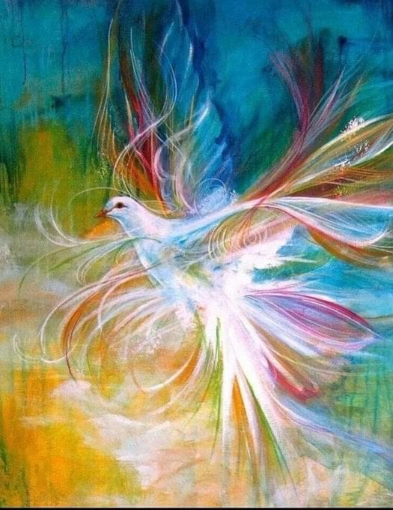
https://www.youtube.com/watch?v=HPxM3eTuQFQ
https://www.youtube.com/watch?v=B3oyxZ8ZJkU
ART ACTIVITY
Notes:
Maia Merrill introduction-
For our art today we are going to draw an Incan pyramid like Machu Picchu. Remember it is considered a world treasure. And you are God’s treasure because He values you so so much! Top link is drawing and bottom link is music (neglect not my commandments (English /French)

Slide 17
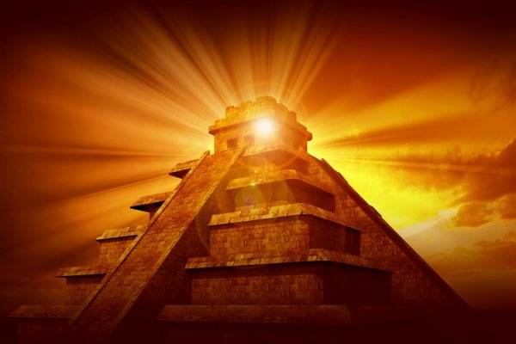
ART SHOW

Slide 18

CLOSING PRAYERS
Notes:
O Ye Sons of Spirit!
Prayer sharers

Slide 19
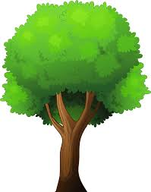







Cassedy
A
H
N
Milan
T
K
O
Y
U
Hudson
Dev
Maia
Devin
Kim and Cora
Kim

Slide 20
You remember the story of Haji Muhammad from our last lesson, how obedient he was to Baha’u’llah
You remember the story of Haji Muhammad from our last lesson, how obedient he was to Baha’u’llah and what strength he drew from trust in God. But Haji Muhammad had not always been so quick to obey. Perhaps you know that he was an excellent hunter and marksman, which means his bullets never missed their targets. He could even hit a small bird in full flight while he was galloping on horseback. One day, with his rifle on his shoulder, he came upon a group of Baha’is who were on an outing with Baha’u’llah and decided to join them.
When Baha’u’llah saw that Haji Muhammad was going to use his rifle, He told him not to kill innocent birds. Haji Muhammad did not pay any attention to what Baha’u’llah said because his mind was on hunting, which he loved very much. So, he continued shooting at every bird he saw. But he was quite surprised to find that none of his bullets hit. He shot once, he shot twice, he shot many times- but did not bring down even one bird. He shot at big birds and at little birds, without ANY success!
The group was returning from the outing when a large, beautiful, white bird caught Haji Muhammad’s eye. It was so big that it could not fly quickly, and Haji Muhammad thought that surely it would be easy to hit this one. His first shot missed. Then he fired four more times, but he missed EVERY TIME! In a panic, the frightened bird flew near them. Haji Muhammad thought that now he could not POSSIBLY miss! He fired two more shots, but the bird ESCAPED!
Haji Muhammad was ASTONISHED and he began to think about the whole incident. All of a sudden, he understood something VERY IMPORTANT. He realized that Baha’u’llah had given him a clear command, but in his preoccupation with his own wishes and desires, he had ignored Baha’u’llah! That day Haji Muhammad made a firm decision to obey the commandments of God AT ALL TIMES.
Notes:
For the end of the story-- Haji Muhammad had a reputation of being an excellent marksman. Imagine how he prided himself in this. He felt superior to others. Imagine how embarrassed he must of felt when he couldn’t hit the side of a barn so to speak). If he had followed Baha’u’llah’s command he wouldn’t have been embarrassed. Similarly, when we don’t obey the counsels of God, we easily set ourselves up for being embarrassed too. What might be sometimes when we feel embarrassed for not obeying God’s laws??
Wouldn’t you much prefer to bring pleasure to God?

