Slide 1

WELCOME

Slide 2
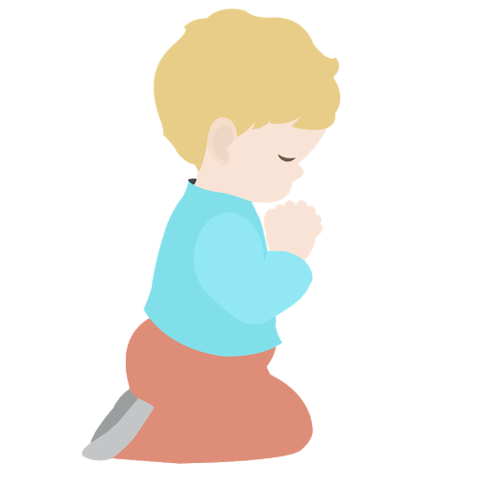
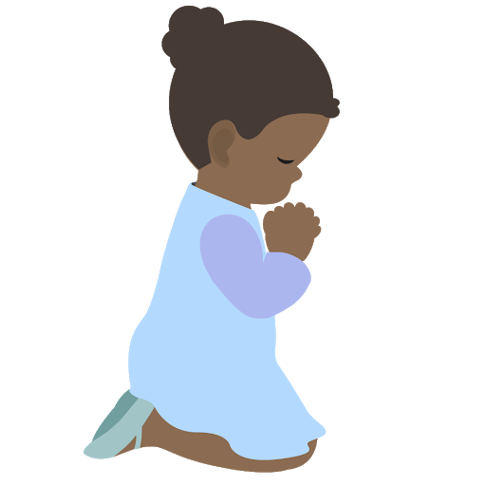
⭐️
⭐️
Prayer Stars⭐
Cassedy | ⭐️
Milan | ⭐️
Devin | ⭐️
Kim | ⭐️
Cora | ⭐️
Hudson | ⭐️
Dev
⭐️
⭐️
Notes:
Explain reward for saying prayers in the morning.

Slide 3
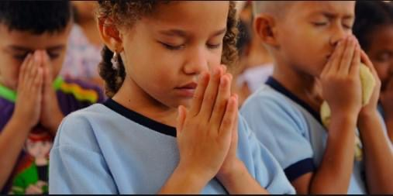
Notes:
Diedre: (All stand) Review O Thou kind Lord I am a little child
Ask if someone would like to sing quote from last week: O Ye Sons of Spirit

Slide 4
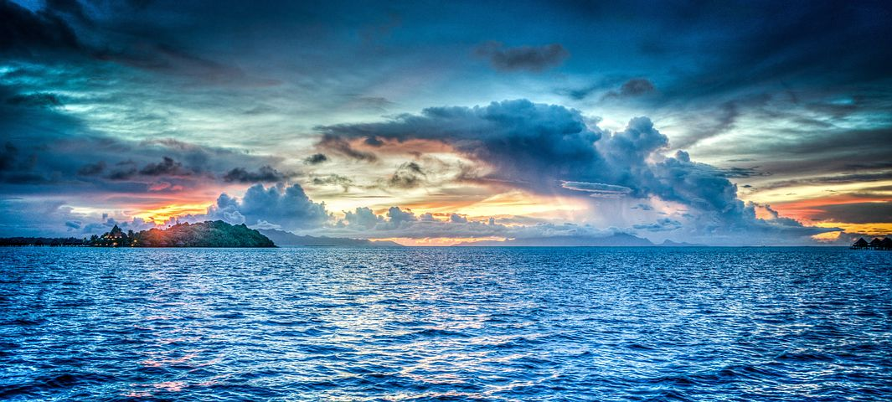
Seeking Knowledge of God
Notes:
Noura-- We are starting a new unit of three lessons on Seeking Knowledge.
Today we are going to learn about seeking the knowledge of God
If you want to know something who do you go to?

Slide 5
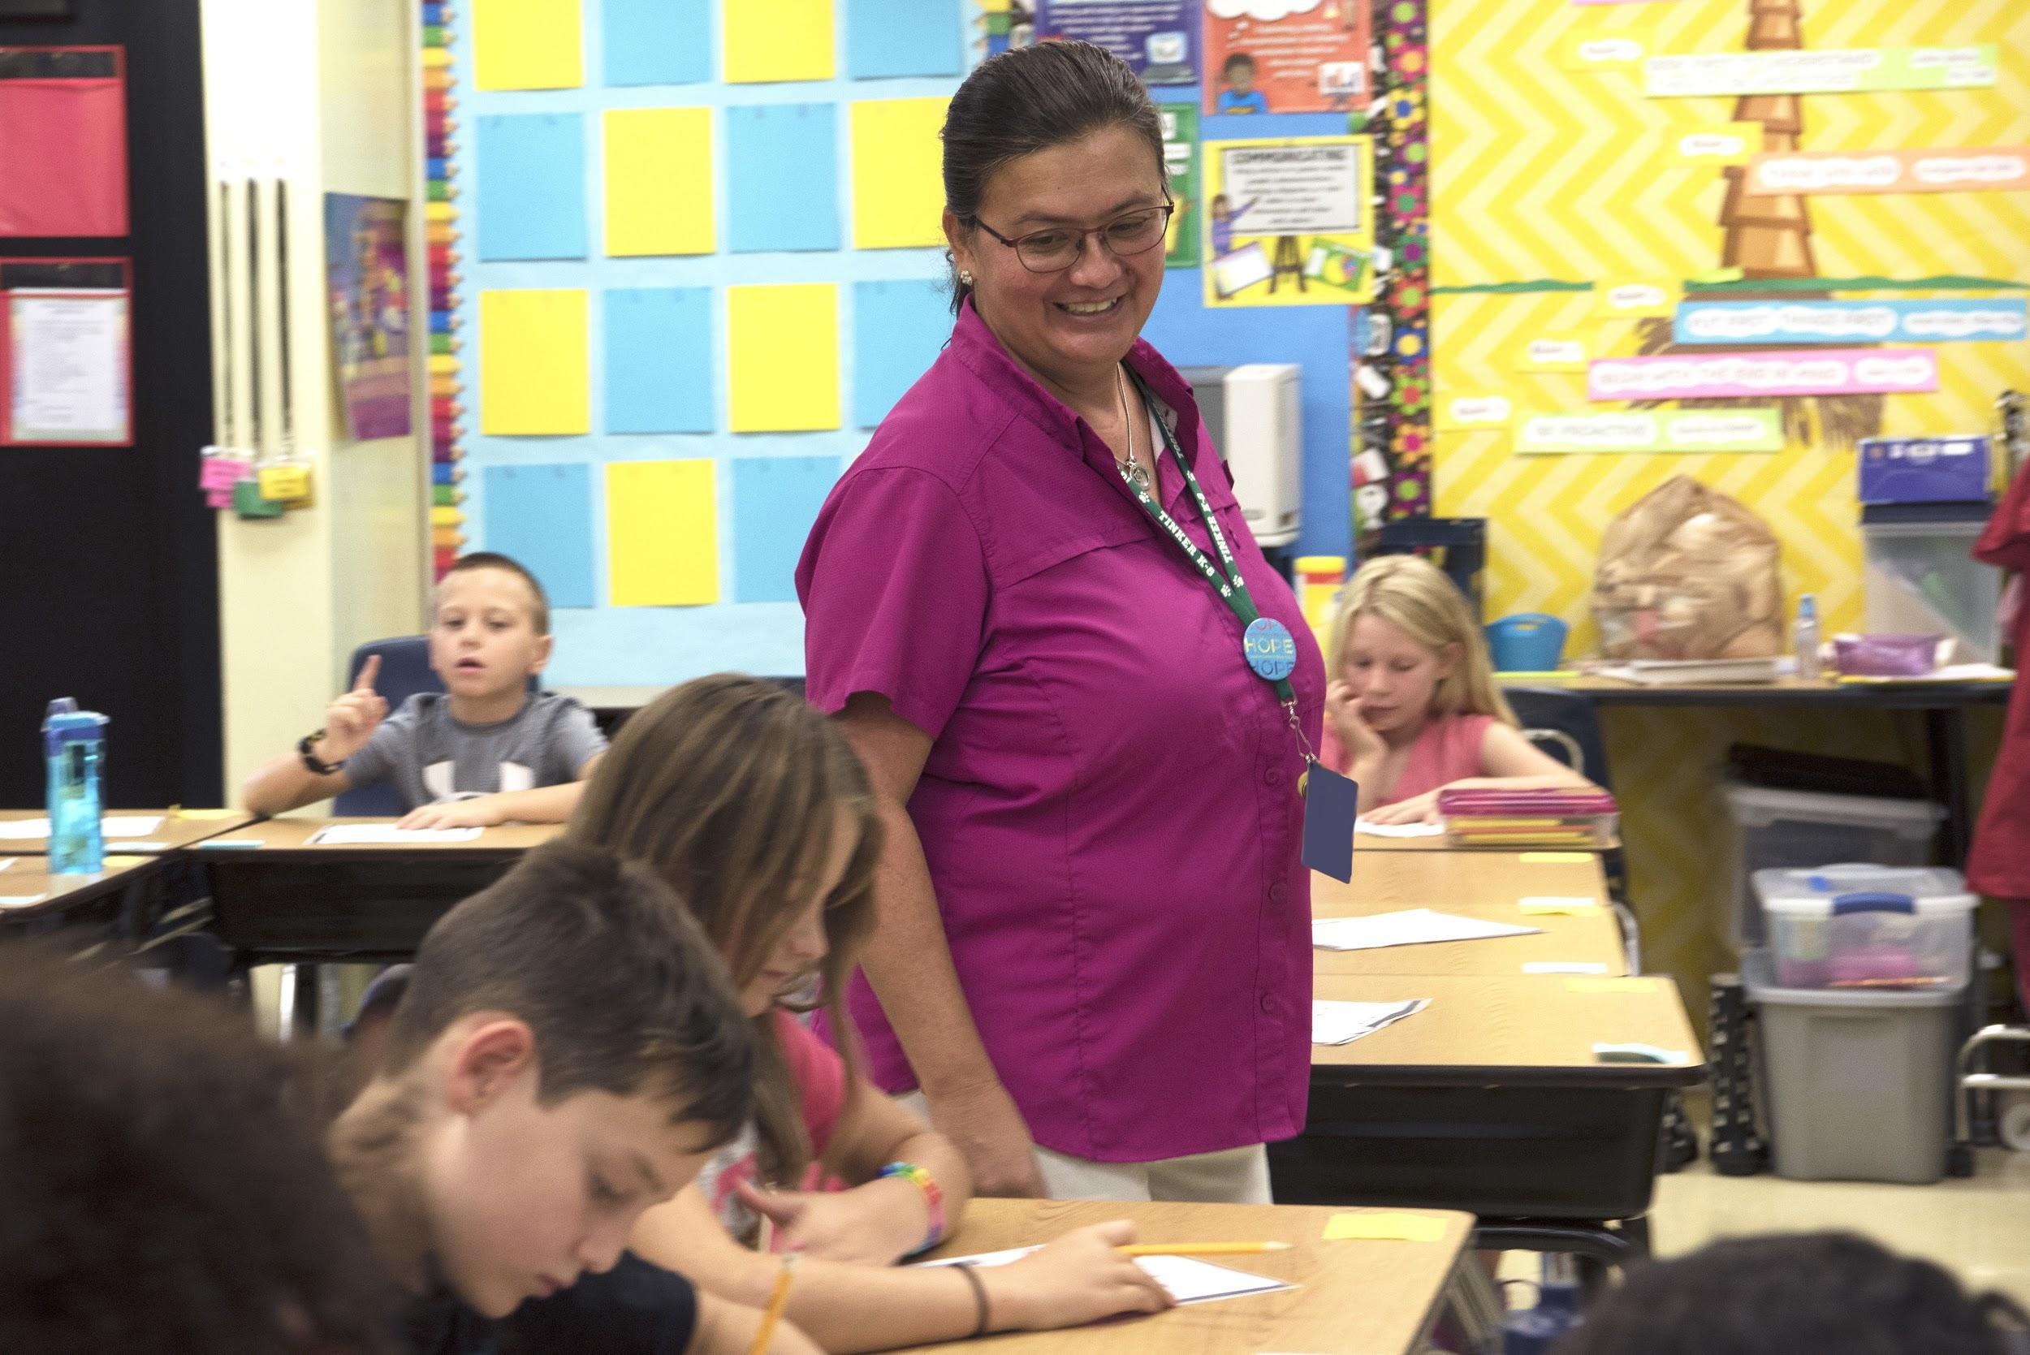
Notes:
Noura-- What would happen if you didn’t have teachers? Just like we have teachers in school, God also sends us Great Teachers who teach us about Him

Slide 6
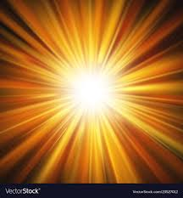

Previous Manifestations
Future Manifestations
Noah
Baha’u’llah
All the prophets of God
proclaim the same Faith
Abraham
Bab
Krishna
Muhammad
Moses
Jesus
Zoroaster
Buddha
Notes:
Noura-- Each of These Great Teachers manifest God; that’s why we call them Manifestations. Each brought a Holy Book. Each of these Holy Books is a chapter in the Book of God’s religion.
Song of Prophets

Slide 7
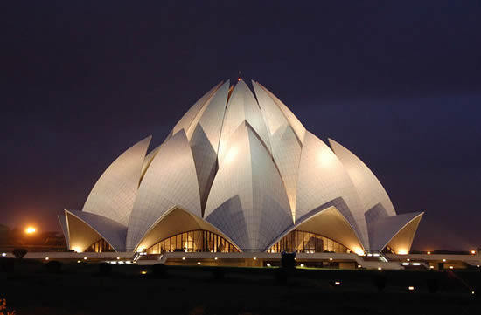
The fundamental purpose animating the Faith of God and His Religion is to
safeguard the interests and promote the unity of the human race, and to
foster the spirit of love and fellowship amongst men..”
Notes:
Noura---The purpose of religion is to keep everyone safe, to promote love and fellowship, and to unify the world.

Slide 8
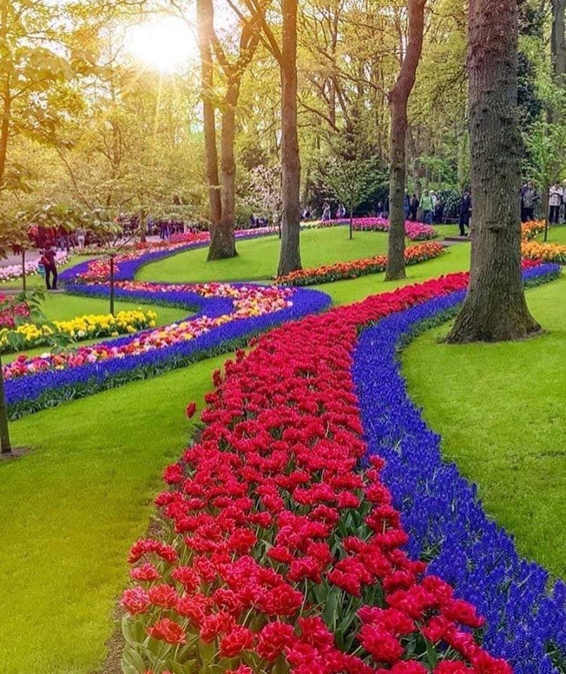
“Whatever is in the heavens and whatever is on the earth is a direct evidence of the revelation within it of the attributes and names of God, inasmuch as within every atom are enshrined the signs that bear eloquent testimony to the revelation of that Most Great Light.”
Nature is the second Book of Revelation
Notes:
Noura--- Nature helps us know God? What do we know about God from this picture. We know of God’s beauty, His power, His love for us, etc
Everywhere we look we see god’s creation: animals, people who make other things

Slide 9
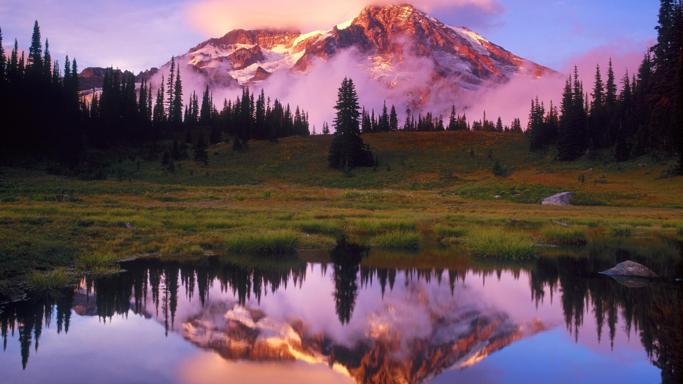
Notes:
Noura----Reminder that we are here to reflect the attributes of God. We can’t be the sun or God, but we can reflect the light of the sun.

Slide 10
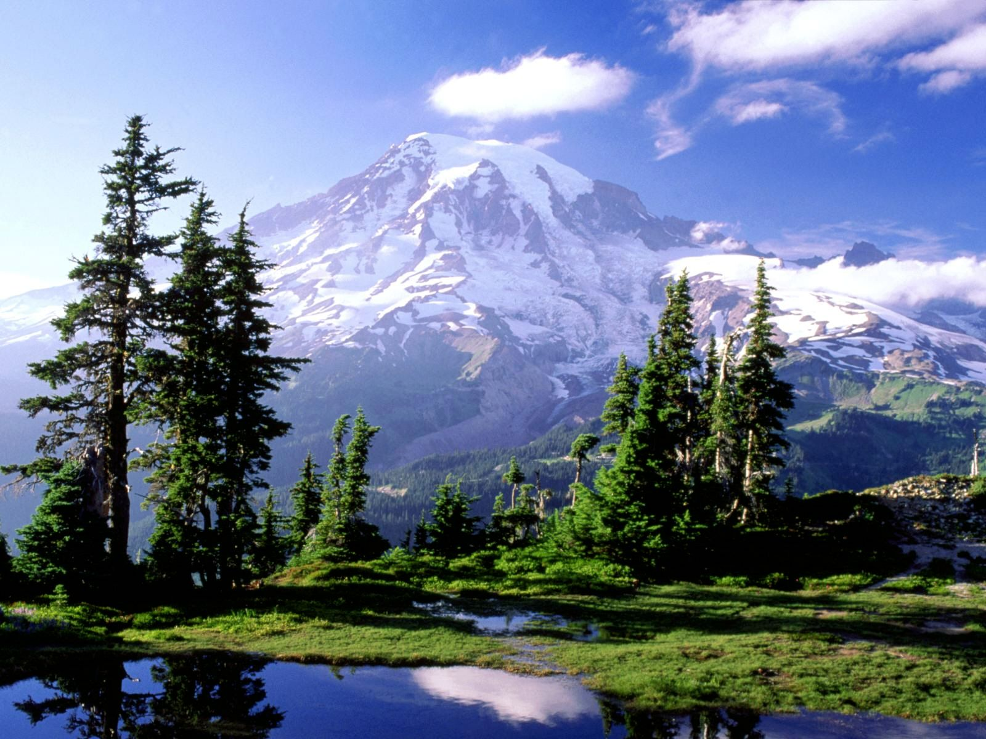
http://www.supportingthecoreactivities.org/theme-3-lesson-7/
“The purpose of God in creating man has
been, and will ever be, to enable him to
know his Creator and to attain His Presence.”
Notes:
Noura---Purpose of God Song from STCA (play song in other tab but come back to this one)
Power break: Run outdoors and see if you see something that tells you something about God? Return and share with class.

Slide 11
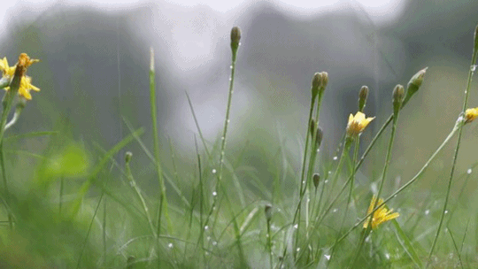
Notes:
Noura---Does rain tell us anything about God?
Tells us that he wants the plants to grow--- just like with us he rains bounties upon us

Slide 12
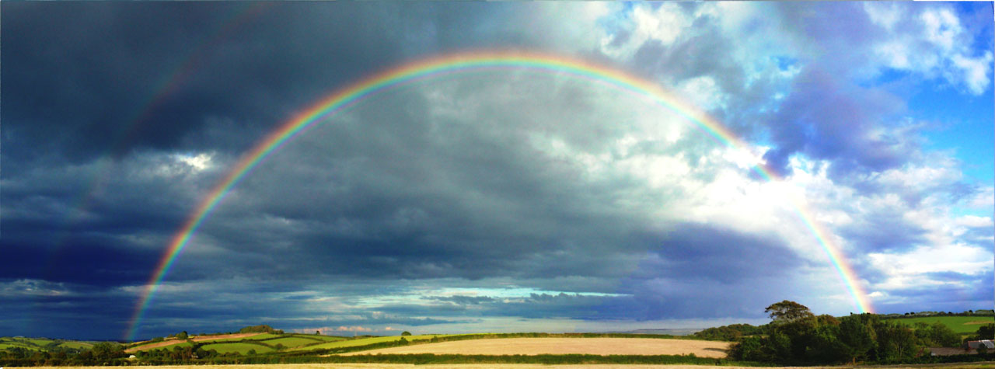
Notes:
Noura--- Double rainbow Look how beautiful
What does a rainbow tell us about God?
God wants us to have hope

Slide 13
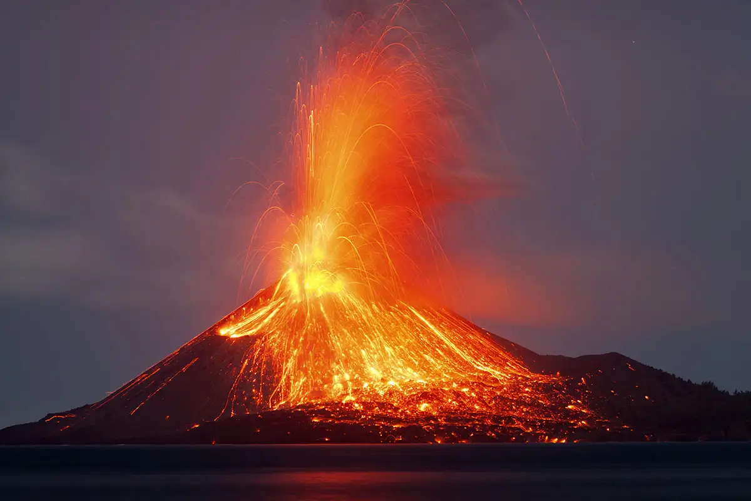
Notes:
Noura-- What do volcanoes tell us about God?
His power and the strength of his love

Slide 14
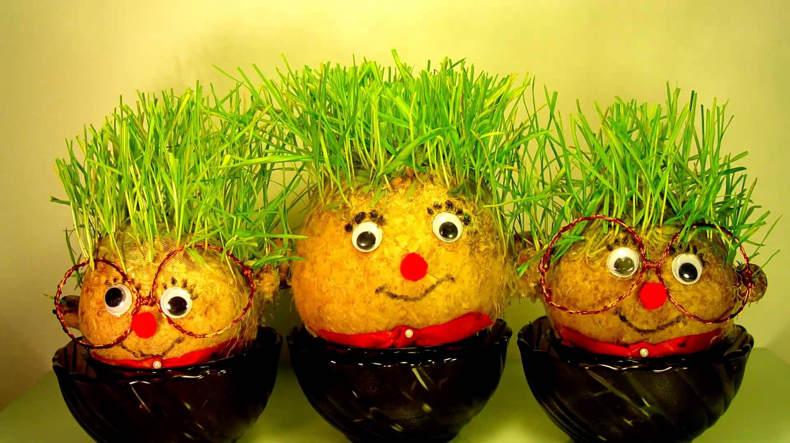
Notes:
Noura---“...the hair of my head declareth the power of Thy sovereignty and might.”

Slide 15
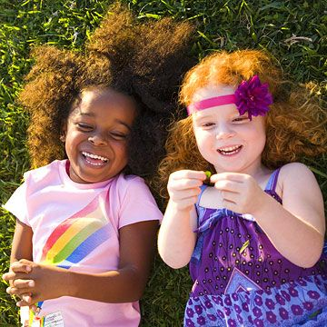


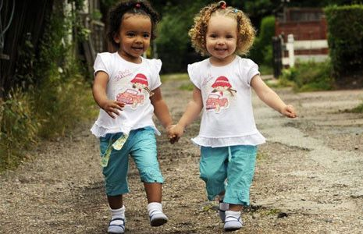
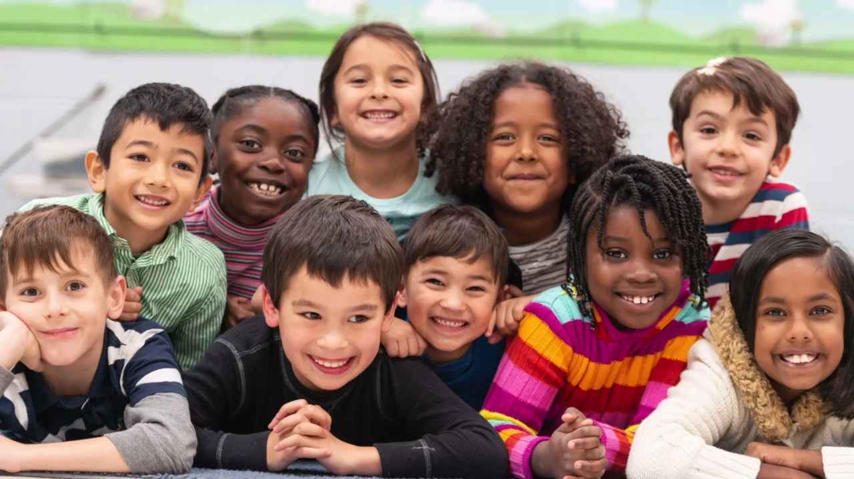
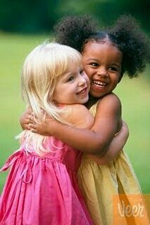

Notes:
This bouquet is beautiful because of its many flowers of different colors and shapes and sizes. Just like us and the human race, we are all more beautiful because of our different colors, shapes, and sizes. If the flowers were all one color or size they would not be as beautiful.

Slide 16

STORY TIME
Notes:
Today I am going to tell you the story of how Mirza Abu’l-Fadl, one of the early believers in the time of Bahau’llah, became a Bahai. Mirza Abu’l-Fadl was very well-known for his penetrating insight, his wealth of knowledge, and his ability to understand and explain complex spiritual ideas. In his youth, he studied in depth such subjects as mathematics, astronomy (study of the stars), philosophy, and the Arabic language, which he mastered in addition to his native Persian language. When he was still a young man, Mirza Abu’l-Fadl became a professor at one of the oldest universities in Tihran, the capital of Iran. This is the story of how he, while in that city, gained a knowledge beyond any he had acquired in all his broad studies- knowledge of the Revelation of Baha’u’llah, the Manifestation of God for this day.
One afternoon, Mirza Abu’l-Fadl and a few of his companions set out on donkeys to visit the countryside. One their way out of the city, one of the donkeys lost a shoe (Show picture of a horse/donkey shoe), and the party called at the nearest blacksmith’s shop to help. Does anyone know what a blacksmith is? (Show picture and explain). When the blacksmith, who had very little formal education, saw Mirza Abu’l-Fadl’s long beard and large turban, in that country those were considered symbols of his vast learning, he asked whether the scholarly man might be willing to answer a question that had perplexed the blacksmith for some time.
Before I tell you the rest of the story, it is important to know that when a Messenger of God comes to the world, His Teachings are pure and bring life to the souls, but over time, people change the words, and bring in ideas and traditions that are not taught by the Messengers of God themselves. This is what had happened at the time that Mirza Abu’l-Fadl was meeting the blacksmith.
So, the blacksmith asked Mirza Abu’l-Fadl, “Is it true,” began the blacksmith, referring to an old written religious tradition- one of those that had become changed by human beings- “Is it true that each drop of rain is accompanied by an angel from heaven, and that this angel brings down the rain to the ground?” “This is true,” Mirza Abu’l-Fadl responded, for it had long been believed by the people in that region that this was so- and remember that He had not yet become a Bahai. After a pause, the blacksmith begged to be allowed another question, to which Mirza Abu’l-Fadl gave his assent. “Is it true,” the blacksmith asked once more, “that if there is a dog in a house no angel will ever visit that house?” Again, Mirza Abu’l-Fadl responded in the affirmative, saying YES, for this too was a belief held by those who followed these written traditions. “In that case,” commented the blacksmith, arriving at his point, “no rain should ever fall on a house where a dog is kept.” Mirza Abu’l-Fadl had no answer. He left the shop embarrassed and angry, for he had been stumped by a blacksmith with no formal schooling!
Mirza Abu’l-Fadl had learned from his companions that the blacksmith was a Bahai. Now, it happened that he and the blacksmith shared a mutual friend, a local draper who had a shop in the bazaar that Mirza Abu’l-Fadl would sometimes visit. When the draper, who was also a Bahai, heard about the incident at the blacksmith’s, he invited Mirza Abu’l-Fadl to take part in some discussions. He accepted the invitation, and the meeting was arranged. In that meeting, Mirza Abu’l-Fadl posed numerous questions and raised many objections. Each one was answered in such simple terms and in such a wise manner that Mirza Abu’l-Fadl found himself at a loss, for he had though he could easily prove wrong the Bahai beliefs.
For several months Mirza Abu’l-Fadl continued to meet many different Bahais, some of them quite scholarly themselves. Finally, forever unable to deny the proofs offered by the followers of Baha’u’llah, he turned his heart in earnest to God and begged to be shown the truth. Soon, he was overwhelmed with the truth of Baha’u’llah’s mission, and became, after nearly a year of protest, a staunch and steadfast believer and an avid teacher of the Cause.
The story of how Mirza Abu’l-Fadl came to recognize the truth of Baha’u’llah’s Revelation shows us how important it is to acquire knowledge not only through the study of God’s creation but also through His Manifestation in the day in which we live.

Slide 17
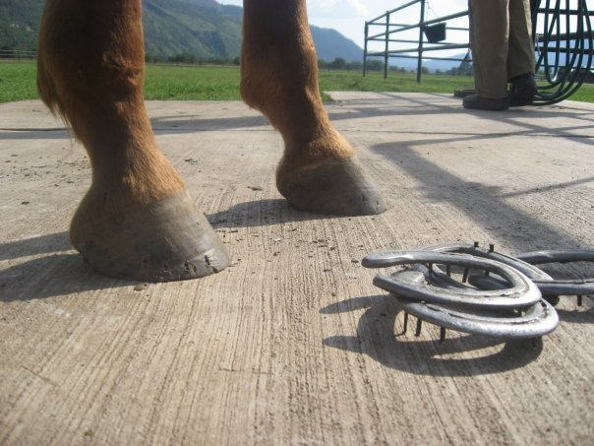

Slide 18
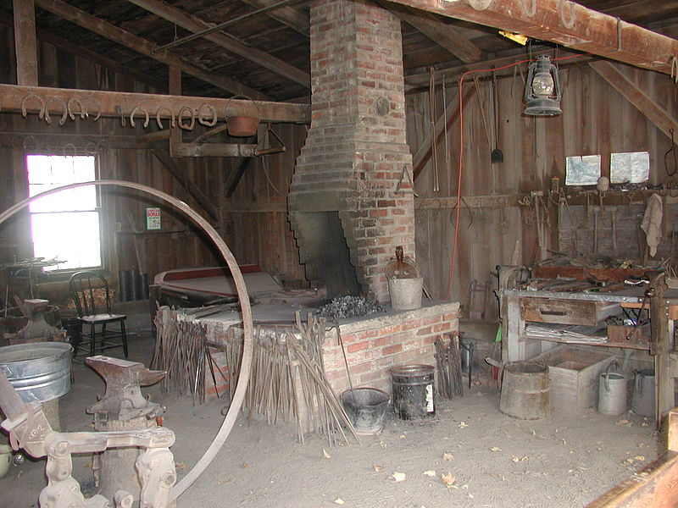
Notes:
Introduction

Slide 19
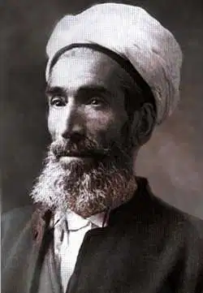
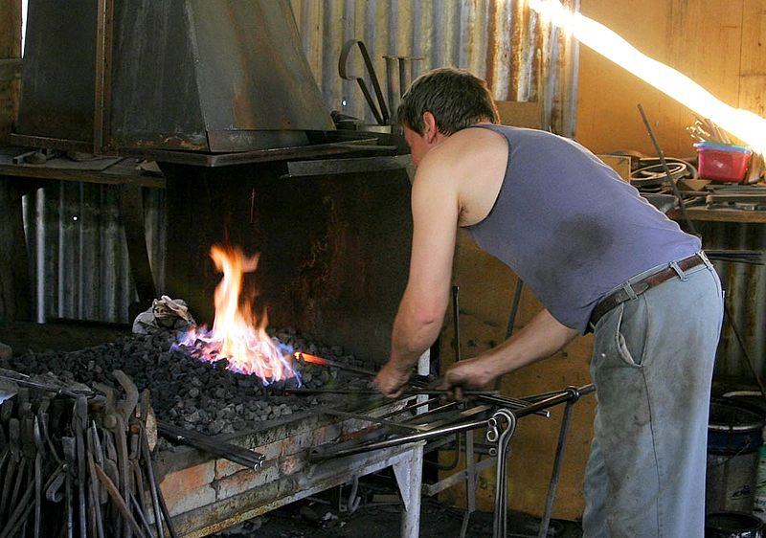

Slide 20

Ayyami-i-Ha Celebration
Notes:
Diedre----Gathering ideas for Ayyam-i-Ha celebration in class February 24
Talent show?
Service?

Slide 21
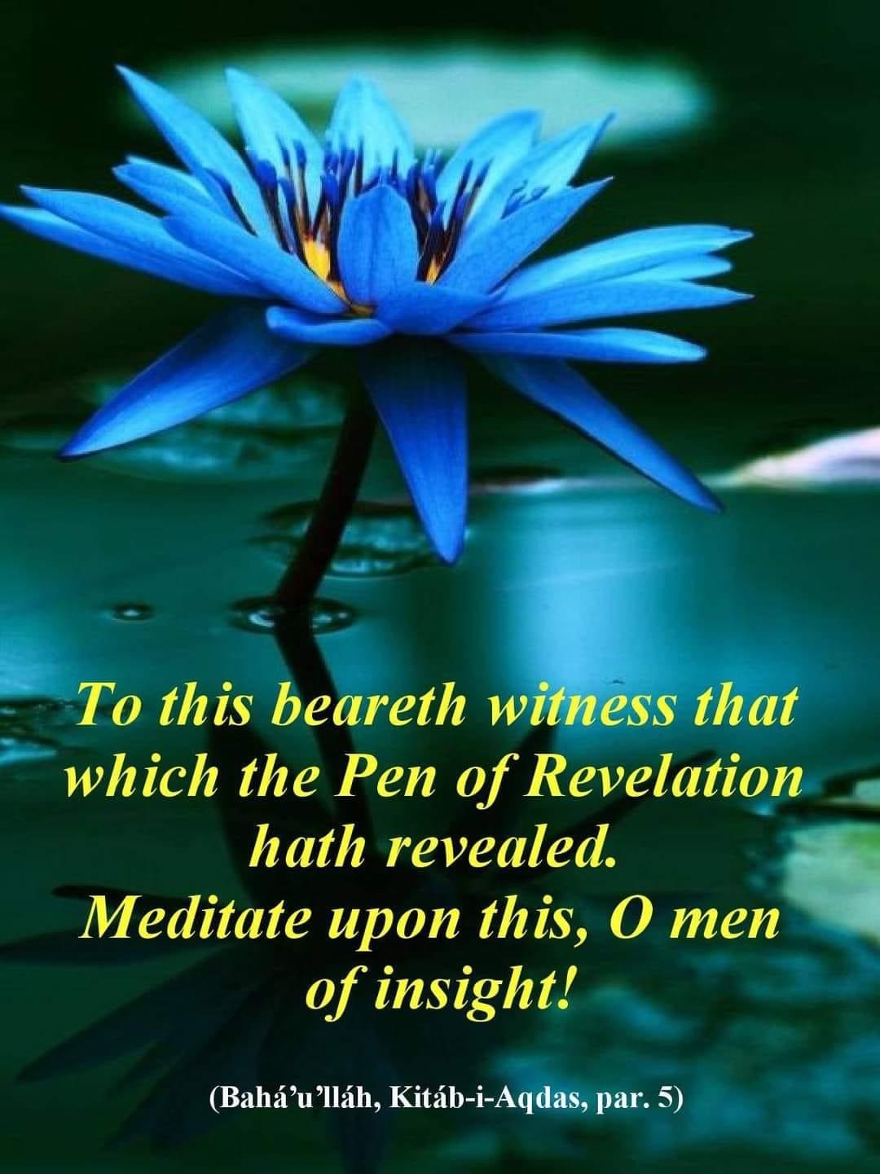
Thank You

Slide 22

CLOSING PRAYERS
Notes:
Who would like to say:
Blessed is the Spot
O God Guide Me
O God Educate These Children

Slide 23

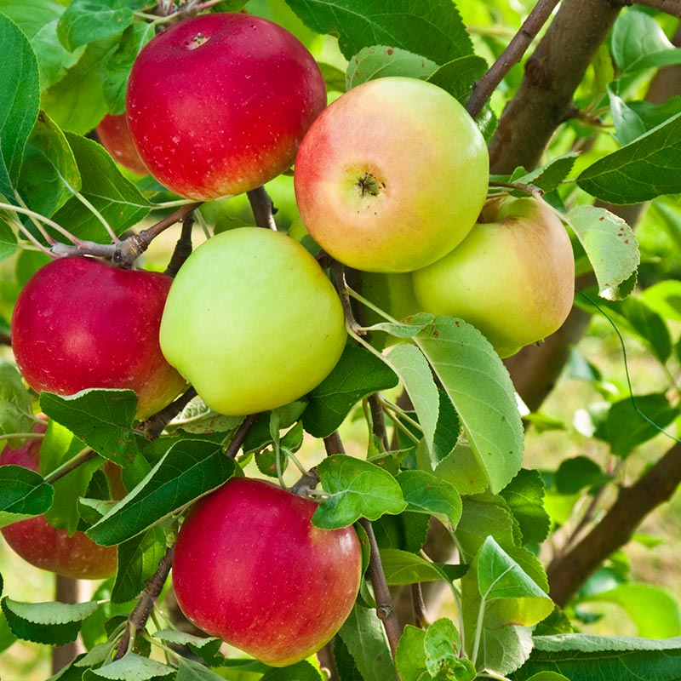
patience
Notes:
Extra activity
Fruits of the spirit/virtues. Insert a virtue as children call out a virtue

