Slide 1


Slide 2
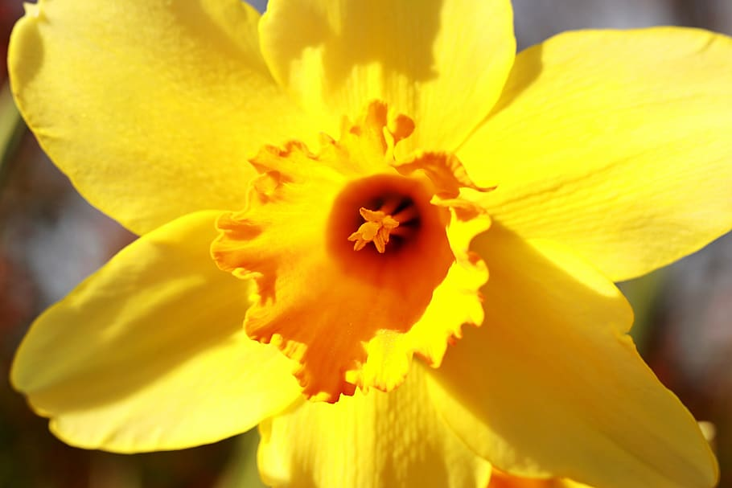
https://www.youtube.com/watch?v=qHGhWvXp-Xs
O God! Refresh and gladden my spirit. Purify my heart. Illumine my powers. I lay all my affairs in Thy hand. Thou art my Guide and my Refuge. I will no longer be sorrowful and grieved; I will be a happy and joyful being. O God! I will no longer be full of anxiety, nor will I let trouble harass me. I will not dwell on the unpleasant things of life.
O God! Thou art more friend to me than I am to myself. I dedicate myself to Thee, O Lord.
OPENING PRAYERS
Notes:
O God refresh music
Diedre lead Blessed is Spot with gestures
Additional prayer sharers

Slide 3
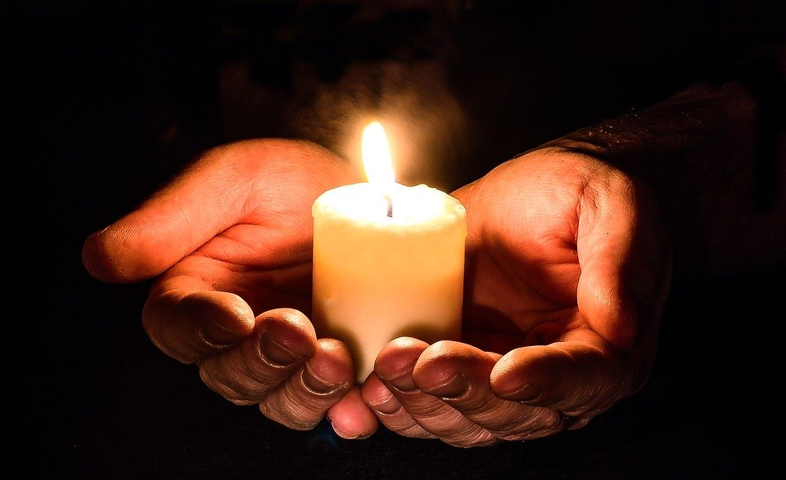
HOW to PRAY
Notes:
Noura--- intro into learning to pray

Slide 4

Notes:
Noura--- Reverence
Raise hand if you would like to tell us what you think reverence is?
Being as still and quiet as though a butterfly landed on your shoulder

Slide 5
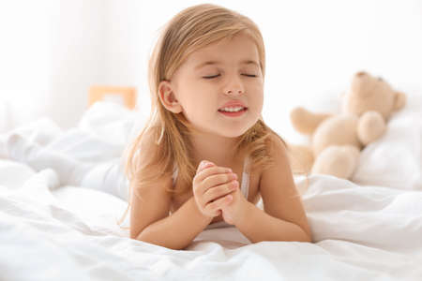
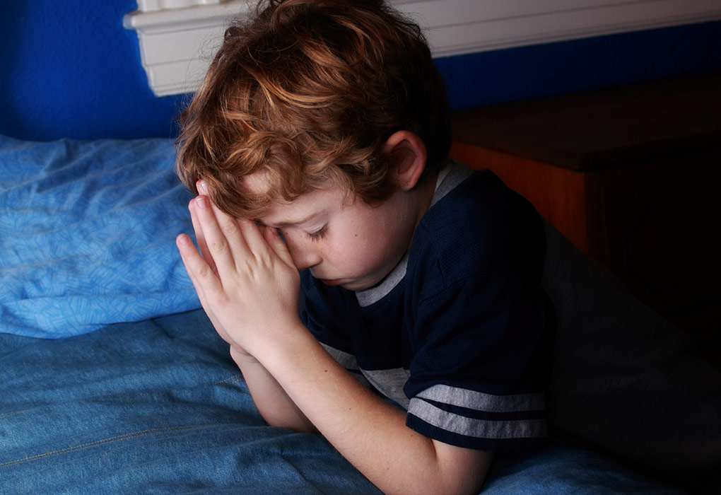
Night Time Prayers
Morning Prayers
https://www.youtube.com/watch?v=Q6YmC6V6U24&list=PL4E90512AB2A25E99&index=15
Notes:
Noura--When do you say prayers?
Night time to end the day and thank God
How’ bout when you start your day? “Greater is God than every great one”, “May Thy will be done”, the morning prayer “I have wakened in Thy shelter.”
First on our lips when awake and last when go to sleep.
Everyone please stand up. Please wait till you hear the entire instructions before moving. Go to your bedroom, find a small stuffed animal (NOT the one you sleep with). Put the stuffed animal under your pillow. Then come back to class. When you go to bed tonight the stuffed animal will remind you to say your prayers. After saying your nightly prayers, put the stuffed animal on the floor next to your bed where you step when you wake up. The stuffed animal will remind you to say your prayer before anything else.

Slide 6
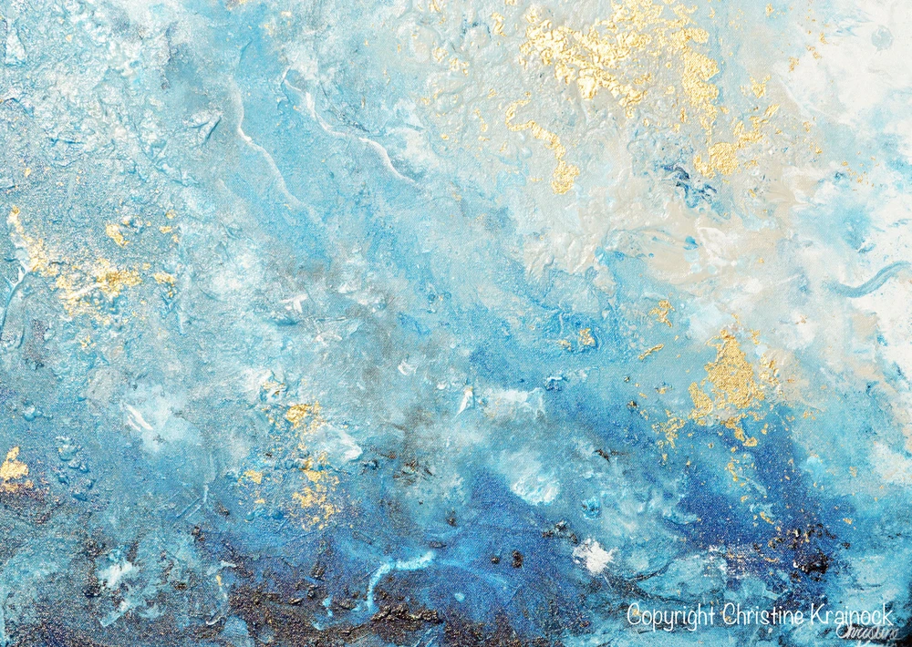
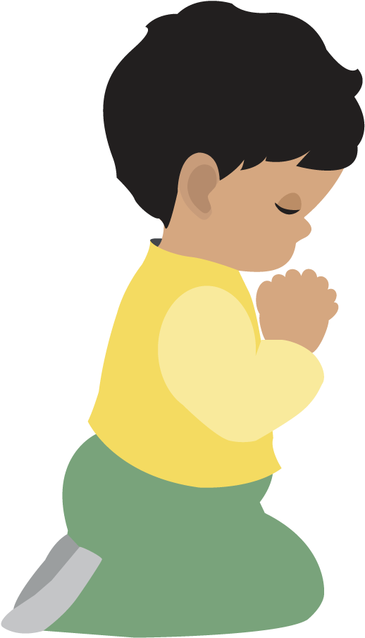
“O Son of Man!
Humble thyself before Me,
that I may graciously visit thee.”
Baha’u’llah
Notes:
Noura-- We must also be humble when we pray to God. What does humble mean?
Read quote. What does Baha’u’llah tell us happens when we are humble when we pray?

Slide 7
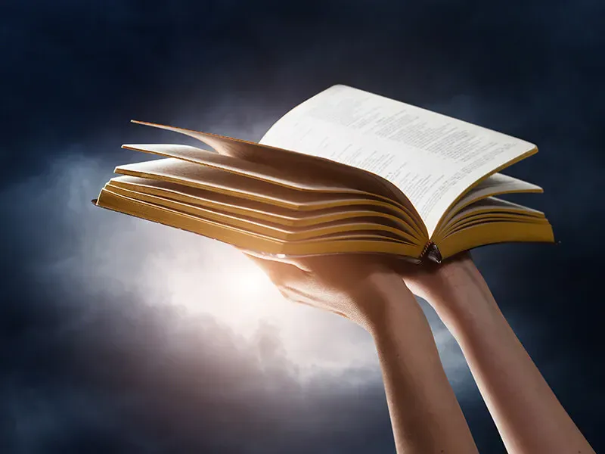
Notes:
Noura--- Each of the Great Messengers from God revealed Holy Writings. Which do you think are more powerful, prayers using our own words or reciting the words of God given to us by the Prophets of God? (It’s alright to talk to God from our heart too)

Slide 8

“Intone, O My servant,
the verses of God that have been received by thee,
as intoned by them who have drawn nigh unto Him,
that the sweetness of thy melody may kindle thine
own soul, and attract the hearts of all men.”
~ Baha’u’llah
Notes:
Noura--- Baha’u’llah tells us to “Intone, O My servant, the verses of God. Remember what intone means? Sing/chant. When we do, it draws us close to God. Isn’t that awesome!

Slide 9
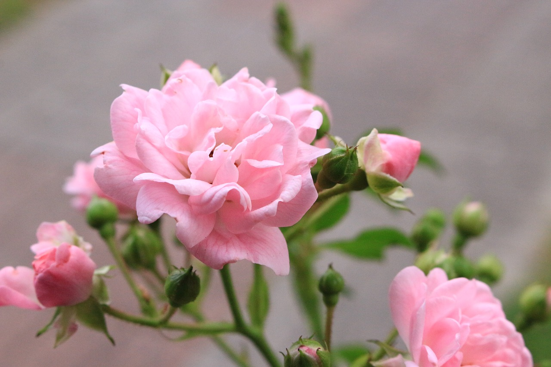
"Prayer and meditation are very important factors in deepening the spiritual life of the individual, but with them must go also action and example... Both are essential."
-From a letter written on behalf of Shoghi Effendi to an individual believer
Notes:
Noura-- Can we pray in other ways than with our words. Read quote
(next slide covers answer)

Slide 10
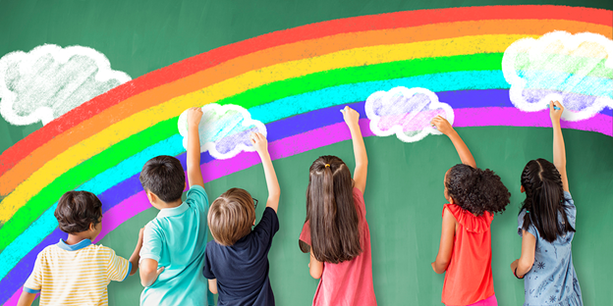
SERVICE IS PRAYER
Notes:
Noura-- One of the ways we can put our prayers into action is by doing service

Slide 11
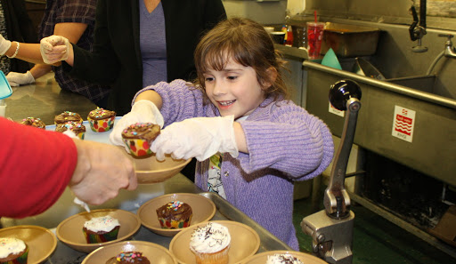
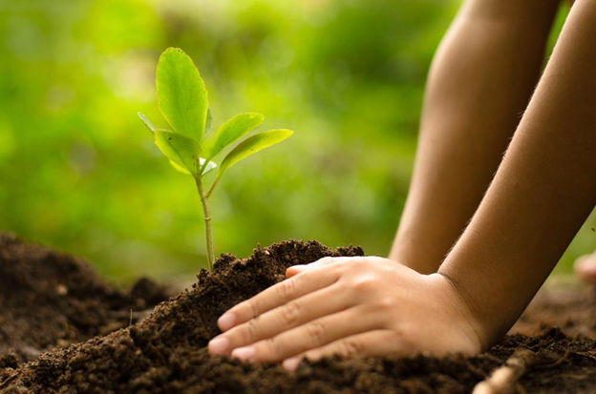
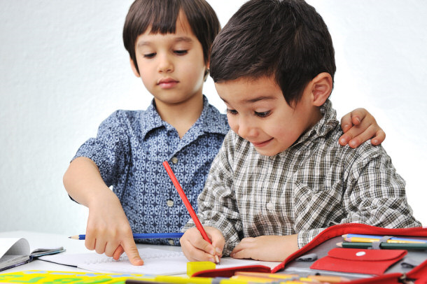
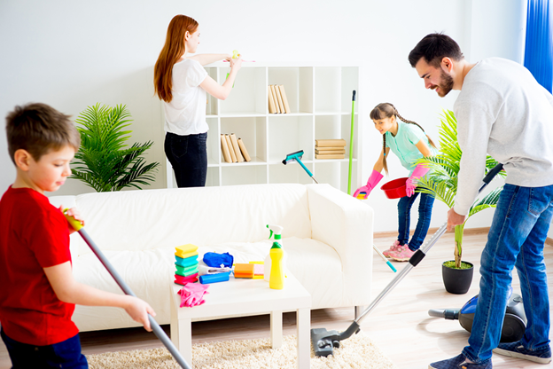
Types of Service
Notes:
Here are some other types of service.

Slide 12
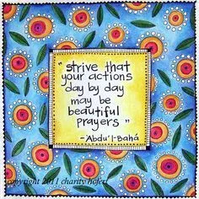
Notes:
Remember the song Strive that your actions day by day may be beautiful prayers?

Slide 13

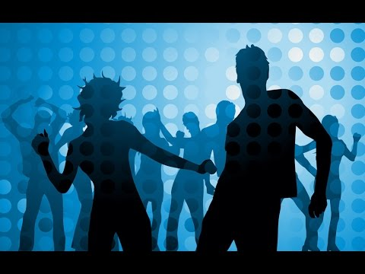
Notes:
Who would like to start our movement activity today by helping us do 20 jumping jacks? etc.

Slide 14

STORY TIME

Slide 15
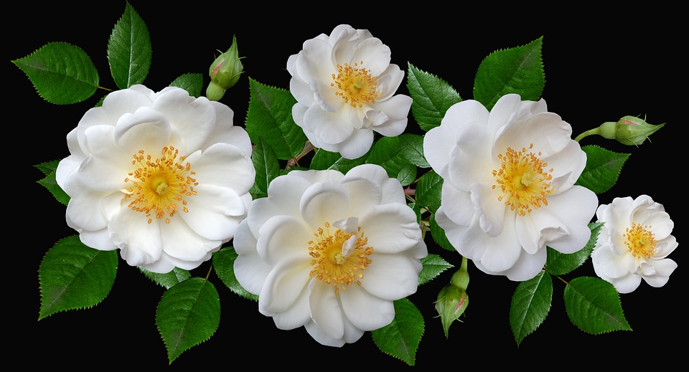

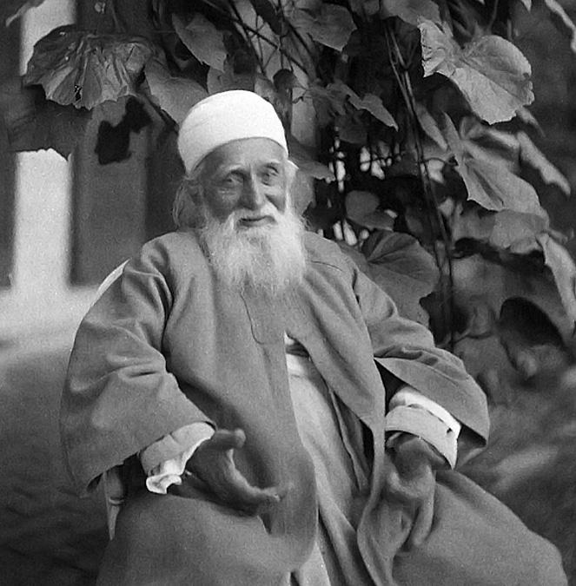
Story of Abdu’l-Baha Teaching Someone to Pray
Notes:
Diedre-- tell story. Play song

Slide 16

https://www.youtube.com/watch?
v=-KQqQRIpDu8 Tutorial
https://youtu.be/n2lpGOGADRs
Make us Rich in Thee
https://www.youtube.com/watch?v=f_l6gYN0ROU
Strive that your actions be beautiful prayers
Notes:
Noura-- We are going to draw a kite going up to God (MAKE SURE YOU MAKE THE KITE BIG). I want you to first draw a kite, then write on the kite one of the virtues you pray for, then draw beautiful skies and background for your kite--- We can help you spell the virtue if you need it

Slide 17
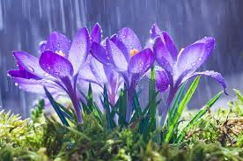
Art Show

Slide 18
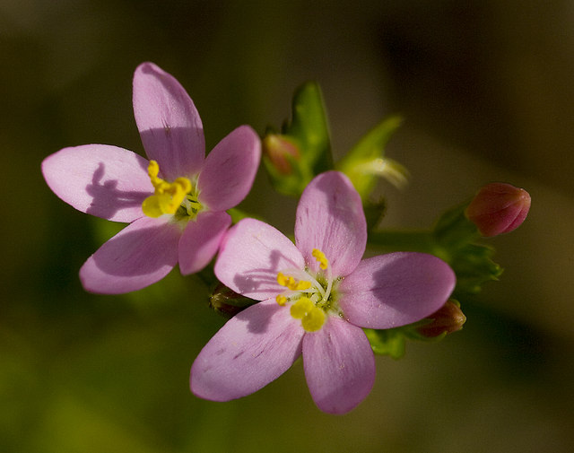
“...strive that your actions day by day may be beautiful prayers. Turn towards God, and seek always to do that which is right and noble. Enrich the poor, raise the fallen, comfort the sorrowful, bring healing to the sick, reassure the fearful, rescue the oppressed, bring hope to the hopeless, shelter the destitute!”
-Abdu’l Baha, Paris Talks
CLOSING PRAYERS
https://www.youtube.com/watch?v=4y2WGjl_9n4
Notes:
Prepare child who can read ahead of time. Cassedy?
Play Strive song
Prayer sharers

Slide 19




Cora
Cassedy
Devin
Kim
Hudson
Milan

Slide 20


Slide 21
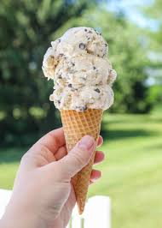

Slide 22
Notes:
Answer: Ice cream (cone)

Slide 23
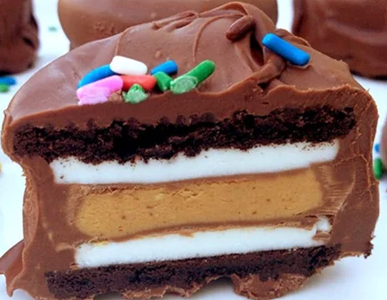

Slide 24
Notes:
Answer: Cake

Slide 25
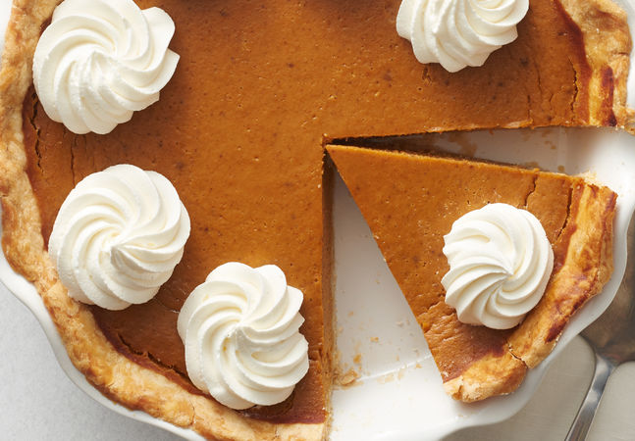

Slide 26
Notes:
Answer: Pumpkin Pie

Slide 27
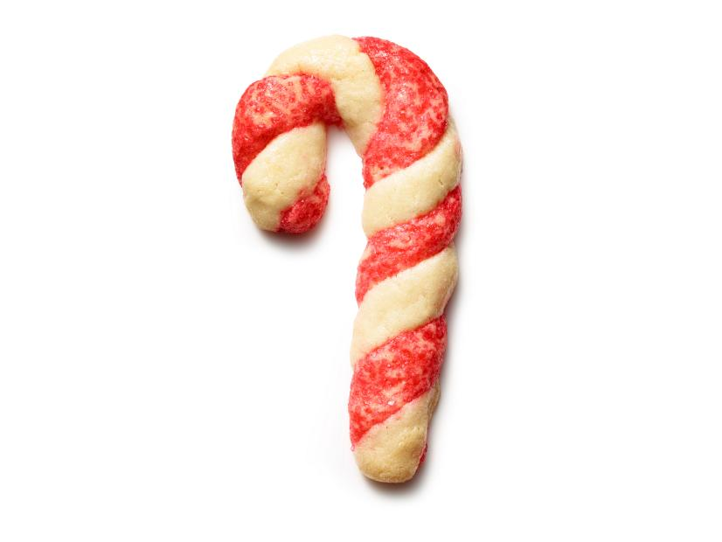

Slide 28
Notes:
Answer: Candy Cane Cookie

Slide 29
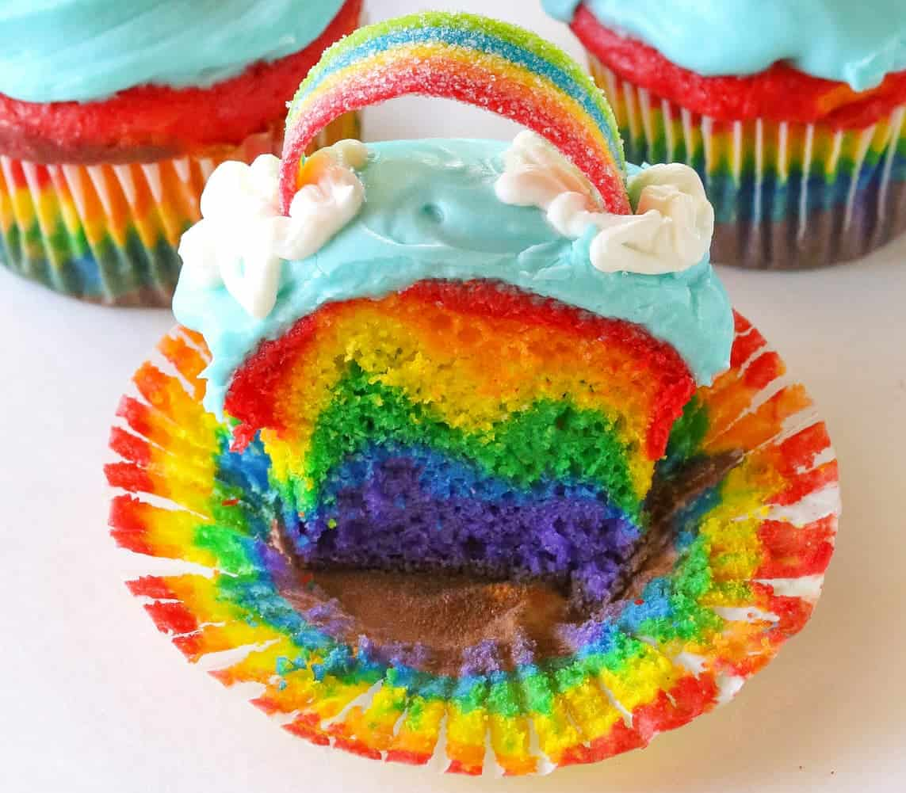

Slide 30
Notes:
Answer: Rainbow Cupcake

Slide 31
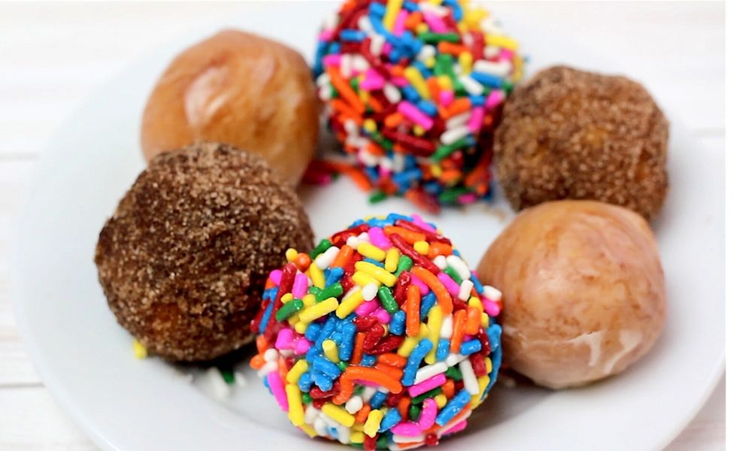

Slide 32
Notes:
Answer: Donut holes

Slide 33
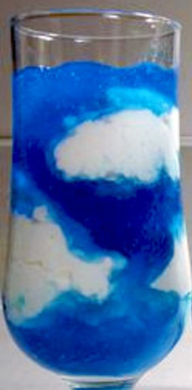

Slide 34
Notes:
Answer: Blue Jell-o in a glass

Slide 35
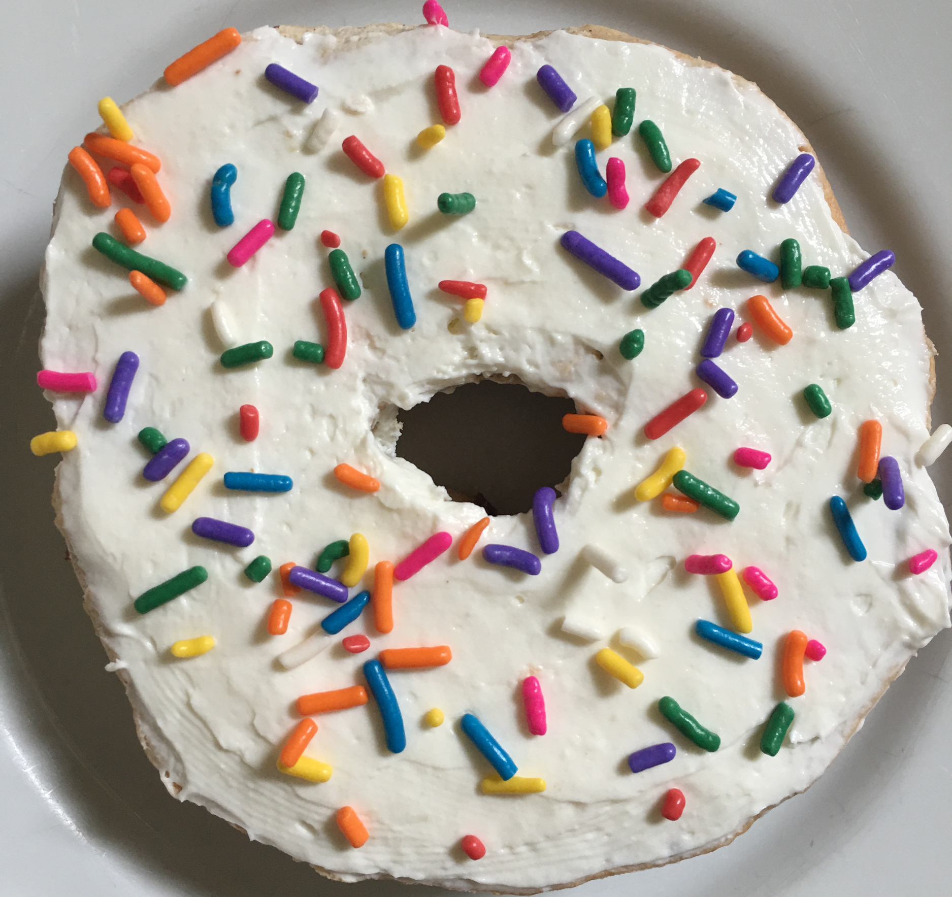

Slide 36
Notes:
Answer: Bagel donut (or donut bagel, whichever you prefer)

Slide 37
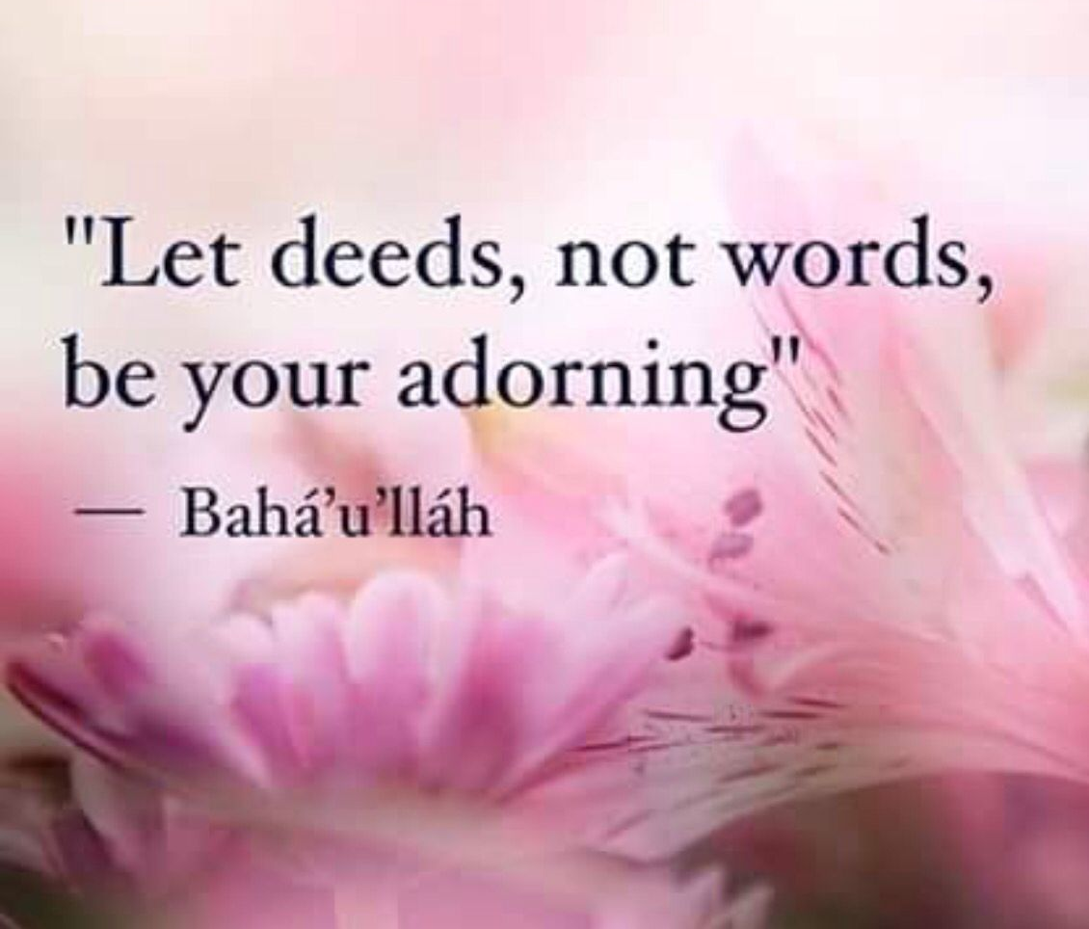
Notes:
Extra

