Slide 1

WELCOME
Notes:
Need paints for art activity
The only time you should be touching your mouse is to unmute yourselves when teacher calls on you. When you don’t follow this rule, you are interrupting class to debunk your computer. This wastes time that could be used for games at the end of class. (Teacher: If does happen ask child to be resilient by listening if not accessing visuals,be patient until next slide…)

Slide 2
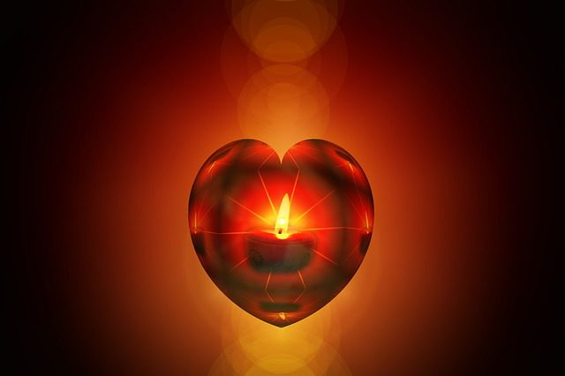
Notes:
Ok everybody let’s turn our hearts towards God. When we pray and turn towards God our hearts become more pure. Who wants to make their heart more pure?

Slide 3
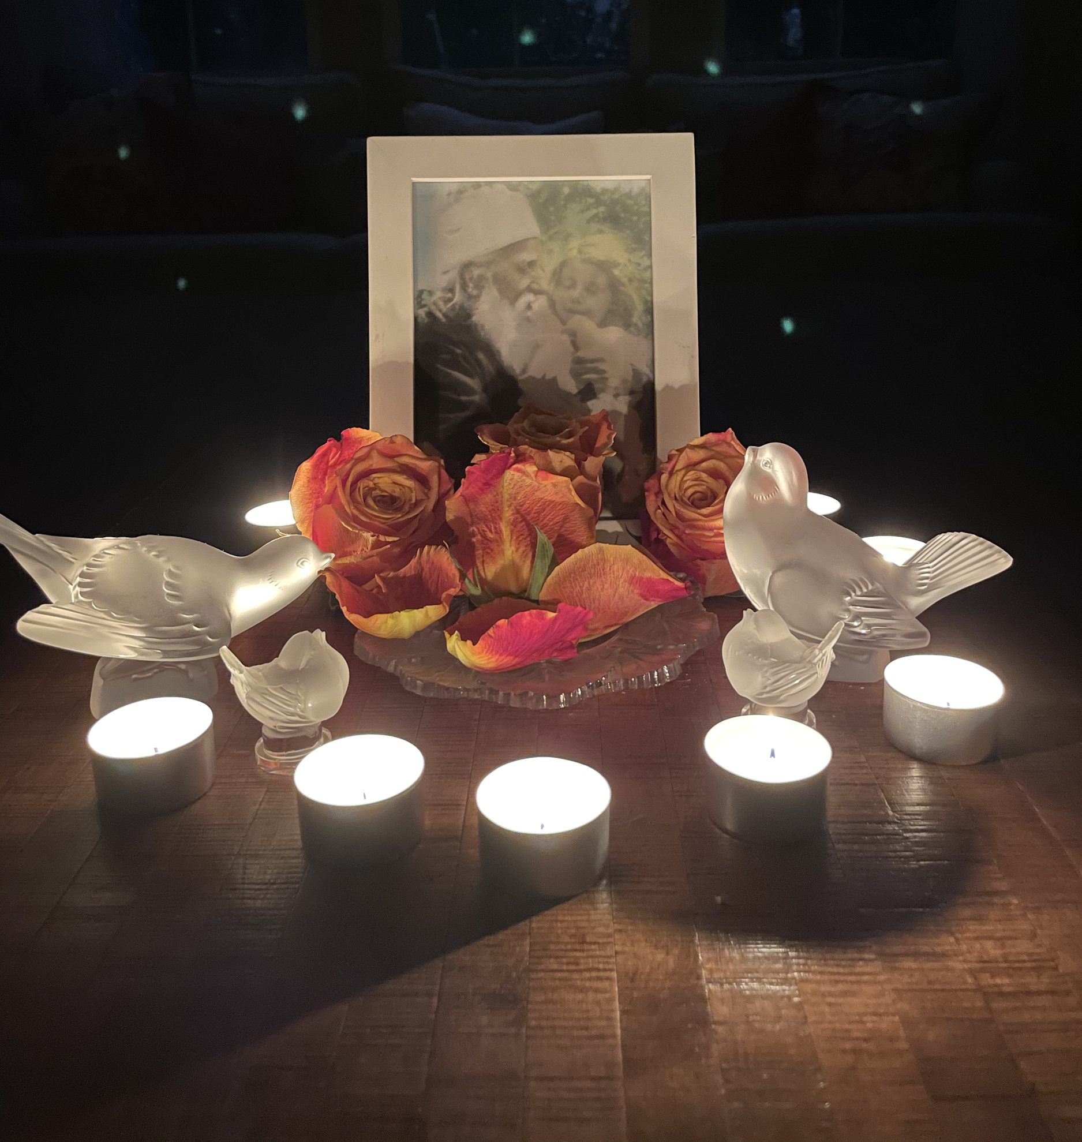
https://www.youtube.com/watch?v=U4uXfJ6atEk
OPENING PRAYERS
https://www.bahaiblog.net/2014/09/luke-slott-create-pure-heart/
Notes:
I am a Tender Plant by Julie
Prayer Sharers
Diedre-- Raise your hand if you are five years old, raise your hand if you are six years old, raise your hand if your seven years old. Since you are getting older, format of class change. Have spent only one class on a virtue. Now will spend three lessons to deepen our knowledge on one virtue like the second graders do..Our next three lessons will be on Prayer

Slide 4

PRAYER is CONVERSATION with GOD
Notes:
Noura-- What do we know so far about prayer?... What is prayer?

Slide 5
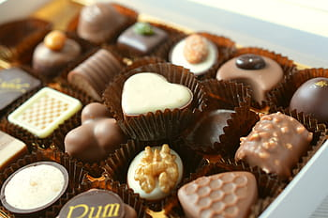
Notes:
Noura-- Intro Grade 2, p 11 Nature of prayer
Think of the sweetest thing you can...Can anyone think of anything sweeter? “There is nothing sweeter in the world of existence than prayer…The most blessed condition is the condition of prayer Why? Bec in God’s presence)

Slide 6
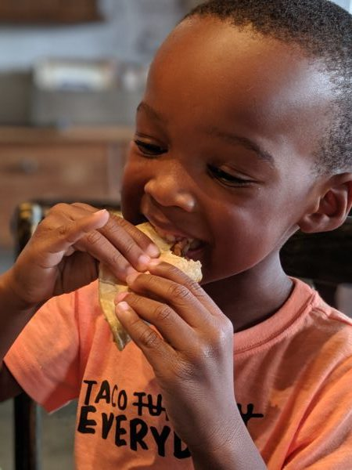
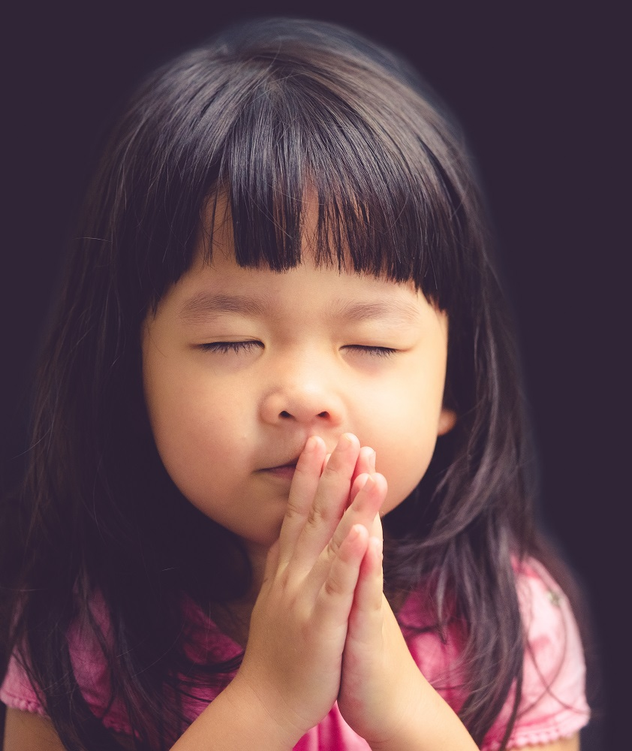
Notes:
Noura--How many of you have Taco Tuesdays at your home? Here’s a little boy who also loves Tacos. Just as our bodies require nourishment (or food) to develop properly, we need regular prayer for our spiritual health and development. Just like tacos help us feel full, prayer makes our souls feel full and nourished. We have food for our bodies and food for our souls. We usually feed our bodies at breakfast, lunch, and dinner. When does your soul feel hungry---Prayer is food for the soul; it deepens the love of God in our hearts and draws us closer to Him.

Slide 7
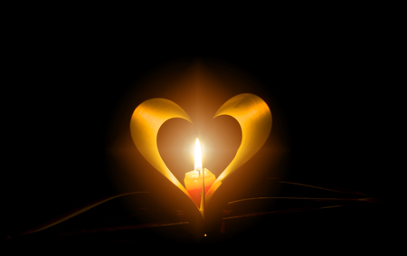
Prayer Gives Life to Our Soul
Notes:
Noura--Remember The First Gift about everyone having a soul. How it’s like a friend who’s with you all the time.
You wouldn’t forget make sure your friend is getting the food/nourishment they need. Prayer is what gives life to our soul

Slide 8
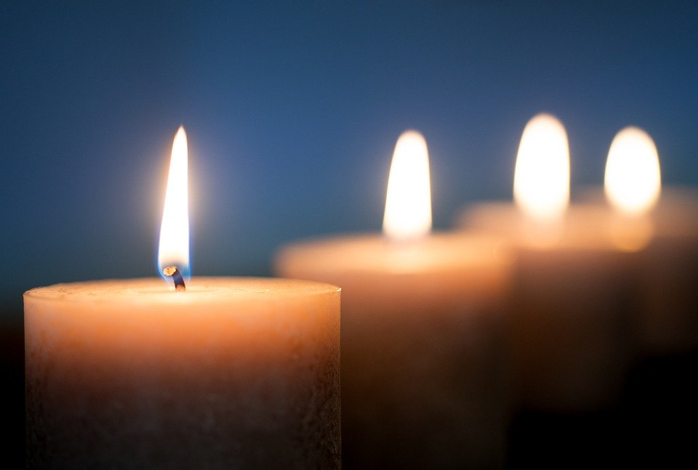
“O SON OF LIGHT!
Forget all save Me and commune with My spirit...”
Baha’u’llah
Notes:
Who can read this for us? I love how Baha’u’llah calls us “Son of LIght!” (Not son of darkness)
Commune is a new word. It means to share one’s intimate (most personal) thoughts and feelings. Things you wouldn’t feel comfortable sharing with others.

Slide 9
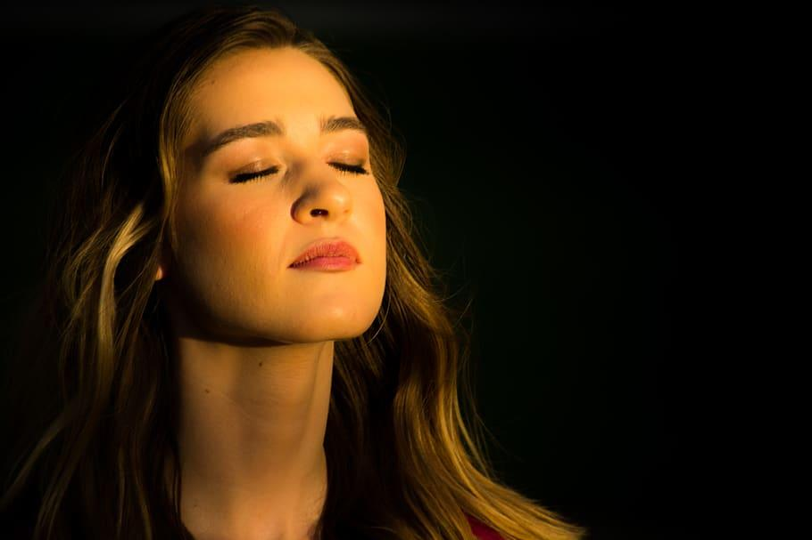
“When a man turns his face to God he finds sunshine everywhere.”
-Abdu’l-Baha
Notes:
This young lady is turning her face to God. What is happening? Look how she is enkindled with God’s love. Read slide, even when we are feeling sad or unhappy. Remember glass ½ full? Even though things may seem rough we are being positive and being grateful for the good things

Slide 10
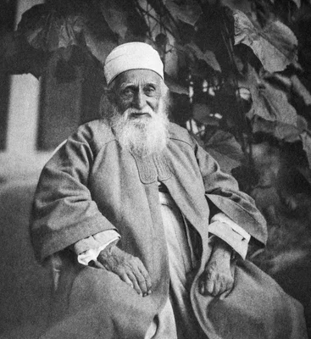
Notes:
Diedre----Who is this? “Abdu’l-Baha lived in a state of prayer. His heart was always turned towards God. What do you think it means to live in a state of prayer? To live in a state of prayer means not only reciting the sacred verses when we pray; it also suggests, that throughout the day we should turn our hearts towards God.
Story about Aaron. When we converse with God each day what do you think happens? Our love for Him grows stronger and we feel closer to Him. Our souls become joyful. When we pray to God to guide us, protect us, ( O God guide me…) we are praying to become worthy of His love. How often does God send us His bounties? We constantly receive His bounties. It’s like the baby when it is born, its unspoken prayer is to be fed, and God has already answered that prayer by providing a mother with milk.

Slide 11
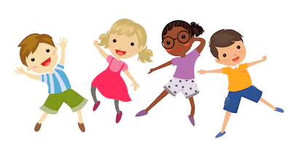
https://www.youtube.com/watch?v=NtCrdlbwhs4&list=RDCMUCuPUdEctaIgaEexj3ZFjkiQ&index=9
MOVEMENT ACTIVITY
Notes:
Body in Motion

Slide 12

“Intone, O My servant,
the verses of God that have been received by thee,
as intoned by them who have drawn nigh unto Him,
that the sweetness of thy melody may kindle thine
own soul, and attract the hearts of all men.”
~ Baha’u’llah
Notes:
Noura--- Baha’u’llah tells us to “Intone, O My servant, the verses of God. What do you think intone means? Remember how Ms Julie sang the opening prayer for us today. She put words to music. When we do, it draws us close to God. Isn’t that awesome!

Slide 13

Notes:
Story of Ruhu’llah
Who ‘Abdu’l-Baha loved hearing chant the prayers in melodious tones. Can you all say Ruhu’llah? Ruhu’llah. That’s right! Suggest break story into sections. Let children know ahead of time you will call on one of them to repeat that portion of the story.

Slide 14
Noura: In the early days of the Baha’i Faith, just like with any new Message from God, there are heroes who do extraordinary things in service to God. This is the story of a young boy, Ruhullah Varqa, who lived during the time of Baha’u’llah and Abdu’l-Baha. So great was Ruhullah’s love for God, and so absolute his dedication to His Cause, that whenever we hear his name we think of a life of devotion and servitude. When Ruhullah was about 7 years old, he travelled with his father to the Holy Land, now called Israel. There he had the great privilege of meeting Baha’u’llah, Who had brought to humanity a message from God for this day. Ruhullah’s heart became filled with love for Baha’u’llah and he wanted nothing more than to serve Him. Upon returning home to Persia he spent his time sharing with others the news of Baha’u’llah’s coming. Ruhullah was truthful, honest, courteous, and kind, and his words has a great effect on all who heard him. He rose at dawn time, in the early morning, each day to pray, and with his heart turned towards God, passed each day in servitude to Him.
Maia: (Why were the people afraid of the new religion?) (What did the people do to people who believed in the new religion?) (Why was Ruhullah asked to share a
prayer?)
One day, Ruhullah was called to appear before an official, a leader in the community. At that time, many people were fearful of the new message that was being spread throughout the land. They wanted to continue doing what they had always done. As a result the followers of the new Faith were often unjustly punished. This has happened with the coming of each Messenger of God- like in the times of Moses and Jesus, their early believers were also persecuted. For this reason, Ruhullah’s father was in great danger. As proof that he had wrongly raised his son in this new Faith, Ruhullah was told to say a prayer in the presence of the official. This, it was hoped, would be enough to convince the official to punish his father. Ok, let’s see if you found the answers to the questions. (Call on someone)
Diedre: (Let’s see if, in this last part of the story, we can learn what happened after Ruhullah recited the prayer?
And Why Ruhullah’s father was saved?)
Calmly, Ruhullah prepared his heart to offer supplication to God. (Supplication means to pray very very hard that God’s will will be done). Then, in a melodious voice, he chanted a Bahai prayer of exquisite beauty. The official was deeply moved. He dismissed the matter immediately, saying he would not bring harm to a man who had raised a child to be so wonderful. And so Ruhullah’s father was saved.
Later, when Ruhullah was about 12 years old, he would once again set out with his father to visit the Holy Land. This time, he would be blessed to pass his days in the presence of Abdu’l-Baha, who loved Ruhullah very much and especially enjoyed hearing him chant in his beautiful voice the many prayers he knew by heart. Ruhullah would leave the Holy Land ablaze with Divine love, prepared to spend his life serving the Cause of God.

Slide 15
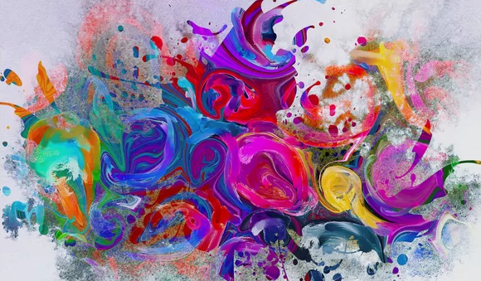
ART ACTIVITY
https://www.youtube.com/watch?v=QgaTQ5-XfMM
Notes:
Diedre---Paint how you feel when you pray. What colors will show your happiness, your purity of heart, your reverence, your love for God...We are not going to paint an object rather our paintings will be abstract like this one. Painting how prayer makes us feel.
Music

Slide 16
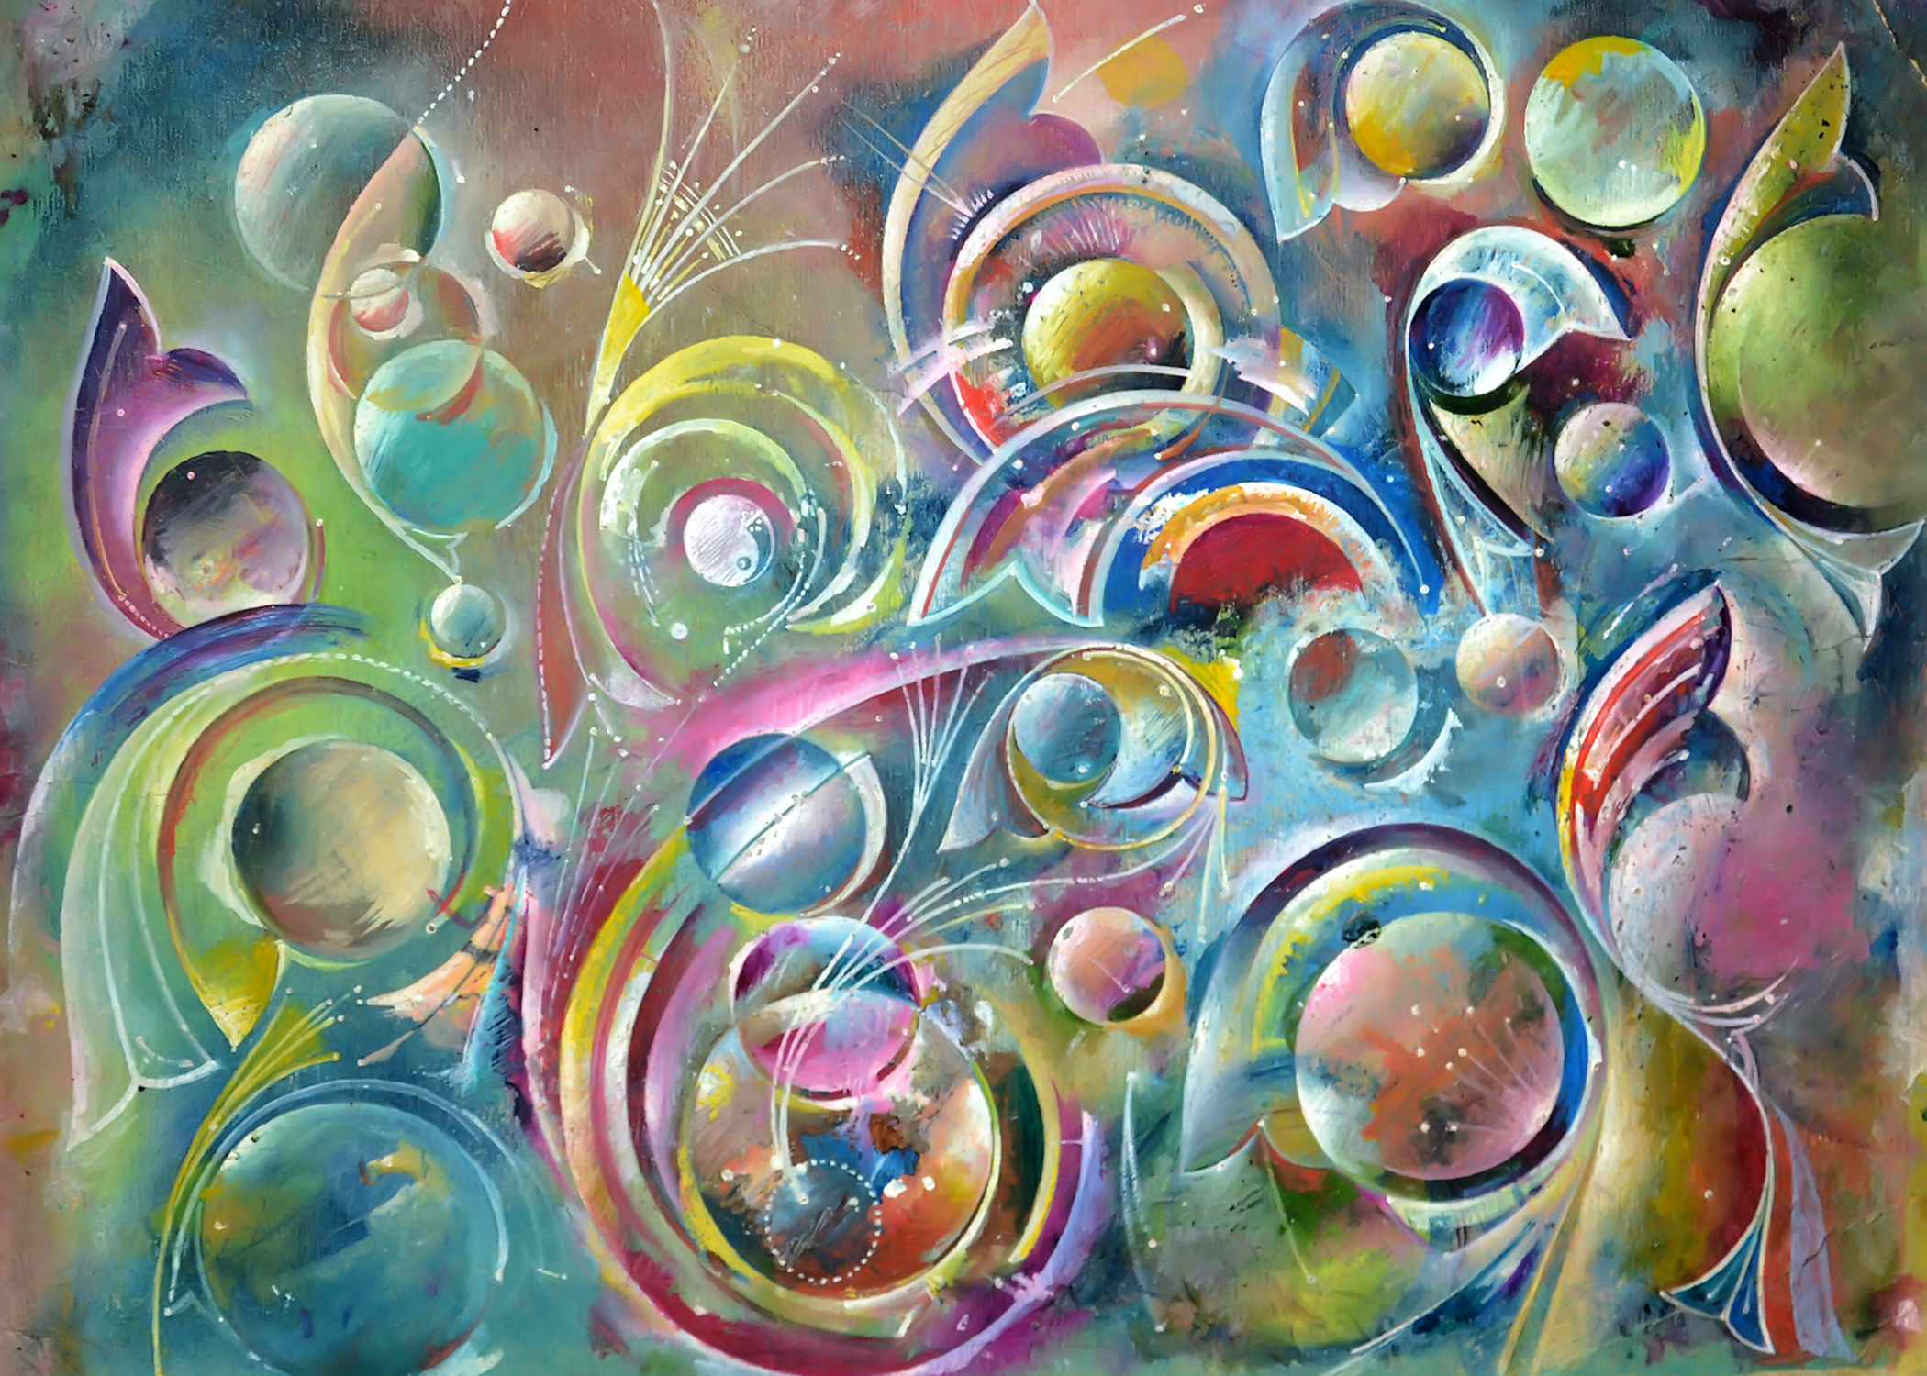
Art Show

Slide 17
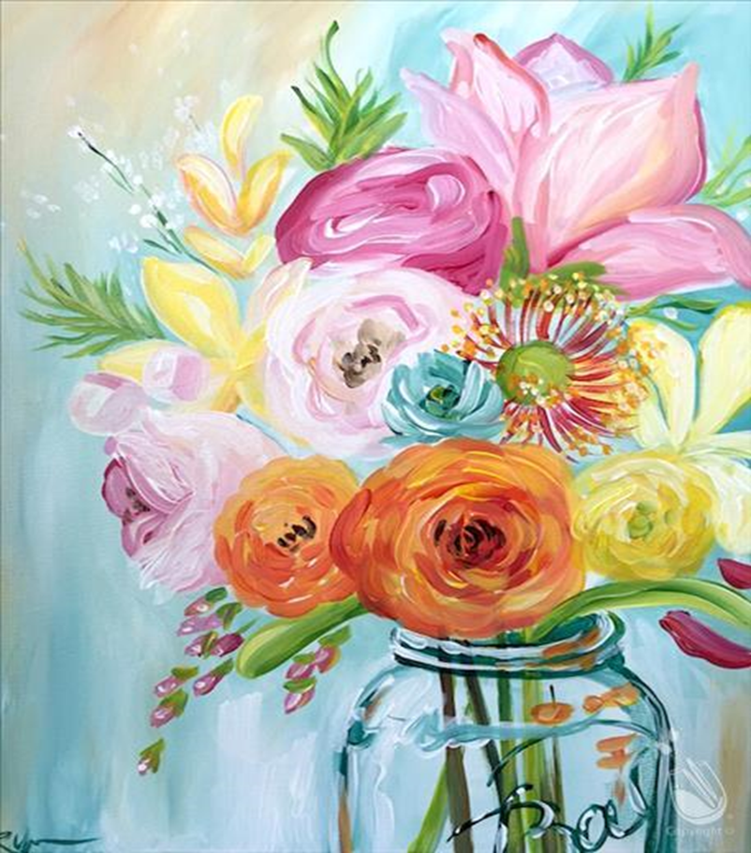
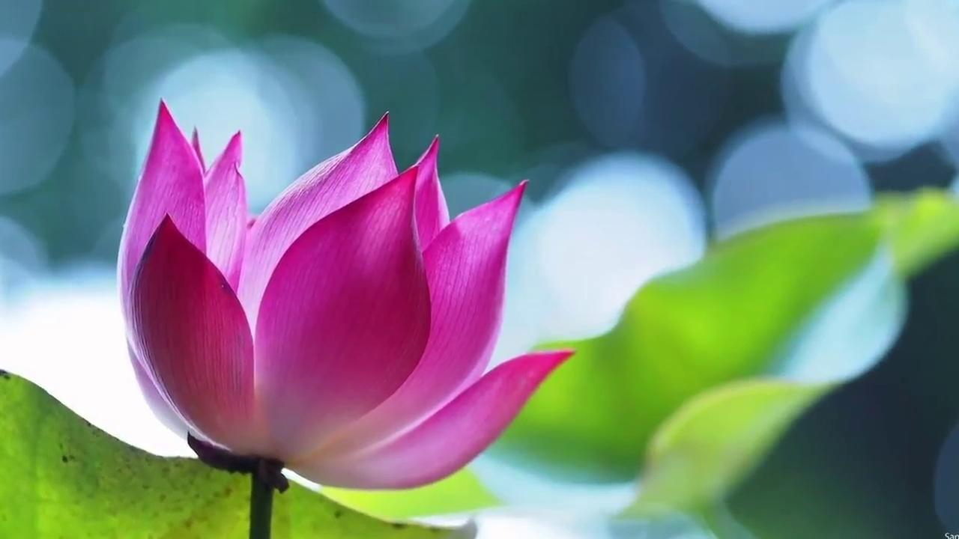
PRAYER
SHARERS
Notes:
Noura--Luke Slott create in me a pure heart
Prayer sharers including Blessed is the Spot. Ask children how many of them can say Blessed is the Spot by heart.
Next week if everyone has it memorized we will have extra game time. When we say this prayer it blesses our heart, our house,our neighborhood, our city, others in the world. Remember the Invisible String, how it reached everywhere?

Slide 18

Notes:
Maia

Slide 19


Slide 20
Notes:
Answer: Pineapple

Slide 21
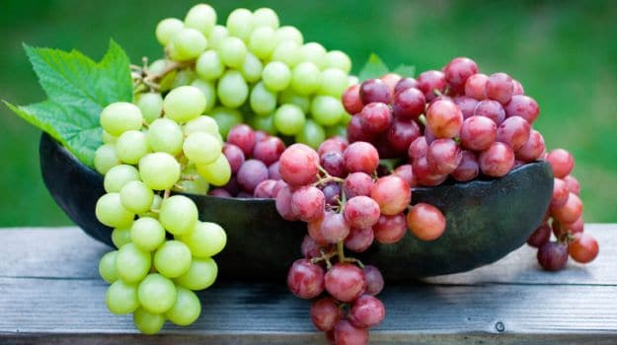

Slide 22
Notes:
Answer: grapes

Slide 23
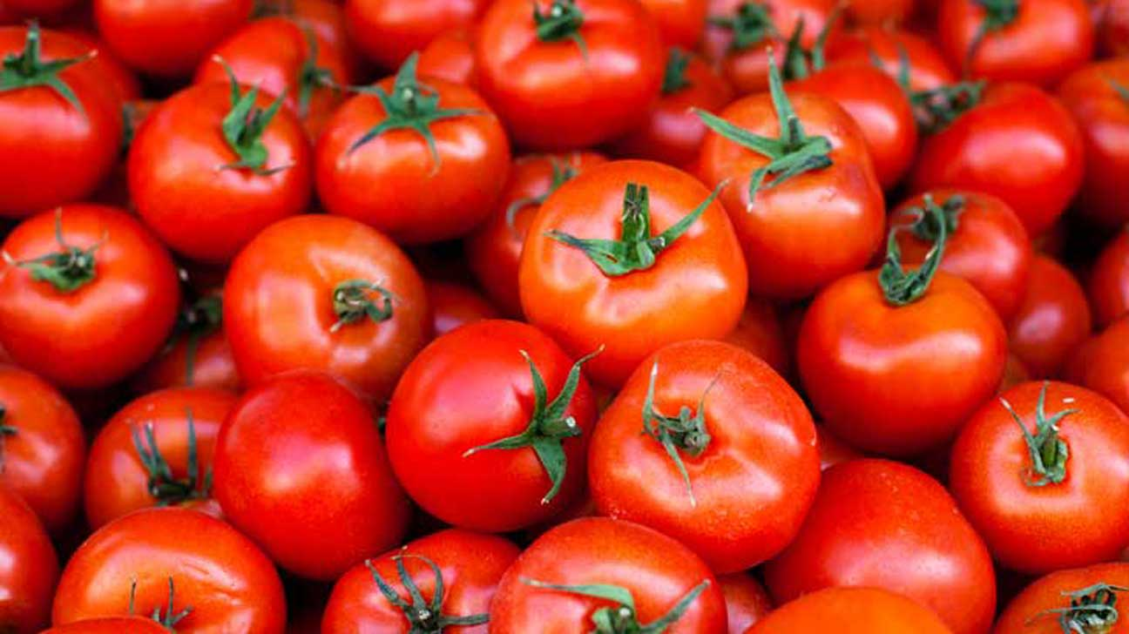

Slide 24
Notes:
Answer: tomatoes

Slide 25
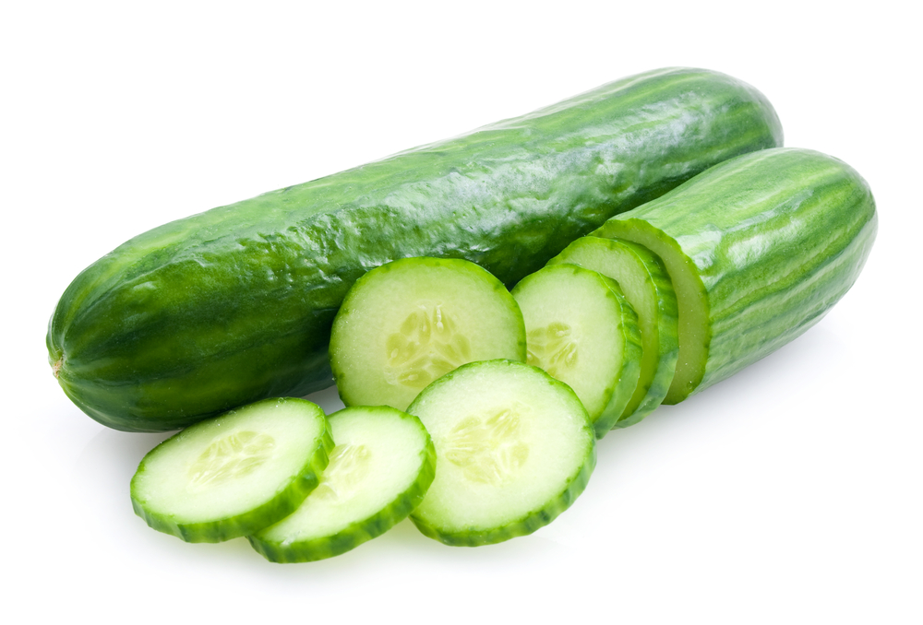

Slide 26
Notes:
Answer: cucumbers

Slide 27
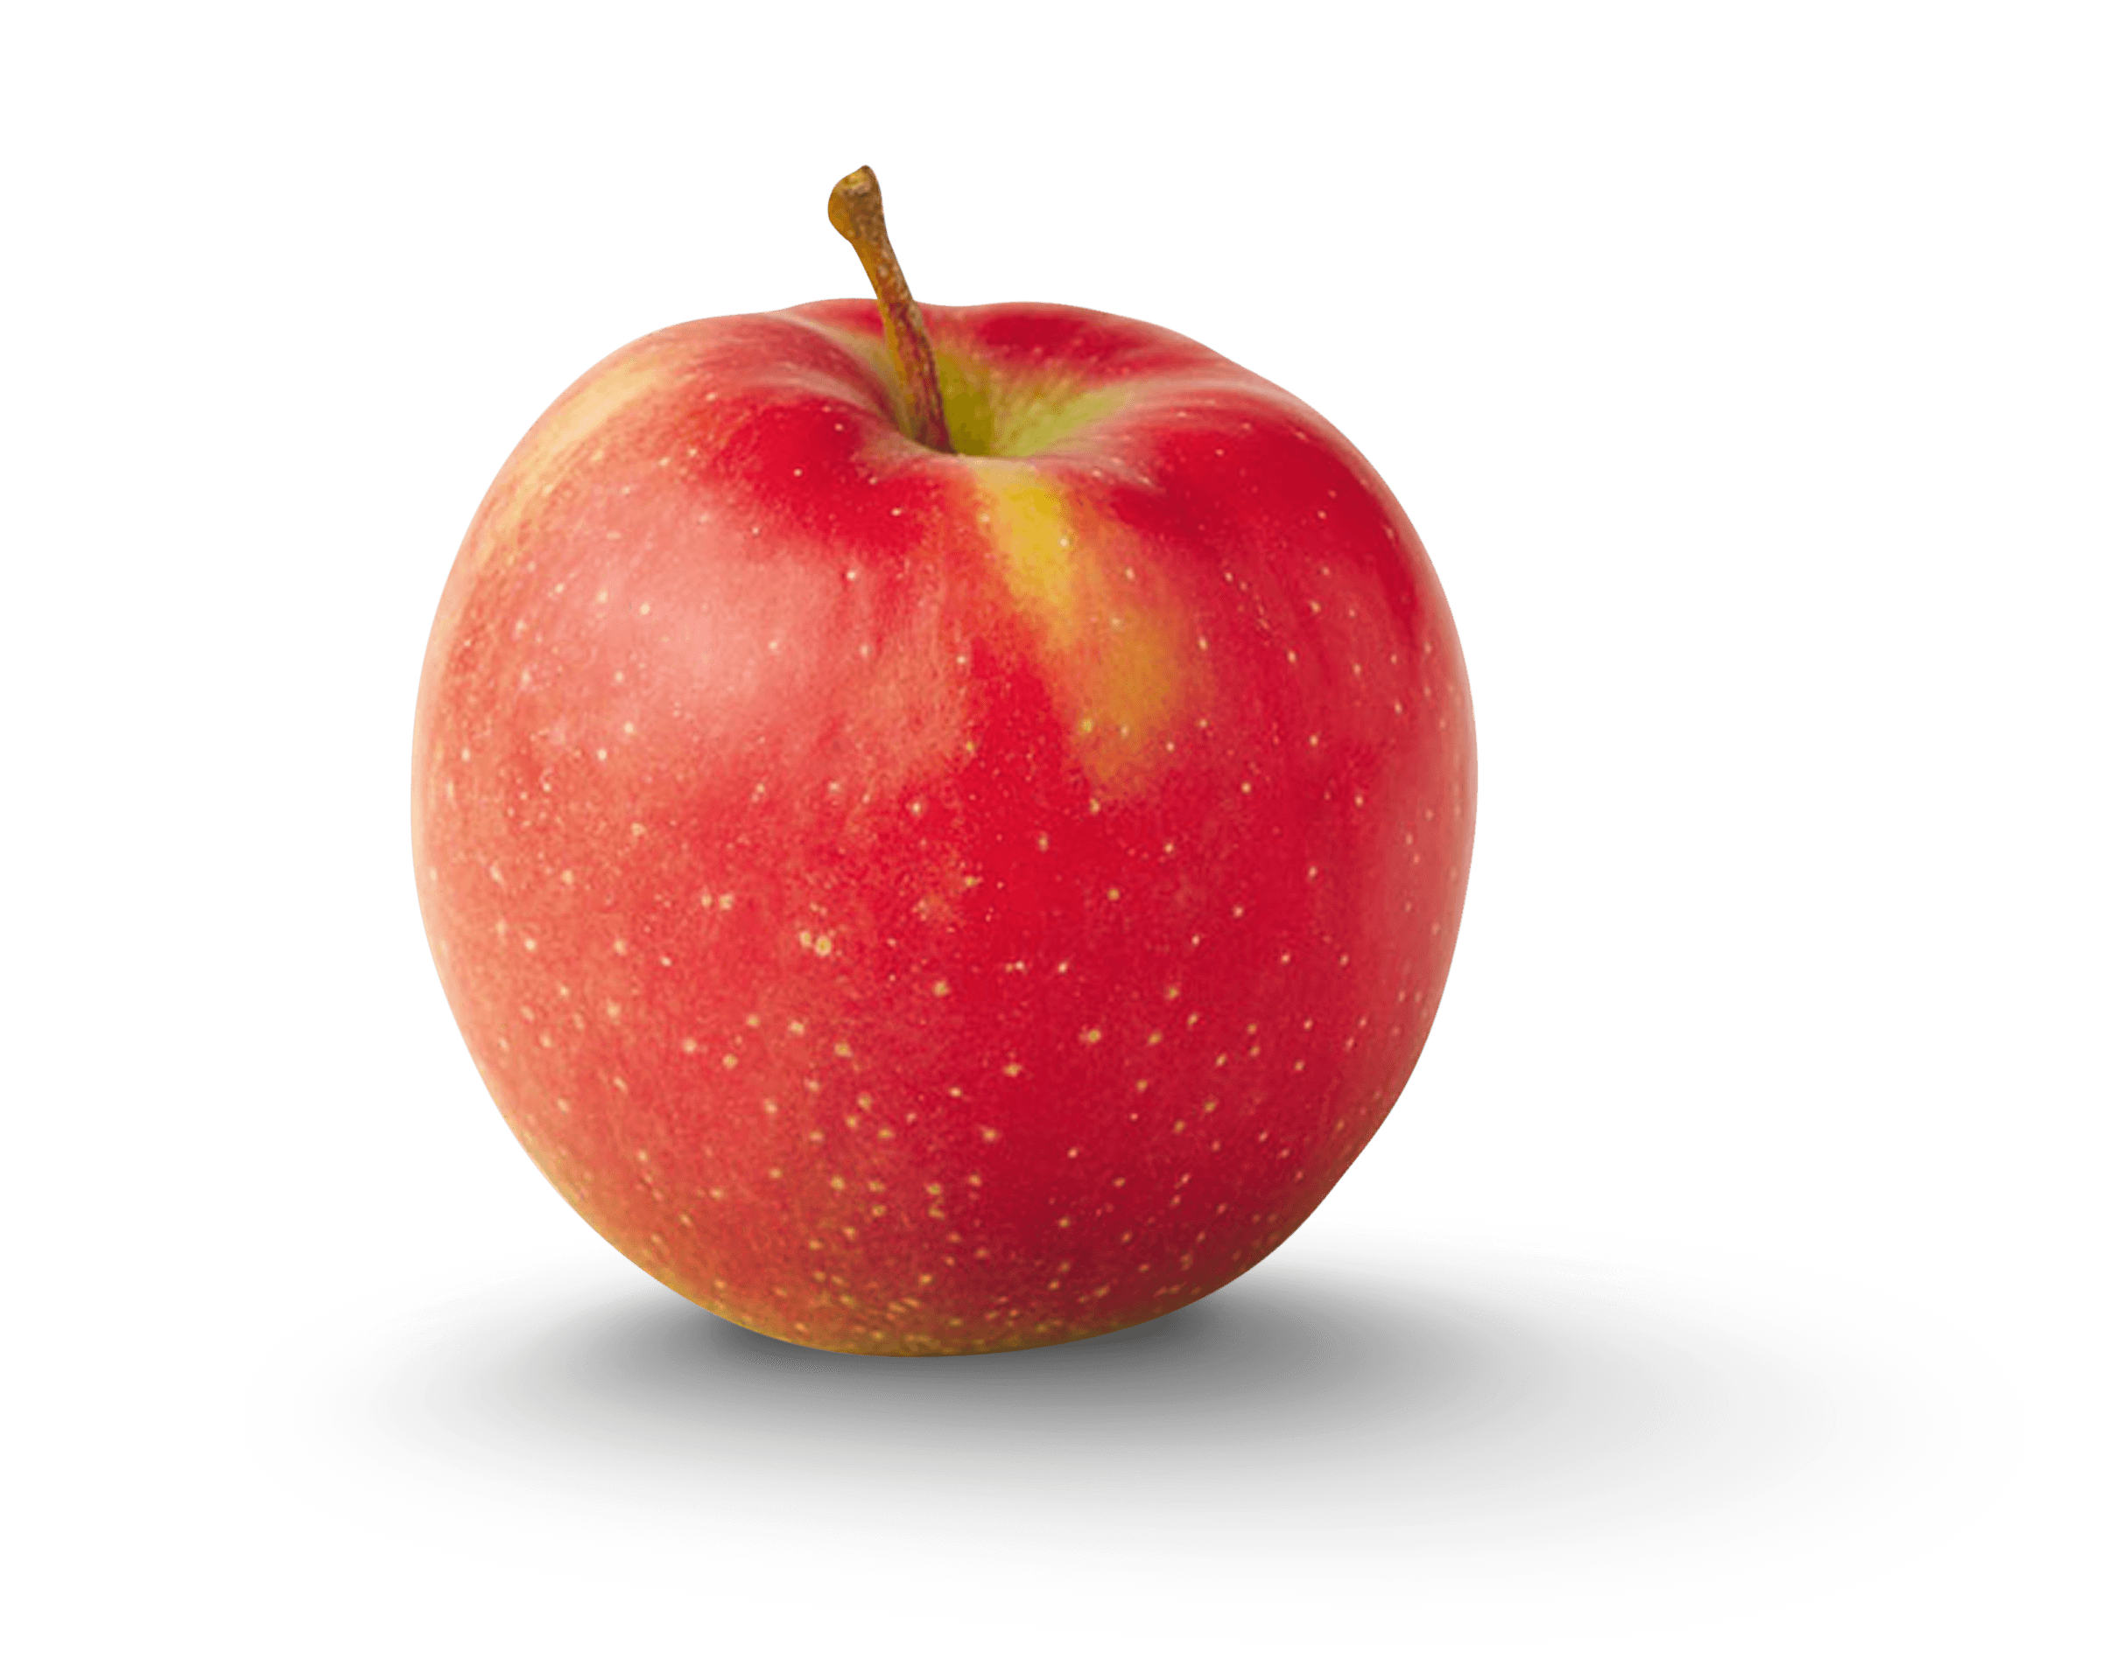

Slide 28
Notes:
Answer: apple

Slide 29
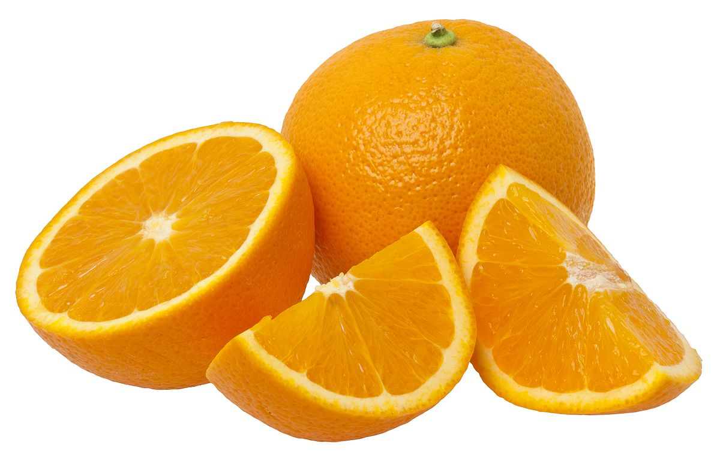

Slide 30
Notes:
Answer: oranges

Slide 31
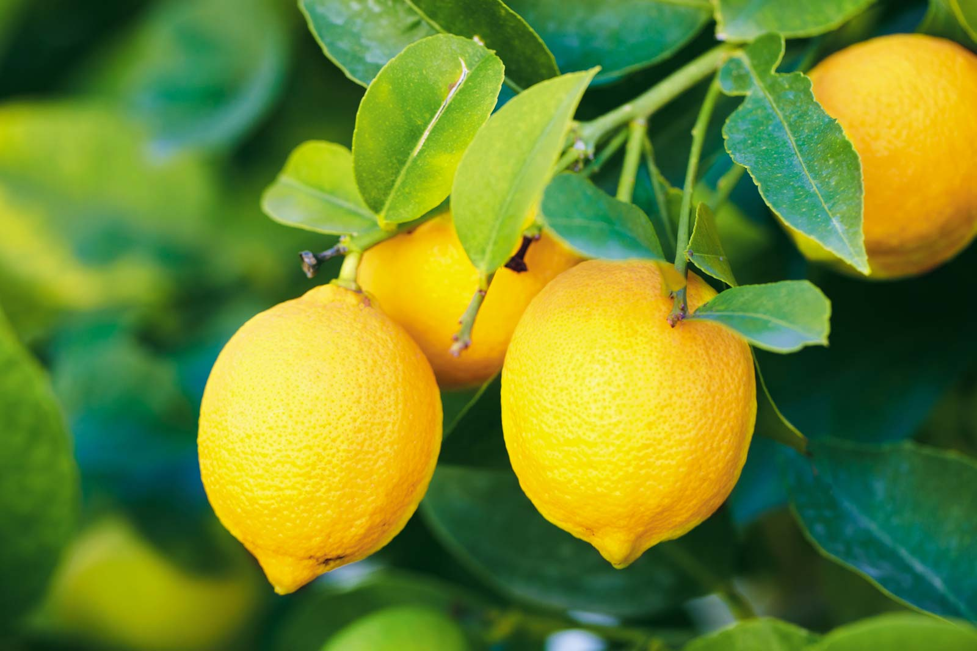

Slide 32
Notes:
Answer: lemons

Slide 33
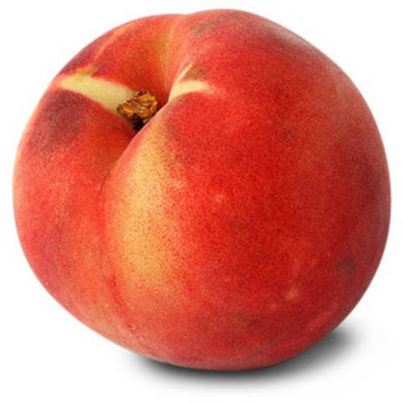

Slide 34
Notes:
answer: peach

Slide 35
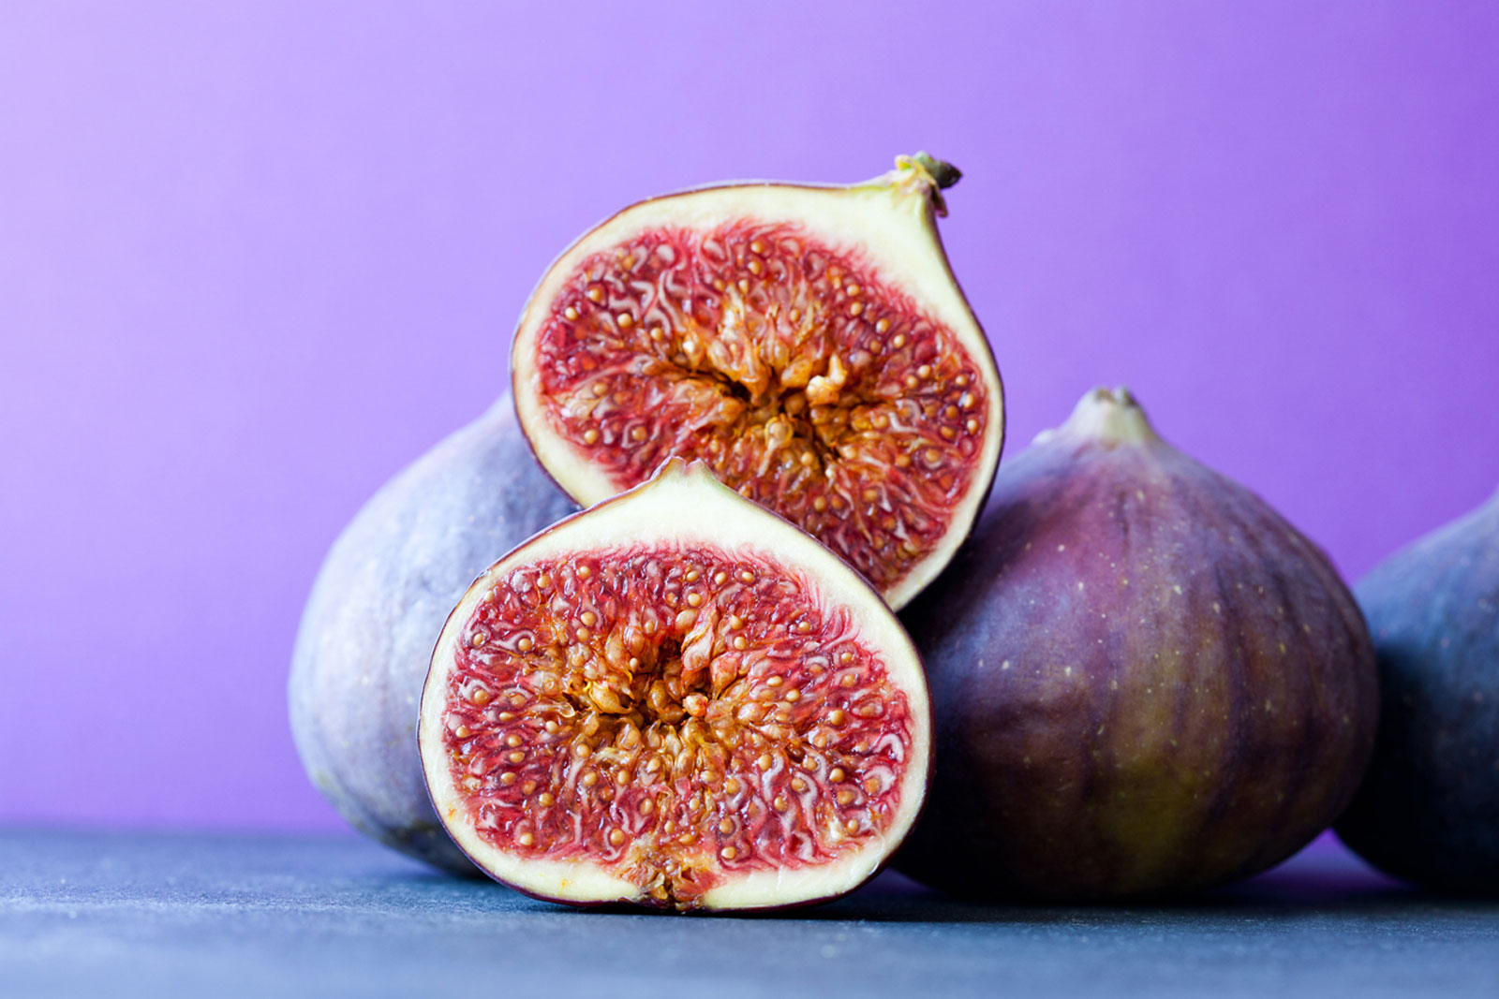

Slide 36
Notes:
answer:fig

Slide 37
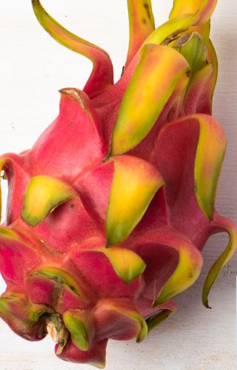

Slide 38
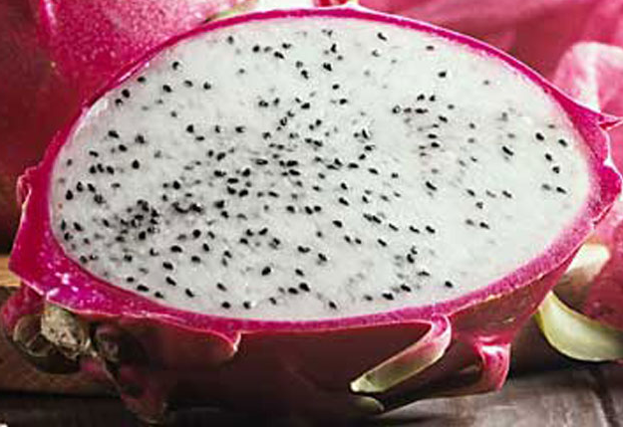
Inside of a Dragon Fruit
Notes:
Answer: Dragon Fruit

Slide 39
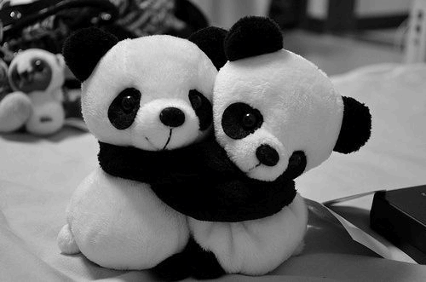
Notes:
Thank you everyone and Maia for the game

