Slide 1

WELCOME
Notes:
Art supplies
Did you say your prayers this morning when you woke up?

Slide 2
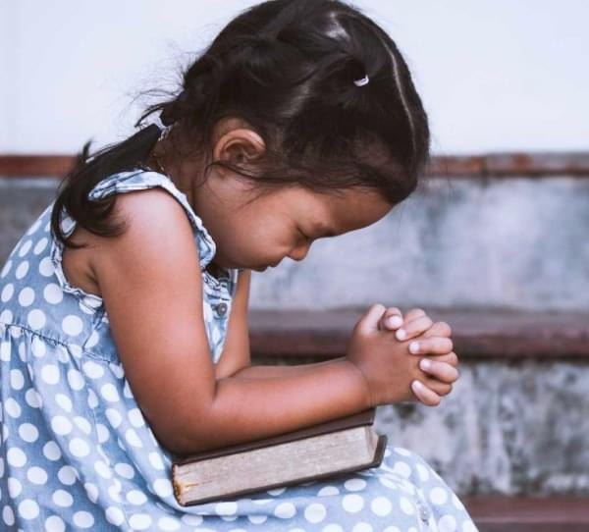
https://www.youtube.com/watch?v=mWmUwfb6R1I
OPENING PRAYERS
Notes:
Url: O God! Educate these children
Prayer sharers

Slide 3
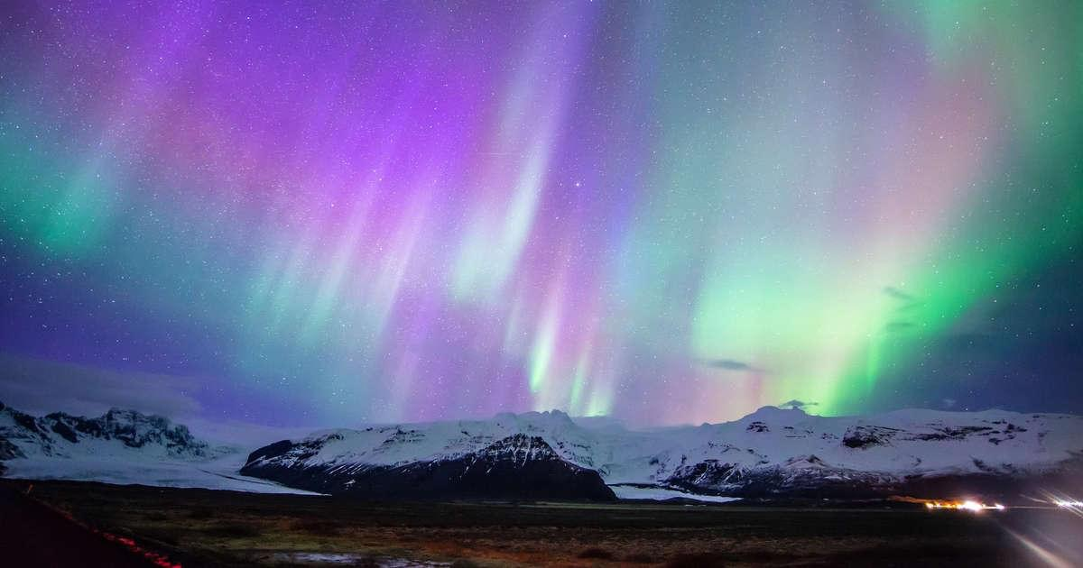
LOVE of GOD and OBEDIENCE
Grade 2 Lesson 5
Notes:
First class on Adhering to Laws of God was about how laws keep us safe. This second lesson is on obeying God bec we love Him so much!
Intro: Noura
INTRO FROM THE BOOK

Slide 4
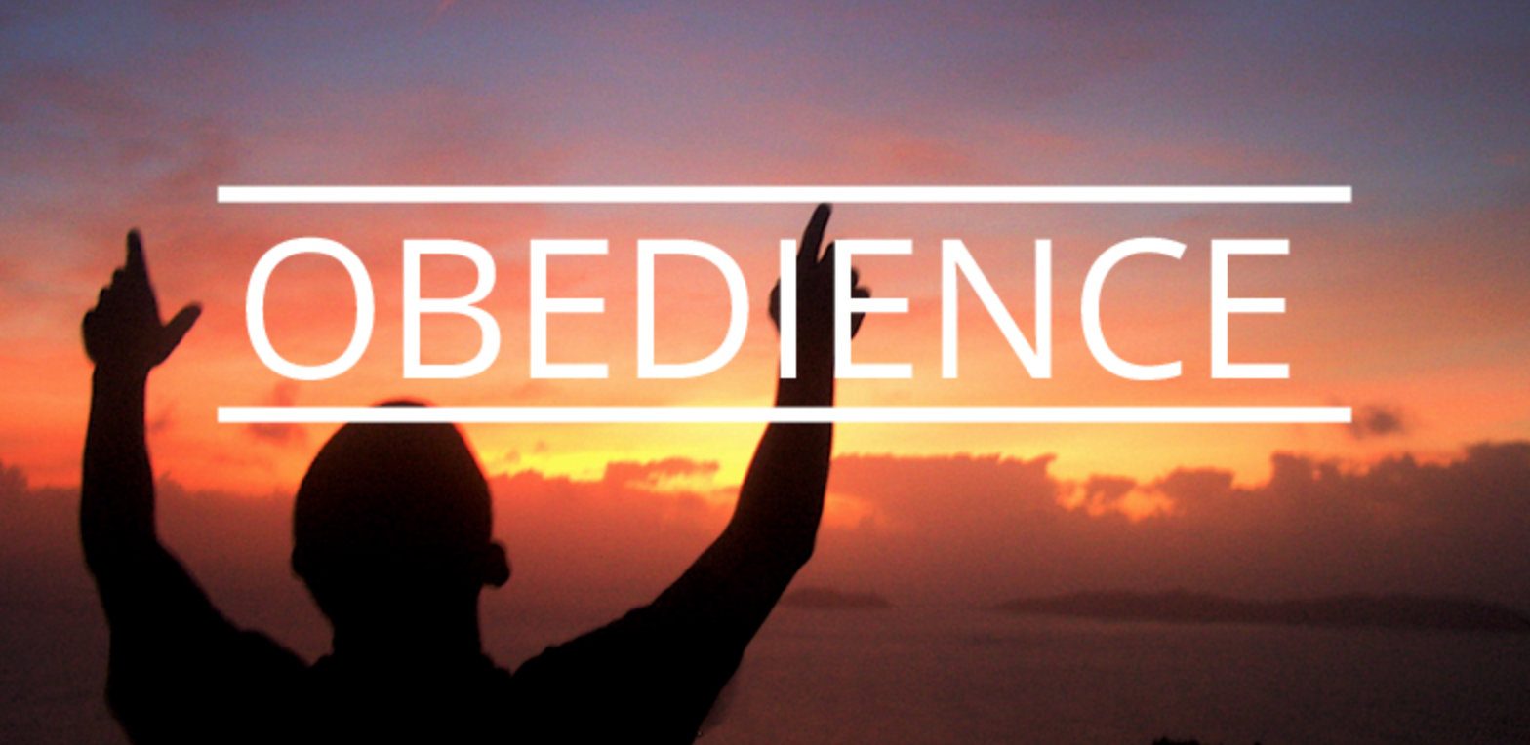
Our Gift to God
Notes:
We like to give gifts to those we love. Obedience is our gift to God.

Slide 5
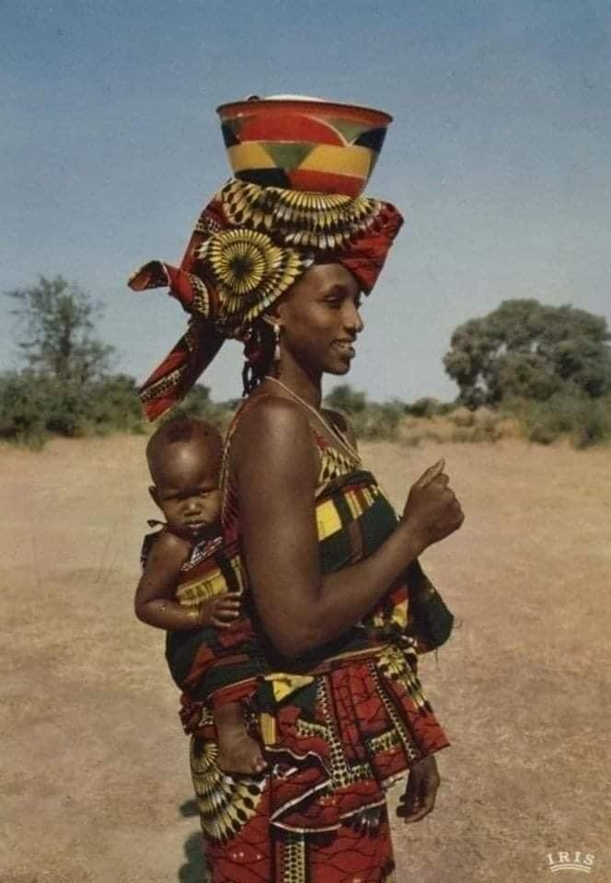
“Where there is love
nothing is too much
trouble and there is
always time.”
Abdu’l-Baha
Notes:
Noura-- Abdu’l-Baha tells us (Read quote) Look at this mother. She is a busy mom. Look at the bowl of food she is carrying on her head. But she also has time to care for her baby.
When we love God, there is always time to do what He asks of us like saying prayers when we first awake, serving others or...

Slide 6
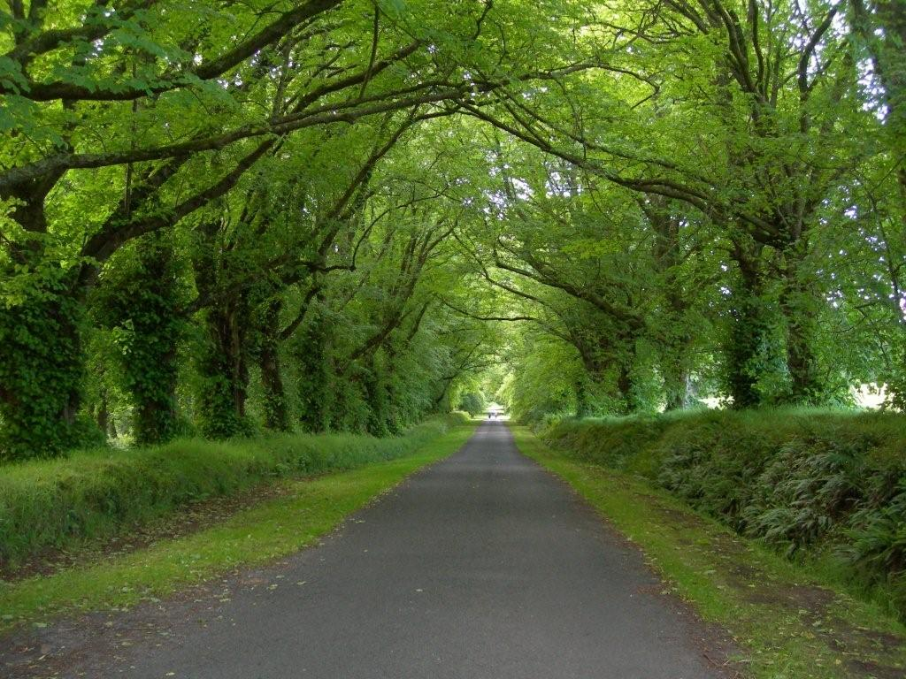

Follow the
commandments
of God
Notes:
How do our actions show whether we are following the laws of God?
Do our actions affect the community we live in? On a smaller scale do our actions affect our neighborhood?
Do our prayers for unity affect our neighborhood? How many of you have devotionals gatherings in your neighborhood? Invite your friends.

Slide 7
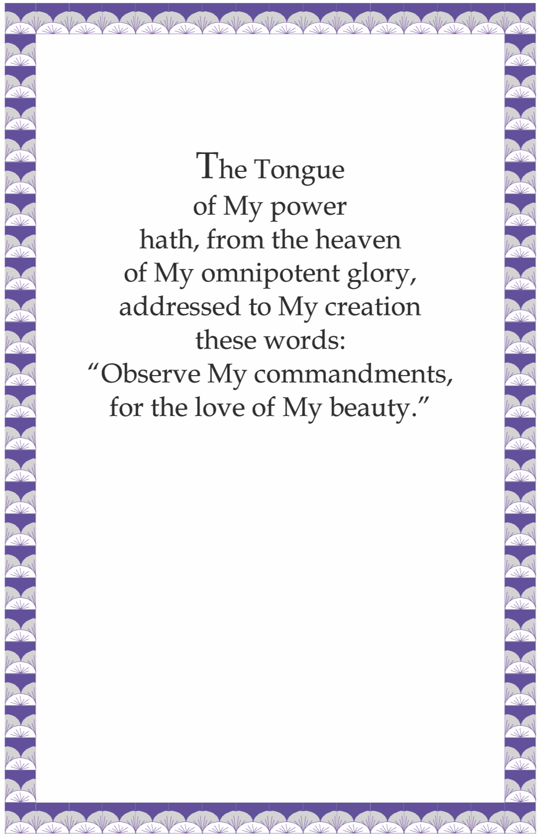
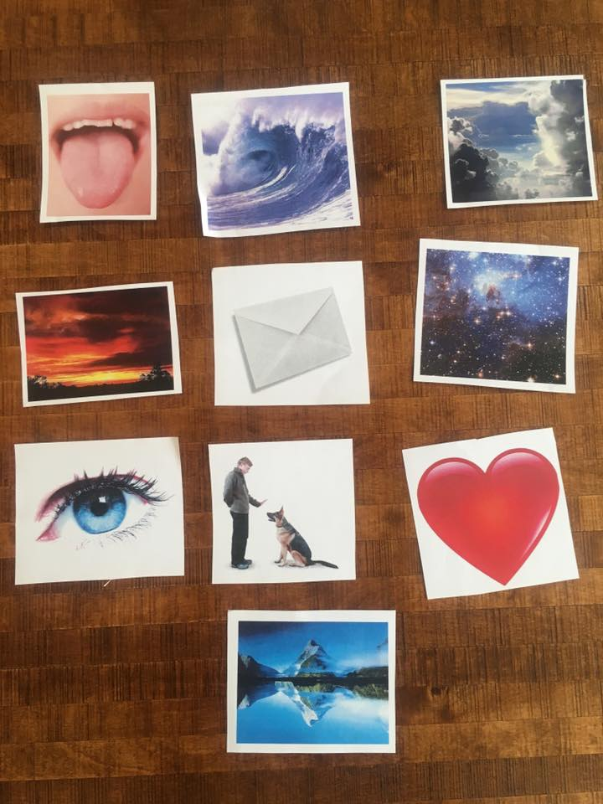
Notes:
Diedre---Read quote and explain omnipotent (All power) glory Review photos. Each child given chance to insert missing words as photo pointed to in entire quote.

Slide 8

“Make firm our steps, O Lord, in Thy path
and strengthen Thou our hearts in Thine obedience…”
~Abdu’l-Baha
https://www.youtube.com/watch?v=YCzrt5UiiQc
Notes:
Noura--- Make firm our steps. Have children get something from kitchen that can me used as an instrument.
Strengthen our muscles through practice, exercising, going to soccer practice.
How do we strengthen our hearts?? By practicing. How can we practice being loving? Ask each child what they love most in the world of nature.
When see things in nature--I love God so much for making stars, blue sky, etc.

Slide 9

MOVEMENT ACTIVITY
https://www.youtube.com/watch?v=Qm1Tiw4Y0Es
Notes:
Get Ready to Wiggle

Slide 10

Story Time

Slide 11
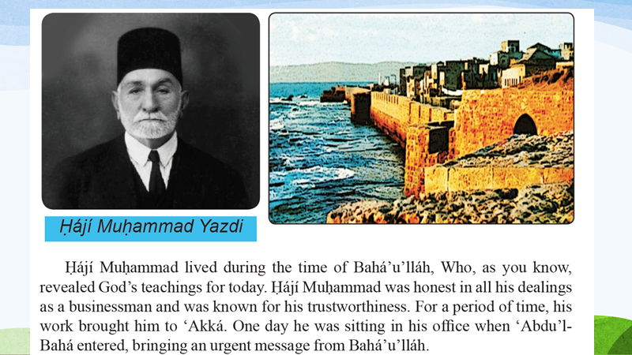
Notes:
Noura: This is Haji Muammad

Slide 12
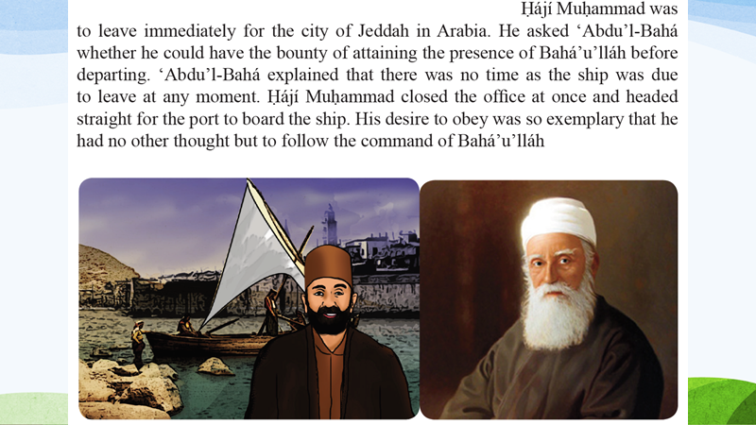

Slide 13
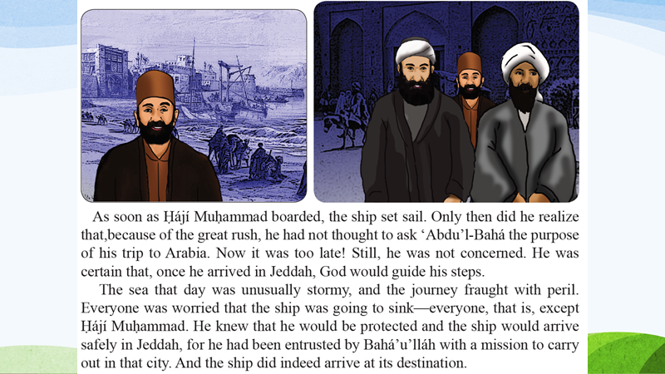

Slide 14
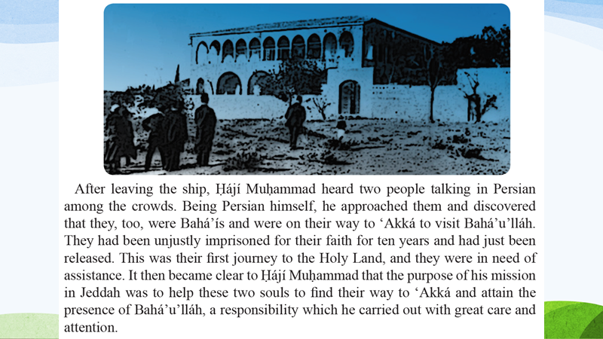
Notes:
He was obedient because he loved God

Slide 15
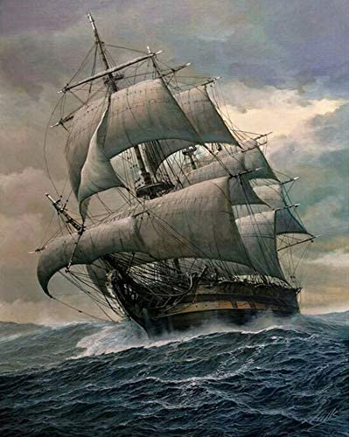
ART
ACTIVITY
Notes:
Maia---This might have been a ship like Haji Muhammad Yazdi traveled on. We are going to learn how to draw a ship. Do you see how this ship is tilted sideways. You can also draw your ship tilted by rotating your paper slightly. Draw a ship with tutorial. https://www.youtube.com/watch?v=WUzQRmAMohM Stop at 2’24”
What color would you like to choose to show a stormy sea? a dark sky?
Grant Hindin-Miller sings 'I Charge You All' based on the writings of Abdu'l-Baha Start at 1’ 6”

Slide 16
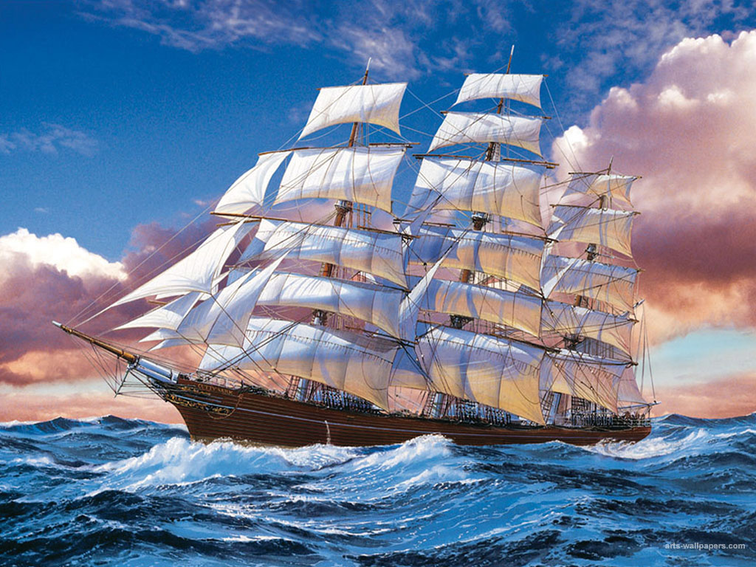
ART SHOW

Slide 17
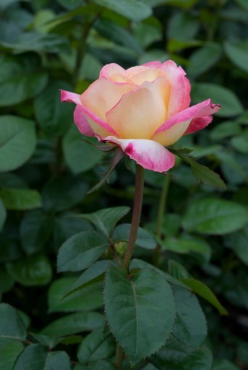
https://www.youtube.com/watch?v=u26mLd6q4qk
O Friend!
In the garden of thy heart
plant naught but
the rose of love.”
Baha’u’llah
Notes:
URL Rose of Love

Slide 18
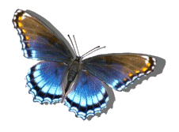

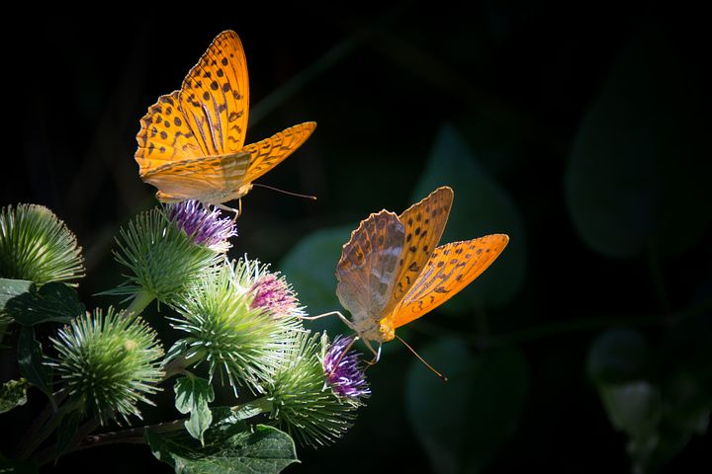





THANK YOU
Milan
Hudson
Kim
Maia
Cassedy
Devin
Cora
Dev

Slide 19

Riddles
Notes:
Maia

Slide 20

If milk grows your bones strong,
why does it also
make you grow old?
Notes:
Gives you a mustache

Slide 21
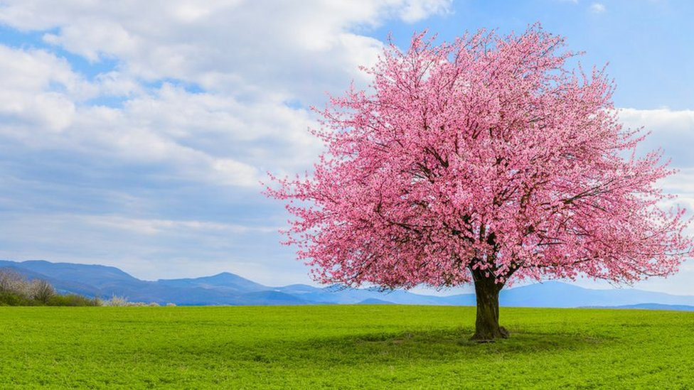
What kind of tree
do you find in a kitchen?
Notes:
A pantry

Slide 22
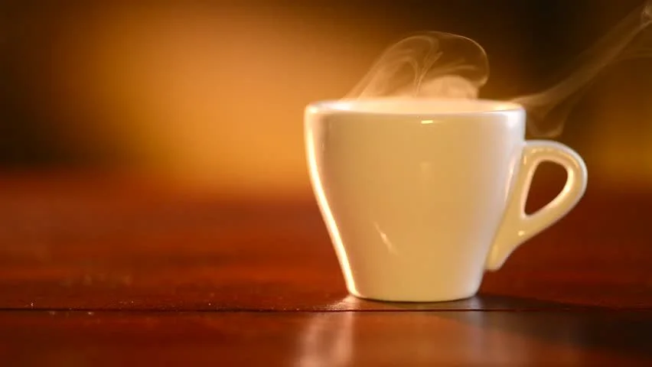
What kind of cup
doesn’t hold water?
Notes:
A cupcake

Slide 23
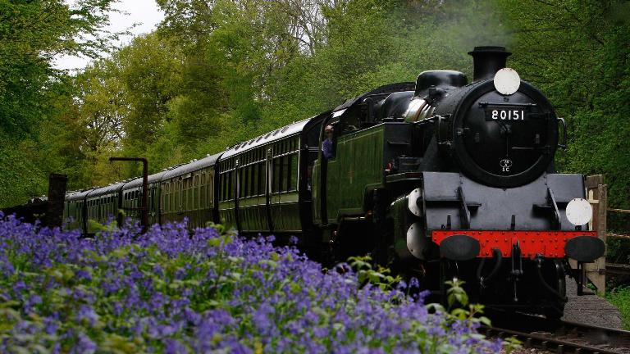
What kind of ears
do trains have?
Notes:
Engineers (engine ears)

Slide 24
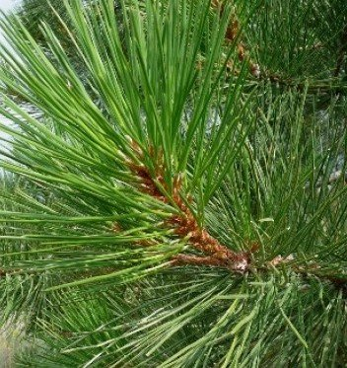
What kind of pine
has the sharpest needles?
Notes:
A porcupine.

