Slide 1


Slide 2
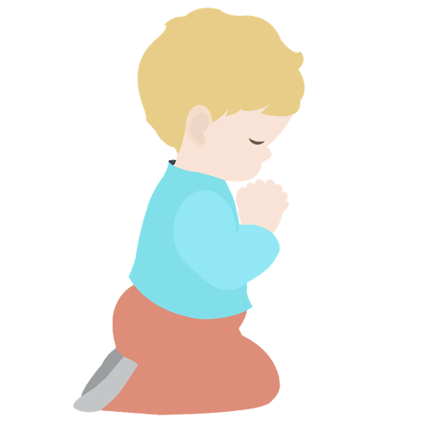
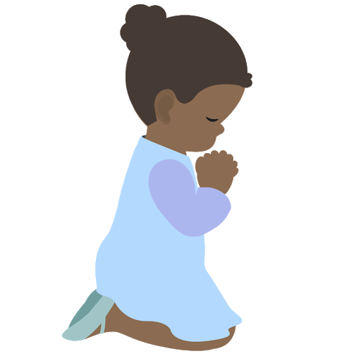
⭐️
⭐️
Prayer Stars⭐
Cassedy | ⭐️⭐️⭐️⭐️
Milan | ⭐️⭐️⭐️⭐️
Devin | ⭐️⭐️⭐️⭐️⭐️
Kim | ⭐️⭐️⭐️
Cora | ⭐️⭐️⭐️⭐️
Hudson | ⭐️⭐️⭐️⭐️
Dev | ⭐️
⭐️
⭐️
Notes:
Explain reward for saying prayers in the morning.

Slide 3
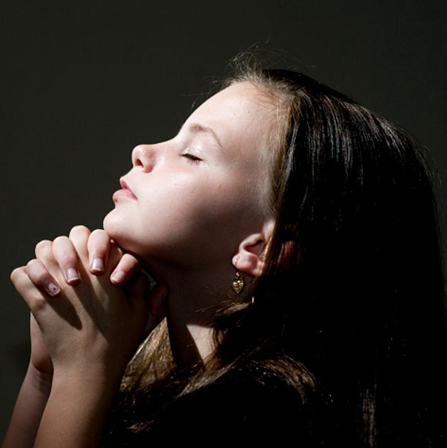
https://www.youtube.com/watch?v=ZVduCyMS2JM
OPENING PRAYERS
Notes:
URL Thy Name is my healing
Prayer sharers

Slide 4
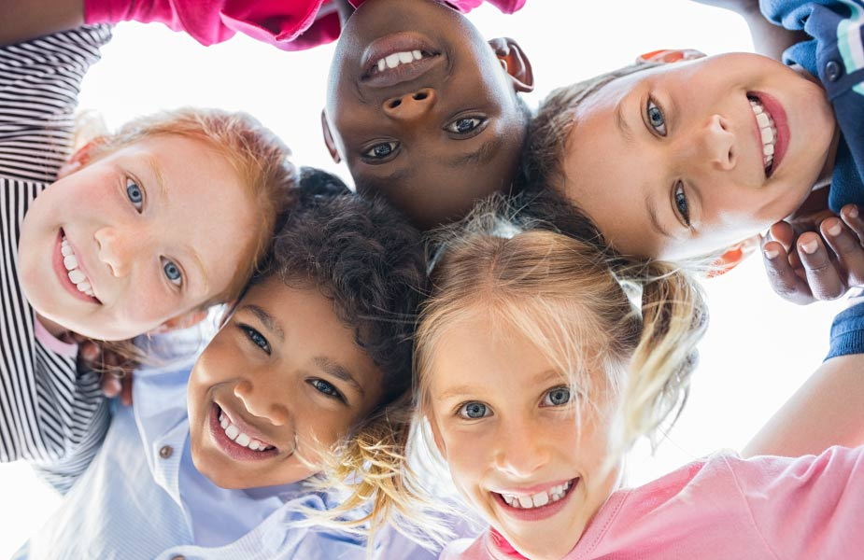
Living in Harmony with Others
Notes:
New theme Living in harmony with others
Next 3 lessons will be on the Importance of Unity, Importance of Justice, and Cooperating with Others.

Slide 5

Importance of Unity
Notes:
There is no greater example of the importance of unity than having unity in the human body.

Slide 6
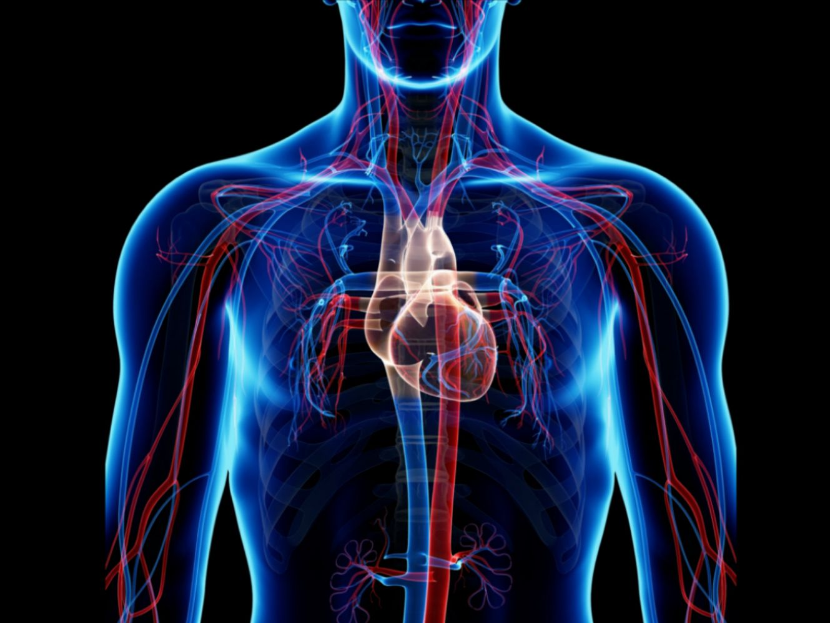
https://www.youtube.com/watch
?v=-s5iCoCaofc
Notes:
Unity is a topic that is very close to our hearts, our physical hearts. In a very organized and unified way our hearts, arteries, and veins make sure we have needed oxygen to live.
If these different parts of our body fought with each other or decided they weren’t going to cooperate together we would die. Let’s look at a video of how our circulatory system works. Listen carefully to learn how our body works in unity. Every part works in harmony with the other parts. URL: Unity in the Circulatory System (6 minutes)

Slide 7

Previous Manifestations
Future Manifestations
Noah
Baha’u’llah
Abraham
UNITY of RELIGION
Bab
Krishna
Muhammad
Moses
Jesus
Zoroaster
Buddha
Notes:
You’ve learned about the different Teachers God has sent.
But did you know Each of these Manifestations of God have brought teachings of unity for each time period and the needs of that time.

Slide 8
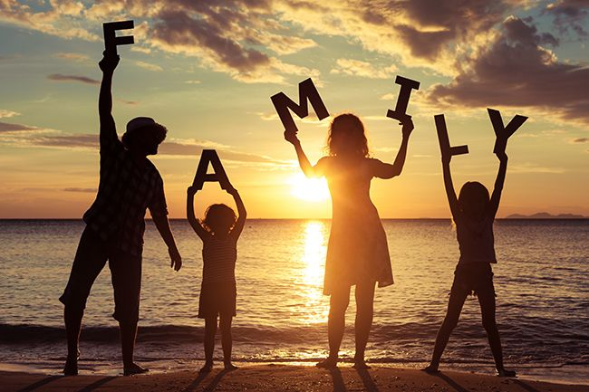
Notes:
The earlier religions focused on unity of family. Of course this is not what families looked like millions of years ago. There were no cars or telephones at that time so their exposure to other people was very limited.

Slide 9
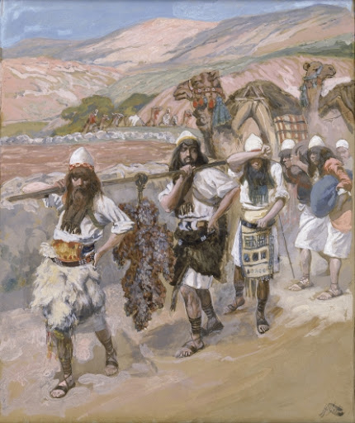
UNITY OF
TRIBES
Notes:
When Moses came He brought unity among the different tribes. Let’s stop and think a minute. Do you think Moses could have united tribes if there was not already unity of the family? If family members are fighting, do you think tribes could be peaceful and unified? Unity of family is the building block for unity of tribes. It’s like the foundation.

Slide 10
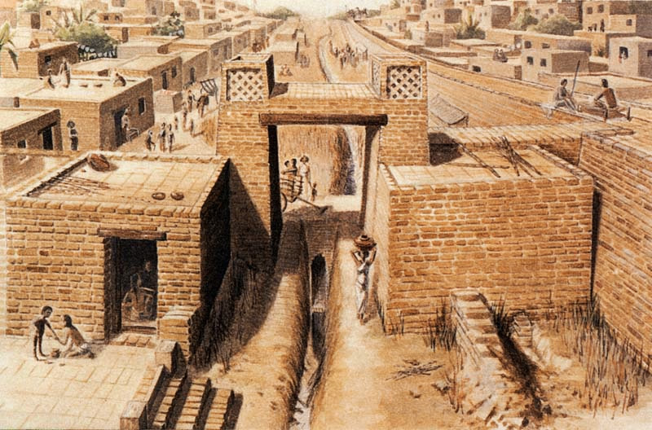
UNITY OF
CITIES
Notes:
Christ emphasized unity of cities. By this time people were traveling, meeting and getting to know a larger group of people. Therefore Christ was given the task of uniting whole cities of people.

Slide 11
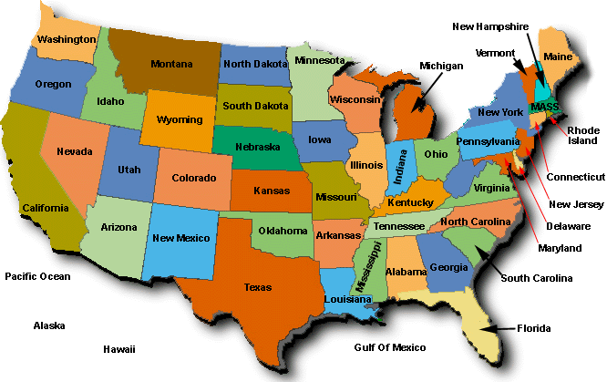
UNITY OF
STATES
Notes:
Next came the unity of states. During this time people had better transportation and communication.

Slide 12
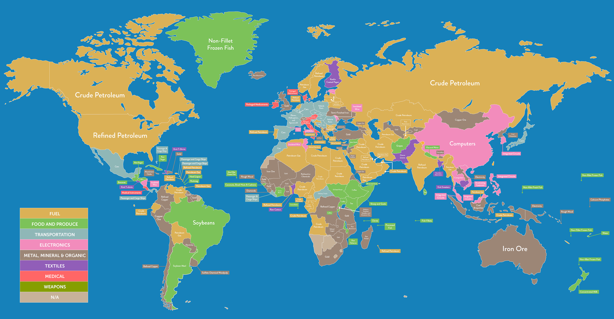
UNITY OF
NATIONS
Notes:
Muhammad broadened that area to include unity of nations. People were now able to travel to far away places. See how it is progressing? Unity of families, then tribes, cities/states, nations?
What do you think comes next?? (the world)

Slide 13
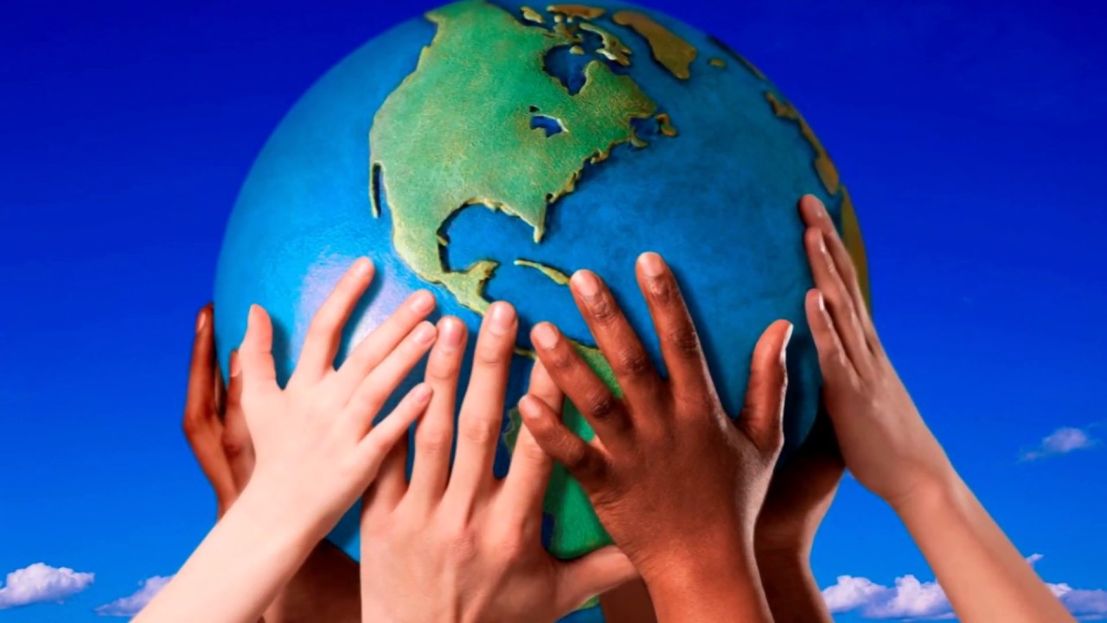
“The earth is but one country and mankind its citizens.”
Notes:
Next to come was the Bab and Baha’u’llah. The Bab prepared people for the coming of Baha’u’llah Who taught us Mankind is one.
Who can read these words of Baha’u’llah? This is now possible because there are jets, cell phones and the internet that make it possible for us to get to know people all over the world. We can even see the earth from space. All this technology had not been discovered during the times of Zooraster, Moses, Buddha, or Krisna for example. Now at this point in history it has and it is our responsibility to help people understand we are all one family.

Slide 14




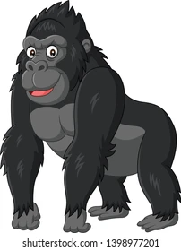
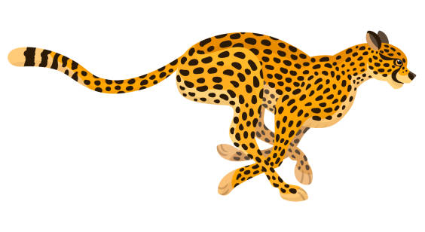

Movement Activity
Notes:
(Frog hop, crab walk, starfish stretch arms in jumping jacks, cheetah run fast as can, bear walk all 4s, gorilla squats, elephant stomp feet)
Call each child’s name to lead class in specific animal movement for 30 seconds

Slide 15
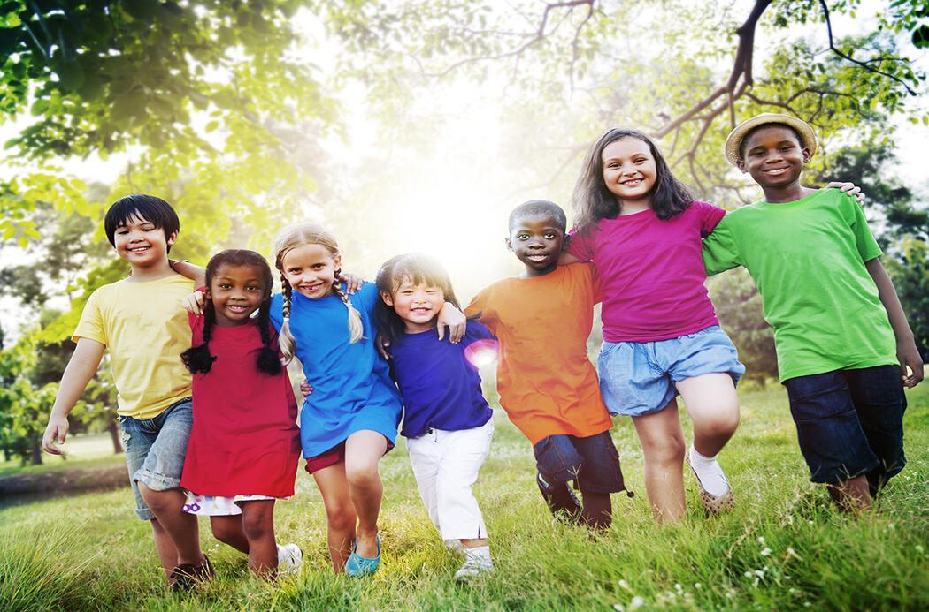
“The well-being of mankind, its peace and security, are unattainable
unless and until its unity is firmly established.
This unity can never be achieved so long as the counsels which
the Pen of the Most High hath revealed are suffered to pass unheeded.”
Baha’u’llah
Notes:
We’ve seen how our individual body parts work in harmony to keep us healthy. When individual people work in harmony it keeps them healthy and the whole of society healthy.
Baha’u’llah tells us (Read first sentence) So we must have unity before peace can be established. (Read second sentence) Remember last class when we learned about searching for truth? Here Baha’u’llah tells us in order for all the people of the world to live in unity, we must obey the commands of God. We know when there is unity in a family the family members are happy and they are better able to deal with challenges. We also see that when neighborhoods follow the commandment ‘prefer your brother before yourself’ those neighborhoods also prosper. That it why we put so much importance in finding things we can do to be of service to our neighbors and cities.

Slide 16
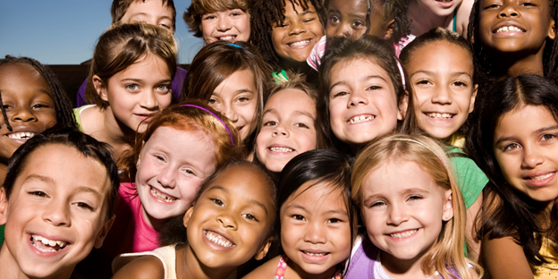
Notes:
Look at this picture and tell me how many races there are.(Trick question.Answer on next slide)

Slide 17
There is only one race THE HUMAN RACE
Notes:
The one thing that mankind needs right now is to consciously recognize the oneness of mankind. You already know that mankind is one. Now we must be unshakable and steadfast in helping the world unite..

Slide 18
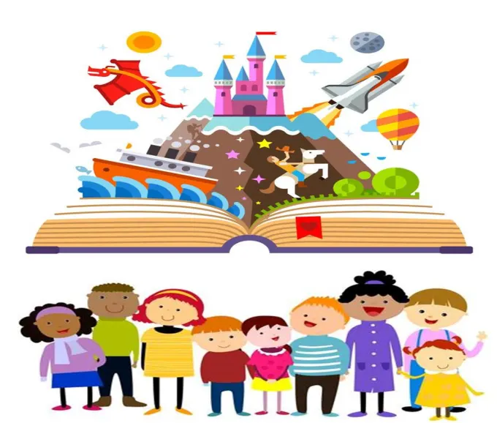
Story Time
Notes:
Story for Grade 2 Lesson 10 on being a good friend

Slide 19
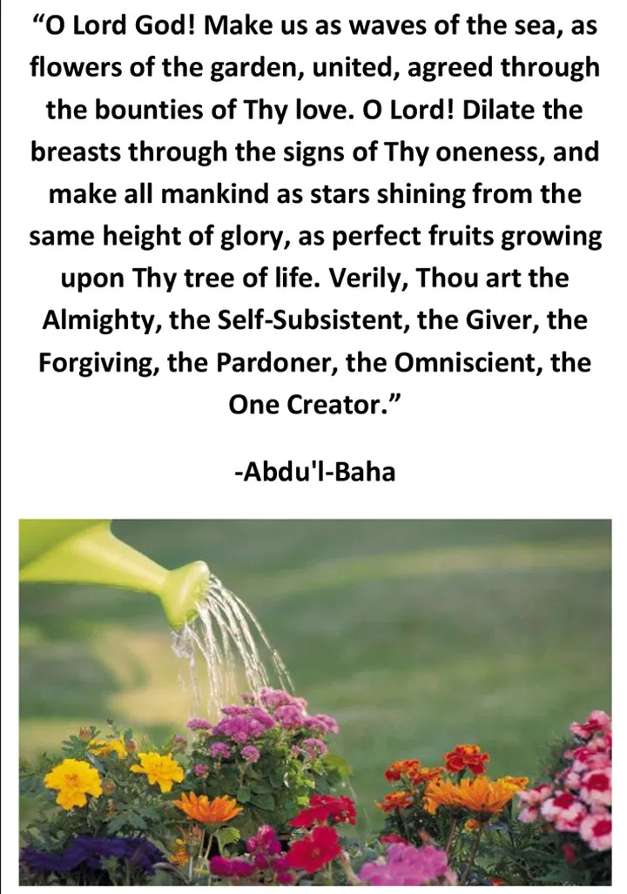
https://www.bahaiblog.net/2021/02/
waves-ali-youssefi/
Notes:
Read quote followed by video. Please listen carefully bec our art activity today will relate to this song.
URL Ali Youssefi WAVES (End 5’46”)

Slide 20

Art Activity
Perfect Fruits Growing Upon Thy Tree of Life
Waves of One Sea
Flowers of One Garden
Stars Shining from the Same
Height of Glory
Notes:
The song we just heard spoke about (Read captions). Children choose which they would like to draw. Now that they are older, encourage children to copy phrase that suits their drawing. Music while drawing: One Tree: https://www.youtube.com/watch?v=nS1RBSrOGng
So So Powerful https://www.youtube.com/watch?v=q1VfQ9czSUA

Slide 21

ART SHOW
Notes:
Individually spot light each child as they share

Slide 22
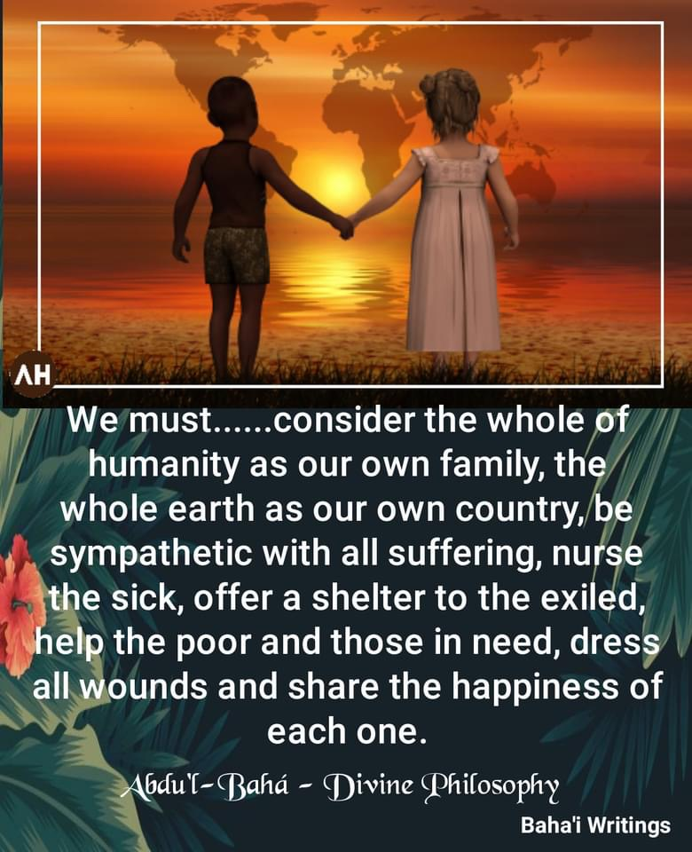
The whole
of humanity
is our family
Notes:
Maia would you please read this quote from ‘Abdu’l-Baha.

Slide 23

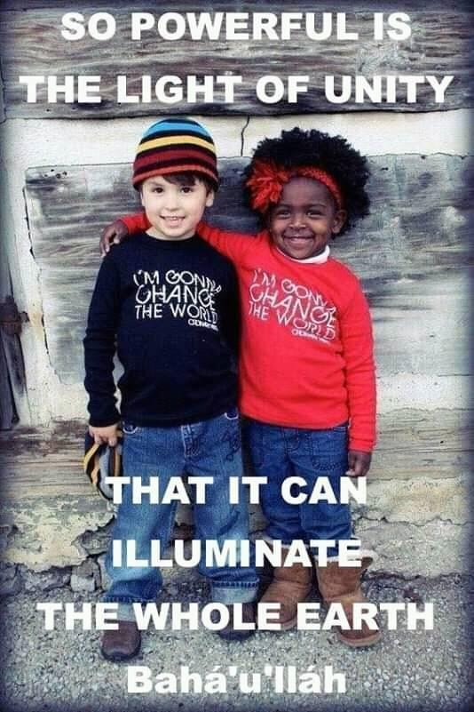
Notes:
This has got to be one of my most favorite slide! Would someone like to read it? Remember the song “So so powerful…”?

Slide 24

Closing Prayers
https://www.youtube.com/watch?v=NJ-VfqK1fS4
Notes:
Devin is going to read “My home is the home of peace.”
URL Unite the hearts of Thy servants

Slide 25
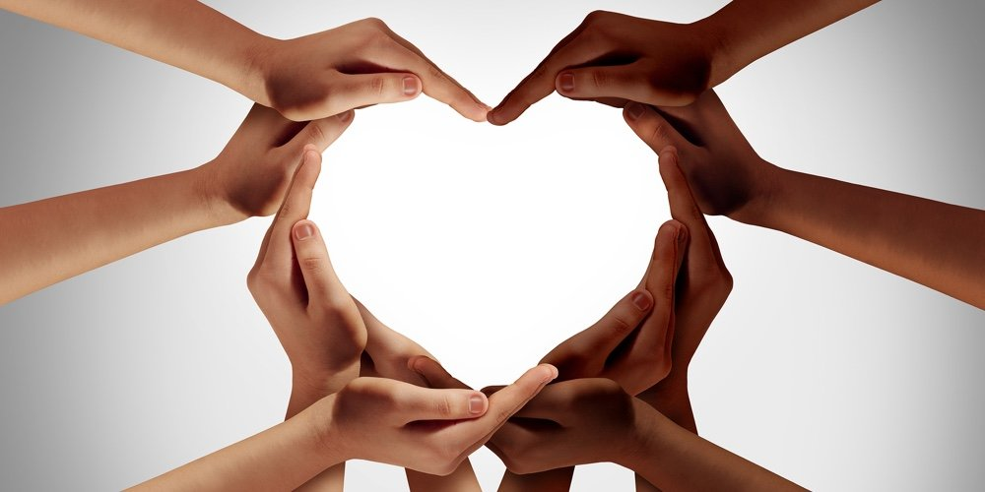
THANK
YOU

Slide 26
Story for Grade 2 Lesson 10 on being a good friend
Throughout His life, Abdu’l Baha brought all different kinds of people together- old and young, rich and poor, of all religions and backgrounds- and helped them to learn the ways of unity. Here is a story that shows how Abdu’l-Baha brought two hearts together.
Every day many people came to visit Abdu’l-Baha in His home, and He welcomed them all with open arms. One day, a gentleman arrived at the house and was greeted warmly. Sometime later, while this gentleman was still visiting with Abdu’l-Baha, a second man came to call, and he, too, was warmly welcomed. Now, it so happened that these two gentlemen had had a disagreement, and they were not at all happy to see each other. In fact, they did not even want to be in the same room together. What would happen? Both wanted to be with Abdu’l-Baha. Would one of them decide to leave?
Abdu’l-Baha resolved the matter immediately. He started by telling some funny stories, and before long, both men were laughing. Then He said that His home was a home of peace and joy, a home of laughter and exultation. He did not want them to leave with feelings of hatred in their hearts. The gentlemen listened carefully, thinking about Abdu’l-Baha’s words. After a while, Abdul-Baha gave them each some sweets and a silk handkerchief (HAVE SWEETS AND A SILK HANKY OUT AS PROPS). These were to be, He indicated, a token of their pledge of friendship. The two men smiled. They recognized that it was God Who had directed their steps to Abdu’l-Baha’s home that day. And they went away from Abdu’l-Baha’s presence joyful and full of laughter.
What do you take away from this story?
In following the ways of Abdu’l-Baha, we never allow differences to come between us, and, if misunderstandings ever arise, we think of our love for God and look for those things that unite us.

