Slide 1

Camila
Cassedy
Hudson
Milan
Devin
Manny
Cora
Kim
Dev
Notes:
Welcome new students. Have Ms Noura and classmates introduce themselves and each explain: If you were coming to class the first time, what is one of things you’d like to know about the class.

Slide 2
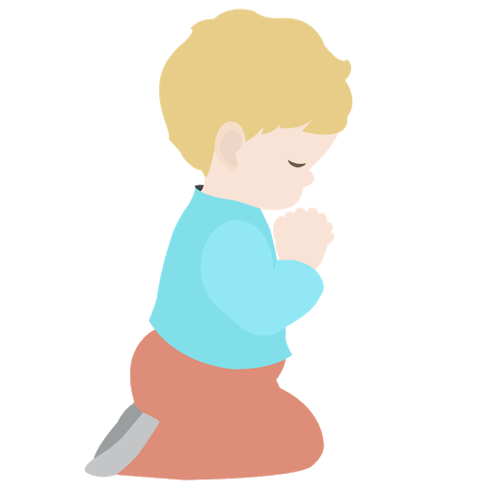
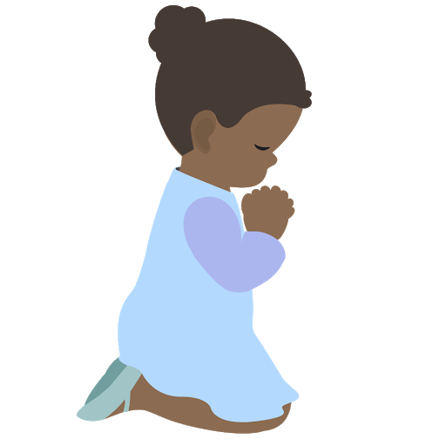
⭐️
⭐️
Prayer Stars⭐
Cassedy | ⭐️⭐️⭐️⭐️
Milan | ⭐️⭐️⭐️⭐️⭐️
Devin | ⭐️⭐️⭐️⭐️⭐️⭐️⭐️
Kim | ⭐️⭐️⭐️
Cora | ⭐️⭐️⭐️⭐️
Hudson | ⭐️⭐️⭐️⭐️⭐️
Dev | ⭐️
⭐️
⭐️
Notes:
Explain reward for saying prayers in the morning. Ask if Manny and Camila would like there names added.

Slide 3
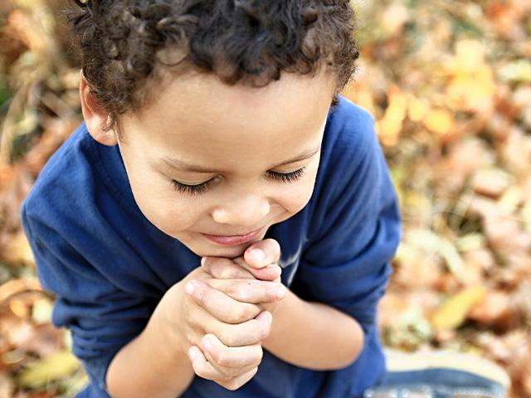
https://www.youtube.com/watch?v=NJ-VfqK1fS4
Opening
Prayers
Notes:
Devin is going to read “My home is the home of peace” that he prepared for last week but didn’t have a chance to say.
Ask if Manny and Camilla if they would like to say a prayer
Unite the hearts of Thy servants https://www.youtube.com/watch?v=NJ-VfqK1fS4

Slide 4
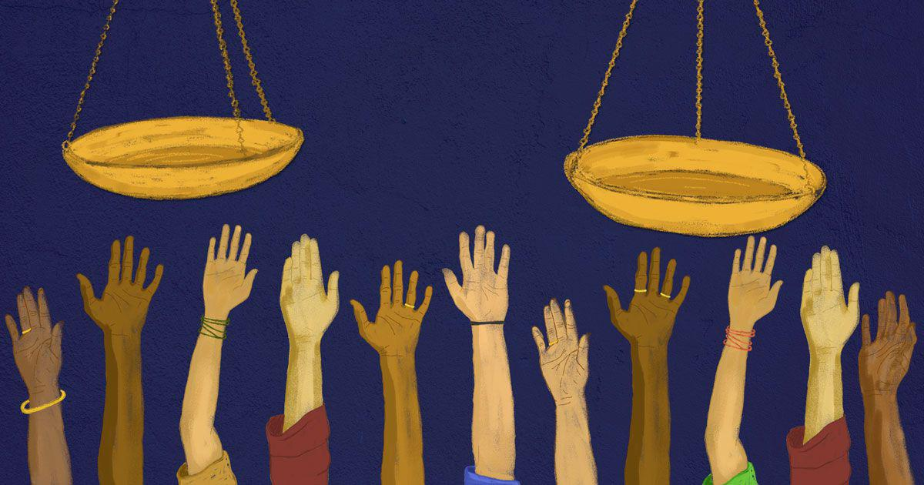
Importance
of Justice
Notes:
Last week we learned about how Unity is so Important. This week we are going to learn about the Importance of Justice.

Slide 5
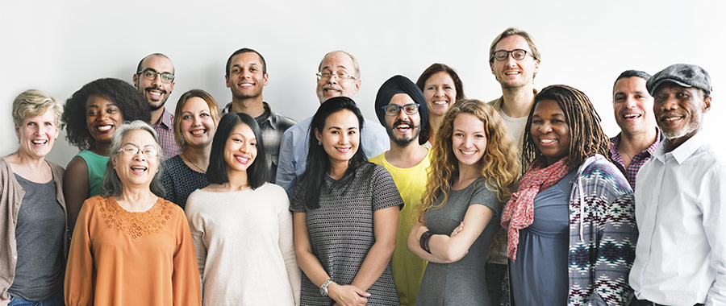
The purpose of justice is the appearance of unity among men. – Baha’u’llah
Notes:
Read quote. We must have justice first in order to have unity. If some people feel they are being treated unfairly they are going to feel angry and hopeless. So which do we have to have first justice or unity? Right. Justice is one of those building blocks that unity can balance on.

Slide 6
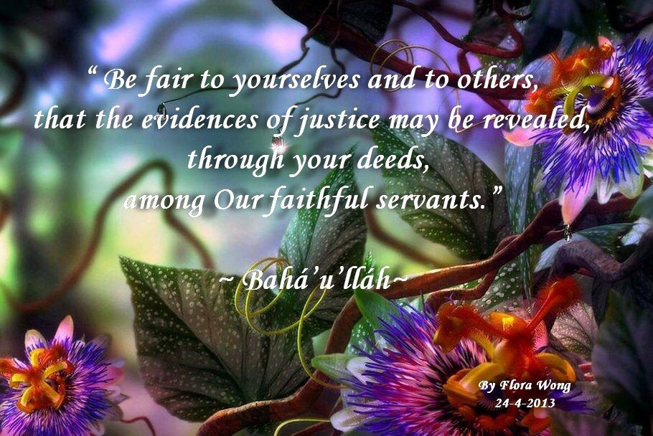
Notes:
Isn’t this beautiful! Who would like to read this quote by Baha’u’llah? Baha’u’llah is telling us words are not enough. We must learn how to put justice and all the other virtues we have learned about into action. Let’s see how we can do that.

Slide 7
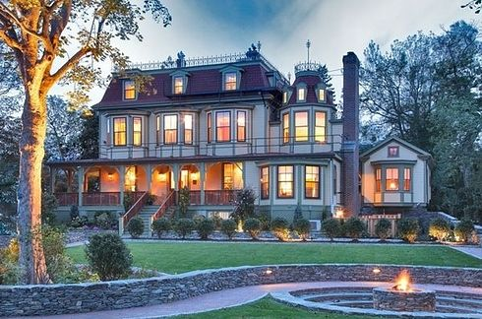

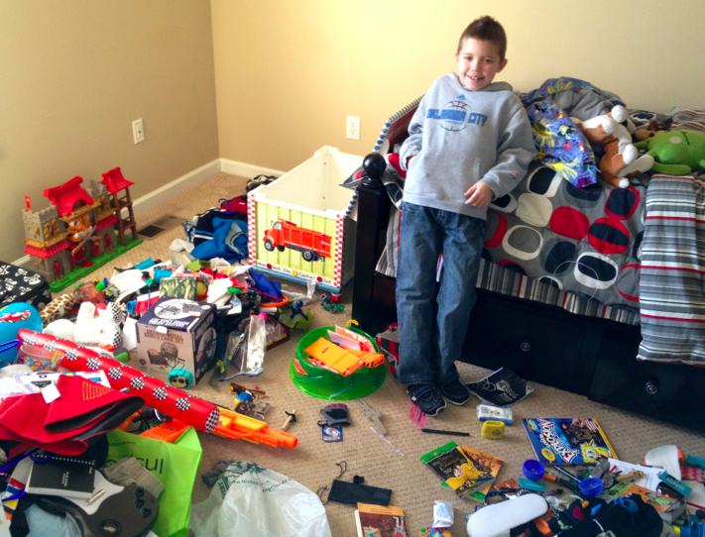

Notes:
Let’s pretend money is like blood. Instead of the red blood cells traveling down the highways, it’s $$ flowing through communities. In San Diego and around the world there are extremely rich people and extremely poor people. What do you think happens if one part of the body gets too much blood? Congestion happens and leads to blood clots, strokes, and heart attacks. People who live in poverty don’t live as long bec it costs too much to go to doctors and they can’t afford healthy food. So our entire society is weaker as a result.

Slide 8
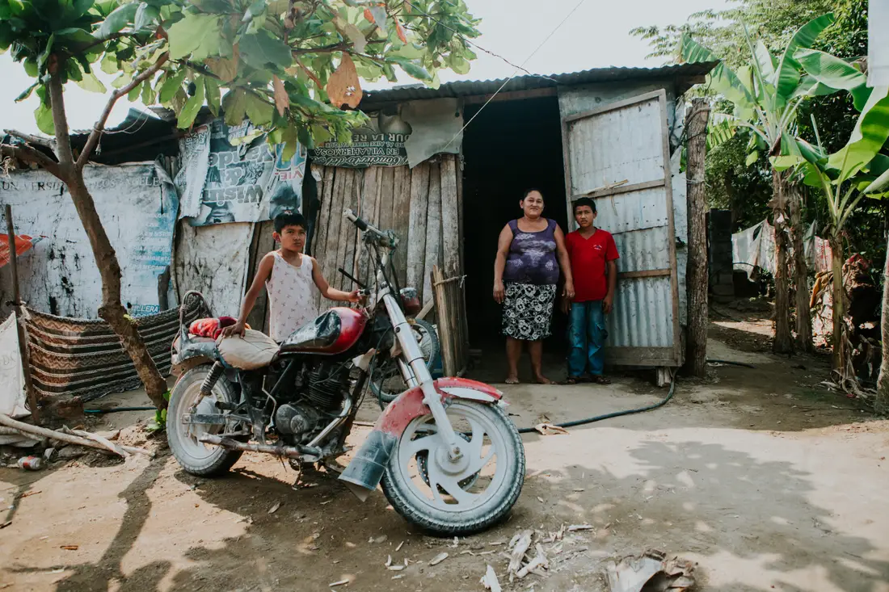
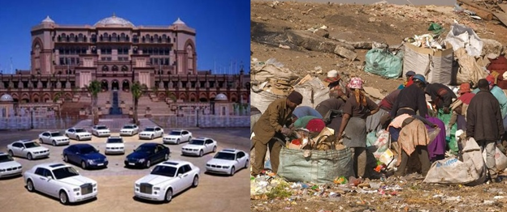
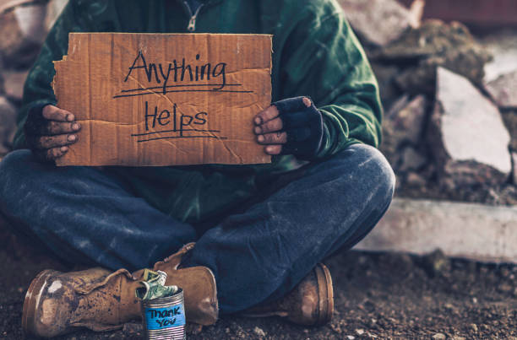
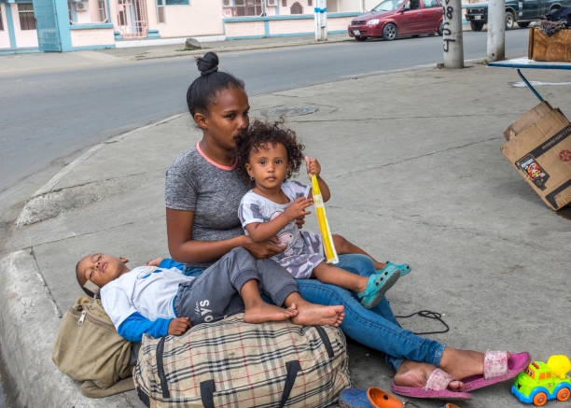
Notes:
We’ve seen what extreme wealth looks like. What happens when there is too little money flowing through parts of the world? Let’s go back to the example of what happens when parts of the body don’t receive enough blood. The body becomes anemic, it becomes weak, it doesn’t grow strong or develop like it should, the heart can become enlarged bec it has to pump so much harder. Baha’u’llah tells us, “It is important to limit riches, as it is also of importance to limit poverty. Either extreme is not good.” He is telling us, if money flows freely through society then everyone is healthier and everyone’s needs are being met. Some people may have less money, some more but that is ok.

Slide 9
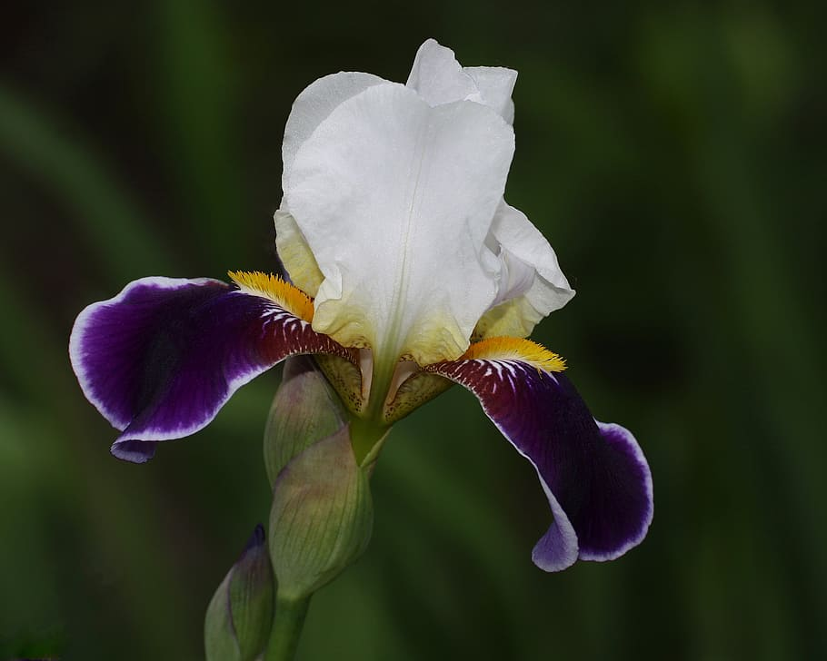
O Ye Rich Ones On Earth!
The poor in your midst are My trust;
guard ye My trust, and be not intent
only on your own ease.
Baha’u’llah
Notes:
Raise your hand if you would like to read how Baha’u’llah tells us we should treat poor people.

Slide 10
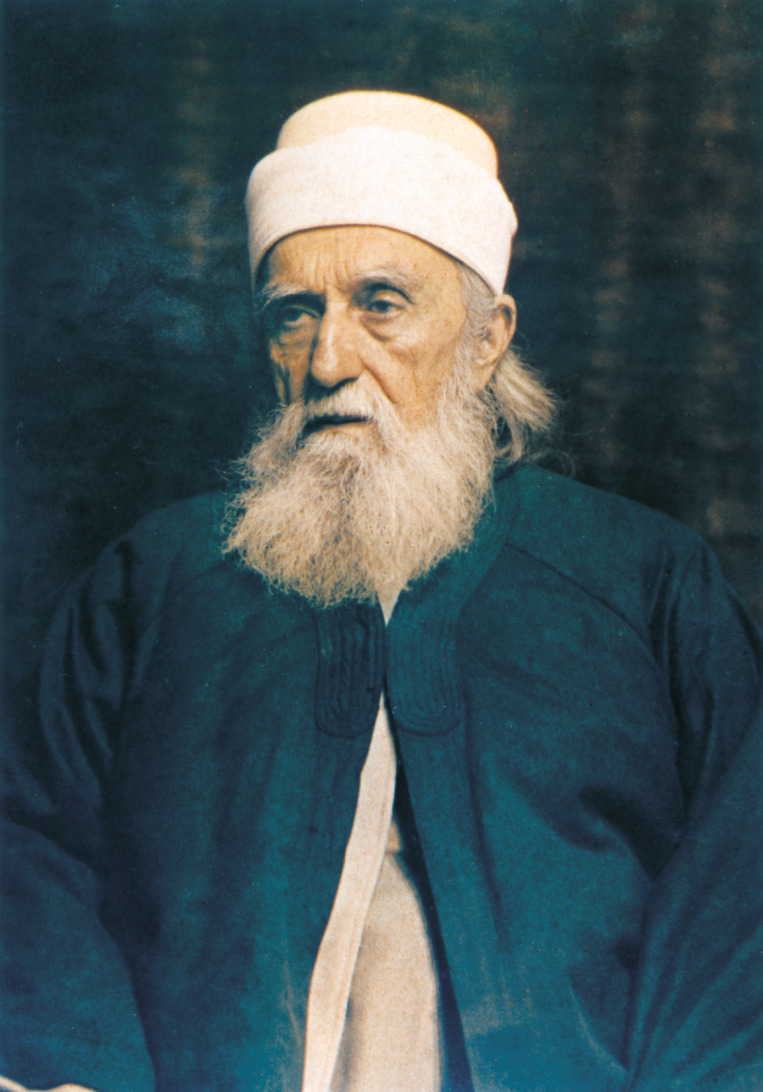
“...the rich should extend assistance to the poor, they should expend their substance for the poor, but of their own free will, and not because the poor have gained this end by force.”
Abdu’l-Baha
Notes:
Remember how ‘Abdu’l-Baha always kept coins in His pocket to give to the poor? He was a great example. This is what He tells us we should do for the poor. Ask Cora and Kim to read this together..

Slide 11

O ye rich ones of the earth!
Flee not from the face of the
poor that lieth in the dust, nay
rather befriend him and suffer
him to recount the tale of the
woes with which God's
inscrutable Decree hath caused
him to be afflicted. By the
righteousness of God! Whilst ye
consort with him, the Concourse
on high will be looking upon you,
will be interceding for you, will be
extolling your names and
glorifying your action.
Notes:
Noura:This quote by Bahaullah tells us about how we should never turn away from helping someone who is poor or without shelter, and instead to listen to what they have been through-- ask them to tell you about their life. When you do that, your actions will be pleasing to God. Plus He will assist you to know how to help them. Diedre For example do you remember when Ms Noura told us about going to a church that was helping feed people who were hungry and she learned one man slept near a train track. The noise of the train made it hard for him to sleep. So what did she do to help him? Remember she gave him a set of headphones to block out the noise so he could sleep better. This is an ex of how God helps us know what people need if we just talk with them.

Slide 12

https://www.youtube.com/watch?v=kiRpnDeAOlI
Movement Activity

Slide 13
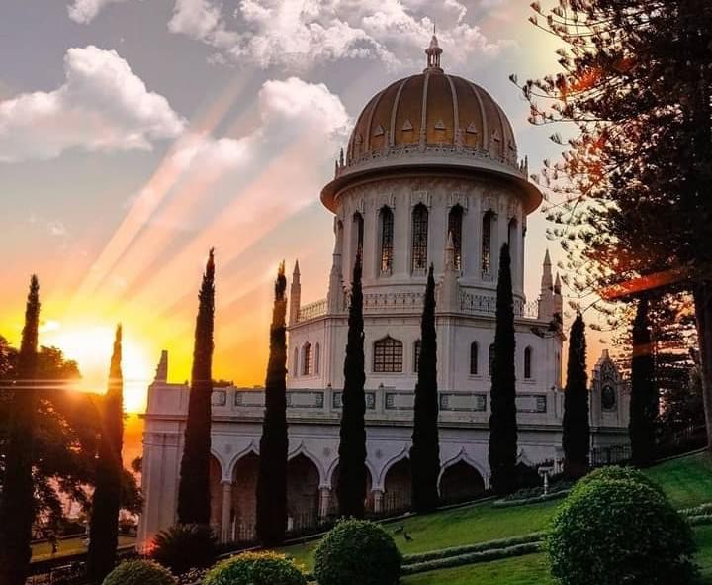
Happpy
Naw-Ruz
Notes:
This coming week Baha’is all around the world will celebrate the Baha’i New Year. Remember how we learned that each Manifestation bring a new calendar. The Baha’i New Year occurs each year on the first day of spring.
(This is a photo of the shrine of the Bab in the Holy Land)

Slide 14
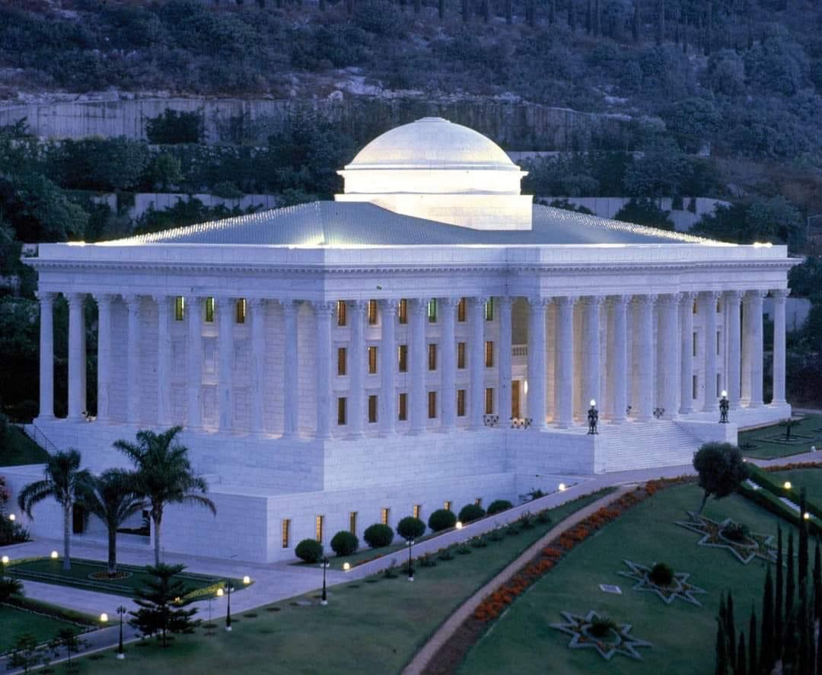
Notes:
This is the Universal House of Justice. It already exists in the Holy Land and it is working to bring Justice to everyone in the world.

Slide 15
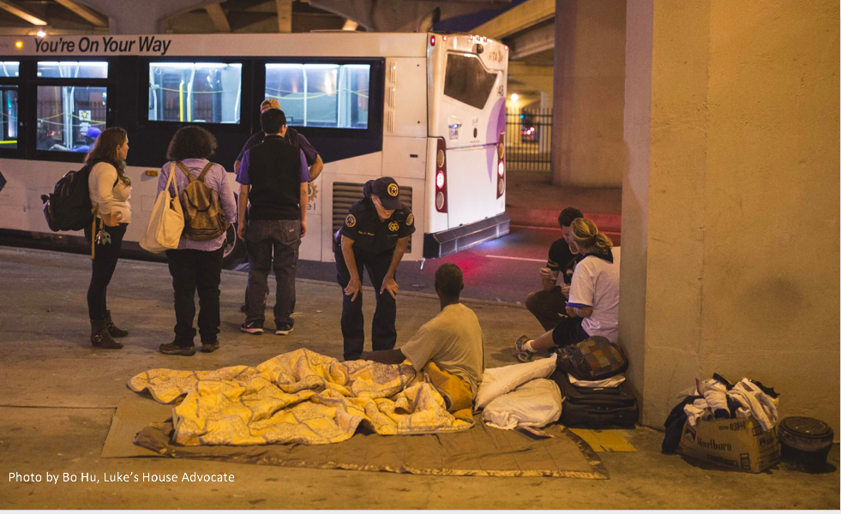
Notes:
Can anyone guess how many unsheltered (or homeless) people there are in San Diego (8,102)? This police officer is trying to help these people get health care.

Slide 16

Notes:
Story by Ms Noura. People without shelter need lots of help. Ms Noura is going to tell us how she found a way to feed the homeless. (Please go into how long food kitchen closed, how you went to facility with a plan, describe…)
Diedre: Isn’t this exactly what Baha’u’llah told us we should be doing?
Noura share plan how children can help. Ask children if they want to do this?
(list of things they can purchase and we can pick it up)

Slide 17

Closing Prayers
Notes:
Plus next slide

Slide 18
He is God!
O Thou kind Lord! We are poor children, needy and insignificant, yet we are plants which have sprouted by Thy heavenly stream and saplings bursting into bloom in Thy divine springtime. Make us fresh and verdant by the outpourings of the clouds of Thy mercy; help us to grow and develop through the rays of the sun of Thy goodly gifts and cause us to be refreshed by the quickening breeze wafting from the meadows of Truth. Grant that we may become flourishing trees laden with fruit in the orchard of knowledge, brilliant stars shining above the horizon of eternal happiness and radiant lamps shedding light upon the assemblage of mankind.
O Lord! Should Thy tender care be vouchsafed unto us, each one of us would, even as an eagle, soar to the pinnacle of knowledge, but were we left to ourselves we would be consumed away and would fall into loss and frustration. Whatever we are, from Thee do we proceed and before Thy threshold do we seek refuge.
Thou art the Bestower, the Bountiful, the All-Loving.
—‘Abdu’l‑Bahá
Hide note
Notes:
Diedre Read

Slide 19


