Slide 1
Welcome!

Slide 2
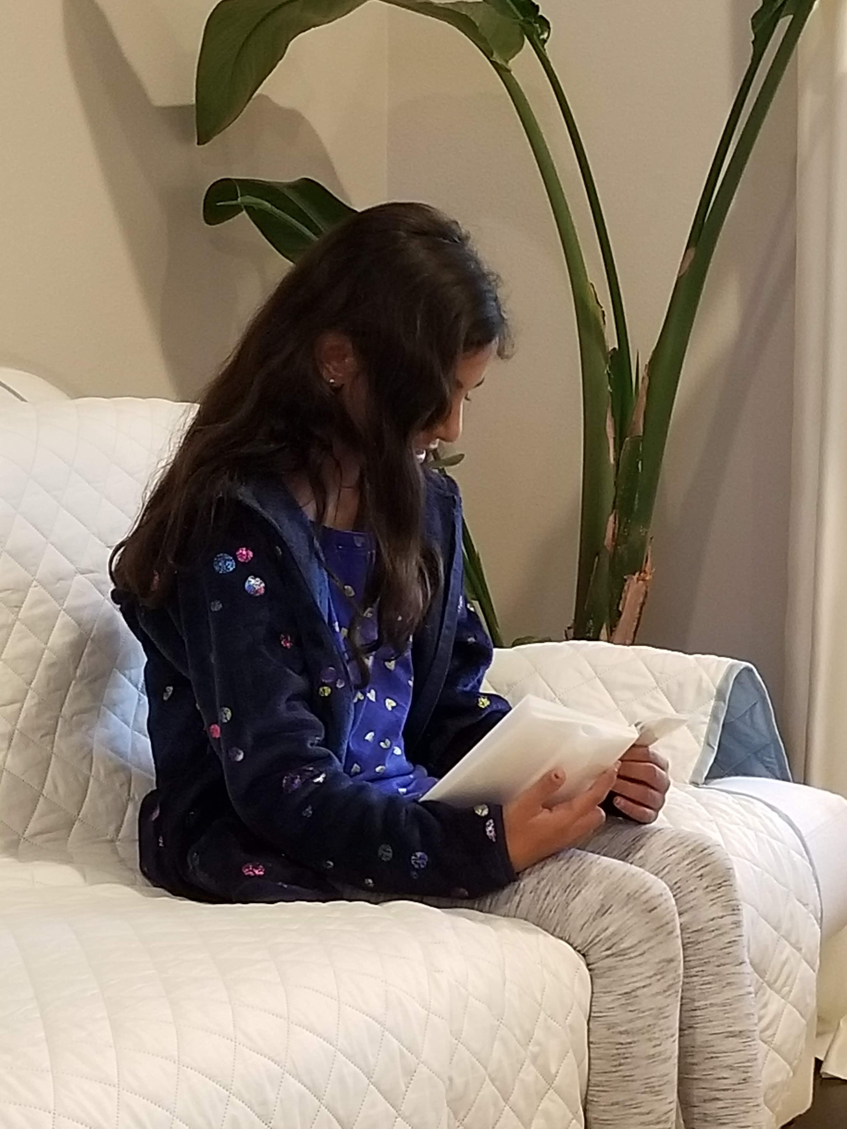
Prayers

Slide 3
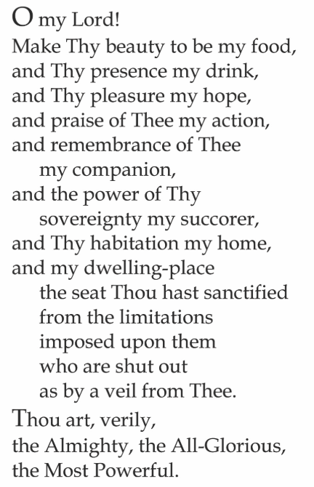

Slide 4
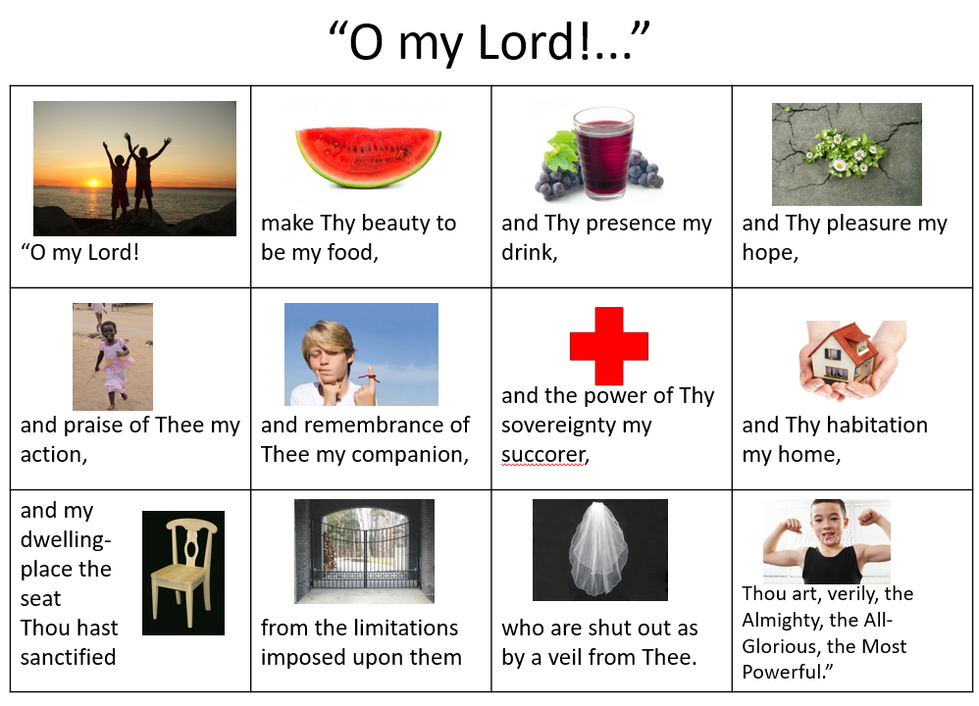

Slide 5

Lesson Theme
Seeking Knowledge
Lesson Today: “Searching After the Truth”

Slide 6

How do we acquire knowledge?

Slide 7
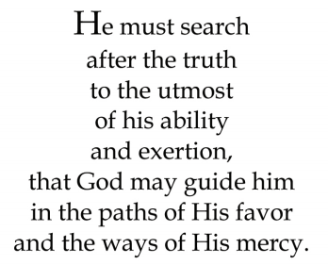
Quote

Slide 8

Story

Slide 9


Slide 10
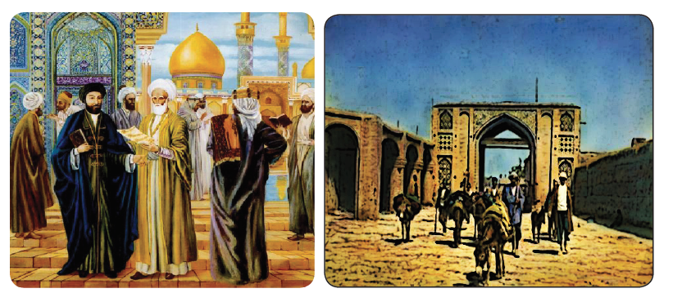

Slide 11
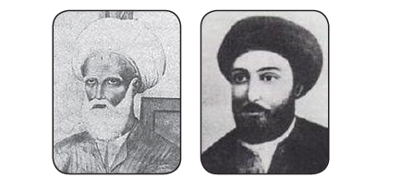

Slide 12
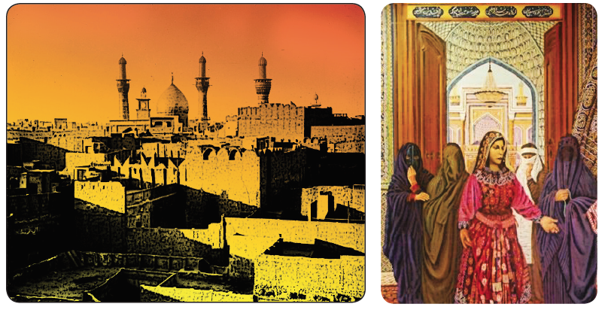

Slide 13
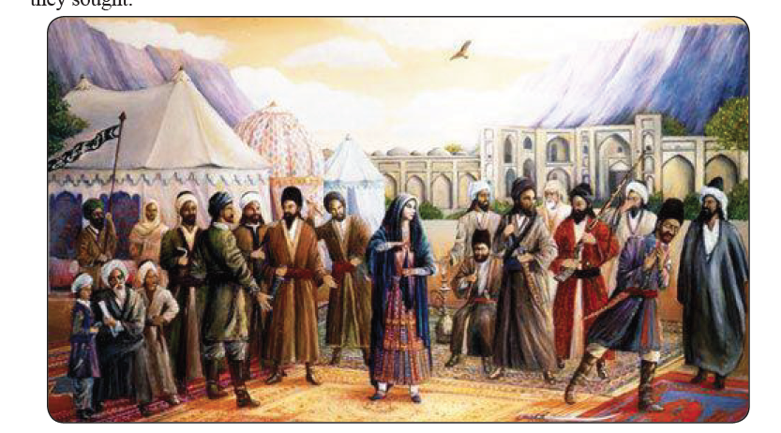

Slide 14
Drama
Today, we are going to use DRAMA and ACT OUT different characters from a story living in the village of Karu Karu.

Slide 15
Drawing
Today in your drawing journals, you can draw a scene or an image that will reinforce the ideas that you have learned in this lesson.

Slide 16
Closing prayer

Slide 17
