Slide 1
Welcome!

Slide 2
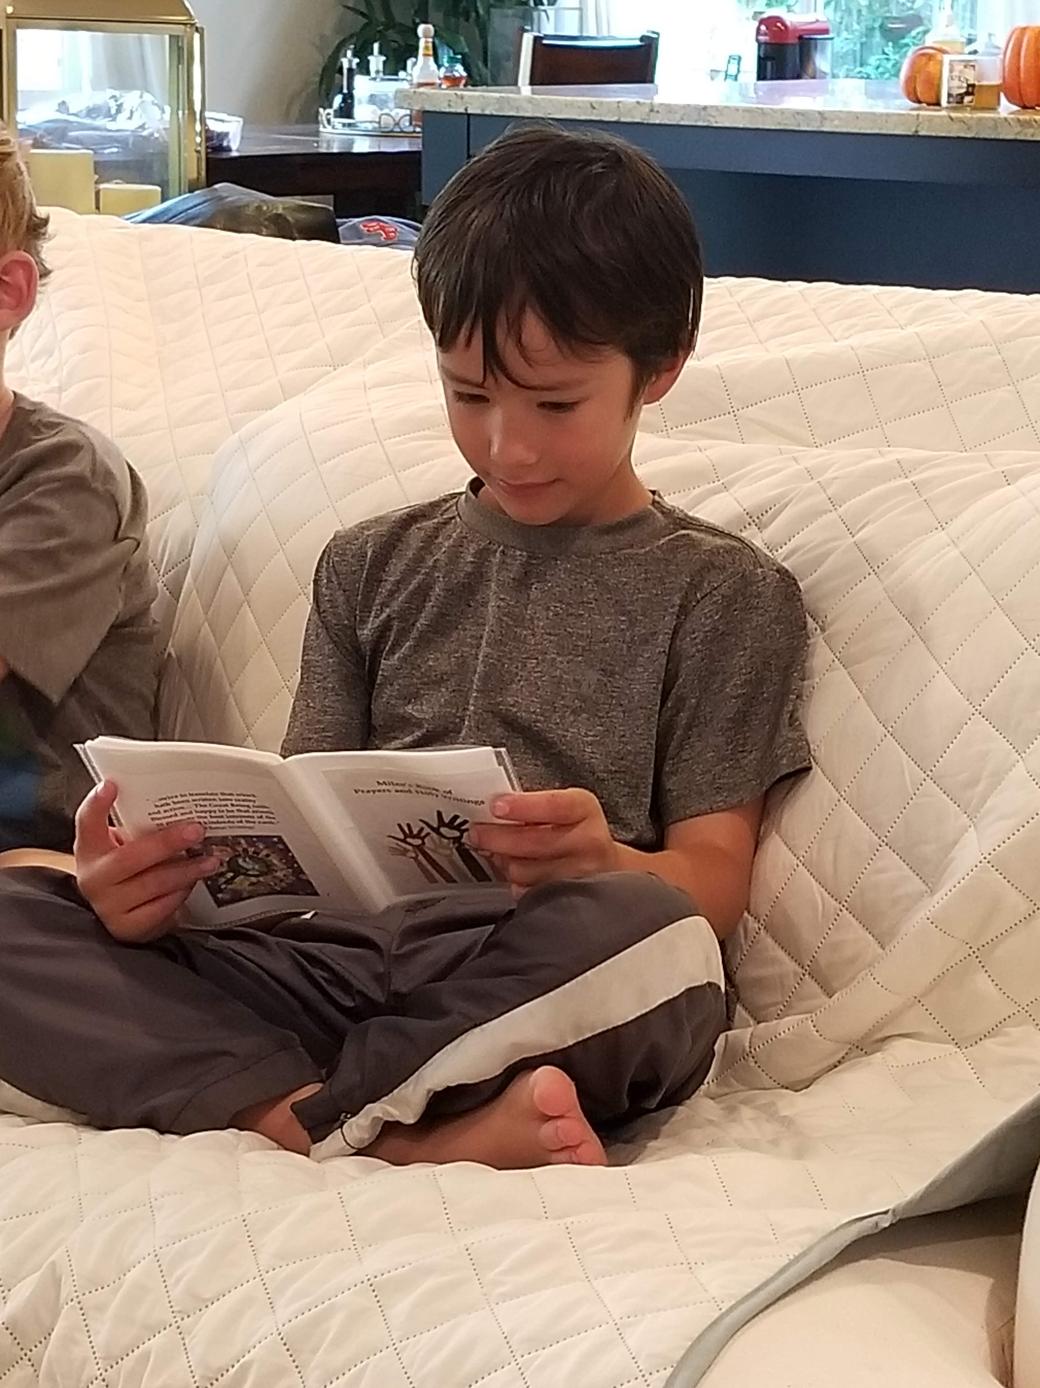
Prayers

Slide 3
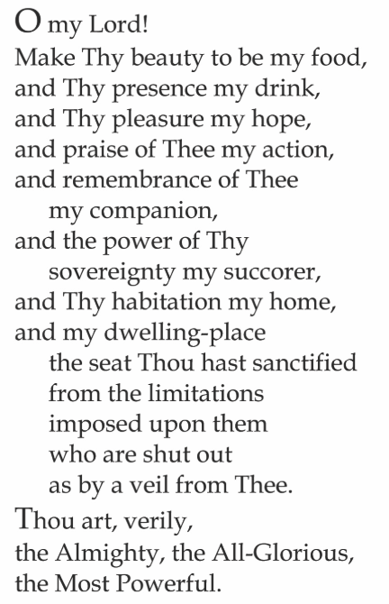

Slide 4
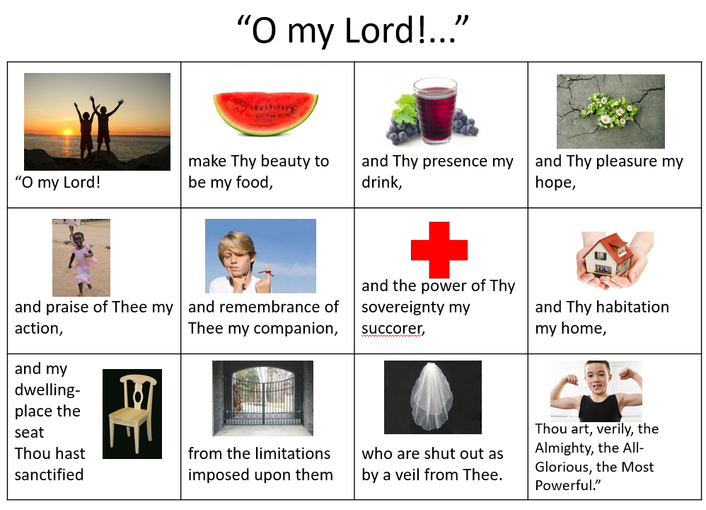

Slide 5
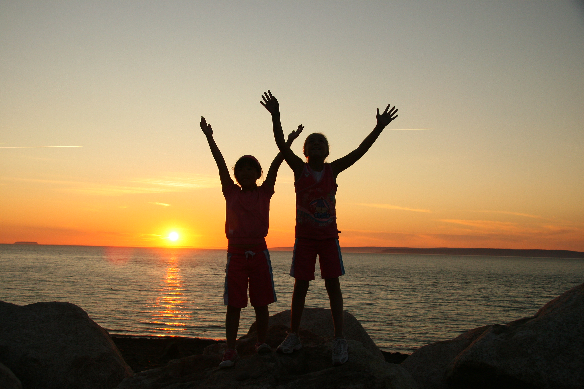
“ O my Lord!

Slide 6
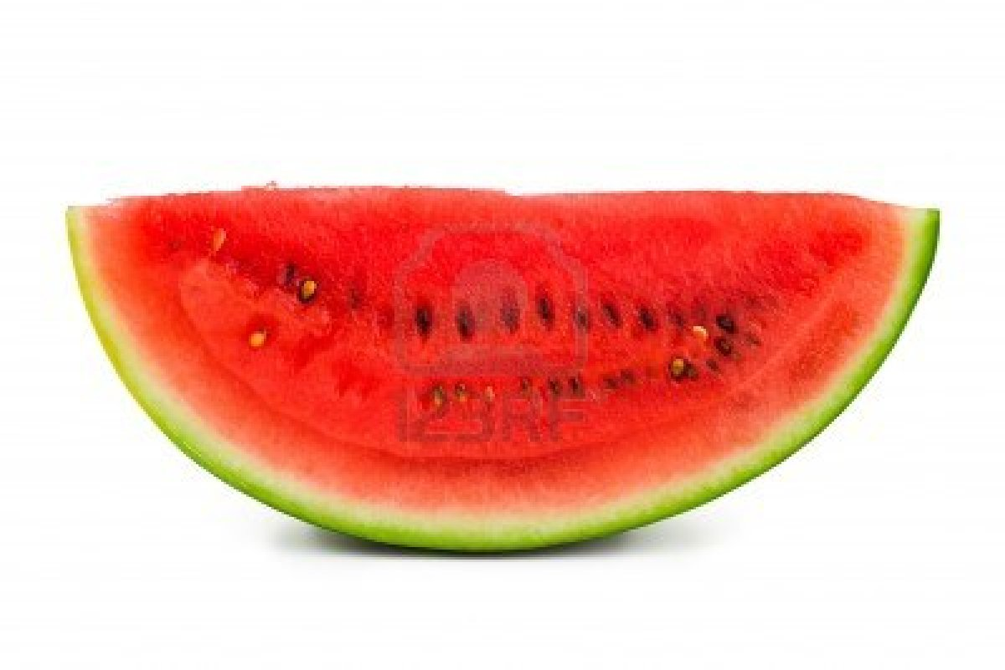
Make Thy beauty to be my food,

Slide 7
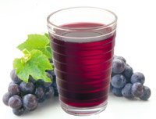
and Thy presence my drink,

Slide 8
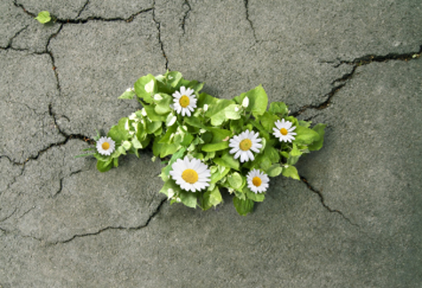
and Thy pleasure my hope,

Slide 9
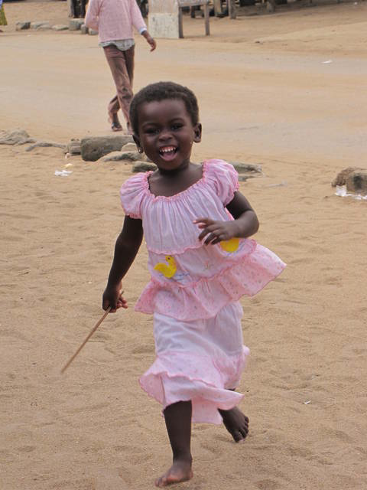
and praise of thee my action,

Slide 10
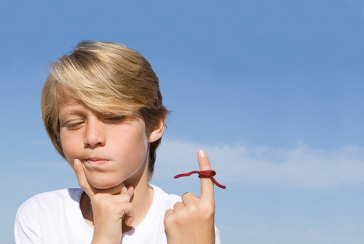
and remembrance of Thee my companion,

Slide 11
and the power of Thy sovereignty my succorer,

Slide 12

and Thy habitation my home,

Slide 13
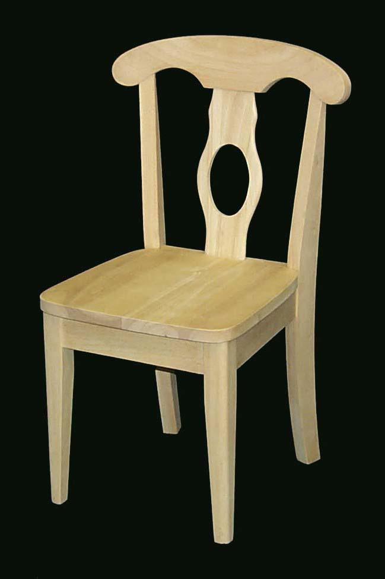
and my dwelling place the seat thou has sanctified,

Slide 14
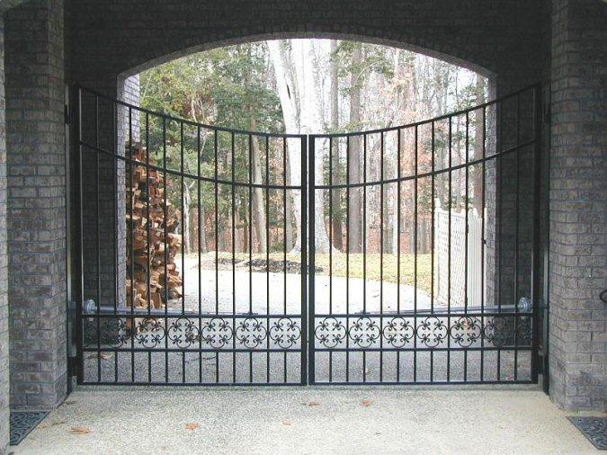
from the limitations imposed on them

Slide 15
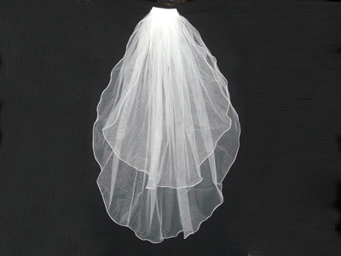
who are shut out as by a veil from Thee.

Slide 16
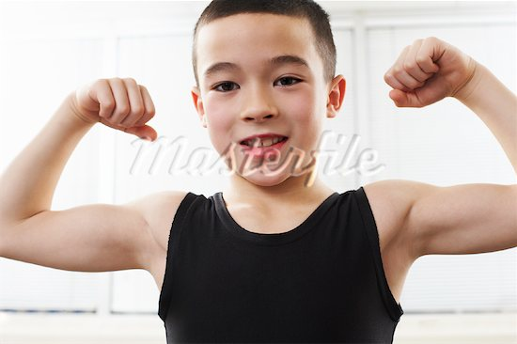
Thou art, verily, the Almighty, the All-Glorious, the Most Powerful.”

Slide 17

Lesson Theme
Seeking Knowledge
Lesson Today: “Knowledge helps us contribute to the betterment of the world”

Slide 18


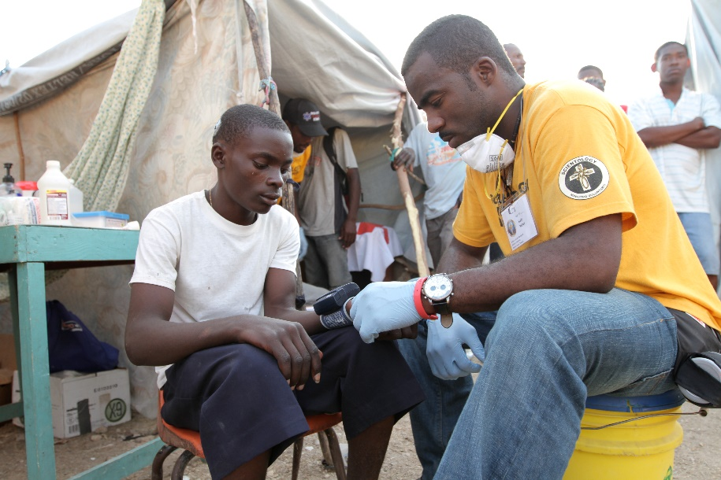
Draw Closer to God

Slide 19
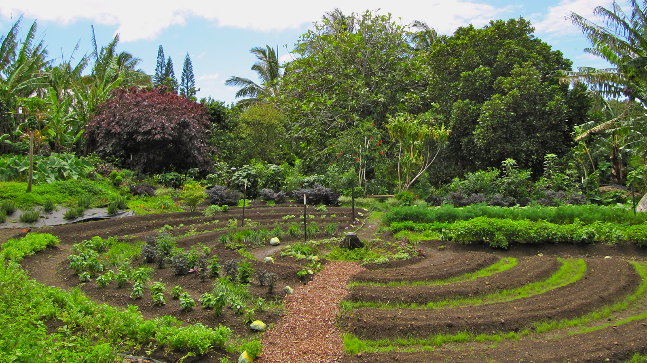

Slide 20
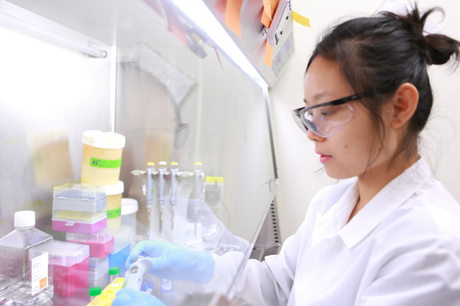

Slide 21


Slide 22
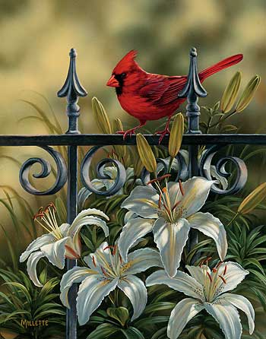

Slide 23
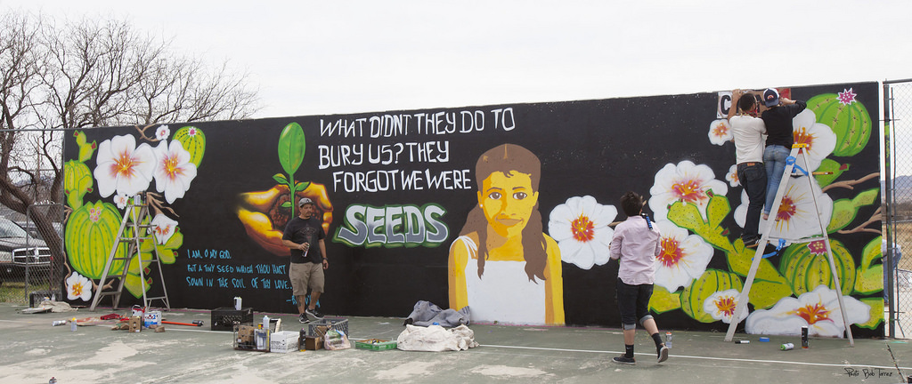

Slide 24
“The happiness and pride of a nation consist in this, that it should shine out like the sun in the high heaven of knowledge…And the honor and distinction of the individual consist in this, that he among all the world’s multitudes should become a source of social good…that by the confirming grace of God he has become the cause of peace and well-being, of happiness and advantage to his fellow men…” (Abdu’l-Baha, The Secret of Divine Civilization)

Slide 25
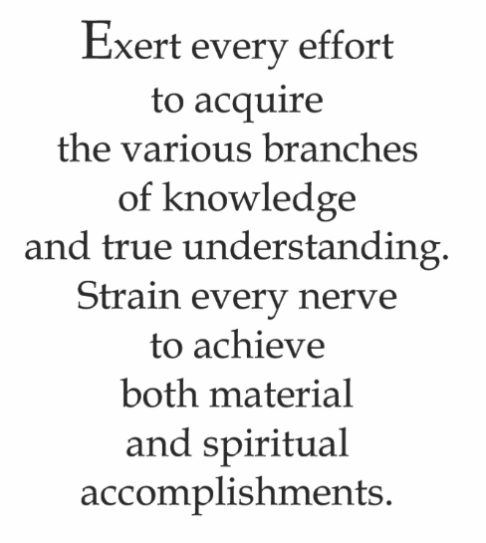
Quote

Slide 26

Song
Praise be unto Thee, O my God, that we have wakened to the splendours of the light of Thy knowledge. X 2
The light of Thy knowledge x 2
Praise be unto Thee, O my God, that we have wakened to the splendours of the light of Thy knowledge.
The light of Thy knowledge x 2
Praise be unto Thee, O my God, that we have wakened to the splendours of the light of Thy knowledge.
The light of Thy knowledge x 2

Slide 27
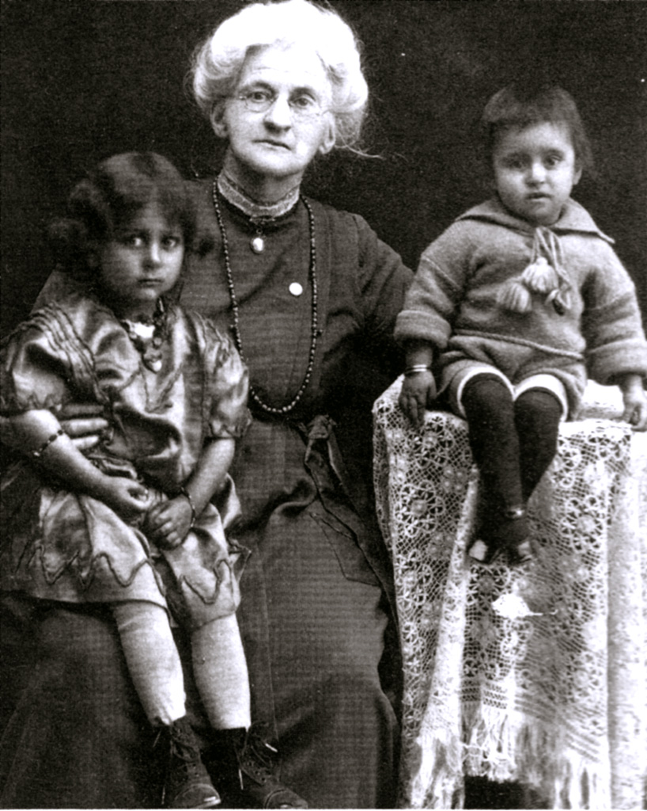
Dr. Susan Moody

Slide 28
Drama
Today, we are going to use DRAMA and ACT OUT different characters from the story you heard about Dr. Susan Moody.

Slide 29
Drawing
Today in your drawing journals, you are going to do a drawing inspired by the story of Susan Moody, such as the hospital or school where Dr. Moody worked, or anything that comes to your heart about the story!

Slide 30
Closing prayer

Slide 31
