Slide 1
Welcome!

Slide 2
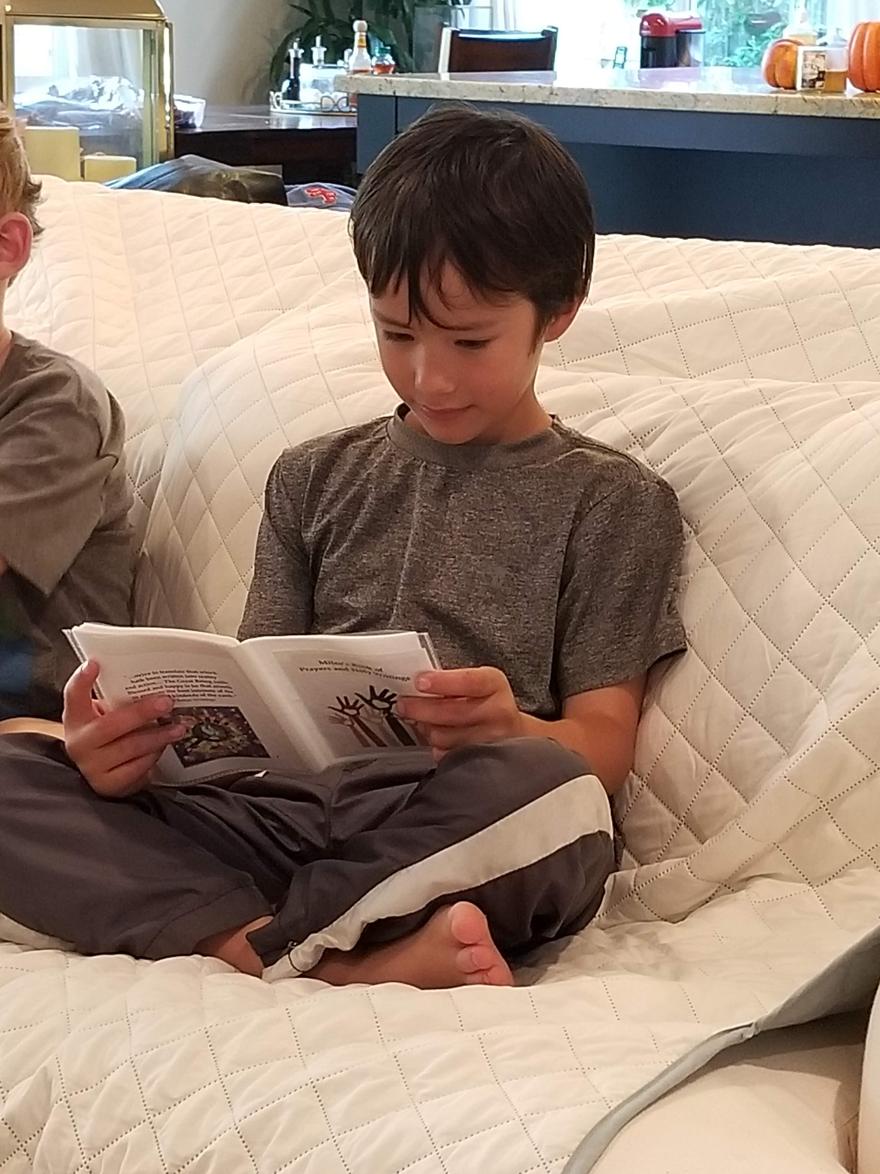
Prayers

Slide 3
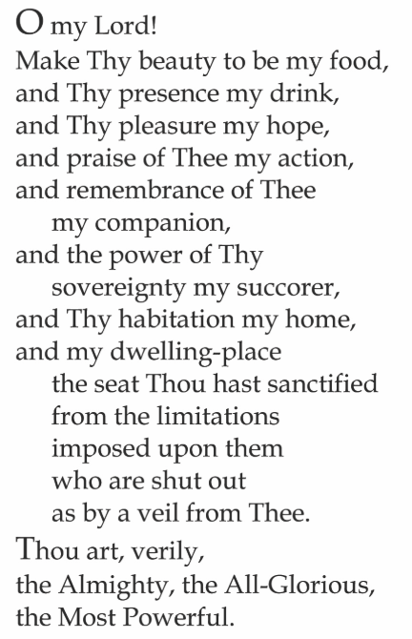

Slide 4

Lesson Theme
Seeking Knowledge
Lesson Today: “Importance of seeking knowledge”

Slide 5


SEEKING KNOWLEDGE OF GOD AND OF HIS CREATION
Knowledge of God Increases
So does our love for God

Slide 6
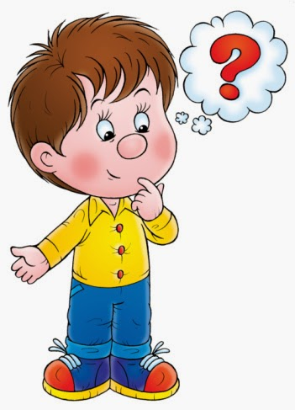
But what does it mean to gain knowledge of God? How do we learn about God?

Slide 7
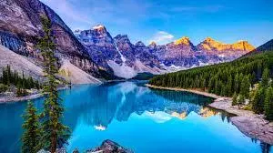
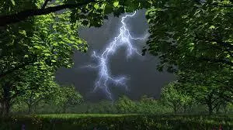
Signs of God

Slide 8
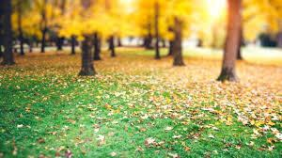
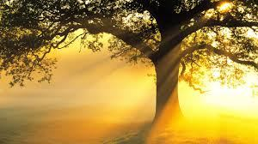
Signs of God

Slide 9
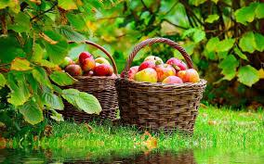
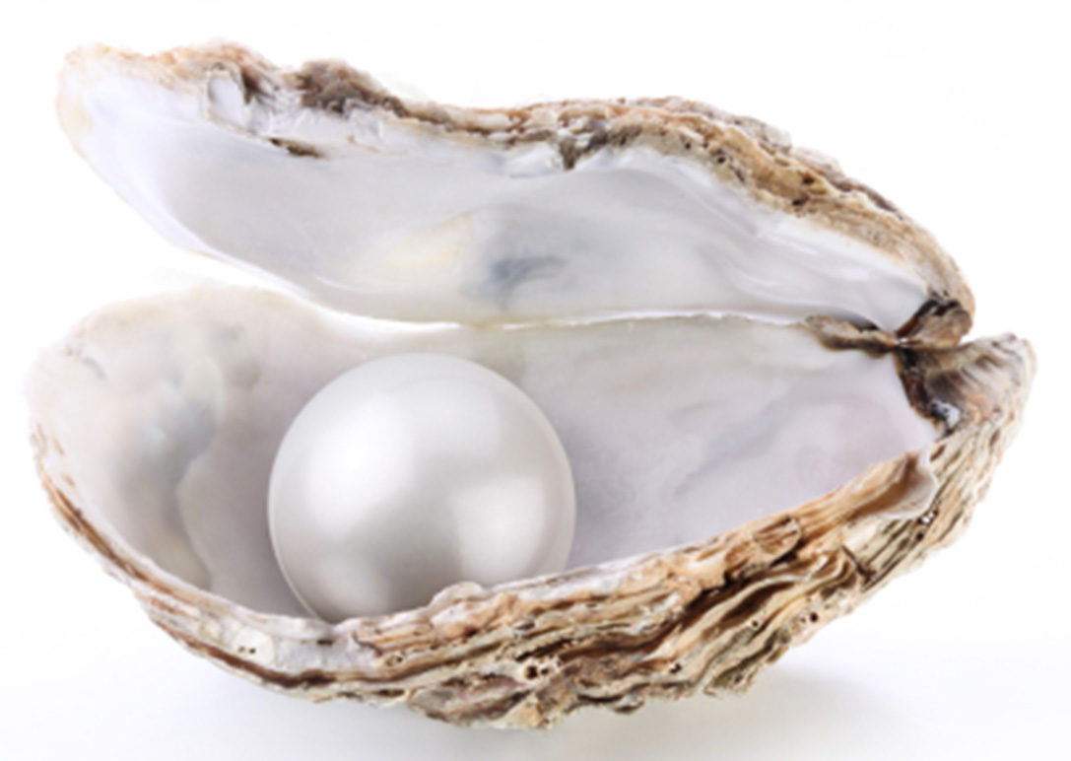
Signs of God

Slide 10
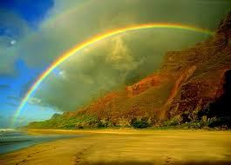
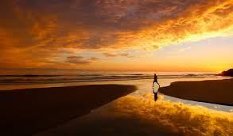
Signs of God

Slide 11
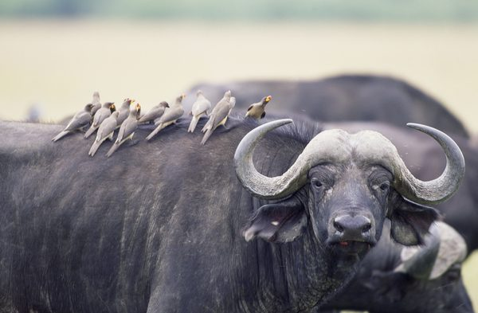
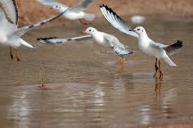
Signs of God

Slide 12
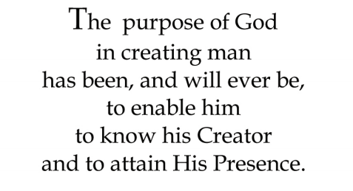
Quote

Slide 13

Song
Man is, in reality, a spiritual being, and only when he lives in the spirit is he truly happy.

Slide 14
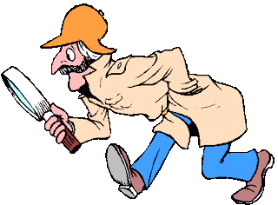
GAME: Investigator

Slide 15
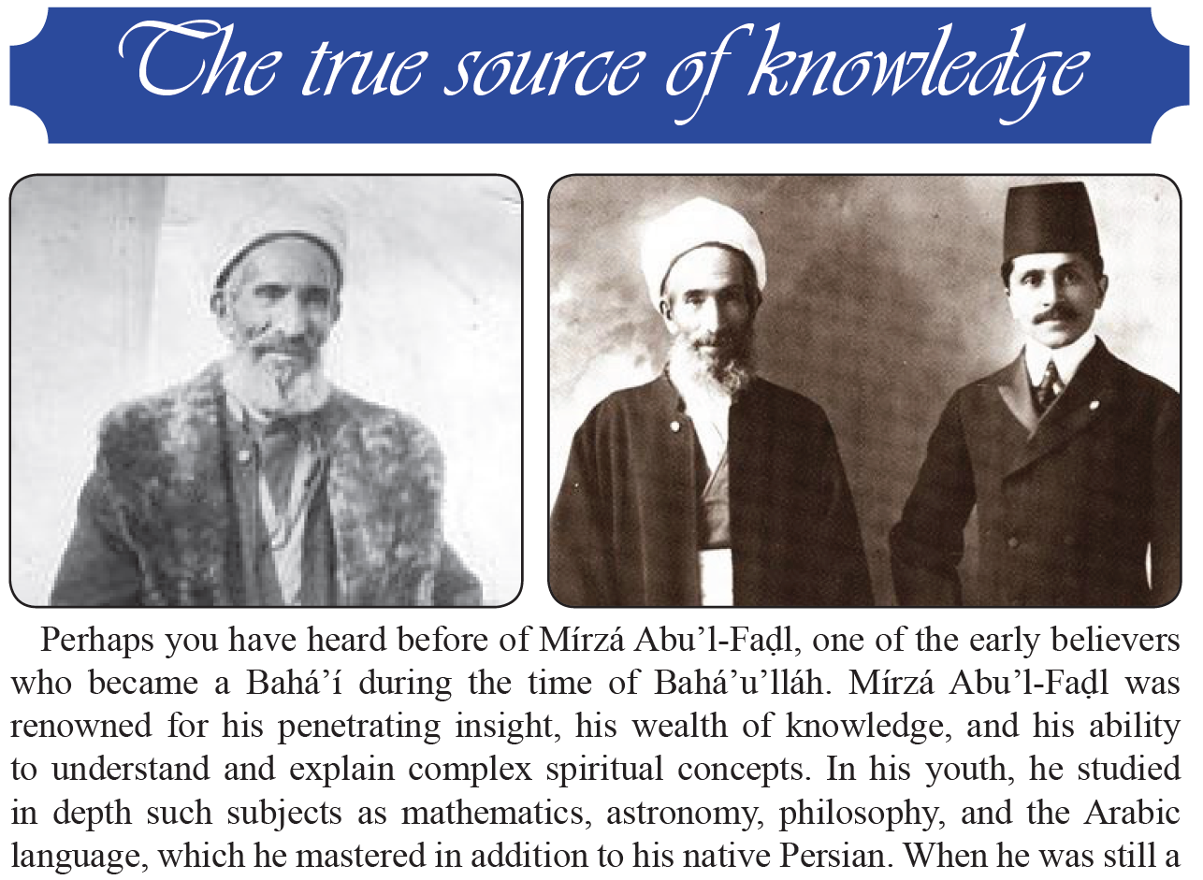

Slide 16
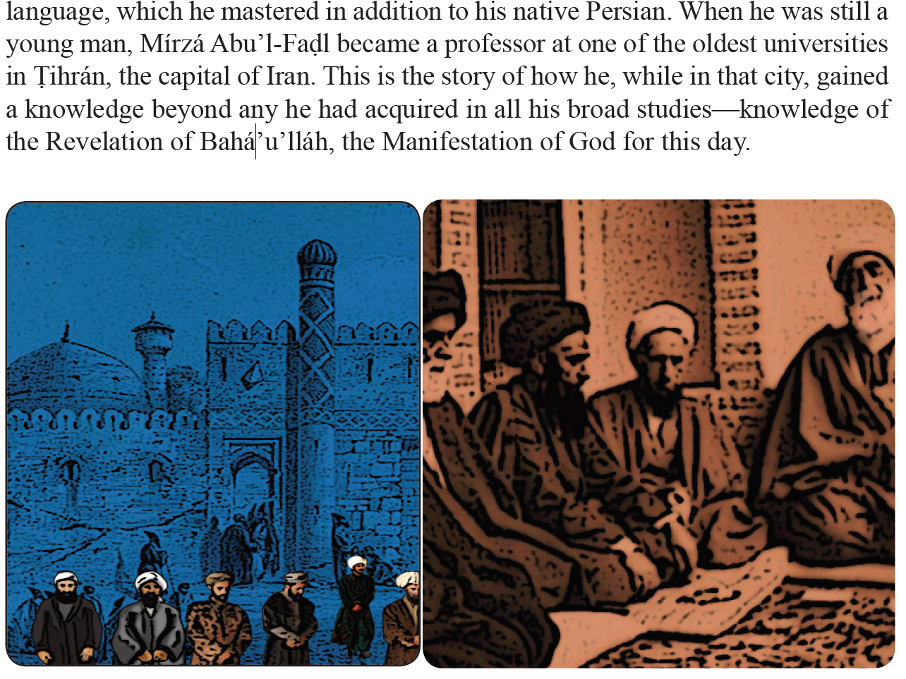

Slide 17
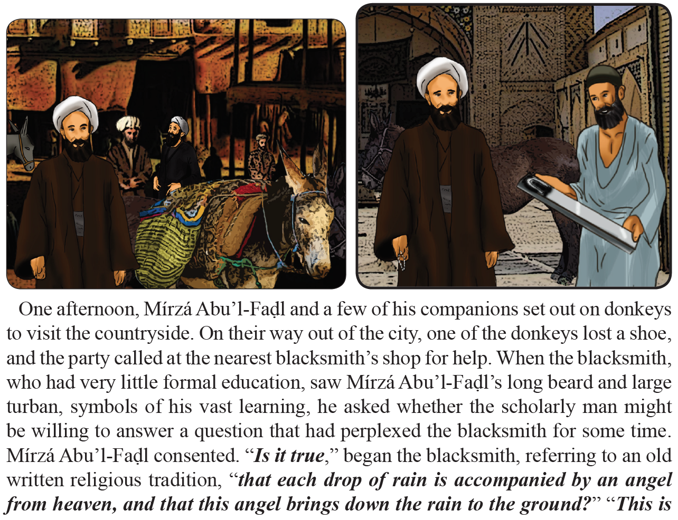

Slide 18
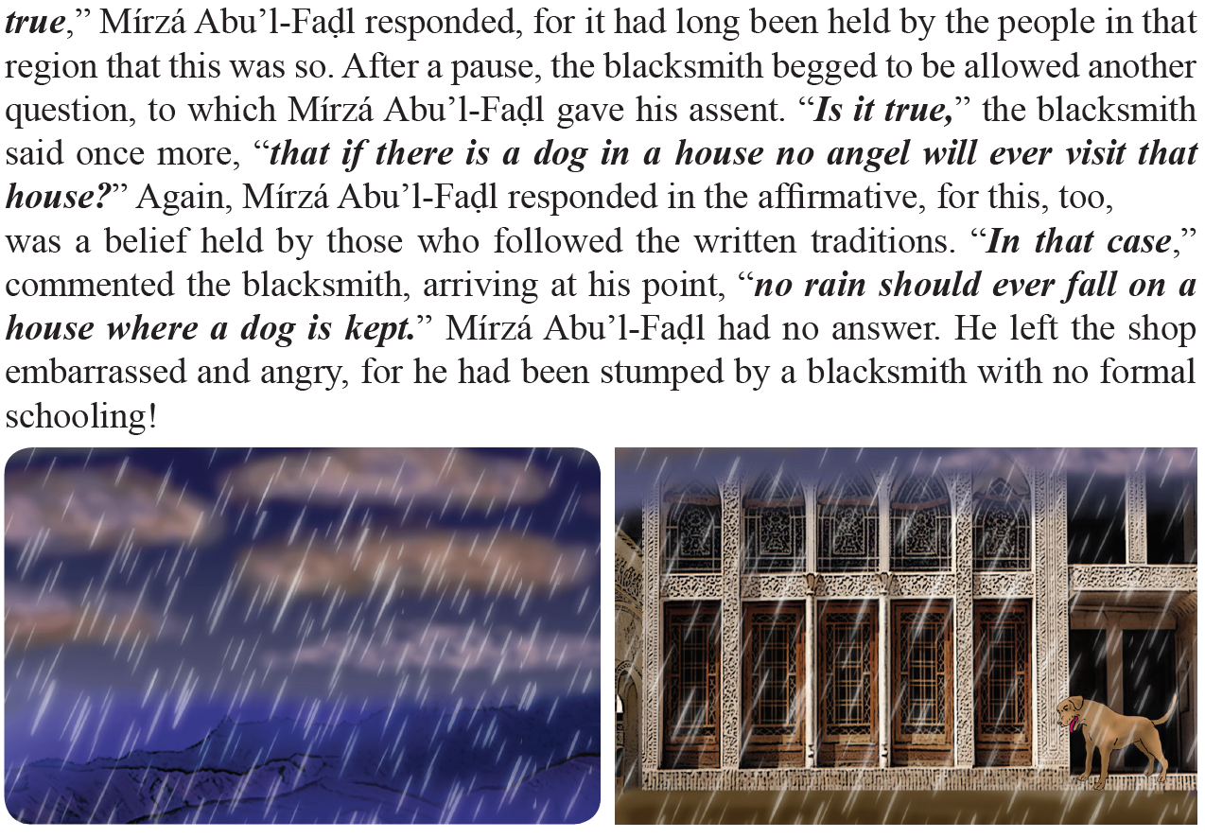

Slide 19
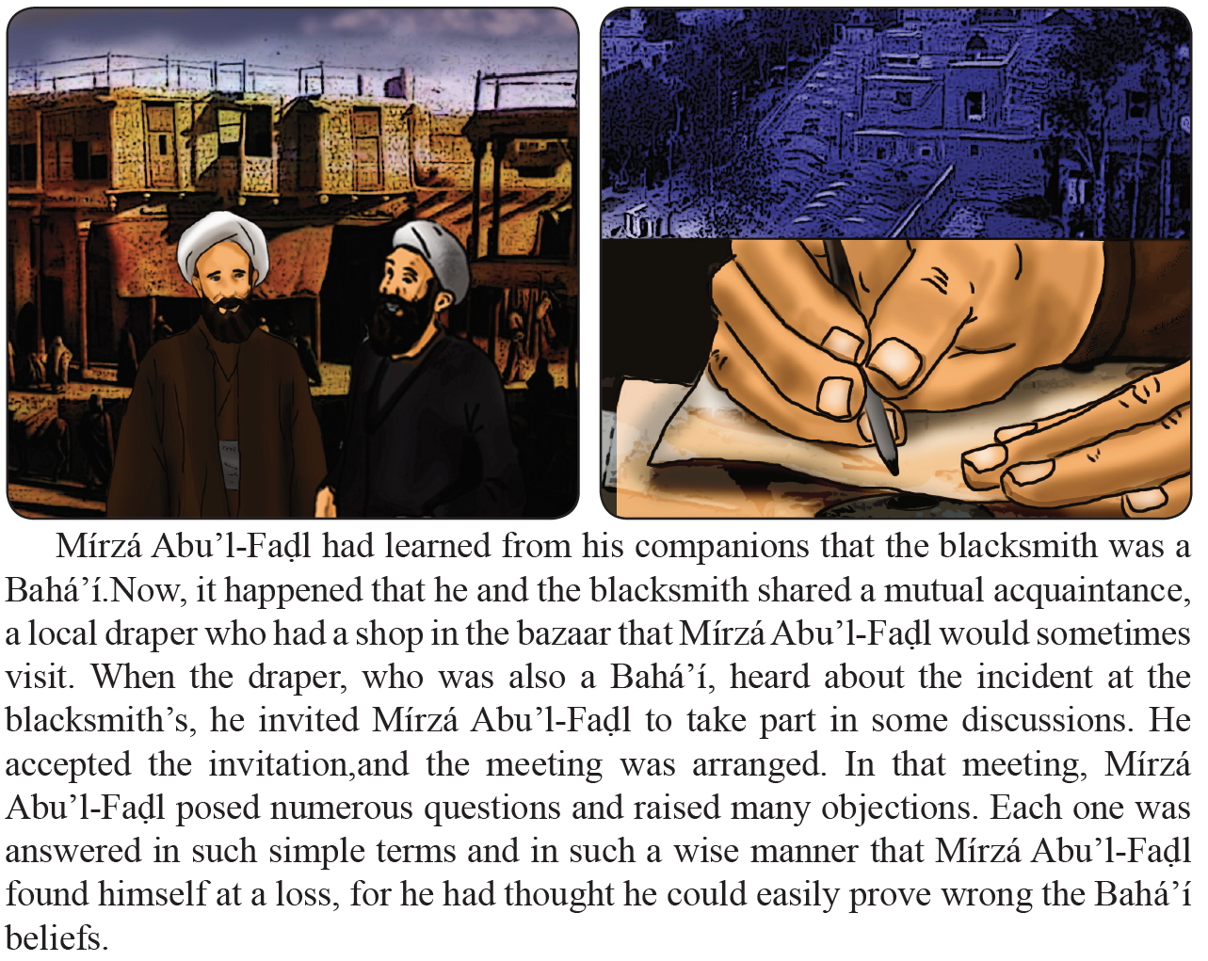

Slide 20
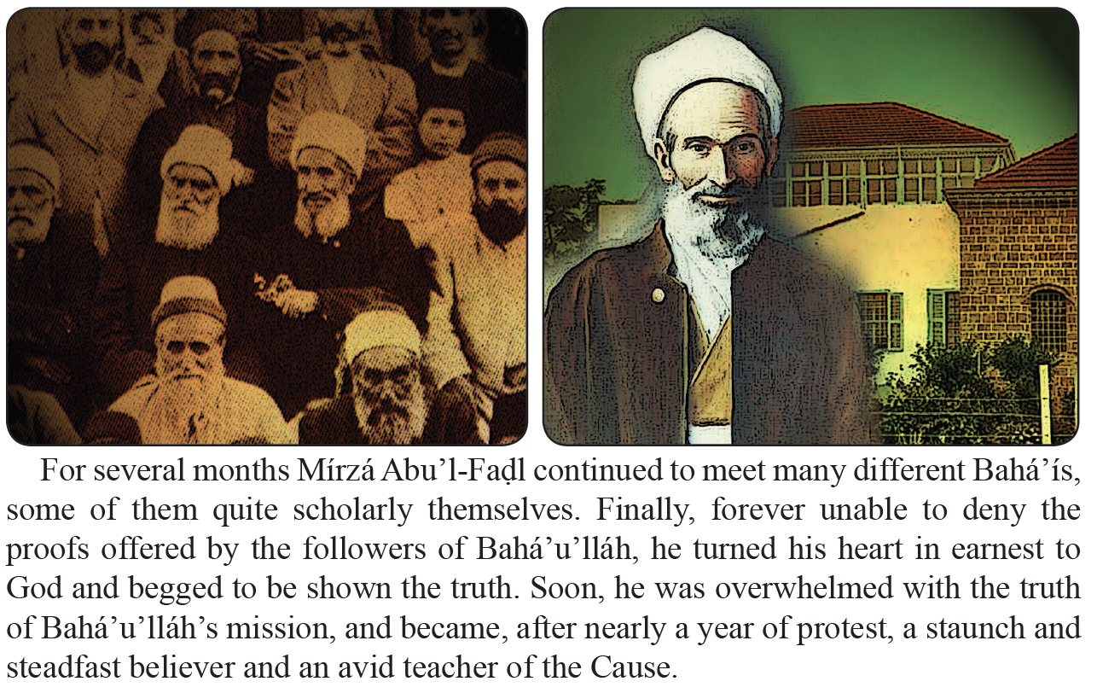

Slide 21
Drama
In all created things, we see the signs of God. I am going to ask you to act out, in turn, different things we see in nature.

Slide 22
Drawing
You can choose to draw some aspect of nature that reminds you of God

Slide 23
Closing prayer

Slide 24
