Slide 1
Welcome!

Slide 2
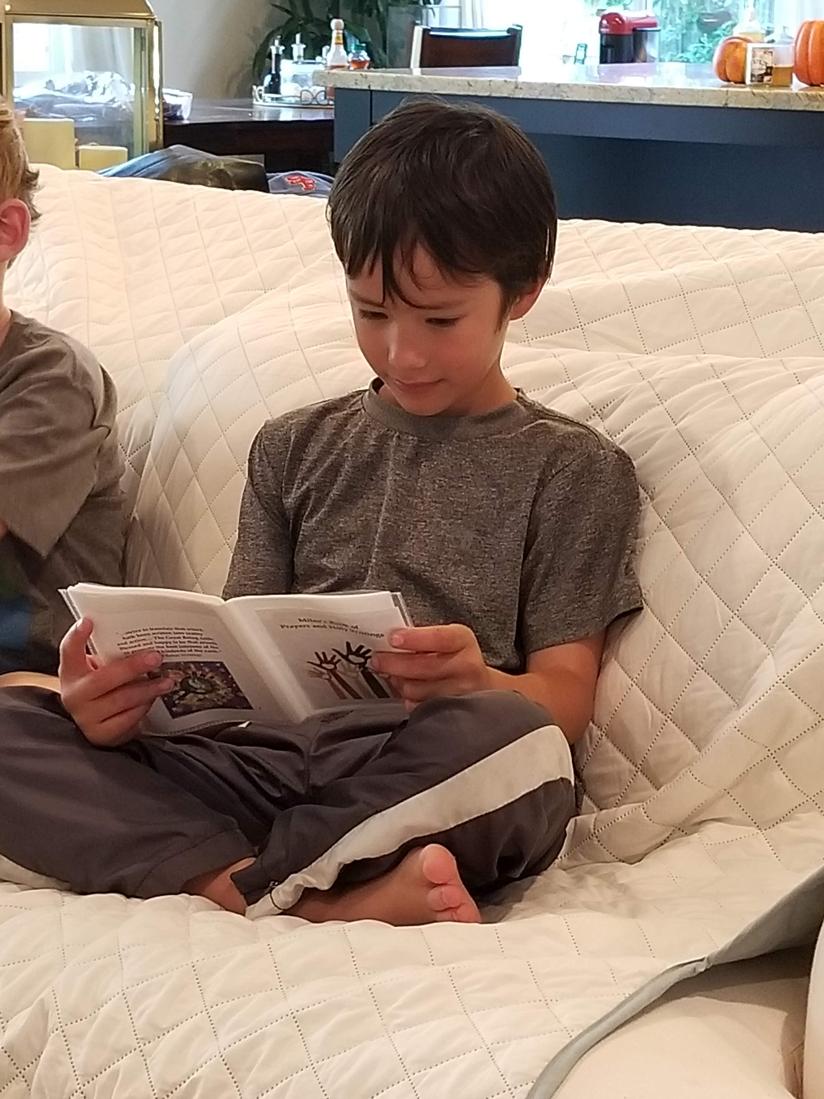
Prayers

Slide 3
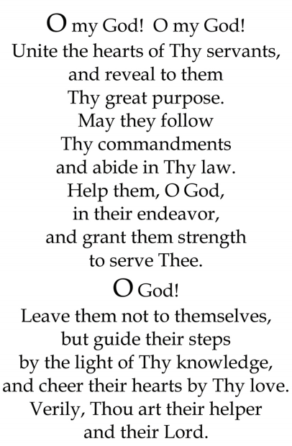
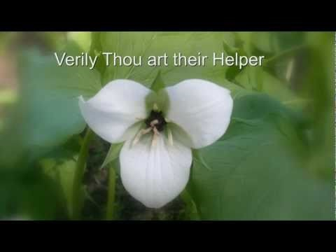

Slide 4

Lesson Theme
Adhering to the Laws of God
Lesson Today: “When We are Faithful to God’s Laws, We Draw Closer to Him ”

Slide 5
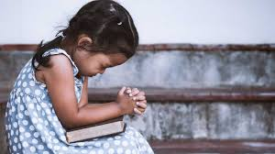
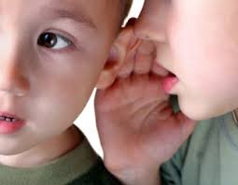
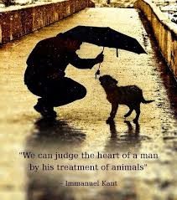
Example of commandments of God

Slide 6

We are encouraged to think each day about what we have done and consider what more we can do so that our actions increasingly come to reflect the teachings of God
what did I do well or feel good about
what did I feel badly about, how will I do it differently tomorrow
what am I looking forward to doing tomorrow

Slide 7


Slide 8
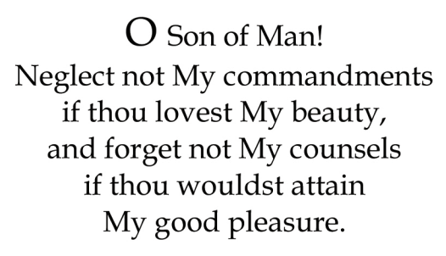

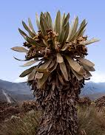


Quote

Slide 9
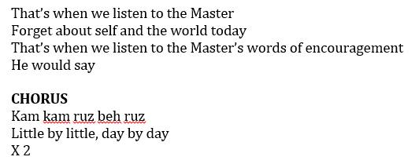
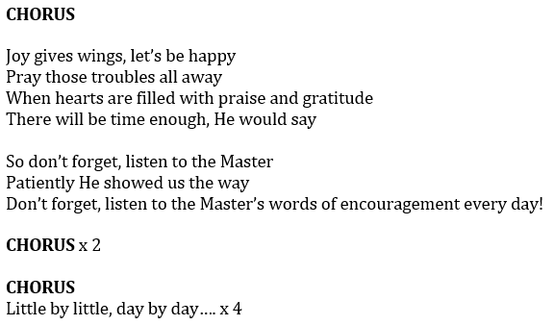
Song

Slide 10
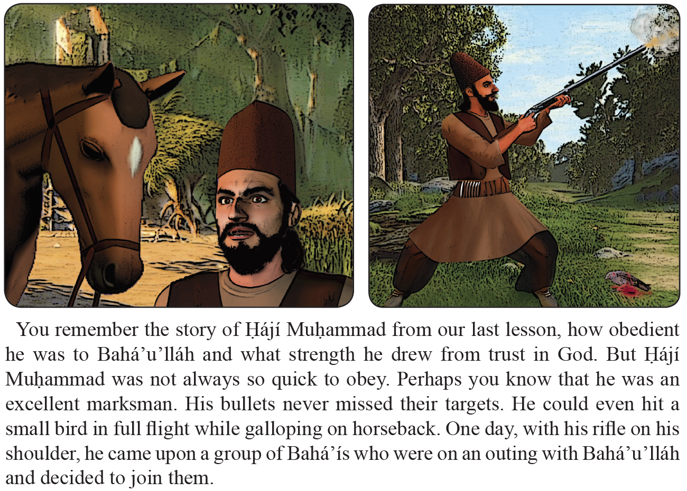

Slide 11
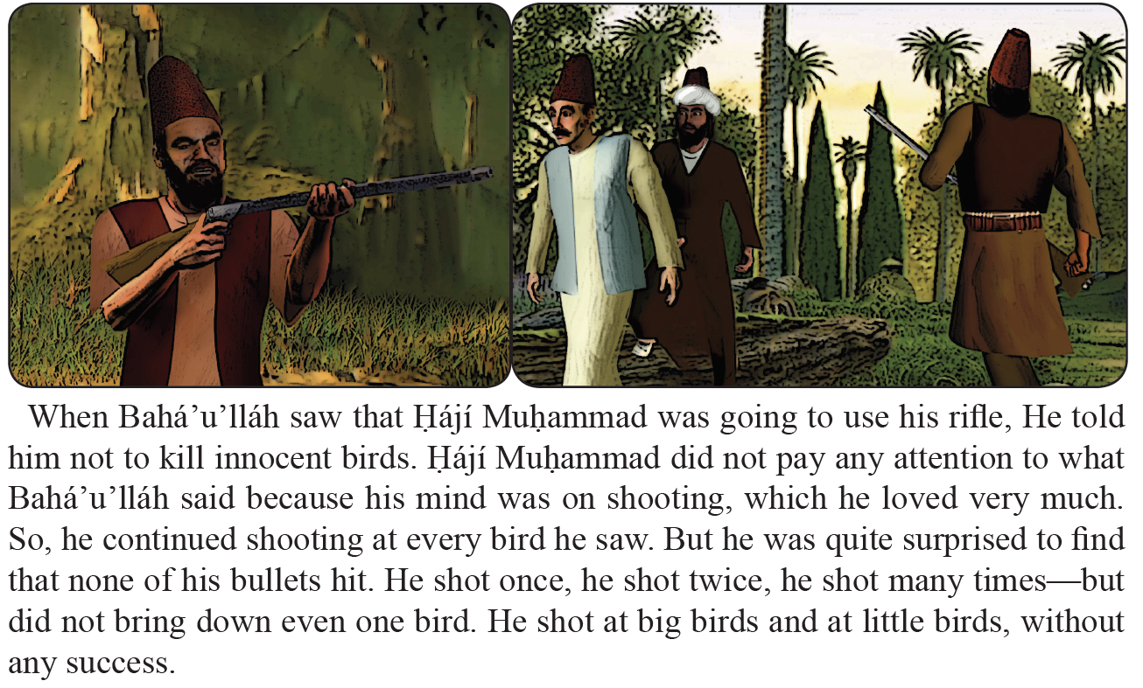

Slide 12
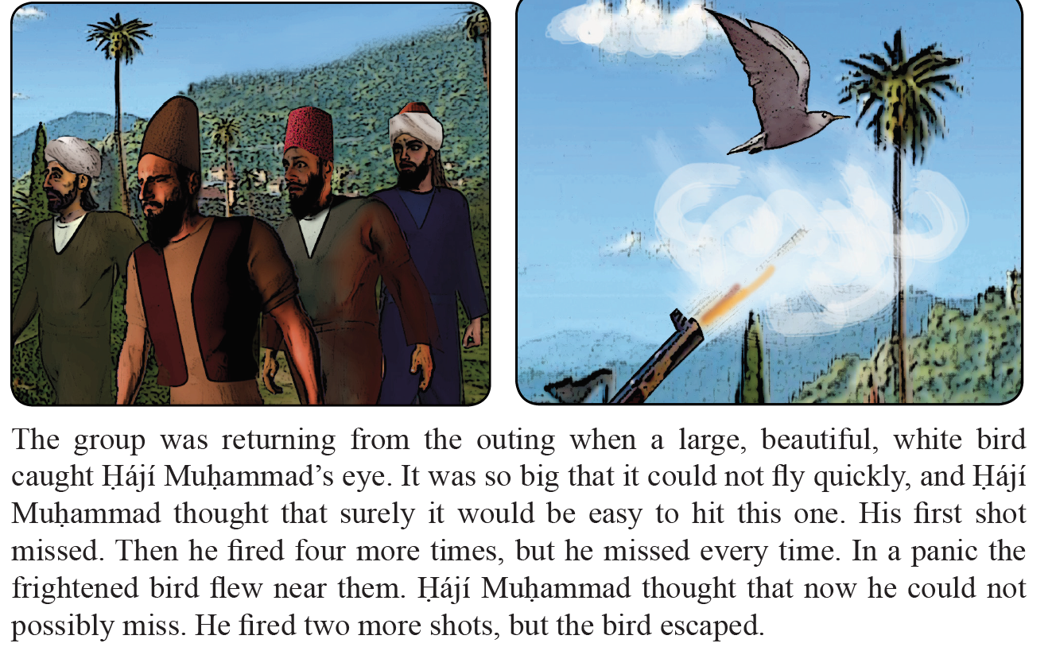

Slide 13
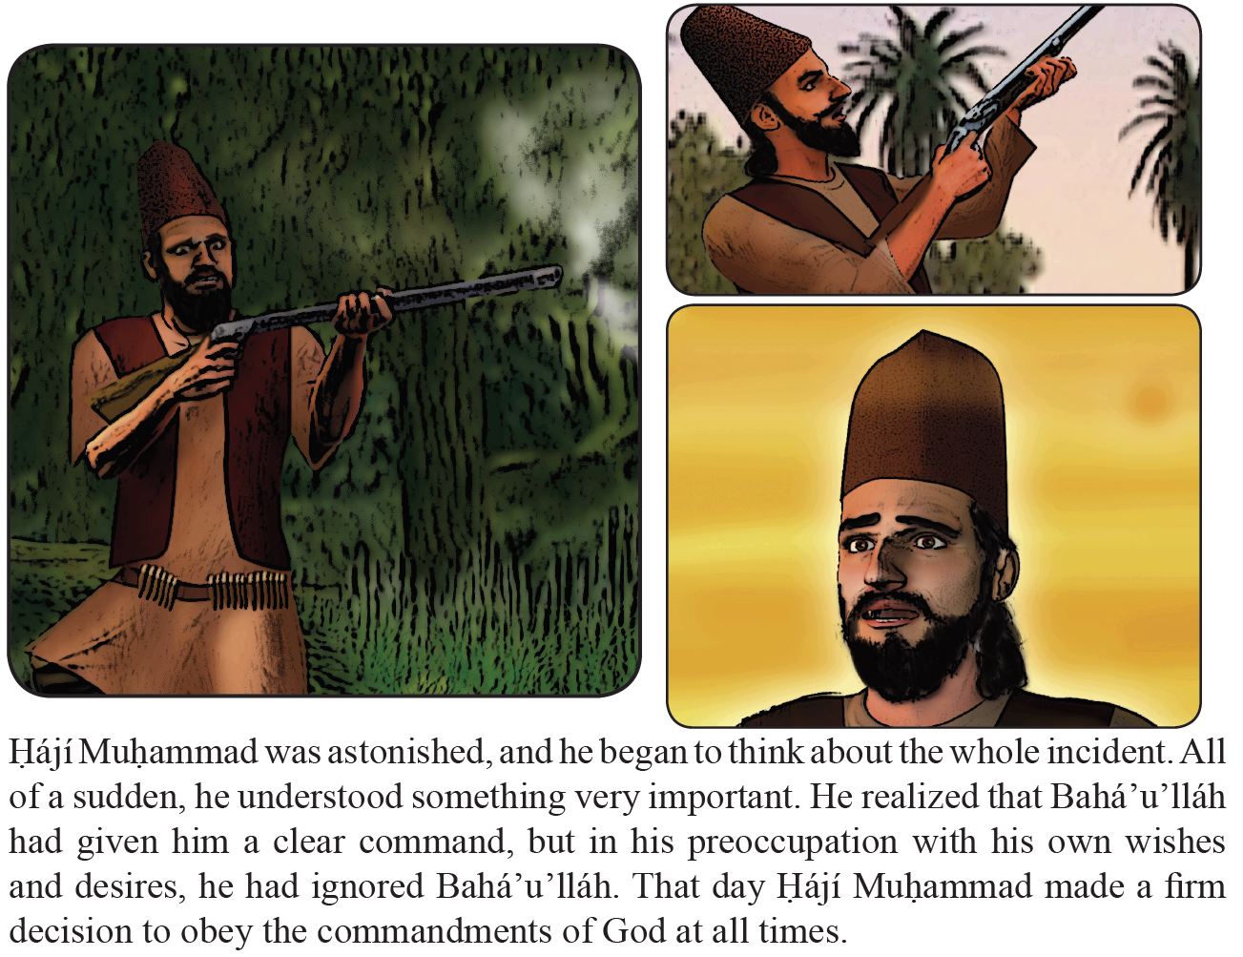

Slide 14
Drama
Doing something with diligence (care, and thoughtfulness)
Doing something without proper care and effort.
VS

Slide 15
Drawing
You can choose to draw a picture of someone following one of the commandments of God that we talked about at the beginning of the lesson, such as being kind to animals, praying each day, not backbiting, or doing their work in the spirit of service and worship.

Slide 16
Game

Slide 17
Closing prayer

Slide 18
