Slide 1
Welcome!

Slide 2
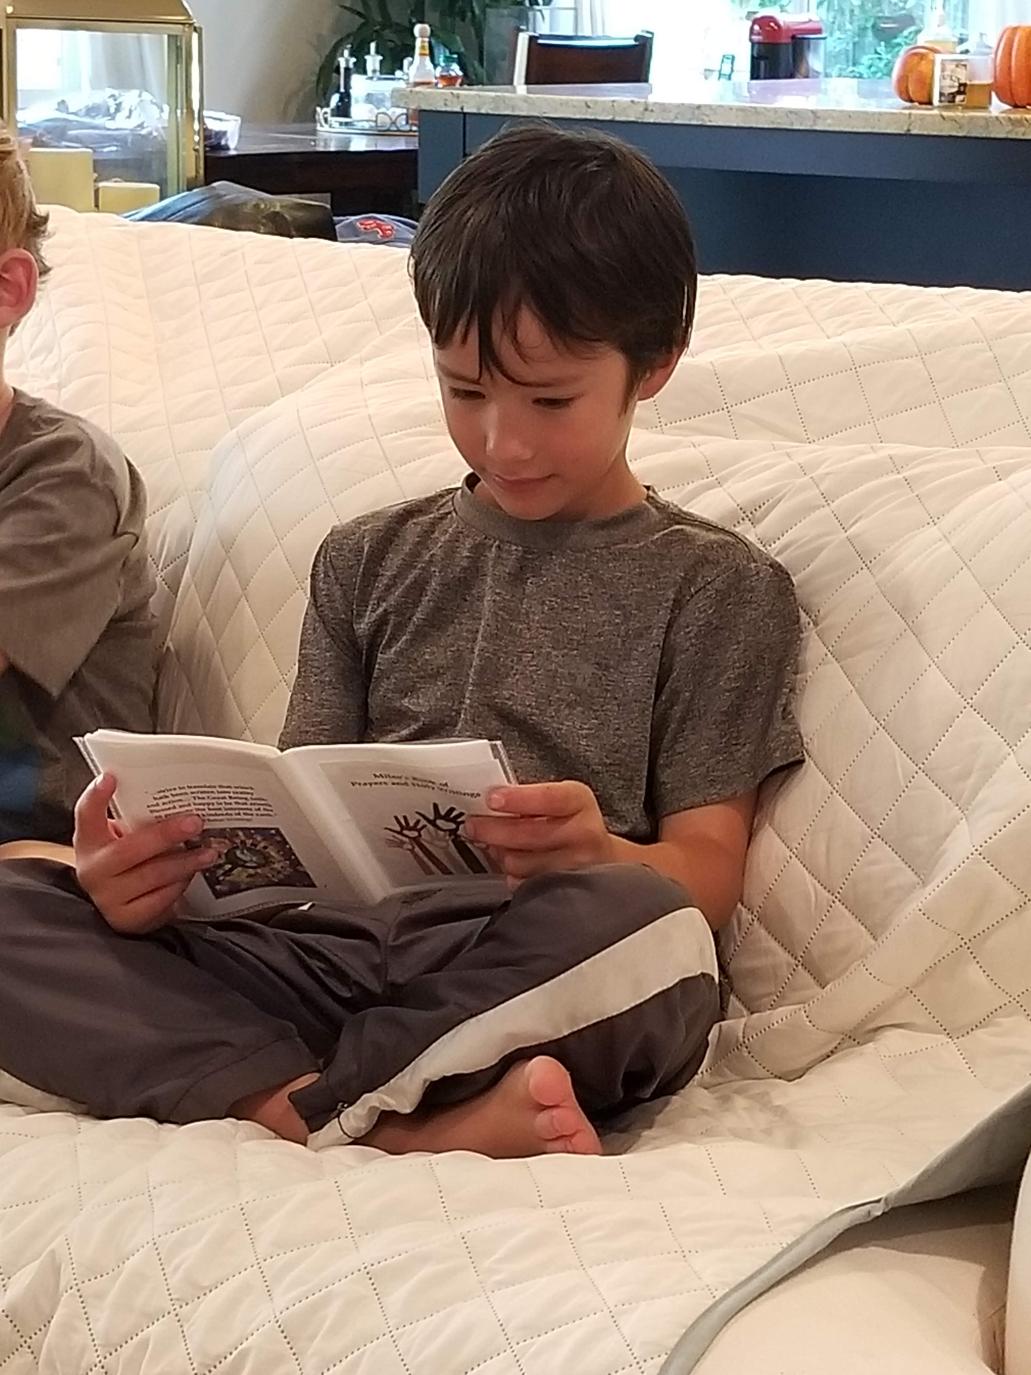
Prayers

Slide 3
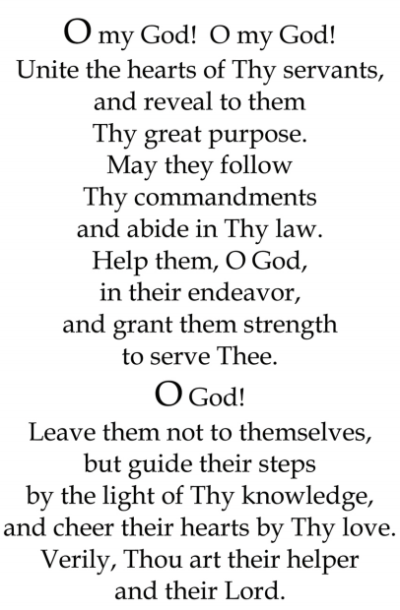


Slide 4

Lesson Theme
Adhering to the Laws of God
Lesson Today: “Obey God’s Commandments Out of Love”

Slide 5
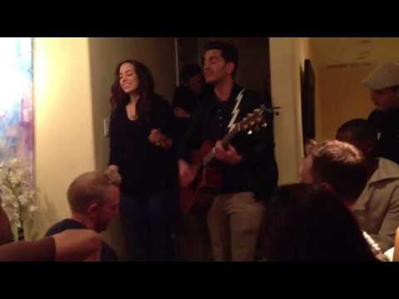
"Where there is love, nothing is too much trouble and there is always time."
― Abdu'l-Bahá

Slide 6
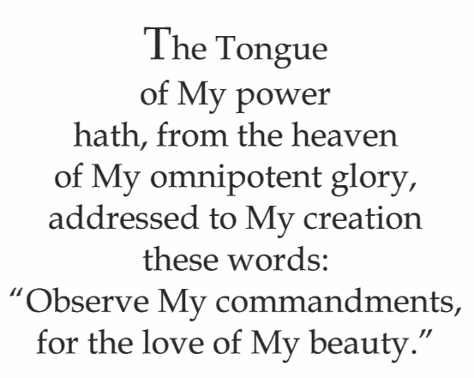



Quote

Slide 7






Slide 8
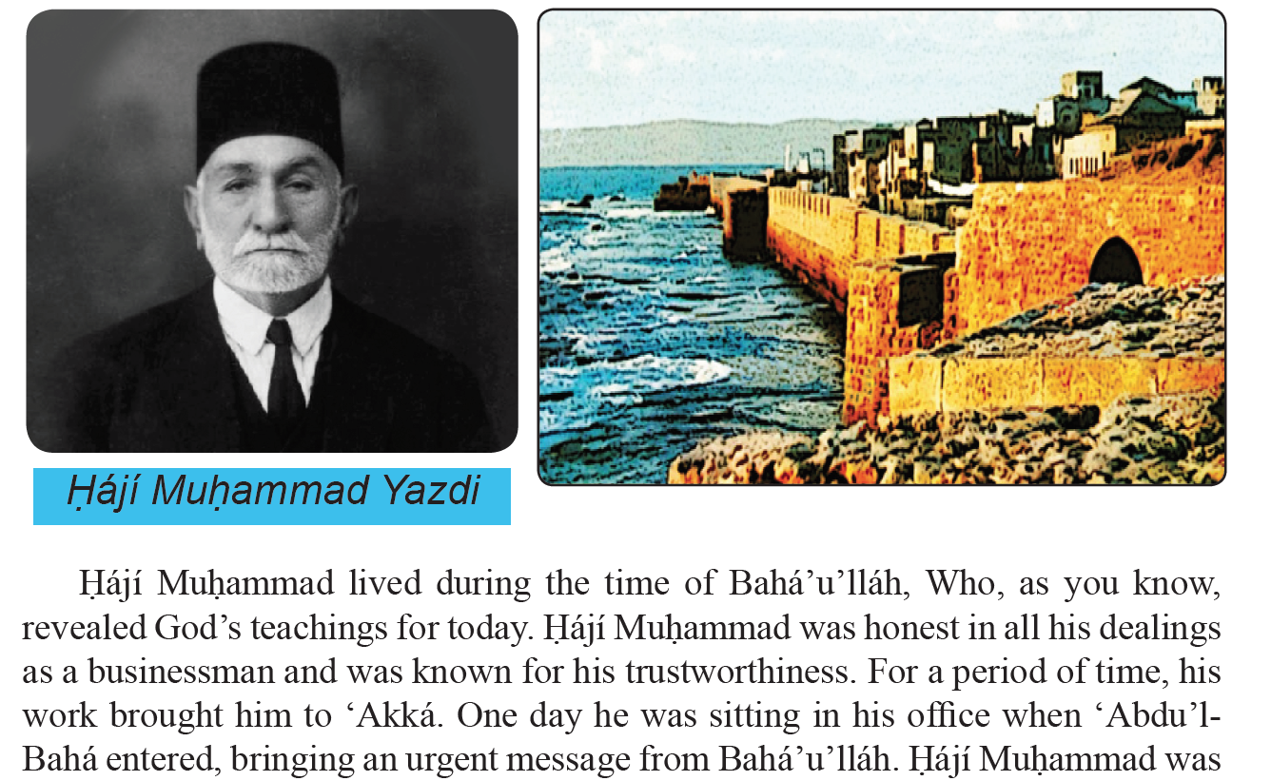

Slide 9
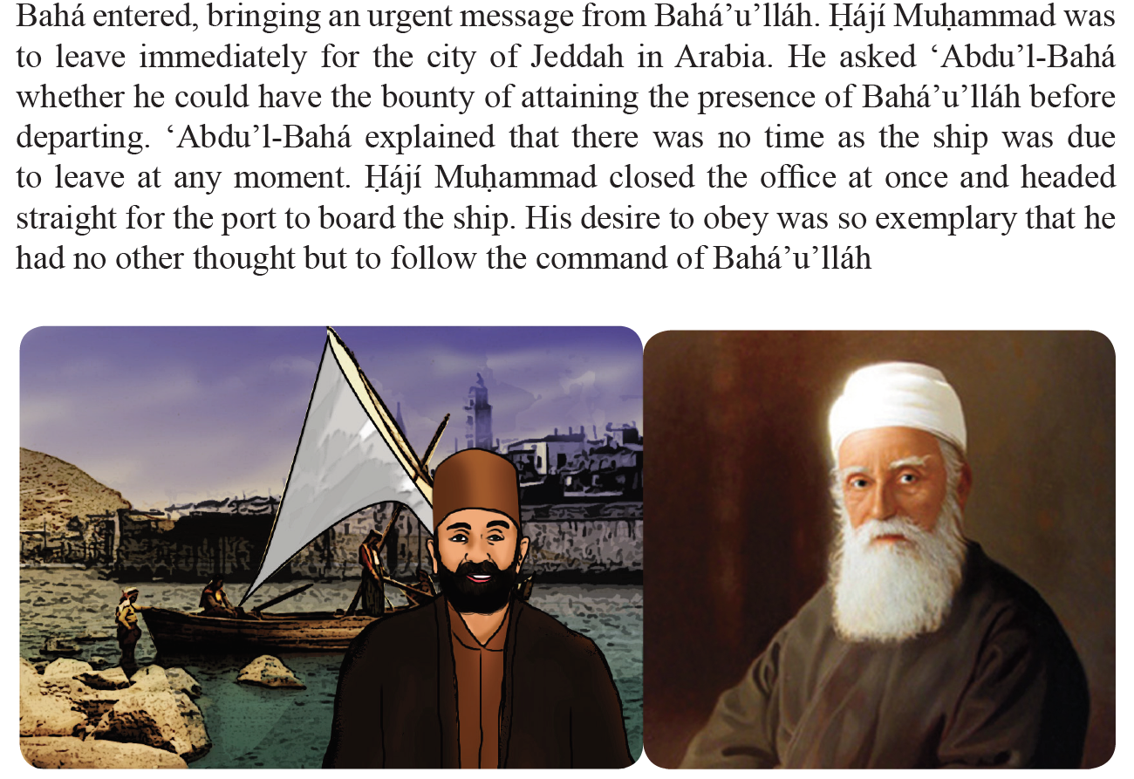

Slide 10
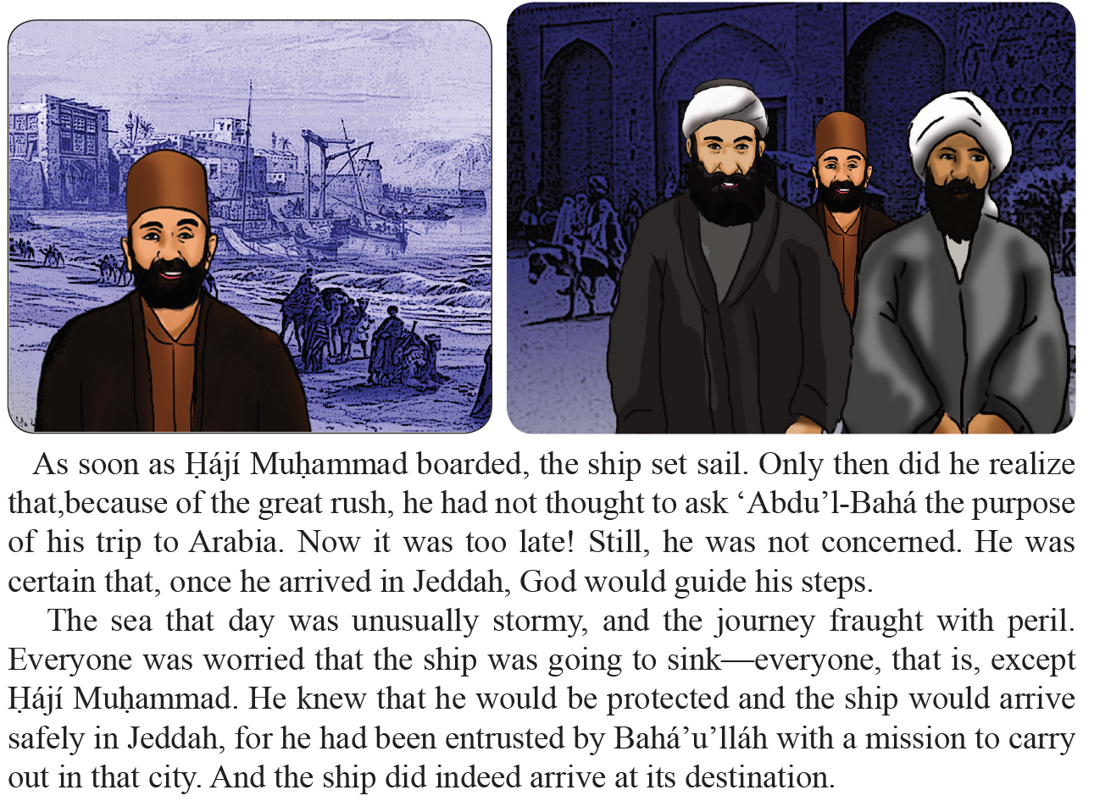

Slide 11
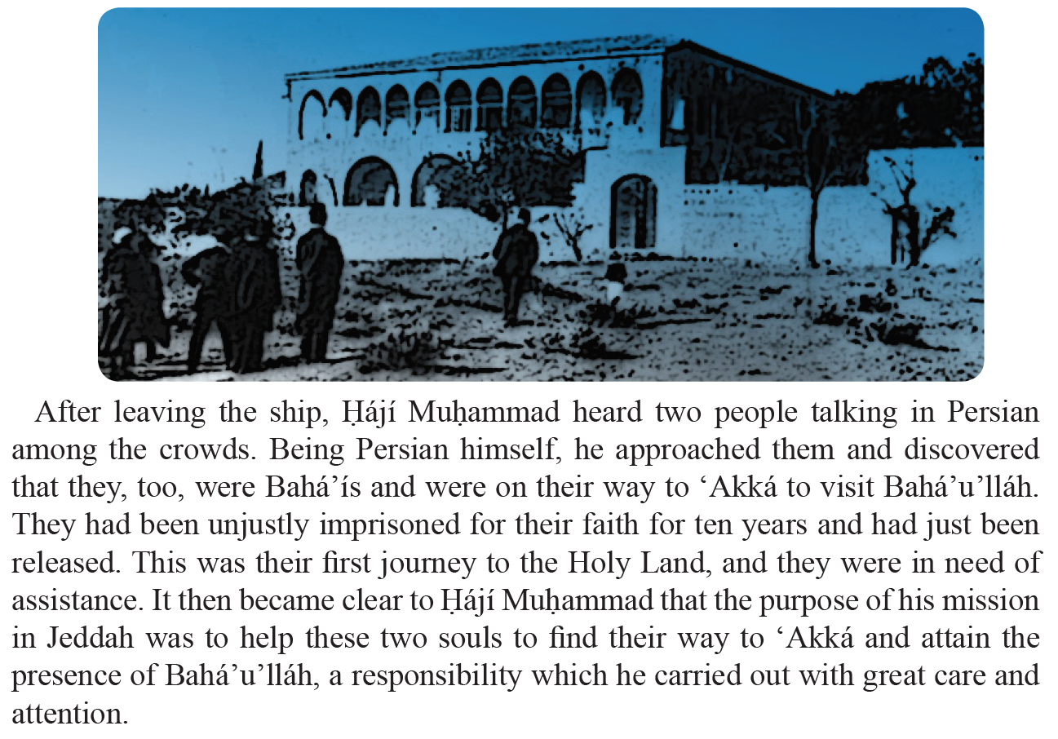

Slide 12
Introduction and practice presentation for Birth of Baha’u’llah and Bab celebration

Slide 13

Drawing
Out of His infinite love, God has given us laws and teachings to live by. These laws and teachings are like lamps that illumine our path. Through their light, we are able to see how it is that God wants us to live. This is the inspiration for today’s craft – colourful lamps! Observe My commandments, for the love of My beauty.’ – Bahá’u’llah

Slide 14
Game

Slide 15
Closing prayer

Slide 16
