Slide 1
Welcome!

Slide 2
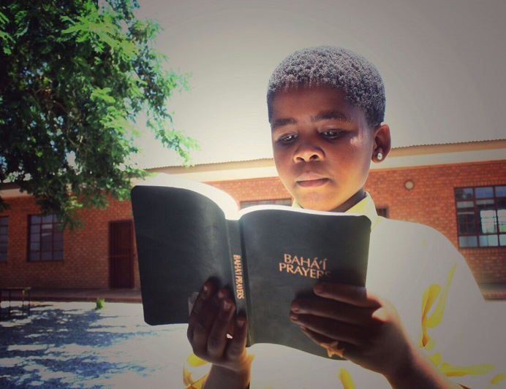
Prayers

Slide 3
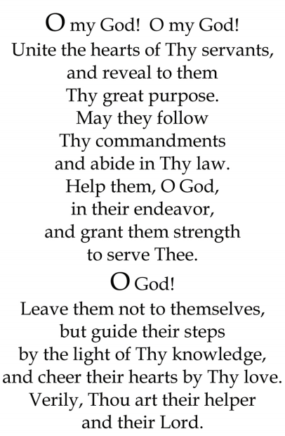


Slide 4

Lesson Theme
Adhering to the Laws of God
Lesson for today: “God’s Laws Keep Us Safe”

Slide 5


God’s Laws Keep Us Safe
All of humanity has been created out of God’s love for His creation, and we are constantly nurtured and protected by His love.

Slide 6
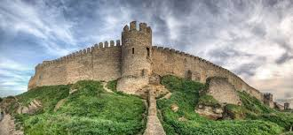
God’s Laws Keep Us Safe
God’s love is like a fortress. A fortress is a mighty building with strong, thick walls that nothing can break through.

Slide 7

God’s Laws Keep Us Safe

Slide 8
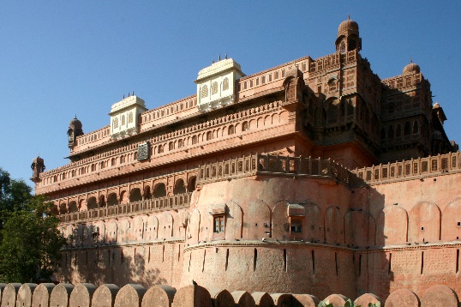
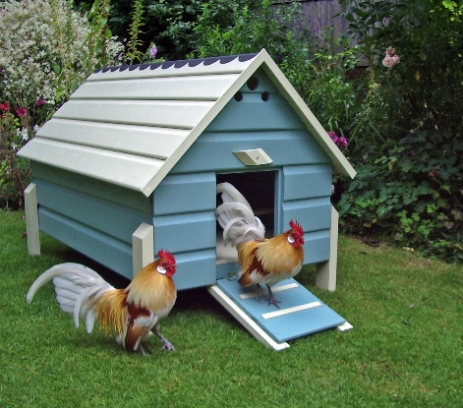
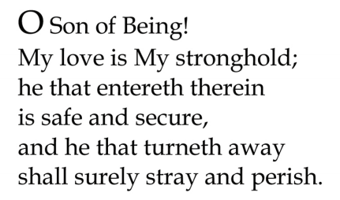
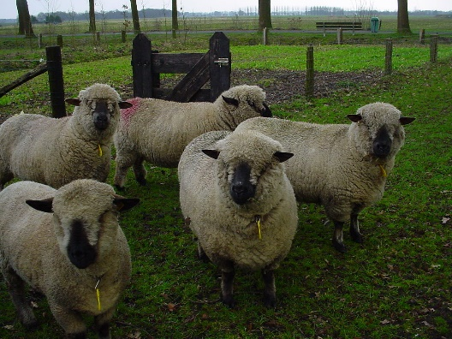
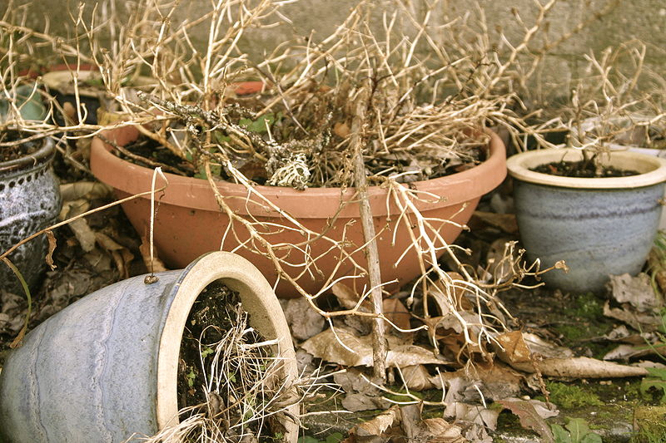

Quote
What does it say is OUR stronghold?
When we enter into the stronghold of God’s love, what are we?
How does God’s love keep us safe and secure?

Slide 9
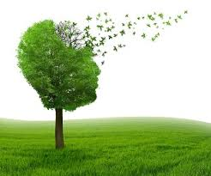
Quote

Slide 10
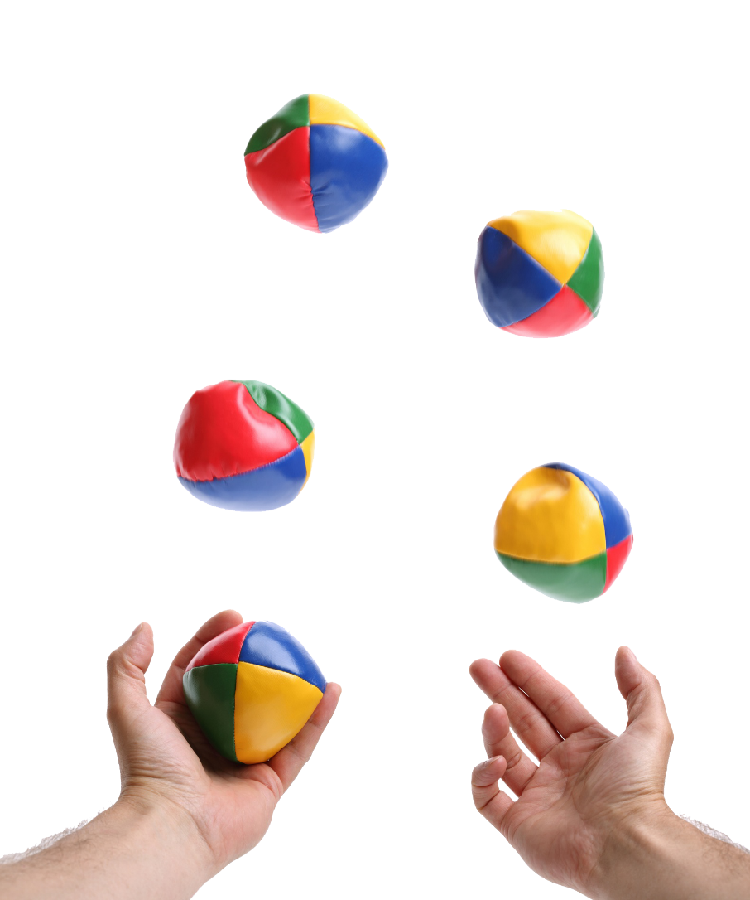
Cooperative juggling Game

Slide 11
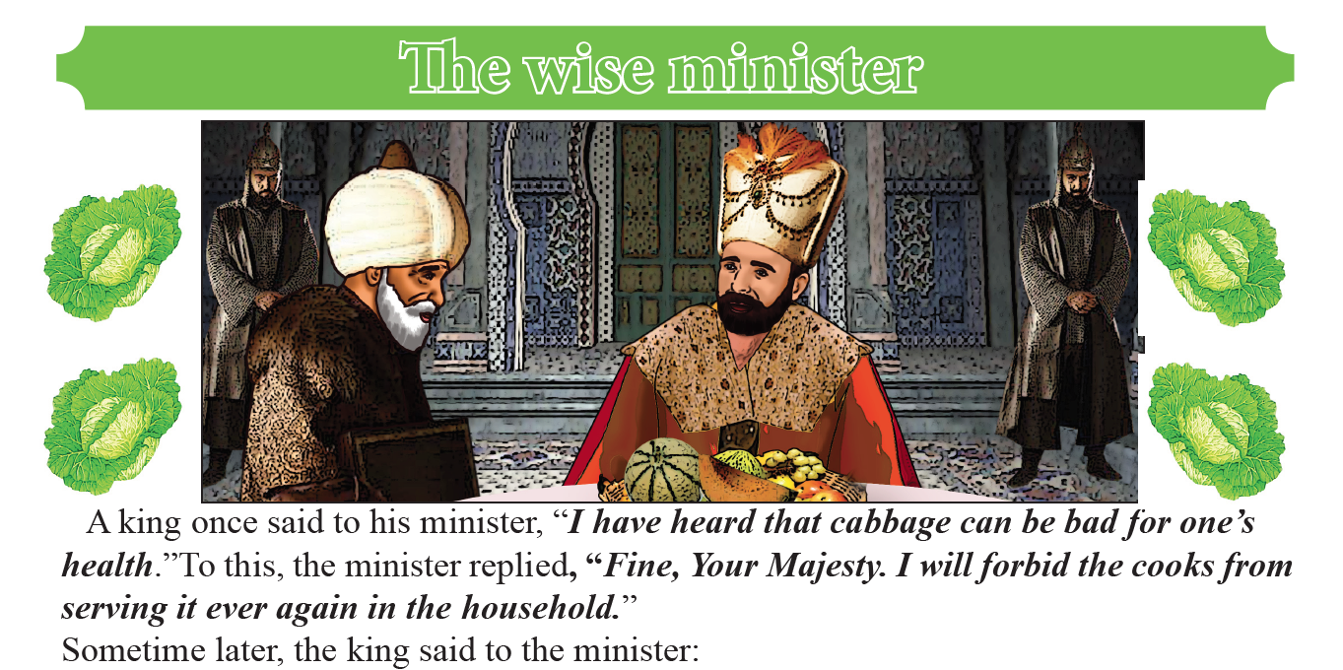

Slide 12
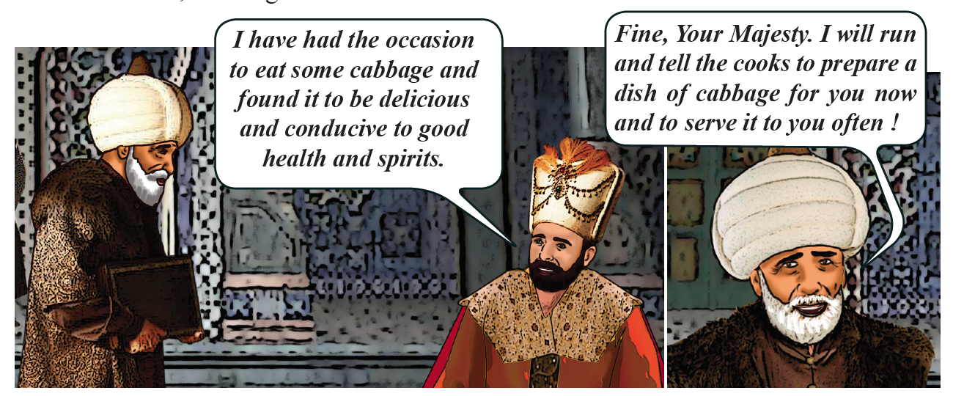

Slide 13
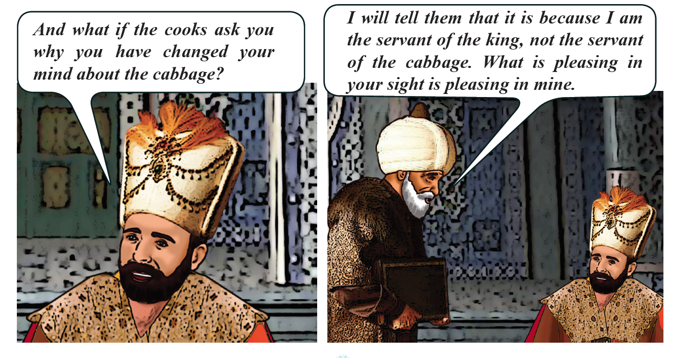

Slide 14
Introduction and practice presentation for Birth of Baha’u’llah and Bab celebration

Slide 15
Drawing
You can draw a picture of a fortess, or any other image that reminds you of today’s lesson about the importance of following God’s guidance and living a life that is pleasing to God.

Slide 16

Game

Slide 17
Closing prayer

Slide 18
