Slide 1
Welcome!

Slide 2
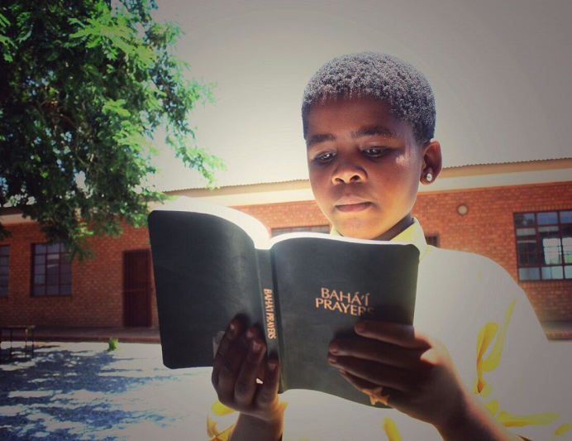
Prayers

Slide 3
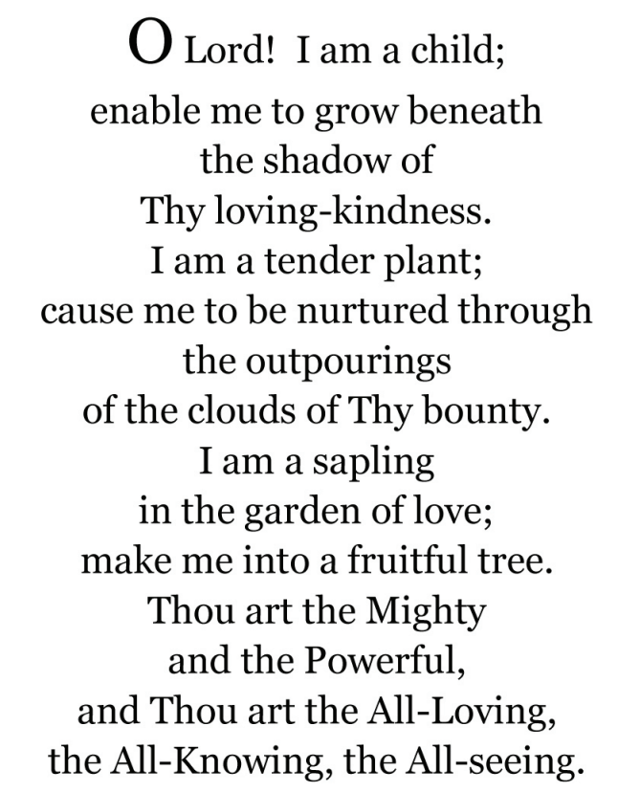

https://youtu.be/0XJI_PzFN6I

Slide 4
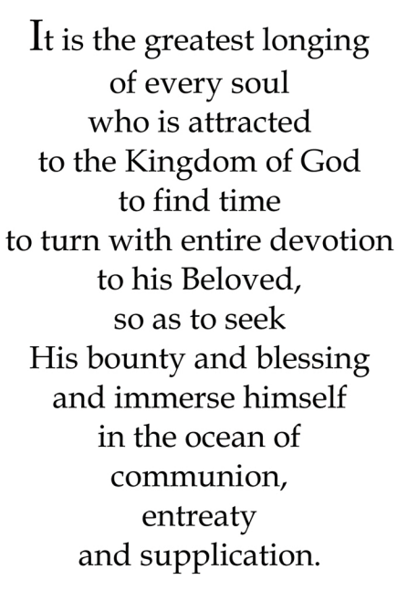
Quote

Slide 5
Name Game
Chantel
Jasmine
Dylan
Luna
Dustin
Vivian
Miles
Hayden
Aaron
Jason
Eileen

Slide 6
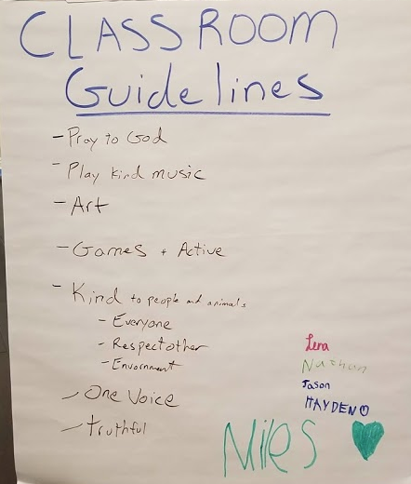

Slide 7
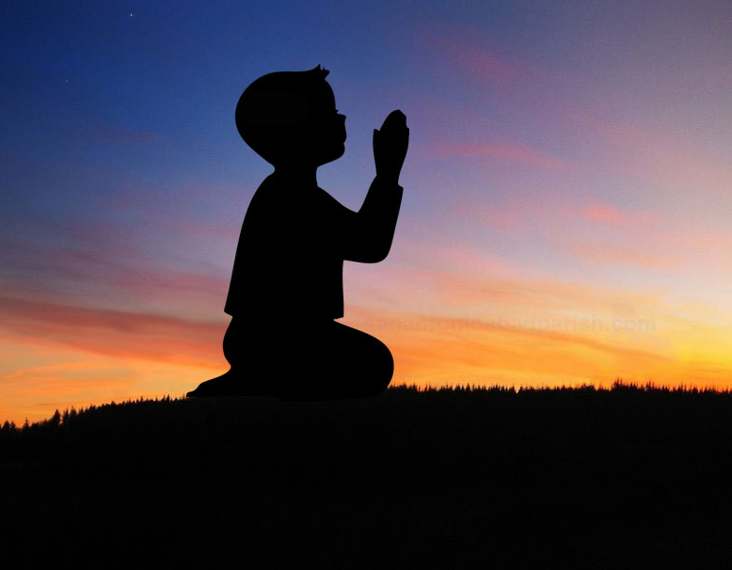
Lesson Theme
Maintaining a prayerful attitude
Previous Lessons
1) Nature of Prayer
2) Why we Pray
Lesson for today: “How to Pray”

Slide 8
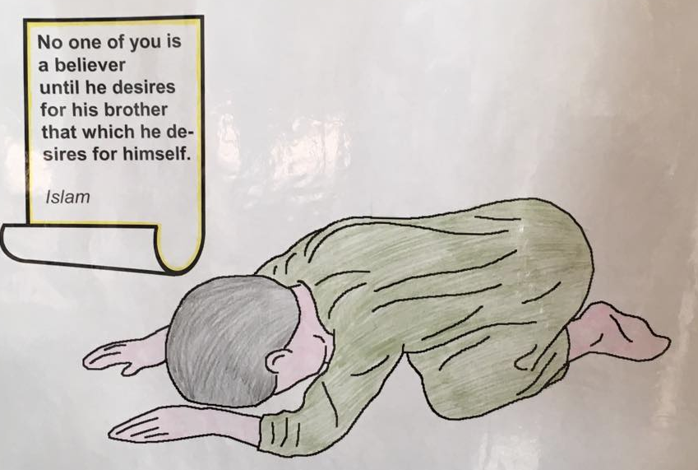
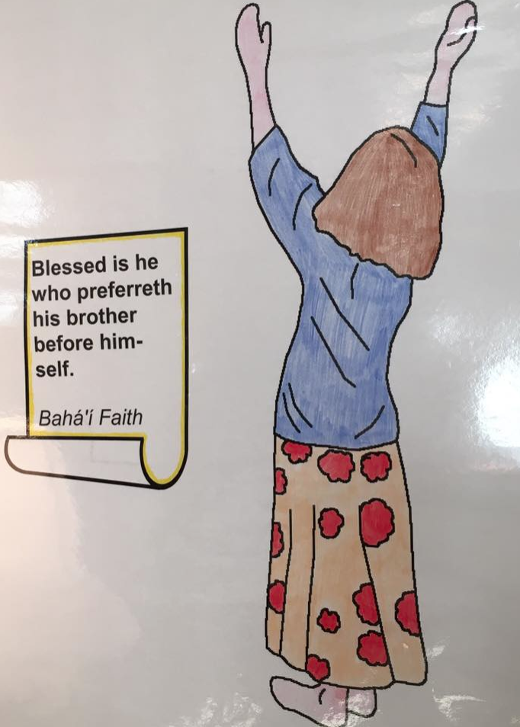
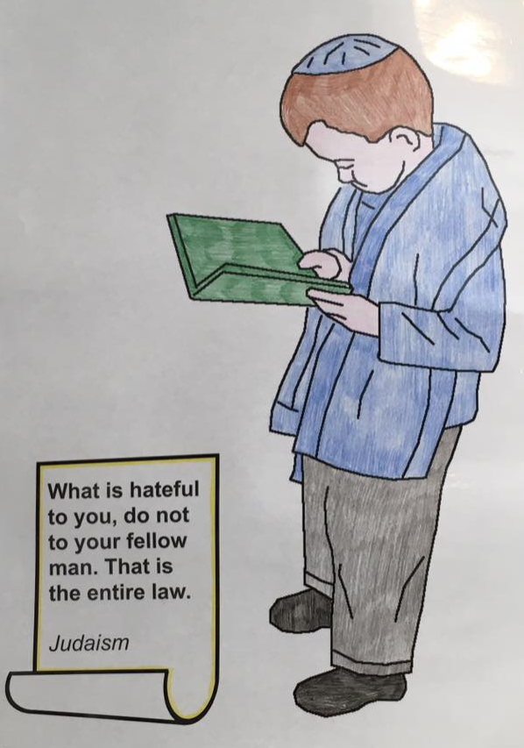
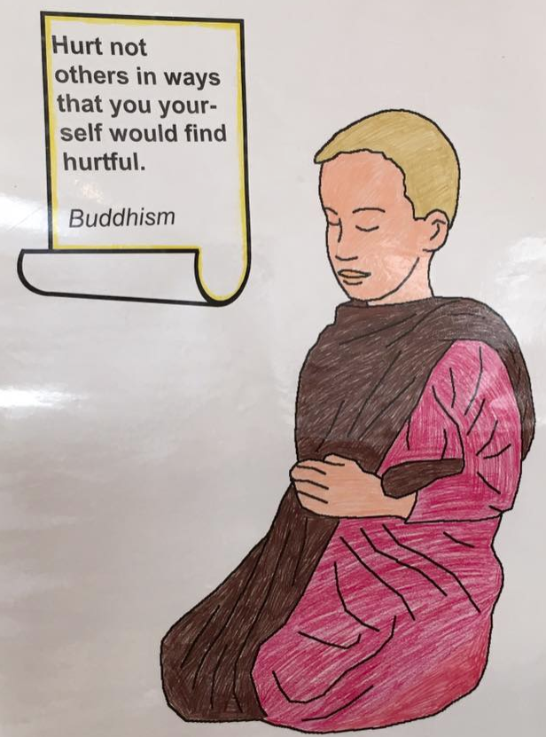
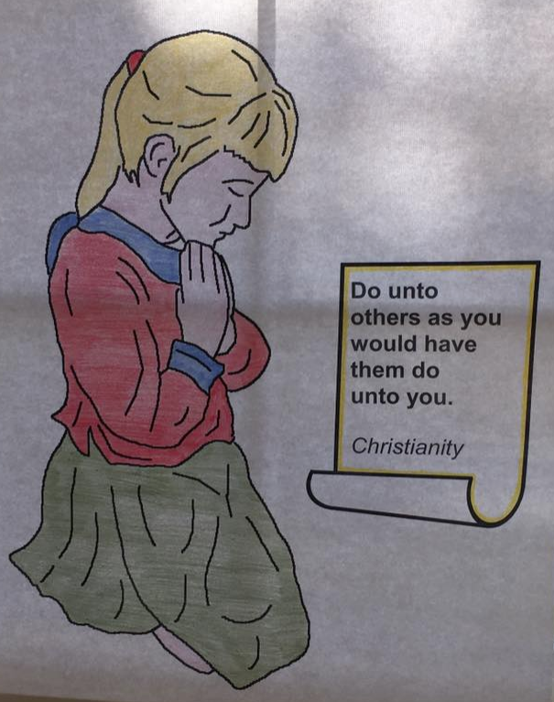
How to Pray?

Slide 9
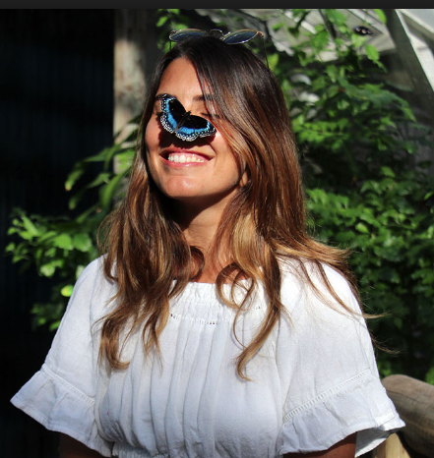
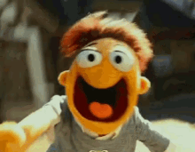
How to Pray?

Slide 10
How to Pray?
The prayers that we recite every day can be chosen from those we know by heart or from those we find in prayer books.
Once we have finished reciting a prayer, we remain still and silent, reflecting on its words.

Slide 11
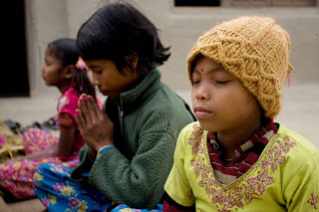
How do we act when others are praying?
we feel as though we are praying ourselves
We listen closely to the words the other is saying and maintain a reverent attitude

Slide 12
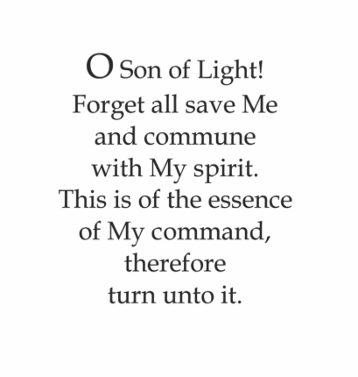
Quote

Slide 13
Drama – How we Pray?

Slide 14
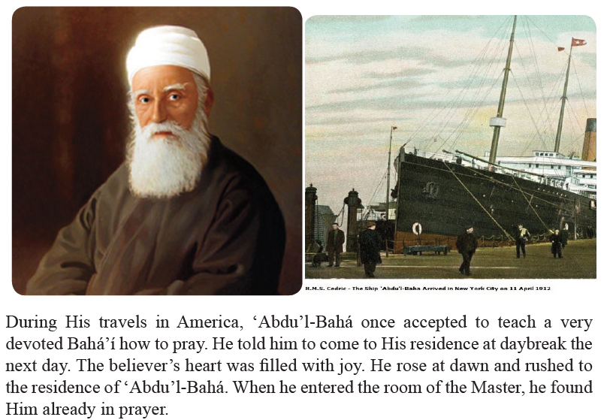
Story

Slide 15
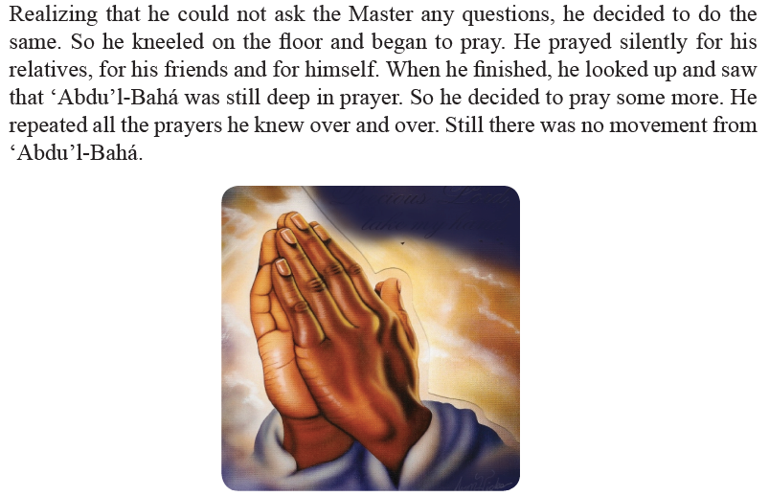

Slide 16
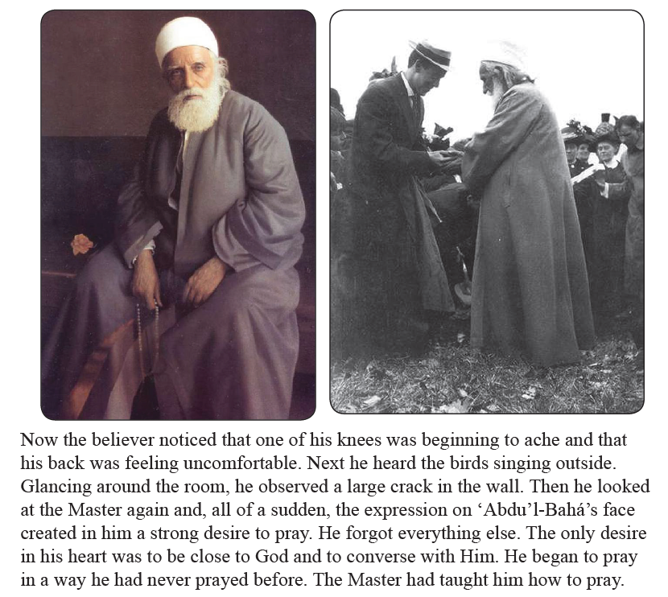

Slide 17
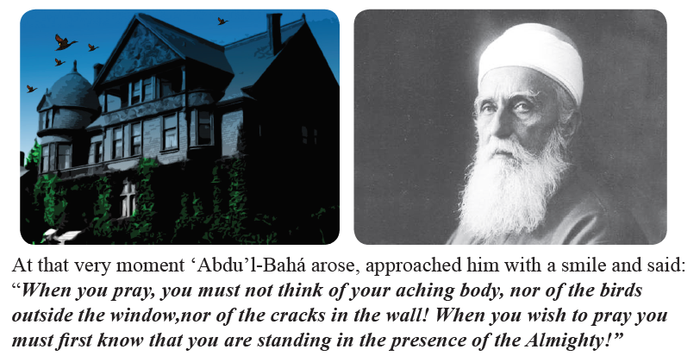

Slide 18
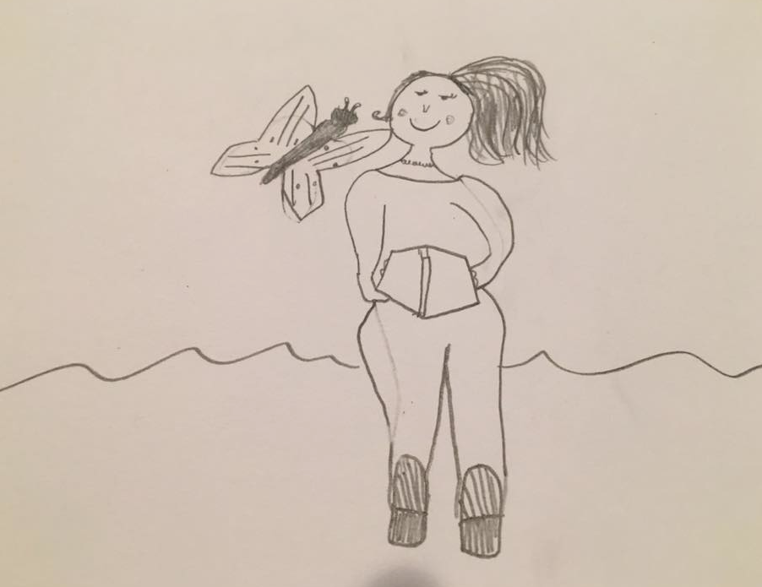
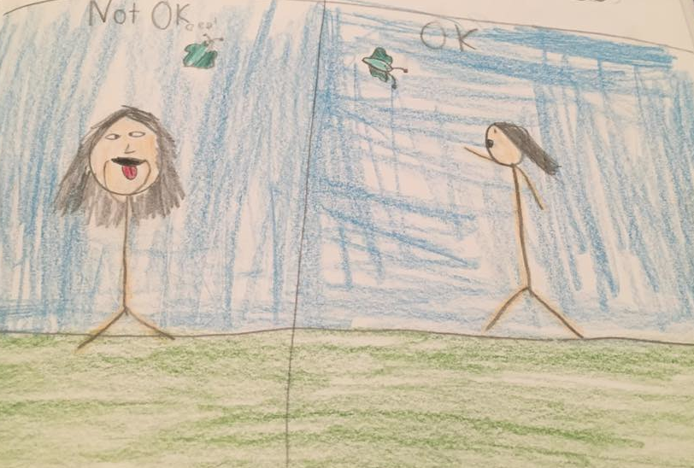
Drawing
You are going to draw a picture that reminds you of this lesson- perhaps a baby bird being held, a face with eyes closed in prayer, or something from the story.

Slide 19

Game

Slide 20
Closing prayer

