Slide 1
Welcome!

Slide 2
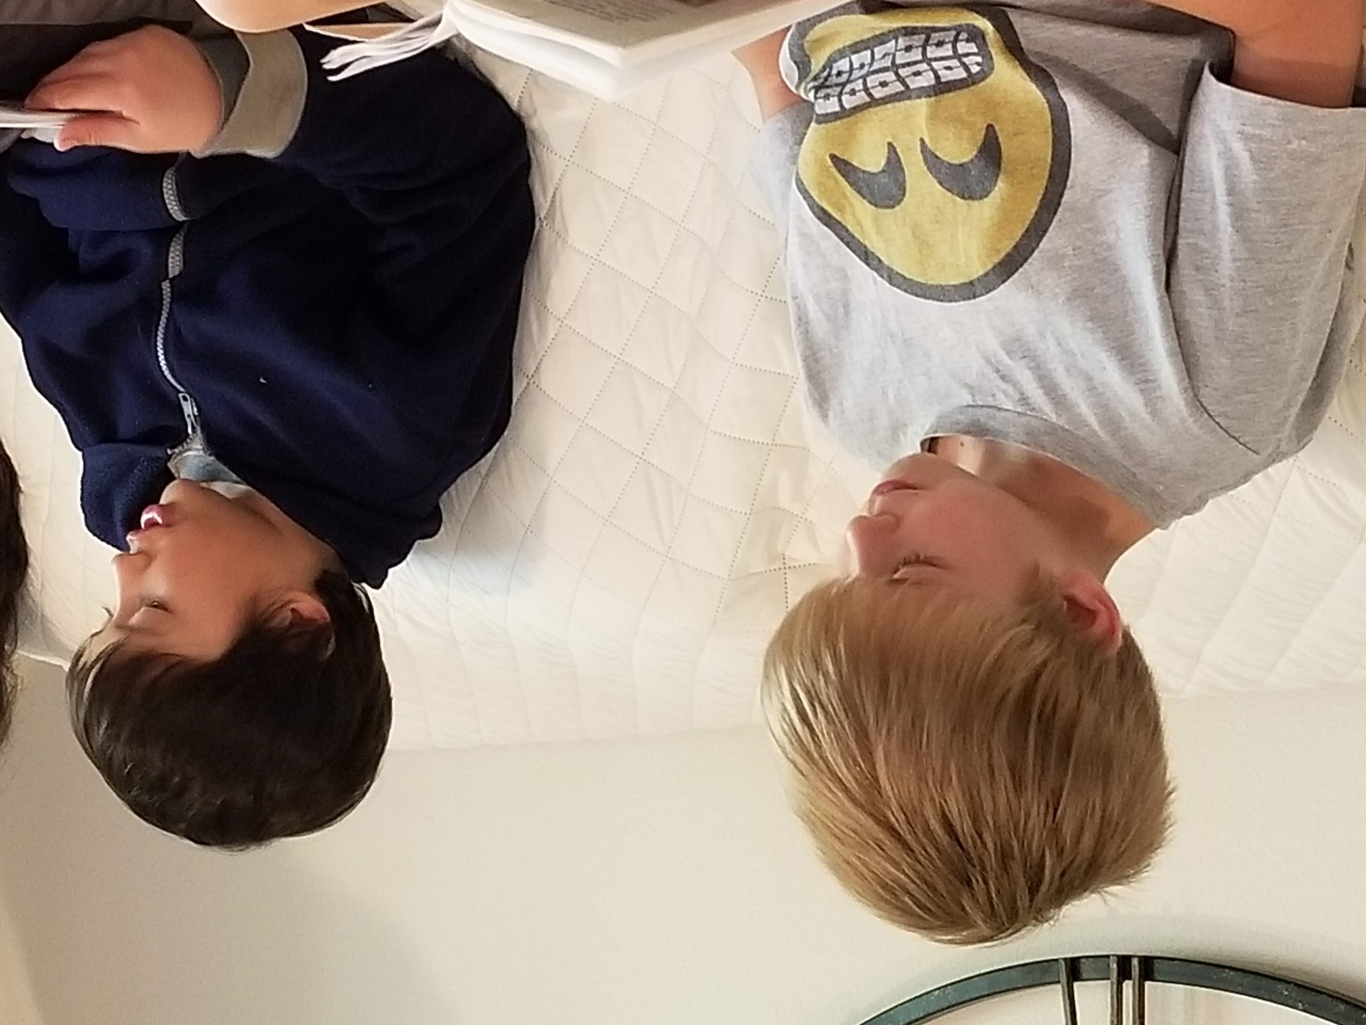
Prayers

Slide 3
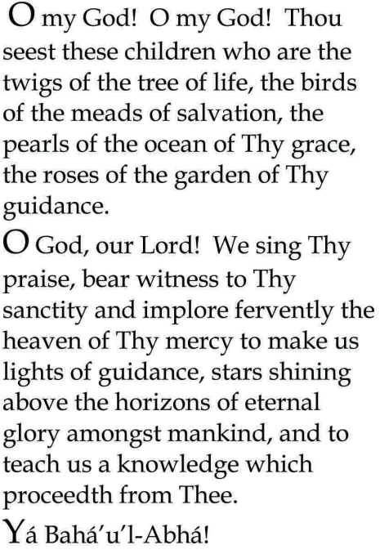


Slide 4

Lesson Theme
Consultation
Lesson Today: “Unity is how consultation enables great things to be achieved”

Slide 5

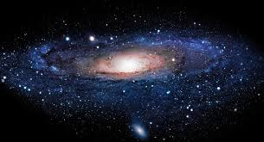
We know that all of creation- the entire universe and all that is in it-is held together by the force of love. Everything is connected into a beautiful whole, and humanity is like one family. Unity and harmony are part of creation. And when we come together to consult and share ideas, we are able to understand the world around us better and better.

Slide 6

Unity and harmony create a powerful bond and we become more and more united in our thoughts and understanding. Sometimes we may need to talk for a long while to see a united way forward; other times we see the path more quickly. And with our thoughts and views united, we are able to make better and better plans and to carry them out more and more effectively. We all understand what we need to do. That is how consultation enables great things to be achieved.

Slide 7
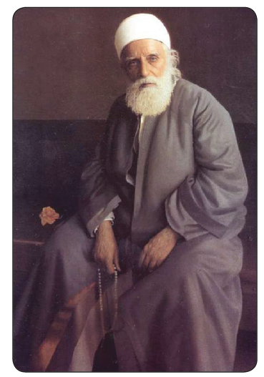
'Abdu'l-Baha and Consultation
'Abdu'l-Baha tells us, In the same way that the strength of several people, is greater than the strength of one person, it is better to have the views and ideas of many people than just one.

Slide 8
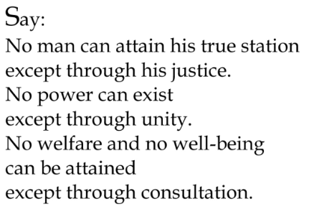
Quote

Slide 9
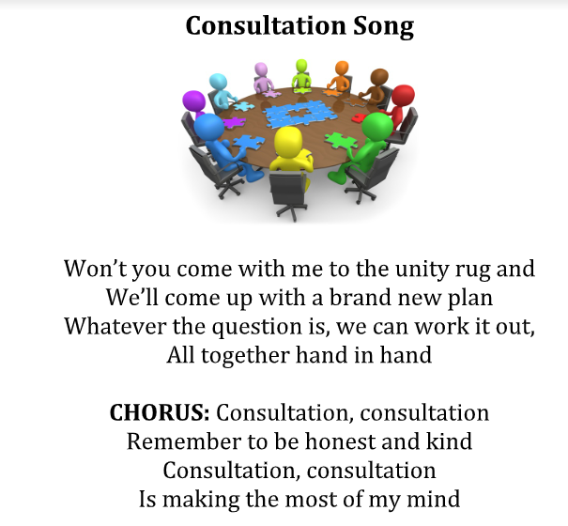
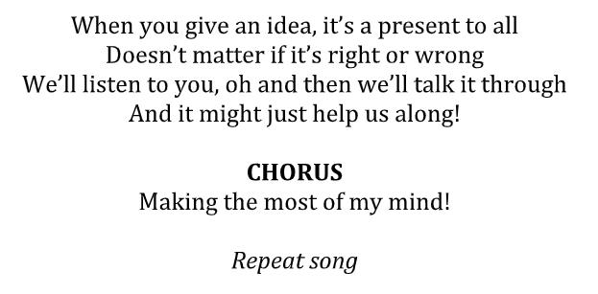
Song

Slide 10
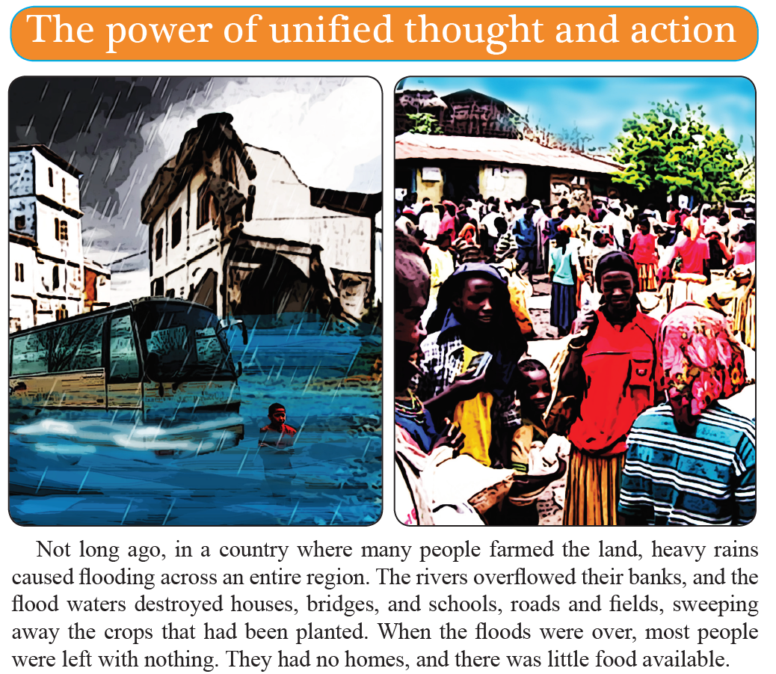

Slide 11
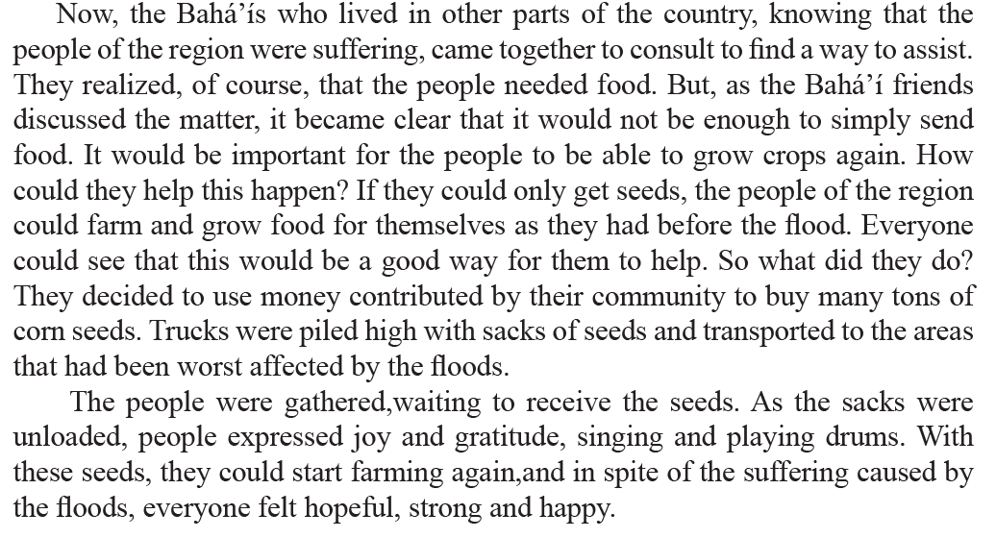

Slide 12
Drama
Drama focused to the theme of today's lesson:
    Carry out a large-group improvisation, which will serve to strengthen your understanding of the nature of true consultation

Slide 13
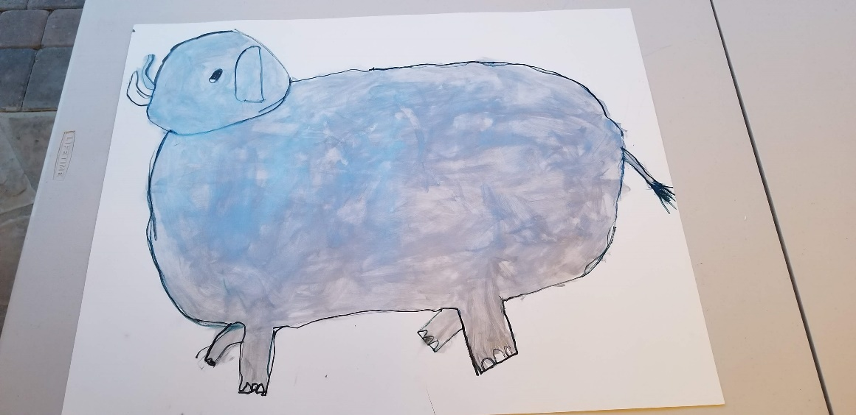
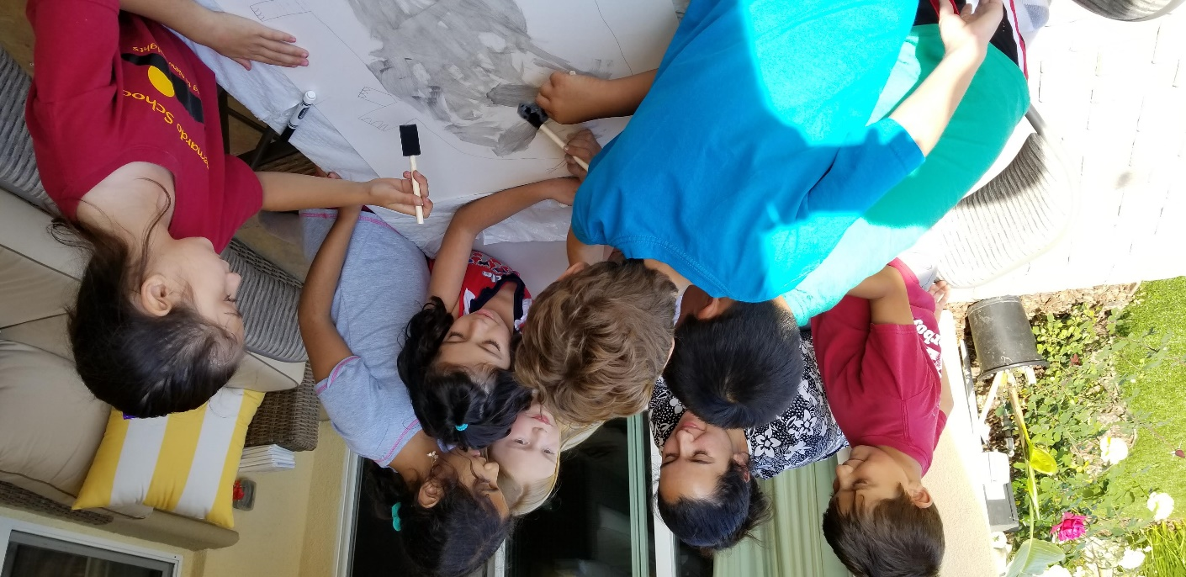
Art
Students draw & paint an elephant by using consultation.

Slide 14
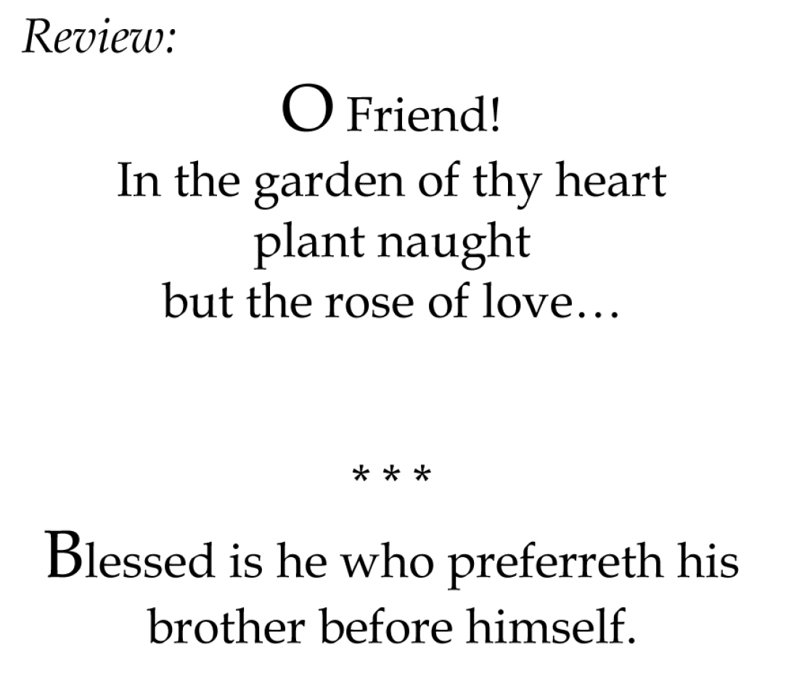

Slide 15
Closing prayer

Slide 16
