Slide 1
Welcome!

Slide 2
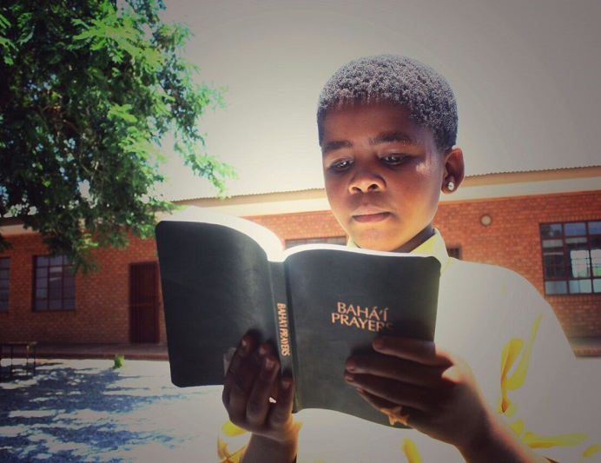
Prayers

Slide 3
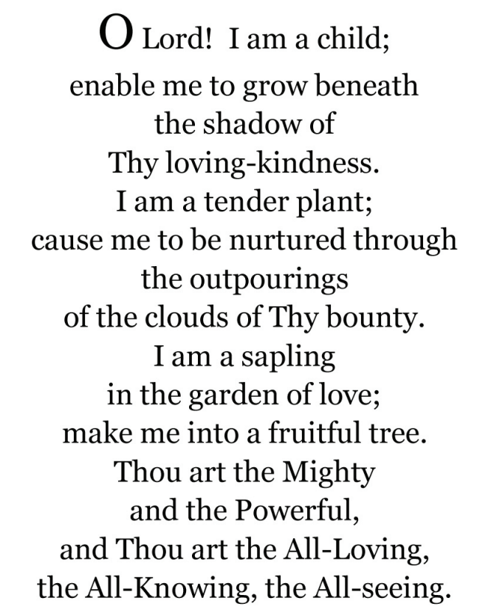

https://youtu.be/0XJI_PzFN6I

Slide 4
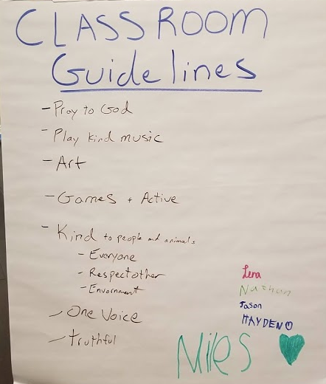

Slide 5
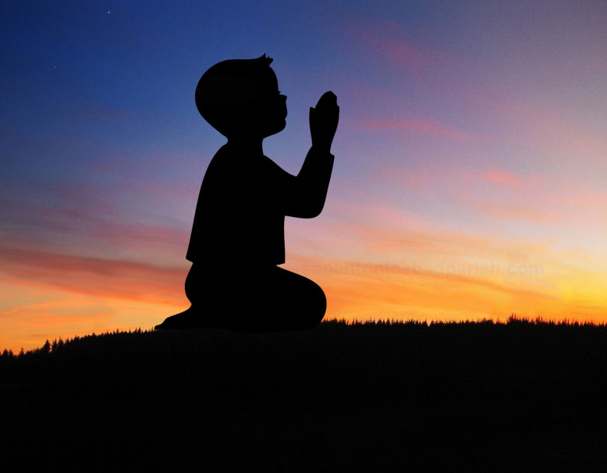
Theme for next 2 lessons:
Maintaining a prayerful attitude
Lesson for today: “Why We Pray”

Slide 6

Why we Pray
God does not need our prayers, but we pray because it serves to strengthen our souls, for prayer is like food for the soul.

Slide 7
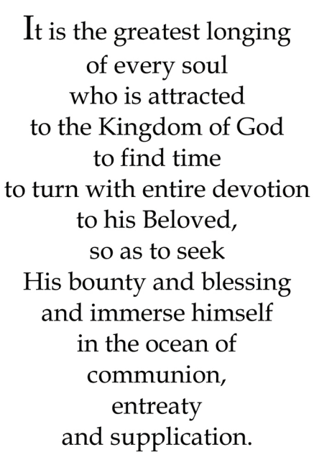
Quote

Slide 8
Quote

Slide 9
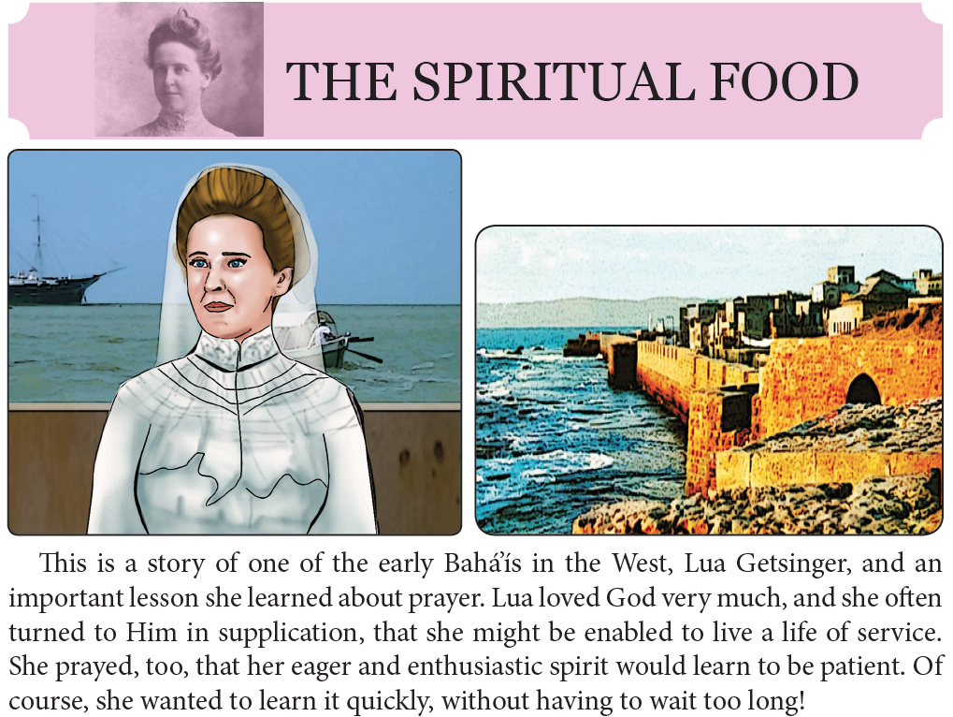
Story

Slide 10
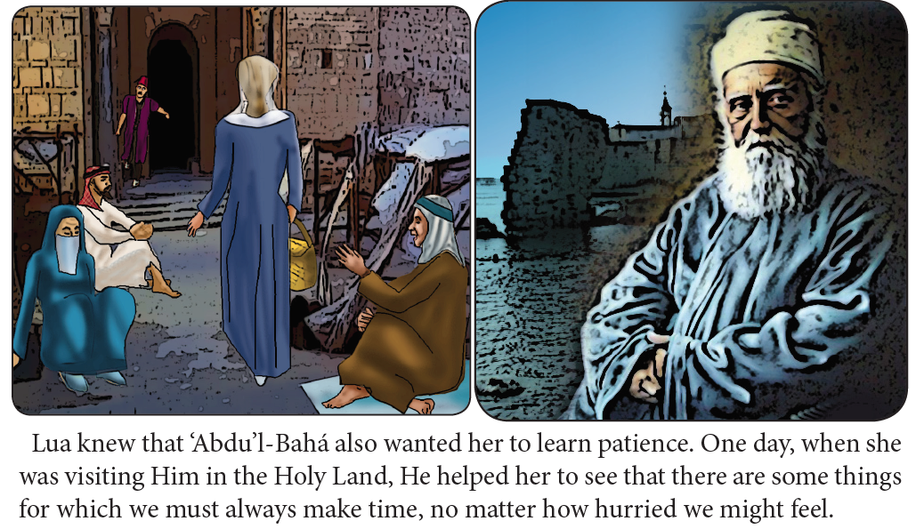

Slide 11
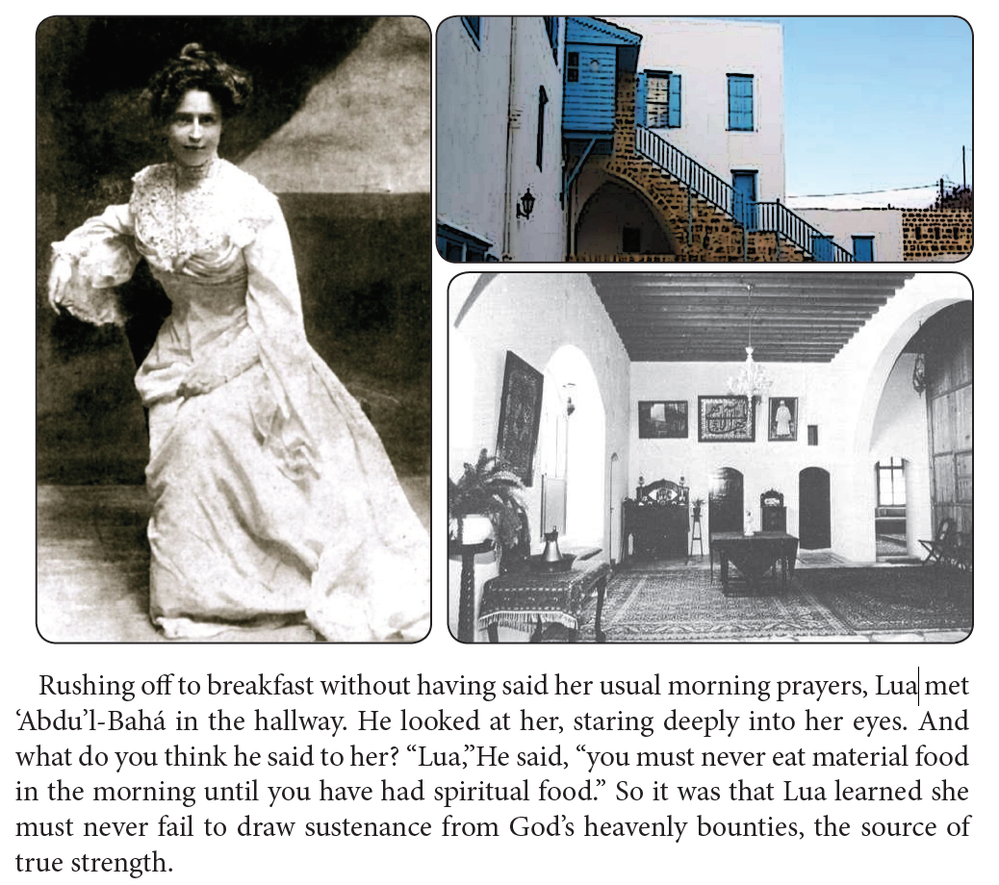

Slide 12
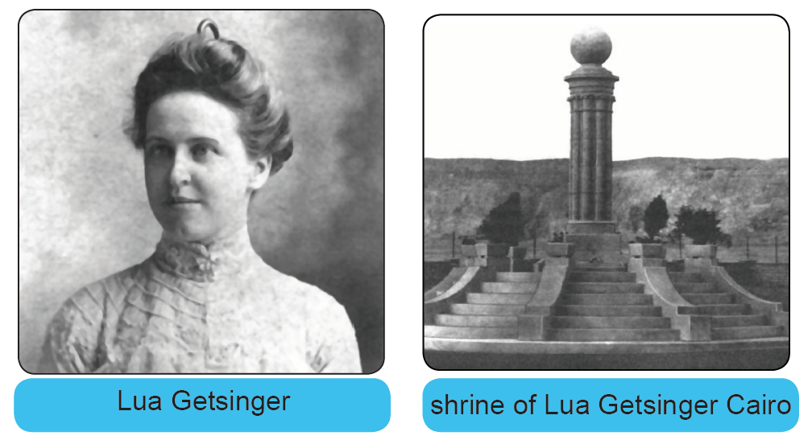

Slide 13
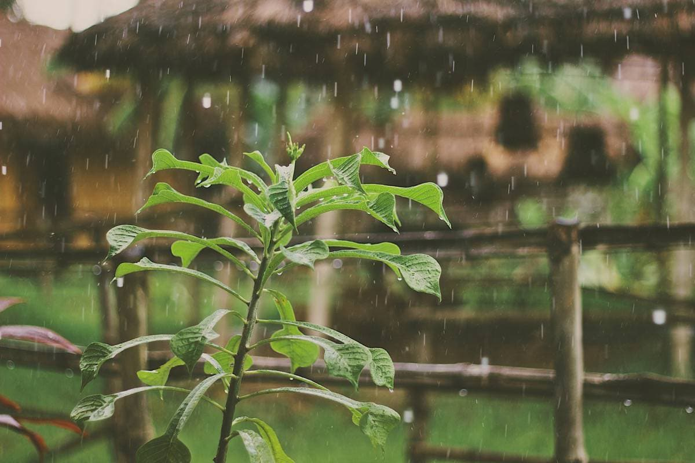
Drama

Slide 14
Drawing
Draw about what you learned in coloring book.

Slide 15
Closing prayer

