Slide 1
Welcome!

Slide 2
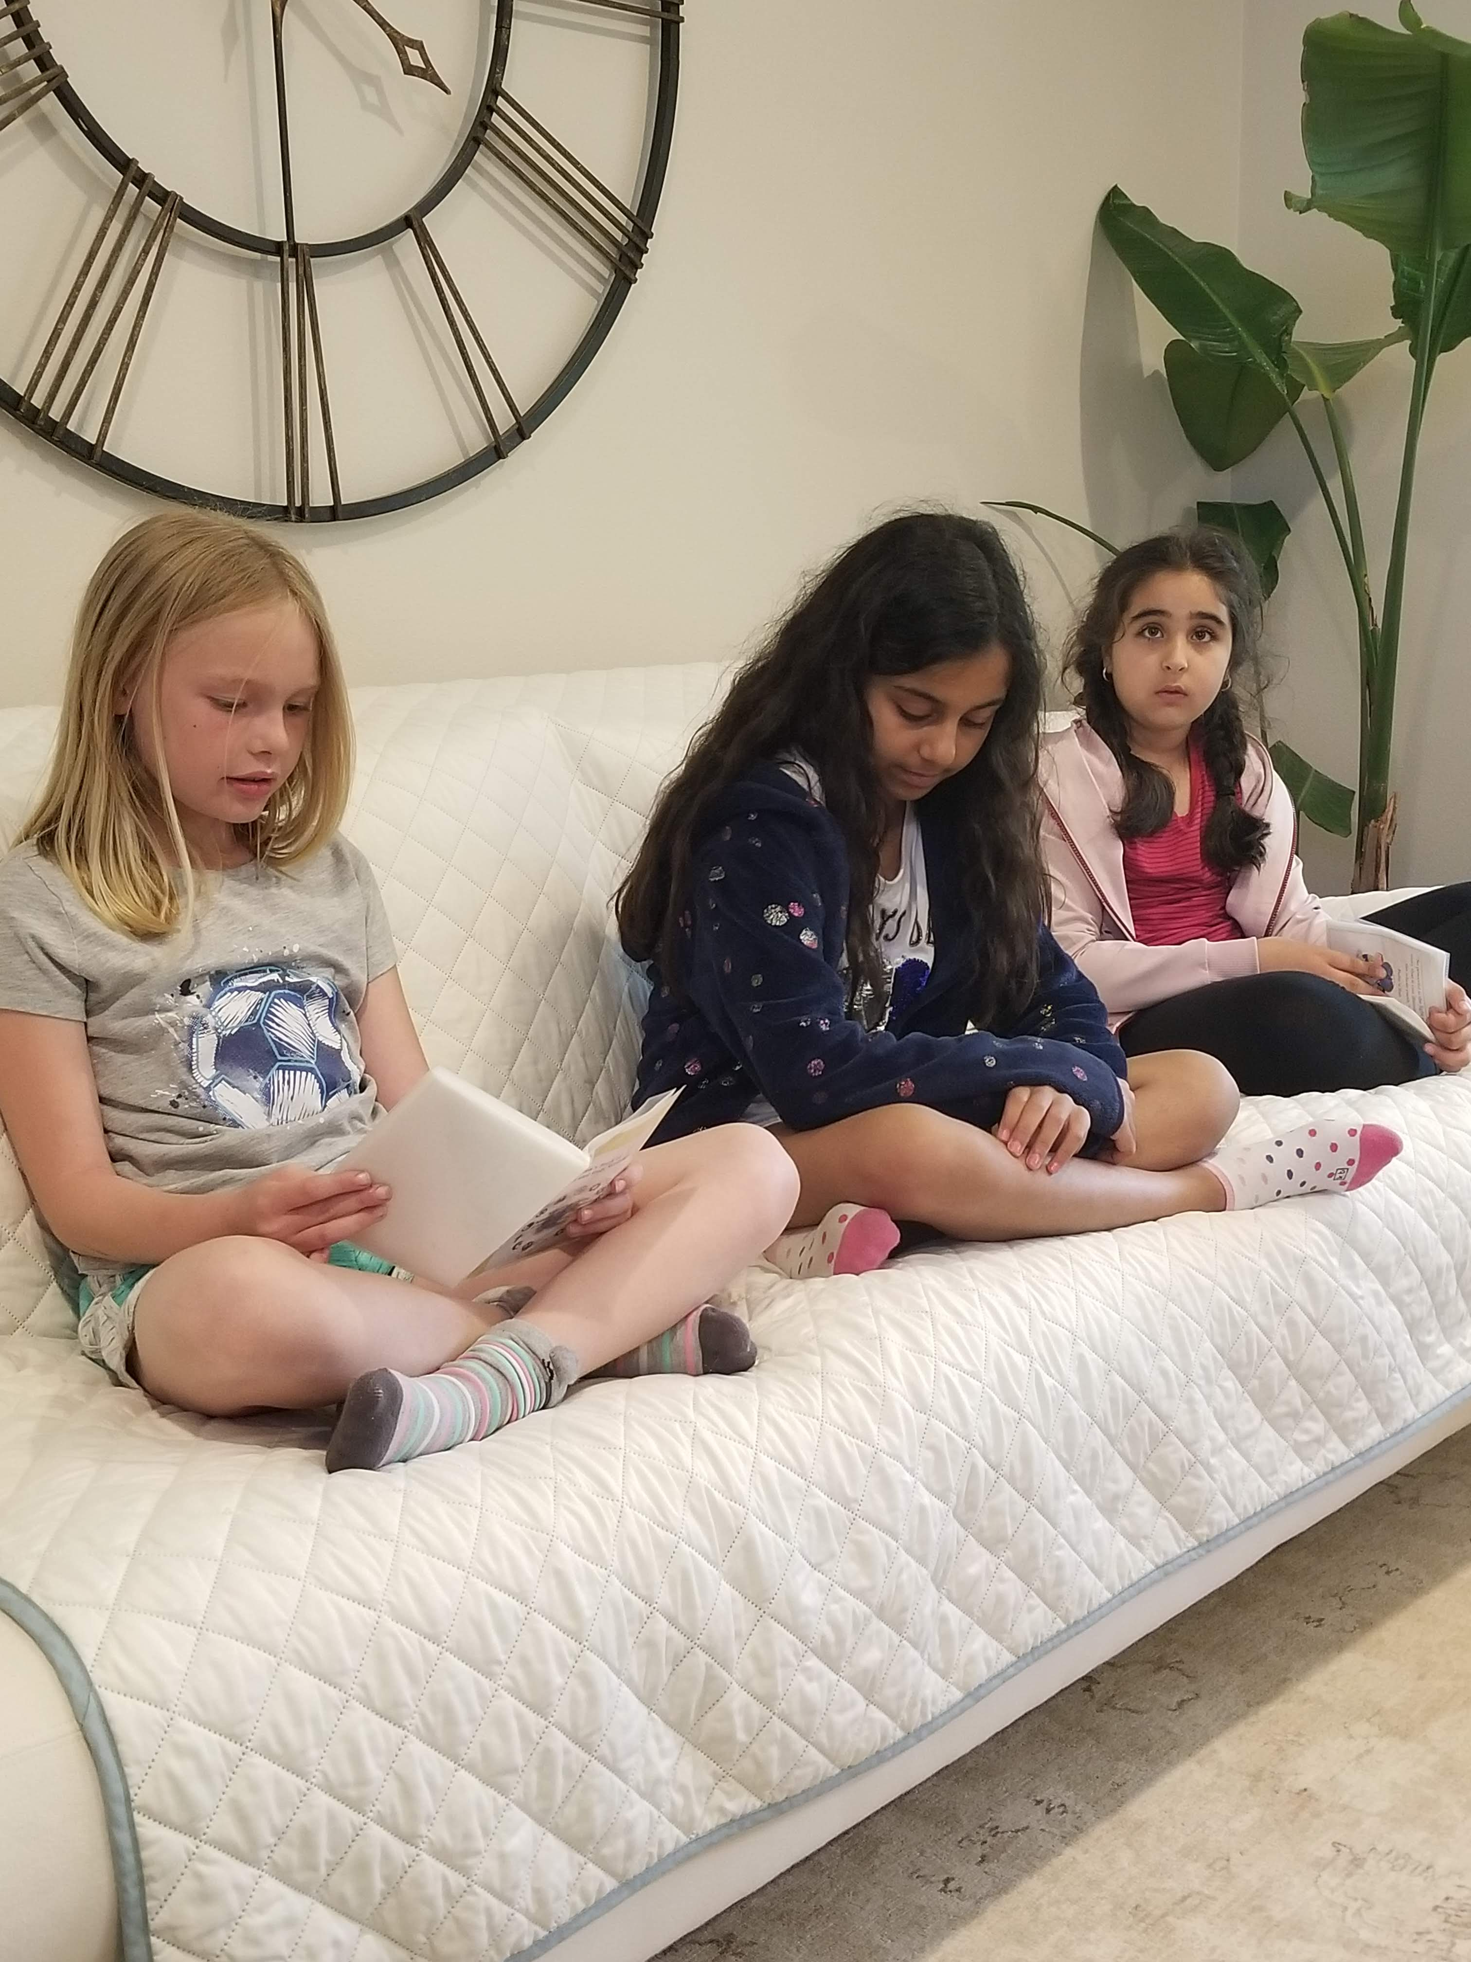
Prayers

Slide 3
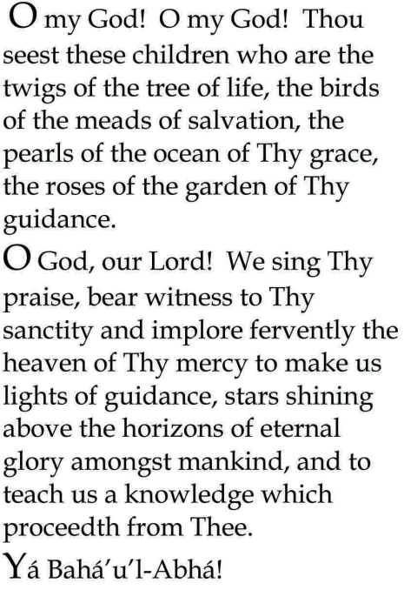


Slide 4

Lesson Theme
Consultation
Lesson Today: “We come together in search of truth”

Slide 5

Sometimes we do not know how best to move forward, but God has given us a most wonderful gift to help us learn little by little how to put His teachings into practice and follow His Divine guidance.

Slide 6

Do you know what that gift is?

Slide 7

CONSULTATION!

Slide 8


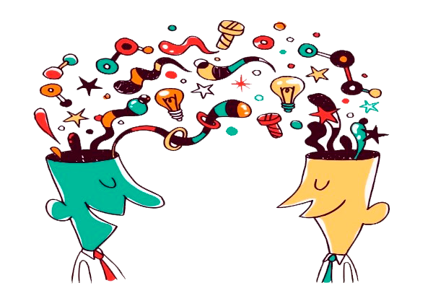
When we consult….
we come together in search of truth
we talk about ideas, and we share understanding
we discuss the possibilities

Slide 9

Everyone participates, so that we can learn from each other, and come up with a unified vision for moving forward.

Slide 10

We know that, as we take action, reflect on our efforts, discuss what we have learned in a loving and prayerful manner, and study God's teachings, the path that lies ahead will become more and more illuminated.

Slide 11
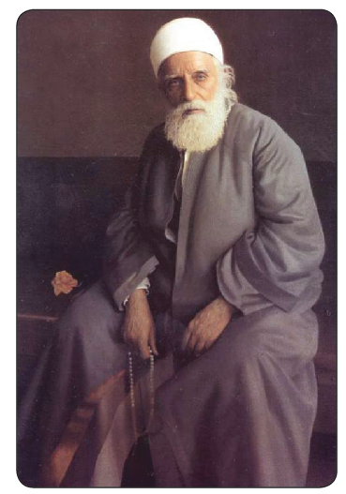
'Abdu'l-Baha and Consultation

Slide 12
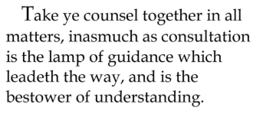
Quote

Slide 13
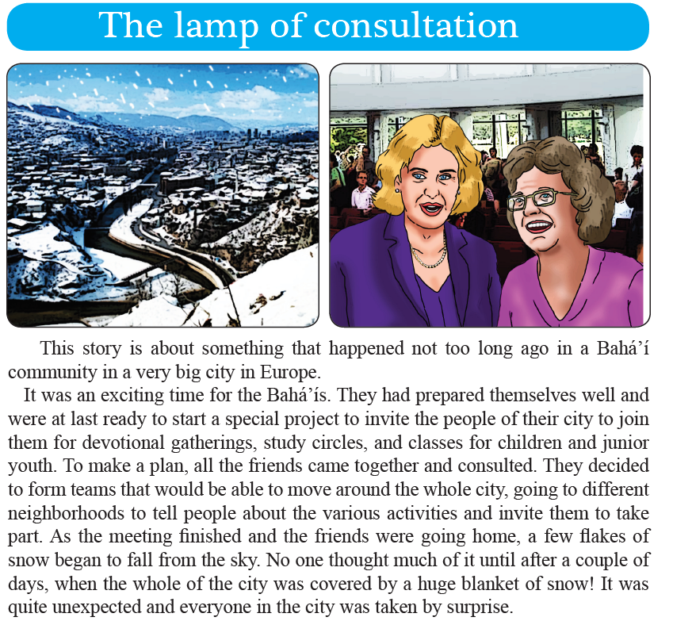

Slide 14
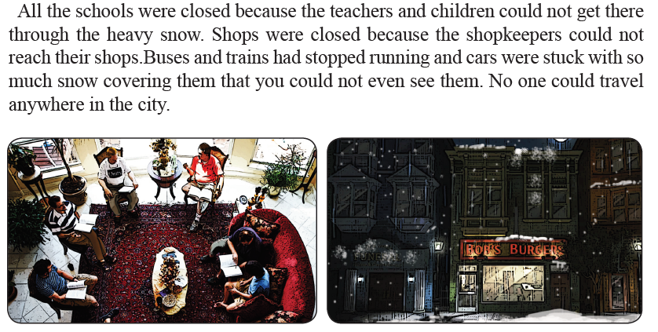

Slide 15
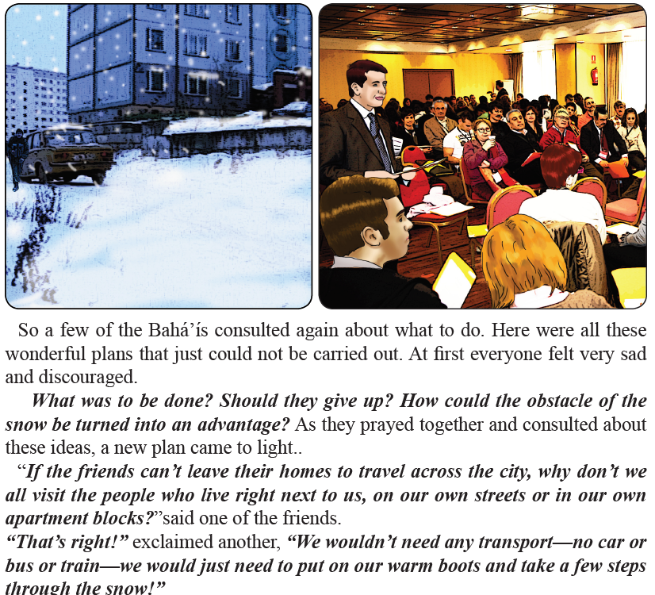

Slide 16
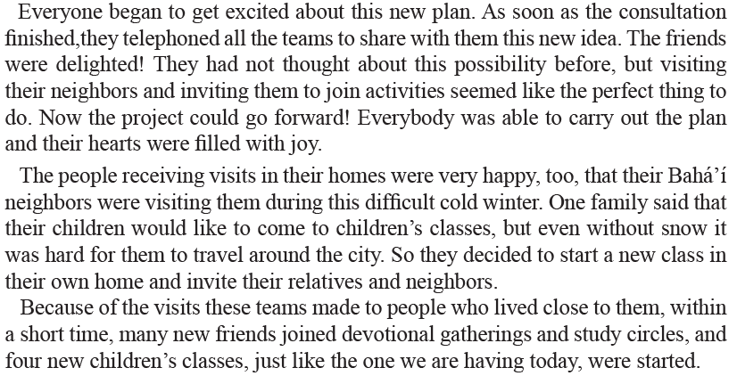

Slide 17
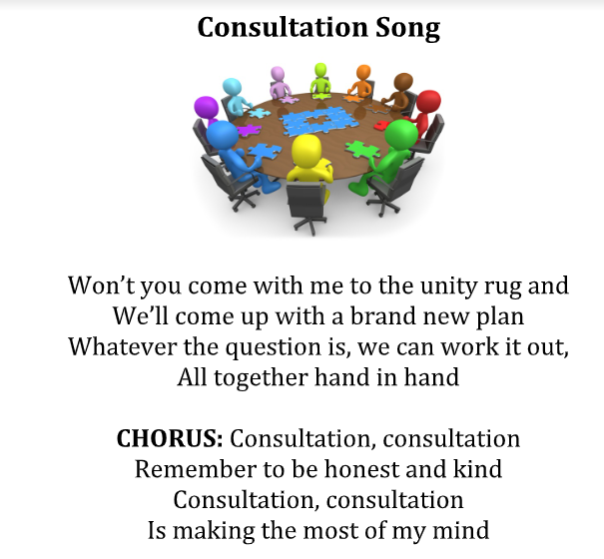
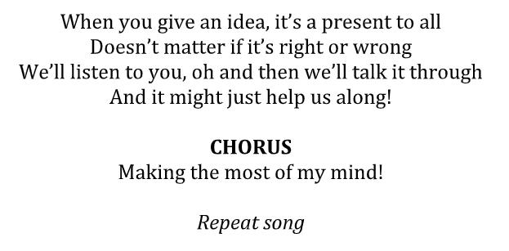
Song

Slide 18
Drama
Drama focused to the theme of today's lesson:
One night, the king arrives riding an animal no one has ever seen before.

Slide 19
Art
Students draw an elephant with no consultation.

Slide 20
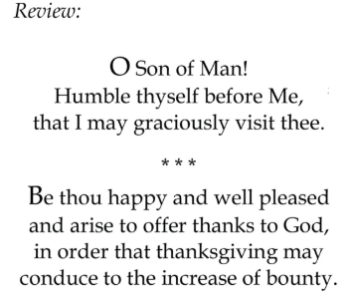

Slide 21
Closing prayer

Slide 22
