Slide 1
Welcome!

Slide 2
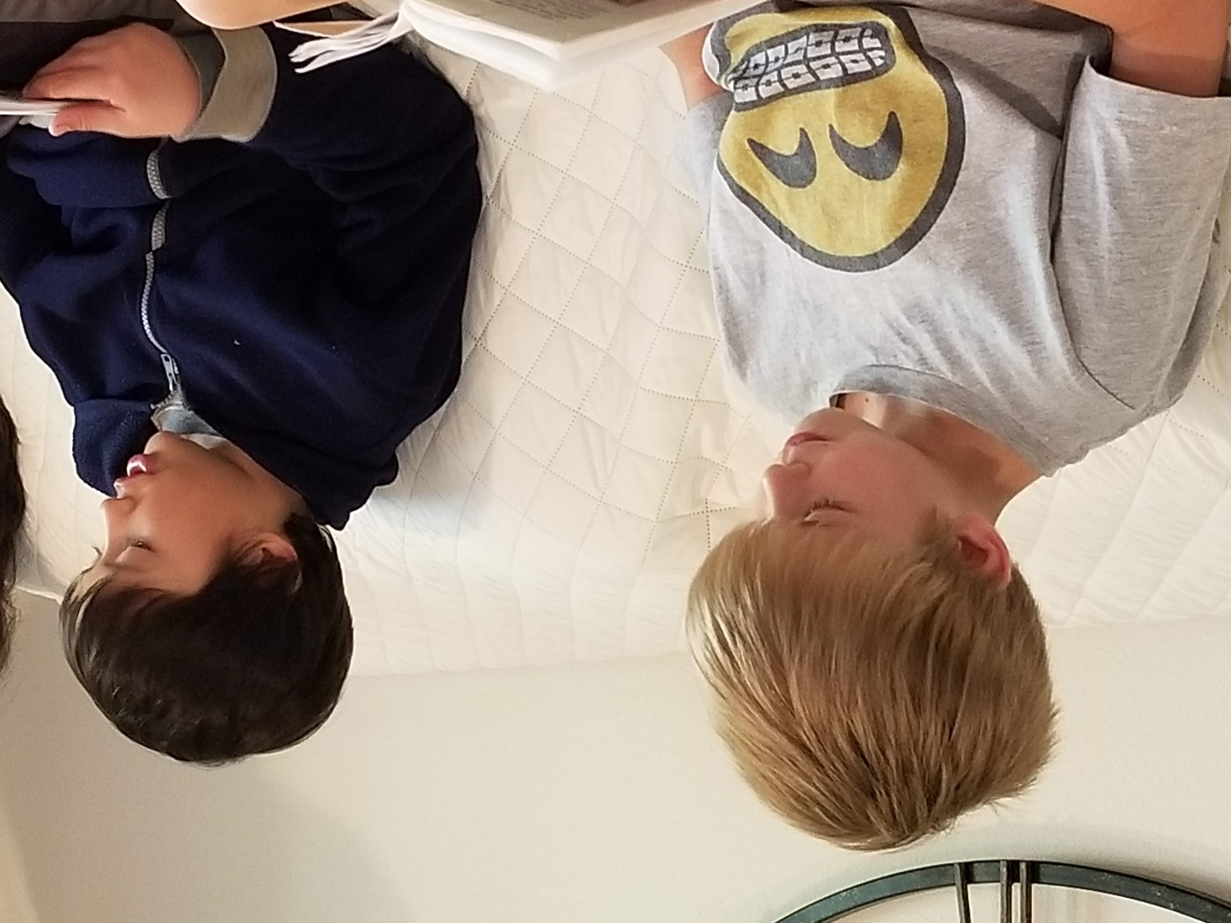
Prayers

Slide 3
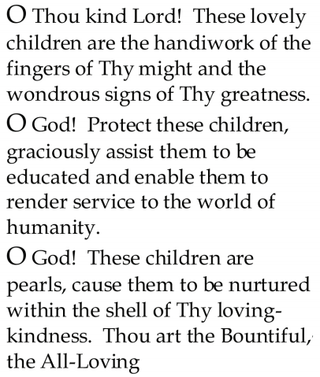


Slide 4
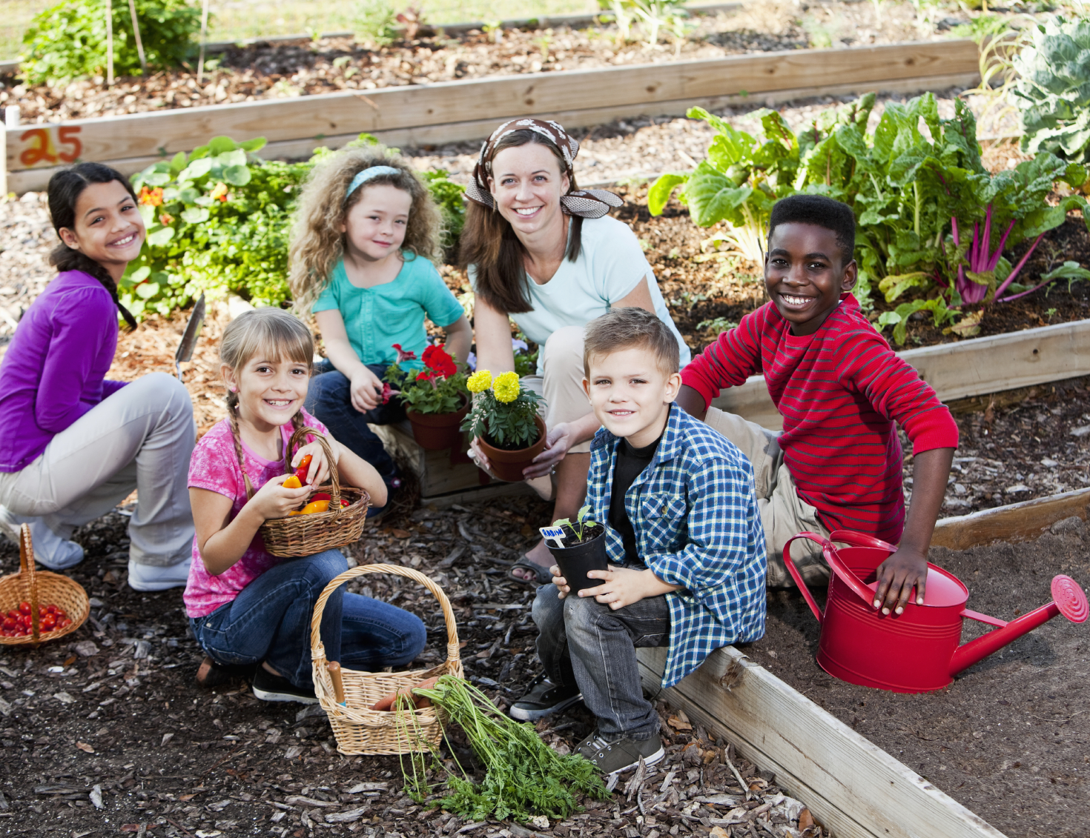
Lesson Theme
Devoting One’s Life to Service
Last Week: “Working Hard for the Benefit of All”
Lesson Today: “Work Done in the Spirit of Service”

Slide 5

As we grow up, we each become engaged in different kinds of work and make effort to acquire the skills and abilities, knowledge and qualities, we need to serve.

Slide 6
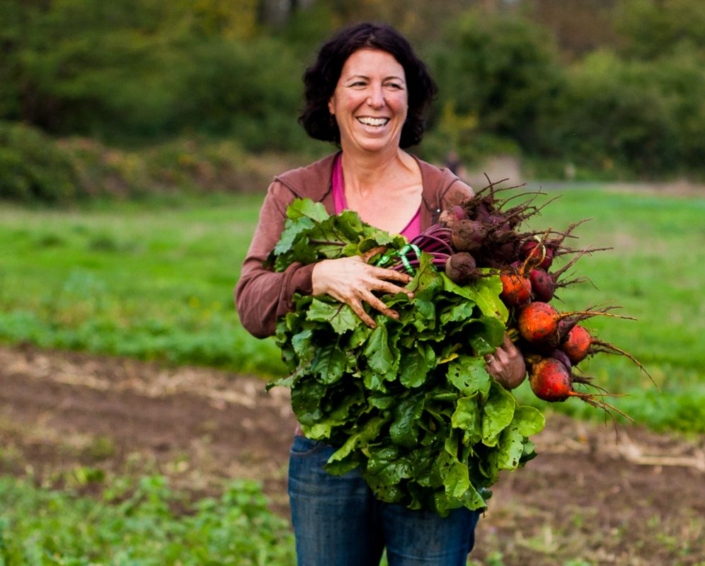



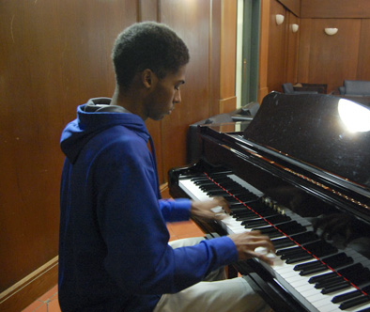
The Baha'i Writings tell us that work done in the spirit of service is accepted by God as worship.

Slide 7
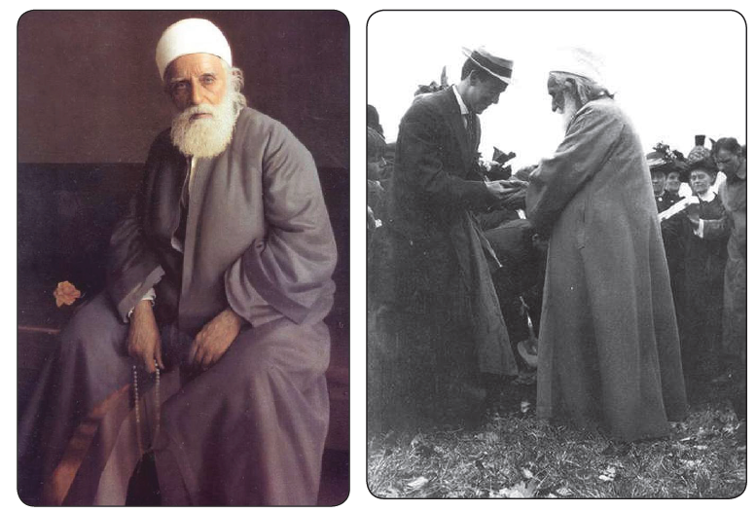
". . . it is incumbent upon every soul to acquire a trade and an occupation. For example, l know how to weave or make a mat, and you know some other trade. This, in itself is an act of worship, provided that it is conducted on the basis of utmost honesty and faithfulness.“ - Abdu'l-Baha

Slide 8
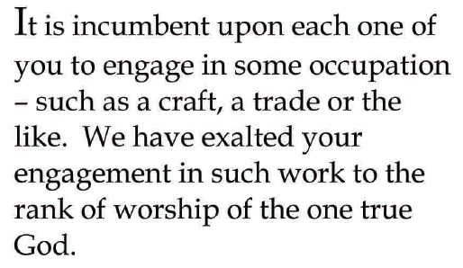
Quote

Slide 9
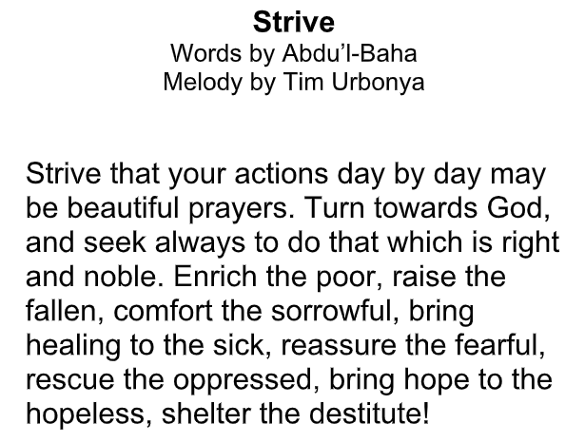
Song

Slide 10
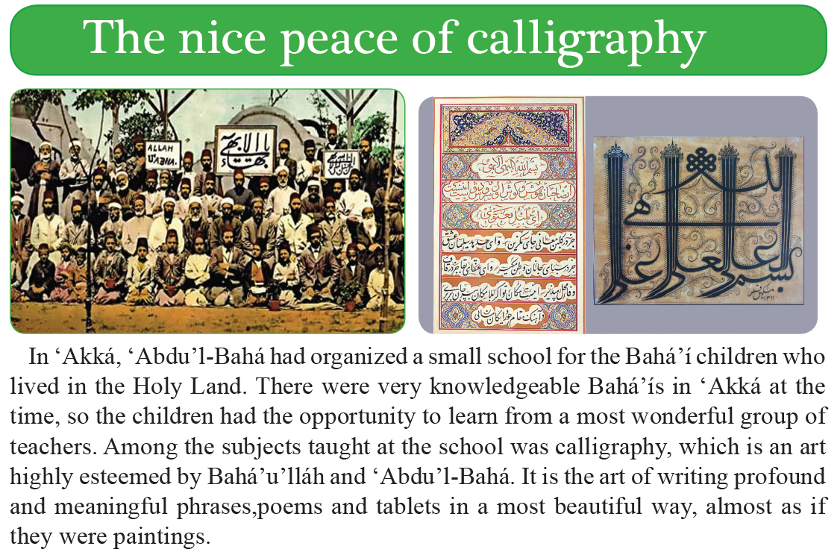

Slide 11
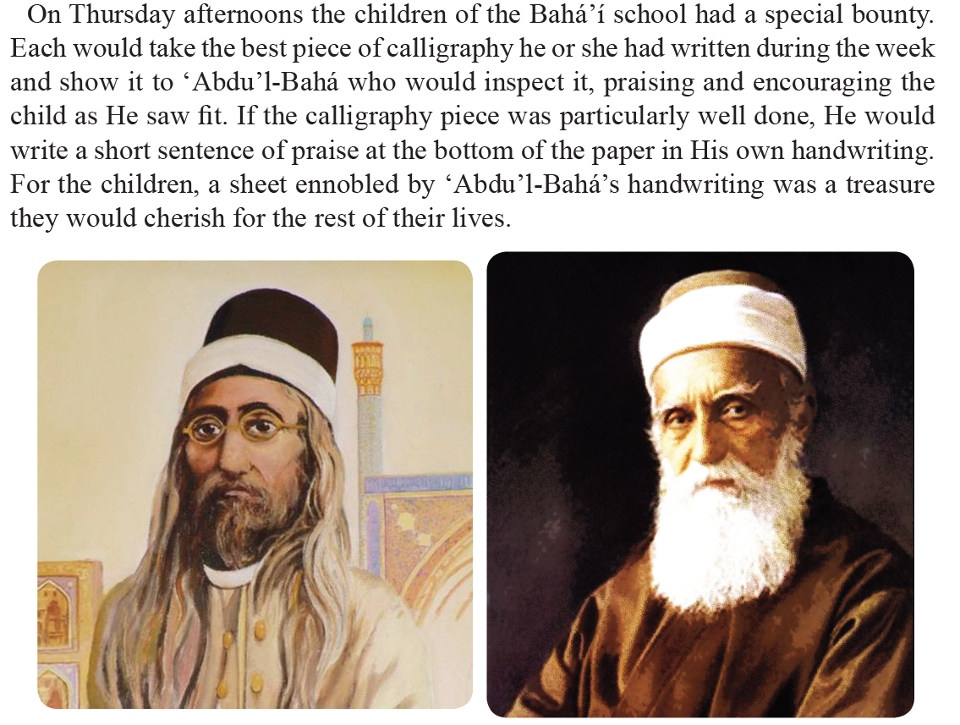

Slide 12
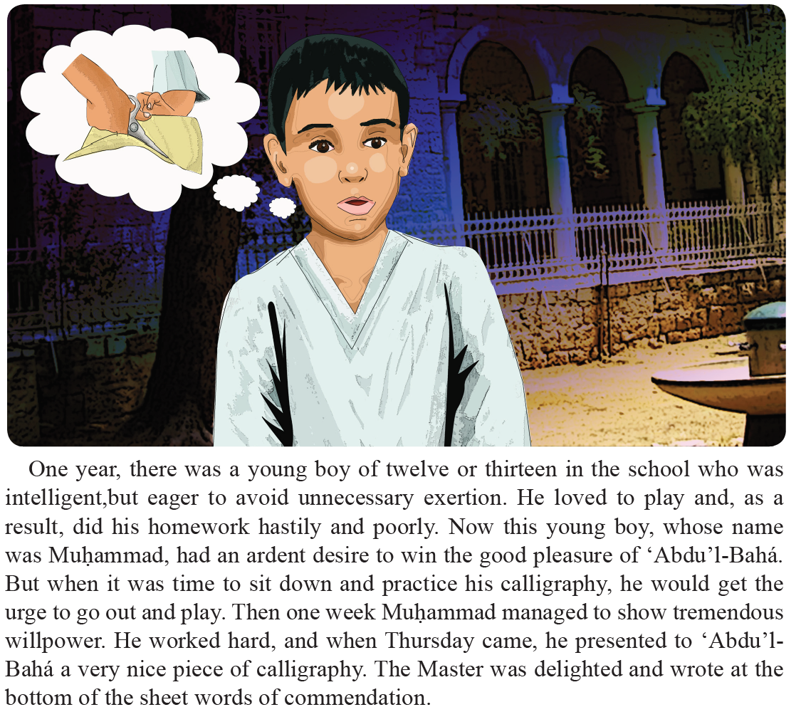

Slide 13
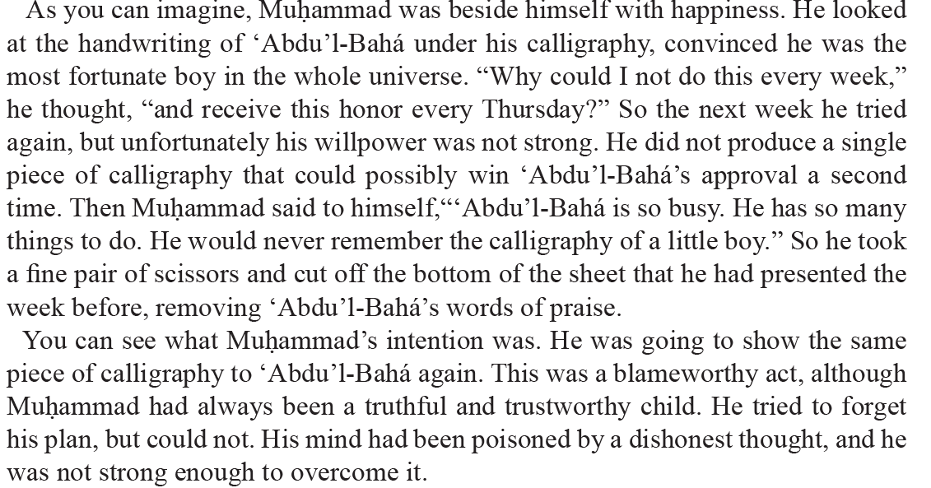

Slide 14
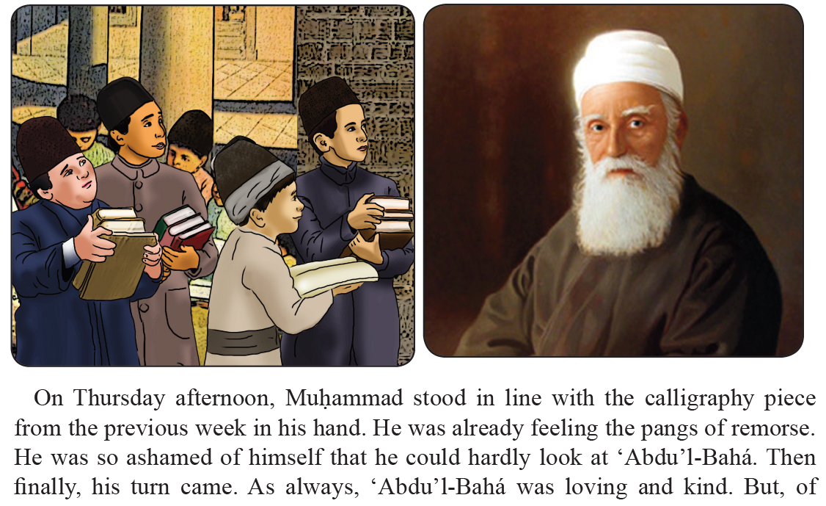

Slide 15
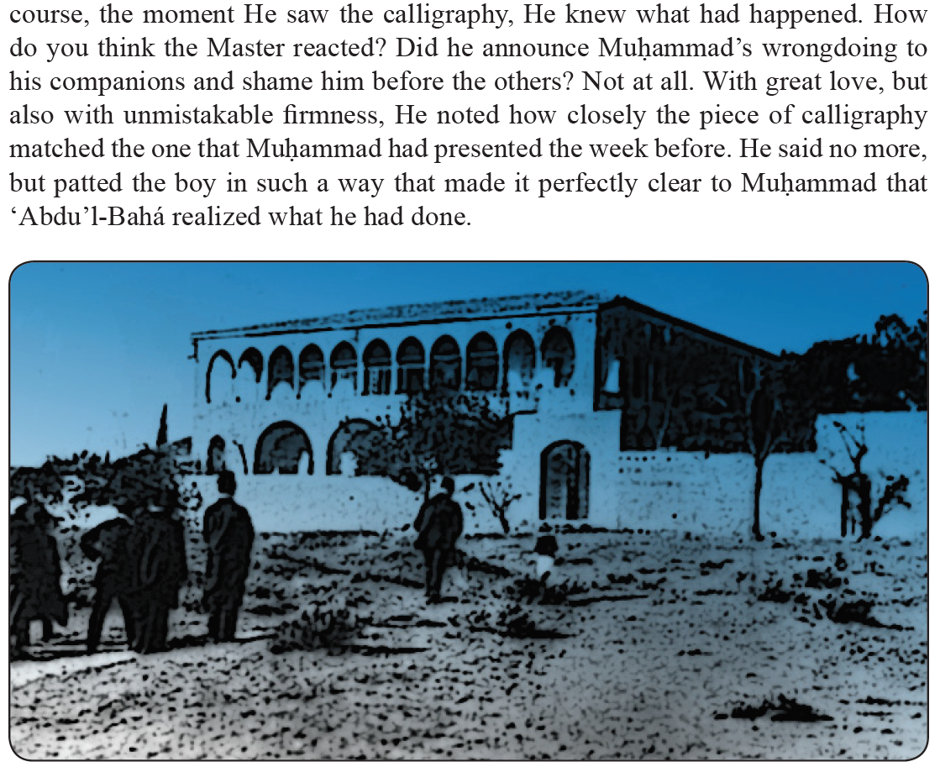

Slide 16
Drama
Drama focused to the theme of today's lesson, of what kind of work you might want to do in the future.

Slide 17
Art
Students draw a scene or an image that will reinforce the ideas they have learned in this lesson. Drawing a picture of what they want to be in the future.

Slide 18
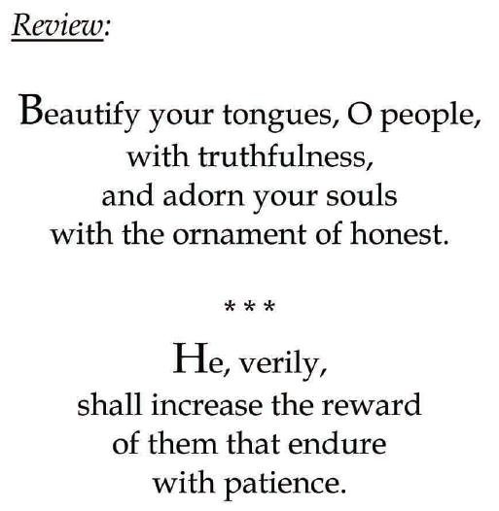

Slide 19
Closing prayer

Slide 20
