Slide 1
Welcome!

Slide 2
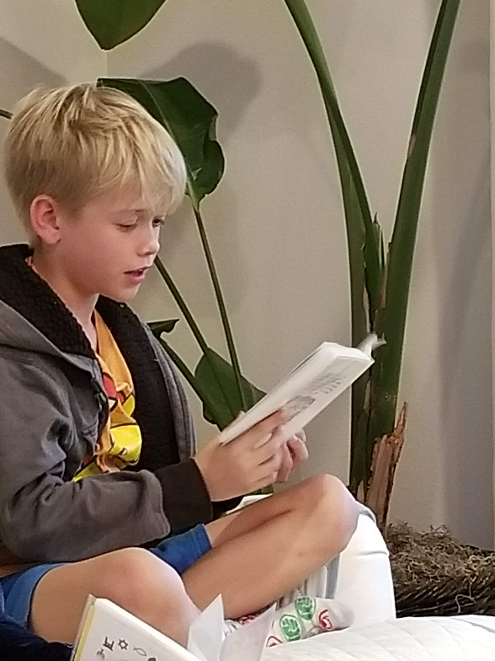
Prayers

Slide 3
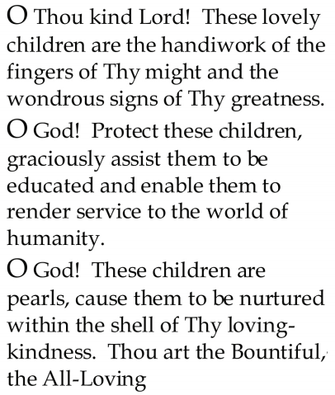


Slide 4
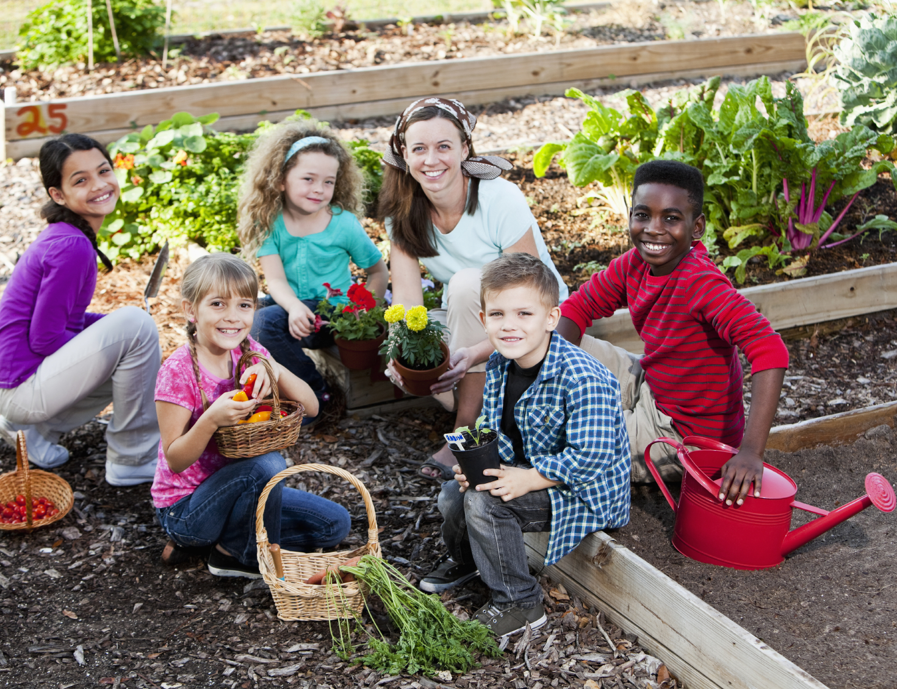
Lesson Theme
Devoting One’s Life to Service
Last Week: “Draw nearer to God through service”
Lesson Today: “Working Hard for the Benefit of All”

Slide 5
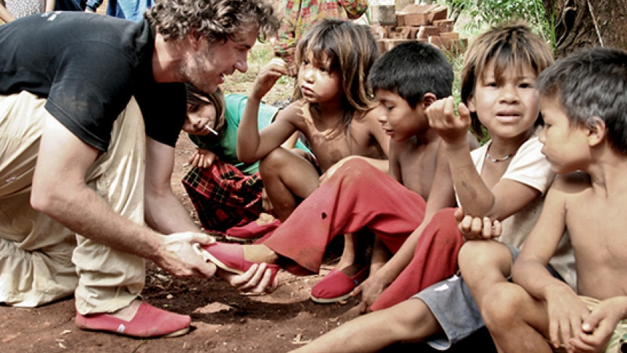
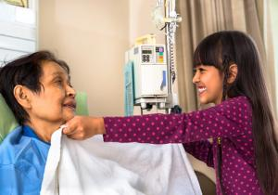
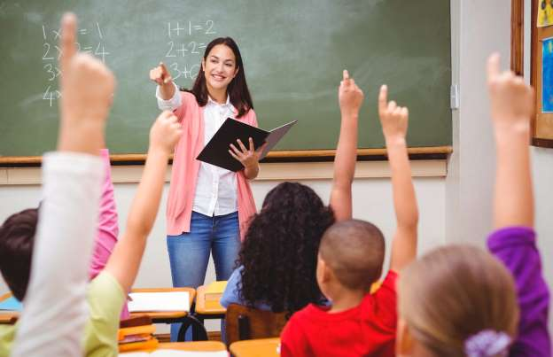
If we are to serve God and humanity, effort is required. We must be diligent and hard working.

Slide 6
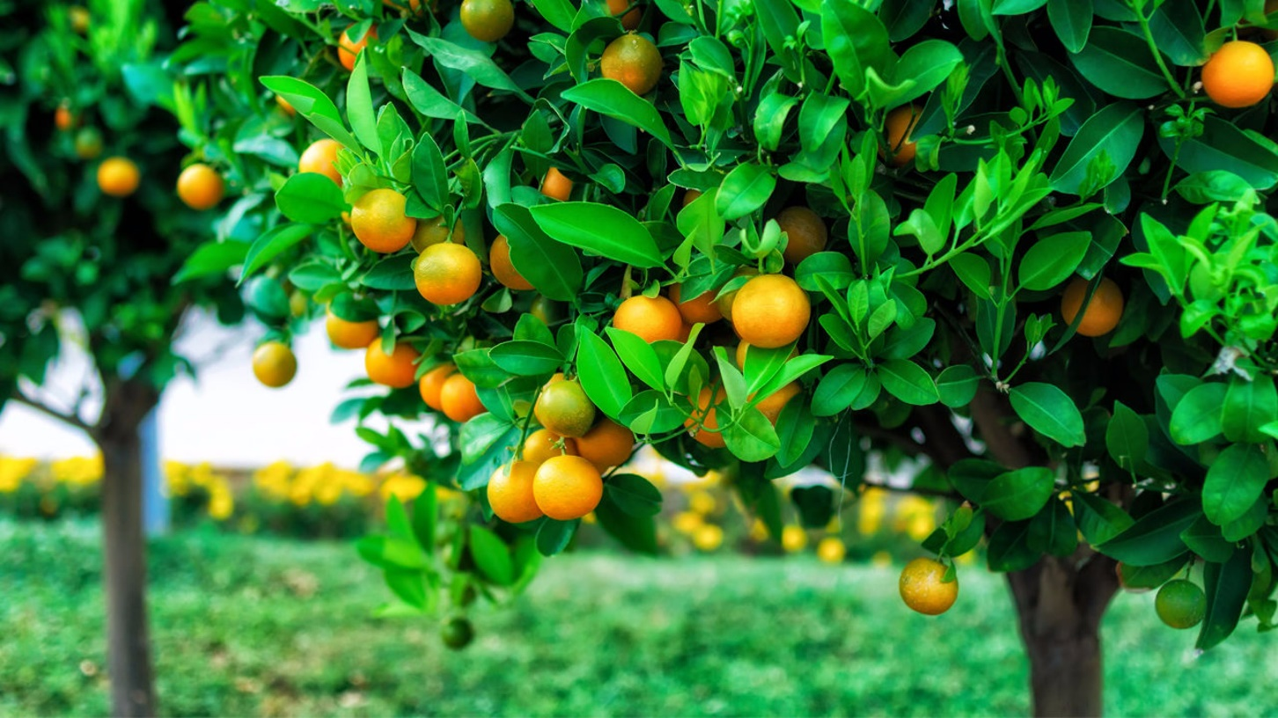
Like trees that give forth goodly and wondrous fruits for the benefit and enjoyment of all,
we make effort and work for the good of those around us

Slide 7
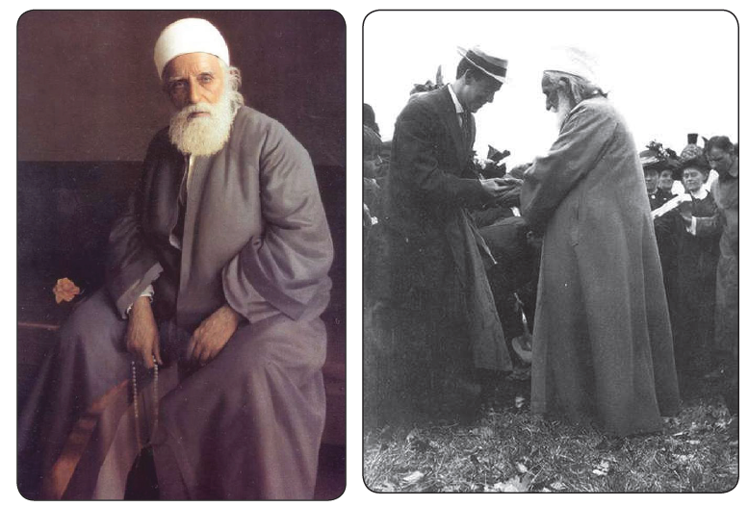
Throughout His life, 'Abdu'l-Baha was constantly active, working for the good of all.

Slide 8
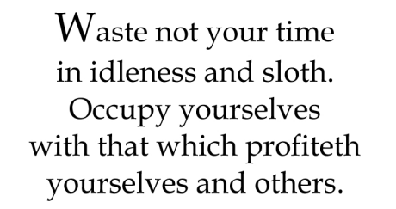
Quote

Slide 9
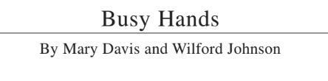
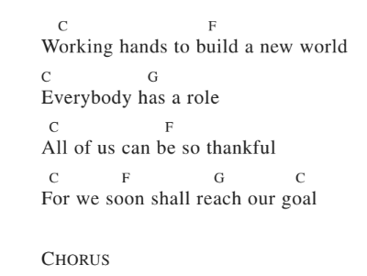
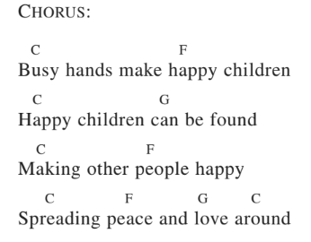
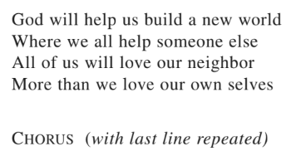
Song

Slide 10
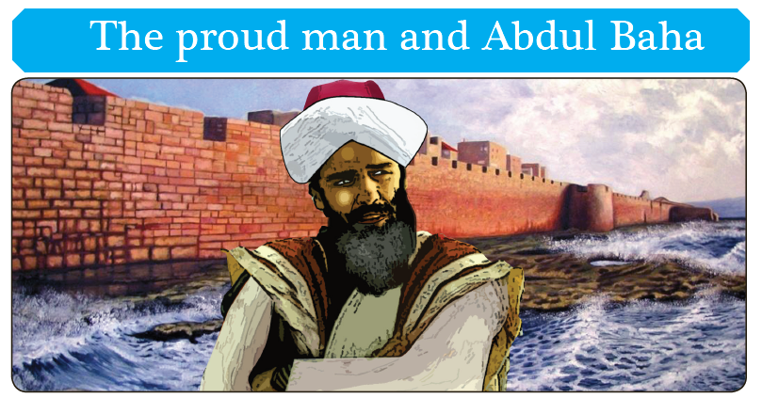

Slide 11
Drama
Drama focused to the theme of today's lesson, of how to perform acts of service.
“The King and the Old Man”

Slide 12
Art
Have the students draw a scene or an image that will reinforce the ideas they have learned in this lesson. Drawing a picture of the king, the old man and the fruit trees might be a suitable choice.

Slide 13
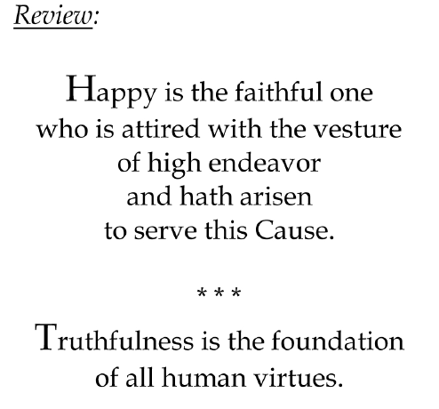

Slide 14
Closing prayer

Slide 15
