Slide 1
Welcome!

Slide 2
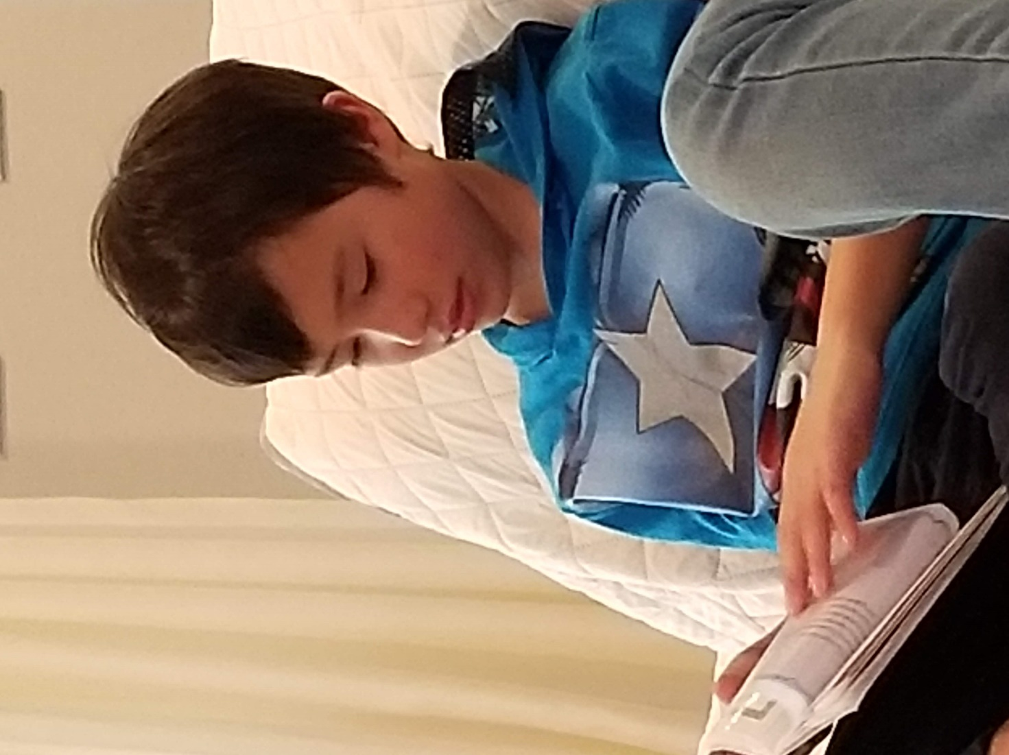
Prayers

Slide 3
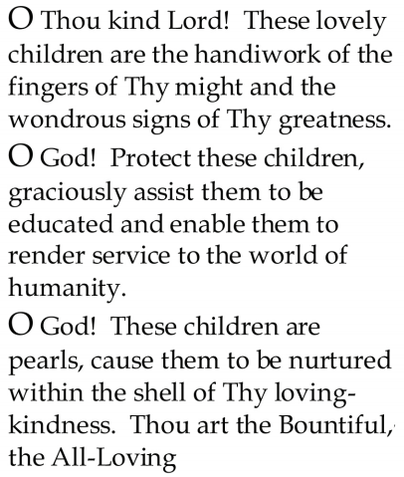


Slide 4
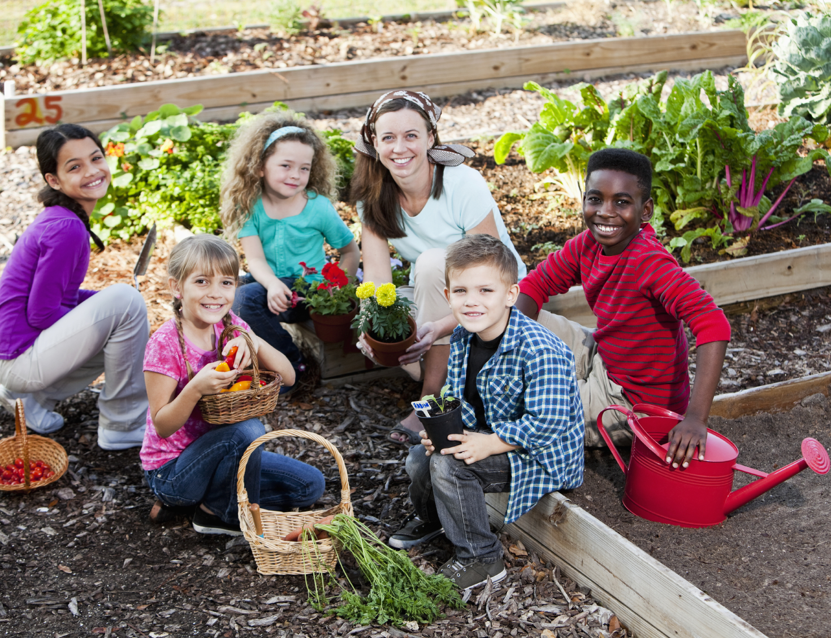
Lesson Theme
Devoting One’s Life to Service
Last Week: “Being a Friend to the Whole Human Race”
Lesson Today: “Draw nearer to God through service”

Slide 5
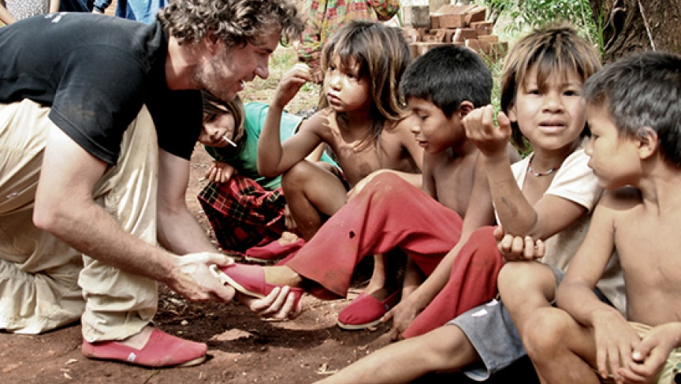
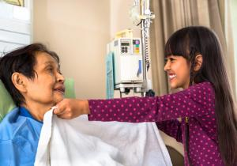

There are many ways in which we can serve our fellow human beings.

Slide 6
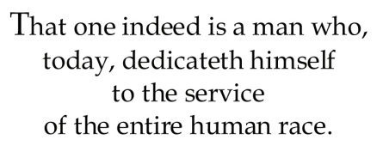
Quote

Slide 7
Quote

Slide 8
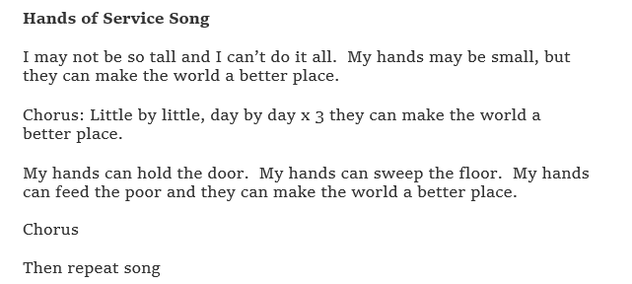
Song

Slide 9
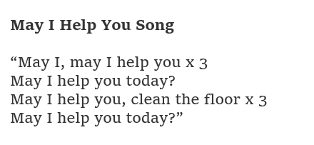
Song

Slide 10
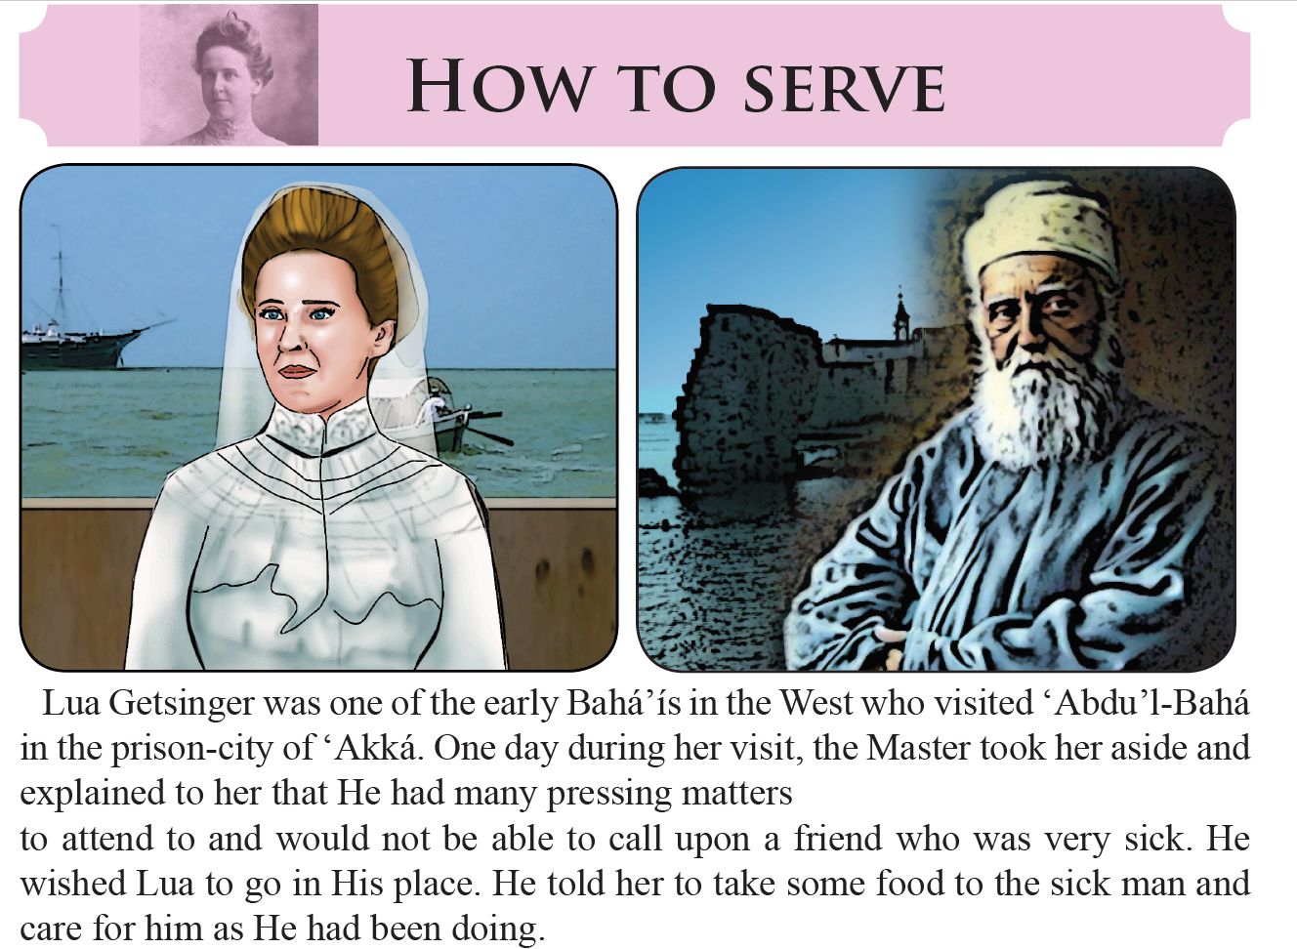

Slide 11
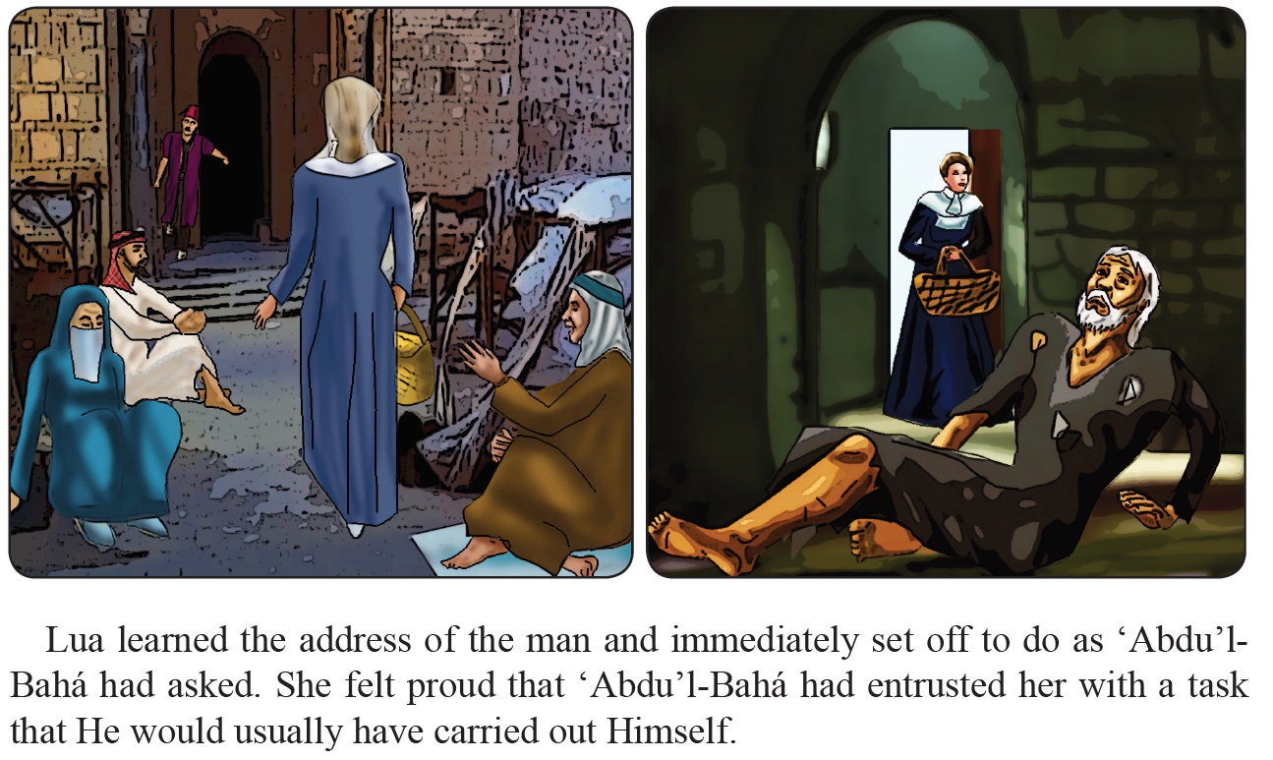

Slide 12
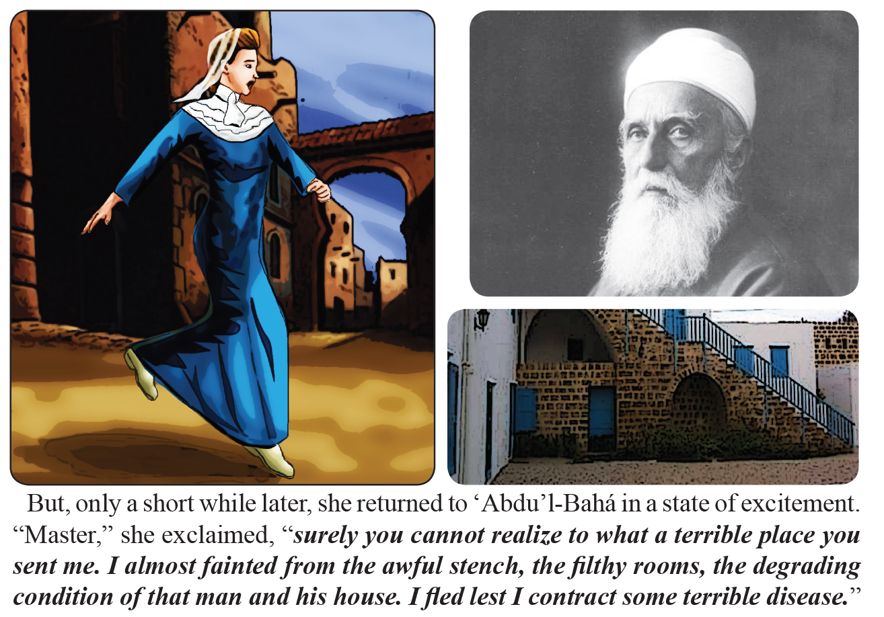

Slide 13
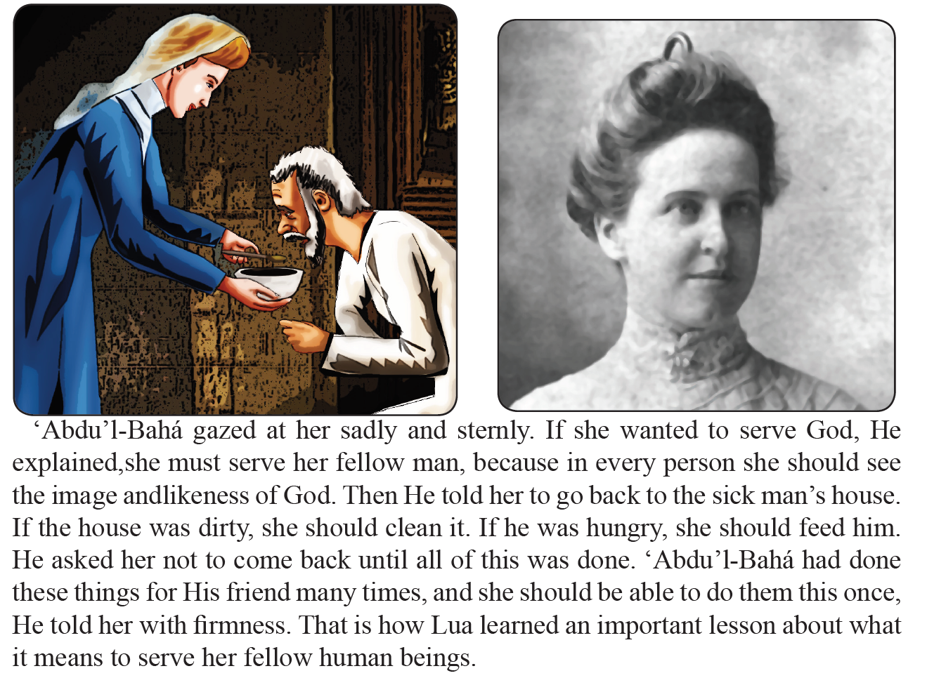

Slide 14
Drama
Drama focused to the theme of today's lesson, of how to perform acts of service.

Slide 15
Art
Have the students draw a scene or an image that will reinforce the ideas they have learned in this lesson. A picture of Lua Getsinger caring for the sick man might be a suitable choice.

Slide 16


Slide 17
Closing prayer

Slide 18
