Slide 1
Welcome!

Slide 2
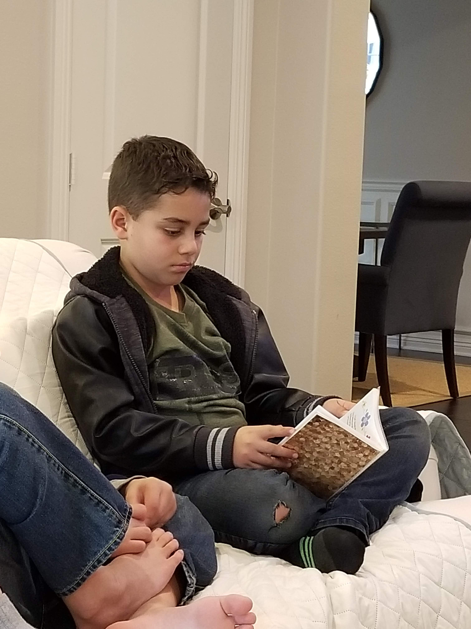
Prayers

Slide 3
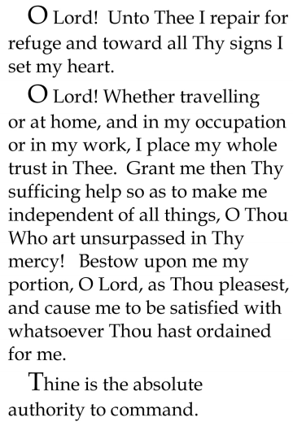


Slide 4
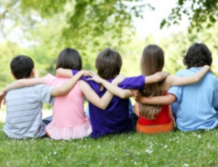
Lesson Theme
Being a Good Friend
Last Week: “Being Trustworthy”
Lesson Today: “Being a Friend to the Whole Human Race”

Slide 5

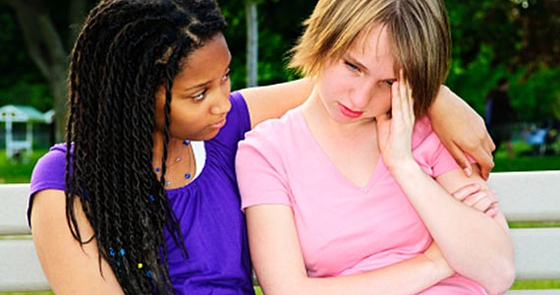
We talked about how true friends trust each other, but does that mean that one accepts blindly whatever the other says or does?
A true friend has the obligation to help the other when he or she strays from the straight path.

Slide 6
It is true that we should feel kindness in our hearts towards all humanity…
Does that mean that we should trust those who are untrustworthy or allow ourselves to be cheated or deceived in the name of friendliness and friendship?

Slide 7
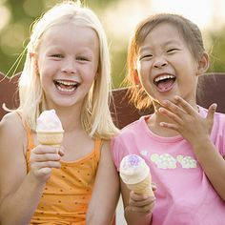
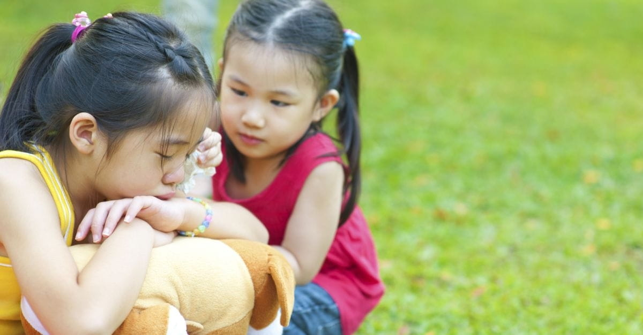
True Friends
Care for each other
Enjoy spending time together
Each wants what is best for the other
Accompany each other during time of sorrow
Help in times of need

Slide 8
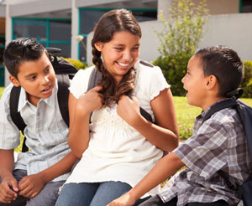
Because we want what is best for our friends, we listen to them and always try to pay attention to their wishes.
In friendship we give of our time and our possessions and share our happiness and our learning.

Slide 9
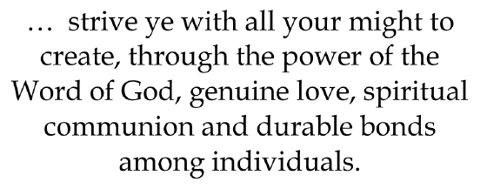
Quote

Slide 10

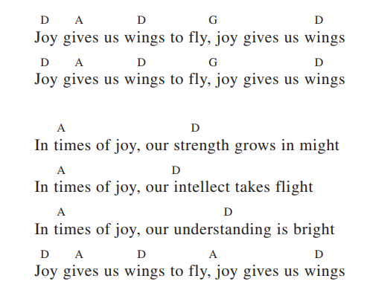
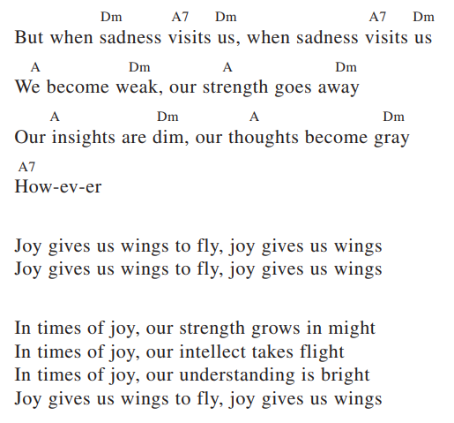

Song

Slide 11
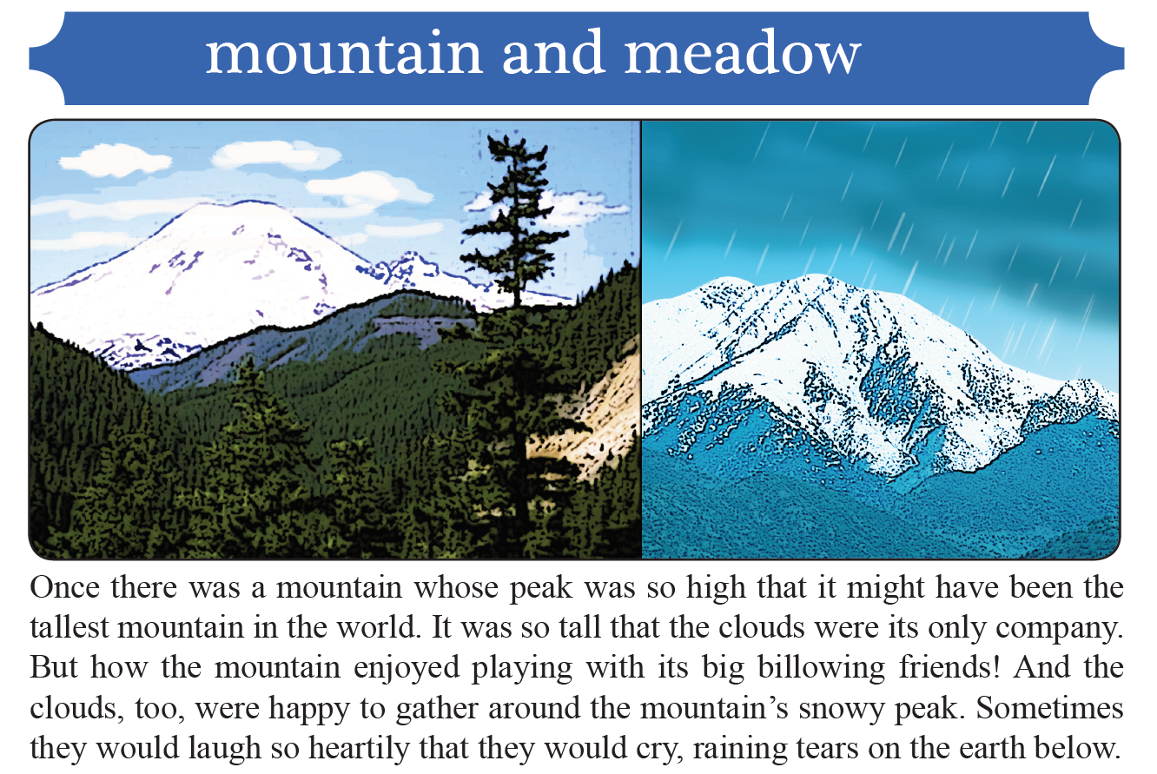
Story

Slide 12
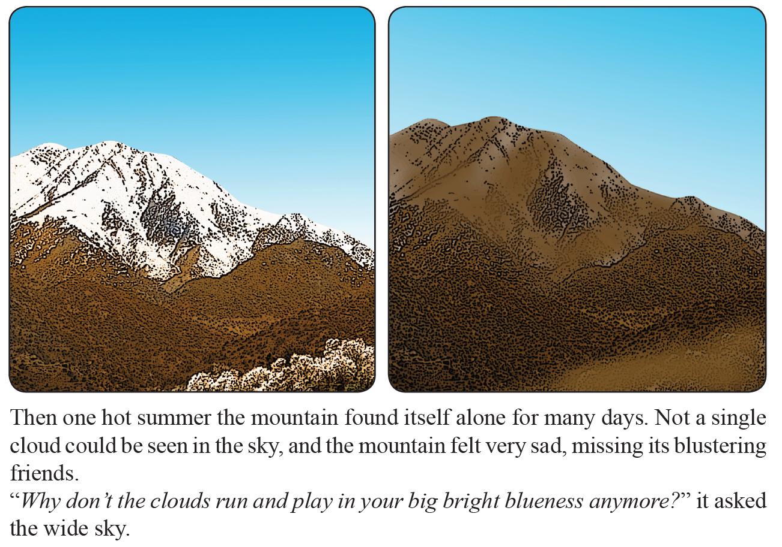

Slide 13
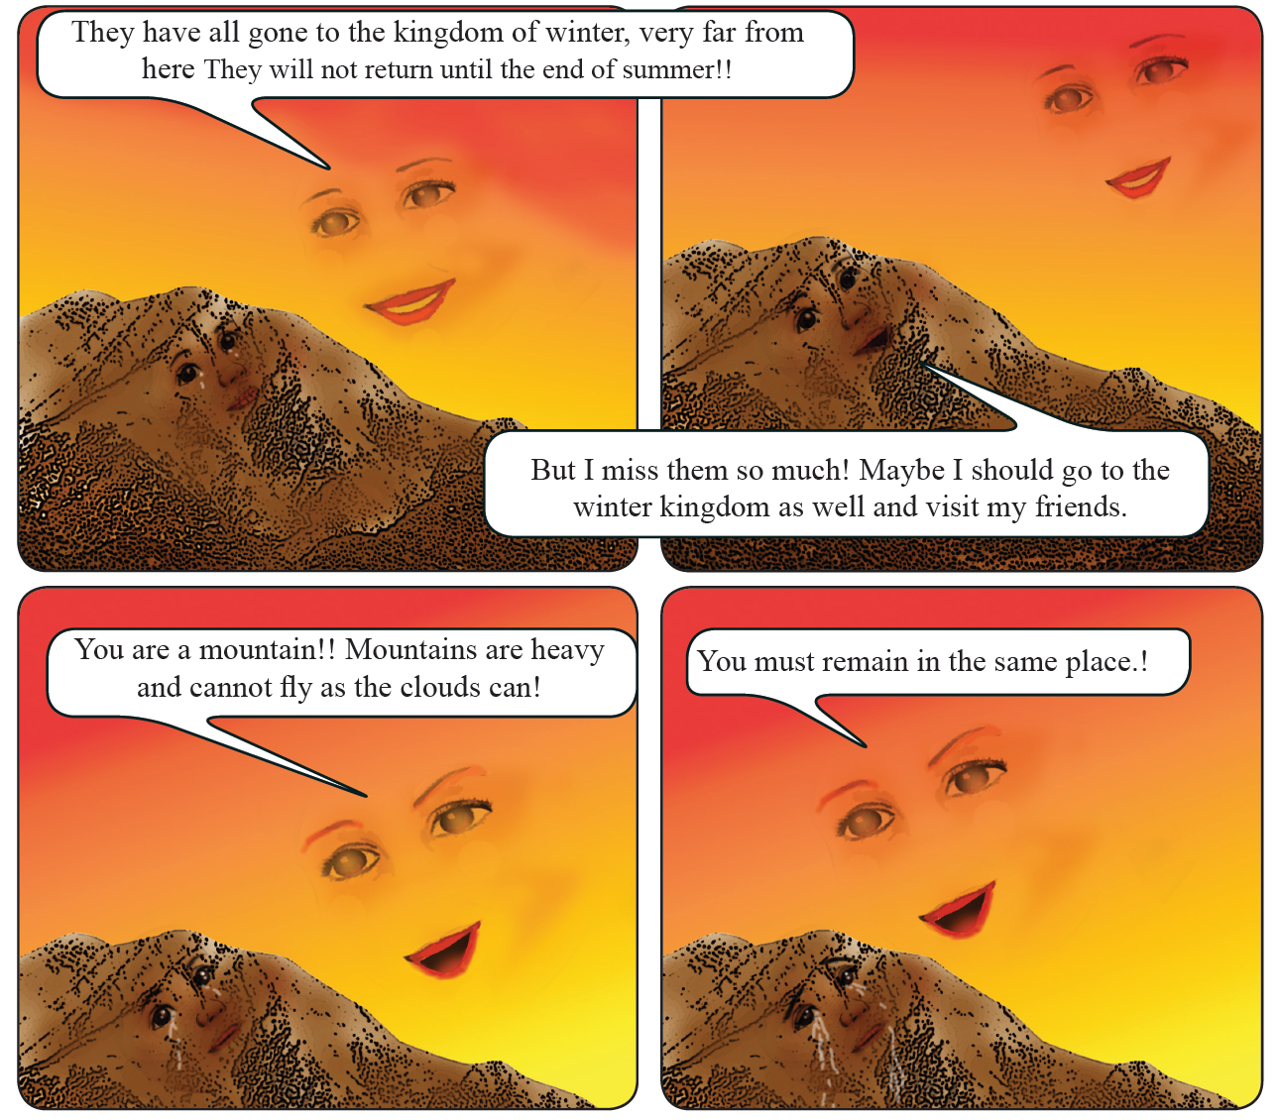

Slide 14
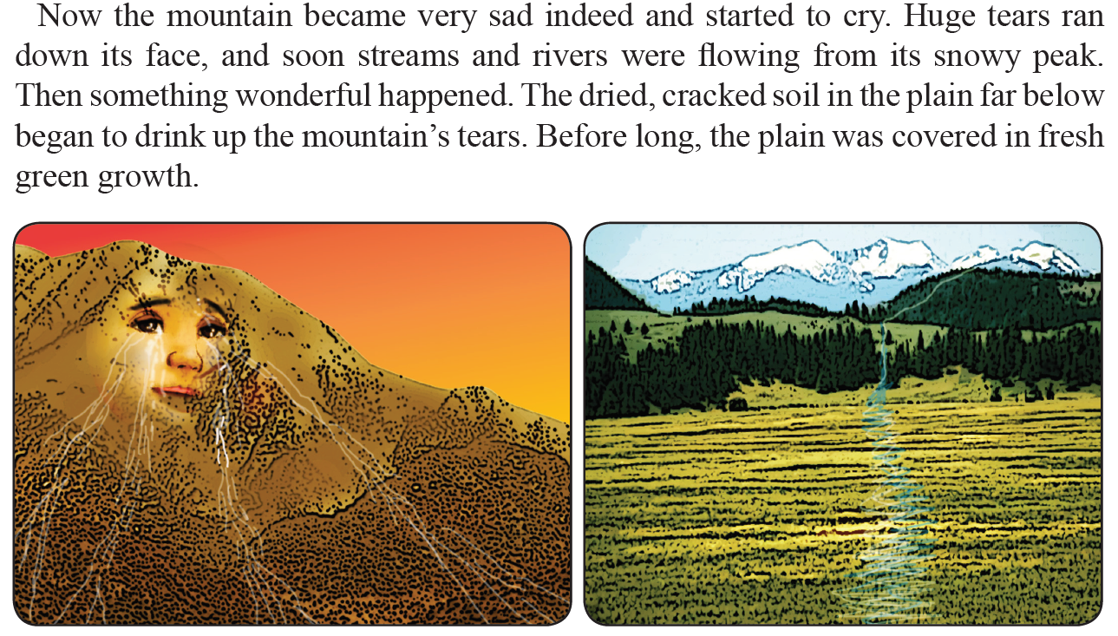

Slide 15
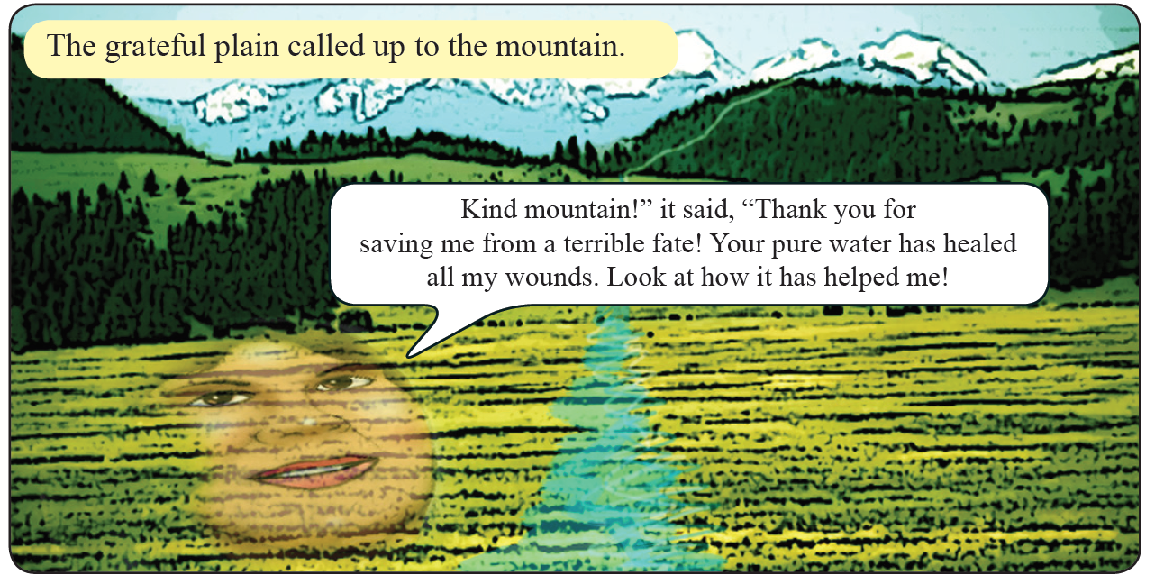

Slide 16
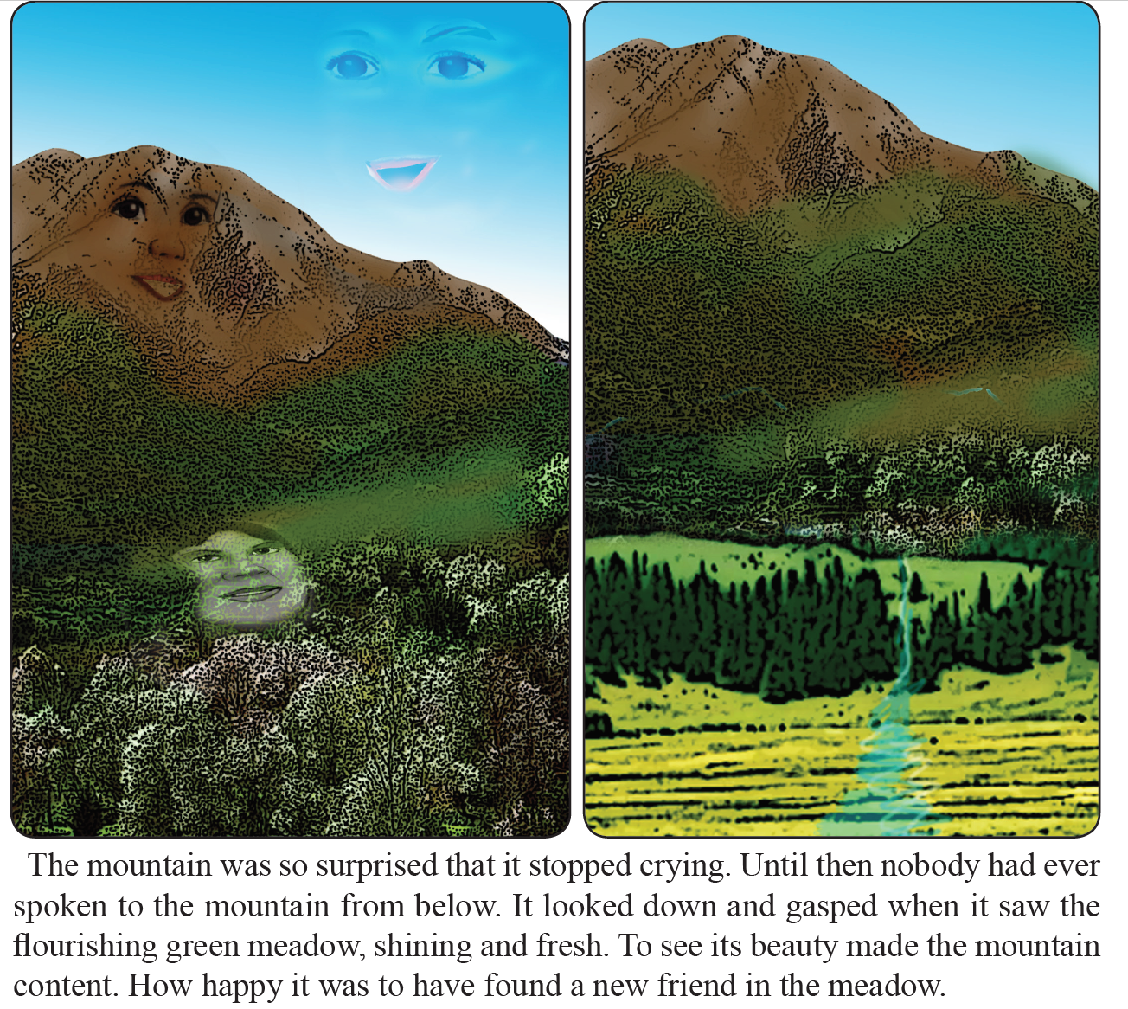

Slide 17
Drama
Drama focused to the theme of today's lesson, that true friends care for each other.

Slide 18
Art
Draw a picture of Marion and Marco visiting their friend Sarah. Another possibility would be to draw the mountain and the meadow from the story you heard.

Slide 19


Slide 20
Closing prayer

Slide 21
