Slide 1
Welcome!

Slide 2
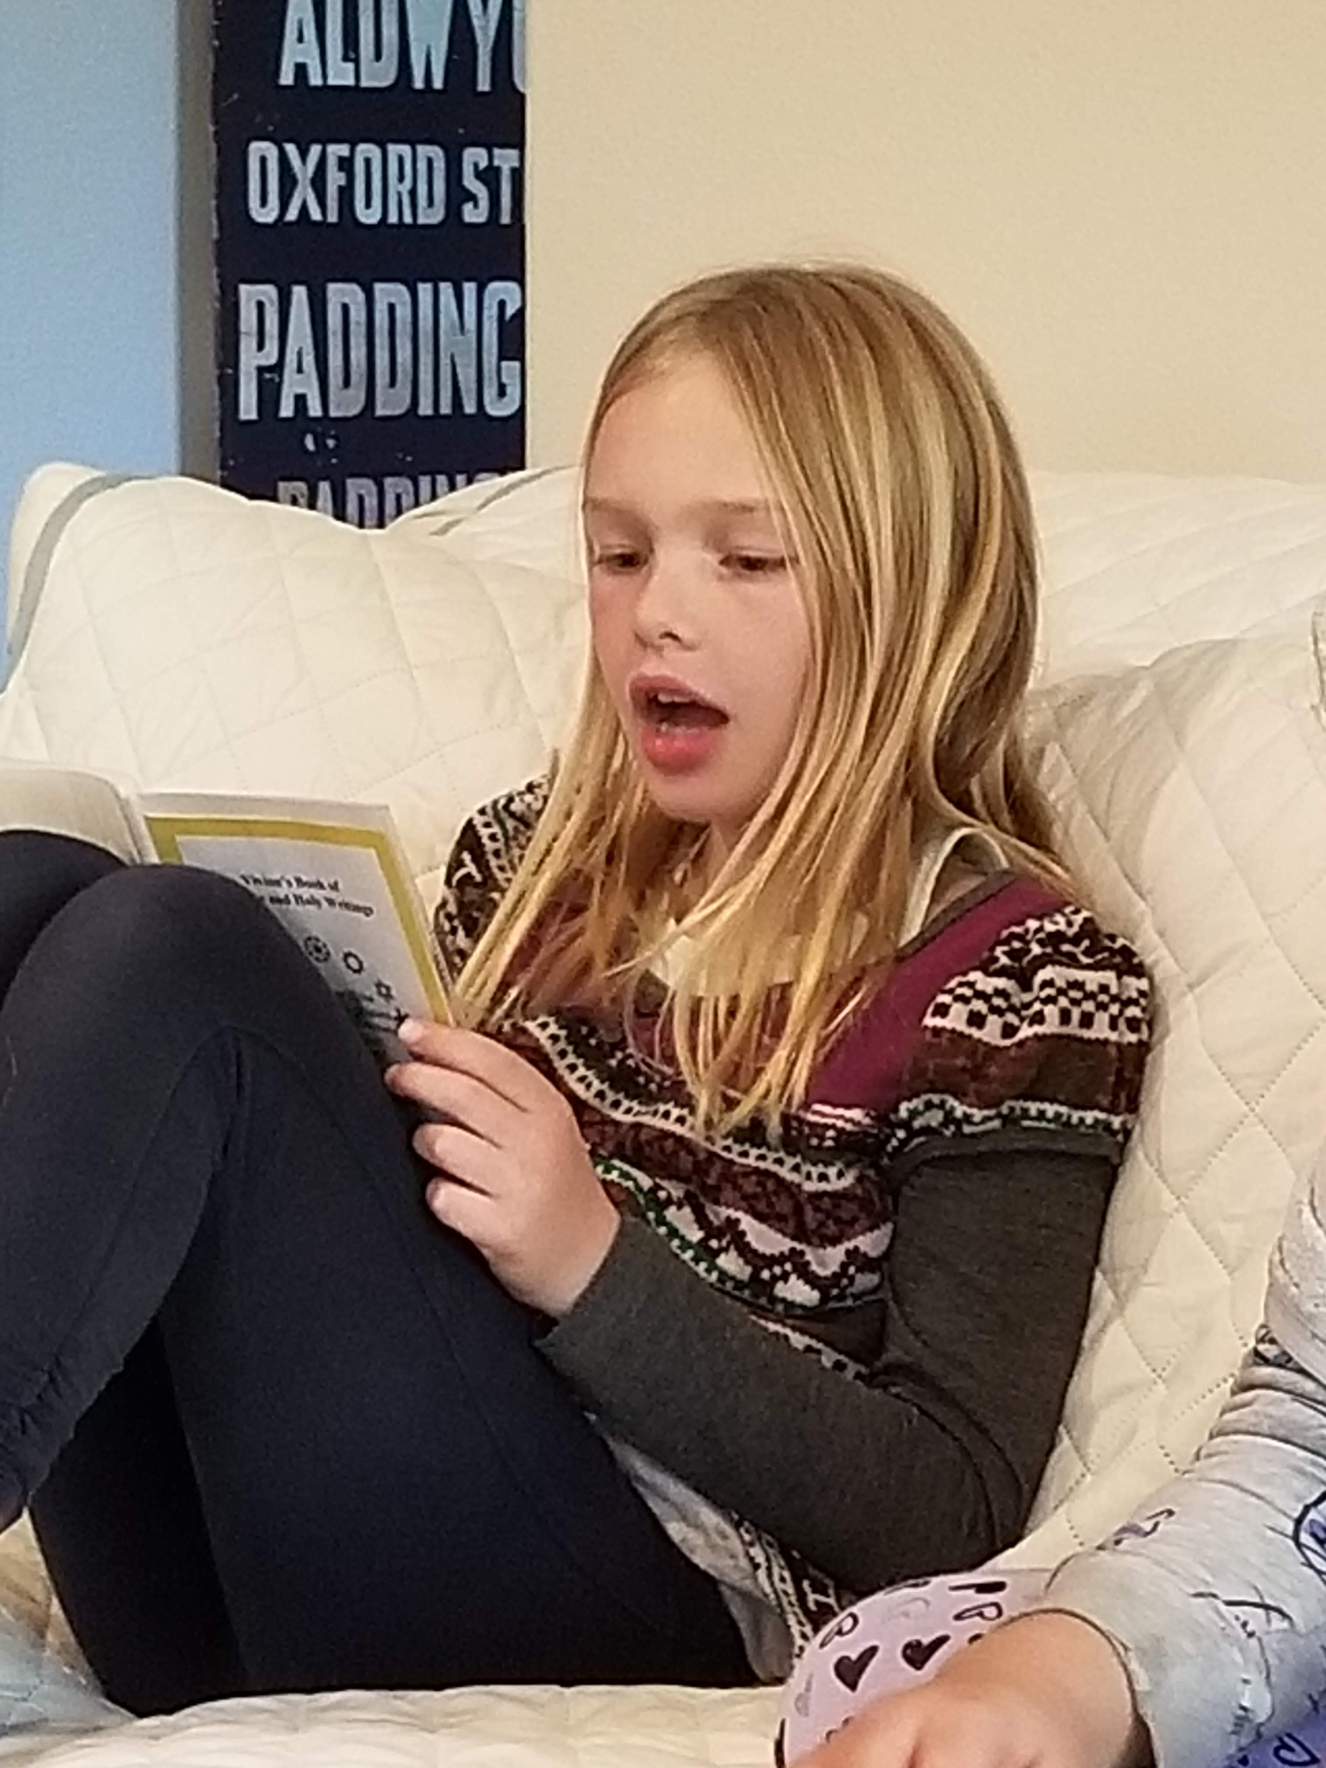
Prayers

Slide 3
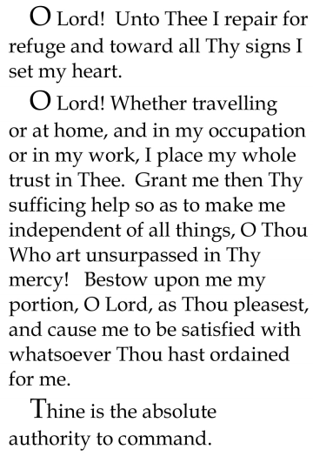


Slide 4
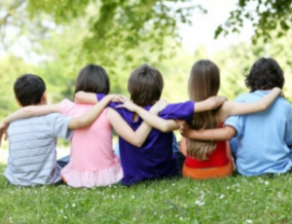
Lesson Theme
Being a Good Friend
Last Week: “God is always with us”
Lesson Today: “Being Trustworthy”

Slide 5

dependable
honest
loyal
Trustworthy
Trust others
Good listener
Supportive
Helpful
Fun

Slide 6
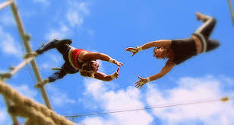
True friends trust each other. A trustworthy person is honest & truthful & can be counted on to keep their word.
True friends know that they can rely on each other to do what is right, that one would never lie to the other or deceive him or her in any way.

Slide 7
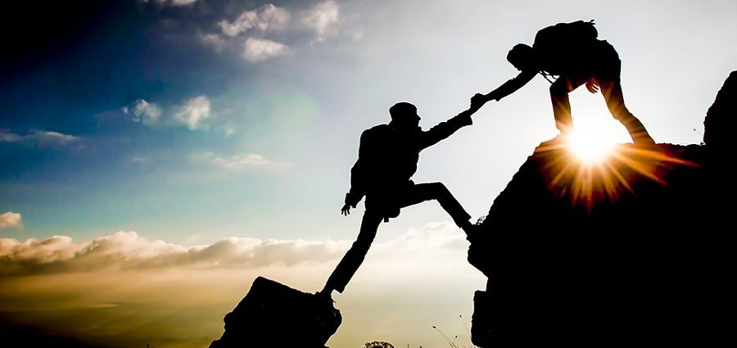
How does the trust between friends grow?
The TRUST that is shared between two friends becomes stronger and stronger the more they know each other.

Slide 8

Is everybody trustworthy?
Do you think it is important to choose close friends who ARE trustworthy?

Slide 9
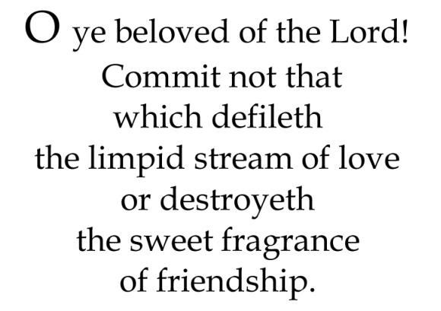
Quote

Slide 10

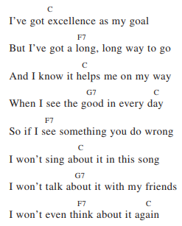
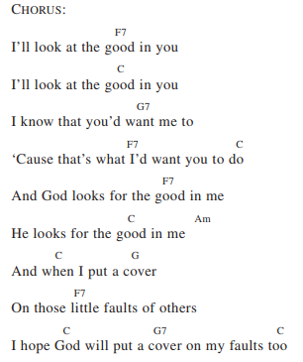
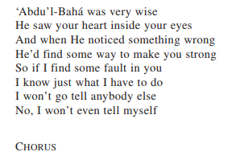

Song

Slide 11
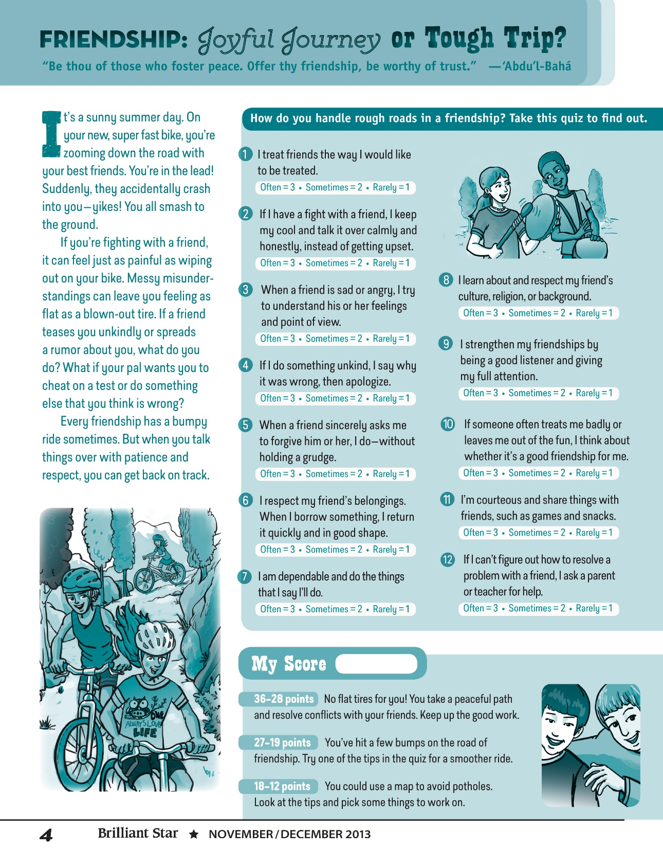
Friendship Quiz

Slide 12

Story

Slide 13
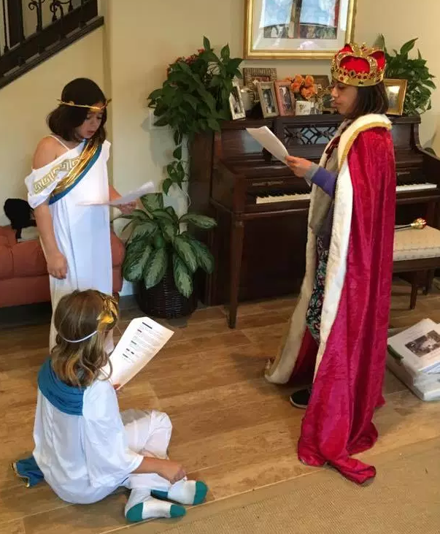
Drama

Slide 14
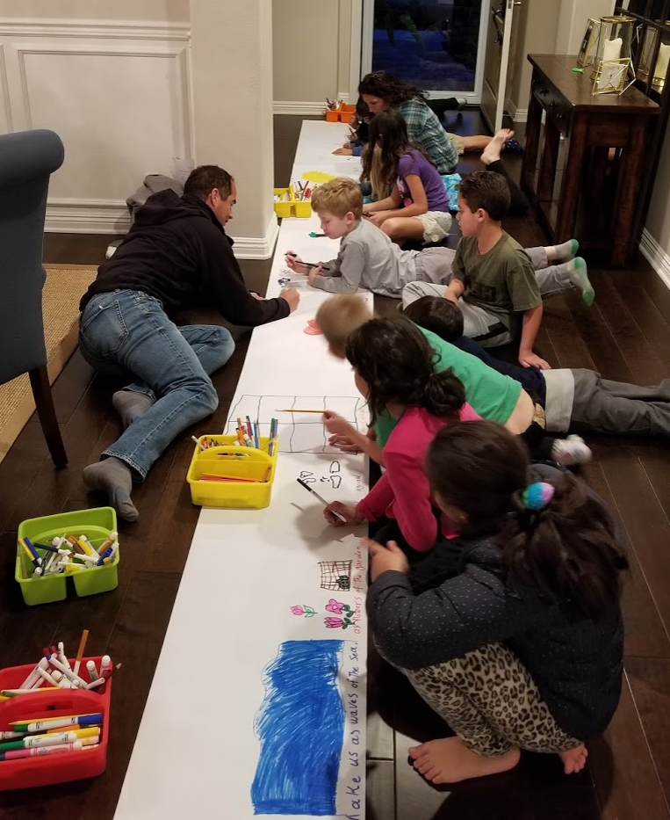
Art
Create a mural based on the prayer: “O Lord, Unto Thee I repair for refuge…”

Slide 15
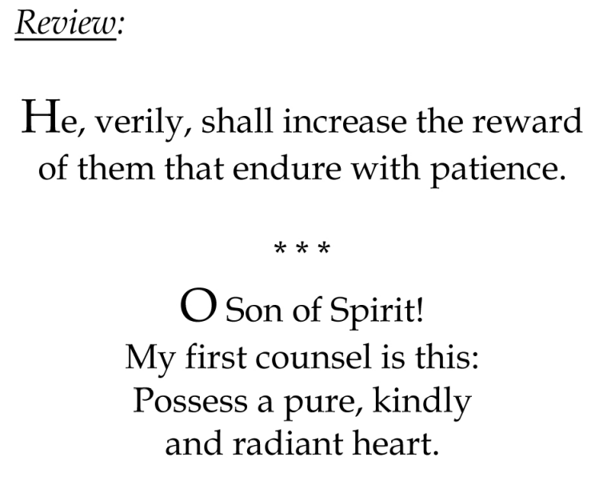

Slide 16
Closing prayer

Slide 17
