Slide 1
Welcome!

Slide 2
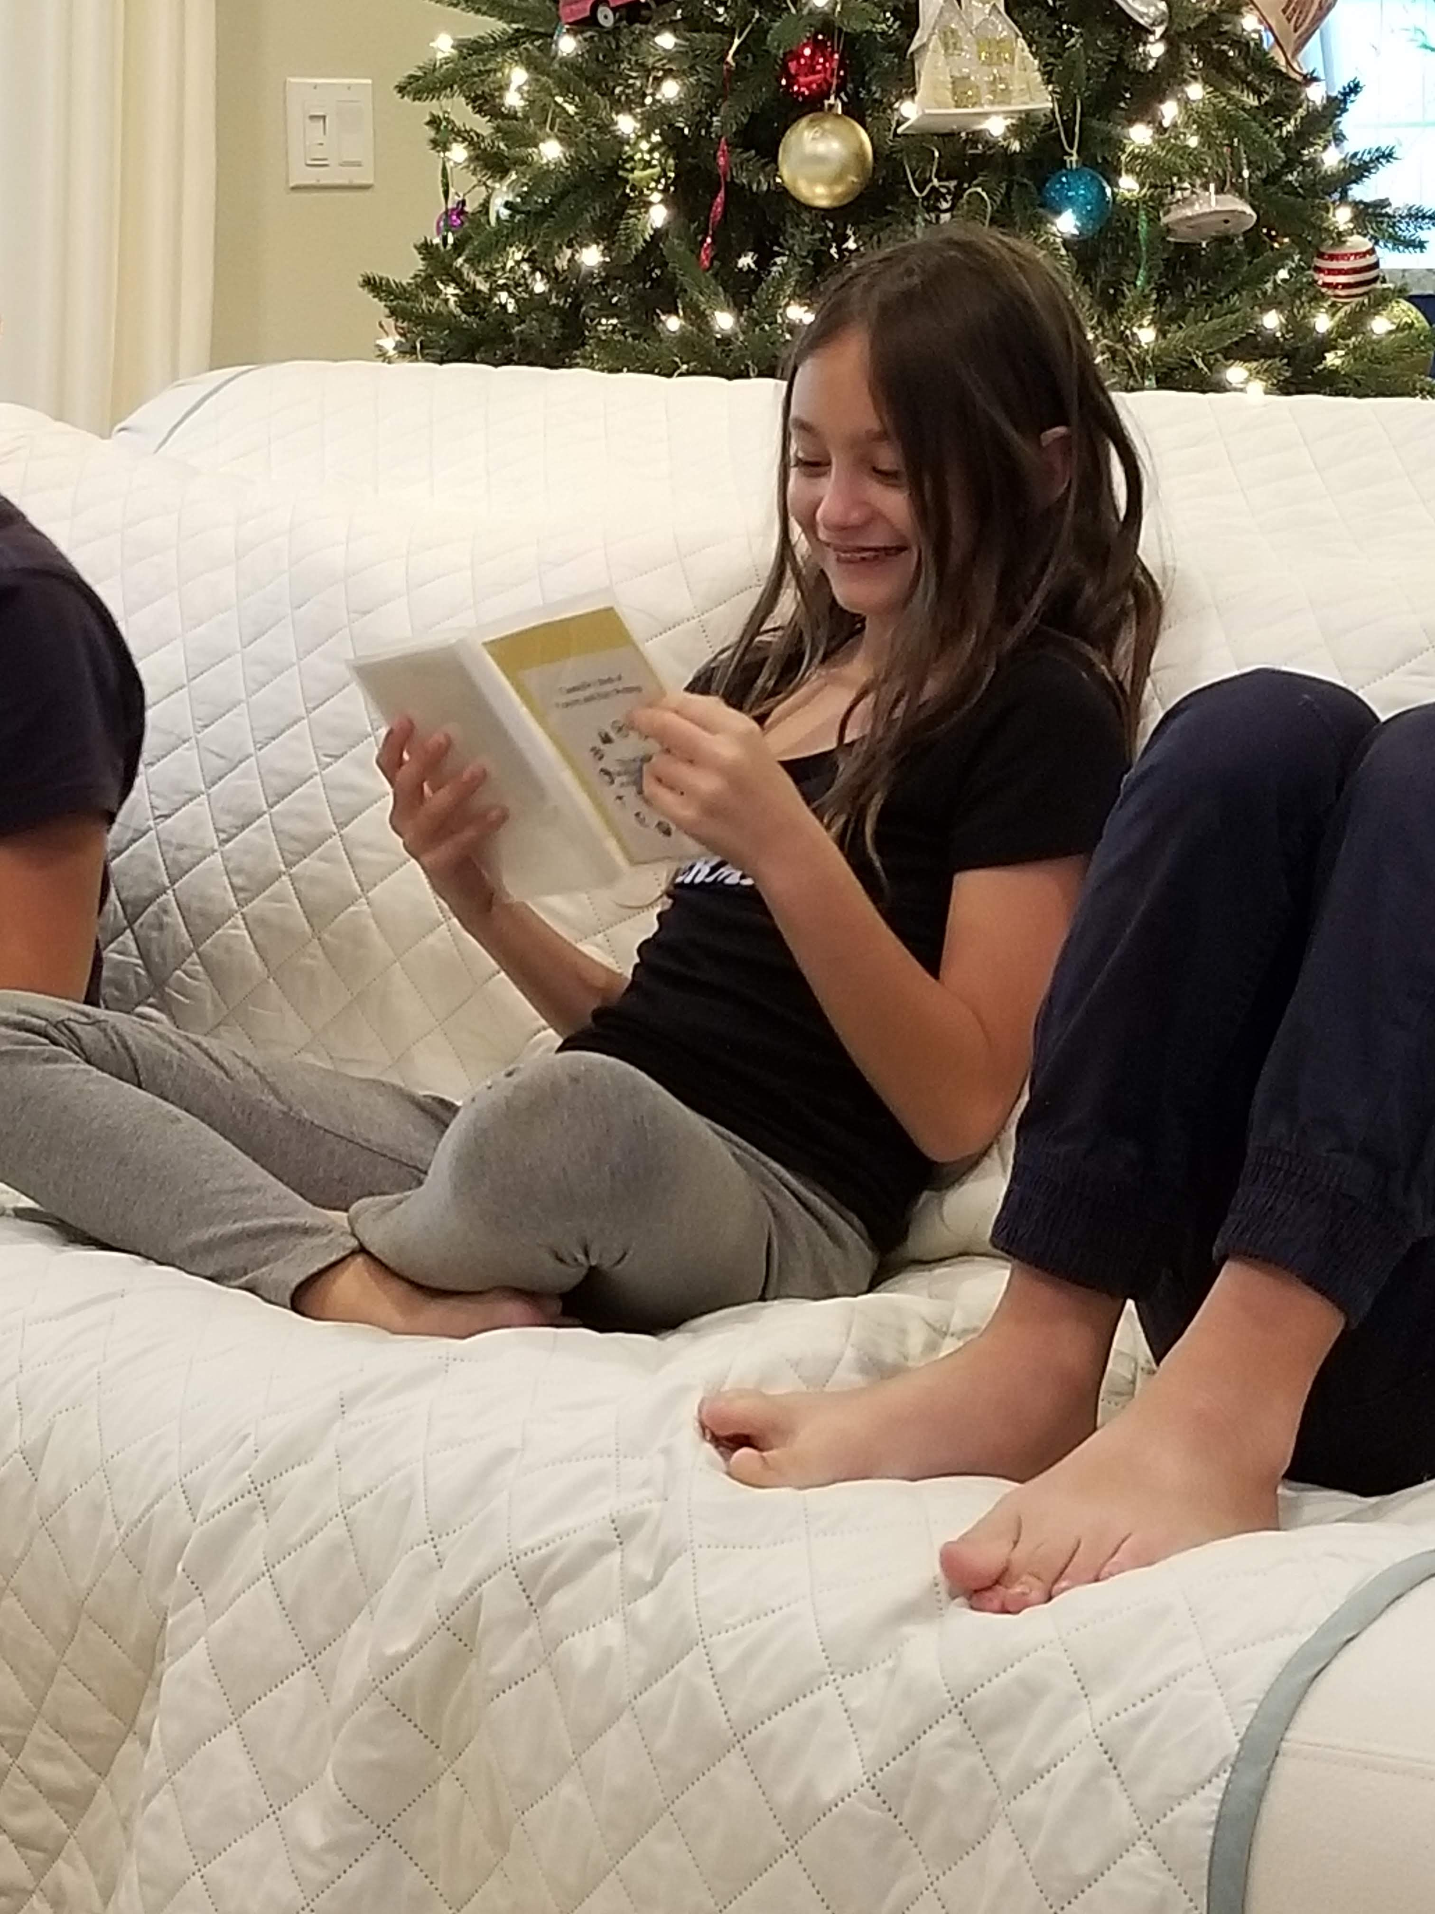
Prayers

Slide 3
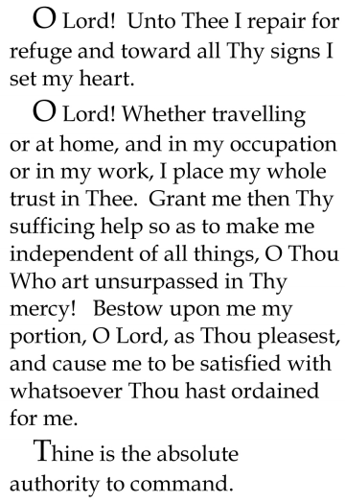


Slide 4

Lesson Theme
Being a Good Friend
Last Week: “COOPERATION AND RECIPROCITY”
Lesson Today: “God is always with us”

Slide 5

None of us are alone in this world.
There are so many people alongside each one of us, encouraging and assisting us as we grow

Slide 6
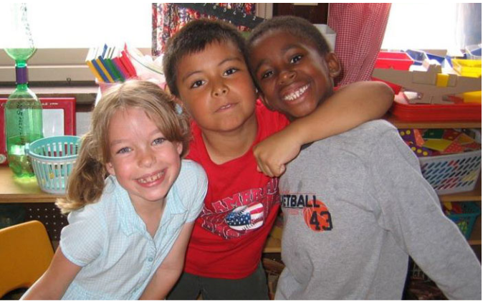
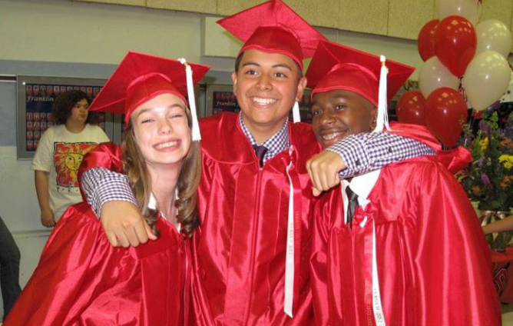
Throughout our lives we make friends with more and more people. Some of these friendships will last a long time, and others may not.

Slide 7
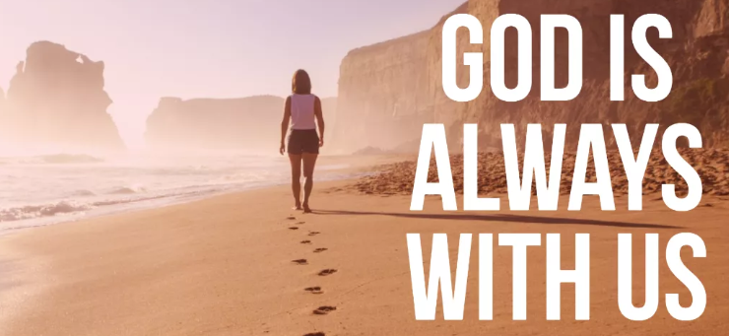
But no matter how many come and go from our lives, we know that God is always with us. He loves each one of us and cares for us all.

Slide 8
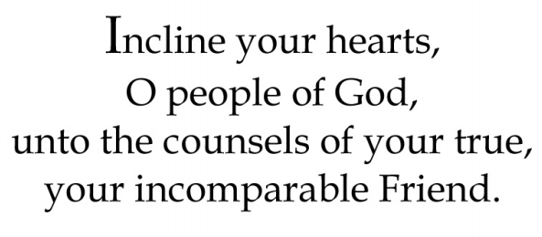
Quote

Slide 9

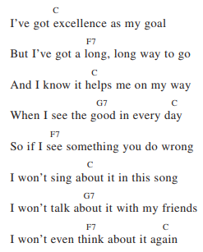
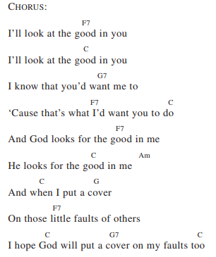
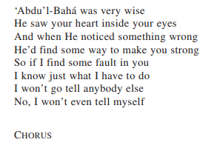

Song

Slide 10
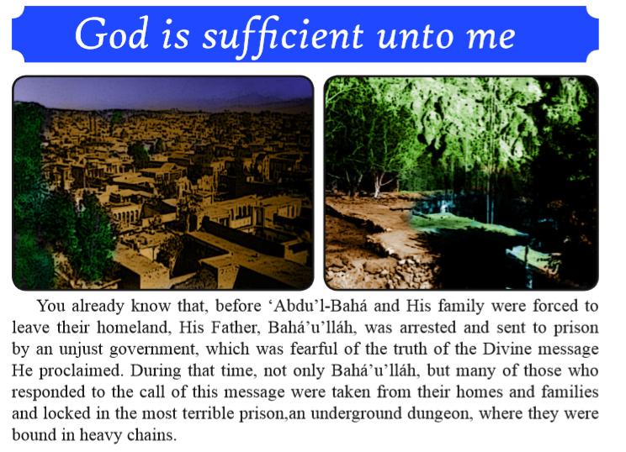
Story

Slide 11
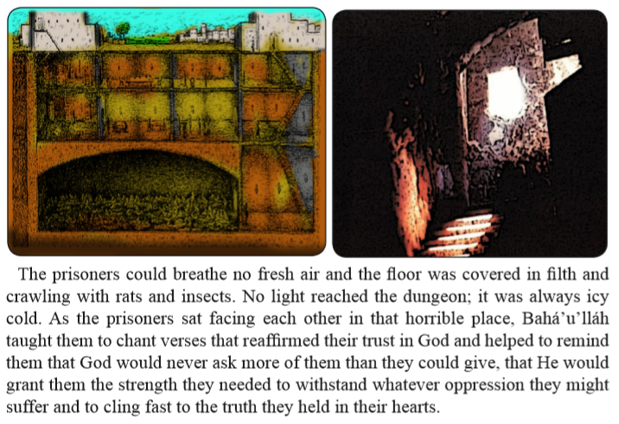

Slide 12
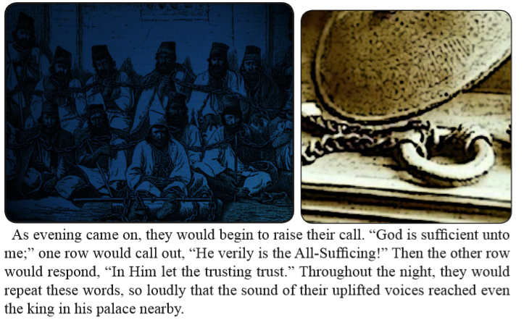

Slide 13
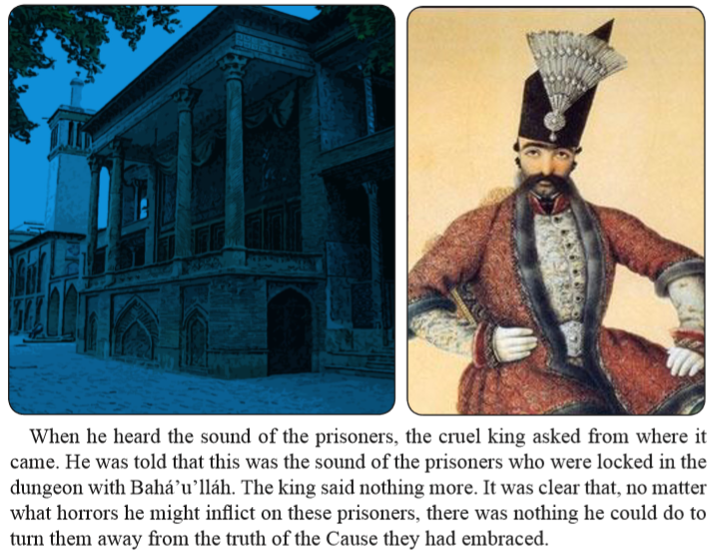

Slide 14

Drama

Slide 15
Art
Draw in your books an image that will reinforce the ideas you have learned in this lesson.

Slide 16
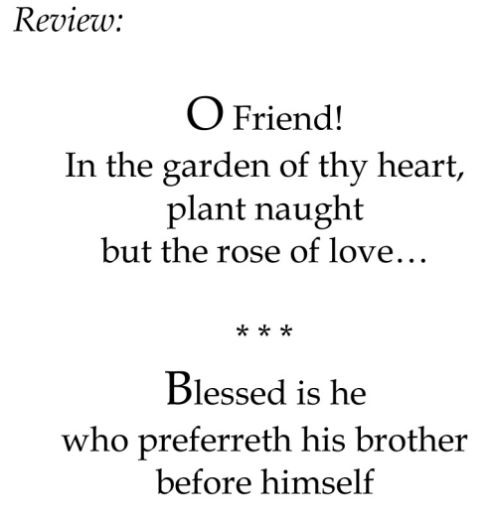

Slide 17
Closing prayer

Slide 18
