Slide 1
Welcome!

Slide 2
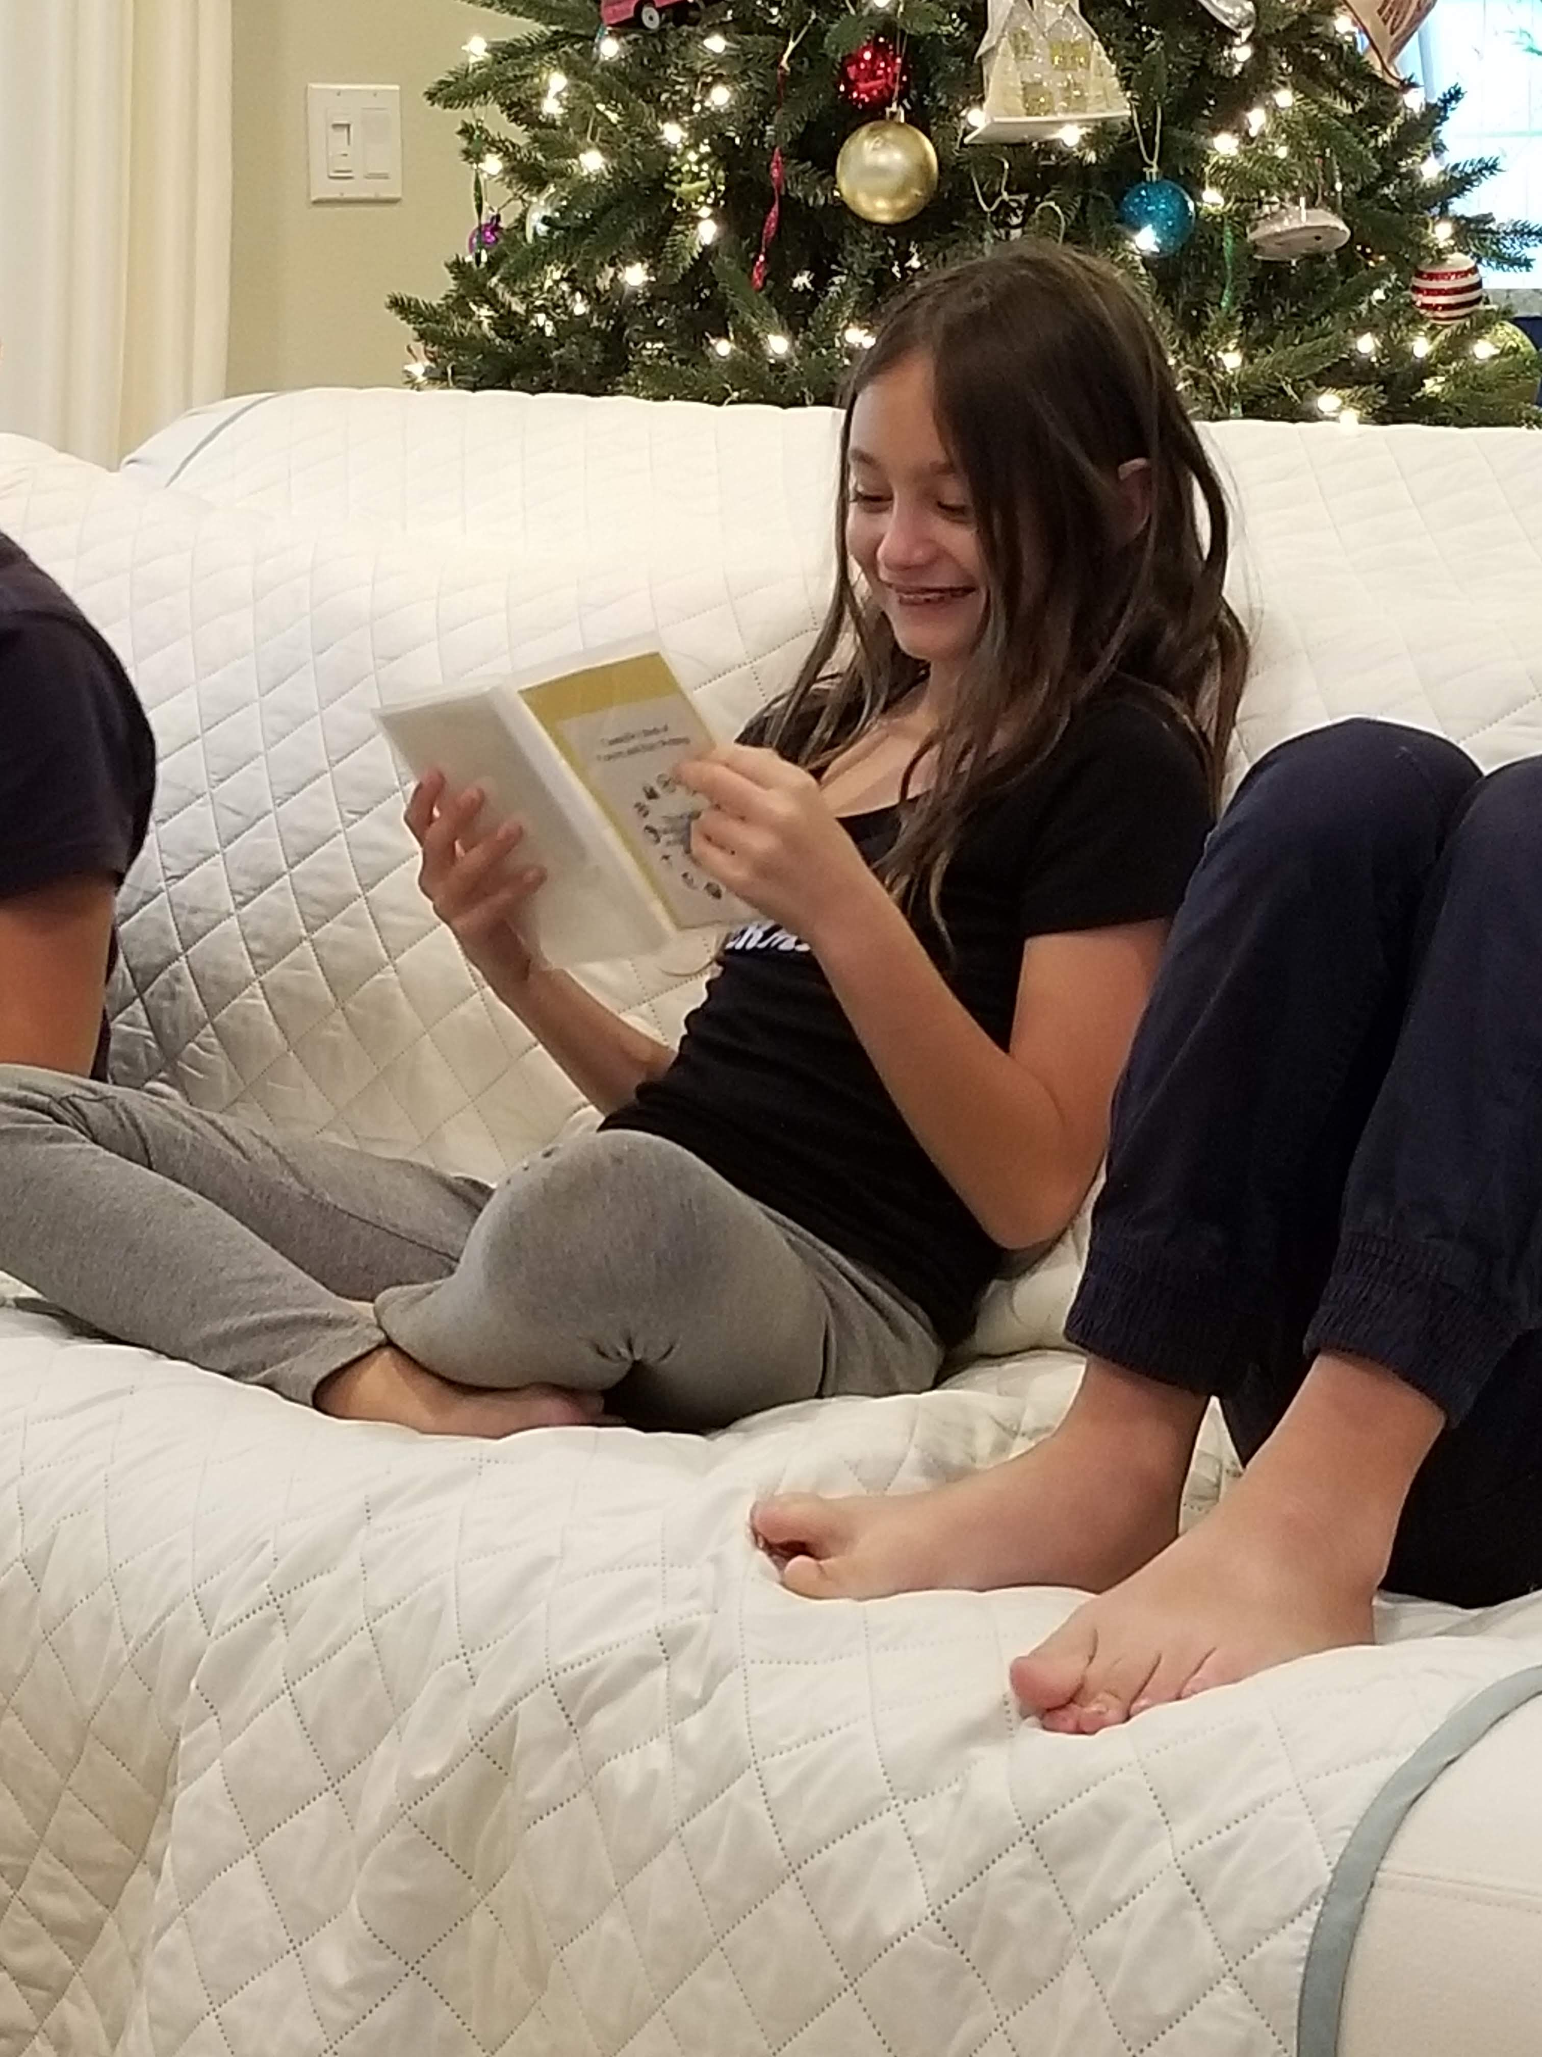
Prayers

Slide 3
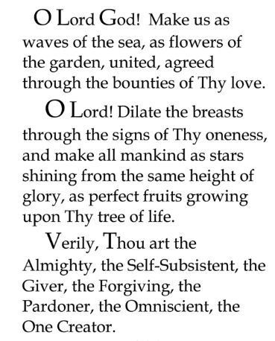

Slide 4

Lesson Theme
Living in Harmony
Last Week: “Justice and Fairness”
Lesson Today: “COOPERATION AND RECIPROCITY”

Slide 5
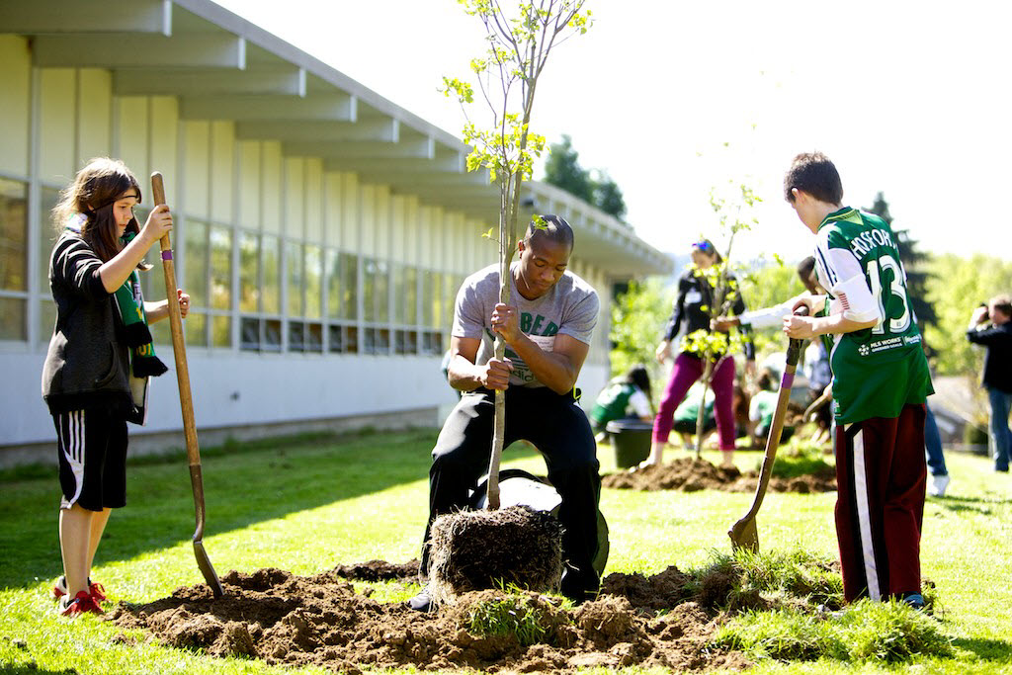
Knowing that we are members of one human family, we work together for the good of ALL.
We cooperate with one another and do everything we can to contribute to goals we all share.

Slide 6
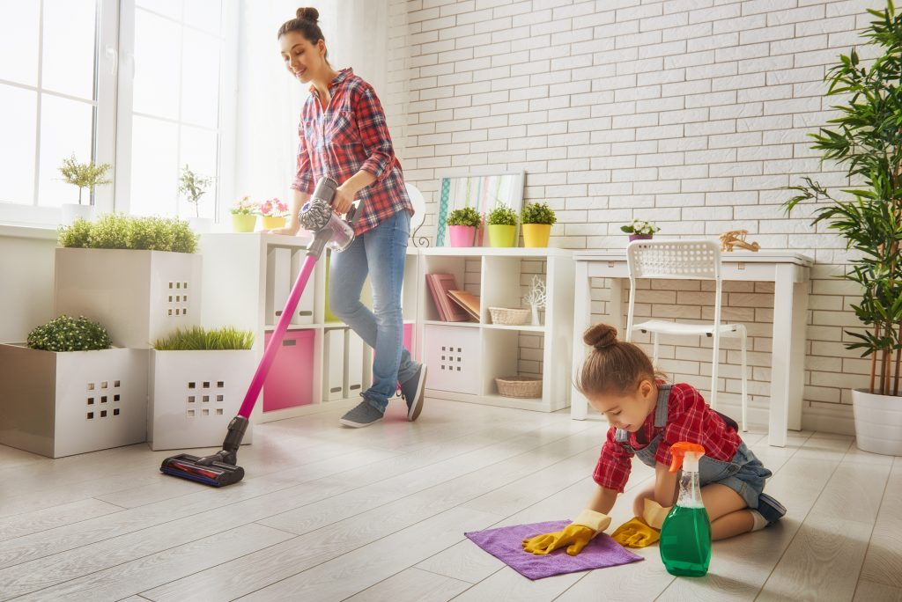
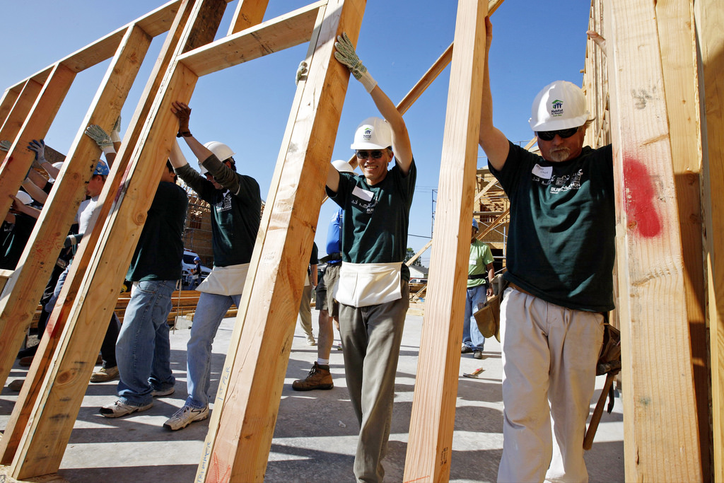
Many things cannot be done by one person alone

Slide 7
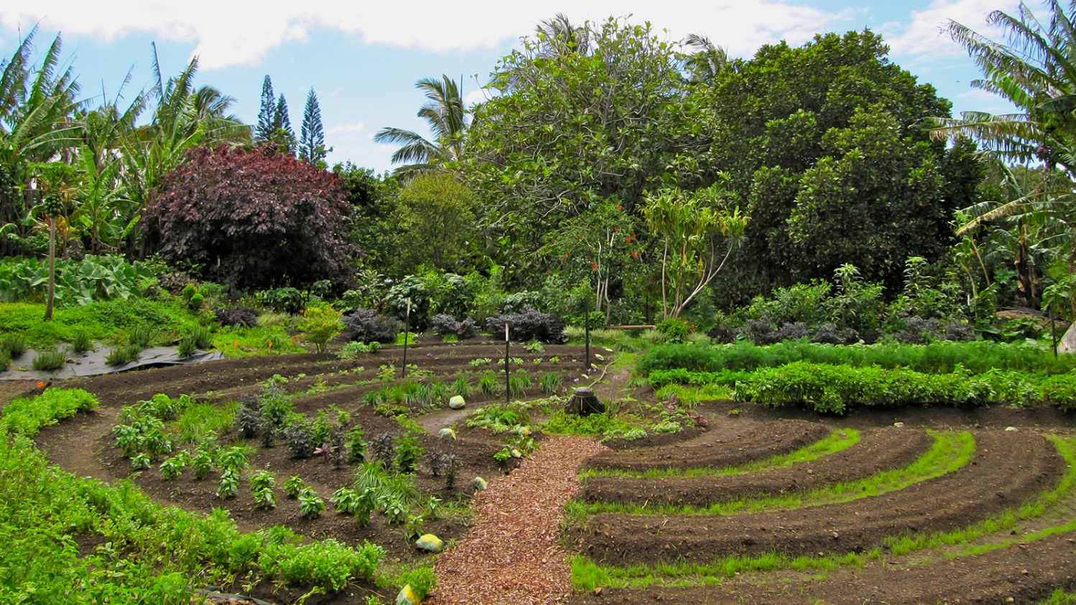
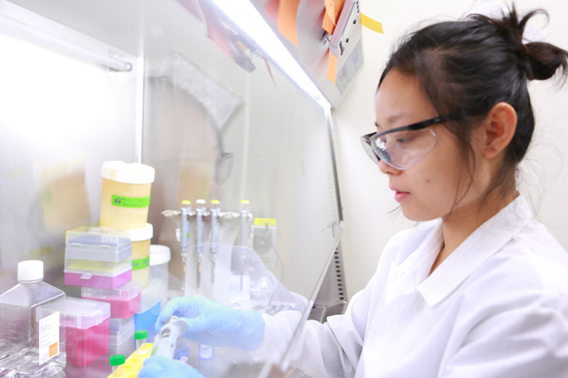

These and so many other wonderful things we have talked about in our classes are the result of what?

Slide 8
COOPERATION!!

Slide 9
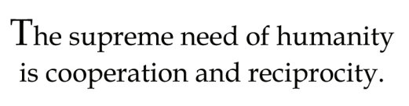
Quote

Slide 10
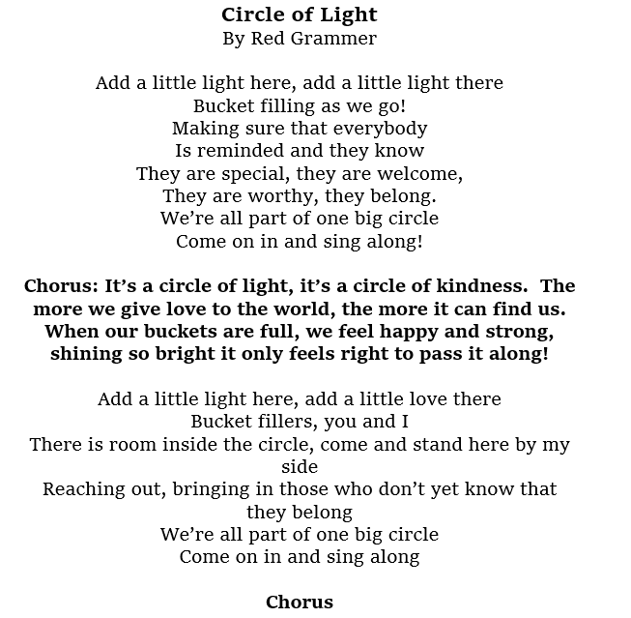

Song

Slide 11
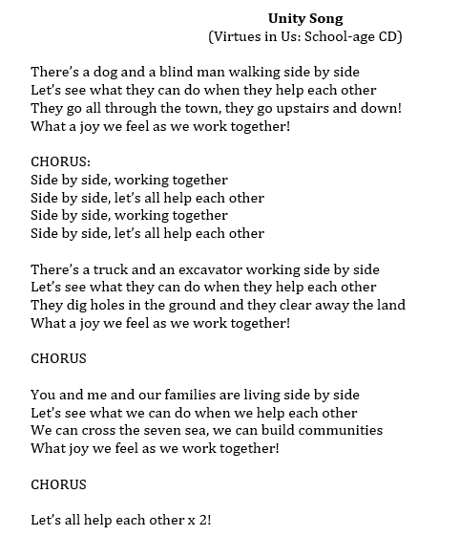
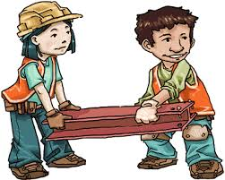

Slide 12
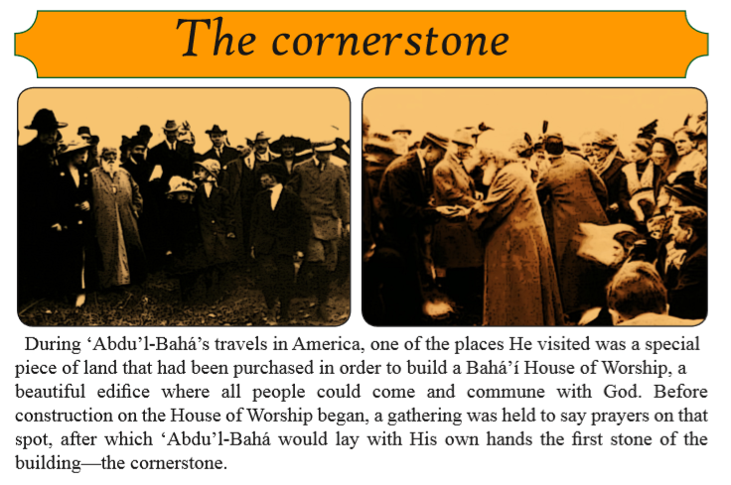
Story

Slide 13
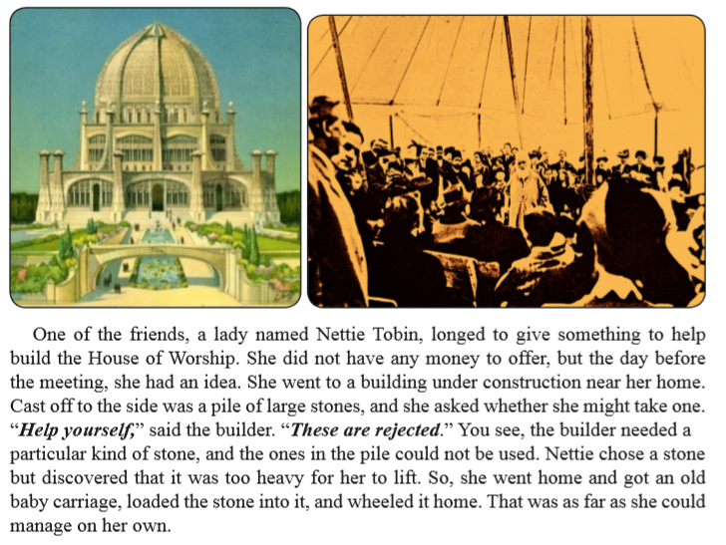

Slide 14
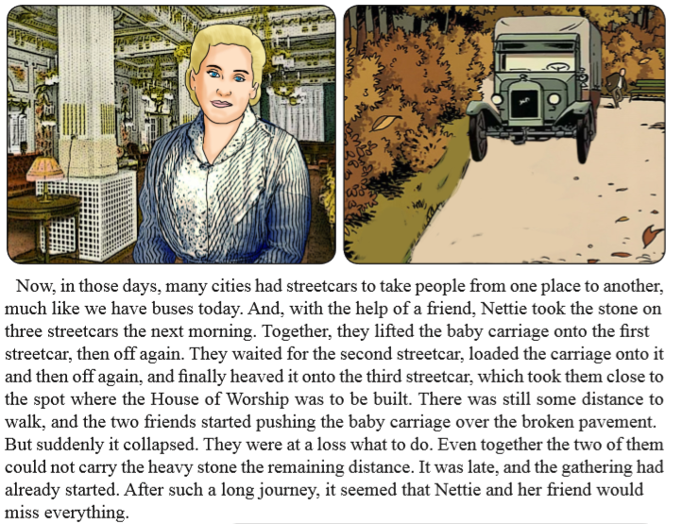

Slide 15
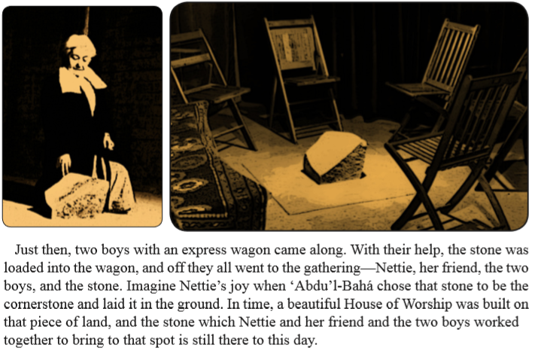

Slide 16
Drama
Today, we are going to use DRAMA and ACT OUT different characters living together in harmony
It is COOPERATION time!

Slide 17
Art
Draw in your books what you learned about cooperation and reciprocity.

Slide 18
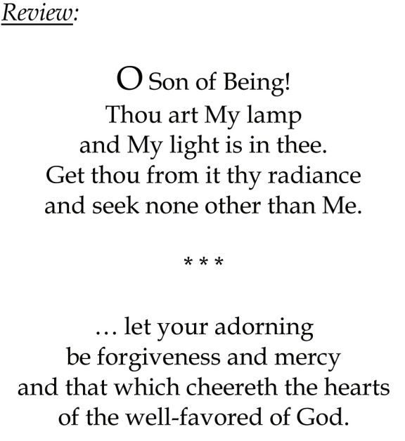

Slide 19
Closing prayer

Slide 20
