Slide 1
Welcome!

Slide 2
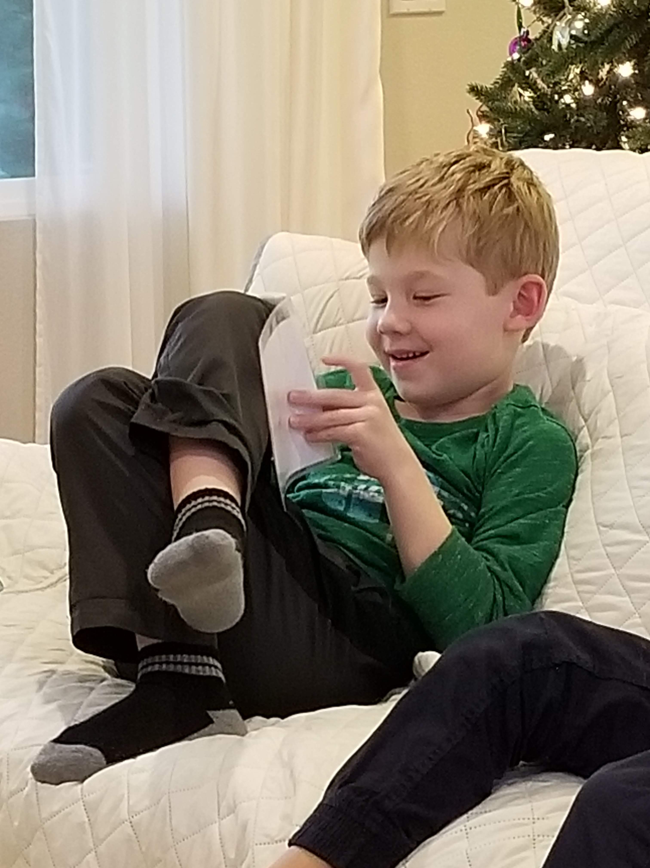
Prayers

Slide 3
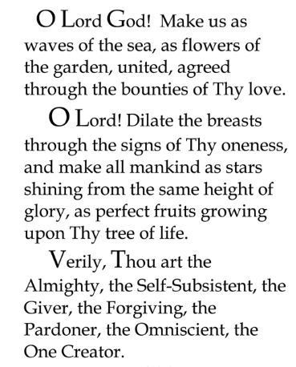

Slide 4

Lesson Theme
Living in Harmony
Last Week: “Unity & Diversity”
Lesson Today: “Justice and Fairness”

Slide 5
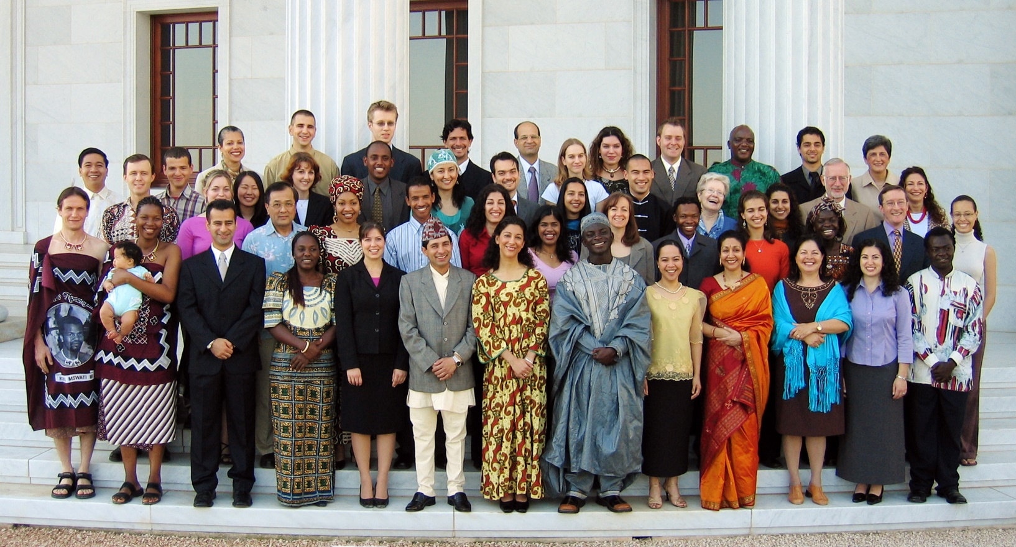
We know all the peoples of the world are meant to live in unity as one family

Slide 6
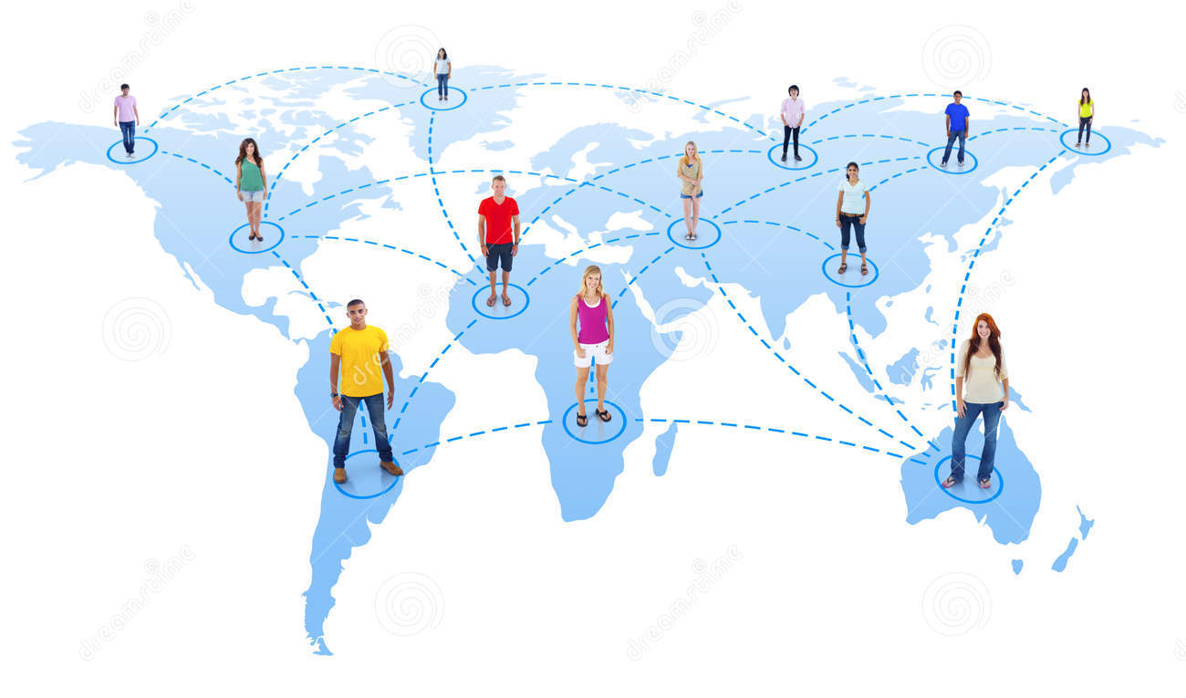
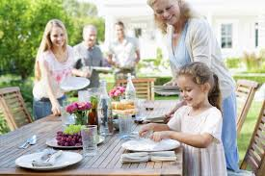
In a family, everyone is treated with fairness.
The well-being of every member is connected to the well-being of the family as a whole.

Slide 7

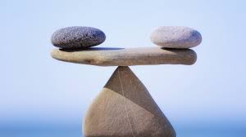
We strive to show forth such JUSTICE and FAIRNESS in our daily lives that we become worthy of the trust and confidence of those around us.
JUSTICE and FAIRNESS

Slide 8
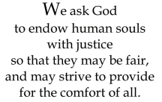

Quote

Slide 9

Song

Slide 10
Drama
Today, we are going to use DRAMA and ACT OUT different characters living together in harmony
It is harvest time!

Slide 11
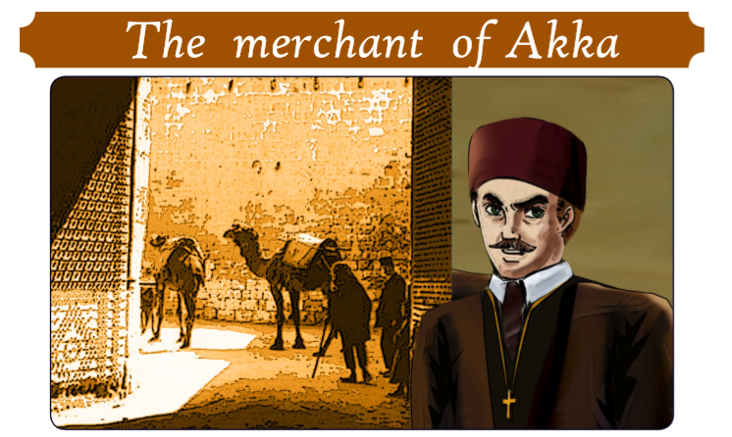
Story

Slide 12
Art
Create mural of - make us as waves of the sea, as flowers of the garden

Slide 13
Closing prayer

Slide 14
