Slide 1
Welcome!

Slide 2
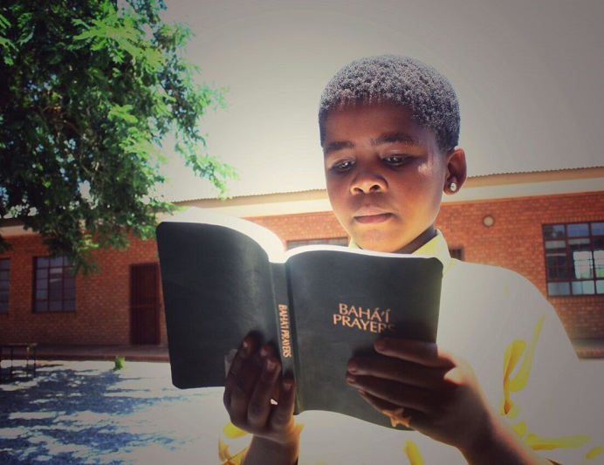
Prayers

Slide 3
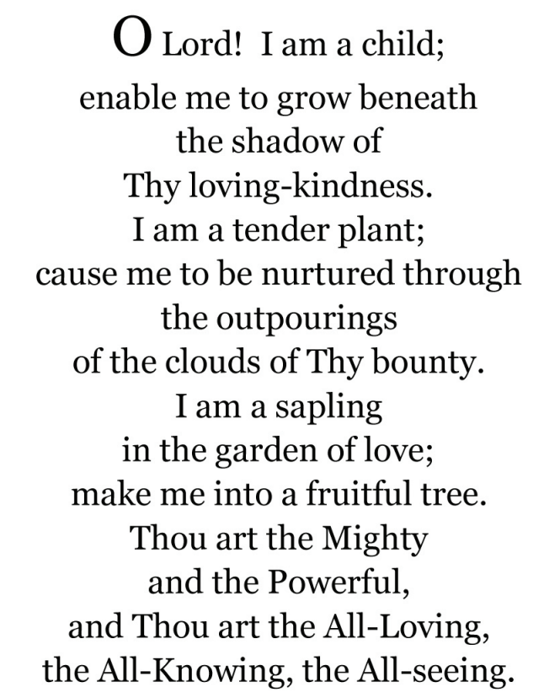


Slide 4
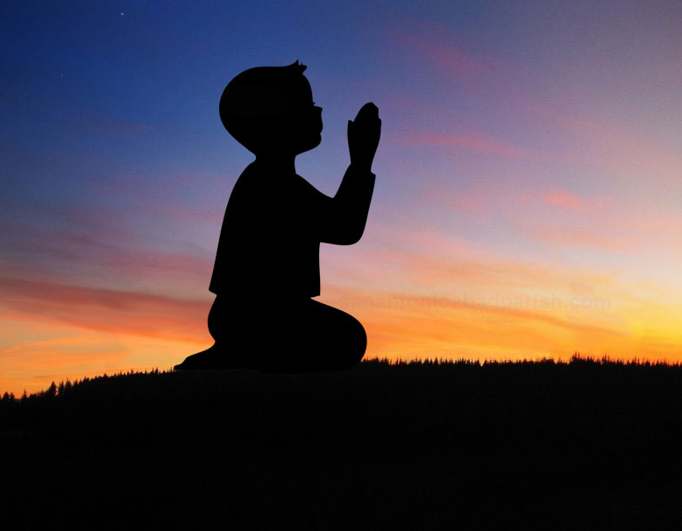
Theme for next 3 lessons:
Maintaining a prayerful attitude
Lesson for today: “Nature of Prayer”

Slide 5
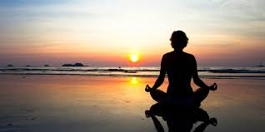
Nature of Prayer
God is far more than we can ever imagine, but we do know that He created us, watches over us and guides our lives. Through our prayers we speak to God.

Slide 6
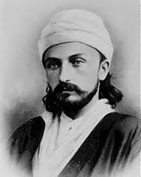
Who is Abdu’l-Baha?
He is the son of Baha’u’llah, and is the perfect example of how to live a life full of virtues.
Abdu’l-Baha lived in a state of prayer.

Slide 7
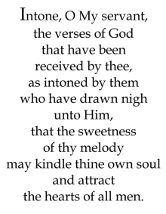
Quote

Slide 8
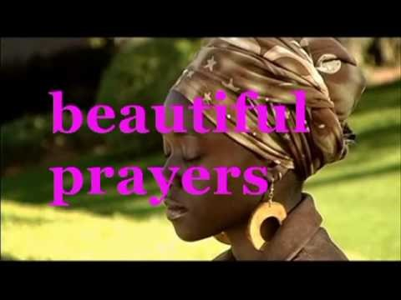
Song

Slide 9
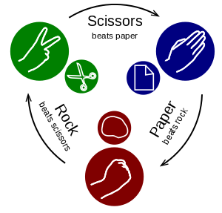
Game

Slide 10
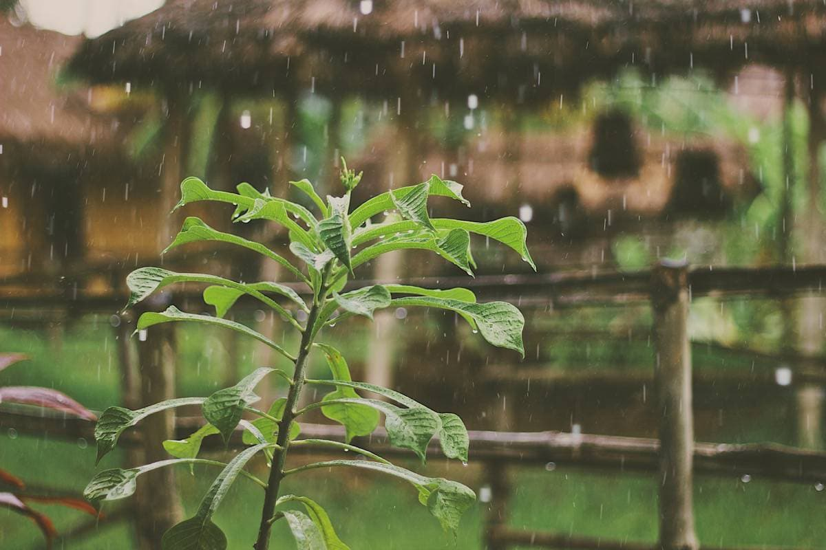
Drama

Slide 11
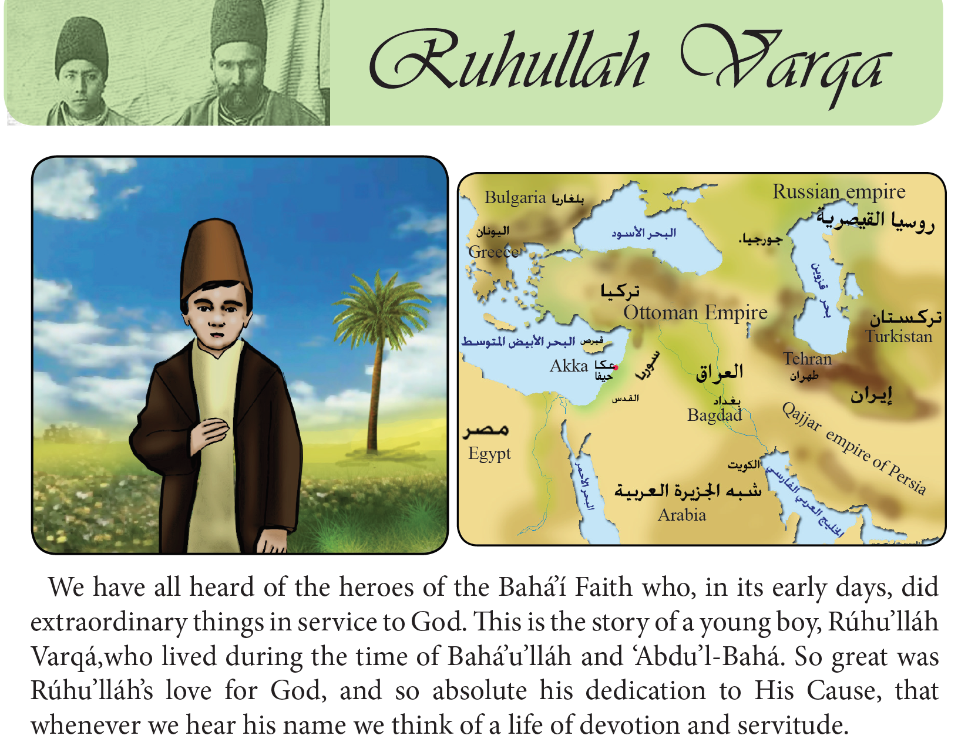

Slide 12
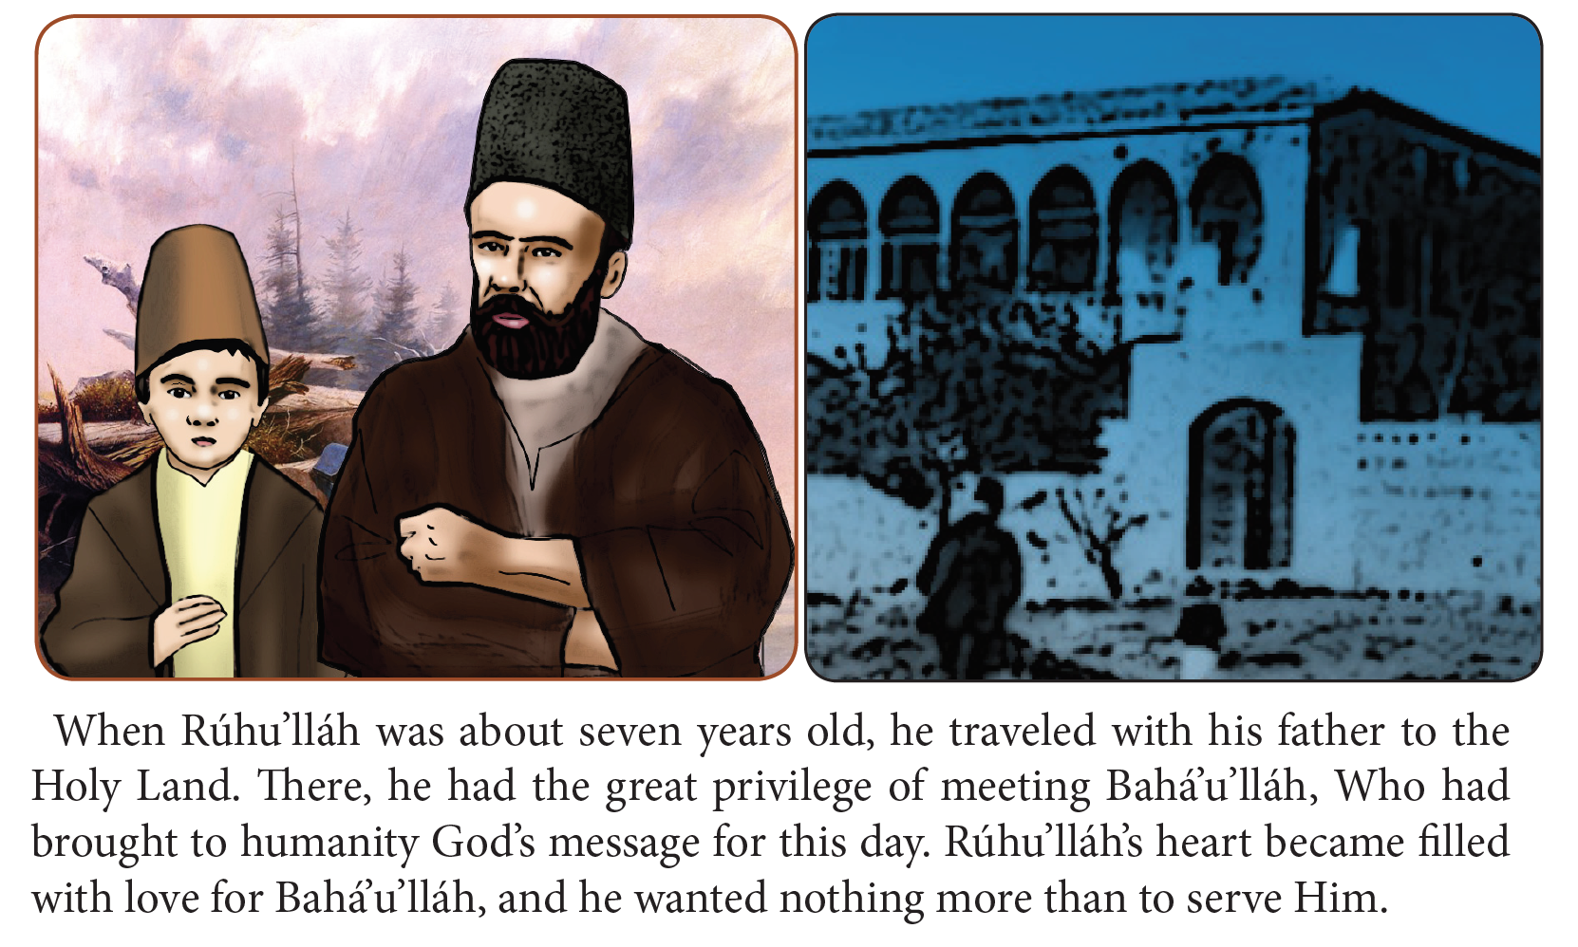

Slide 13
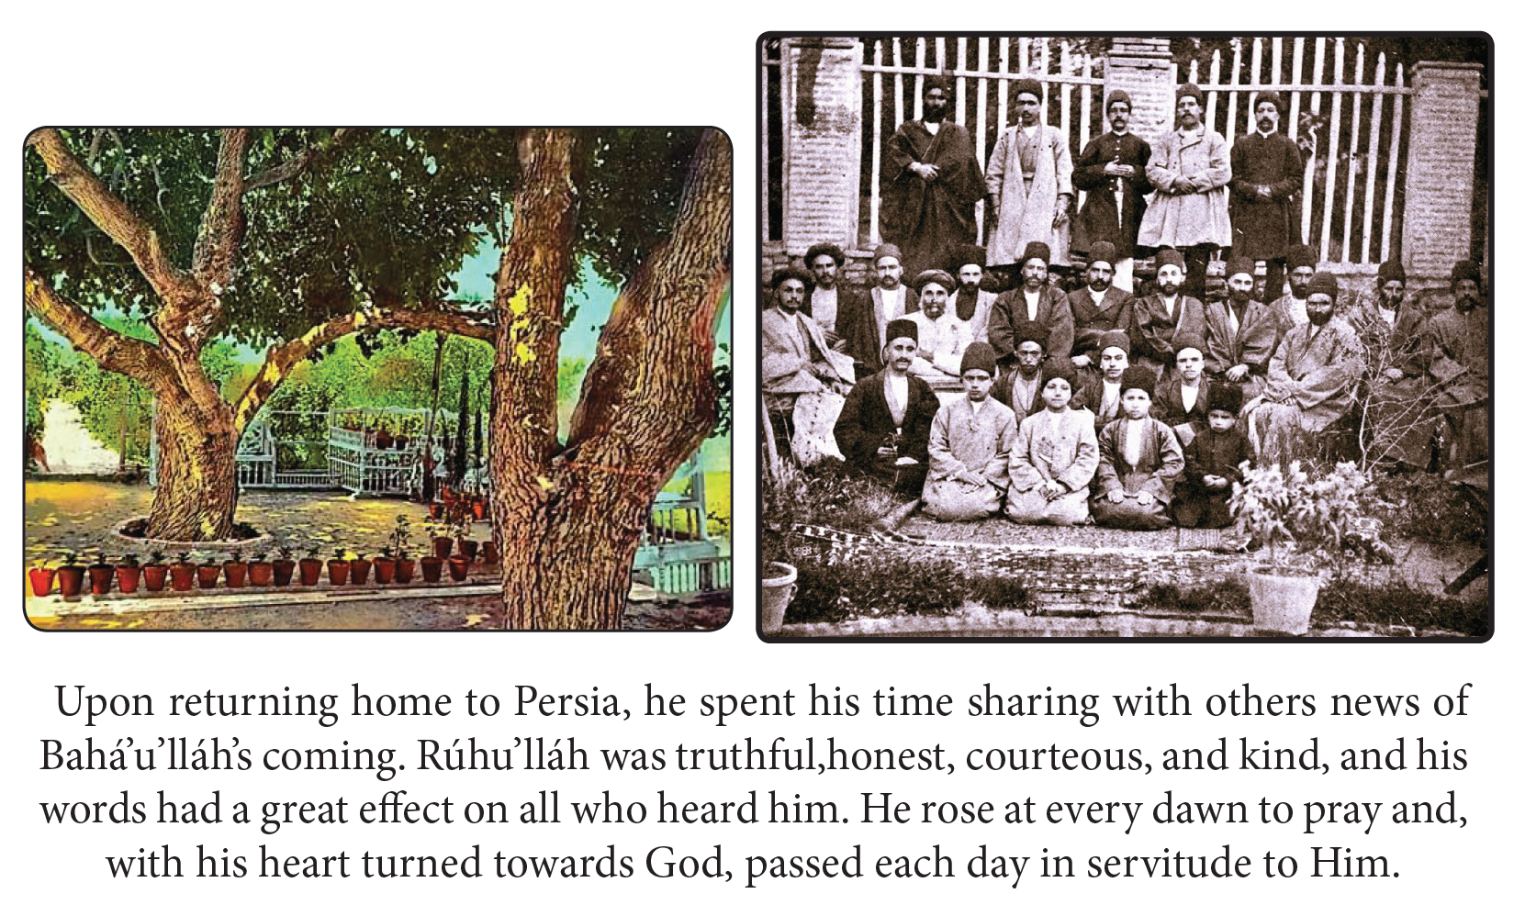

Slide 14
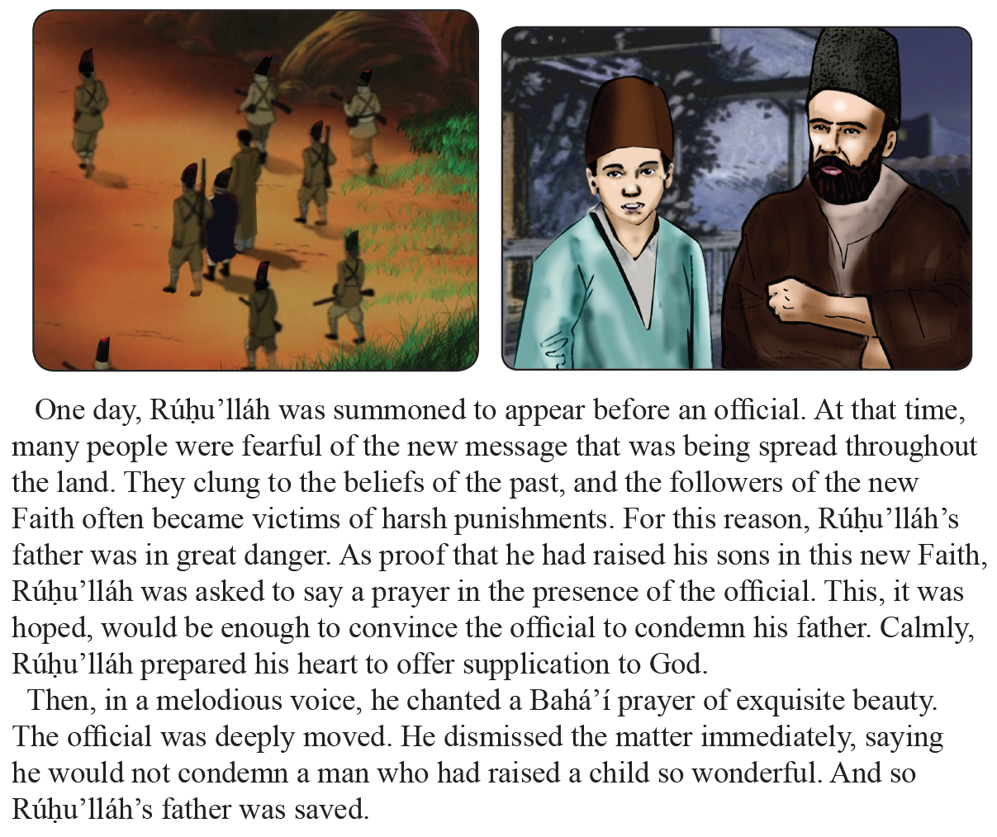

Slide 15
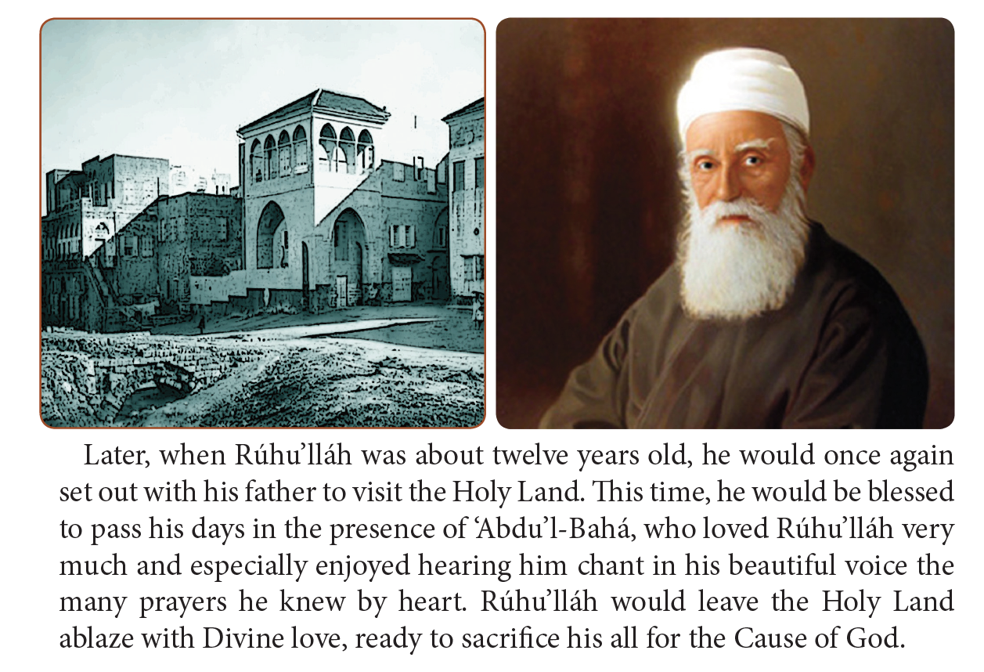

Slide 16
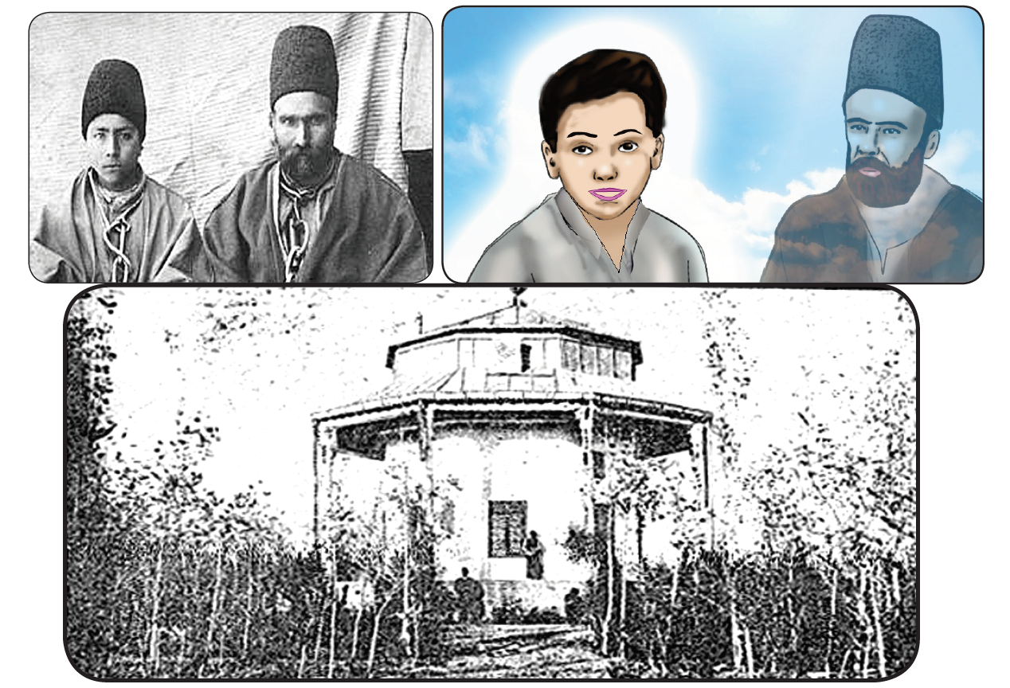

Slide 17
COLORING
Draw about what you learned in coloring book.

Slide 18
Review
SINCERITY
“We should at all times manifest our truthfulness and sincerity…”
THANKFULNESS
“Be thou happy and well pleased and arise to offer thanks to God, in order that thanksgiving may conduce to the increase of bounty.”

Slide 19
Closing prayer

