Slide 1

Welcome

Slide 2
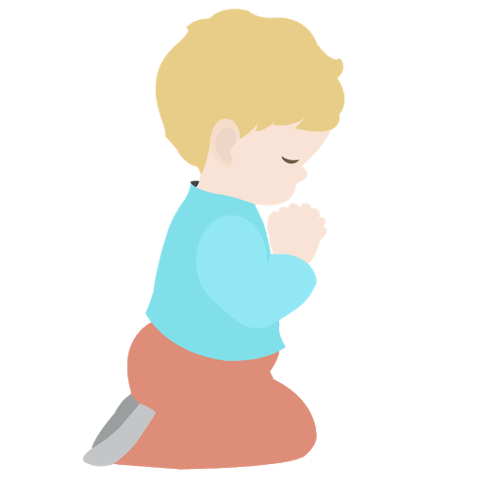
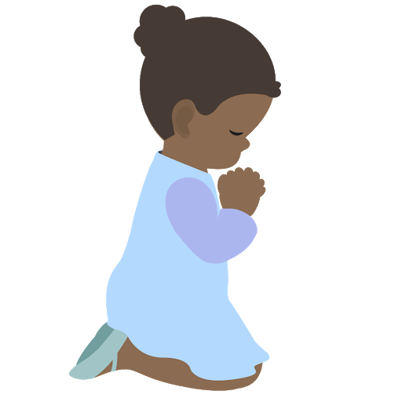
⭐️
⭐️
Prayer Stars⭐
Cassedy | ⭐️⭐️⭐️⭐️⭐️⭐️⭐️⭐️⭐️
Milan | ⭐️⭐️⭐️⭐️⭐️
Devin | ⭐️⭐️⭐️⭐️⭐️⭐️⭐️⭐️⭐️⭐️
Kim | ⭐️⭐️⭐️
Cora | ⭐️⭐️⭐️⭐️⭐️⭐️⭐️⭐️
Hudson | ⭐️⭐️⭐️⭐️⭐️⭐️⭐️
Dev | ⭐️⭐️⭐️
Manny | ⭐️⭐️⭐️⭐️⭐️⭐️⭐️⭐️⭐️⭐️⭐️⭐️
Camila | ⭐️⭐️⭐️⭐️⭐️⭐️⭐️⭐️⭐️⭐️⭐️⭐️
⭐️
⭐️
Notes:
(Next let’s give prizes when child can recite a new prayer in class. Many only know one prayer by heart.
Have lots of time to memorize new prayer bec won’t have class next week. Have 2 weeks.

Slide 3
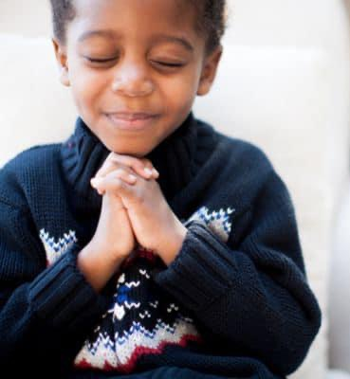
https://www.youtube.com/watch?v=3kGmqeMYQsk&list=RDKlefXTls3OQ&index=3
Opening Prayers
Notes:
URL: Unto Thee I Repair for Refuge
Prayer sharers

Slide 4
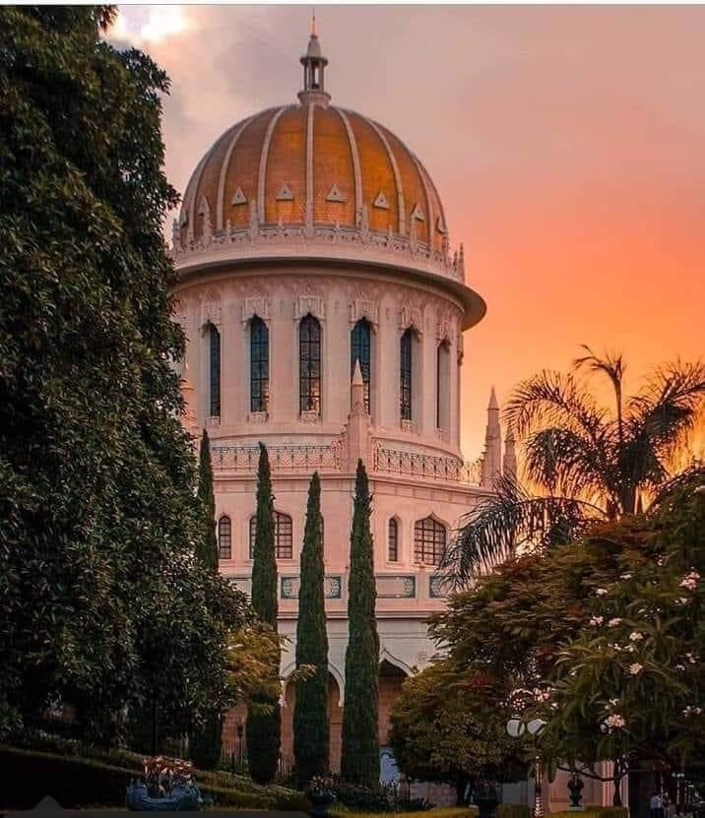
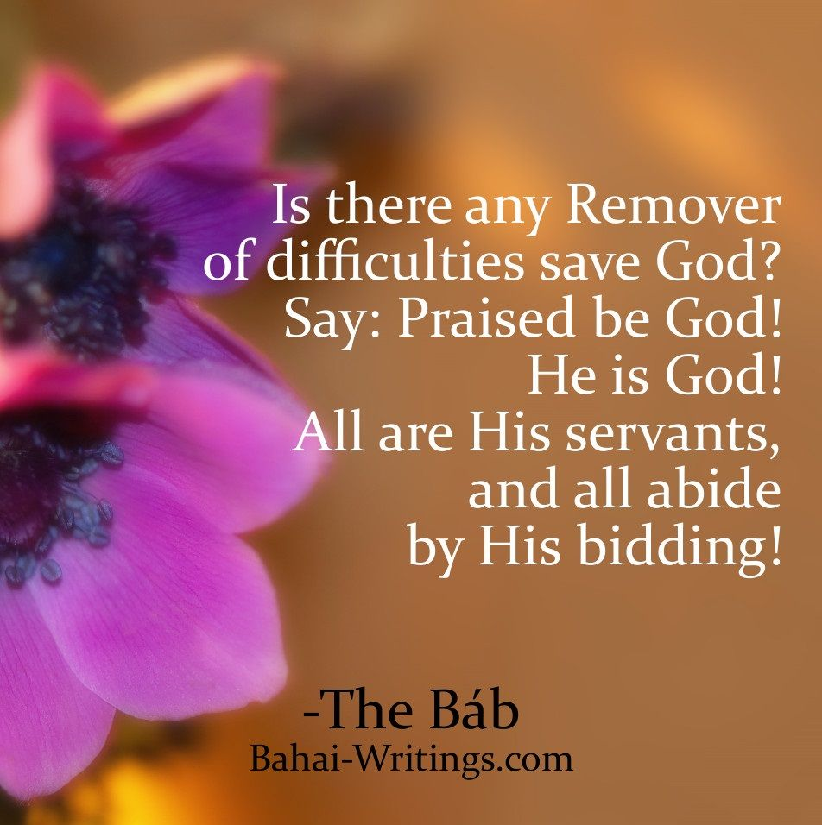
https://www.youtube.com/watch?v=PfORUZW8--c
Notes:
Memorize: Explain meaning of Say (Like in Bible-Thus sayeth the Lord) and abide. Break into groups of two. Each group says one of four phrases.
https://www.youtube.com/watch?v=GCWYkghmPZI Slott
https://www.youtube.com/watch?v=IQrWYGxtpdw Shadi E/Arabic

Slide 5
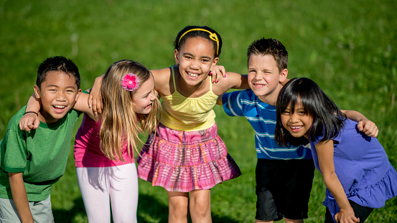
Being a Good Friend
Notes:
Being a Good Friend is the theme of our next three lessons
Who would you say is our true best friend? God is Our True Best Friend.
The second class will be on Friends Sacrifice for Each Other, then Taking Care of Our Friends

Slide 6
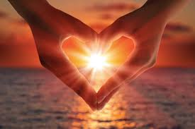
God is Our Best Friend
Notes:
Raise your hand if you can read this. Let’s all read it together. Why do you think God is our best friend? (He is always with us no matter what.
He knows us better than anybody bec He created us, what else? We trust him with our prayers and we trust that he will help us when we are in need)

Slide 7
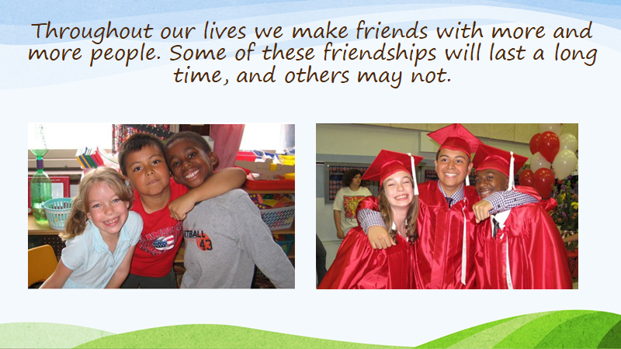
Notes:
Do you have friends you have known a long time? The most lasting friendships are those friendships of the spirit. But even these friends cannot be with us every day. God is with us no matter where we may move to or what time it happens to be. He loves each of us and cares for all of us!

Slide 8

“Incline your hearts, O people of God,
unto the counsels of your true, your incomparable Friend.”
Notes:
Who can read this quote? What does counsels mean? What are some of the counsels we find in the Holy Books of God? (.......Also all have Golden) Rule) Explain incomparable and have children repeat as new vocabulary word.

Slide 9

https://www.youtube.com/watch?v=I1gMUbEAUFw
MOVEMENT ACTIVITY
Notes:
Cha Cha slide

Slide 10
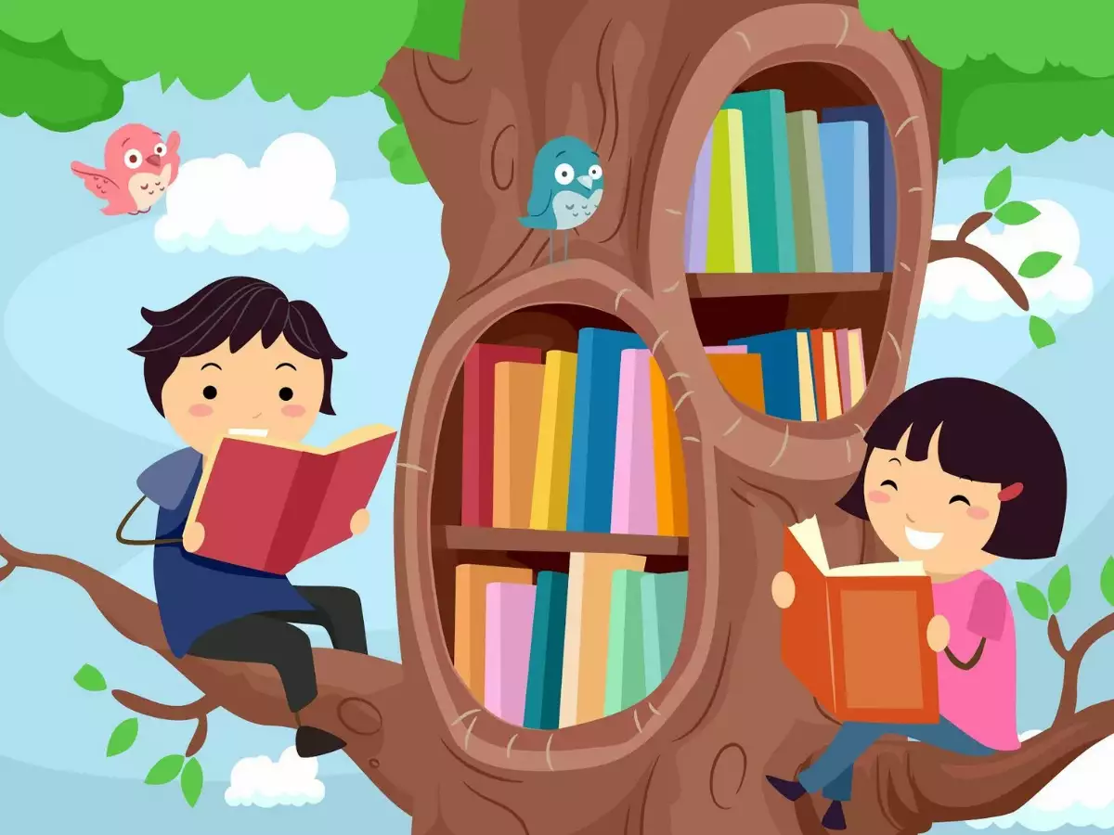
Notes:
Story Time

Slide 11
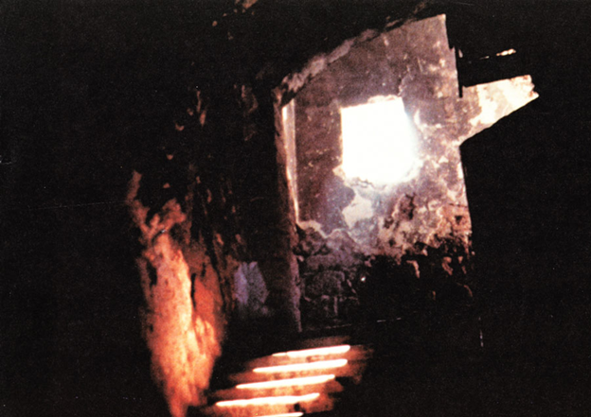
https://beyondforeignness.org/4616
Notes:
Each time God sends a new Messenger, people resist Him and try to harm Him to put out God’s light. Do you think they can ever do this?
People don’t like change especially if they are very powerful and fear losing that power. This is a photo of the underground dungeon where Baha’u’llah was imprisoned. It was called the Siyah-Chal which means the Black Pit. The authorities thought if they hid Baha’u’llah underground it would put a stop to the Divine Message He was sent to proclaim. Many of those who responded to the call of this message were taken from their homes and families and locked up with Baha’u’llah.

Slide 12
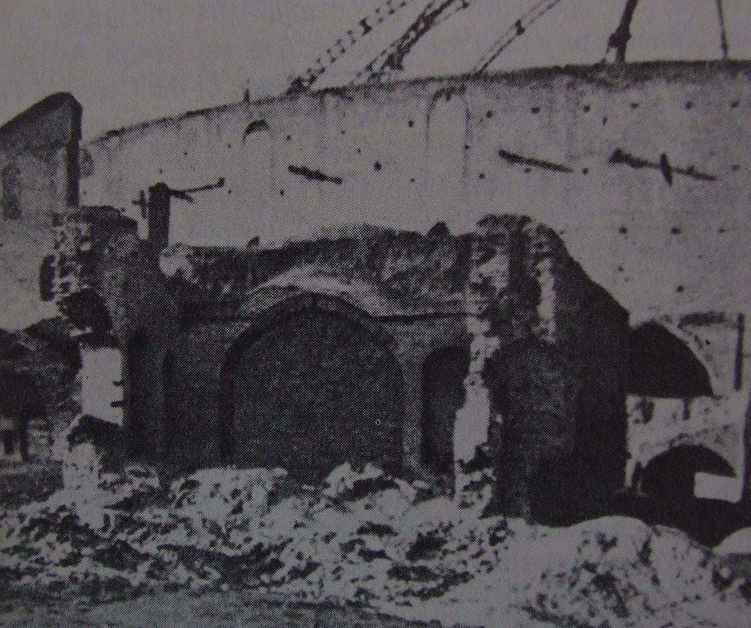
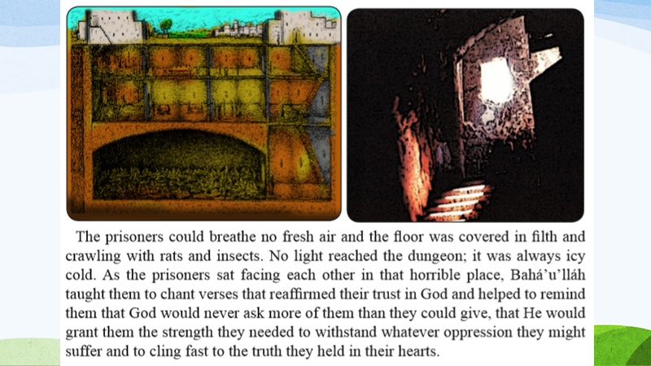
Siyah-Chal
Notes:
Here is a photo of the outside of the prison and the inside You can see how far down the prisoners were below two stories of shops. The prisoners could breath no fresh air and the floor was covered in filth and crawling the rats and insects. No light reached the dungeon; it was always icy cold. (Baha’u’llah remained in this prison for 4 months. When he entered the prison His hair was jet black. When ‘Abdu’l-Baha saw Him, His father was in poor health and His hair had turned white.) As the prisoners sat facing each other in that horrible place, Baha’u’llah taught them to chant verses that spoke of putting their trust in God. He helped remind them that God would never ask more of them than they could give; that He would grant them the strength they needed to withstand whatever cruelty they might suffer and to cling fast to the truth they held in their hearts.

Slide 13
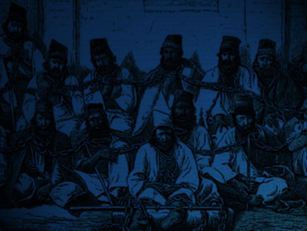
Notes:
If you look carefully you can see how closely the prisoners were chained together including at their feet so if one prisoner moved it pulled the chains tighter around others.

Slide 14
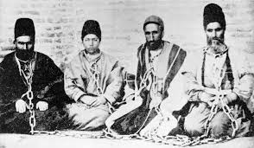
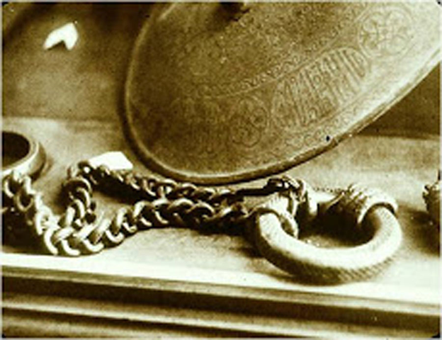
Qara-Guhar weighed 112 pounds
and means Black Pearl
Notes:
This photo shows better the chains the prisoners were bound with. You can see how heavy there were. The heaviest one weighed 112 pounds and was named the Black Pearl. The chains dug deep into the prisoners’ necks. Baha’u’llah bore the scars of the chains for the rest of His life. As evening came in the prison, the prisoners would begin to raise their voices in prayer, singing, “God is sufficient unto me. He verily is the All-Sufficing!” Then another row of prisoners would respond with, “In Him let the trusting trust.” Throughout the night they would repeat this prayer so loudly that the sound of their uplifted voices reached even the king in his palace nearby.

Slide 15
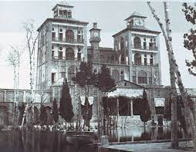
Notes:
This is the King’s Palace.

Slide 16
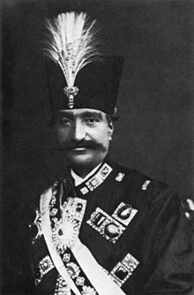
Nasiru’d-Din Shah
Notes:
And when the king heard the prisoners, he asked where the noise was coming from. He was told that this was the sound of the prisoners who were locked in the dungeon with Baha’u’’lah. The king said nothing more. It was clear that, no matter what horrors he might inflict on these prisoners, there was nothing he could do to turn them away from the new religion they had embraced. ( Now today, the Baha’i Faith has become the second most widespread religion in the world.)

Slide 17
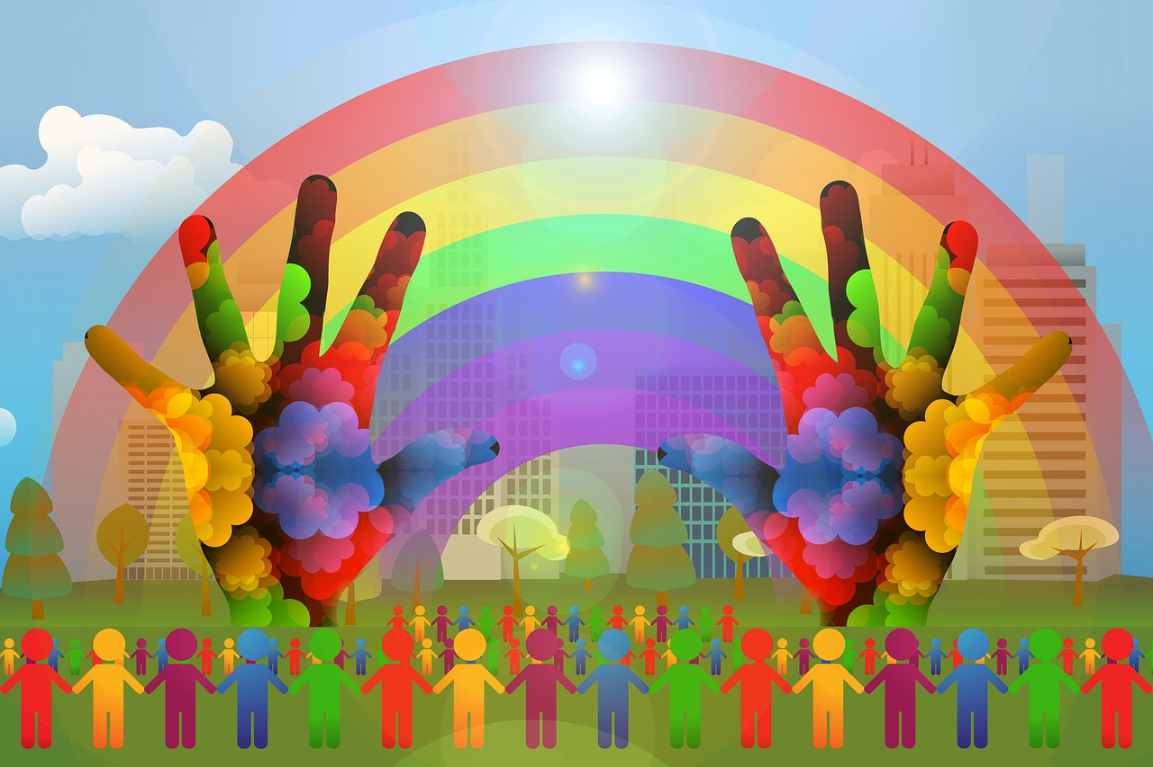
https://www.youtube.com/watch?v=ZSG7q3qLLrA
ART ACTIVITY
Notes:
Draw a picture that reminds you of the story we heard today
URL Tom Price God is Sufficient Unto Me

Slide 18
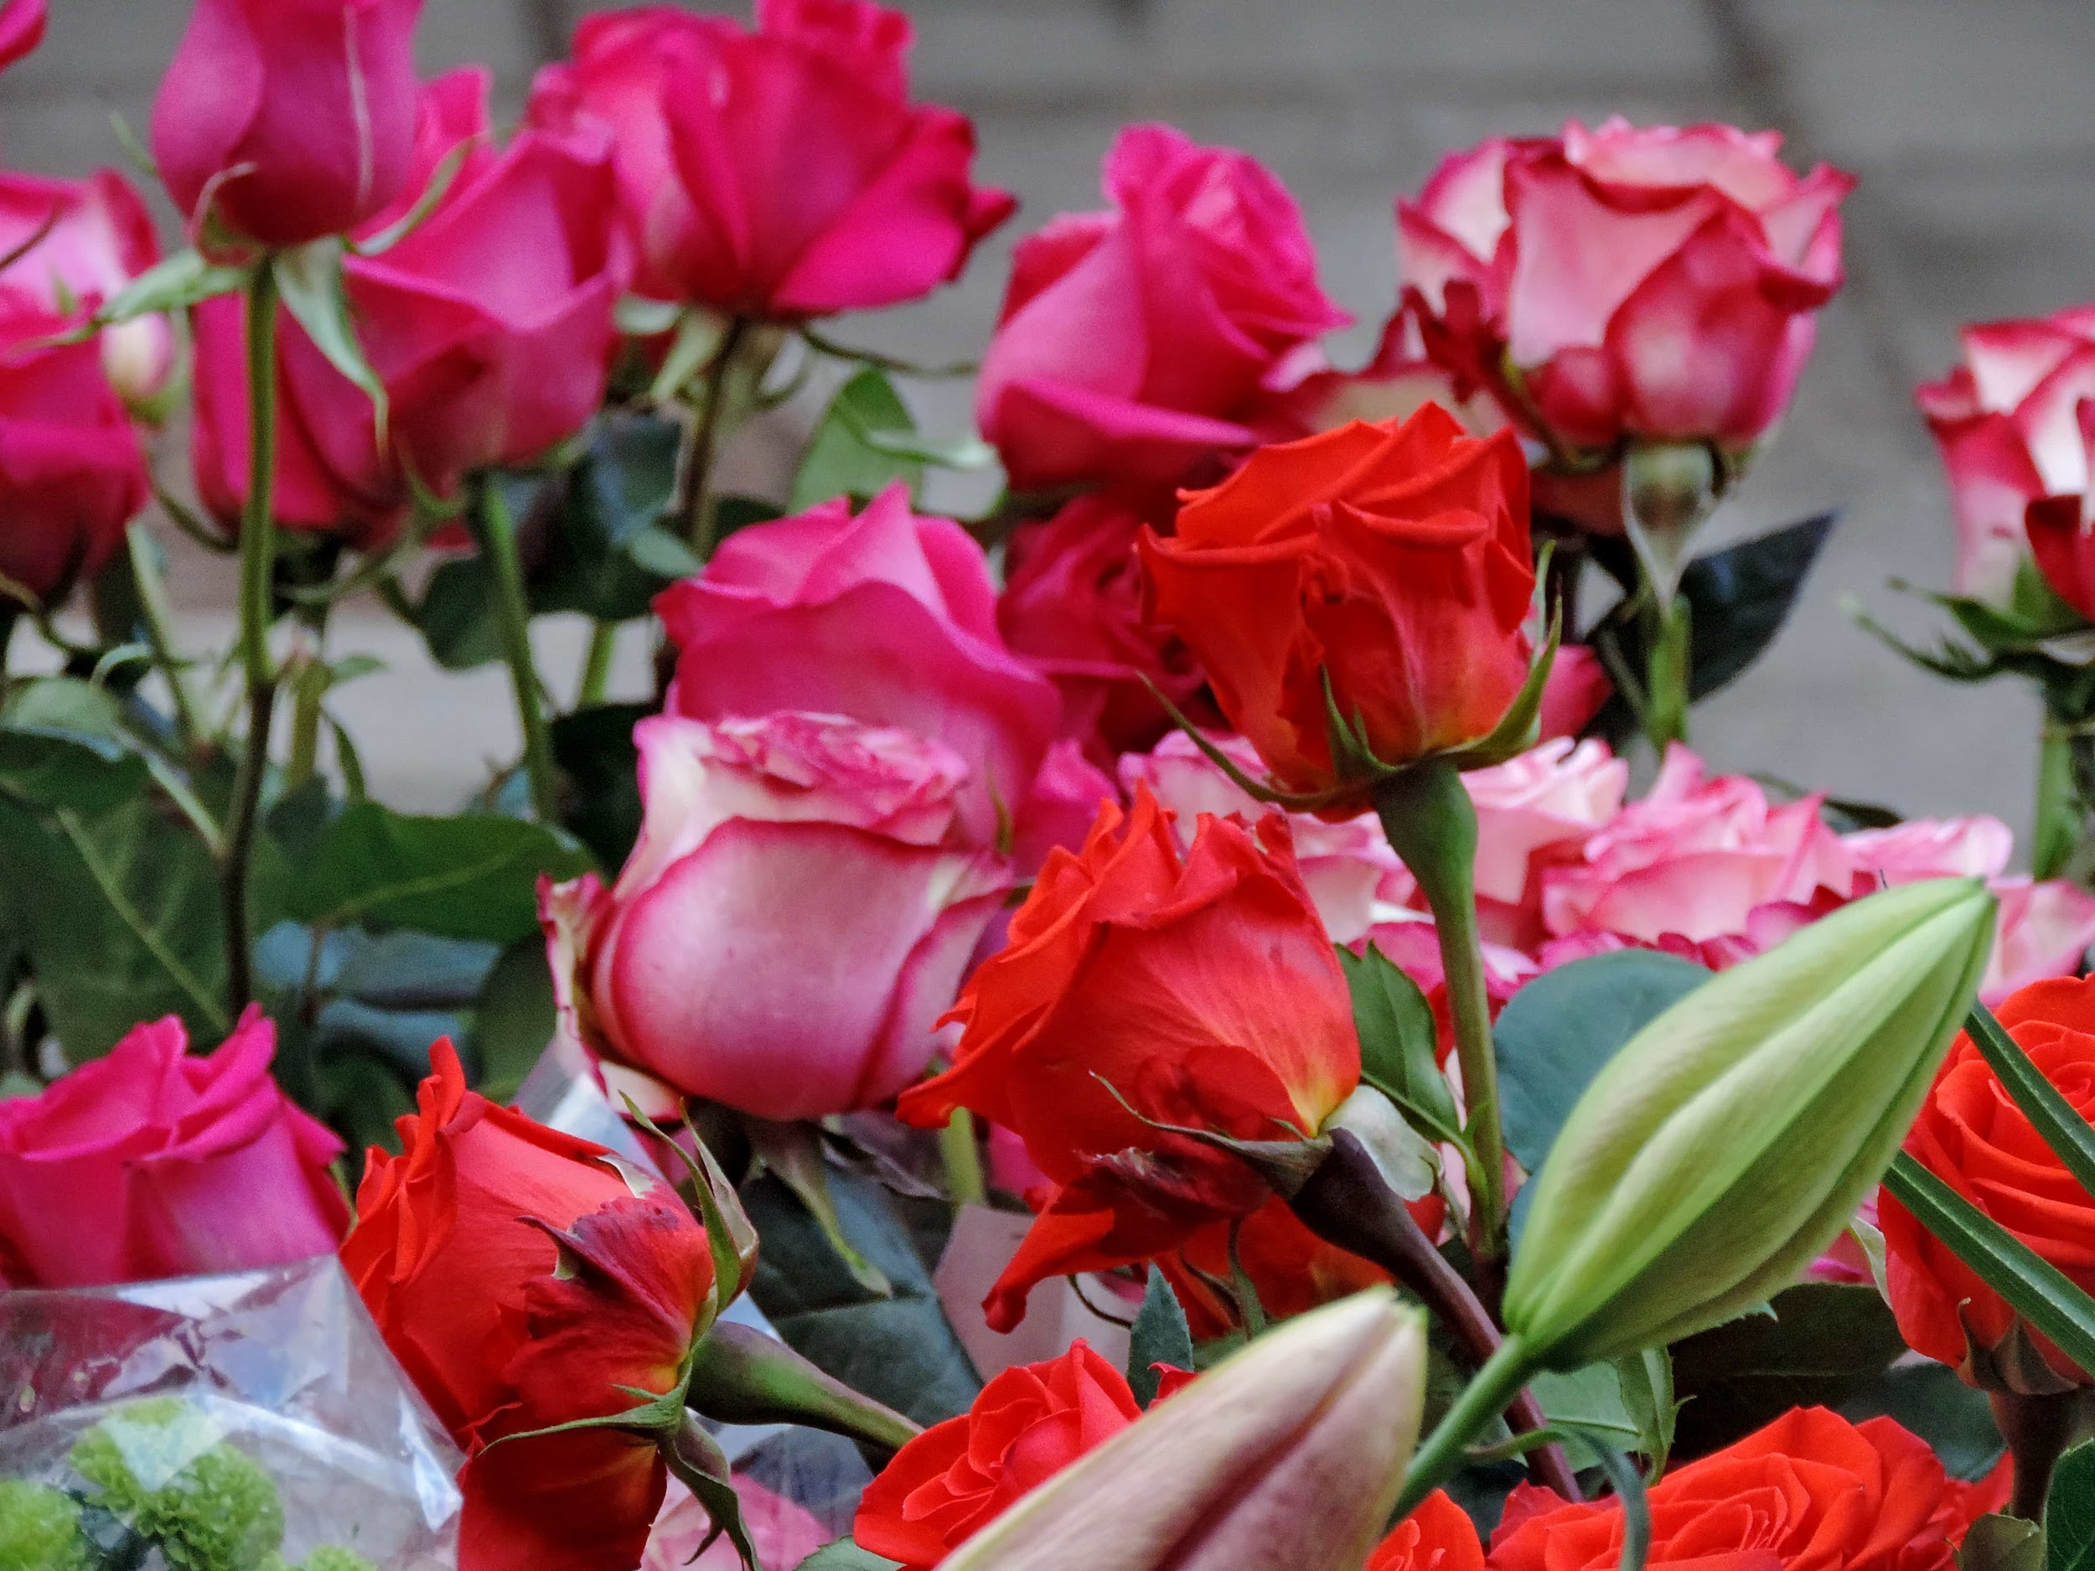
ART SHOW

Slide 19

CLOSING PRAYERS
Notes:
Review Any Remover of Difficulties
https://www.youtube.com/watch?v=VDuIAwaGqnQ God is Sufficient Unto Me
Prayer sharers

Slide 20


