Slide 1
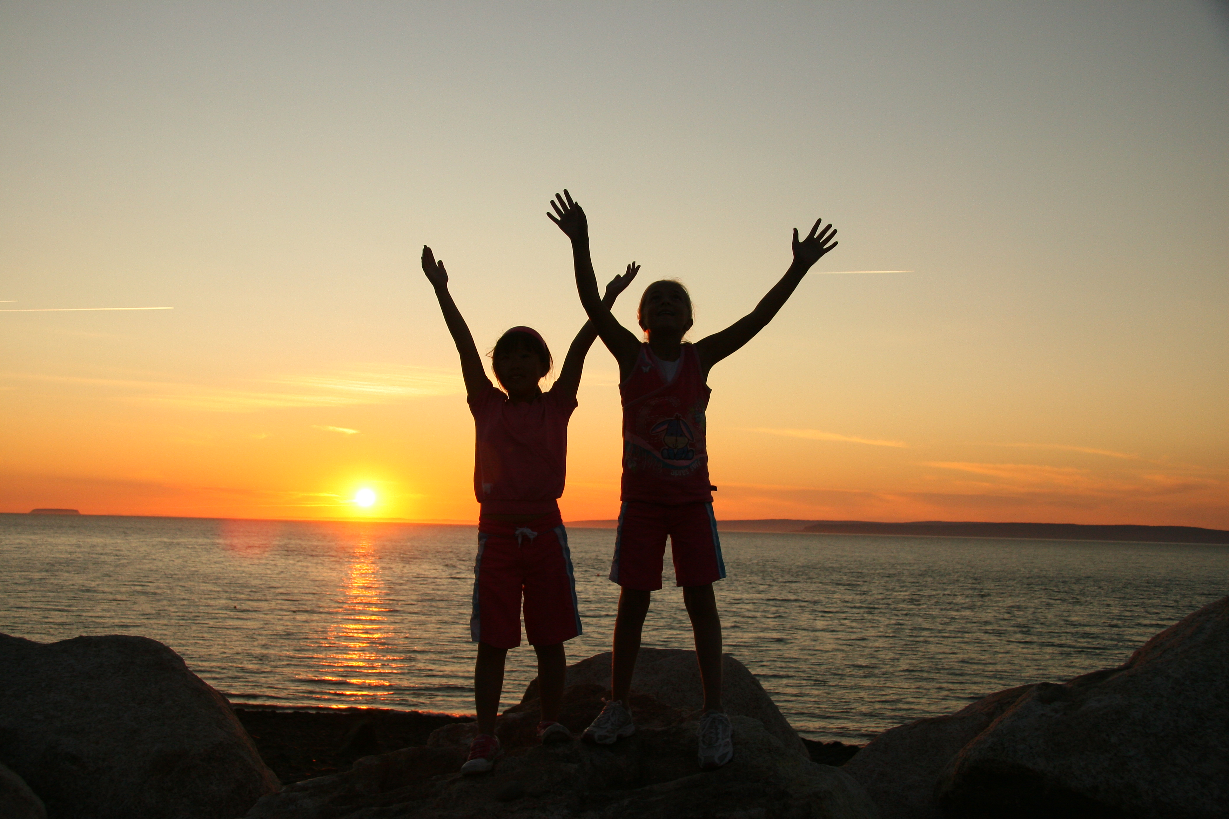
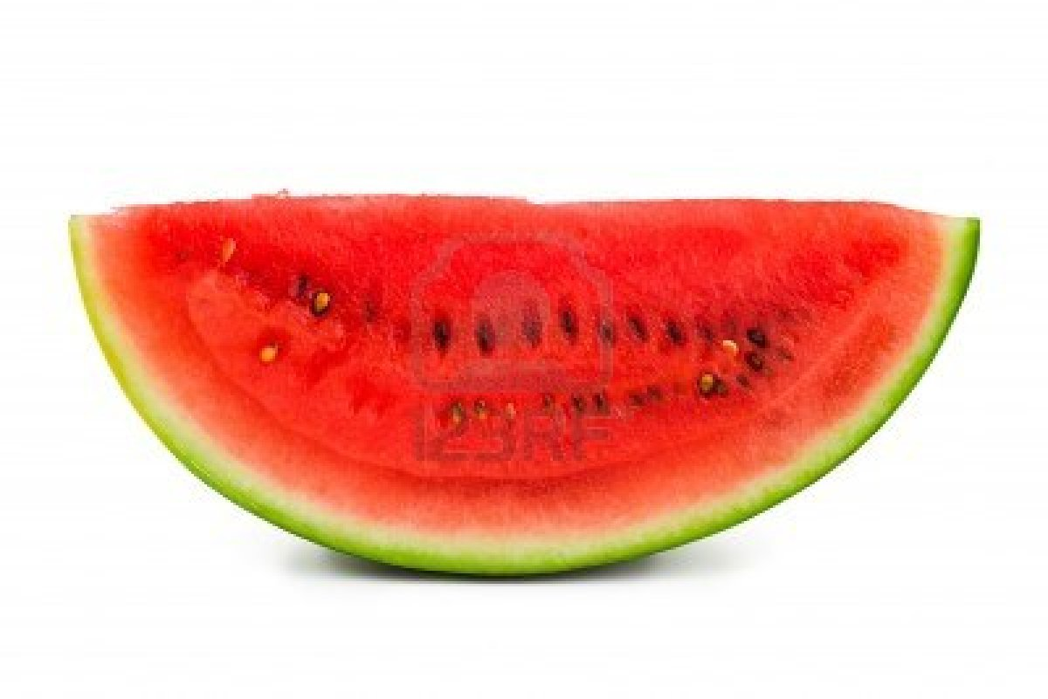
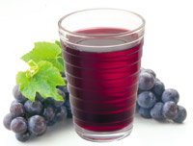





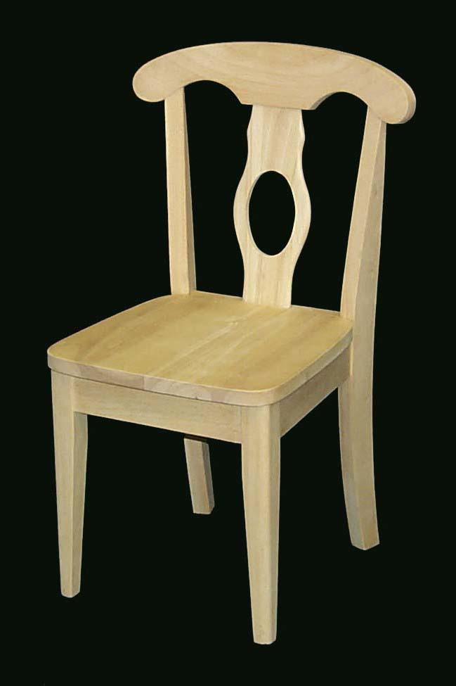
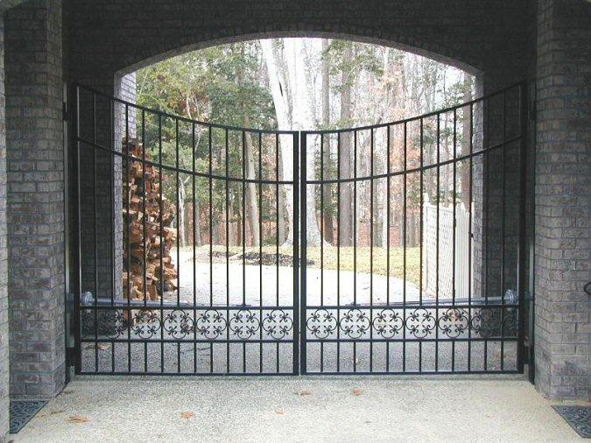


“O my Lord!...”
“O my Lord! | make Thy beauty to be my food, | and Thy presence my drink, | and Thy pleasure my hope,
and praise of Thee my action, | and remembrance of Thee my companion, | and the power of Thy sovereignty my succorer, | and Thy habitation my home,
and my dwelling- place the seat Thou hast sanctified | from the limitations imposed upon them | who are shut out as by a veil from Thee. | Thou art, verily, the Almighty, the All-Glorious, the Most Powerful.”

Slide 2
“ O my Lord!

Slide 3
Make Thy beauty to be my food,

Slide 4
and Thy presence my drink,

Slide 5
and Thy pleasure my hope,

Slide 6
and praise of thee my action,

Slide 7
and remembrance of Thee my companion,

Slide 8
and the power of Thy sovereignty my succorer,

Slide 9
and Thy habitation my home,

Slide 10
and my dwelling place the seat thou has sanctified,

Slide 11
from the limitations imposed on them

Slide 12
who are shut out as by a veil from Thee.

Slide 13
Thou art, verily, the Almighty, the All-Glorious, the Most Powerful.”

Slide 14
and Thy habitation my home,

Slide 15
and Thy habitation my home,

