Slide 1
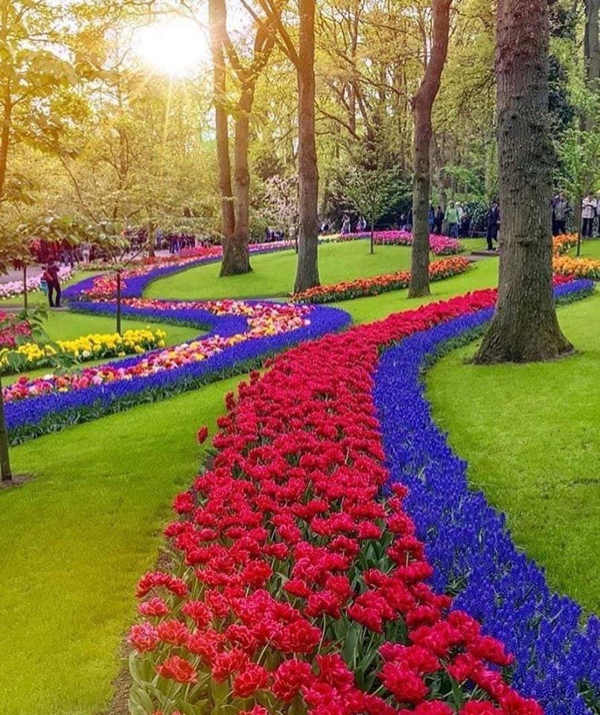
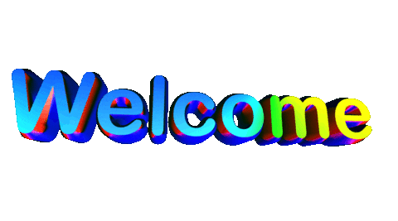
Notes:
I would like to talk about one of our class guidelines, that of being respectful. When you attend school in person, do you get up and walk out of class before class is over? It’s the same in children’s class. Please wait to be dismissed by the teacher before you log out. Otherwise you are showing disrespect for not only your teachers but also your classmates.

Slide 2
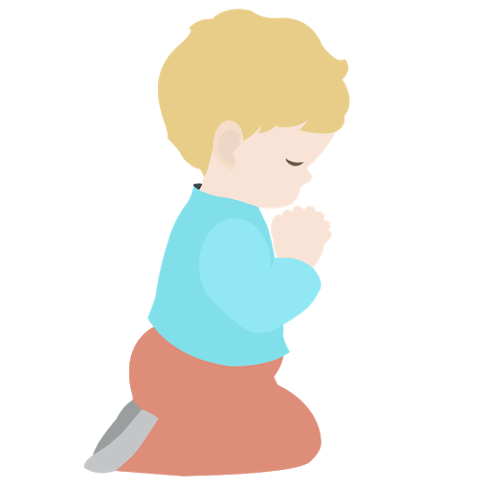
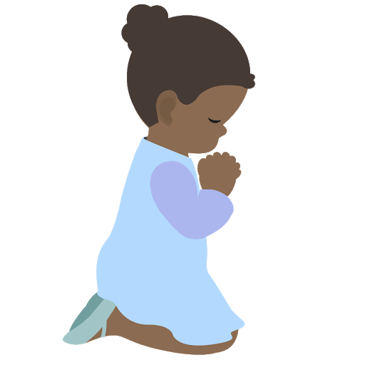
⭐️
⭐️
Prayer Stars⭐
Cassedy | ⭐️⭐️⭐️⭐️⭐️⭐️⭐️⭐️⭐️⭐️⭐️⭐️⭐️✅
Milan | ⭐️⭐️⭐️⭐️⭐️
Devin | ⭐️⭐️⭐️⭐️⭐️⭐️⭐️⭐️⭐️⭐️✅
Kim | ⭐️⭐️⭐️⭐️
Cora | ⭐️⭐️⭐️⭐️⭐️⭐️⭐️⭐️⭐️⭐️⭐️✅
Hudson | ⭐️⭐️⭐️⭐️⭐️⭐️⭐️
Dev | ⭐️⭐️⭐️
Manny | ⭐️⭐️⭐️⭐️⭐️⭐️⭐️⭐️⭐️⭐️⭐️⭐️✅
Camila | ⭐️⭐️⭐️⭐️⭐️⭐️⭐️⭐️⭐️⭐️⭐️⭐️✅
⭐️
⭐️
Notes:
Some of you have already reached the goal of ten star and have received your lego kit. That would be Manny, Camila, and Devin.
We will continue the prayer stars until everyone receives 10 stars. By the time you receive ten stars we assume you have developed the habit of praying each morning.

Slide 3
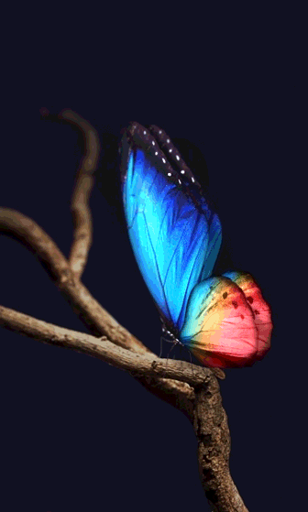
Prayer Sharers
Notes:
Say ones they can by heart

Slide 4
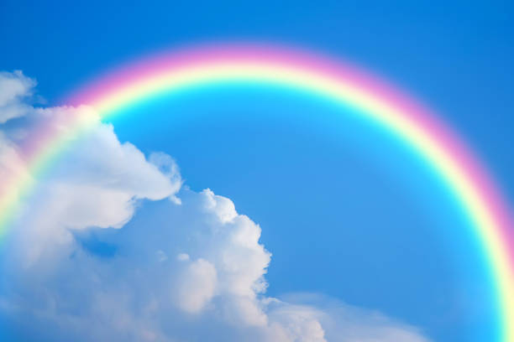
“...verily, thy Lord is of more good to thee
than anything in the material world.
He is the best companion and the best friend
and will accompany thee under all aspects…”
‘Abdu’l-Baha
Notes:
We are continuing our lessons on Being a Good Friend. Who can remember from our last class Who is our true best Friend? (God)
Read quote

Slide 5
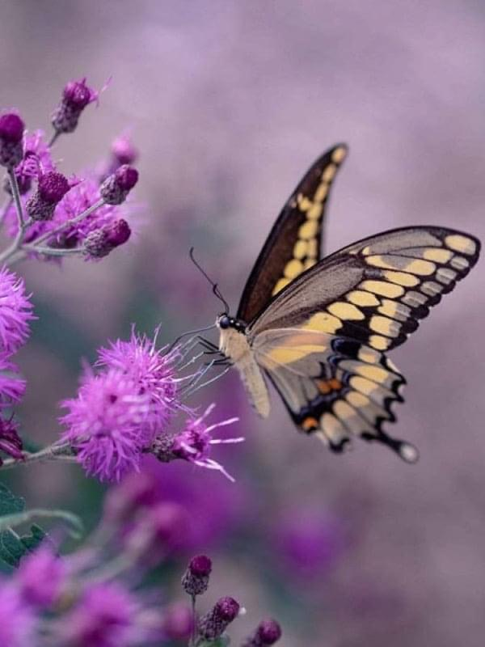
True Friends
are
Trustworthy
Notes:
Today we are going to learn what it means to be a trustworthy friend.
Intro Grade 2 p. 115 paragraph 1

Slide 6
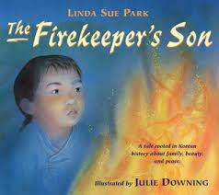
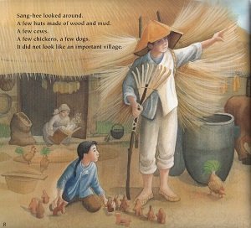
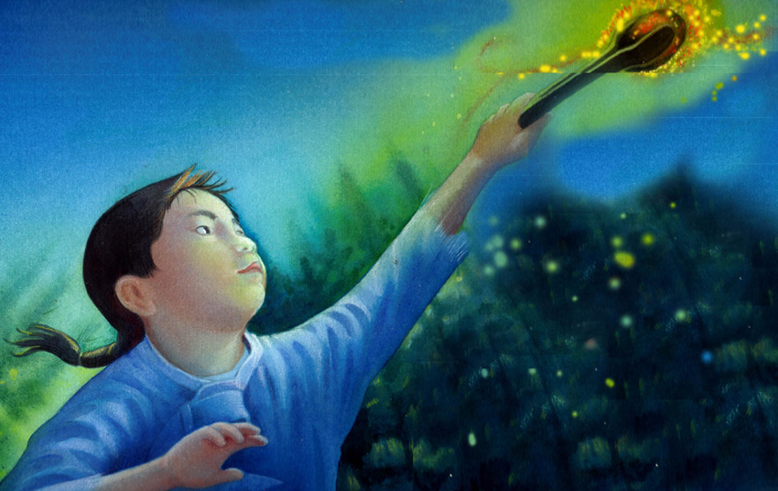
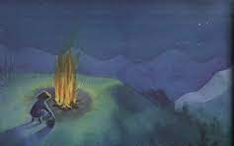
Notes:
How many of you remember the story The Firekeeper’s Son? He was very trustworthy. How did he prove he was trustworthy to his father, his village? Allow time for children to share what they remember about the Firekeeper’s son.

Slide 7
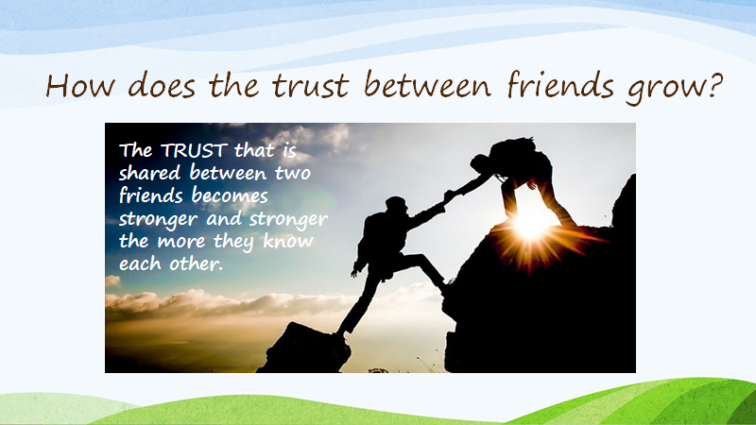
Notes:
Explain briefly-- spending time and caring for eachother makes your bond grow stronger--- having memories you can look back on and laugh creates a strong bond

Slide 8
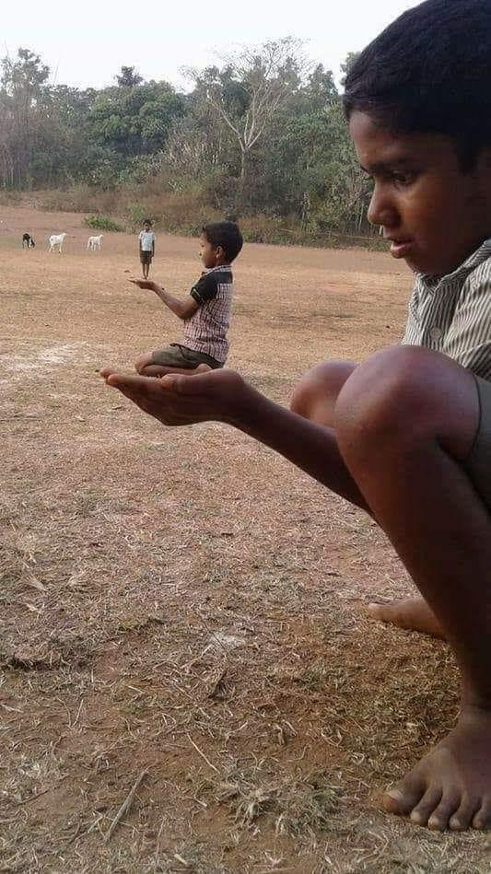
“Trustworthiness is the
greatest portal leading
unto the tranquility and
security of the people.”
Baha’u’llah
Notes:
Let’s look at this photo and talk about what we see. ….Look how trusting these three friends are of one another. Trustworthiness is not only essential between friends but Baha’u’llah tells us (Read quote)
Memorize with gestures (diedre will do the gestures)

Slide 9
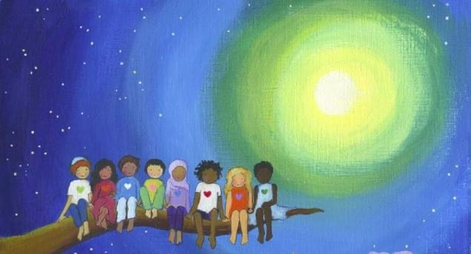
“We work and pray for the unity of mankind, that all the races of the earth
may become one race, all the countries one country, and that all hearts
may beat as one heart, working together for perfect unity and brotherhood.”
‘Abdu’l-Baha
Notes:
Who would like to read this quote by ‘Abdu’l-Baha? So to whom are we to be trustworthy friends?

Slide 10
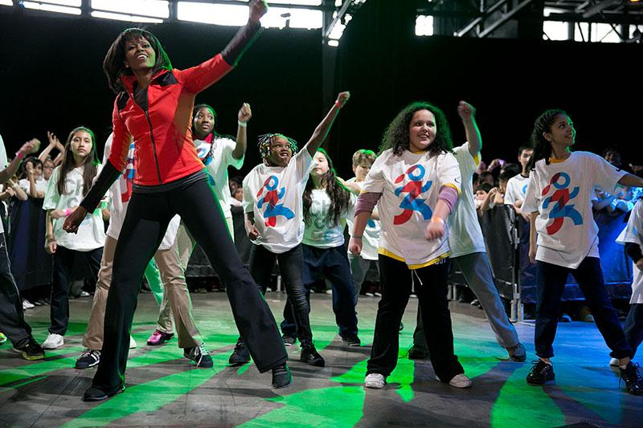
Movement Activity
Notes:
(Background music Noura? Do we need to extend time?)
Hudson: Will you please lead us in doing 10 sit ups?
Milan: Will you lead us in doing 10 elephant stomps?
Kim: Please help us fly like an airplane.
Dev: Would you please lead us in walking on all fours like a bear?
Camila: Now let’s get up and bounce like a ball.
Manny: Let’s do a moonwalk ten times.
Devin: Would you please lead the class in doing 10 jumping jacks?
Cora: Would you please help us pretend to be a seed growing into a beautiful flower blowing in the gentle breeze?
Cassedy:Would you please finish off our movement activity by helping us stretch up as high as we can ready to receive God’s bounties,

Slide 11
Friends Sacrifice
for One Another
Notes:
True friends also sacrifice for one another. What do you think that means??
When we sacrifice we offer up something of value (time, $, our love) in service to others. Remember how
‘Abdu’l-Baha sacrificed his entire life for the well-being of others.

Slide 12

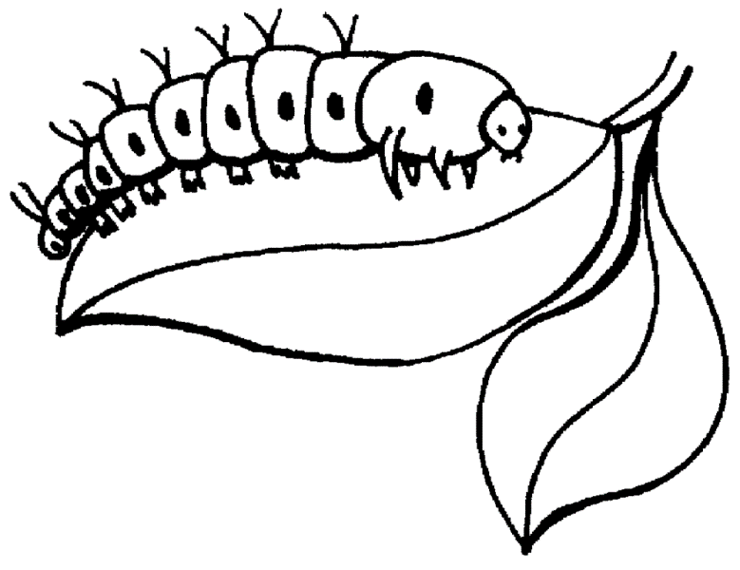
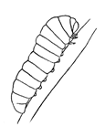
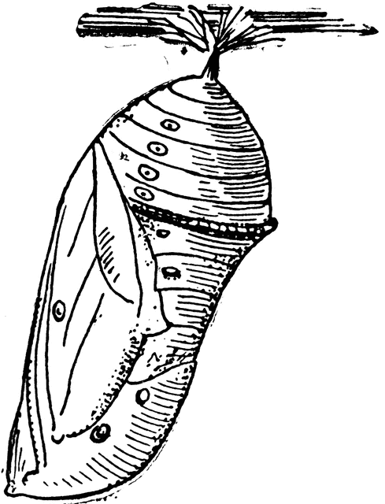

Sacrifice
Notes:
Sacrifice is something we see in nature all the time; it is an essential part of growth.
A caterpillar sacrifices itself to become a beautiful butterfly.

Slide 13
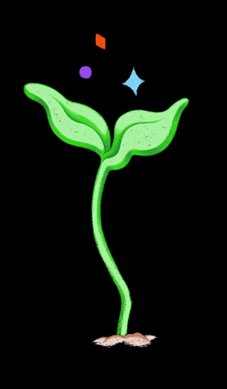
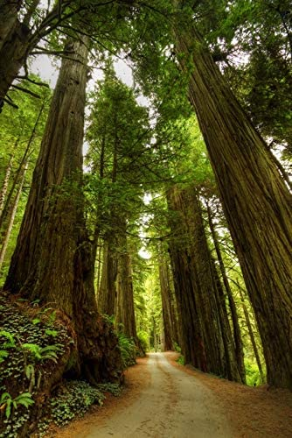
Notes:
A seed sacrifices itself to become a plant or a giant redwood tree.
Both the caterpillar and seed sacrifice themselves to a higher level of existence.

Slide 14
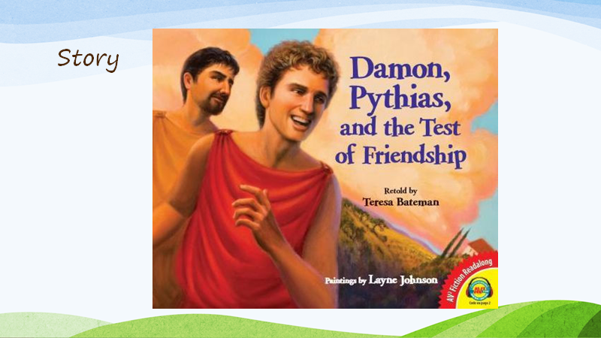
Story Time
https://www.youtube.com/watch?v=fhUleahpsMM
Notes:
This story is about two young boys who were willing to sacrifice their lives for one another. To me, sacrifice also means to make sacred.
You will see how these boys make their friendship something that is sacred.

Slide 15
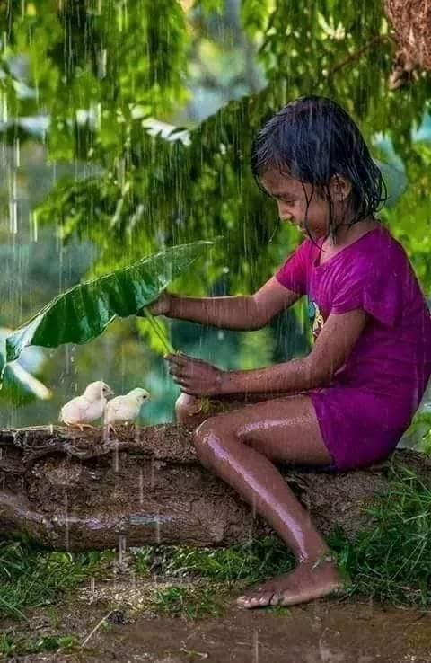
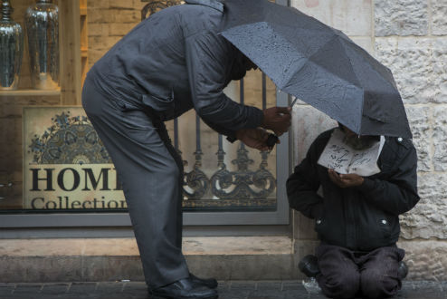
Sheltering the Weak
Notes:
Isn’t this little girl cute? Is she sacrificing her comfort to shelter the chicks? Look at the joy it is giving her.
Can we feel this same way about people who don’t have shelter?

Slide 16

ART ACTIVITY
Notes:
Draw a picture of the story of Damon and Pythias.

Slide 17
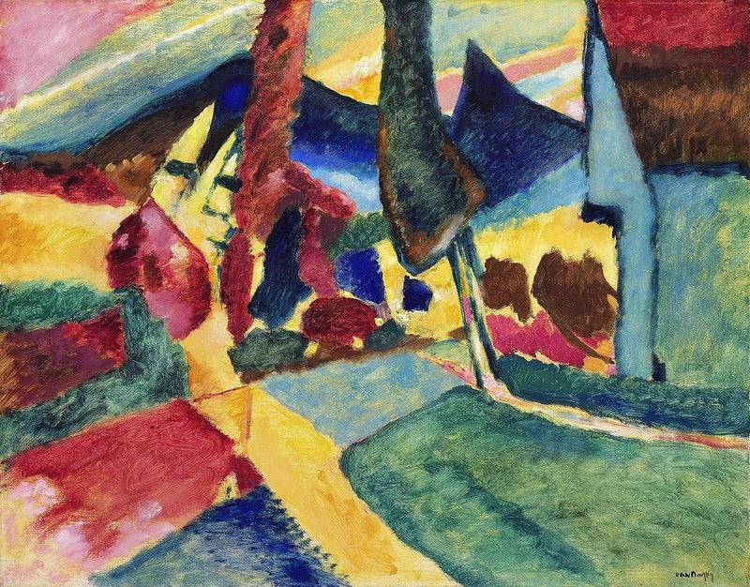
ART SHOW

Slide 18


Closing Song
God has crowned you with honor
and in your heart has He set a radiant star.
Notes:
Review quote of the day with gestures. “Trustworthiness is the greatest portal leading unto the tranquility and security of the people”
Radiant Heart #16 on Love All the World

Slide 19
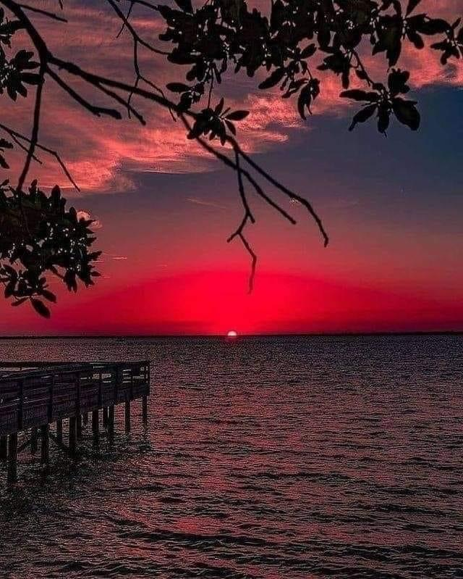
Closing Prayers
Notes:
Prayer sharers

Slide 20
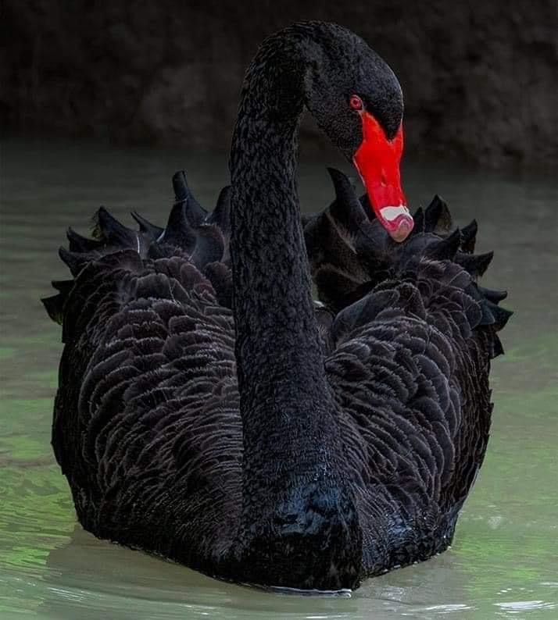
THANK YOU
Miss Noura

Slide 21
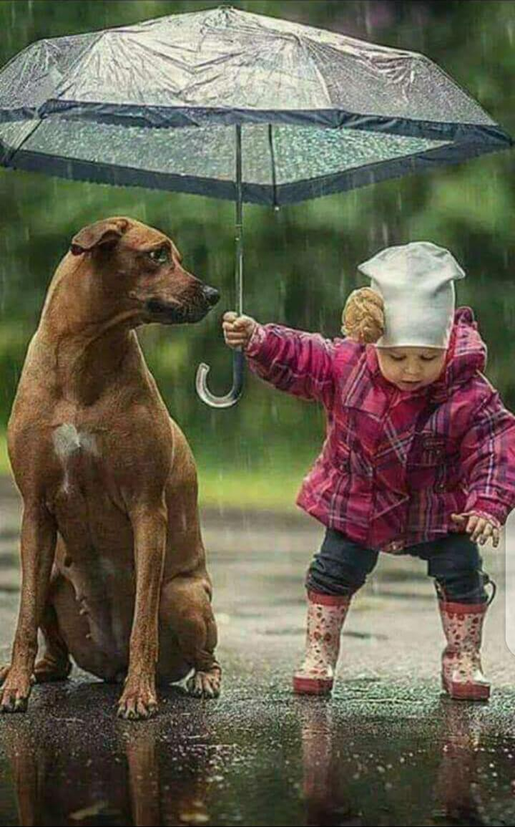
“Justice, love and kindness
must be the instruments of
strength, not of weakness.”
~ ‘Abdu’l-Baha~
Notes:
Does it take strength to sacrifice for a friend? Read quote

Slide 22
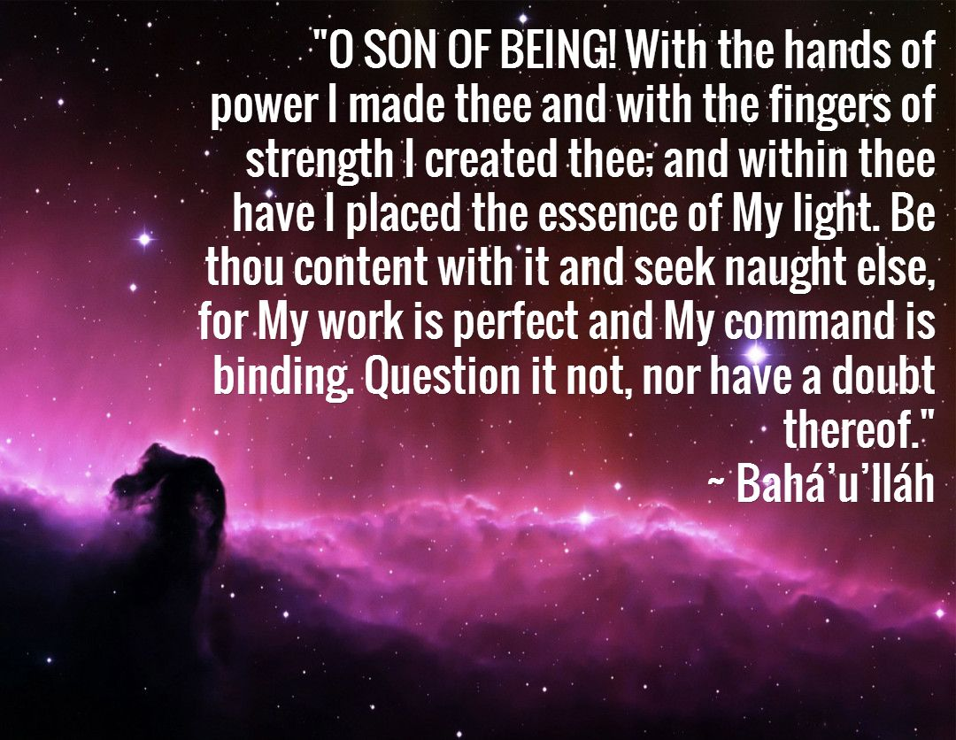
Horsehead nebula
Notes:
Who would like to read this quote from Baha’u’llah? (2 x) This quote tells us within each of us God has placed His light. Our prayers ask God to make us brilliant stars, bright with His light. We reflect God’s light. Isn’t that amazing!! Remember our lessons on Radiance and Enkindlement? We each have within us the capacity to share God’s light with others. We learn to put others before ourselves, sacrifice for them, and for no other reason than to bring pleasure to God.

