Slide 1
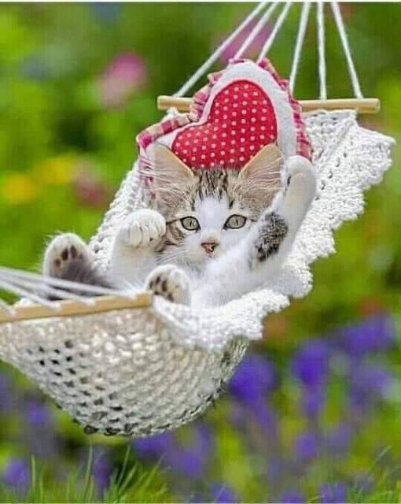
Welcome

Slide 2


Prayer Stars⭐
⭐️
⭐️
Cassedy | ⭐️⭐️⭐️⭐️⭐️⭐️⭐️⭐️⭐️⭐️⭐️⭐️⭐️✅
Milan | ⭐️⭐️⭐️⭐️⭐️
Devin | ⭐️⭐️⭐️⭐️⭐️⭐️⭐️⭐️⭐️⭐️✅
Kim | ⭐️⭐️⭐️⭐️⭐️⭐️⭐️⭐️⭐️⭐️⭐️⭐️⭐️⭐️⭐️⭐️⭐️⭐️⭐️✅
Cora | ⭐️⭐️⭐️⭐️⭐️⭐️⭐️⭐️⭐️⭐️⭐️✅
Hudson | ⭐️⭐️⭐️⭐️⭐️⭐️⭐️
Dev | ⭐️⭐️⭐️⭐️
Manny | ⭐️⭐️⭐️⭐️⭐️⭐️⭐️⭐️⭐️⭐️⭐️⭐️✅
Camila | ⭐️⭐️⭐️⭐️⭐️⭐️⭐️⭐️⭐️⭐️⭐️⭐️✅
Phoenix | ⭐️⭐️⭐️⭐️
⭐️
⭐️

Slide 3
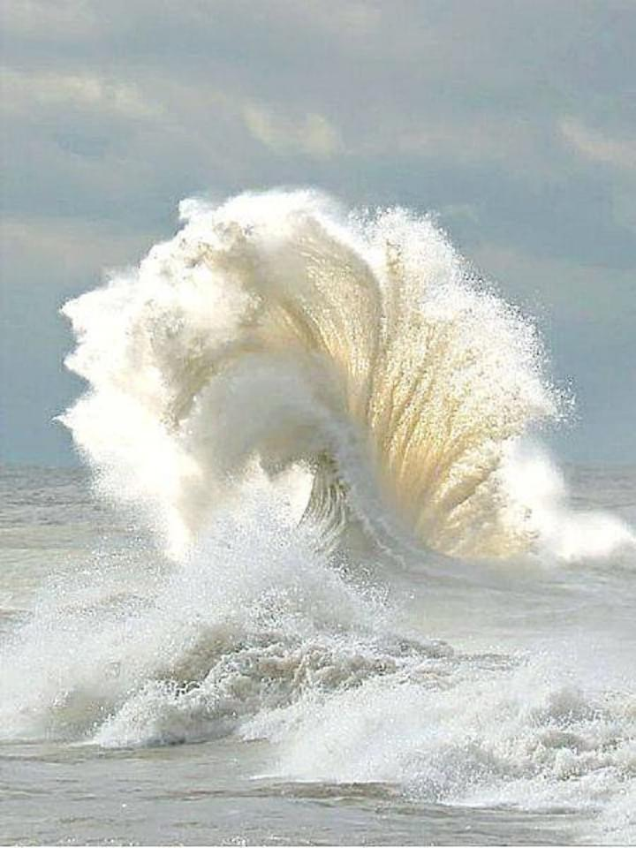
://www.youtube.com/watch?v=QQJjay_6Uvwhttps
Opening Prayers
Notes:
Disclose each child’s prayer partner
URL These lovely children
Prayer sharers

Slide 4
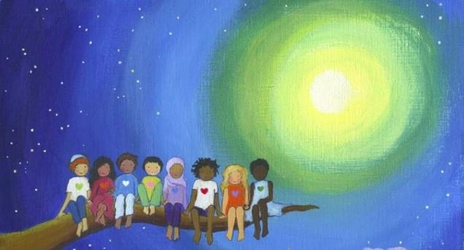
“That one indeed is
a man who, today,
dedicateth himself
to the service of the
entire human race.”
Notes:
Last week we completed the section on Being Good Friends.
Our next three lessons will be about Devoting One’s Life to Service.
Today we will explore how we draw nearer to God through service.

Slide 5
“Think ye
at all times
of rendering
some service
to every member
of the human race”
Notes:
Diedre--- do the memorization and gestures “ye”=you “Rendering”=performing (offering)

Slide 6
“Think ye
at all times
of rendering
some service
to every member
of the human race”
Notes:
Teacher call on student to read through quote filling in missing blank as teacher points to each word. Then class reads through entire quote.
Repeat process through as many slides as necessary.

Slide 7
“Think ye
at all times
of rendering
some service
to every member
of the human race”

Slide 8
“Think ye
at all times
of rendering
some service
to every member
of the human race”

Slide 9
“Think ye
at all times
of rendering
some service
to every member
of the human race”

Slide 10
“Think ye
at all times
of rendering
some service
to every member
of the human race”

Slide 11
“Think ye
at all times
of rendering
some service
to every member
of the human race”

Slide 12
“Think ye
at all times
of rendering
some service
to every member
of the human race”

Slide 13
“Think ye
at all times
of rendering
some service
to every member
of the human race”

Slide 14
“Think ye
at all times
of rendering
some service
to every member
of the human race”

Slide 15
“Think ye
at all times
of rendering
some service
to every member
of the human race”

Slide 16
“Think ye
at all times
of rendering
some service
to every member
of the human race”

Slide 17
“Think ye
at all times
of rendering
some service
to every member
of the human race”

Slide 18
“Think ye
at all times
of rendering
some service
to every member
of the human race”

Slide 19
“Think ye
at all times
of rendering
some service
to every member
of the human race”

Slide 20
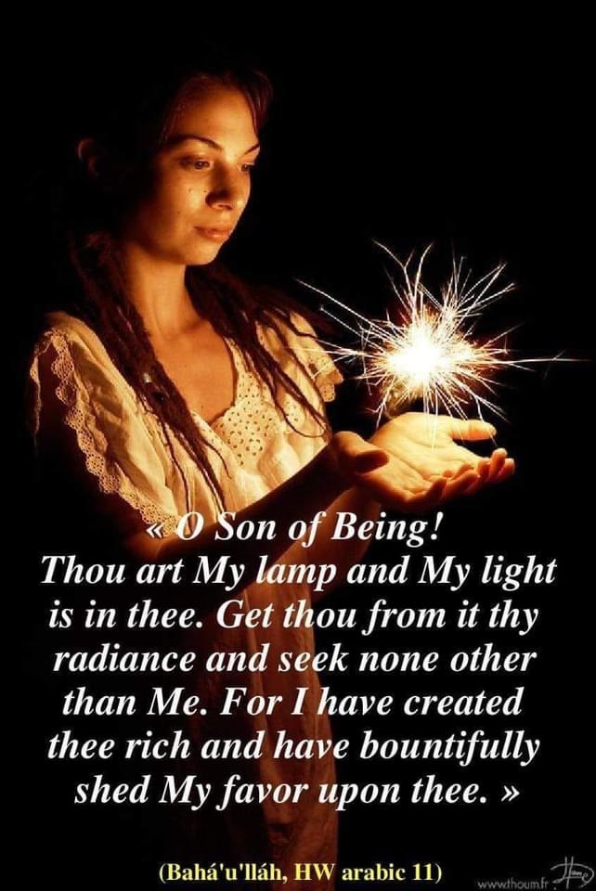
“Waste not your time
in idleness and sloth.
Occupy yourselves
with that which profiteth
yourselves and others.”
Notes:
How do we waste time? Need to see what really matters in life

Slide 21
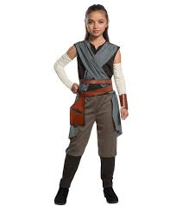
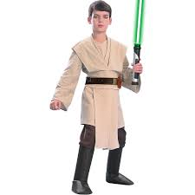
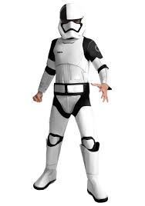
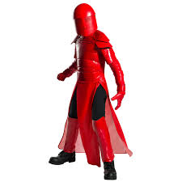
https://www.youtube.com/watch?v=xACwd1Q-42U
Movement Activity
Be a Force of Change
Notes:
End at 2 min 50 seconds

Slide 22

https://www.youtube.com/watch?v=mvuduWpLL_c
Notes:
Story Time-- story starts with a senator speaking

Slide 23
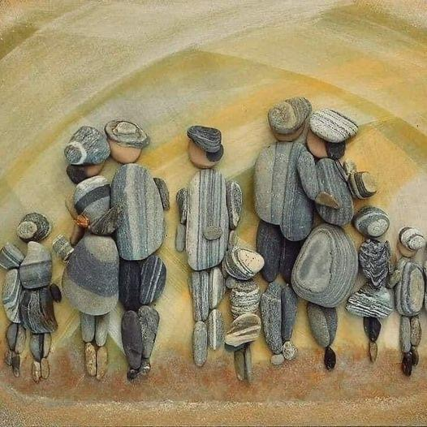
Art Activity
Notes:
Isn’t it creative how this artist used stones to make a work of art.

Slide 24
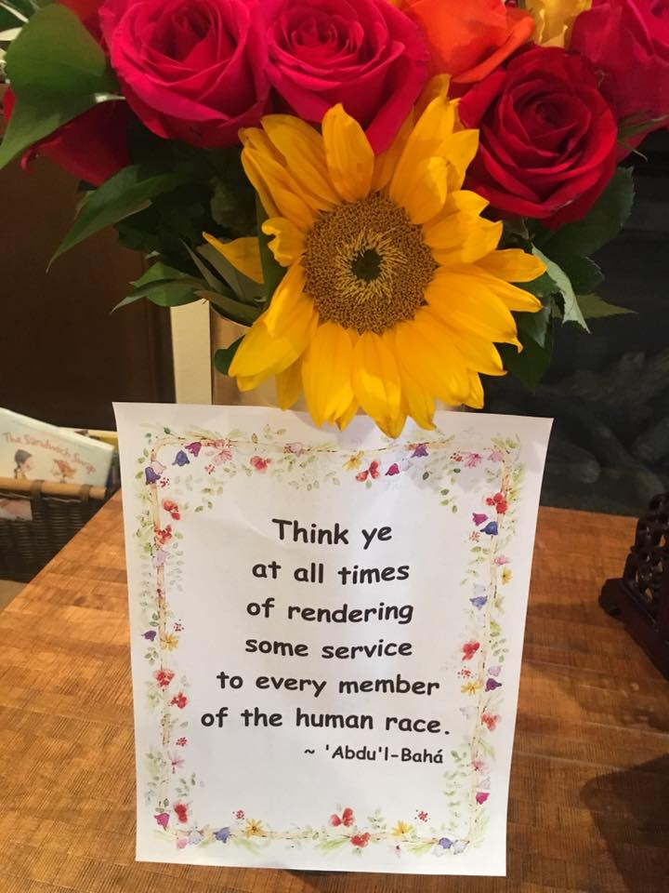
“Think ye
at all times
of rendering
some service
to every member
of the human race.”
‘Abdu’l-Baha
Notes:
Turn page so vertical. Copy quote first then add decorative border and hang up in home.
Art show

Slide 25

Closing Prayer
https://www.youtube.com/watch?v=ZD9hsSLTt-E
Notes:
URL: Be a lamp shining forth
Prayer sharer

Slide 26

THANK YOU

