Slide 1

Notes:
Ask children if they have a plate, marble, and bowl for science experiment plus art supplies.

Slide 2

https://www.youtube.com/watch?v=2oJLPoUFmyU
Opening Prayers
Notes:
Unity prayer
Prayer sharers
How many of you said prayers this morning when you first woke up? How is the stuffed toy working. Even with something as important as saying our prayers morning and evening, sometime we need reminding until it becomes a habit. (Offer to contact parents to remind them if feel that would be helpful)
Last 3 lessons were about prayer (Conversatin with God, why we pray and how we pray) Now we are beginning another 3 lessons about Obeying the laws of God.

Slide 3

God's Laws Keep Us Safe
Notes:
The crosswalk represents the straight path, helmet, walking slowly (Thinking before we act), obeying stop sign. By obeying the laws you are keeping safe and also keeping others safe.

Slide 4
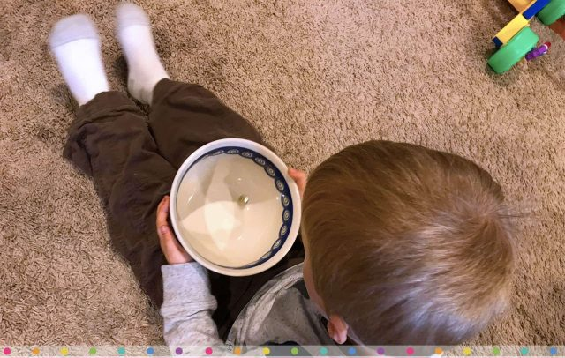
Science Experiment
Notes:
PUT Materials behind you; please don’t touch…)The marble represents us. (Maia demonstrate using the plate first-start slow) Like the marble, when we don’t have any boundaries in our lives, we can easily spin out of control, fall down, hurt ourselves and others. (Maia demo rolling marble around in the bowl. The marble can get going really fast because it has the walls of the bowl to protect it. With the walls the marble can be the best marble it can be by rolling super fast. God’s commandments are like the sides of the bowl. They create safe boundaries for our lives so that we can move more freely and without having to worry about spinning out of control, getting off track. God didn’t give us His commandments to make us miserable, but because He can see beyond what we can see and He wants to keep us safe. God knows that when we follow His commandments we are free to to become the best person we can be. LET CHILDREN DO EXPERIMENT

Slide 5
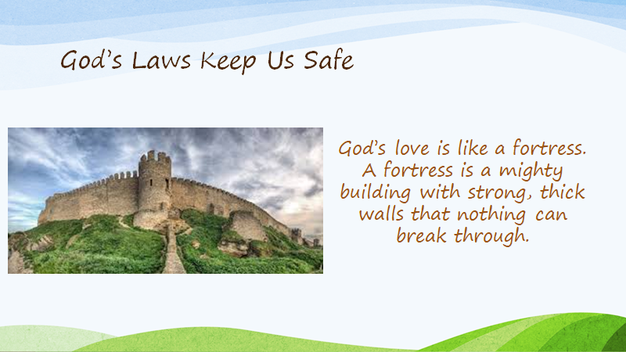
Notes:
God’s love is like a fortress. What is a fortress? It keeps you safe.
All humanity has been created out of God’s love. We are constantly nurtured and protected by his fortress of love.

Slide 6
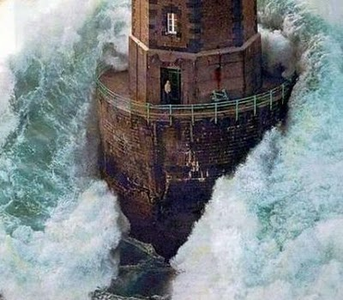
"O Son of Being!
My love is My stronghold;
he that entereth therein
is safe and secure,
Notes:
Diedre and Maia: Read slide and sing 2x

Slide 7
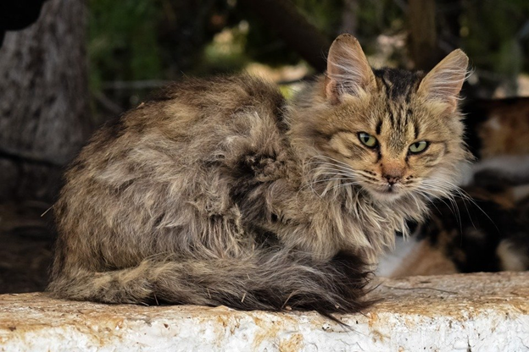
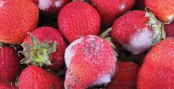
and he that turneth away
shall surely stray and perish.”
Notes:
Diedre and Maia: Read slide and sing 2x
Stray cat, has no home. Not protected from fleas and disease like if it had a home. We have a choice of whether we stray from God’s protection.
Perishable means they can lose their normal qualities. When that happens they no longer are healthy for us. SING entire quote

Slide 8
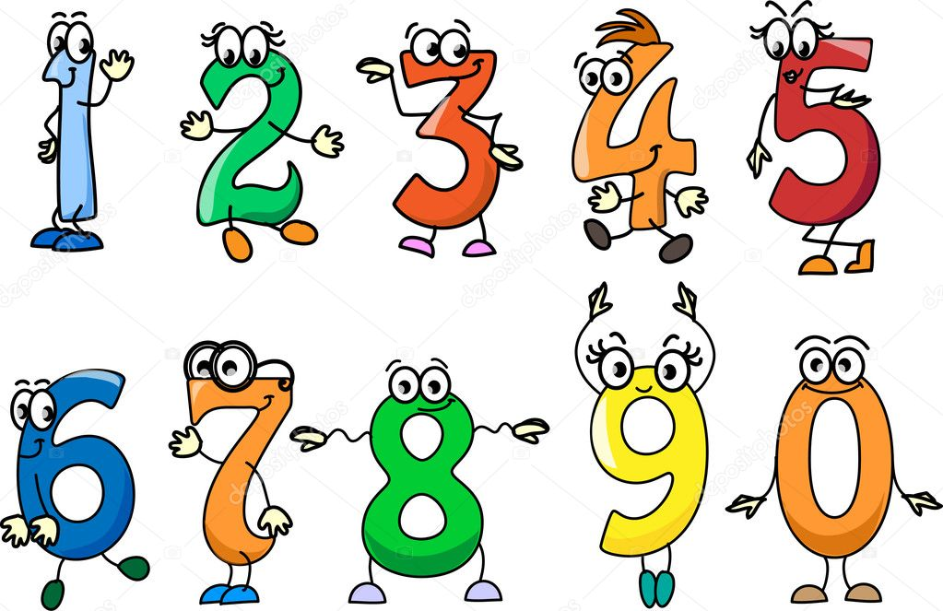
Notes:
Game break: Unmute yourselves. Count to 5 trying not to interrupt each other. If two say number at same time have to start over with 1.

Slide 9

Notes:
Diedre: story of train that wouldn’t stay on the track By Irene Taafaki

Slide 10
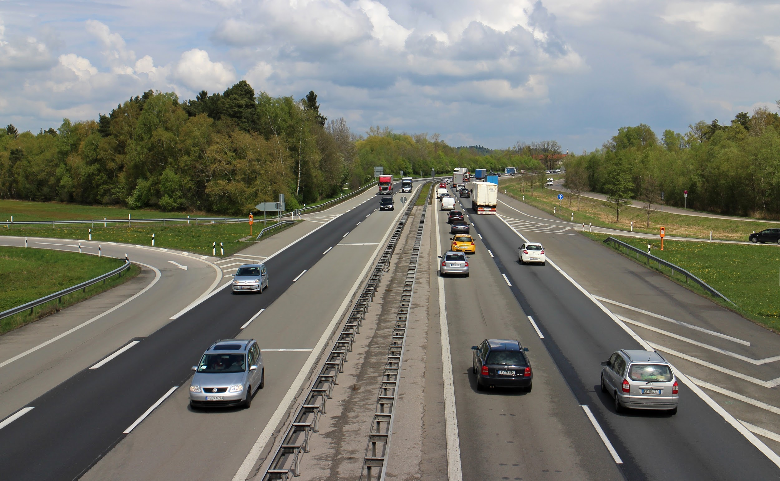
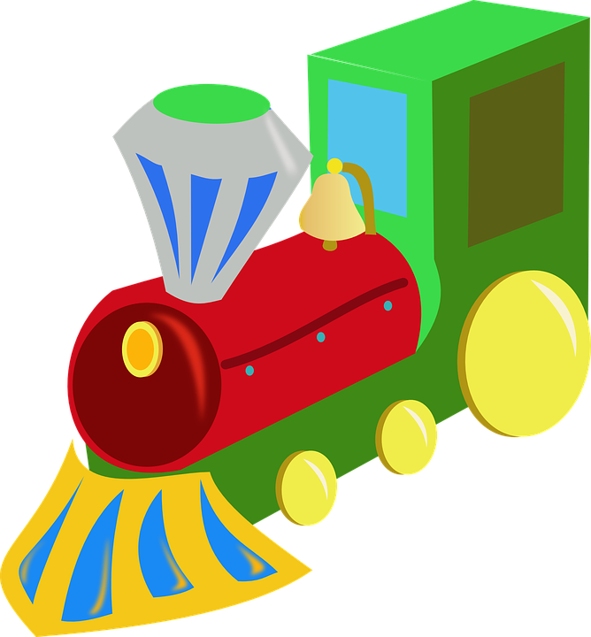
There’s plenty of room on the road for me!
Keep off! You are supposed to be on the track!
Notes:
Why shouldn’t the train be on the road? (It dangers himself and others, and people have to wait all day for things that never came)

Slide 11
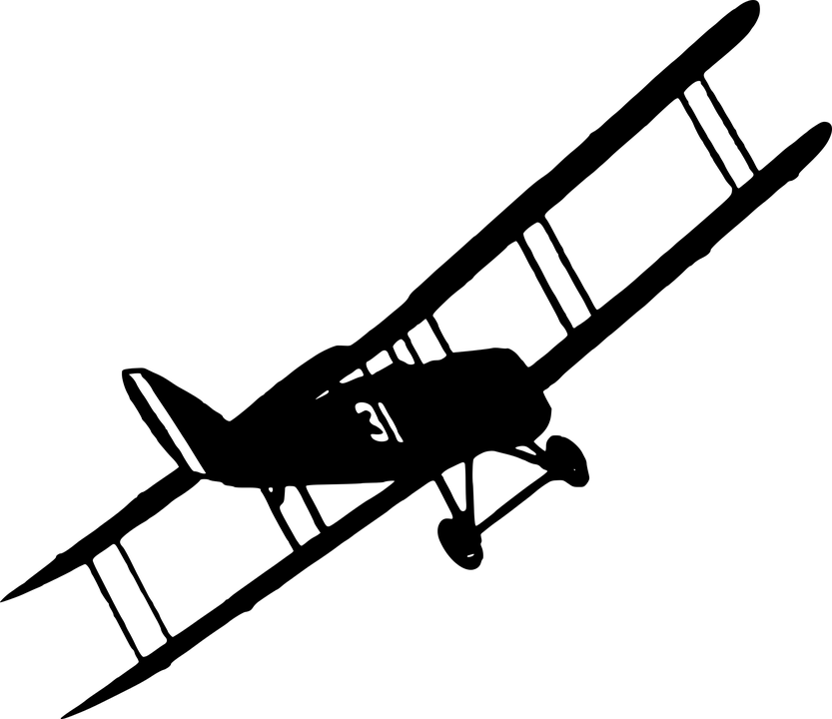
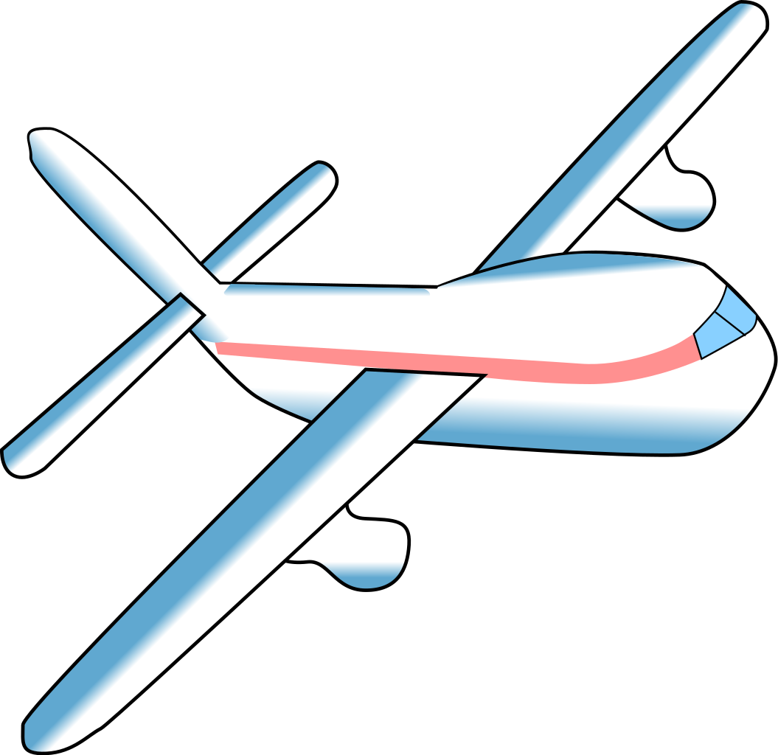
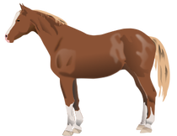
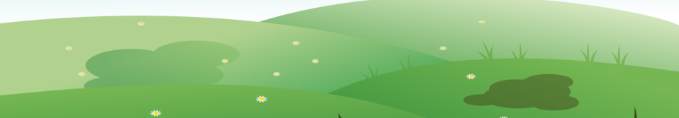
I want to fly too!
You can’t fly, you have to go on a track!

Slide 12
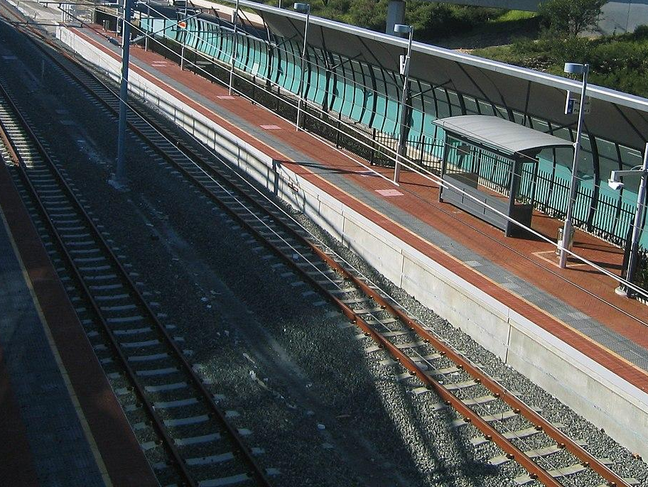
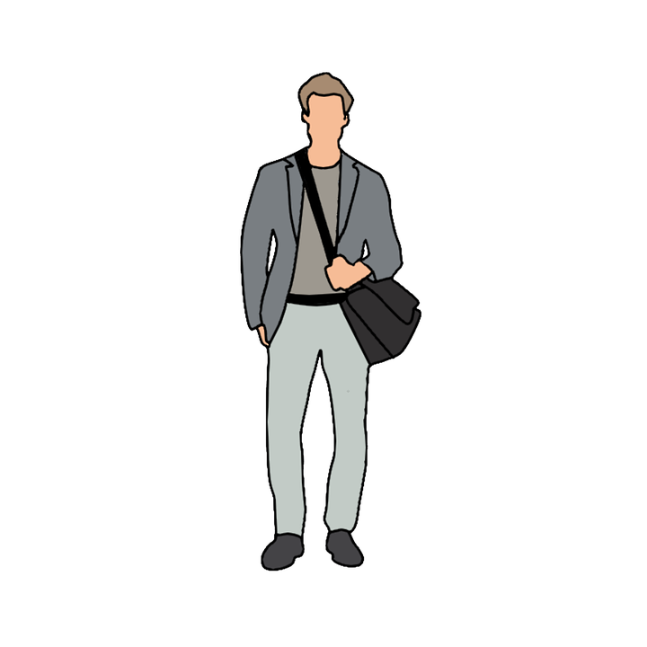
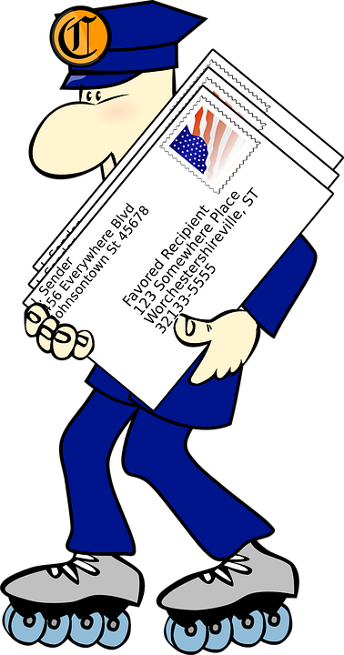

This is just where I belong!

Slide 13
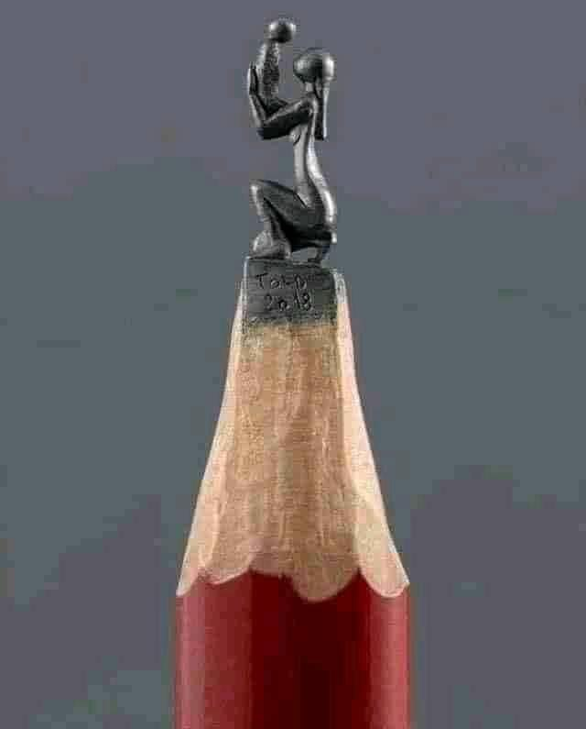
Art Activity
https://www.youtube.com/watch?v=7yTtdE_Cz4I
Notes:
We are going to draw a picture of a fortress to remind us of today’s lesson about the importance of following God’s guidance and living a life that is pleasing to God.
Castle drawing tutorial

Slide 14
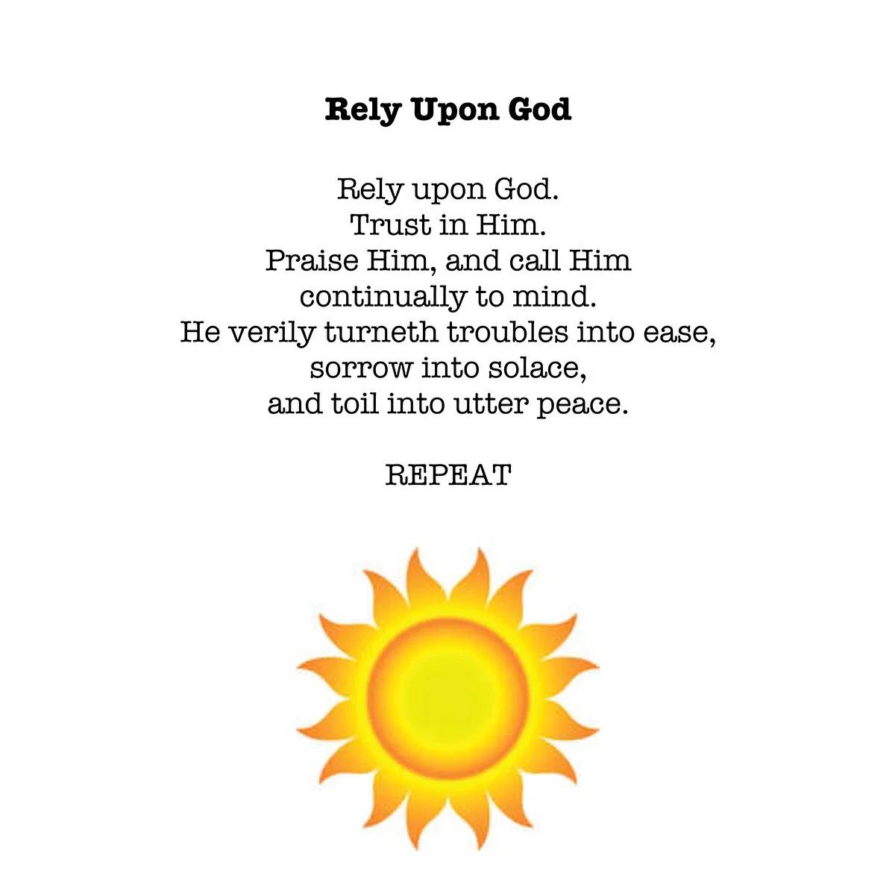
https://www.youtube.com/watch?v=whpbfKHPzMw
Notes:
4 minute song Rely Upon God while finishing drawing. More music

Slide 15


Slide 16
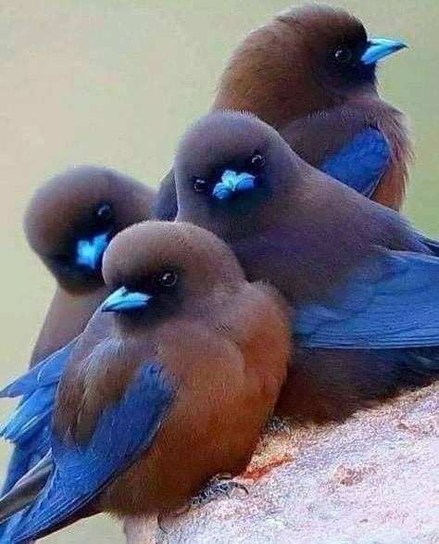
CLOSING PRAYERS
Notes:
Together: Blessed is the spot, Educate these children

Slide 17







Cassedy
Kim
Milan
Cora
Devin
Hudson
Notes:
Thank you to Maia too

Slide 18


Slide 19
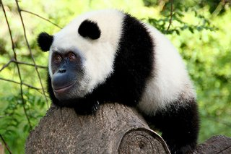

Slide 20
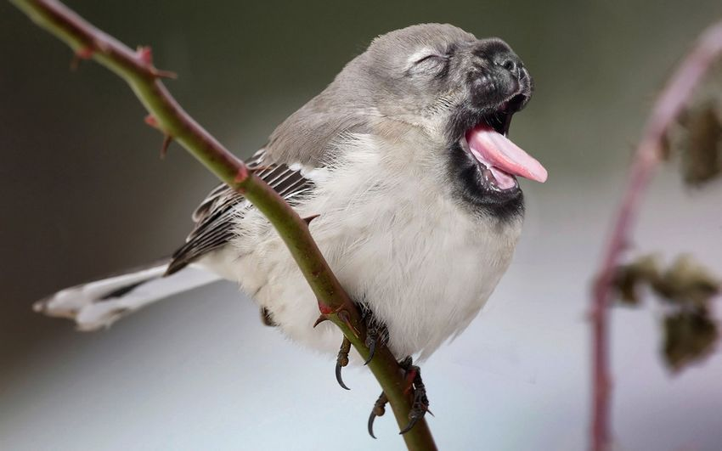

Slide 21
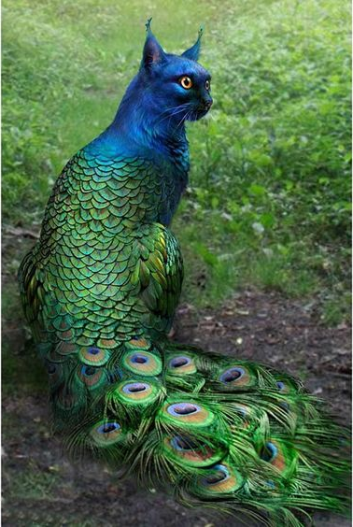

Slide 22
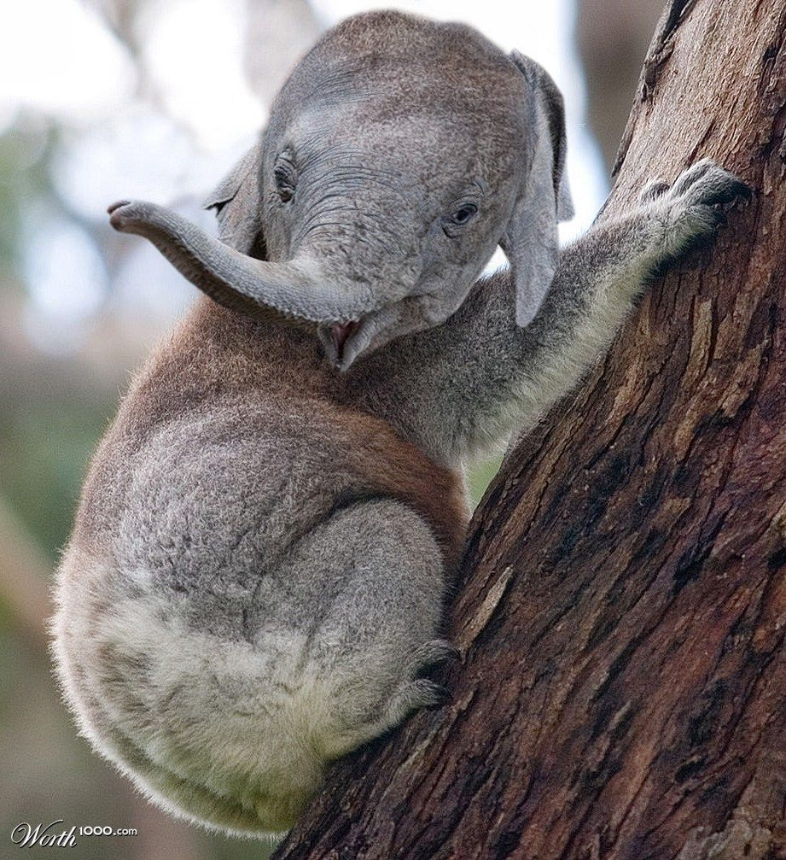

Slide 23
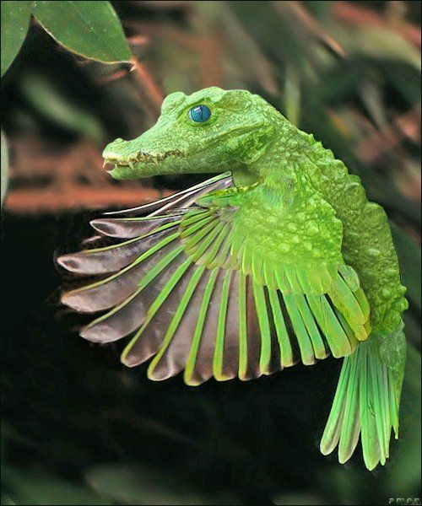

Slide 24
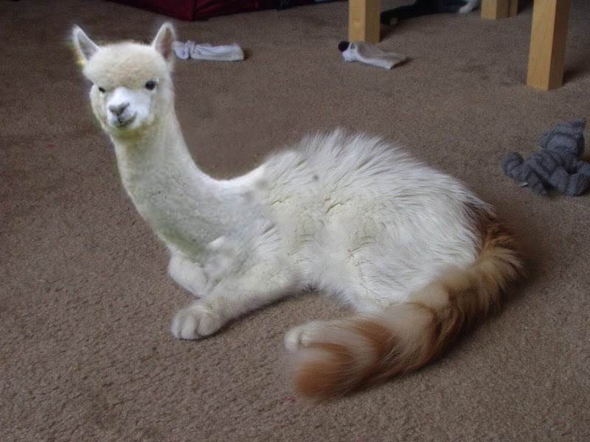

Slide 25
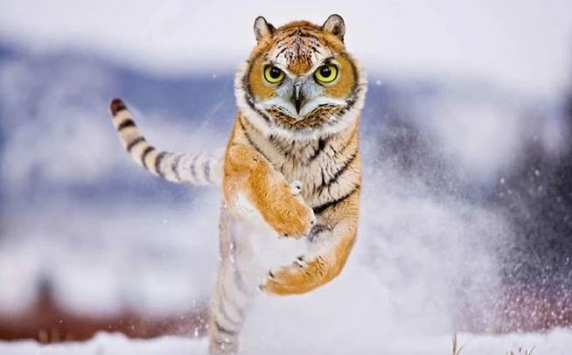

Slide 26
