Slide 1
Unity

Slide 2
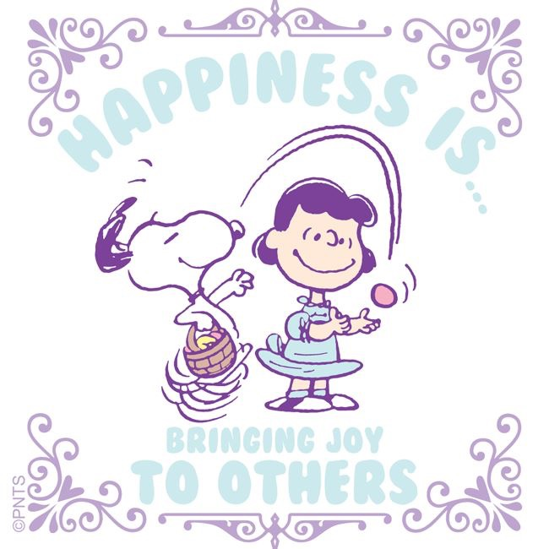
“You live to do good and to bring happiness to others.”
-Abdu’l-Baha

Slide 3
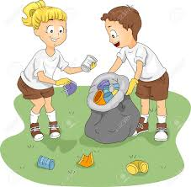
Clean up song
Clean up, clean up, everybody everywhere.
Clean up, clean up, everybody do your share.

Slide 4

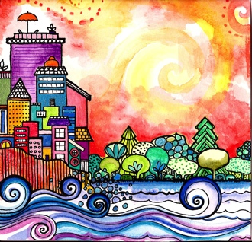
Good morning, Good morning!
It’s lovely to see you! Please come in and join us, we’d love to be with you. Today is going to be:
*Wonderful *Joyful *Beautiful *Peaceful
Today is going to be…How is your day going to be?
Today is going to be ____(Full of Unity).
Today I’m going to be:
*Happy *Helpful
Good morning, Good morning! It’s lovely to see you! X 2

Slide 5
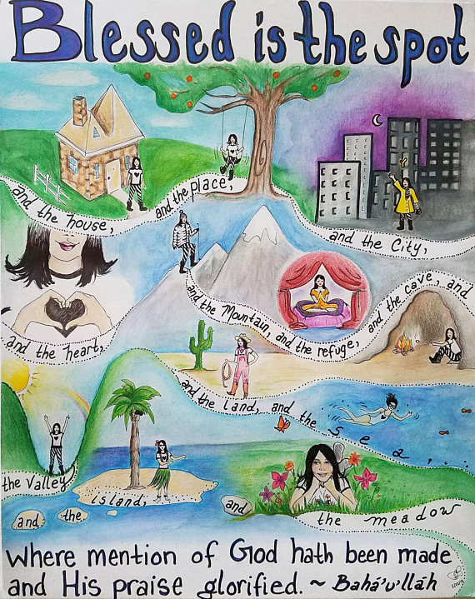
Opening Prayer
Blessed is the spot, and the house, and the place
and the city, and the heart, and the mountain,
and the refuge, and the cave, and the valley,
and the land, and the sea, and the island,
and the meadow where mention of God hath been
made and His praise glorified.
~ Bahá'u'lláh

Slide 6

HELLO
Hello everybody! So glad to see you! Hello everybody, so glad to see you too!
Hello to ____, so glad to see you! Hello to _______, so glad to see you too! Hello everybody! So glad to see you! Hello everybody, so glad to see you!

Slide 7
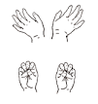



Open and shut them
Open and shut them
Open and shut them, open and shut them, give a little clap
Open and shut them, open and shut them, fold them in your lap.
Creep them, creep them, slowly creep them right up to your chin.
Open up your little mouth but do not let them in!

Slide 8
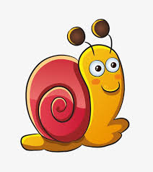
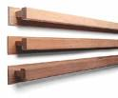
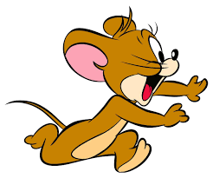

Slowly and Quickly
Slowly, slowly, very slowly creeps the garden snail
Slowly, slowly, very slowly, up the wooden rail.
Quickly, quickly, very quickly runs the little mouse.
Quickly, quickly, very quickly in his little house!

Slide 9

Introduction to the Virtue of Unity and Storytime!

Slide 10

The More We Get Together
The more we get together, together, together,
the more we get together the happier we’ll be,
for your friends are my friends and my friends are your friend
The more we get together the happier we’ll be!

Slide 11
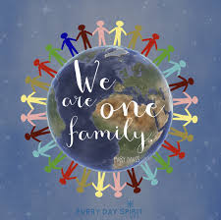

I Love You and You Love Me
I love you and you love me. We are one big family.
All around the world you’ll see us teaching peace and unity.
I love you and you love me. We are one big family.

Slide 12
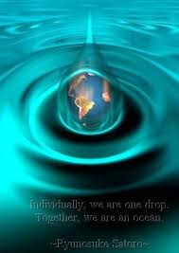
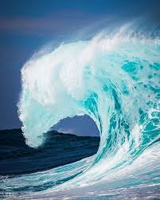

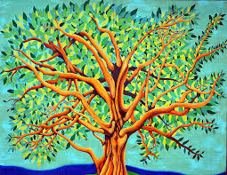
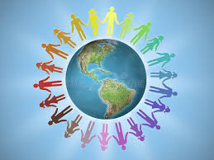
Unity Song
We are drops (we are drops) of one ocean (of one ocean).
We are waves (we are waves) of one sea (of one sea).
CHORUS: Come and join us (come and join us) in our quest for unity.
It’s a way of life for you and me.
We are flowers (we are flowers) of one garden (of one garden).
We are leaves (we are leaves) of one tree (of one tree).
CHORUS:
All the earth (all the earth) is one country (is one country).
We are one (we are one) family (family).
CHORUS:

Slide 13
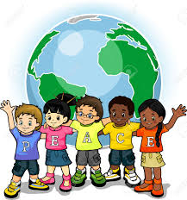
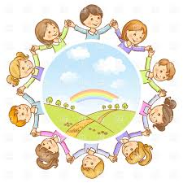
We are Peacemakers
We are peacemakers (*2)
we want world unity.
Come and join us, (*2)
The future is ours to see.

Slide 14

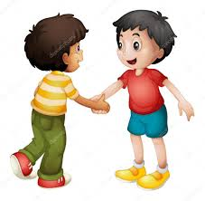
Meeting a New Friend
When I meet a new friend, I say "Hello!"… "Hello!"
When I meet a new friend, I say "Hello!"… "Hello!"
When I meet a new friend, I can give her hand a shake;
When I meet a new friend, I say "Hello!"… "Hello!"

Slide 15

Hello to All the Children of the World
CHORUS: Hello, Bonjour, Buenos Dias, G’day, Guten Tag, Konnichiwa,
Ciao, Shalom, Dobrey Dyen, Hello to all the children of the world!
We live in different places from all around the world.
We speak in many different ways.
Though some things might be different, we’re children just the same
and we all like to sing and play.
CHORUS
There are children in the deserts and children in the towns
and children who live down by the sea.
If we could meet each other to run and sing and play,
then what good friends we all could be.
CHORUS

Slide 16
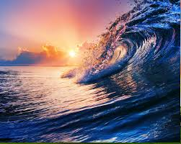
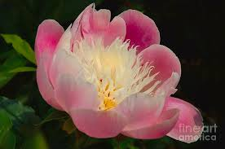
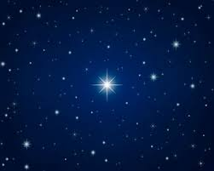

United, Agreed
O Lord God! Make us as waves of the sea,
as flowers of the garden,
united, agreed through the bounties of Thy love.
O Lord! Dilate the breasts through the signs of Thy oneness,
and make all mankind as stars shining from the same height of glory,
as perfect fruits growing upon Thy tree of life.

Slide 17
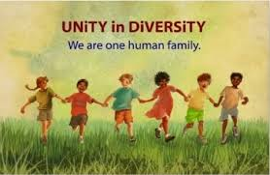
Unity Song #2
I am connected to everything. I am connected to everybody.
I am a part of God's universe. I am a member of humanity
CHORUS: Unity brings peace. Unity brings harmony.
Unity is powerful. It creates beauty from diversity
Unity starts with my own family. The joy of one is the joy of all.
The tears of one are the tears of all. The honor of one is the honor of all
CHORUS:
The power of unity solves conflict. Let's listen to each other and find solution.
Like instruments in an orchestra, we blend in harmony in unison.
CHORUS x3

Slide 18
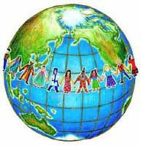
Closing Verse
"The earth is but one country, and mankind its citizens."
~ Bahá’u’lláh

Slide 19
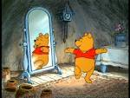




Uniting child, uniting child
turn around.
Uniting child, uniting child,
touch the ground.
Uniting child, uniting child,
show your shoe
Uniting child, uniting child,
I love you!
Uniting child, uniting child,
reach for the sky.
Children’s class is over. It’s time to say goodbye!

