Slide 1
Respect for the Environment

Slide 2

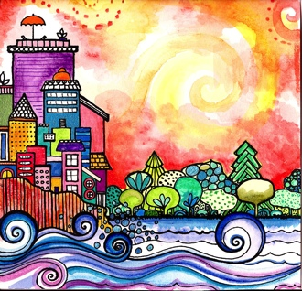
Good morning, Good morning!
It’s lovely to see you! Please come in and join us, we’d love to be with you. Today is going to be:
*Wonderful *Joyful *Beautiful *Peaceful
Today is going to be…How is your day going to be?
Today is going to be ____(FULL OF RESPECT).
Today I’m going to be:
*Happy *Helpful
Good morning, Good morning! It’s lovely to see you! X 2

Slide 3
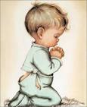
Opening Prayer
O Thou the Compassionate God.
Bestow upon me a heart which, like unto a glass,
may be illumined with the light of Thy love,
and confer upon me thoughts which may change this world
into a rose garden through the outpourings of heavenly grace .
~ 'Abdu’l-Bahá

Slide 4

Hello
Hello everybody! So glad to see you! Hello everybody, so glad to see you too! Hello to ____, so glad to see you! Hello to _______, so glad to see you too! Hello everybody! So glad to see you! Hello everybody, so glad to see you!

Slide 5

Introduction to Respect for the Environment and Book

Slide 6

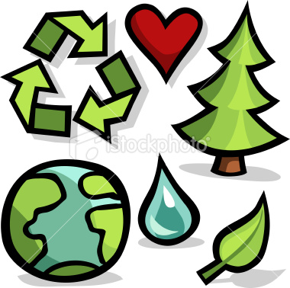
Environment
What can I do differently today to live a more environmental way?
When I go to bed at night, I can turn out all the lights.
I can do it differently today.
What can you do differently today to live a more environmental way?
When you’re buying groceries, don’t use plastic bags please!
You can do it differently today.
What can we do differently today to live a more environmental way?
We can drive a smaller car. We can walk if it’s not far.
We can do it differently today.
What can I do differently today to live a more environmental way?
I’ll save water for the flowers just by taking shorter showers.
I can do it differently today. Yay!

Slide 7
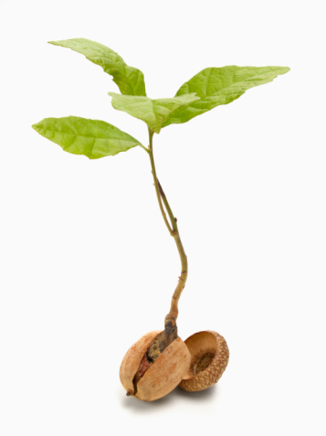
Tiny Seed Song
I am -xxx-
O my God -xxx-
but a tiny seed -xxx-
which Thou -xxx-
hast sown -xxx-
in the soil of Thy love -xxx-
and caused -xxx-
to spring forth by the hand of Thy bounty.
I am -xxx-
O my God -xxx-
but a tiny seed -xxx-

Slide 8

Hooray for the World Song
CHORUS:
Hooray for the world, I’m glad to be on it.
Hooray for the world, I’m glad to be on it.
Hooray for the world, it’s a special place,
We got mother nature and the human race.
The world’s got buffalo. The world’s got bees.
The world’s got jellyfish swimming in the seas.
We got beavers and bears, bats and bugs,
Miniature poodles and slimy old slugs. Oh…
CHORUS
The world’s got salami, the world’s got cheese,
We got maple syrup and mulberries.
We got Egg Foo-Yung, bagels and lox,
Corn on the cob, and raisins in a box, so…
CHORUS
We got moms and dads, uncles and aunts,
Brothers, sisters, grandmas and gramps.
We got neighbors next door, kids down the street.
Everywhere we go we got new friends to meet, oh…
CHORUS

Slide 9

Show Responsibility
Horses, buffalos, even the bugs, they are beautiful and they help us
Tigers, panda bears, kangaroos, they are gifts for us too,
So we must show responsibility, show responsibility
If we shelter them, give them love and care, they will always be there.
Rivers, forests, even the grass, they are beautiful. Let’s make them last.
Carrots, cabbages, juicy bamboo, they are gifts for us too
So we must show responsibility, show responsibility
If we shelter them, give them love and care, they will always be there
If we shelter them, give them love and care, they will always be there.

Slide 10
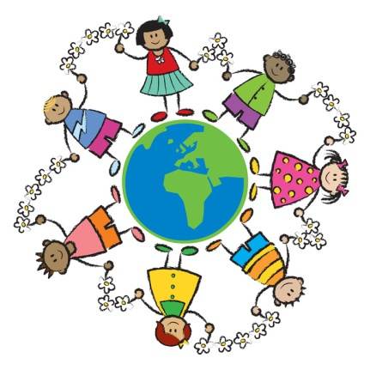
Hello World
CHORUS:
Hello World! My old friend
It's another day, I'm glad to see you again
The sun is up, I'm ready to play
Hello World! So what do you say?
There are bikes to ride, frogs to find
Forts to build, trees to climb
Dolls to dress, beads to string
Teams to choose, and songs to sing
CHORUS
There are games to play, ducks to feed
Berries to pick, books to read
Fish to catch, friends to meet
Jokes to tell, cookies to eat
(CHORUS) then (Instrumental chorus) then (Double Chorus)
(ending) Hello World! So what do you say?

Slide 11
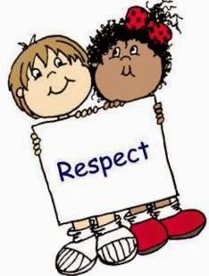
Respect
CHORUS
If I respect you and you respect me,
And we respect each other, what a world this will be
You’ll be glad I’m me, I’ll be glad you’re you
Cause that’s just what folks who respect each other do
VERSE 1
If you let me talk till I’m finished
And I listen when you speak your mind
We chose our words carefully, we’ll hear each other differently
It’s one more way respect can be defined
VERSE 2
When I don’t dis’ what you do
And you let me be who I am
And we don’t label anyone or pick on others just for fun
We show respect’s a word we understand
CHORUS

Slide 12

Quotation on Respect for the Environment
“Man is organic with the world. His inner life moulds the environment and is itself also deeply affected by it.”
–Shoghi Effendi

Slide 13
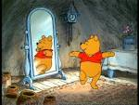


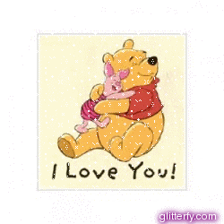

Respectful child, Respectful child
turn around.
Respectful child, Respectful child
touch the ground.
Respectful child, Respectful child
show your shoe.
Respectful child, Respectful child
I love you!
Respectful child, Respectful child
reach for the sky.
Children’s class is over. It’s time to say goodbye!

