Slide 1
Prayerfulness

Slide 2

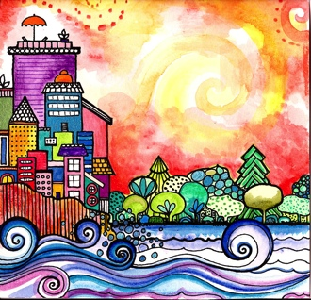
Good morning, Good morning!
It’s lovely to see you! Please come in and join us, we’d love to be with you. Today is going to be:
*Wonderful *Joyful *Beautiful *Peaceful
Today is going to be…How is your day going to be?
Today is going to be ____(FULL OF PRAYER).
Today I’m going to be:
*Happy *Helpful
Good morning, Good morning! It’s lovely to see you! X 2

Slide 3
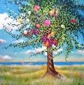

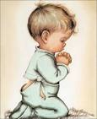
Opening Prayer
“I have committed, O my Lord, my spirit and my entire being into the right hand of Thy might and Thy protection, and I lay my head on my pillow through Thy power, and lift it up according to Thy will and Thy good pleasure. Thou art, in truth, the Preserver, the Keeper, the Almighty, the Most Powerful.”
~ 'Abdu’l-Bahá

Slide 4

Hello
Hello everybody! So glad to see you! Hello everybody, so glad to see you too! Hello to ____, so glad to see you! Hello to _______, so glad to see you too! Hello everybody! So glad to see you! Hello everybody, so glad to see you!

Slide 5

Intro to Prayerfulness

Slide 6



Blessed is the Spot
“Blessed is the spot, and the house, and the place, and the city, and the heart, and the mountain, and the refuge, and the cave, and the valley, and the land, and the sea, and the island, and the meadow, where mention of God hath been made and His praise glorified.”
- Baha’u’llah

Slide 7

Opening prayer
“O God! Guide me, protect me. Make of me a shining lamp and a brilliant star. Thou art the Mighty and the Powerful.”
– ‘Abdu’l-Baha

Slide 8


He is God
“He is God! O God, my God!
Bestow upon me a pure heart,
like unto a pearl.”
~ 'Abdu’l-Bahá

Slide 9
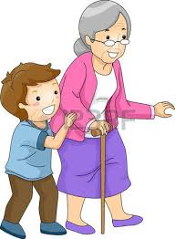
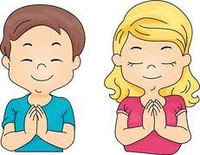
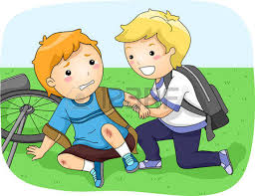
Strive
“Strive that your actions day by day may be beautiful prayers. Turn towards God, and seek always to do that which is right and noble. Enrich the poor, raise the fallen, comfort the sorrowful, bring healing to the sick, reassure the fearful, rescue the oppressed, bring hope to the hopeless, shelter the destitute!” ~ 'Abdu’l-Bahá

Slide 10

Remover of Difficulties
“Is there any Remover of difficulties save God?
Say: Praised be God! He is God!
All are His servants, and all abide by His bidding!”
~ The Báb

Slide 11

Tiny Seed
I am xxx O my God xxx but a tiny seed xxx which Thou xxx hast sown xxx in the soil of Thy love xxx and caused xxx to spring forth by the hand of Thy bounty. I am xxx O my God xxx but a tiny seed xxx
(xxx= clap three times)

Slide 12
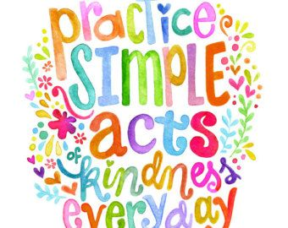

Utmost Love
Treat all thy friends and relatives, even strangers, with a spirit of utmost love and kindliness.

Slide 13

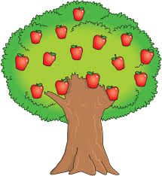


Waves of One Sea
May you become as the waves of one sea, stars of the same heaven, fruits adorning the same tree, roses of one garden in order that through you, the oneness of humanity may establish its temple in the world of mankind… the oneness of humanity may establish its temple in the world of mankind.

Slide 14
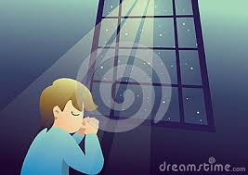
Closing Verse
“Prayer is conversation with God.”
~ 'Abdu’l-Bahá

Slide 15
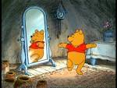


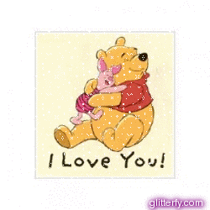

Prayerful child, Prayerful child
turn around.
Prayerful child, Prayerful child
touch the ground.
Prayerful child, Prayerful child
show your shoe.
Prayerful child, Prayerful child
I love you!
Prayerful child, Prayerful child
reach for the sky.
Children’s class is over. It’s time to say goodbye!

