Slide 1
An Introduction to the Baha’i Faith

Slide 2
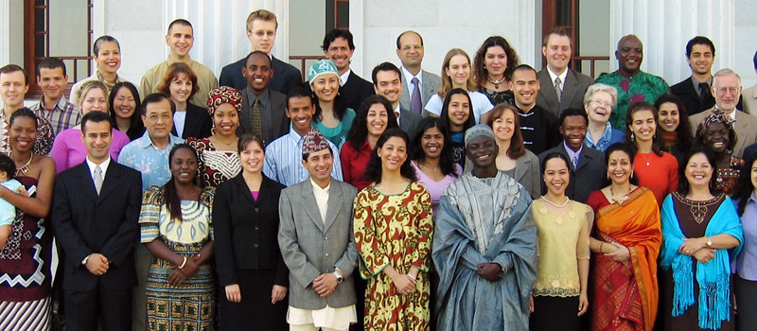

Slide 3
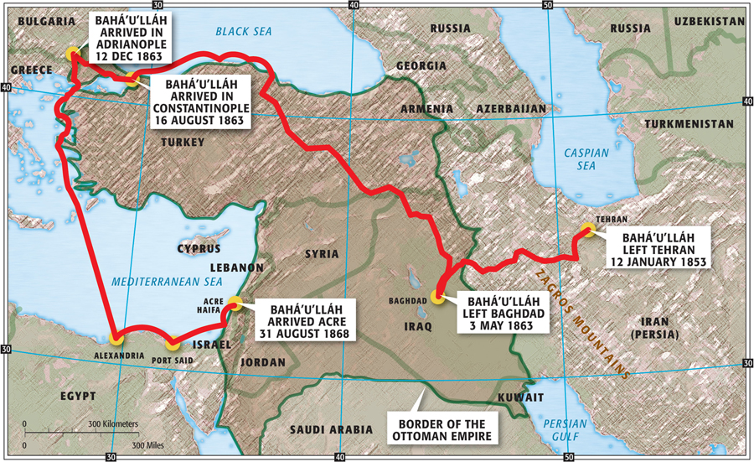

Slide 4

“The Bahai teaching brings peace and understanding. It is like a wide embrace gathering together all those who have long searched for words of hope. It accepts all great Prophets gone before, it destroys no other creeds and leaves all doors open. Saddened by the continual strife amongst believers of many confessions and wearied of their intolerance towards each other, I discovered in the Bahai teaching the real spirit of Christ so often denied and misunderstood. Unity, instead of strife, Hope instead of condemnation, Love instead of hate, and a great reassurance for all men…if ever the name of Baha’u’llah or Abdu’l-Baha comes to your attention, do not put their writings from you. Search out their Books, and let their glorious, peace-bringing, love-creating words and lessons sink into your hearts as they have into mine.” –Queen Marie of Romania

Slide 5
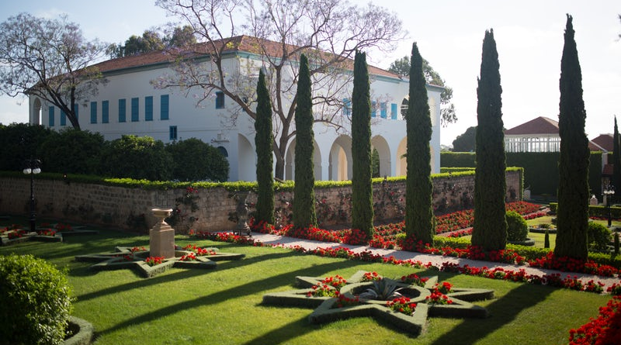
If you are interested in learning more about the life of Baha’u’llah, there is a one hour film called “Light to the World” which is an engaging story, told by His followers in a really beautiful way, that highlights His impact. It is accessible at www.bahai.org.

Slide 6

THE CORE BELIEFS OF THE BAHAI FAITH
The oneness of God
The oneness of Religion
The oneness of Humanity

Slide 7

THE ONENESS OF GOD
“To every discerning and illuminated heart it is evident that God, the unknowable Essence, the Divine Being, is immensely exalted beyond every human attribute, such as corporeal existence, ascent and descent, egress and regress. Far be it from His glory that human tongue should adequately recount His praise, or that human heart comprehend His fathomless mystery. He is, and hath ever been, veiled in the ancient eternity of His Essence, and will remain in His Reality everlastingly hidden from the sight of men. ‘No vision taketh in Him, but He taketh in all vision; He is the Subtle, the All-Perceiving.’” –Baha’u’llah

Slide 8

“I loved thy creation, hence I created thee. Wherefore do thou love Me, that I may name thy name and fill thy soul with the spirit.”

Slide 9
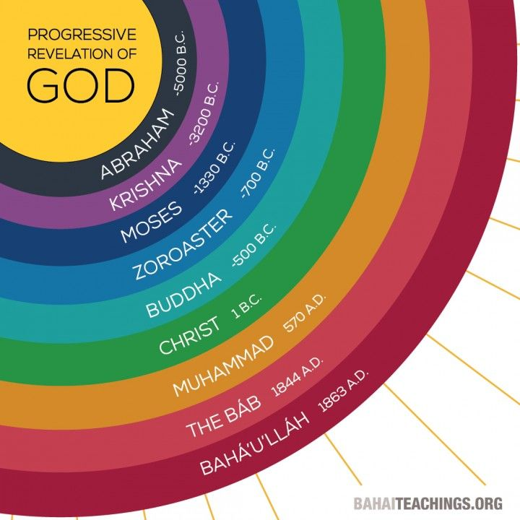

Slide 10

“There can be no doubt whatever that the peoples of the world, of whatever race or religion, derive their inspiration from one heavenly Source, and are the subjects of one God.”
“They all abide in the same tabernacle, soar in the same heaven, are seated upon the same throne, utter the same speech, and proclaim the same Faith.” He urges the peoples of the world to “consort with the followers of all religions in a spirit of friendliness and fellowship.” -Baha’u’llah

Slide 11

“That the divers communions of the earth, and the manifold systems of religious belief, should never be allowed to foster the feelings of animosity among men, is, in this Day, of the essence of the Faith of God and His Religion. These principles and laws, these firmly established and mighty systems, have proceeded from one Source, and are the rays of one Light. That they differ one from another is to be attributed to the varying requirements of the ages in which they were promulgated.” –Baha’u’llah

Slide 12

“…the divine religions of the holy Manifestations of God are in reality one though in name and nomenclature they differ. Man must be a lover of the light no matter from what day-spring it may appear. He must be a lover of the rose no matter in what soil it may be growing. He must be a seeker of the truth no matter from what source it come. Attachment to the lantern is not loving the light…” –Abdu’l-Baha

Slide 13


Slide 14
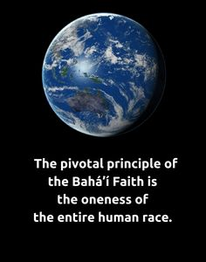

Slide 15
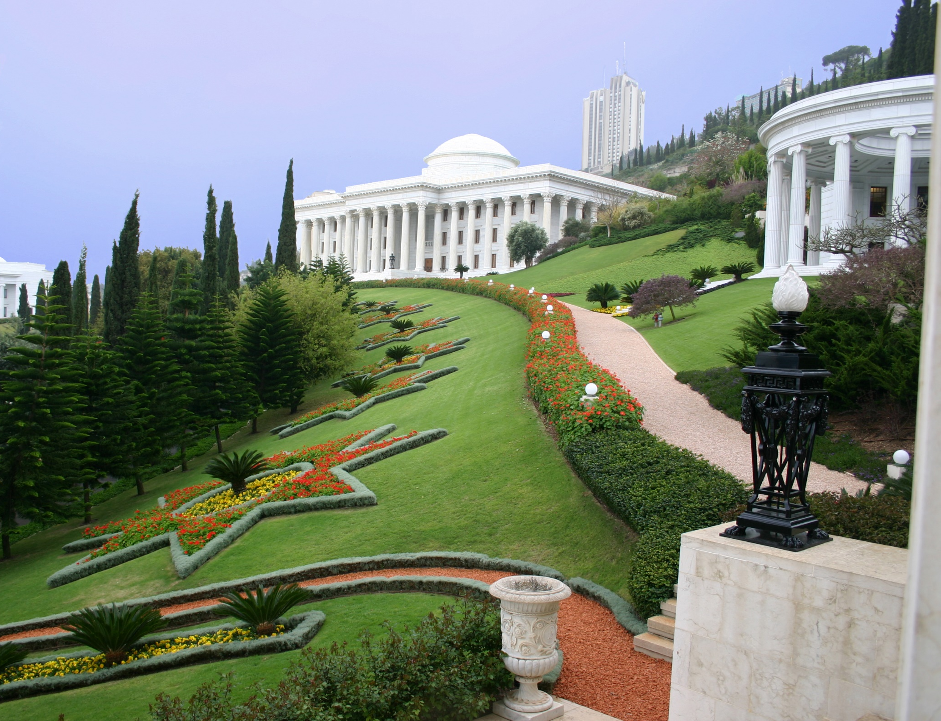
“The light of men is Justice. Quench it not with the contrary winds of oppression and tyranny. The purpose of justice is the appearance of unity among men.” –Baha’u’llah

Slide 16

“The diversity of the human family should be the cause of love and harmony, as it is in music where many different notes blend together in the making of a perfect chord. If you meet those of a different race and colour from yourself, do not mistrust them and withdraw yourself into your shell of conventionality, but rather be glad and show them kindness. Think of them as different coloured roses growing in the beautiful garden of humanity, and rejoice to be among them.” –Abdu’l-Baha

Slide 17

“It is through love for all people, and by subordinating lesser loyalties to the best interests of humankind, that the unity of the world can be realized and the infinite expressions of human diversity find their highest fulfillment. Fostering unity, my harmonizing disparate elements and nurturing in every heart a selfless love for humankind, is the task of religion.” –The Universal House of Justice
Baha’u’llah said, “Take pride not in love for yourselves but in love for your fellow-creatures. Glory not in love for your country, but in love for all mankind.”

Slide 18

The harmful effects of prejudice
“And the breeding-ground of all these tragedies is prejudice: prejudice of race and nation, of religion, of political opinion; and the root cause of prejudice is blind imitation of the past- imitation in religion, in racial attitudes, in national bias, in politics. So long as this aping of the past persisteth, just so long will the foundations of the social order be blown to the four winds, just so long will humanity be continually exposed to direst peril.” –Abdu’l-Baha

Slide 19

“Bahá’ís are encouraged to see in the revolutionary changes taking place in every sphere of life the interaction of two fundamental processes. One is destructive in nature, while the other is integrative; both serve to carry humanity, each in its own way, along the path leading towards its full maturity. The operation of the former is everywhere apparent—in the vicissitudes that have afflicted time-honoured institutions, in the impotence of leaders at all levels to mend the fractures appearing in the structure of society, in the dismantling of social norms that have long held in check unseemly passions, and in the despondency and indifference exhibited not only by individuals but also by entire societies that have lost any vital sense of purpose. Though devastating in their effects, the forces of disintegration tend to sweep away barriers that block humanity’s progress, opening space for the process of integration to draw diverse groups together and disclosing new opportunities for cooperation and collaboration. Bahá’ís, of course, strive to align themselves, individually and collectively, with forces associated with the process of integration, which, they are confident, will continue to gain in strength, no matter how bleak the immediate horizons. Human affairs will be utterly reorganized, and an era of universal peace inaugurated.” –The Universal House of Justice

Slide 20
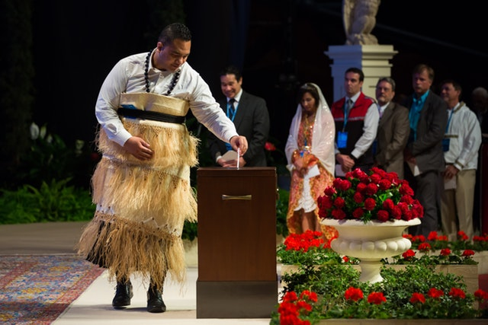
Diversity of the Baha’i Community

Slide 21

The Independent Investigation of Truth
“God has not intended man to imitate blindly his fathers and ancestors…God has given man the eye of investigation by which he may see and recognize truth. He has endowed man with ears that he may hear the message of reality and conferred upon him the gift of reason by which he may discover things for himself. This is his endowment and equipment for the investigation of reality. Man is not intended to see through the eyes of another, hear through another’s ears nor comprehend with another’s brain. Each human creature has individual endowment, power and responsibility in the creative plan of God. Therefore, depend upon your own reason and judgment and adhere to the outcome of your own investigation; otherwise, you will be utterly submerged in the sea of ignorance and deprived of all the bounties of God. Turn to God, supplicate humbly at His threshold, seeking assistance and confirmation, that God may rend asunder the veils that obscure your vision.”

Slide 22

Harmony of Science and Religion
“Religion and Science are inter-twined with each other and cannot be separated. These are the two wings with which humanity must fly. One wing is not enough. Every religion which does not concern itself with science is mere tradition…. Therefore science, education and civilization are most important necessities for the full religious life.” –Abdu’l-Baha

Slide 23

Equality of Women and Men
“The world of humanity has two wings—one is women and the other men. Not until both wings are equally developed can the bird fly. Should one wing remain weak, flight is impossible. Not until the world of women becomes equal to the world of men in the acquisition of virtues and perfections, can success and prosperity be attained as they ought to be.” –Abdu’l-Baha

Slide 24

“The world in the past has been ruled by force, and man has dominated over woman by reason of his more forceful and aggressive qualities both of body and mind. But the balance is already shifting; force is losing its dominance, and mental alertness, intuition, and the spiritual qualities of love and service, in which woman is strong, are gaining ascendancy. Hence the new age will be an age less masculine and more permeated with the feminine ideals, or, to speak more exactly, will be an age in which the masculine and feminine elements of civilization will be more evenly balanced.” –Abdu’l-Baha

Slide 25
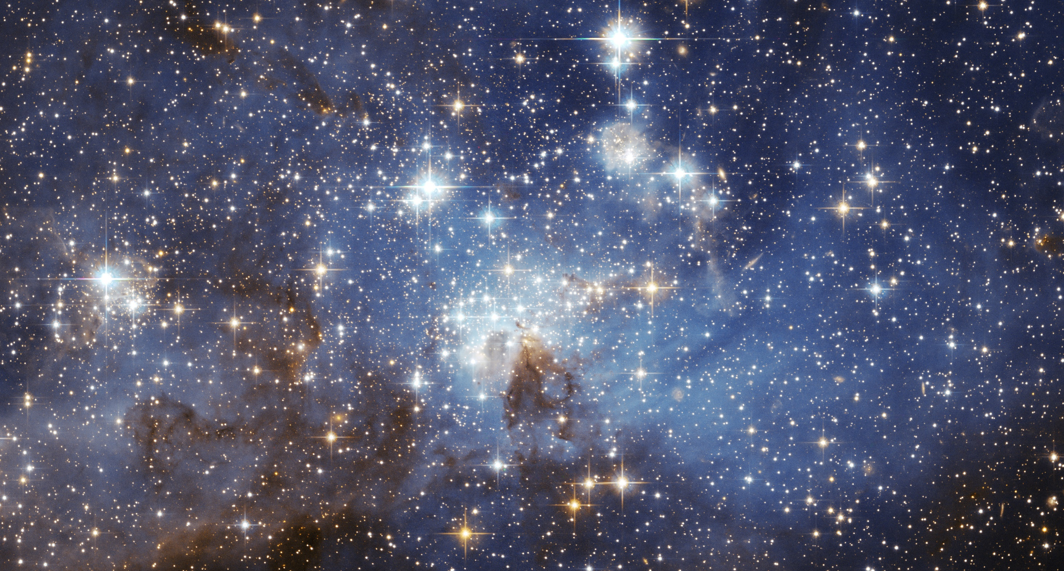
“As long as women are prevented from attaining their highest possibilities, so long will men be unable to achieve the greatness which might be theirs.” –Abdu’l-Baha

Slide 26
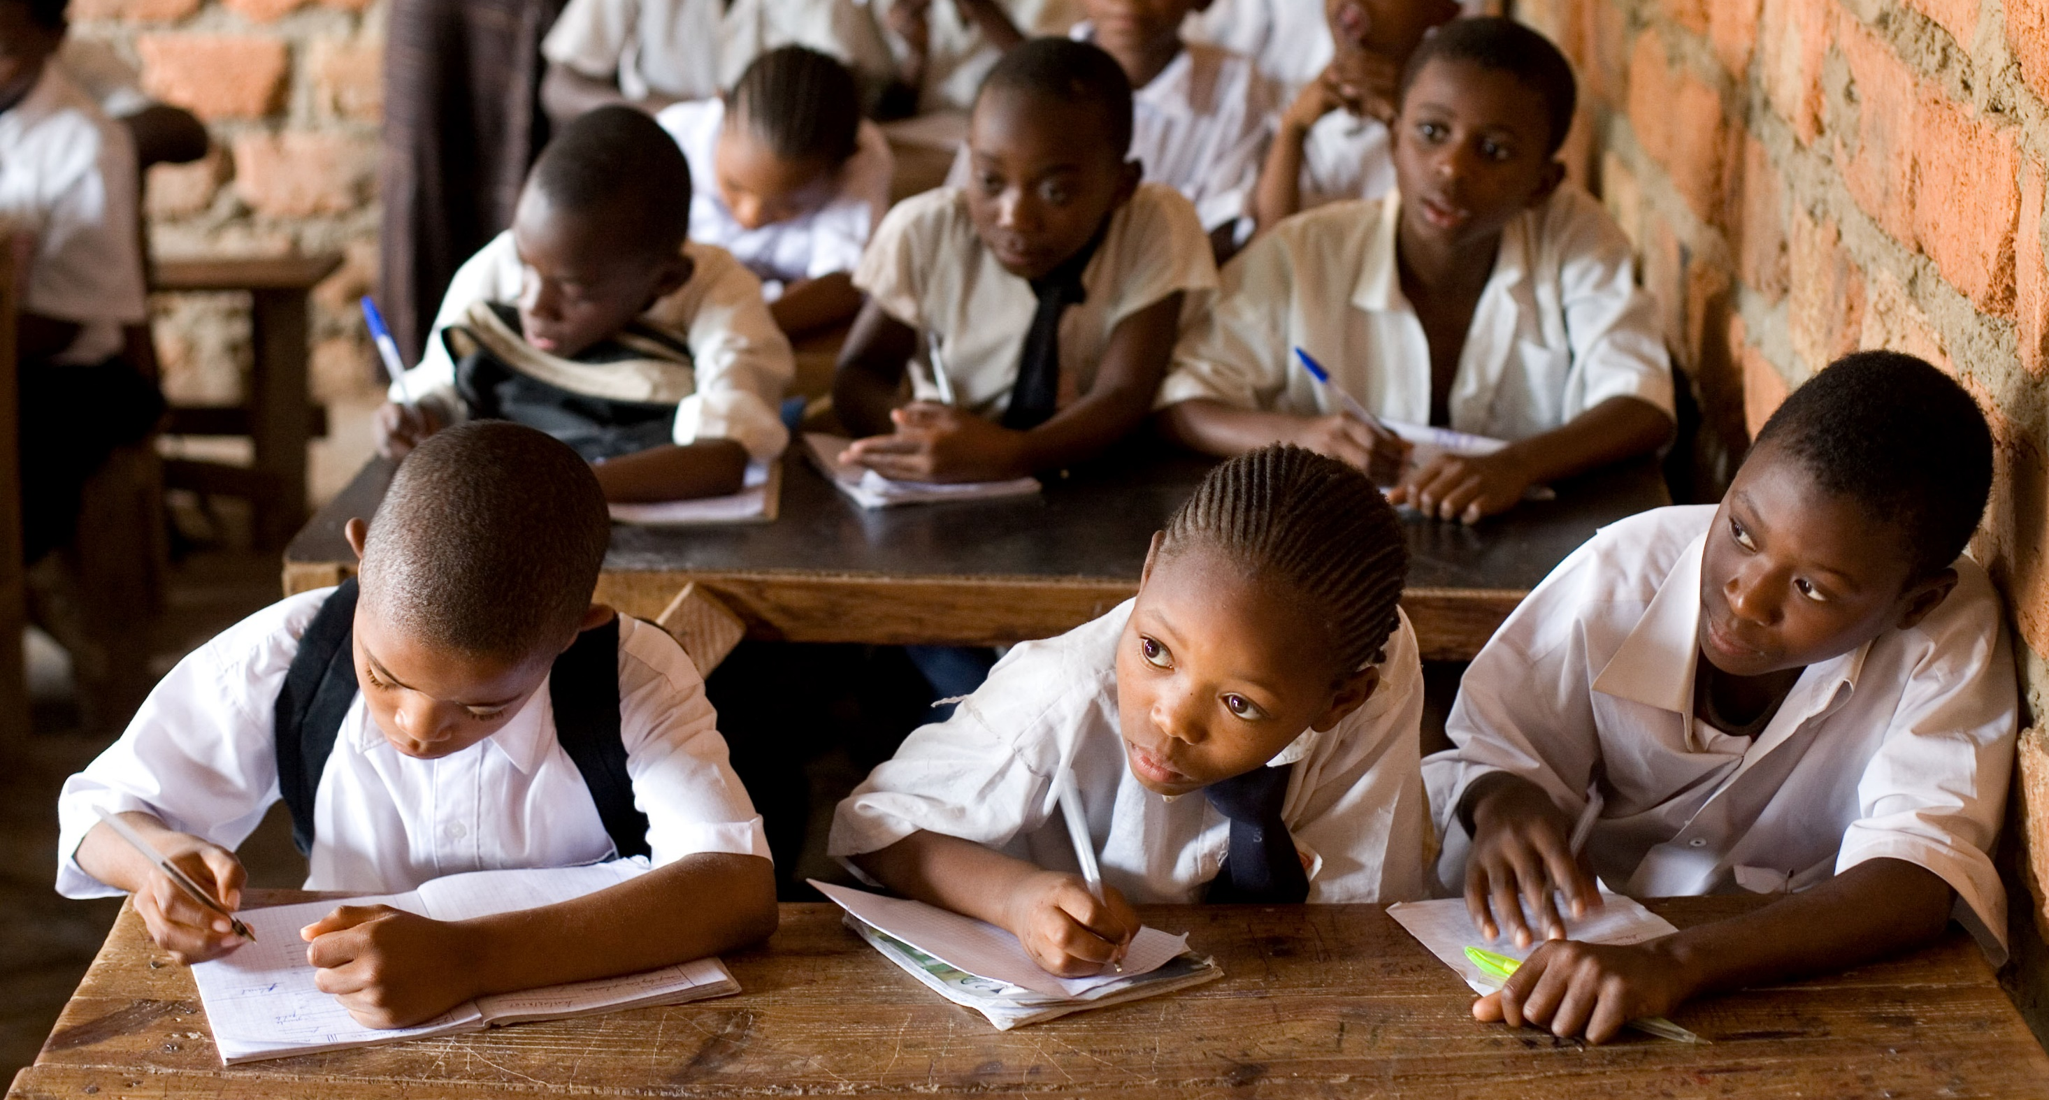
Universal Education
“The cause of universal education, which has already enlisted in its service an army of dedicated people from every faith and nation, deserves the utmost support that the governments of the world can lend it. For ignorance is indisputably the principal reason for the decline and fall of peoples and the perpetuation of prejudice. No nation can achieve success unless education is accorded all its citizens. Lack of resources limits the ability of many nations to fulfil this necessity, imposing a certain ordering of priorities. The decision-making agencies involved would do well to consider giving first priority to the education of women and girls, since it is through educated mothers that the benefits of knowledge can be most effectively and rapidly diffused throughout society. In keeping with the requirements of the times, consideration should also be given to teaching the concept of world citizenship as part of the standard education of every child.” –The Universal House of Justice

Slide 27
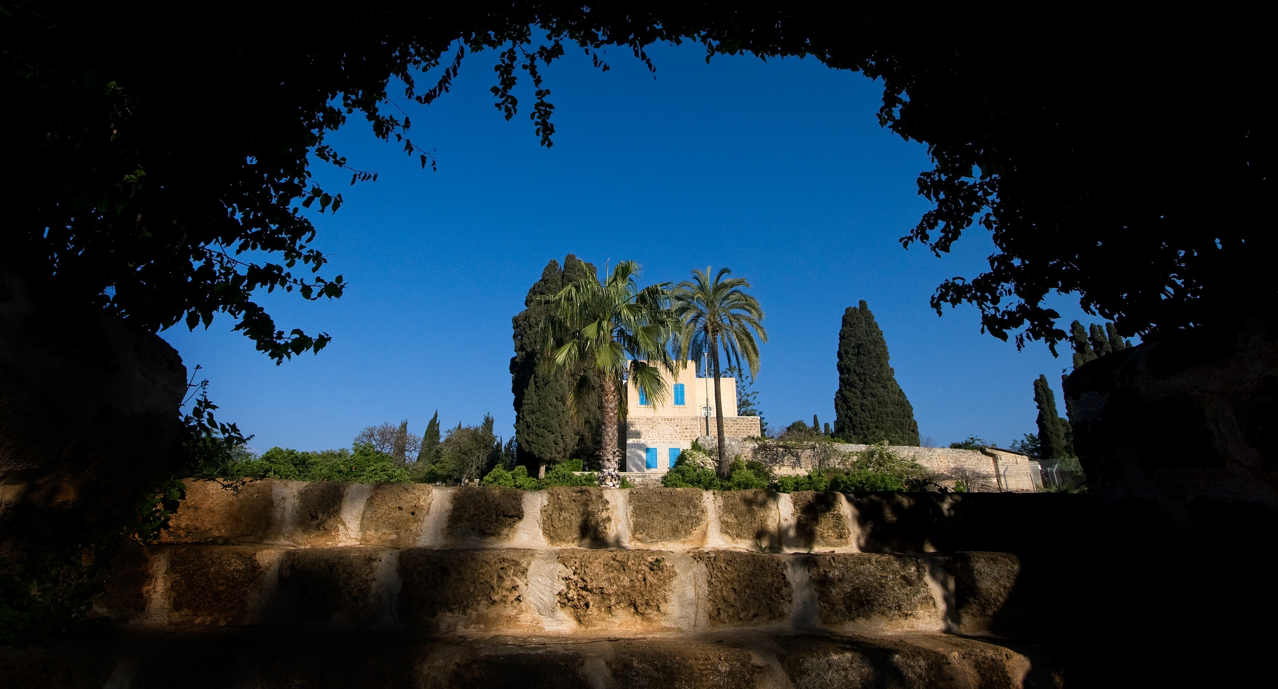
Universal Language
“The day is approaching when all the peoples of the world will have adopted one universal language and one common script. When this is achieved, to whatsoever city a man may journey, it shall be as if he were entering his own home.” - Baha’u’llah

Slide 28
OUR TWO-FOLD MORAL PURPOSE
To take charge of our own intellectual and spiritual growth
and
To contribute to the transformation of society

Slide 29
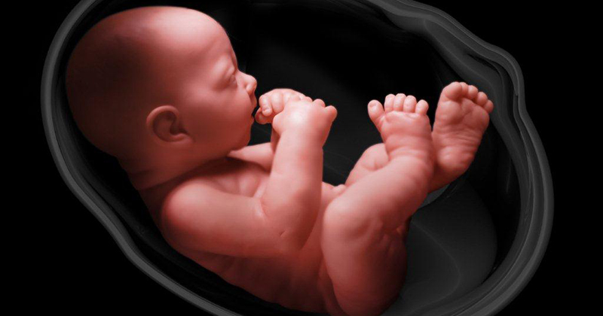
“…Therefore, in this world he must prepare himself for the life beyond. That which he needs in the world of the Kingdom must be obtained here. Just as he prepared himself in the world of the matrix by acquiring forces necessary in this sphere of existence, likewise, the indispensable forces of the divine existence must be potentially attained in this world.” –Abdu’l-Baha

Slide 30

“What is he in need of in the Kingdom which transcends the life and limitation of this mortal sphere? That world beyond is a world of sanctity and radiance; therefore, it is necessary that in this world he should acquire these divine attributes. In that world there is need of spirituality, faith, assurance, the knowledge and love of God. These he must attain in this world so that after his ascension from the earthly to the heavenly Kingdom he shall find all that is needful in that eternal life ready for him. That divine world is manifestly a world of lights; therefore, man has need of illumination here. That is a world of love; the love of God is essential. It is a world of perfections; virtues or perfections, must be acquired. That world is vivified by the breaths of the Holy Spirit; in this world we must seek them. That is the Kingdom of everlasting life; it must be attained during this vanishing existence.” -Abdu’l-Baha

Slide 31

“How does one look forward to the goal of any journey? With hope and with expectation. So it is with the end of this earthly journey. In the next world, man will find himself freed from many of the disabilities under which he now suffers…”
Shoghi Effendi, the Guardian of the Bahai Faith, said, “Man is destined by God to undergo a spiritual development that extends throughout eternity. His life upon this earth is only the first stage of that development. When we outgrow our physical form, and are considered by God ready to reap the fruit of our spiritual development, we proceed to the other world. We term it death only because of our short sightedness. A more proper term would be a more abundant life. It is a forward step we have taken.”

Slide 32
“I have made death a messenger of joy to thee. Wherefore dost thou grieve? I made the light to shed on thee its splendor. Why dost thou veil thyself therefrom?” –Baha’u’llah
“Thou art My dominion and My dominion perisheth not; wherefore fearest thou thy perishing? Thou art My light and My light shall never be extinguished; why dost thou dread extinction? Thou art My glory and My glory fadeth not; thou art My robe and My robe shall never be outworn. Abide then in thy love for Me, that thou mayest find Me in the realm of glory.” –Baha’u’llah

Slide 33

Bird leaving cage

Slide 34

Our Nobility
“Noble have I created thee, yet thou has abased thyself. Rise then unto that for which thou wast created.”
“O Son of Spirit! I created thee rich, why dost thou bring thyself down to poverty? Noble I made thee, wherewith does thou abase thyself? Out of the essence of knowledge I gave thee being, why seekest thou enlightenment from anyone beside Me? Out of the clay of love I molded thee, how doest thou busy thyself with another? Turn they sight unto thyself, that thou mayest find Me standing within thee, mighty powerful and self-subsisting.”

Slide 35

“All that which ye potentially possess can be manifested only as a result of your own volition.” –Baha’u’llah

Slide 36

Pure intention brought into field of action
“Let deeds not words be your adorning.”
“Let your acts be a guide unto all mankind, for the professions of most men…differ from their conduct. It is through your deeds that ye can distinguish yourselves from others. Through them the brightness of your light can be shed upon the whole earth.” -Baha’u’llah

Slide 37
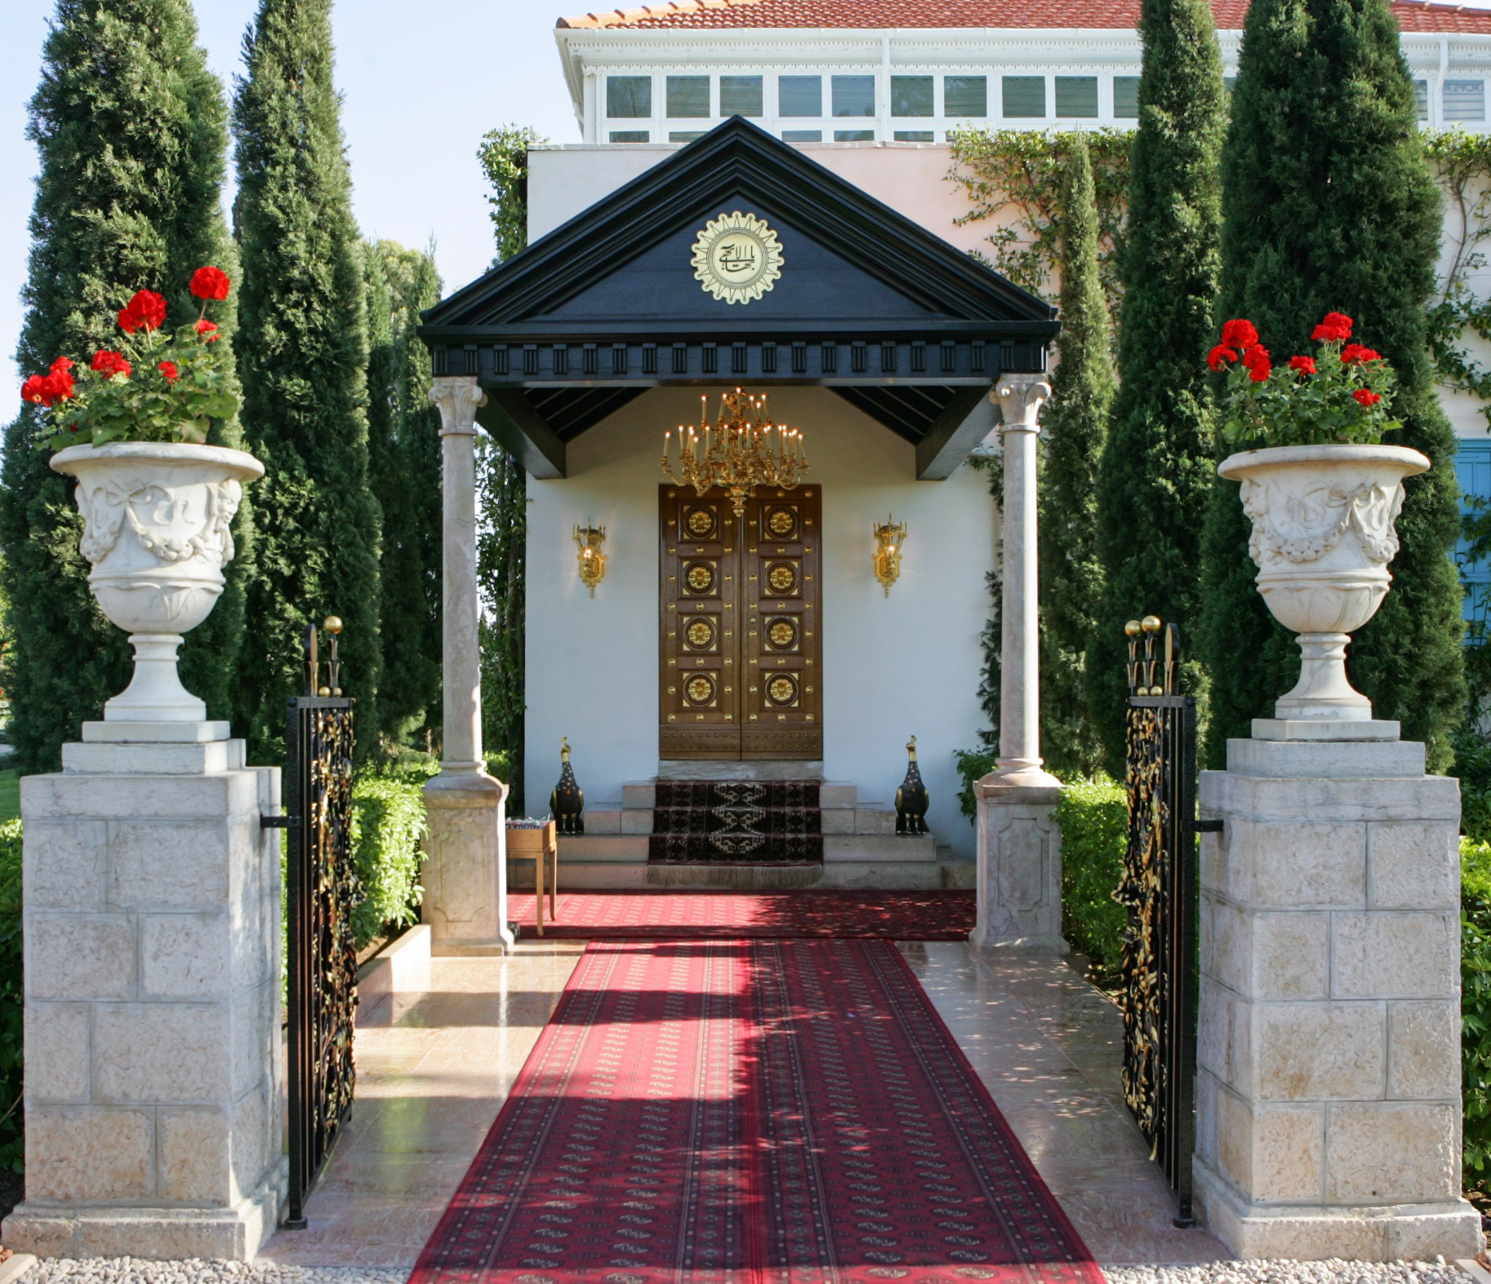
Service is Prayer
“Briefly, all effort and exertion put forth by man from the fullness of his heart is worship, if it is prompted by the highest motives and the will to do service to humanity. This is worship: to serve mankind and to minister to the needs of the people. Service is prayer. A physician ministering to the sick, gently, tenderly, free from prejudice and believing in the solidarity of the human race, he is giving praise.“ -Abdu’l-Baha

Slide 38
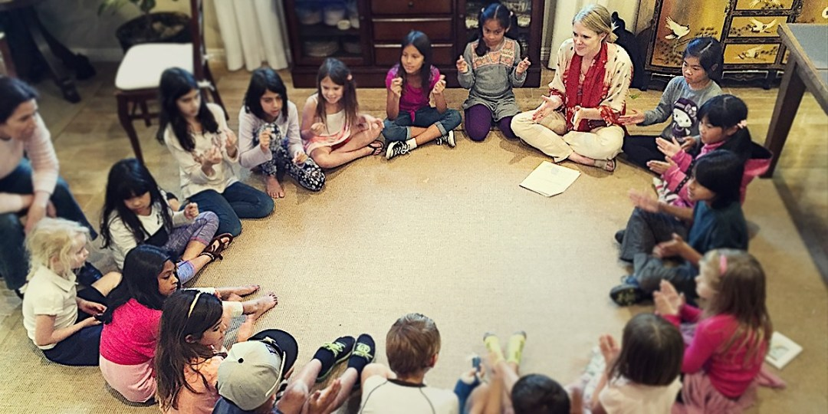
Children’s Classes

Slide 39

Junior Youth Spiritual Empowerment Program

Slide 40
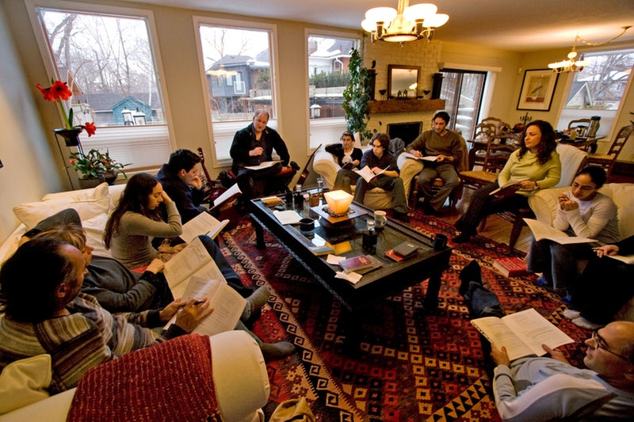
Study Circles

Slide 41
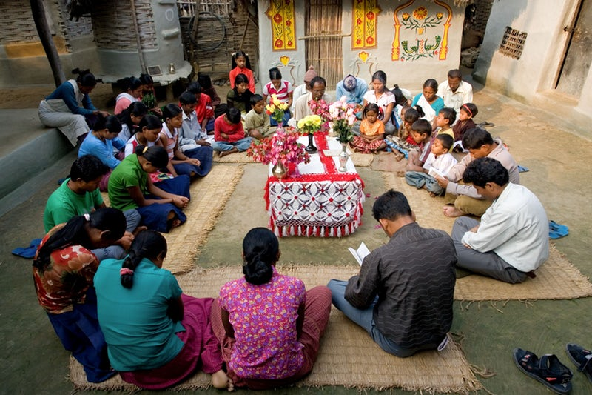
Devotional Gatherings

Slide 42

The Role of Art in the Elevation of Humanity
“I rejoice to hear that thou takest pains with thine art, for in this wonderful new age, art is worship. The more thou strivest to perfect it, the closer wilt thou come to God. What bestowal could be greater than this, that one's art should be even as the act of worshipping the Lord? That is to say, when thy fingers grasp the paintbrush, it is as if thou wert at prayer in the Temple.” –Abdu’l-Baha

Slide 43

“Of all pilgrimages, the greatest is to relieve the sorrow-laden heart.”

Slide 44

“…peace must first be established among individuals, until it leadeth in the end to peace among nations. Wherefore, O ye Baha’is, strive ye with all your might to create, through the power of the Word of God, genuine love, spiritual communion and durable bonds among individuals. This is your task.”

Slide 45

Baha’i Houses of Worship

Slide 46
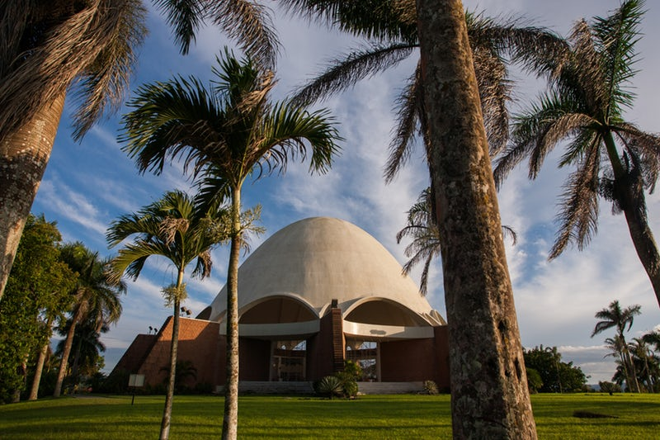
Baha’i House of Worship in Panama

Slide 47
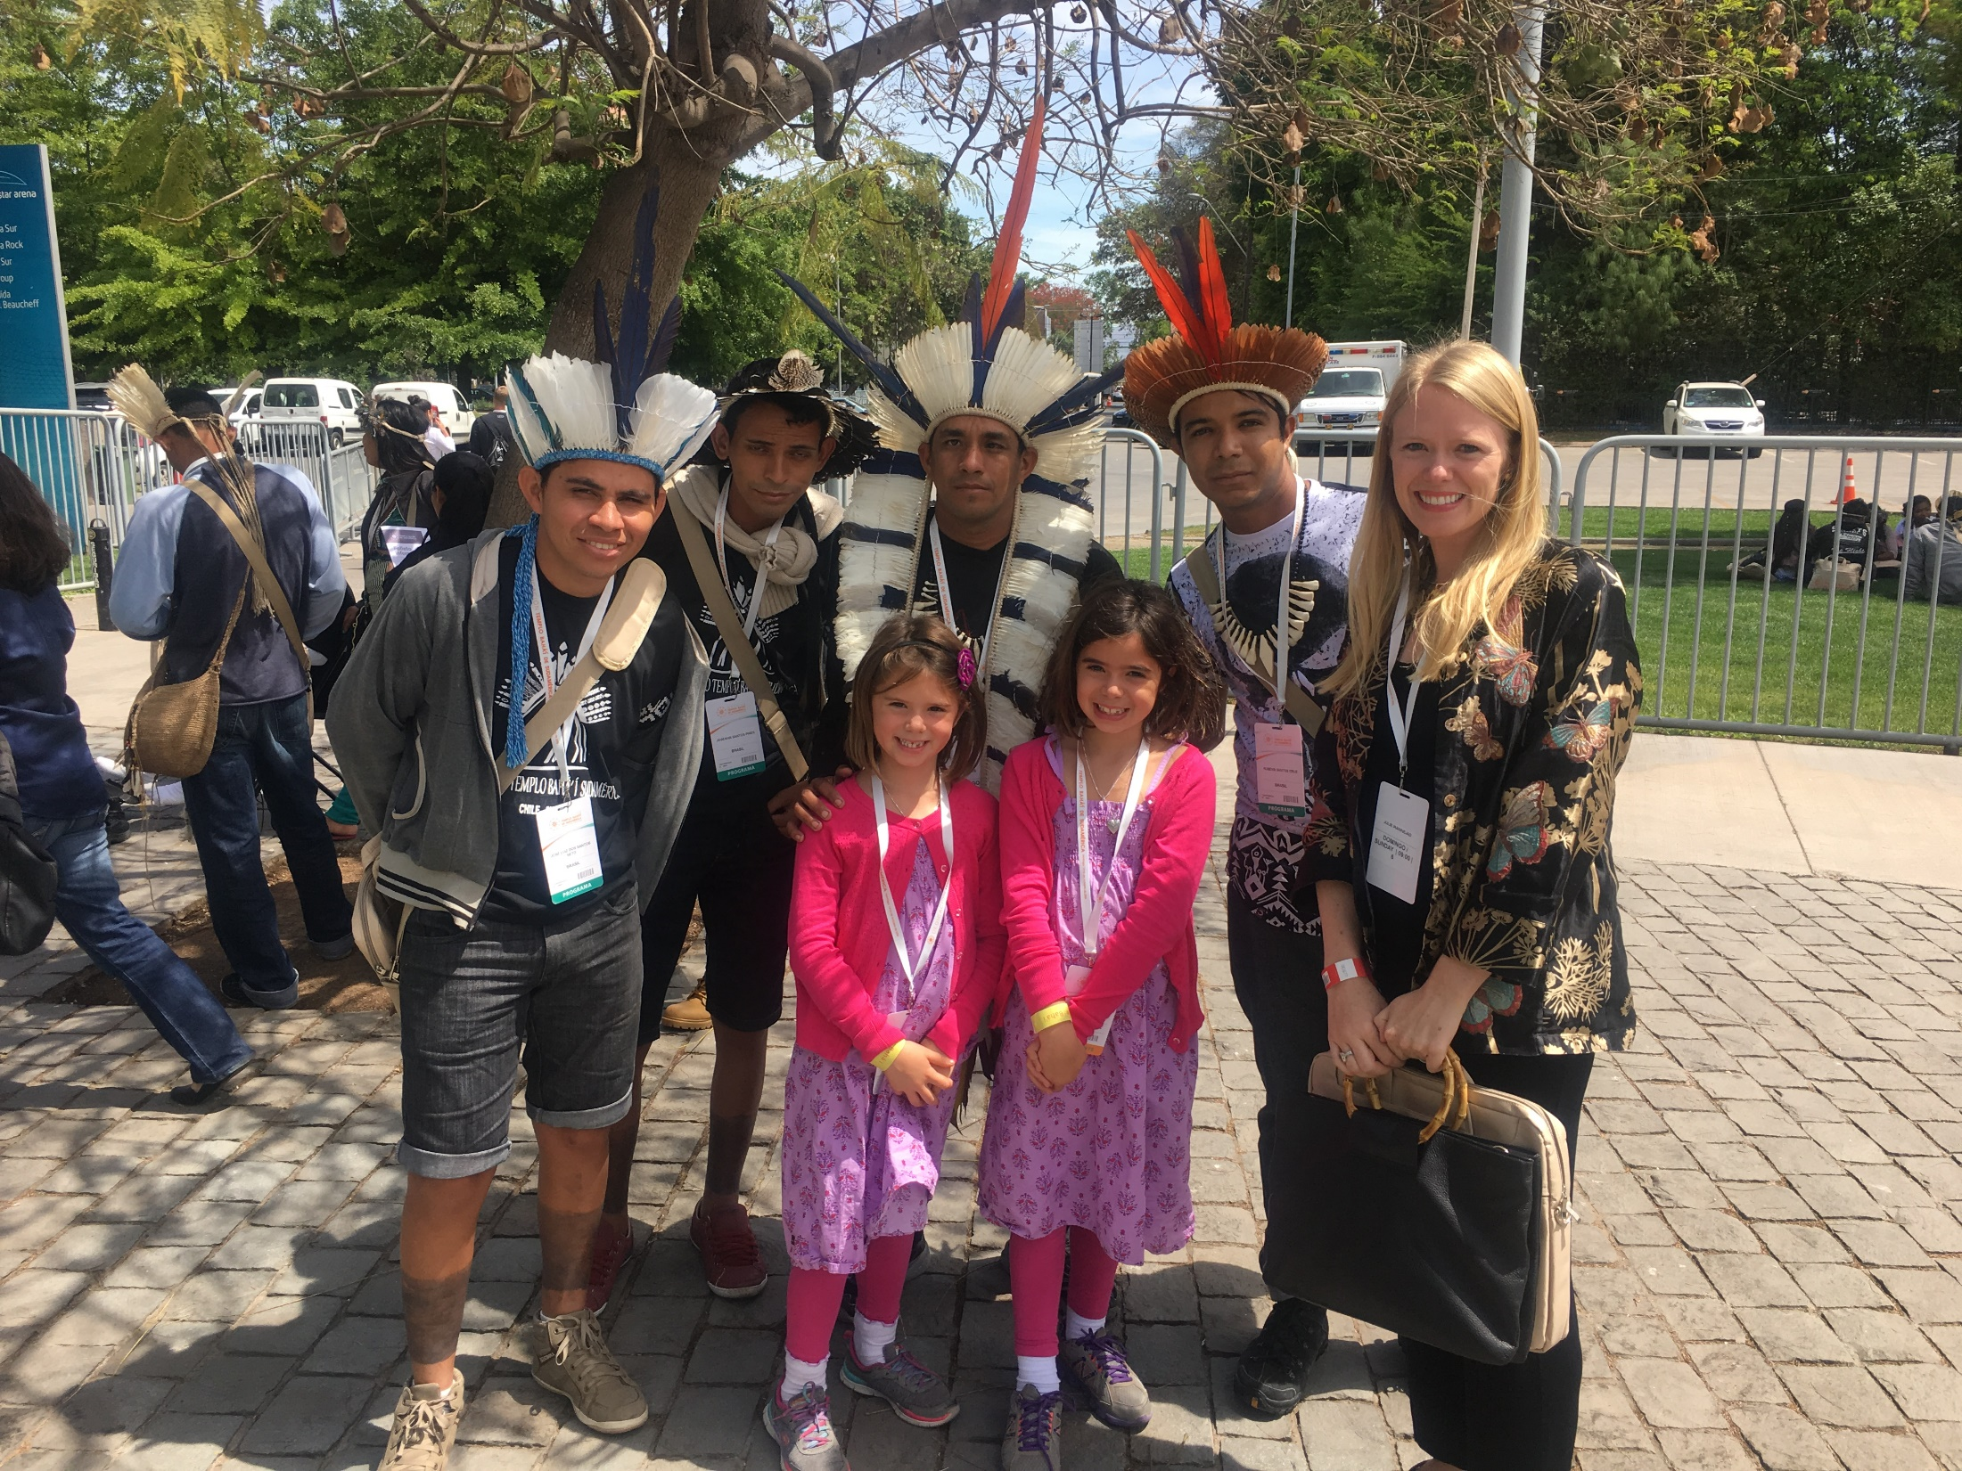

Slide 48
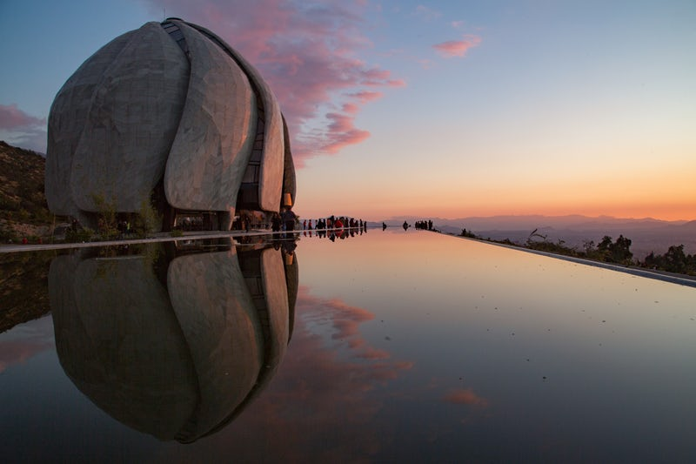
Baha’i House of Worship in Chile

Slide 49
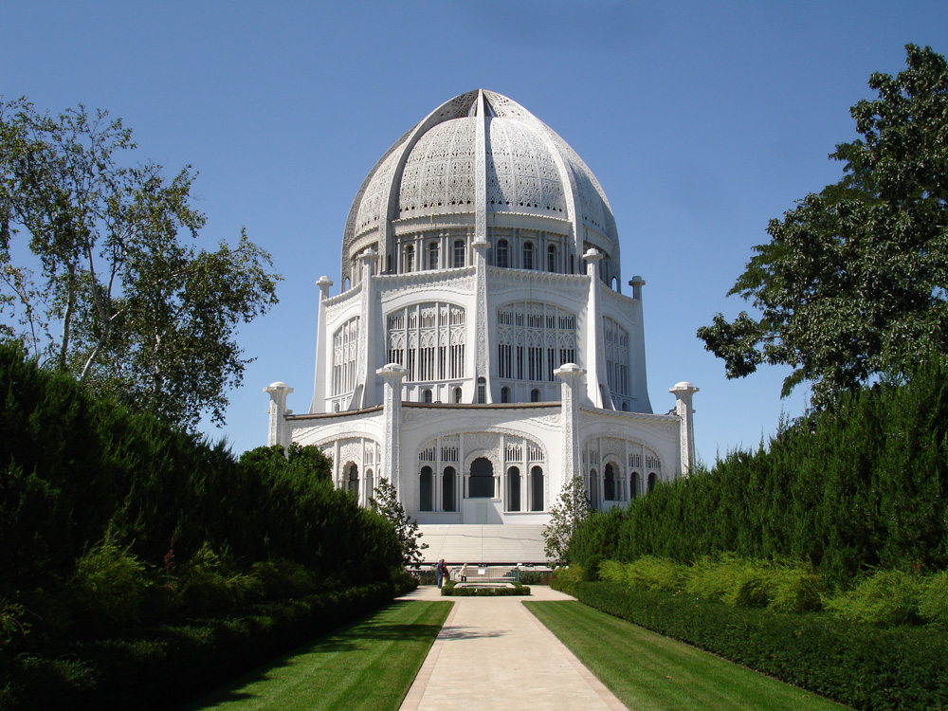
Baha’i House of Worship in Chicago

Slide 50

The Local Bahai House of Worship
in Battambang, Cambodia

Slide 51
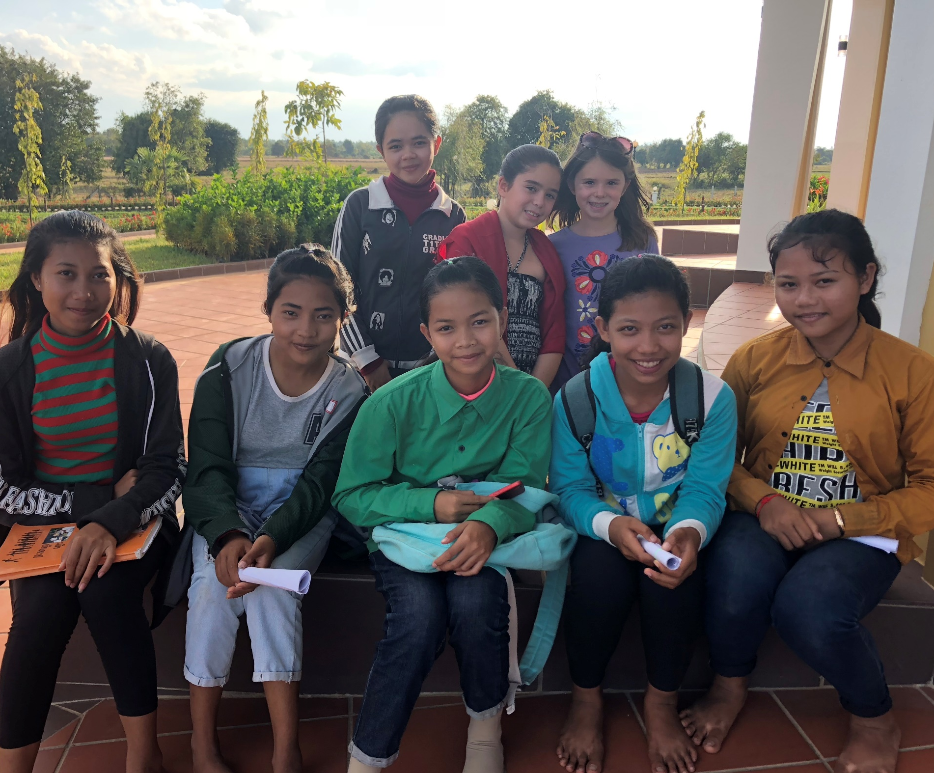
Youth at the Forefront
“Blessed is he who in the prime of his youth and the heyday of his life will arise to serve the Cause of the Lord of the beginning and of the end, and adorn his heart with His love. The manifestation of such a grace is greater than the creation of the heavens and of the earth. Blessed are the steadfast and well is it with those who are firm.” –Baha’u’llah

Slide 52

Thank you for your attention and open hearts!
For more information on the Bahai Faith,
Please visit:
www.bahai.org
www.us.bahai.org

