Slide 1
Helpfulness

Slide 2

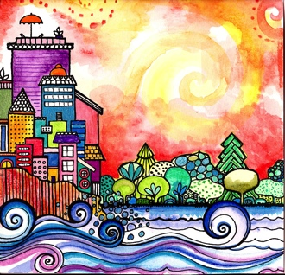
Good morning, Good morning!
It’s lovely to see you! Please come in and join us, we’d love to be with you. Today is going to be:
*Wonderful *Joyful *Beautiful *Peaceful
Today is going to be…How is your day going to be?
Today is going to be ____(FULL OF HELPFULNESS).
Today I’m going to be:
*Happy *Helpful
Good morning, Good morning! It’s lovely to see you! X 2

Slide 3
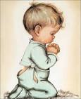
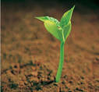
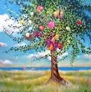
Opening Prayer
“O Lord! I am a child; enable me to grow
beneath the shadow of Thy loving-kindness.
I am a tender plant;
cause me to be nurtured through the
outpourings of the clouds of Thy bounty.
I am a sapling of the garden of love;
make me into a fruitful tree. Thou art
the Mighty and the Powerful, and Thou art
the All-Loving, the All-Knowing, the All-Seeing.”
~ 'Abdu’l-Bahá

Slide 4

Hello
Hello everybody! So glad to see you! Hello everybody, so glad to see you too! Hello to ____, so glad to see you! Hello to _______, so glad to see you too! Hello everybody! So glad to see you! Hello everybody, so glad to see you!

Slide 5
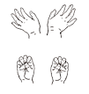



Open and shut them
Open and shut them, open and shut them, give a little clap
Open and shut them, open and shut them, fold them in your lap.
Creep them, creep them, slowly creep them right up to your chin.
Open up your little mouth but do not let them in!

Slide 6

Storybook about HELPFULNESS

Slide 7

Virtues in You
There are virtues in you and virtues in me.
Let’s bring them all out so we can serve humanity.

Slide 8


Time to be Happy is Now
The time to be happy is now.
The place to be happy is here.
And the way to be happy is to make others happy and to build a little heaven down here!

Slide 9
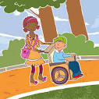
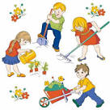
Serving My Friends
I like to serve my friends every day.
I like to serve my friends in every way.
The service that I do can bring a smile or two.
I like to serve my friends everyday in every way!

Slide 10
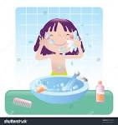
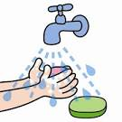
This is the way we wash our face
This is the way we wash our face,
wash our face, wash our face,
This is the way we wash our face
because we want to be clean x 2
This is the way we wash our hands,
wash our hands, wash our hands,
This is the way we wash our hands
because we want to be clean x 2

Slide 11



Sleeping Children
Sleeping children, sleeping children
Ssh, ssh, ssh, ssh, ssh, ssh
Now it’s time to wake up
Now it’s time to wake up
It’s a great day!
It’s a great day!

Slide 12


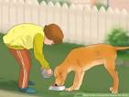
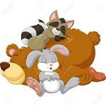
If An Animal Be Sick
If an animal be sick, let the children try to heal it;
if it be hungry, let them feed it;
if thirsty, let them quench its thirst;
if weary let them see that it rests.

Slide 13



Kindness (1/3)
A helping hand, a thoughtful word,
a worried friend you’ve reassured,
mending the wing of a fallen bird,
they all add up to kindness.
Complimenting the friends you meet,
helping old folks cross the street,
getting’ up and giving someone else your seat,
it all adds up to kindness.
CHORUS:
You know it’s really nothing new. Kindness starts with me and you.
The little things we say and do. They all add up to kindness.

Slide 14



Kindness(2/3)
Thanking Mom for the cookies she bakes,
apologizing for our mistakes,
giving people even breaks,
it all adds up to kindness.
Helping Grandpa climb the stairs,
being someone who always shares,
sayin’ you like what your sister wears,
it all adds up to kindness.
CHORUS: You know it’s really nothing new. Kindness starts with me and you.
The little things we say and do. They all add up to kindness

Slide 15
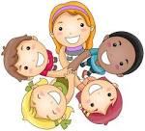
Kindness(3/3)
Choose the shy kid for your team,
honor someone else’s dream…kindness!
Helping out at Grandma’s house, stop the cat and save the mouse…kindness!
Take your brother on a hike, let somebody ride your bike…kindness!
Smiling when you don’t know why, thinking of the other guy…
that’s how we spread some kindness!
CHORUS: You know it’s really nothing new. Kindness starts with me and you.
The little things we say and do. They all add up to kindness

Slide 16

May I Help You?
May I, may I help you (x 3)
May I help you today?
May I help you, clean the floor (x 3)
May I help you today?
“put away your toys”, “put on your shoes”, “open the door”, etc.

Slide 17


Give My Friend a Hug
Let me give my friend a hug, a gentle hug, a gentle hug;
Let me give my friend a hug when he is hurting;
Let me get a tissue, a tissue, a tissue,
Let me get a tissue to wipe away his tears. La, la, la…”

Slide 18
I Think You’re Wonderful
Chorus I think you're wonderful When somebody says that to me I feel wonderful, as wonderful can be It makes me wanna say the same thing to somebody new And by the way I've been meaning to say I think you're wonderful, too
If we practice this phrase in the most honest way And find something special in someone each day We'll lift up the world one heart at a time It all starts by saying this one simple line
Chorus
When each one of us feels important inside Loving and giving and glad we're alive Oh what a difference we'll make in each day And all because someone decided to say...
Chorus
And by the way I've been meaning to say, I think you're wonderful, too

Slide 19
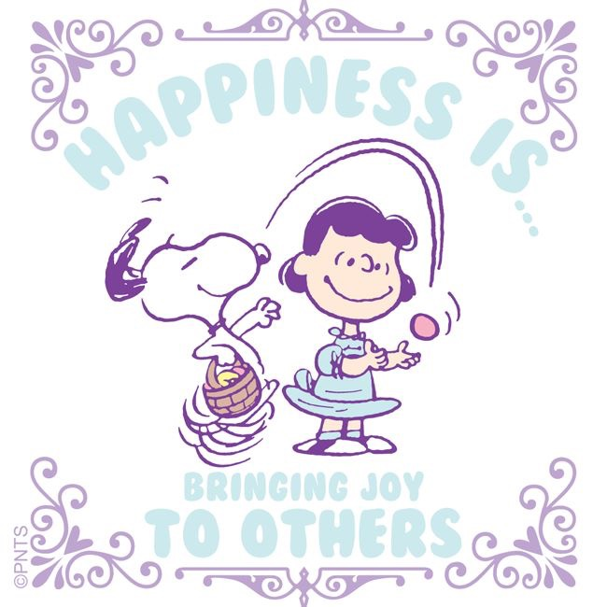
Quotation on Helpfulness
“You live to do good and to bring happiness to others.” -Abdu’l-Baha

Slide 20
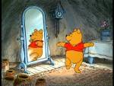




Helpful child, Helpful child
turn around.
Helpful child, Helpful child
touch the ground.
Helpful child, Helpful child
show your shoe.
Helpful child, Helpful child
I love you!
Helpful child, Helpful child
reach for the sky.
Children’s class is over. It’s time to say goodbye!

