Slide 1
Courage

Slide 2
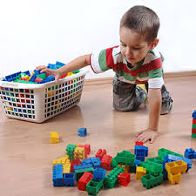
Clean Up Time
Clean up, clean up, everybody everywhere!
Clean up, clean up, everybody do your share!

Slide 3


Good morning, Good morning!
It’s lovely to see you! Please come in and join us, we’d love to be with you. Today is going to be:
*Wonderful *Joyful *Beautiful *Peaceful
Today is going to be…How is your day going to be?
Today is going to be ____(Courageous). Today I’m going to be:
*Happy *Helpful
Good morning, Good morning! It’s lovely to see you!

Slide 4

Opening prayer
“O God, guide me, protect me, make of me a shining lamp and a brilliant star. Thou art the Mighty and the Powerful.”
– ‘Abdu’l-Baha

Slide 5

Hello
Hello everybody! So glad to see you! Hello everybody, so glad to see you too! Hello to ____, so glad to see you! Hello to _______, so glad to see you too! Hello everybody! So glad to see you! Hello everybody, so glad to see you!

Slide 6




Open and shut them
Open and shut them, open and shut them, give a little clap
Open and shut them, open and shut them, fold them in your lap.
Creep them, creep them, slowly creep them right up to your chin.
Open up your little mouth but do not let them in!

Slide 7

I Have Ten Little Fingers
I have ten little fingers and they all belong to me!
I can make them do things, just you wait and see!
I can shut them up tight or open them wide.
I can put them together or make them all hide.
I can make them jump high.
I can make the jump low.
I can fold them quietly and hold them just so!

Slide 8


I Can Do It!
I can do it! I can do it!
Yes, I can. Yes, I can.
When I think I can,
when I think I can,
I can do it! I can do it!

Slide 9


This Little Light of Mine
This little light of mine, I’m going to let it shine x 3
“Let it shine, let it shine, let it shine”
Won’t let anyone put it out, I’m going to let it shine x 3
Chorus
Hide it under my hat? NO! I’m going to let it shine x 3
Chorus
Take this light around the world, I’m going to let it shine x3
Let it shine, let it shine, let it shine.

Slide 10

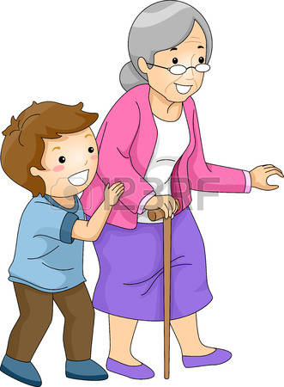
Good Character
Good character,
is doing the right thing,
at the right time,
and for the right reason
(x 8)

Slide 11



We are drops
We are drops, of one ocean, We are waves, of one sea
Chorus: Come and join us, in our quest for unity, it’s a way of life for you and me.
We are flowers, of one garden, We are leaves of one tree
Chorus:
All the earth, is one country, We are one, family
Chorus:

Slide 12

Courage is My Motto
I’ve got a virtue inside me and courage is its name-o.
Chorus: C-O-U-R-A-.... -G-E, here to stay.
I stand strong today and courage is my motto!
In the face of fear I stand, strong and brave with courage… Chorus:
Finding courage to put things, right I can face the challenge.... Chorus:
I’ve got a virtue inside me and courage is its name-o… Chorus:
(REPEAT Chorus but CHANGE ONE WORD): (WE stand strong today!)

Slide 13


Meeting a New Friend
When I meet a new friend I say “Hello!”, “Hello!”;
When I meet a new friend I say “Hello!”, “Hello!”;
When I meet a new friend I can give her hand a shake;
When I meet a new friend I say “Hello!”, “Hello”

Slide 14


We are Peacemakers
We are peacemakers, we are peacemakers,
we want world unity.
Come and join us, come and join us.
The future is ours to see.

Slide 15

I’m a Peacemaker (1/2)
Chorus:
I’m a peacemaker, I’m a peacemaker. Brave and gentle, firm and kind. Brave and gentle, firm and kind.
If someone is rude to me, I will not be mad.
I’ll try to be the best friend that they’ve ever had.
If I’m angry, I know what to do.
I’ll sing myself a happy song and that will get me through.
Chorus
Notes:
Use wooden sticks to tap to this song

Slide 16

I’m a Peacemaker (2/2)
If I disagree with you, that’ll be okay.
I’ll never try to hurt you just to get my own way.
If there’s something unfair, I’ll ask you to help out.
Together we can find a better way there’s no doubt.
Chorus

Slide 17

Be Strong
Chorus: Be strong and let your heart take courage.
Be strong and let your heart take courage. Be strong.
Getting feelings off your chest may be hard for you.
When it’s time to take a test, this is what you’ll have to do.
Chorus
Saying, “Sorry, I was wrong” may be hard for you
When the bus ride takes too long, this is what you’ll have to do
Chorus
Notes:
Use instruments for this song

Slide 18


Work! Work!
Work, work with all your strength, spread the Cause of the Kingdom! x 2
Work! Work with all your strength! x 2
(song repeats several times)
Notes:
Use drums for this song

Slide 19

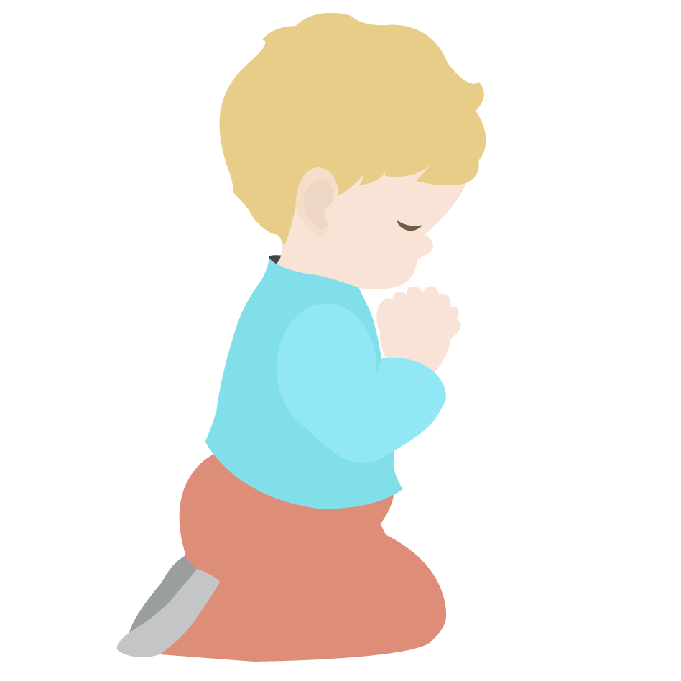

Closing Verse
“Take courage! God never forsakes His children who strive and work and pray!”
– ‘Abdu’l-Baha

Slide 20





Courageous child, Courageous child
turn around.
Courageous child, Courageous child
touch the ground.
Courageous child, Courageous child
show your shoe.
Courageous child, Courageous child
I love you!
Courageous child, Courageous child
reach for the sky.
Children’s class is over. It’s time to say goodbye!

Slide 21

Have a wonderful, courageous week and we can’t wait to see you next week for children’s class!

