Slide 1
Patience

Slide 2

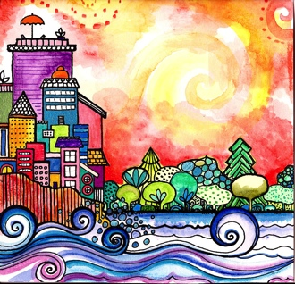
Good morning, Good morning!
It’s lovely to see you! Please come in and join us, we’d love to be with you. Today is going to be:
*Wonderful *Joyful *Beautiful *Peaceful
Today is going to be…How is your day going to be?
Today is going to be ____(PATIENT).
Today I’m going to be:
*Happy *Helpful
Good morning, Good morning! It’s lovely to see you! X 2

Slide 3

Opening prayer
“O God, guide me, protect me, make of me a shining lamp and a brilliant star. Thou art the Mighty and the Powerful.” – ‘Abdu’l-Baha

Slide 4

Hello
Hello everybody! So glad to see you! Hello everybody, so glad to see you too! Hello to ____, so glad to see you! Hello to _______, so glad to see you too! Hello everybody! So glad to see you! Hello everybody, so glad to see you!

Slide 5
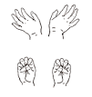



Open and shut them
Open and shut them, open and shut them, give a little clap
Open and shut them, open and shut them, fold them in your lap.
Creep them, creep them, slowly creep them right up to your chin.
Open up your little mouth but do not let them in!

Slide 6
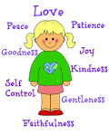
Virtues in You
There are virtues in you and virtues in me.
Let’s bring them all out so we can serve humanity.

Slide 7
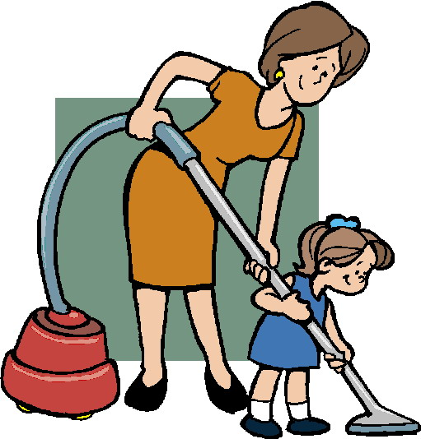
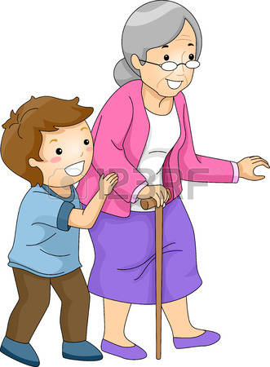
Good Character
Good character,
is doing the right thing,
at the right time,
and for the right reason (x 8)

Slide 8
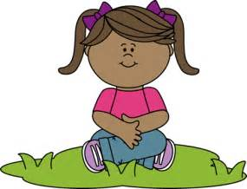
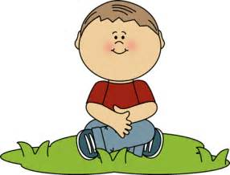
The Patience Song
We can be patient. We can wait, even if Dad’s a little bit late. We can have fun waiting for Mom to take us home today. Some things take time you see, like planting a seed to grow a tree. That’s how patient we can be while waiting here today.
Chorus: Practicing patience makes me strong, clapping my hands and sing a song, What do we do as we wait a bit longer on the mat today?
Twiddle my thumbs! On the mat today. (Chorus) Pat our knees! On the mat today. (Chorus) Stretch our arms! On the mat today. (Chorus)
We were patient, we could wait, even though they were a little bit late. While we waited we were GREAT at practicing patience today!

Slide 9
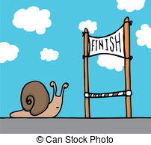
Patient Under All Conditions
Chorus: I will be patient, patient under all conditions.
When I want to use the same toy as my friend, I say, you go first, I can wait, wait, wait! (Chorus)
When I want to use the same crayon as my friends, I say, you can go first, I can wait, wait, wait! (Chorus)
When I want to read the same book as my friend, I say, you go first, I can wait, wait, wait! (Chorus)
When I want to drink the same water as my friend, I say, you go first, I can wait, wait, wait! (Chorus)
When I want to eat the same apple as my friend, I say, you go first, I can wait, wait, wait!
I will be patient. I will be patient. I will be patient… Under all conditions.

Slide 10

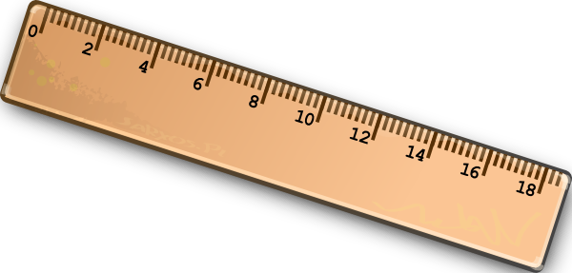
Measure My Patience
Measure my patience x 2, It’s easy you know x 2, this is how I do it x 2, I’m ready to go x 2
I find a clock x 2, or my watch will do x 2, when I need to be patient x 2, I really try to x 2
I note the time x 2, then see how long x 2, I can be patient x 2, quiet and strong x 2
(Be silent and still until song starts again- keeping arms crossed)
How did I do? x 2? I’ll time myself again x 2, I’ll wait a little longer x 2, and score 10 our of 10 x 2
I’ll measure my difference x 2, make progress everyday x 2, I am patient for longer x 2, and things come my way x 2
Yes, I’m patient for longer x 2, and things come my way x 2, all together- YAY!

Slide 11
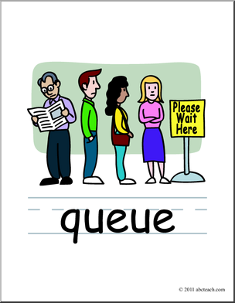
Waiting Patiently
I am waiting patiently for my turn x 2
I am waiting patiently x 2
I am waiting patiently for my turn x 2

Slide 12



Sleeping Children
Sleeping children, sleeping children
Ssh, ssh, ssh, ssh, ssh, ssh
Now it’s time to wake up
Now it’s time to wake up
It’s a great day!
It’s a great day!

Slide 13
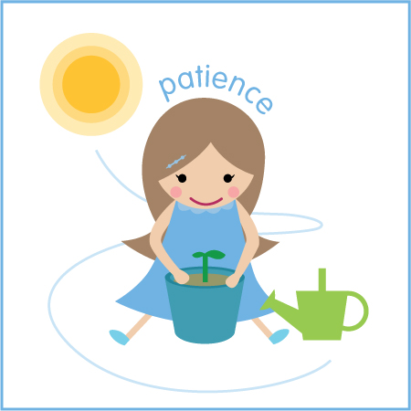
Patience
Chorus: I am waiting without complaining. I accept things I cannot control. I am trusting with quiet expectation that all will be well and I calm my soul.
I am gentle with myself and others when mistakes are made. I am patient with humor and acceptance while waiting for someone who is delayed. (chorus)
I set goals and persevere until my goals are won. I do what I can, then calmly wait and trust that results will come. (chorus)
As a seed will one day bloom into a flower, good things take time. Patience is seeing the end in the beginning. Start something now to make my future shine! (chorus)

Slide 14

Patience (1/2)
Waiting, waiting, waiting…so hard for me to do! Nothing seems to happen when I want it to. Wishing, hoping, wanting won’t change my misery, so when I get impatient this works for me.
CHORUS:
I breathe in (breathe in), breathe out (breathe out); wiggle, swiggle my shoulders, shake the crazies all about! (wiggle body) ;And then I count (1, 2, 3, 4, 5) to 10 (6, 7, 8, 9, 10) and if I’m still impatient I do it all again!
Sitting by the telephone, wanting it to ring, getting so impatient I can’t do anything. Water takes a while to boil and bread needs time to rise. Things happen when their ready, there’s no need to traumatize.
CHORUS:

Slide 15
Patience (2/2)
I hate it when somebody makes me have to wait. Nothing makes me crazier than when I’m running late. When I start to lose it and it feels so unfair, patience helps me keep myself from tearing out my hair!
CHORUS:
Waiting at the movies and the ticket line it move so slowly - hey, this is an opportunity to be PATIENT! My homework special project came out so, so good. I cannot wait to figure out what grade I got! I have to be PATIENT! My birthday is next Friday, I think I know what I am getting for a present. It’s just so hard to be PATIENT!
CHORUS:
1, 2, 3, 4, 5, 6, 7, 8, 9, 10! Ahhh…that’s better!

Slide 16



Teaching Peace
Teaching PEACE, all the world around,
You and me, every city every town,
One by one in our work and in our play…
We are teaching PEACE
By what we do and what we say!

Slide 17
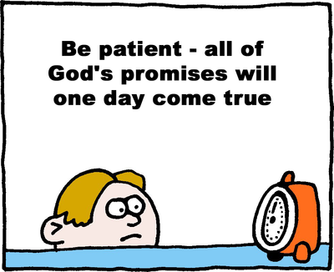
Quotation on Patience
“Be patient under all conditions and place your whole trust and confidence in God.” -Baha’u’llah

Slide 18
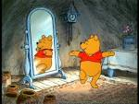




Patient child, Patient child
turn around.
Patient child, Patient child
touch the ground.
Patient child, Patient child
show your shoe.
Patient child, Patient child
I love you!
Patient child, Patient child
reach for the sky.
Children’s class is over. It’s time to say goodbye!

