Slide 1
Love

Slide 2

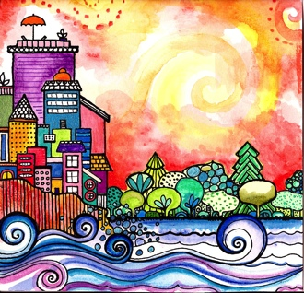
Good morning, Good morning!
It’s lovely to see you! Please come in and join us, we’d love to be with you. Today is going to be:
*Wonderful *Joyful *Beautiful *Peaceful
Today is going to be…How is your day going to be?
Today is going to be ____(FULL OF LOVE).Today I’m going to be:
*Happy *Helpful
Good morning, Good morning! It’s lovely to see you!

Slide 3
Opening prayer
“O Thou the Compassionate God! Bestow upon me a heart which, like unto glass, may be illumined with the light of Thy love, and confer upon me thoughts which may change this world into a rose-garden through the outpourings of heavenly grace. Thou art the Compassionate, the Merciful! Thou art the Great Beneficent God!”
– ‘Abdu’l-Baha

Slide 4
Opening prayer
“O God, guide me, protect me,
make of me a shining lamp and a brilliant star.
Thou art the Mighty and the Powerful.
– ‘Abdu’l-Baha

Slide 5

Hello
Hello everybody! So glad to see you!
Hello everybody, so glad to see you too! Hello to ____, so glad to see you! Hello to _______, so glad to see you too! Hello everybody! So glad to see you! Hello everybody, so glad to see you!

Slide 6

Storybook about LOVE

Slide 7




Love, Service, Joy and Gentleness
Love, service, joy and gentleness.
Love, service, joy and gentleness.
These are virtues we possess.
Love, service, joy and gentleness.

Slide 8

I’ve Got Peace Like a River
I’ve got peace like a river. I’ve got peace like a river.
I’ve got peace like a river in my soul.
[Repeat]
I’ve got joy like a fountain. I’ve got joy like a fountain.
I’ve got joy like a fountain in my soul.
[Repeat]
I’ve got love like the ocean. I’ve got love like the ocean.
I’ve got love like the ocean in my soul.
[Repeat]
I’ve got peace like a river in my soul. I’ve got peace like a river in my soul.

Slide 9


Love, Love, Love Your Friends
Love, love, love your friends. Love them everyday.
Show them that you care for them by sharing when you play.
Pray, pray, pray each day, morning, noon and night,
For God to fill your heart with love, happiness and light.

Slide 10

Utmost Love and Kindness
Treat all thy friends and relatives, even strangers, with the spirit of utmost love and kindliness

Slide 11

Love is Something if you Give it Away
Love is something if you give it away,
you give it away, you give it away.
Love is something if you give it away,
it comes right back to you.
It’s just like a magic penny. Hold on tight and you won’t have any!
Lend it, spend it, give it away and it comes right back to you.
[Replace “Love” with “Hug”, “Smile”, etc.]

Slide 12



Concentrate
Concentrate all the thoughts of your heart on love and unity. [Repeat]
When a thought of war comes oppose it by a stronger thought of peace.
A thought of hared must be destroyed with a more powerful thought of love.

Slide 13

All You Need Is Love
All you need is love…
All you need is love…
All you need is love, love,
All you need is LOVE!

Slide 14
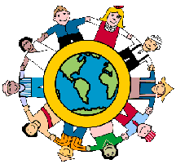
Love All the World
To be a Baha’i simply means
to love all the world,
To love humanity and try to serve it.
To work for universal peace and universal brotherhood.

Slide 15
Closing Verse
“O Friend! In the garden of thy heart plant naught but
the rose of love”
– Bahá’u’lláh

Slide 16
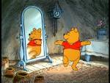




Loving child, Loving child
turn around.
Loving child, Loving child
touch the ground.
Loving child, Loving child
show your shoe.
Loving child, Loving child
I love you!
Loving child, Loving child
reach for the sky.
Children’s class is over. It’s time to say goodbye!

