Slide 1
Joyfulness

Slide 2

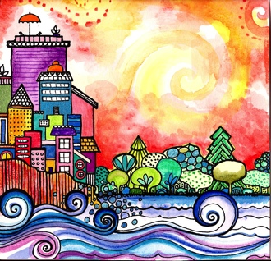
Good morning, Good morning!
It’s lovely to see you! Please come in and join us, we’d love to be with you. Today is going to be:
*Wonderful *Joyful *Beautiful *Peaceful
Today is going to be…How is your day going to be?
Today is going to be ____(JOYFUL).
Today I’m going to be:
*Happy *Helpful
Good morning, Good morning! It’s lovely to see you! X 2

Slide 3
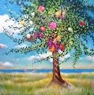

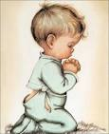
Opening Prayer
O God! Educate these children. These children are the plants of Thine orchard, the flowers of Thy meadow, the roses of Thy garden. Let Thy rain fall upon them; let the Sun of Reality shine upon them with Thy love. Let Thy breeze refresh them in order that they may be trained, grow and develop, and appear in the utmost beauty. Thou art the Giver. Thou art the Compassionate. ~ 'Abdu’l-Bahá

Slide 4

Hello
Hello everybody! So glad to see you!
Hello everybody, so glad to see you too! Hello to ____, so glad to see you! Hello to _______, so glad to see you too! Hello everybody! So glad to see you! Hello everybody, so glad to see you!

Slide 5
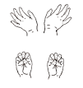



Open and shut them
Open and shut them, open and shut them, give a little clap
Open and shut them, open and shut them, fold them in your lap.
Creep them, creep them, slowly creep them right up to your chin.
Open up your little mouth but do not let them in!

Slide 6



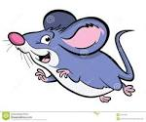
Slowly and Quickly
Slowly, slowly, very slowly creeps the garden snail
Slowly, slowly, very slowly, up the wooden rail.
Quickly, quickly, very quickly runs the little mouse.
Quickly, quickly, very quickly in his little house!

Slide 7
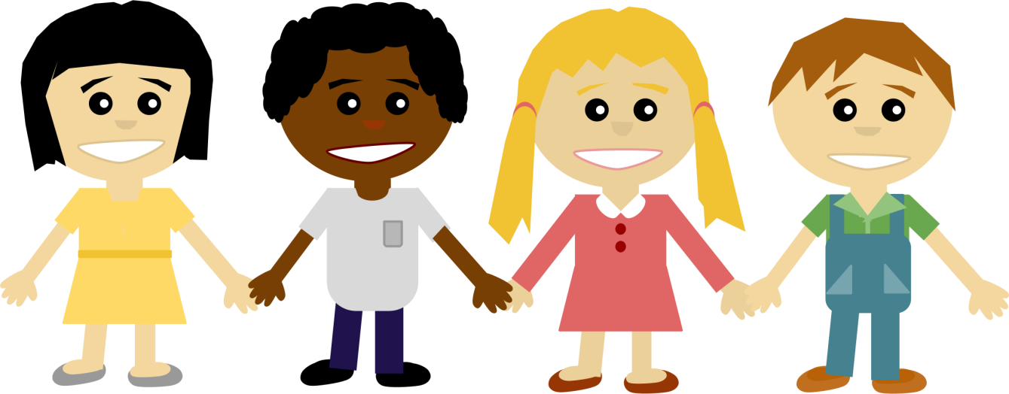
The More We Get Together
The more we get together, together, together,
The more we get together the happier we’ll be,
For your friends are my friends and my friends are your friends.
The more we get together the happier we’ll be!

Slide 8


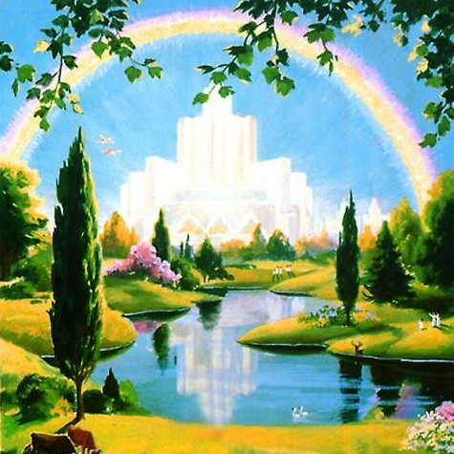
Time to be Happy is Now
The time to be happy is now.
The place to be happy is here.
And the way to be happy is to make others happy and to build a little heaven down here!

Slide 9



Love, Service, Joy and Gentleness
Love, service, joy and gentleness.
Love, service, joy and gentleness.
These are virtues we possess.
Love, service, joy and gentleness.

Slide 10
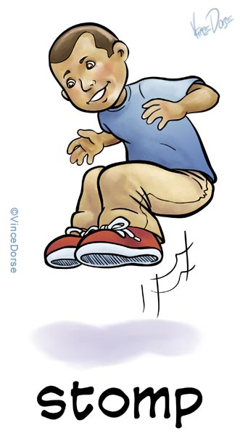


If You’re Happy and You Know It
If you’re happy and you know it, clap your hands x2
If you’re happy and you know it, then your face will surely show it
If you’re happy and you know it clap your hands!
… stomp your feet!
… shout hooray!
… do all 3!

Slide 11
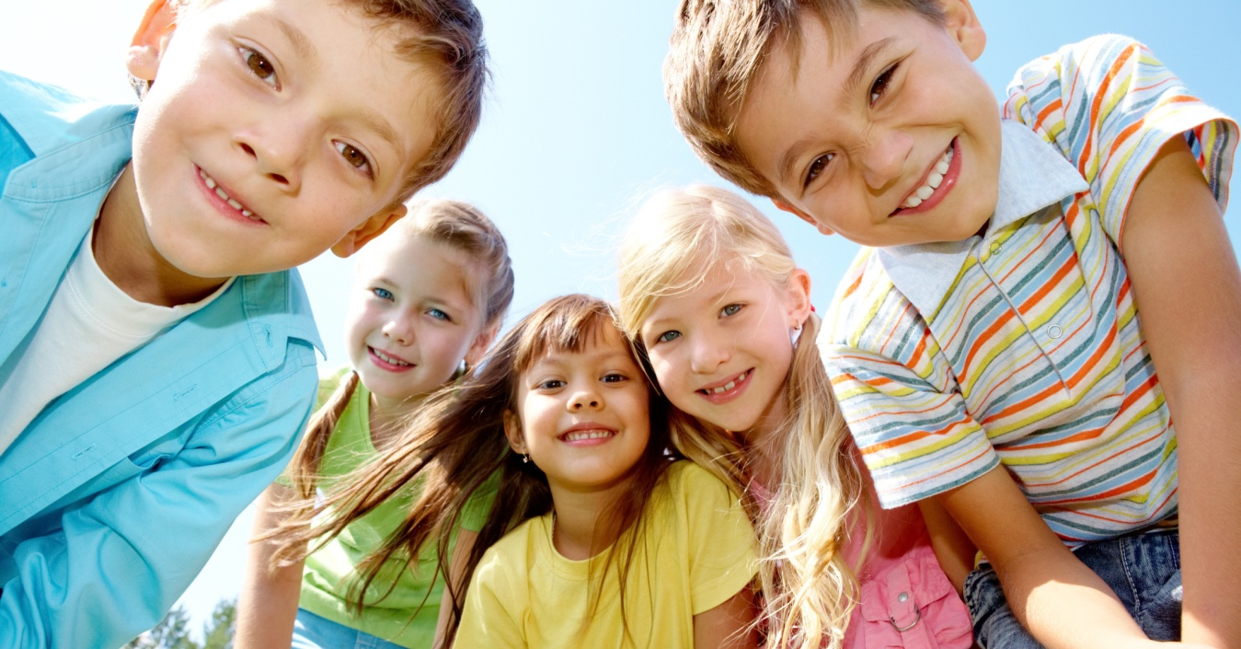
A Smile Is Something
A smile is something if you give it away, give it away, give it away.
A smile is something if you give it away, it comes right back to you!

Slide 12


Slide 13
I Think You’re Wonderful
I think you're wonderful, When somebody says that to me, I feel wonderful, as wonderful can be. It makes me wanna say the same thing to somebody new, And by the way I've been meaning to say, I think you're wonderful, too.
If we practice this phrase in the most honest way And find something special in someone each day We'll lift up the world one heart at a time. It all starts by saying this one simple line!
Chorus
When each one of us feels important inside Loving and giving and glad we're alive Oh what a difference we'll make in each day And all because someone decided to say...
Chorus
And by the way I've been meaning to say, I think you're wonderful, too!

Slide 14
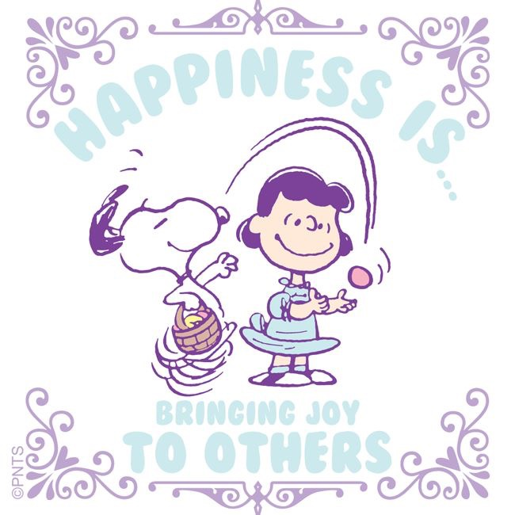
Quotation on Joyfulness
“Joy gives us wings!” -Abdu’l-Baha

Slide 15
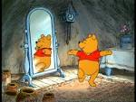


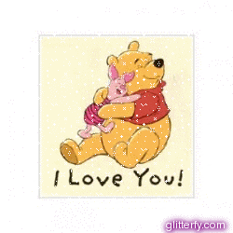

Joyful child, Joyful child
turn around.
Joyful child, Joyful child
touch the ground.
Joyful child, Joyful child
show your shoe.
Joyful child, Joyful child
I love you!
Joyful child, Joyful child
reach for the sky.
Children’s class is over. It’s time to say goodbye!

