Slide 1
Gentleness

Slide 2

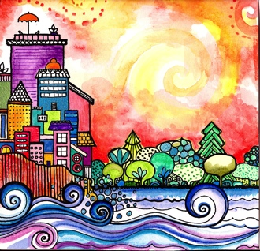
Good morning, good morning! It’s lovely to see you! Please come in and join us, we’d love to be with you. Today is going to be wonderful. Today is going to be joyful. Good morning, good morning! It’s lovely to see you! Please come in and join us, we’d love to be with you. Today is going to be beautiful. Today is going to be peaceful. Good morning, good morning! It’s lovely to see you! Please come in and join us, we’d love to be with you. Today is going to be…How is your day going to be? Get ready to sing! Today is going to be _______(Gentle!). Today I’m going to be happy. Today I’m going to be helpful. Good morning, good morning! It’s lovely to see you! Good morning, good morning! It’s lovely to see you!

Slide 3
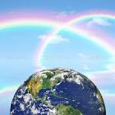
Opening prayer
God sufficeth all things above all things,
and nothing in the heavens or in the earth but God sufficeth.
Verily, He is in Himself the Knower,
the Sustainer, the Omnipotent.
~The Báb

Slide 4
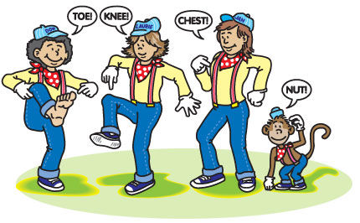
Tony Chestnut knows I love you
Tony knows x 2
Tony Chestnut knows I love you
That’s what Tony knows.
(Repeat)

Slide 5




Love, service, joy and gentleness.
Love, service, joy and gentleness.
These are virtues we possess.
Love, service, joy and gentleness.

Slide 6


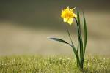
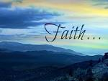
The fruits of the spirit is love, joy, peace, long-suffering, gentleness, goodness and faith. X 5
(The Bible, Galations 5:22)

Slide 7
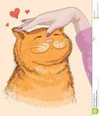

Gentle Old MacDonald (2/3)
Old MacDonald had a farm, e-i-e-i-o!
and on that farm he had a cat, e-i-e-i-o!
Be gentle with the cat- meow!
We’re gentle with the cat – meow!
Old MacDonald had a farm, e-i-e-i-o!
and on that farm he had a horse, e-i-e-i-o!
Be gentle with the horse, neigh.
We’re gentle with the horse, neigh

Slide 8
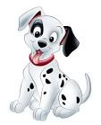
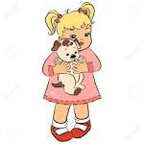
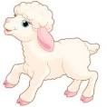
Gentle Old MacDonald (1/3)
Old MacDonald had a farm, e-i-e-i-o,
and on that farm he had a puppy, e-i-e-i-o
Be gentle with the puppy- woof!
We’re gentle with the puppy- woof!
Old MacDonald had a farm, e-i-e-i-o!
Old Macdonald…he had a sheep…
be gentle with the sheep- baa!
We’re gentle with the sheep- baa

Slide 9
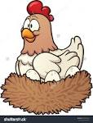
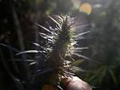
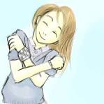
Gentle Old MacDonald (3/3)
…hen...be gentle with eggs, I’m gentle with the eggs, cluck, cluck, cluck…
…he had a field of prickles- e-i-e-i- OW!
Be gentle on yourself, gentleness!
I’m gentle on myself, gentleness!
Old MacDonald had a farm, e-i-e-i-o, e-i-e-i-o!

Slide 10
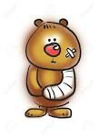
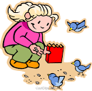
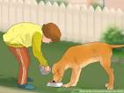
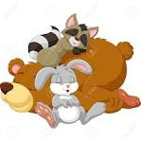
If An Animal Be Sick
If an animal be sick, let the children try to heal it;
if it be hungry, let them feed it;
if thirsty, let them quench its thirst;
if weary let them see that it rests.

Slide 11
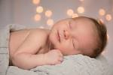


Sleeping Children
Sleeping children, sleeping children
Ssh, ssh, ssh, ssh, ssh, ssh
Now it’s time to wake up
Now it’s time to wake up
It’s a great day!
It’s a great day!

Slide 12


Fruits of the Spirit (1/3)
We can help a friendship start if we fill our hearts with the fruits of the spirit
When you speak to another, be truthful
When you meet a stranger, be warm
These fruits in your heart have been growing ever since the day that you were born
A fruit of the spirit is love
A fruit of the spirit is joy
A fruit of the spirit is peace
(repeated)

Slide 13

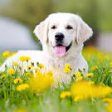
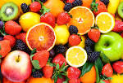
Fruits of the Spirit (2/3)
If you touch a flower, be gentle
If you play with a dog, be kind
These kind of fruits are the most delicious!
Let’s see how many we can find!

Slide 14
Fruits of the Spirit (3/3)
A fruit of the spirit is thoughtfulness
A fruit of the spirit is service
A fruit of the spirit is….(gentleness)-
A fruit of the spirit is love
A fruit of the spirit is joy
A fruit of the spirit is…(gentleness)
We can help a friendship start if we fill our hearts with the fruits of the spirit!

Slide 15
Closing Quotation
We must associate with all humanity in gentleness and kindliness.
–Abdu’l-Baha

Slide 16
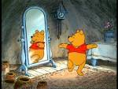


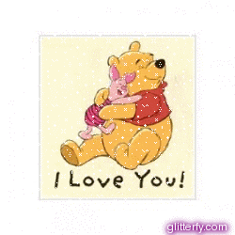


Gentle child, Gentle child
turn around.
Gentle child, Gentle child,
touch the ground.
Gentle child, Gentle child,
show your shoe.
Gentle child, Gentle child,
I love you!
Gentle child, Gentle child,
reach for the sky.
Children’s class is over. It’s time to say goodbye!

Slide 17

See you next week for
another amazing class

