Slide 1
Cleanliness

Slide 2
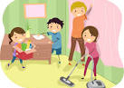
Clean up (1)
Clean up, clean up, everybody everywhere.
Clean up, clean up, everybody do your share

Slide 3

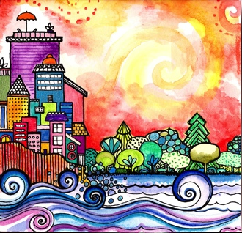
Good morning, good morning! It’s lovely to see you! Please come in and join us, we’d love to be with you. Today is going to be wonderful. Today is going to be joyful. Good morning, good morning! It’s lovely to see you! Please come in and join us, we’d love to be with you. Today is going to be beautiful. Today is going to be peaceful. Good morning, good morning! It’s lovely to see you! Please come in and join us, we’d love to be with you. Today is going to be…How is your day going to be? Get ready to sing! Today is going to be _______(very clean!). Today I’m going to be happy. Today I’m going to be helpful. Good morning, good morning! It’s lovely to see you! Good morning, good morning! It’s lovely to see you!

Slide 4

“Is there any Remover of difficulties save God? Say: Praised be God! He is God! All are His servants, and all abide by His bidding!” ~ The Báb

Slide 5

Hello
Hello everybody! So glad to see you! Hello everybody, so glad to see you too! Hello to ____, so glad to see you! Hello to _______, so glad to see you too! Hello everybody! So glad to see you! Hello everybody, so glad to see you!

Slide 6
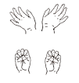

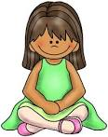
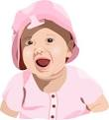
Open and shut them
Open and shut them, open and shut them, give a little clap
Open and shut them, open and shut them, fold them in your lap.
Creep them, creep them, slowly creep them right up to your chin.
Open up your little mouth but do not let them in!

Slide 7
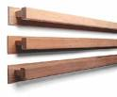


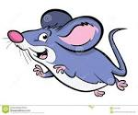
Slowly and Quickly
Slowly, slowly, very slowly creeps the garden snail
Slowly, slowly, very slowly, up the wooden rail.
Quickly, quickly, very quickly runs the little mouse.
Quickly, quickly, very quickly in his little house!

Slide 8
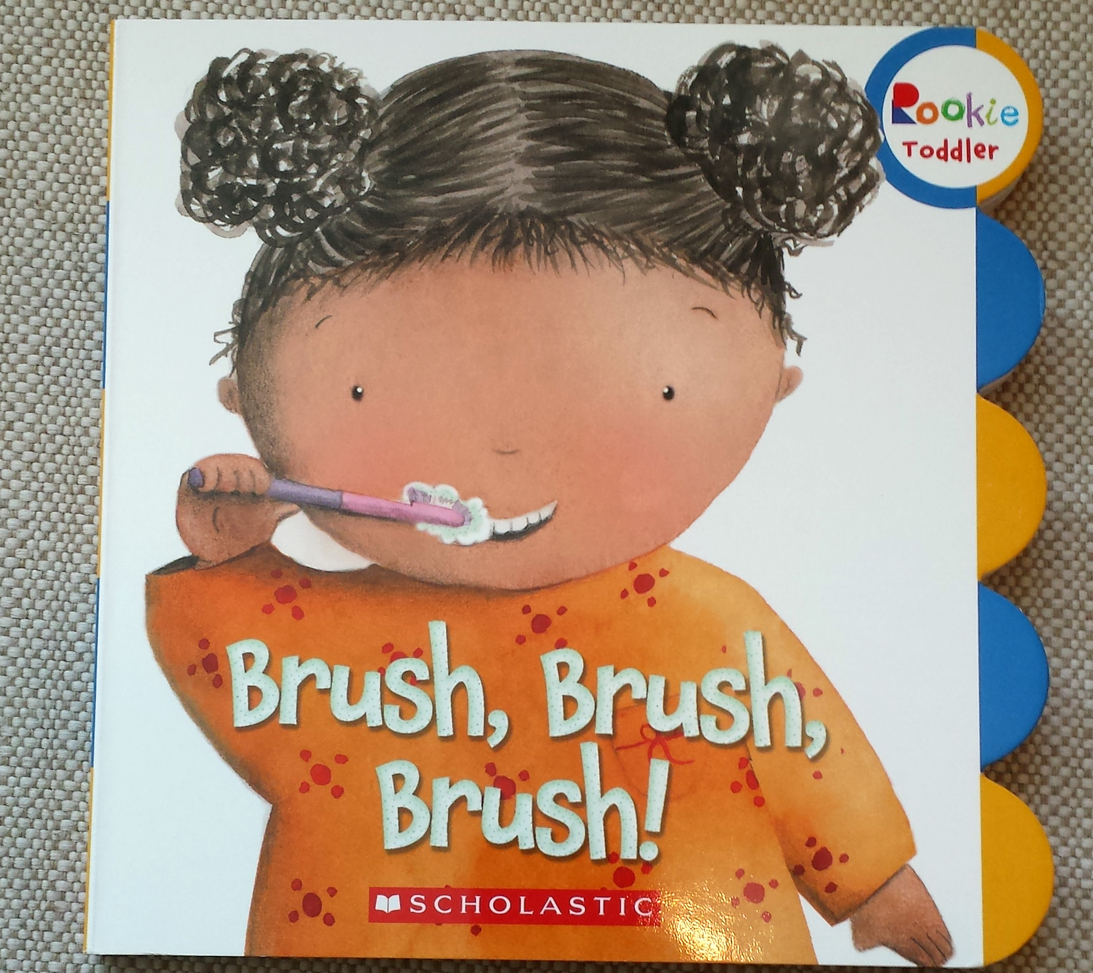
Book about Cleanliness

Slide 9
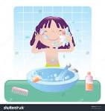
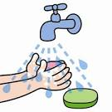
Cleanliness
This is the way we wash our face,
wash our face, wash our face,
This is the way we wash our face
because we want to be clean x 2
This is the way we wash our hands,
wash our hands, wash our hands,
This is the way we wash our hands
because we want to be clean x 2

Slide 10
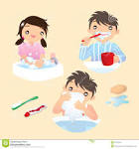
If you’re healthy and you know it
If you’re healthy and you know it, wash your hands x 2
Be a happy human being, be healthy and clean!
If you’re healthy and you know it wash your hands!
If you’re healthy and you know it, clean your teeth x 2
Be a happy human being, be healthy and clean!
If you're healthy and you know it clean your teeth!

Slide 11
If you’re healthy and you know it
I am healthy and I know it and I think clean thoughts x 2
I’m a happy human being, being healthy and clean!
I am healthy and I know it and I think clean thoughts!
I am healthy and I know it and I speak clean words x 2
I’m a happy human being, being healthy and clean!
I am healthy and I know it and I speak clean words!

Slide 12


Brush Your Teeth
When you wake up in the morning, it’s a quarter to one
and you want to have a little fun,
you brush your teeth- chhh, chhh, chhh, chhh, chhh…
you brush your teeth, chhh, chhh, chhh, chhh, chhh…

Slide 13

Brush Your Teeth
When you wake up in the morning, it’s a quarter to two
and you want to find something to do,
you brush your teeth- chhh…

Slide 14

Brush Your Teeth
When you wake up in the morning,
it’s a quarter to three and your mind starts hummin’ twiddle dee dee-
you brush your teeth- chhh…..

Slide 15

Brush Your Teeth
When you wake up in the morning, it’s a quarter to four
and you think you hear a knock at your door-
you brush your teeth, chhh…

Slide 16

Brush Your Teeth
When you wake up in the morning, it’s a quarter to five
and you just can’t wait to come alive,
you brush your teeth- chhh…
You brush your teeth, chhh….

Slide 17

Scrubba Dubba
Chorus:
Scrub, scrub, scrub, scrub a dubby
Scrub, scrub, scrub-i-do-da
Scrub a dub a do, scrub a dub a dee
Scrub a little toe and scrub a little knee
Scrub a little ear and all that’s in between
Scrub a dub a dub a dee until I’m squeaky clean

Slide 18
Scrubba Dubba
Chorus
Scrub a dub a doo, scrub a dub a dum
Scrub a little finger, scrub a little thumb
Scrub a little nose and scrub a little cheek
Scrub a dub a dub a dee until I’m squeaky clean
And oh, I love to scrub a dee doo, scrub a da dee, scrub a dub dub
Right here in my tub, goin’ to scrub and scrub ‘til I’m all scrubbed up!

Slide 19
Scrubba Dubba
Chorus
Scrub a duba do, scruba duba dee
Scrub a little you and scrub a little me
Scrub a little hand and the other if you please
Scruba dub a dub a dee until I’m squeaky clean!

Slide 20
Scrubba Dubba
Chorus repeated several times
Scrub a dub a do, scrub a dub a dee
Scrub a little toe and scrub a little knee
Scrub a little ear and all that’s in between
Scrub a dub a dub a dee until I’m squeaky clean!
(*2)

Slide 21

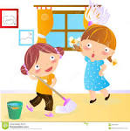
Cleanliness
I’m a clean kid. I keep my life in order.
I’m a clean kid. I wash my face everyday.
I’m a clean kid. I do my share to keep our house in order.
I’m a clean kid, from Sunday to Saturday!

Slide 22

Cleanliness
When my mind starts thinking not good thoughts,
I say, “Whad’ ya doin’ here?” and I think all my good, good, good, good thoughts!
I’m a clean kid. I keep my life in order.
I’m a clean kid. I brush my teeth everyday.
I’m a clean. I do my share to keep our house in order.
I’m a clean kid, from Sunday to Saturday!

Slide 23
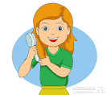
Cleanliness
When I’ve made a mistake and I know I’m wrong,
I clean up my act and choose to change and know God keeps me strong.
I’m a clean kid. I keep my life in order.
I’m a clean kid. I comb my hair everyday.
I’m a clean kid. I do my share to keep our house in order.
I’m a clean kid, from Sunday to Saturday!

Slide 24

Hokey pokey
You put your right foot in, you put your right foot out
You put your right foot in and you CLEAN it all about
You do the hokey pokey and you turn yourself around, that’s what it’s all about!
You put your left foot in…
Right hand…
Left hand…
Head…
Whole self…
That’s what it’s all about, yay!

Slide 25
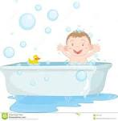
Rub a Dub
Chorus:
Don’t you love to have fun in the tub, rub a dub
Just hop in the water and scrub, rub a dub
Pile up the bubbles, just as high as they’ll go
Then start at the top and work down to each toe
In the scrubbly, bubbly tub

Slide 26
Rub a Dub
First you wash your face
To make your cheeks bright
But remember to keep your eyes shut tight!
Then ears in and out
And neck round and round
Then move on to your shoulders and arms up and down

Slide 27
Rub a Dub
Chorus
Your fingers and toes, they need extra soap
And you haven’t forgotten your tummy at all, plus your bottom and legs
Scrub on down to those feet
Then up, down and sideways, you’re all clean and sweet
Chorus

Slide 28
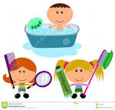
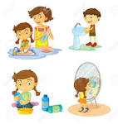
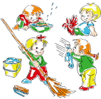
“Be ye the very essence of cleanliness amongst mankind.”
~ Bahá'u'lláh

Slide 29
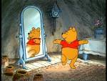


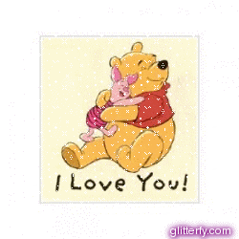


Cleanly child, cleanly child
turn around.
Cleanly child, cleanly child,
touch the ground.
Cleanly child, cleanly child,
show your shoe.
Cleanly child, cleanly child,
I love you!
Cleanly child, cleanly child,
reach for the sky.
Children’s class is over. It’s time to say goodbye!

Slide 30

See you next week for
another amazing class

