Slide 1
Peacefulness

Slide 2
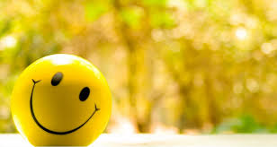
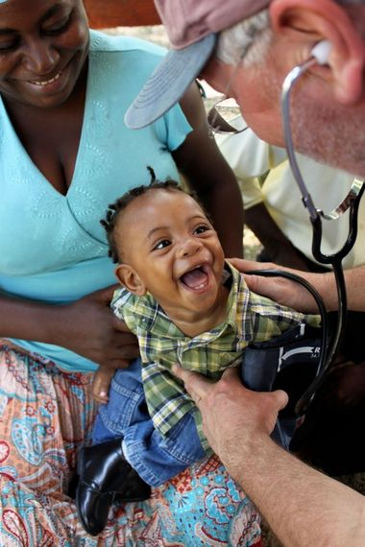
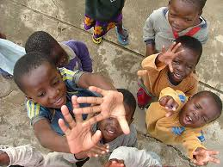
“You live to do good and
to bring happiness to others.”

Slide 3
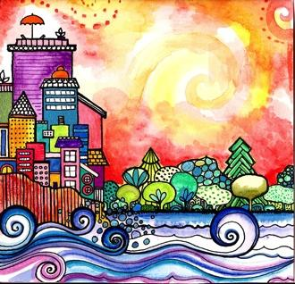

Good morning, Good morning!
It’s lovely to see you! Please come in and join us, we’d love to be with you. Today is going to be:
*Wonderful *Joyful *Beautiful *Peaceful
Today is going to be…How is your day going to be?
Today is going to be ____(PEACEFUL).
Today I’m going to be:
*Happy *Helpful
Good morning, Good morning! It’s lovely to see you! X 2

Slide 4
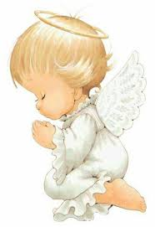
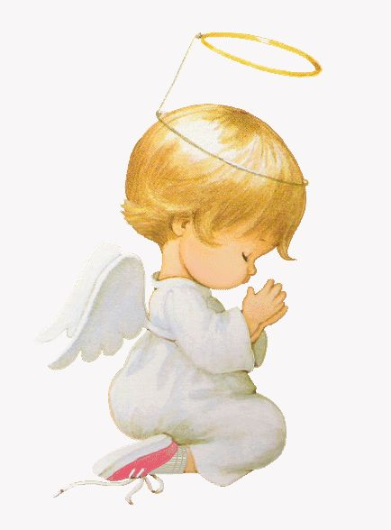
Opening Prayer
O God! Guide me, protect me.
Make of me a shining lamp and a brilliant star.
Thou art the Mighty and the Powerful.
~ 'Abdu’l-Bahá

Slide 5
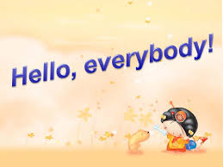

Hello everybody!
Hello everybody! So glad to see you!
Hello everybody, so glad to see you too! Hello to ____, so glad to see you! Hello to _______, so glad to see you too! Hello everybody! So glad to see you! Hello everybody, so glad to see you!

Slide 6
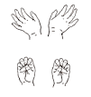

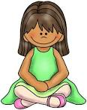
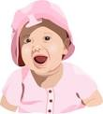
Open and shut them
Open and shut them, open and shut them, give a little clap
Open and shut them, open and shut them, fold them in your lap.
Creep them, creep them, slowly creep them right up to your chin.
Open up your little mouth but do not let them in!

Slide 7
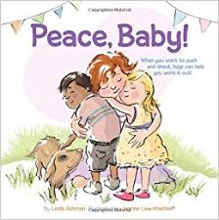
An Introduction to Peacefulness

Slide 8
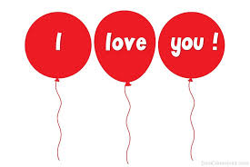
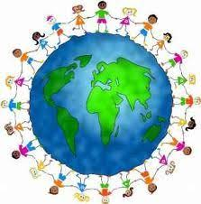


I love you and you love me
I love you and you love me.
We are one big family.
All around the world
you’ll see us teaching peace and unity.
I love you and you love me.
We are one big family

Slide 9
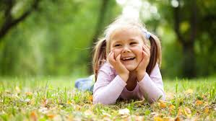
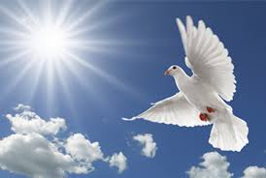
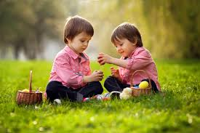
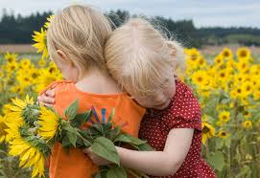
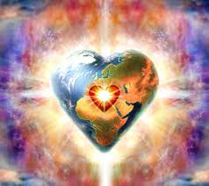
Peace Is The World Smiling
Peace is the world smiling.
Peace is a gentle dove.
Peace is sharing.
Peace is caring.
Peace is filling the world with love!

Slide 10
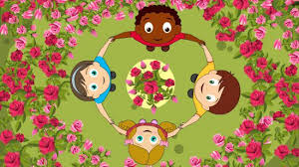
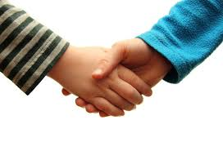
Peace Around the World
Peace around the world,
peace around the world.
Friendship! Friendship!
We all shake hands!

Slide 11

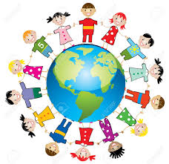
We are Peacemakers
We are peacemakers, we are peacemakers,
we want world unity.
Come and join us, come and join us
The future is ours to see

Slide 12
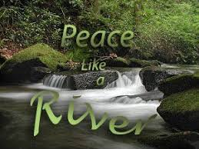
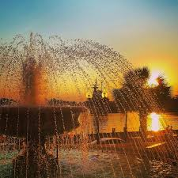
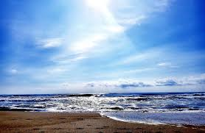
I’ve Got Peace Like a River
{I've got peace like a river (*3) in my soul. } *2
{I’ve got joy like a fountain (*3) in my soul. }*2
{I’ve got love like the ocean (*3) in my soul. } *2
I've got peace like a river in my soul. (*2)

Slide 13

Put A Little Love In Your Heart
Think of your fellowman, lend him a helping hand, put a little love in your heart!
You see it’s getting late, oh please don’t hesitate, put a little love in your heart!
Chorus: And the world will be a better place x 2 For you and me, just wait and see!
Another day goes by, still the children cry, put a little love in your heart!
If you want the world to know, we won’t let hatred grow, put a little love in your heart!
Chorus: And the world will be a better place x 2 For you and me, just wait and see!
Take a good look around, and if you’re looking down, put a little love in your heart!
I hope when you decide kindness will be your guide, put a little love in your heart!
Chorus: Put a little love in your heart x 5

Slide 14
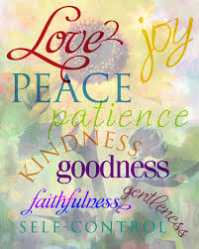
Peace Will Come
If we practice kindness, ..... love, ….. service, peace will come!
….. honesty, ..... joy, ….. unity, peace will come, yeah peace will come!
If we practice understanding, ... truth, justice, peace will come, yeah peace will come!
We welcome peace and ….. love and ….. kindness!
….. giving, ….. sharing, and ….. peacefulness, just peacefulness!
If we practice spirit, ….. bliss, ….. evolution, peace will come, yeah peace will come, oh peace will come
We welcome peace and ….. love and ..... kindness!
..... giving, ..... sharing, and we welcome peacefulness

Slide 15
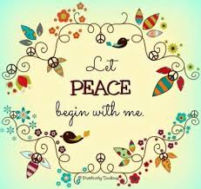
Peace will come #2
... peace will.... peace will come. And let it begin with me.
We....... we need......., we need peace. And let it begin with me.
Oh, my own life is all I can hope to control
Oh, let my life be lived, lived for the good, good of my soul.
Let it bring:
Peace.... sweet peace.... peace will come, and let it begin with me

Slide 16
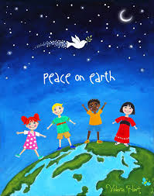
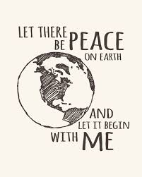
Let There Be Peace On Earth
Let there be peace on earth, and let it begin with me Let there be peace on earth, the peace that was meant
to be
With God as our Father, brothers all are we
Let me walk with my brothers in perfect harmony
Let peace begin with me, let this be the moment now
With every step I take, let this be my solemn vow
To take each moment, and live each moment in peace eternally
Let there be peace on earth, and let it begin with me!
Let there be peace on earth, and let it begin with me Let there be peace on earth, the peace that was meant to be
To take each moment, and live each moment in peace eternally
Let there be peace on earth and let it begin with me!

Slide 17
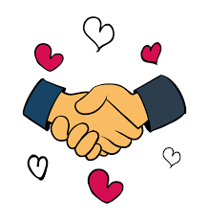
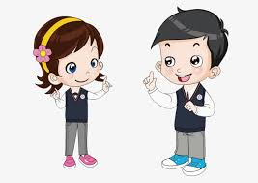
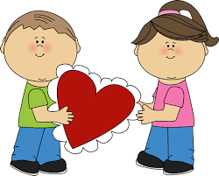
I’ve Got Peace in My Fingers
I’ve got peace, peace, peace in my fingers, watch what I can do
I’ve got peace, peace, peace in my fingers. I’m going to shake hands with you (Repeat)
I’ve got words, words, words in my head, watch what I can do
I’ve got words, words, words in my head. I’m going to talk things over with you (Repeat)
I’ve got love, love, love in my heart, watch what I can do
I’ve got love, love, love in my heart. I’m going to give some to you
I’ve got peace, peace, peace in my fingers
I’ve got words, words, words in my head
I’ve got love, love, love in my heart, I’m going to give some to you!

Slide 18

Dona Nobis Pacem Grant Us Peace
Dona Nobis Pacem, Pacem
Dona Nobis Pacem
Dona Nobis Pacem
Dona Nobis Pacem!

Slide 19
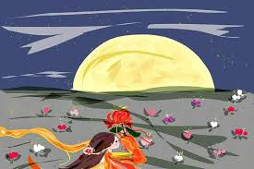
Closing quote
"Be thou of those who foster peace."
~ 'Abdu’l-Bahá

Slide 20
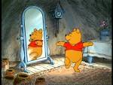


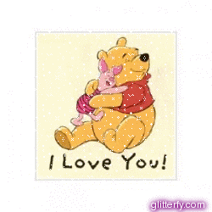

Peaceful child, peaceful child turn around.
Peaceful child, peaceful child, touch the ground.
Peaceful child, peaceful child, show your shoe
Peaceful child, peaceful child, I love you!
Peaceful child, peaceful child, reach for the sky.
Children’s class is over. It's time to say goodbye!

