Slide 1
Devotional for kids
Devotional for kids

Slide 2
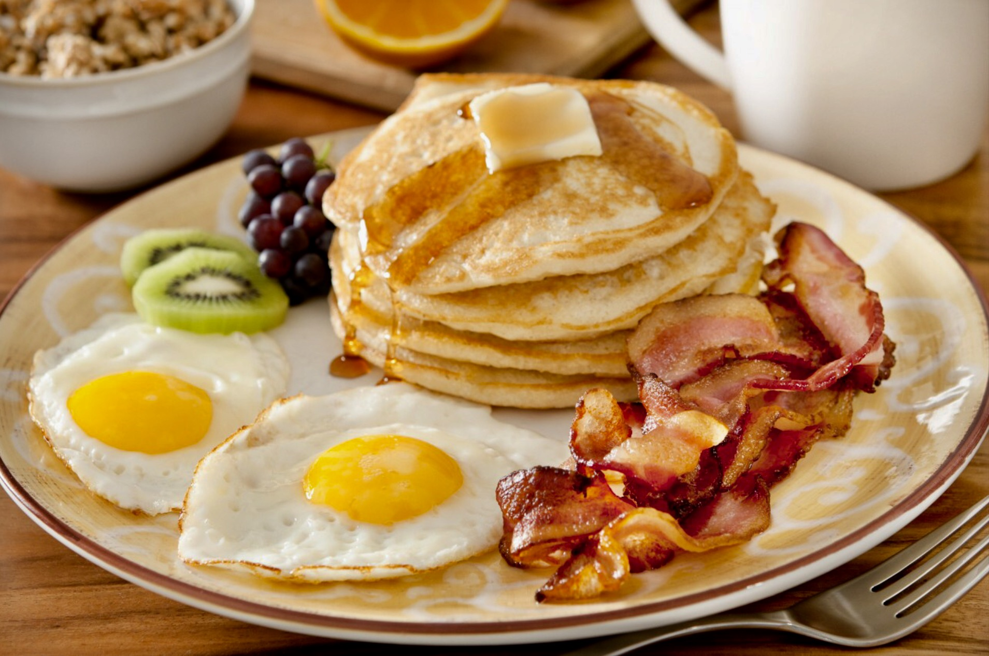
Breakfast

Slide 3
By:Lilly
Welcome I wanted to start out by saying thank you for being here and telling you the purpose of this devotional. We started this devotional because we wanted the world to be united and all the religions to have peace together.
Introduction

Slide 4
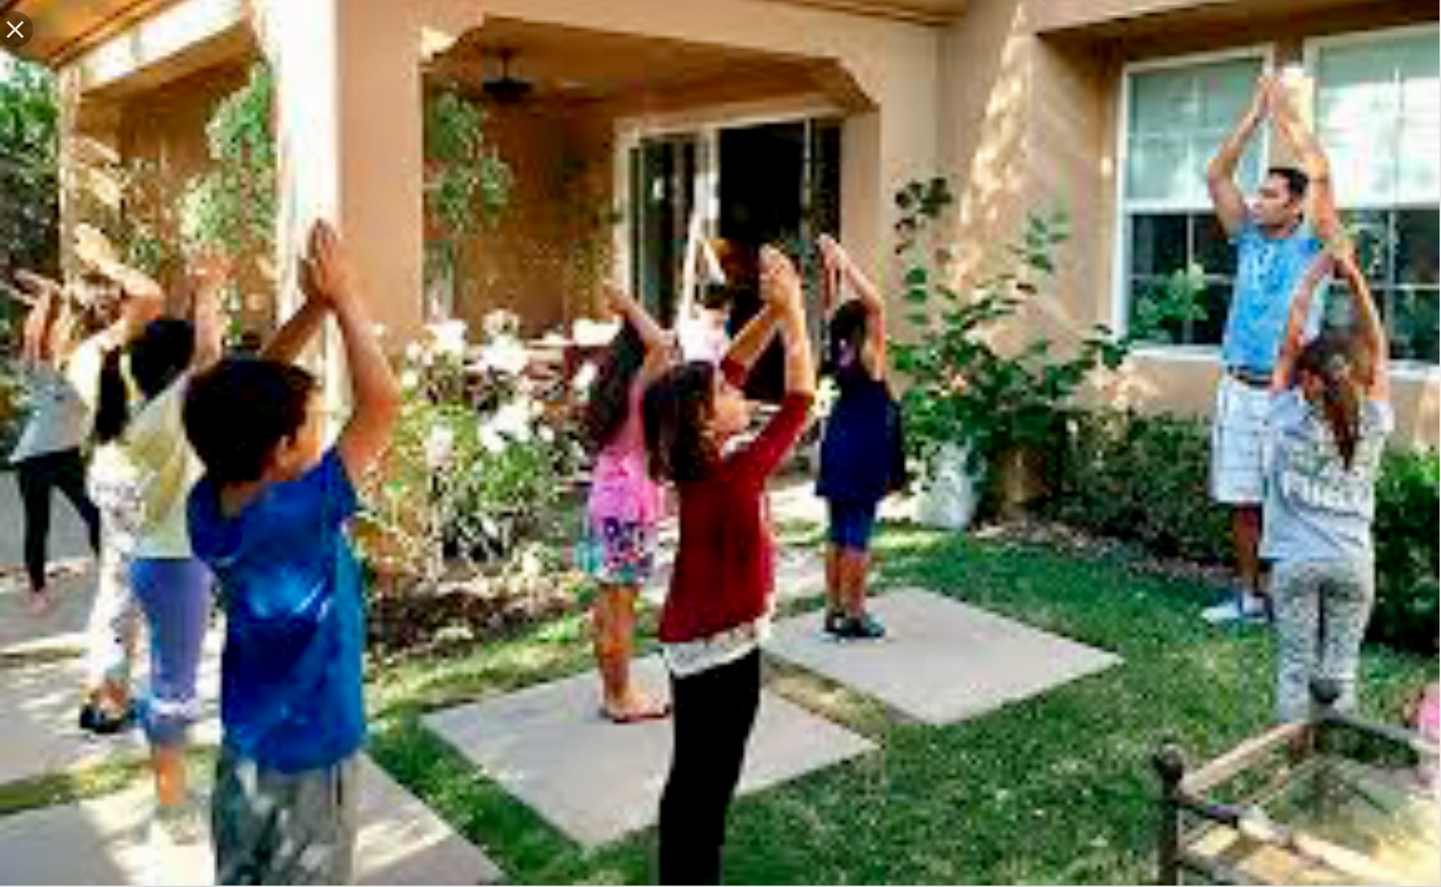
Welcome game
Welcome game

Slide 5
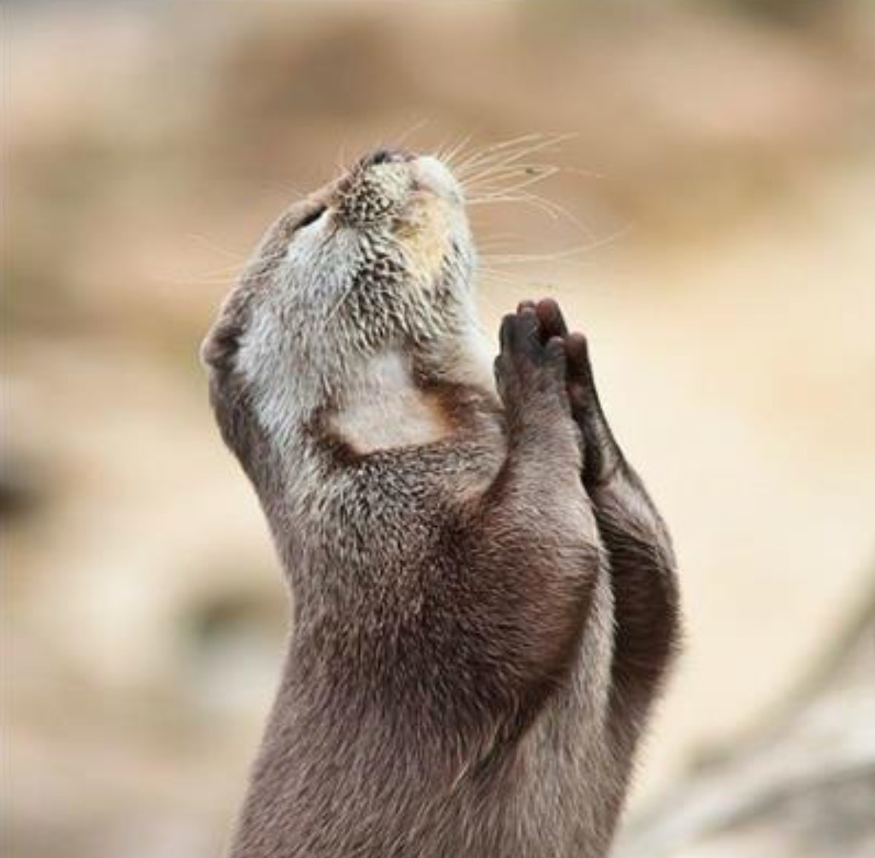
Prayers

Slide 6
https://m.youtube.com/watch?v=zfPzUZ_25yw
“Unite and bind together the hearts, join in accord all the souls...O Lord make these faces radiant through the light of Thy oneness.”

Slide 7
“O my God! O my God! Unite the hearts of Thy servants, and reveal to them Thy great purpose. May they follow Thy commandments and abide in Thy law. Help them, O God, in their endeavor, and grant them strength to serve Thee. O God! Leave them not to themselves, but guide their steps by the light of Thy knowledge, and cheer their hearts by Thy love. Verily, Thou art their Helper and their Lord.”

Slide 8
Lakota Prayer: Oh, Great Spirit have mercy upon us so that we may live with our relatives. Grand Father, hear our voices for we are small Oh, Great Spirit see that we come to you in a good way. Help us to see and recognize and understand our place in this great circle of life. Grand Father, we give thanks to you for this day and all the blessings we have received from you.

Slide 9
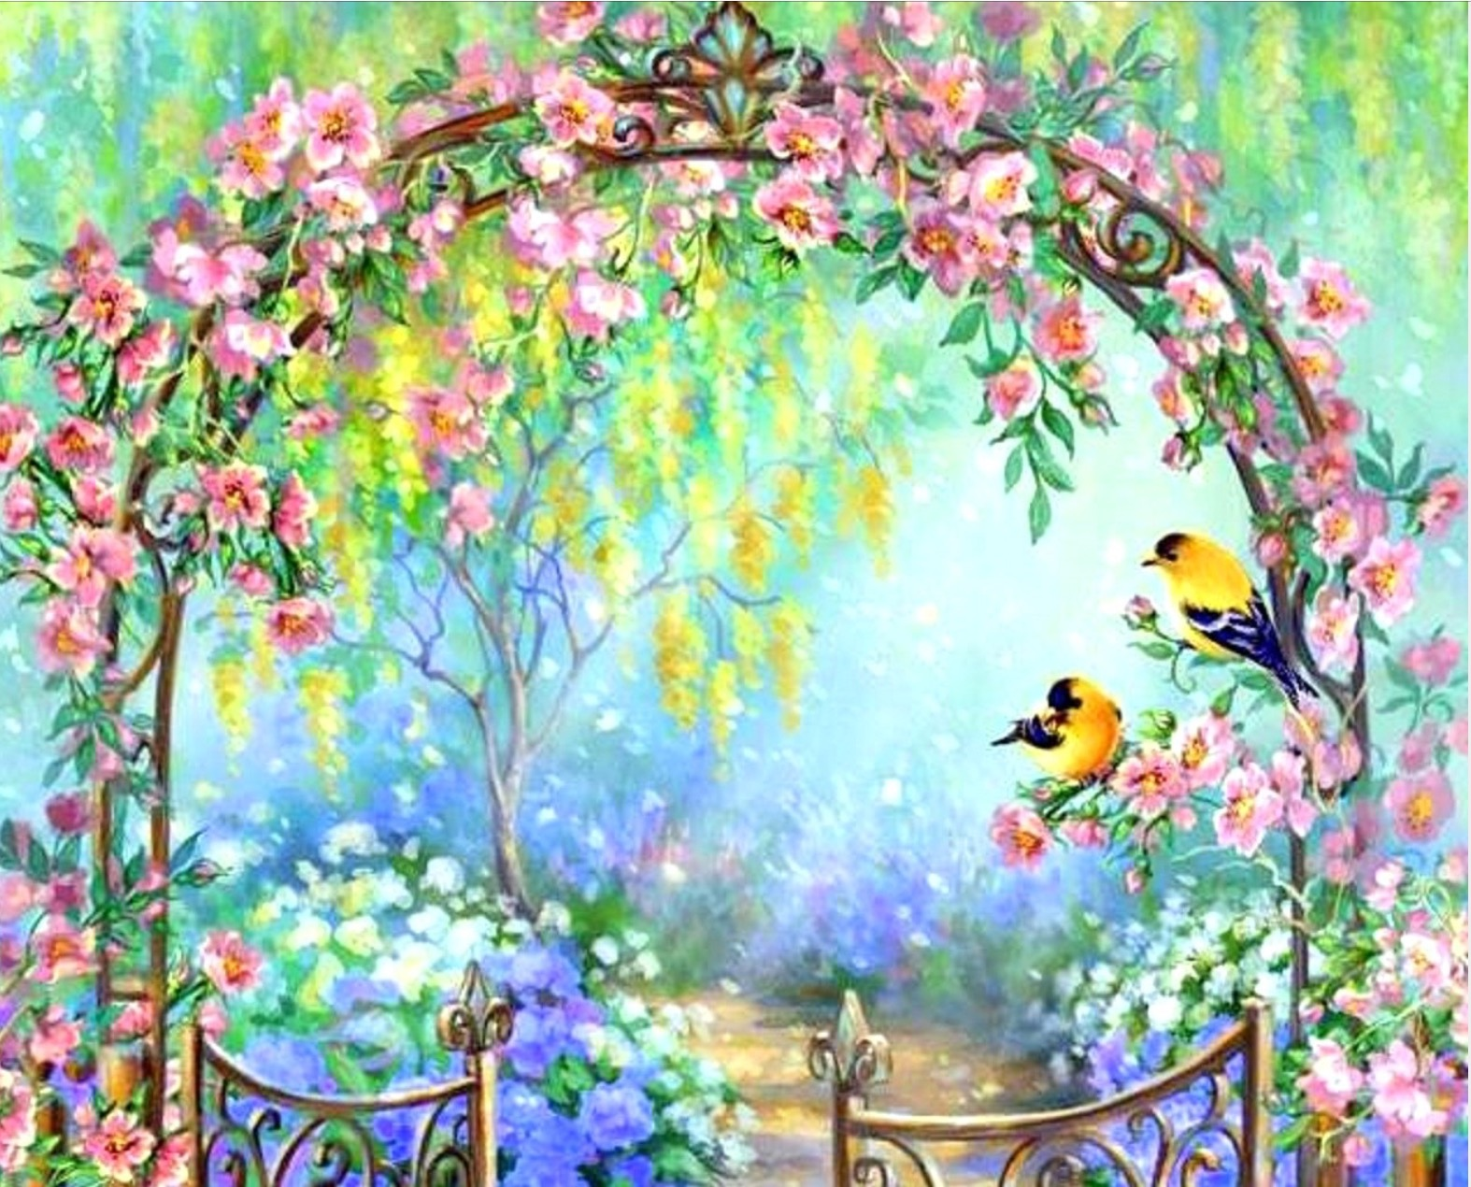
QUOTES
QUOTES

Slide 10
The well-being of mankind, its peace and security, are unattainable unless and until its unity is firmly established.”

Slide 11
“The tabernacle of unity hath been raised; regard ye not one another as strangers. Ye are the fruits of one tree, and the leaves of one branch.”

Slide 12
“Do not be content with showing friendship in words alone, let your heart burn with loving kindness for all who may cross your path.”

Slide 13
“Behold, how good and pleasant it is when brothers dwell in unity!” -Old Testament, Psalms 133: 1

Slide 14
Let there arise out of you a band of people inviting to all that is good, Enjoining what is right, and forbidding what is wrong: They are the ones to attain felicity. Be not like those who are divided among themselves.” -Holy Qur'án, Súrih II: 103-105

Slide 15
“Close your eyes to racial differences, and welcome all with the light of oneness.”

Slide 16
Story
Notes:
And we are all one human family story shades of people

Slide 17
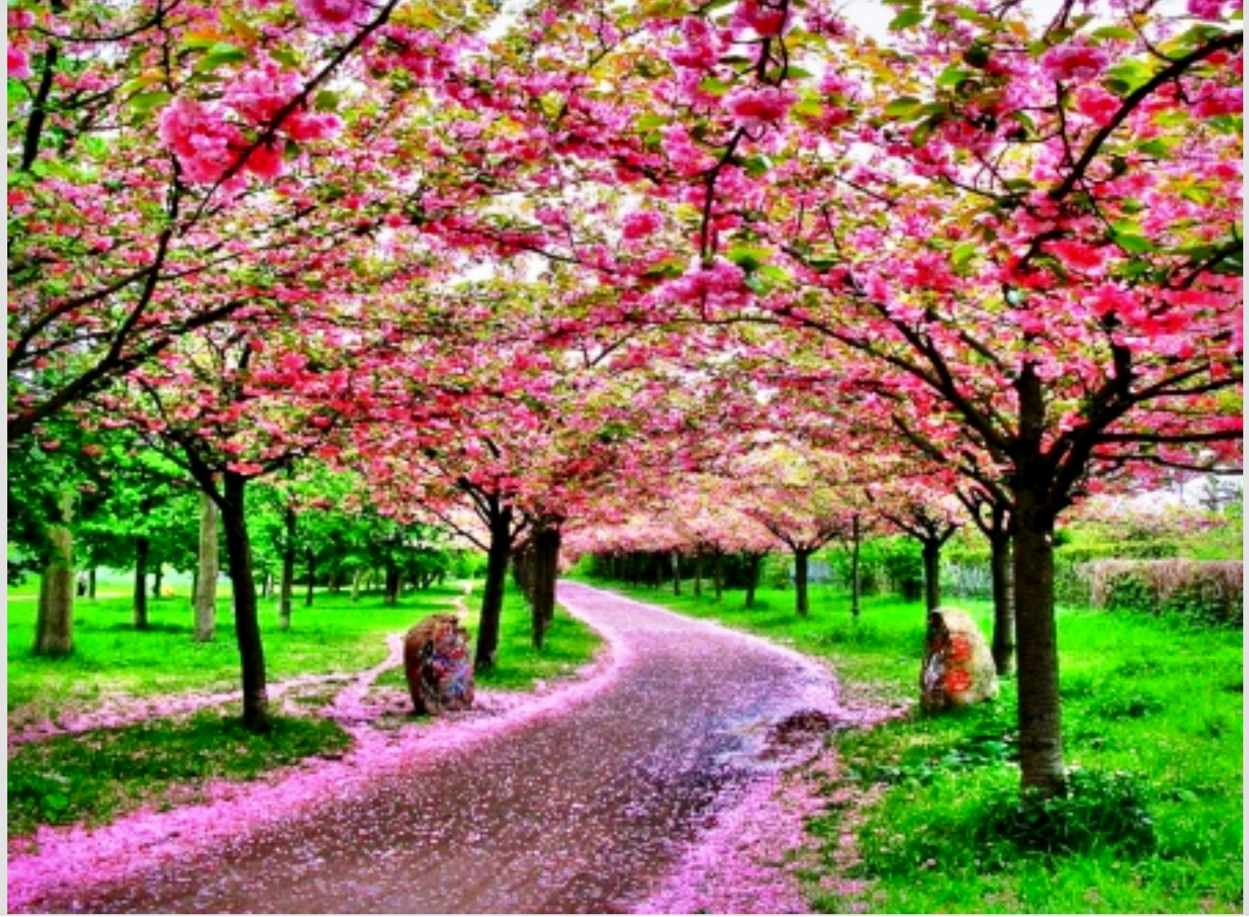
SONGS

Slide 18
If you desire
If you desire with all your heart, friendship with every race on earth, your thought, spiritual and positive, will spread; it will become the desire of others, growing stronger and stronger, until it reaches the minds of all men.”
https://youtu.be/luRkeDCoxZ4

Slide 19
Closing song
“May you always listen, always hear, always speak with the power of the spirit.”X2

Slide 20
If anyone wants to say a prayer feel free too.

Slide 21
Thank you for coming to our monthly devotions we will be privileged to have you at our next devotion if you have any questions feel free to ask Lillian or Rose iraninejad
Thank you everyone

Slide 22
Feel free to play upstairs in the main room

